Slide 1
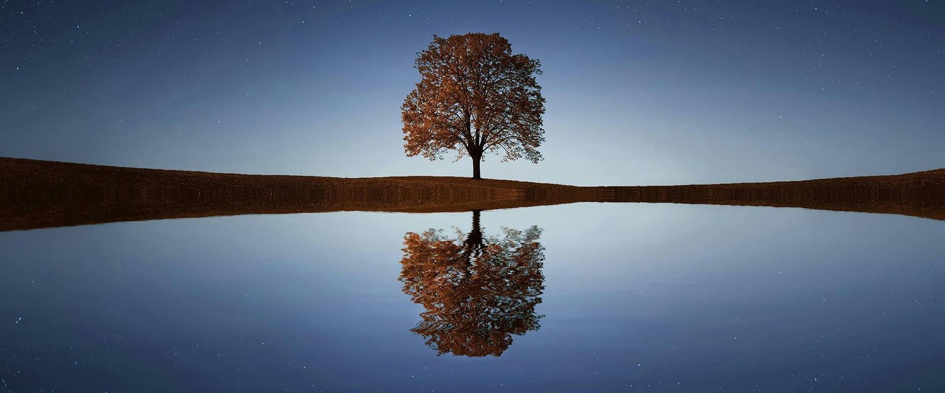
The End of Time According to John (Revelation 19-22)

Slide 2
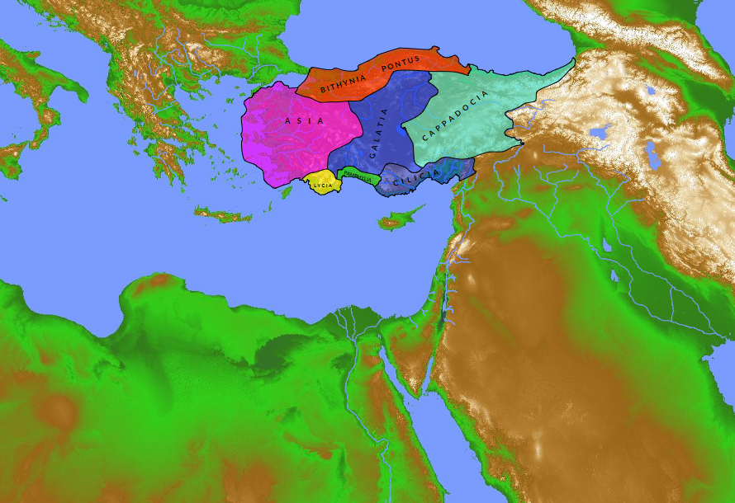

Slide 3
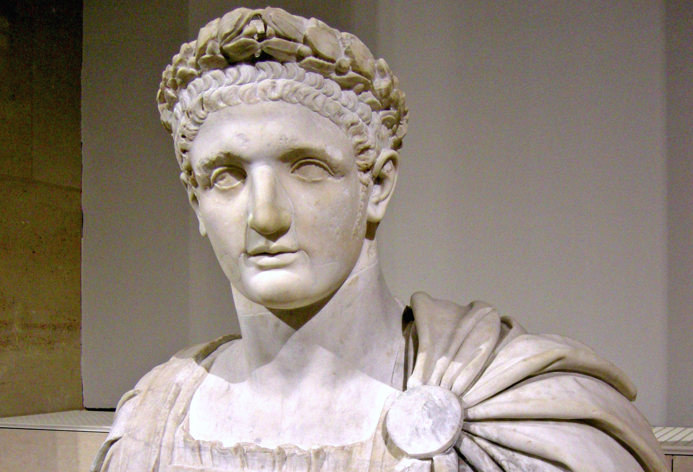

Slide 5
Then I saw heaven opened, and behold, a white horse! The One sitting on it is called Faithful and True, and in righteousness He judges and makes war. (Rev. 19:11)

Slide 6
And I saw the beast and the kings of the earth with their armies gathered to make war against Him who was sitting on the horse and against His army. (Rev. 19:19)

Slide 7
And the beast was captured, and with it the false prophet who in its presence had done the signs by which he deceived those who had received the mark of the beast and those who worshiped its image. These two were thrown alive into the lake of fire that burns with sulfur. (Rev. 19:20)

Slide 8
And the rest were slain by the sword that came from the mouth of Him who was sitting on the horse, and all the birds were gorged with their flesh. (Rev. 19:21)

Slide 9
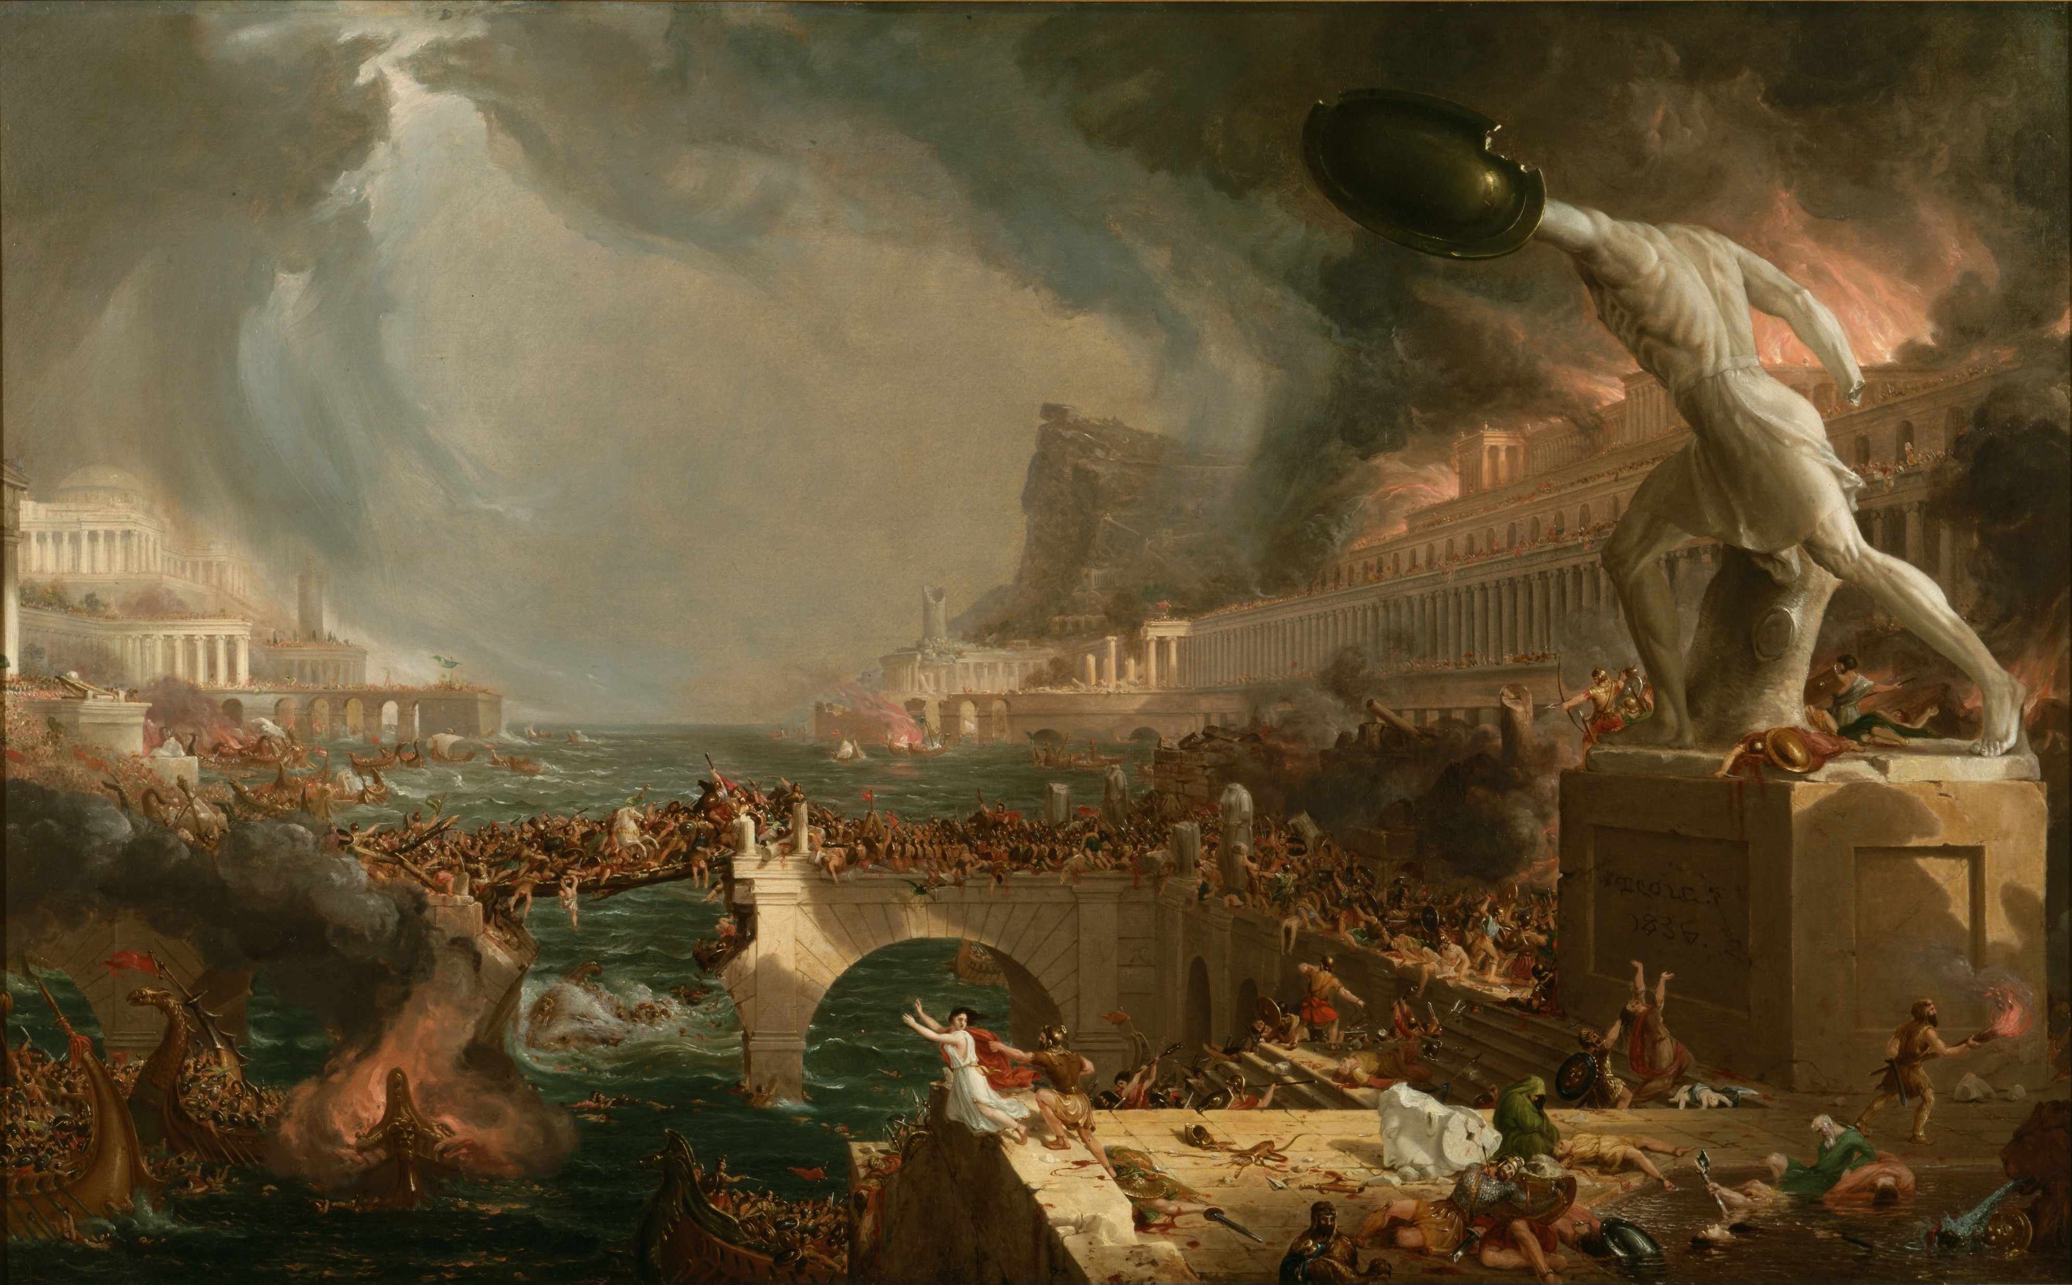

Slide 10
The primary message of Revelation to the Christians in Asia was that they must not compromise but be faithful until God destroyed the empire at the heart of their oppression.

Slide 11
Then I saw an angel coming down from heaven, holding in his hand the key to the bottomless pit and a great chain. (Rev. 20:1)

Slide 12
And he seized the dragon, that ancient serpent, who is the devil and Satan, and bound him for a thousand years. (Rev. 20:2)

Slide 13
And when the thousand years are ended, Satan will be released from his prison and will come out to deceive the nations… (Rev. 20:7)

Slide 14
But fire came down from heaven and consumed them, and the devil who had deceived them was thrown into the lake of fire and sulfur where the beast and the false prophet were… (Rev. 20:9-10)

Slide 15
Then Death and Hades were thrown into the lake of fire. This is the second death, the lack of fire. And if anyone’s name was not found written in the book of life, he was thrown into the lake of fire. (Rev. 20:14-15)

Slide 16
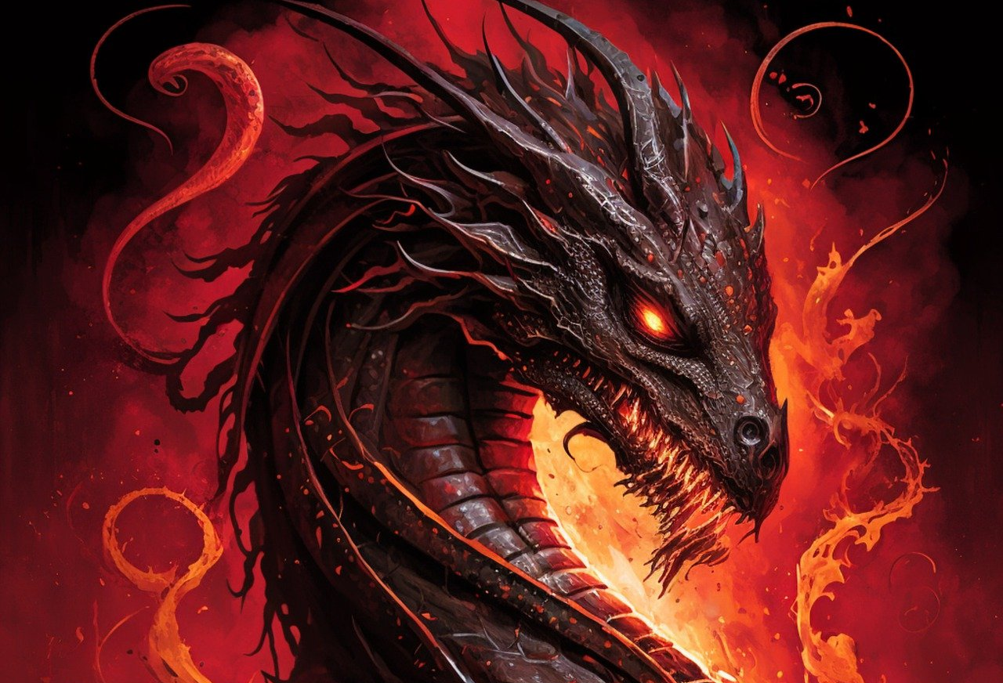

Slide 17
Just as God assured His people He would judge Rome very soon, He also assured them that Satan and all his followers would ultimately be judged as well, in His time.

Slide 18
Then I saw a new heaven and a new earth, for the first heaven and the first earth had passed away, and the sea was no more. And I saw the holy city, new Jerusalem, coming down out of heaven from God, prepared as a bride adorned for her husband. (Rev. 21:1-2)

Slide 19
And I heard a loud voice from the throne saying, “Behold, the tent of God is with man. He will dwell with them, and they will be His people, and God Himself will be with them as their God. (Rev. 21:3)

Slide 20
He will wipe away every tear from their eyes, and death shall be no more, neither shall there be mourning, nor crying, nor pain anymore, for the former things have passed away. (Rev. 21:4)

Slide 22
Finally, after all evil is judged, the faithful will enjoy eternity in perfect fellowship with the Father in a perfect state of being, removed from all evil and pain.

Slide 23
And He who was seated on the throne said, “Behold, I am making all things new.” Also He said, “Write these things down, for these words are trustworthy and true.” (Rev. 21:5)

Slide 24
And He said to me, “It is done! I am the Alpha and the Omega, the beginning and the end. To the thirst I will give from the spring of the water of life without payment.” (Rev. 21:6)

Slide 25
Then came one of the seven angels… and spoke to me, saying, “Come, I will show you the Bride, the wife of the Lamb.” (Rev. 21:9)

Slide 26
And he carried me away in the Spirit to a great, high mountain, and showed me the holy city Jerusalem coming down out of heaven from God. (Rev. 21:10)

Slide 27
And I saw no temple in the city, for its temple is the Lord God the Almighty and the Lamb. and the city has no need of sin or moon to shine on it, for the glory of God gives it light, and its light is the Lamb. By its light will the nations walk… (Rev. 21:22-24)

Slide 28
Then the angel showed me the river of the water of life, bright as crystal, flowing from the throne of God and of the Lamb through the middle of the street of the city; (Rev. 22:1-2a)

Slide 29
Also, on either side of the river, the tree of life with its twelve kinds of fruit, yielding its fruit each month. The leaves of the tree were for the healing of the nations. (Rev. 22:2b)

Slide 30
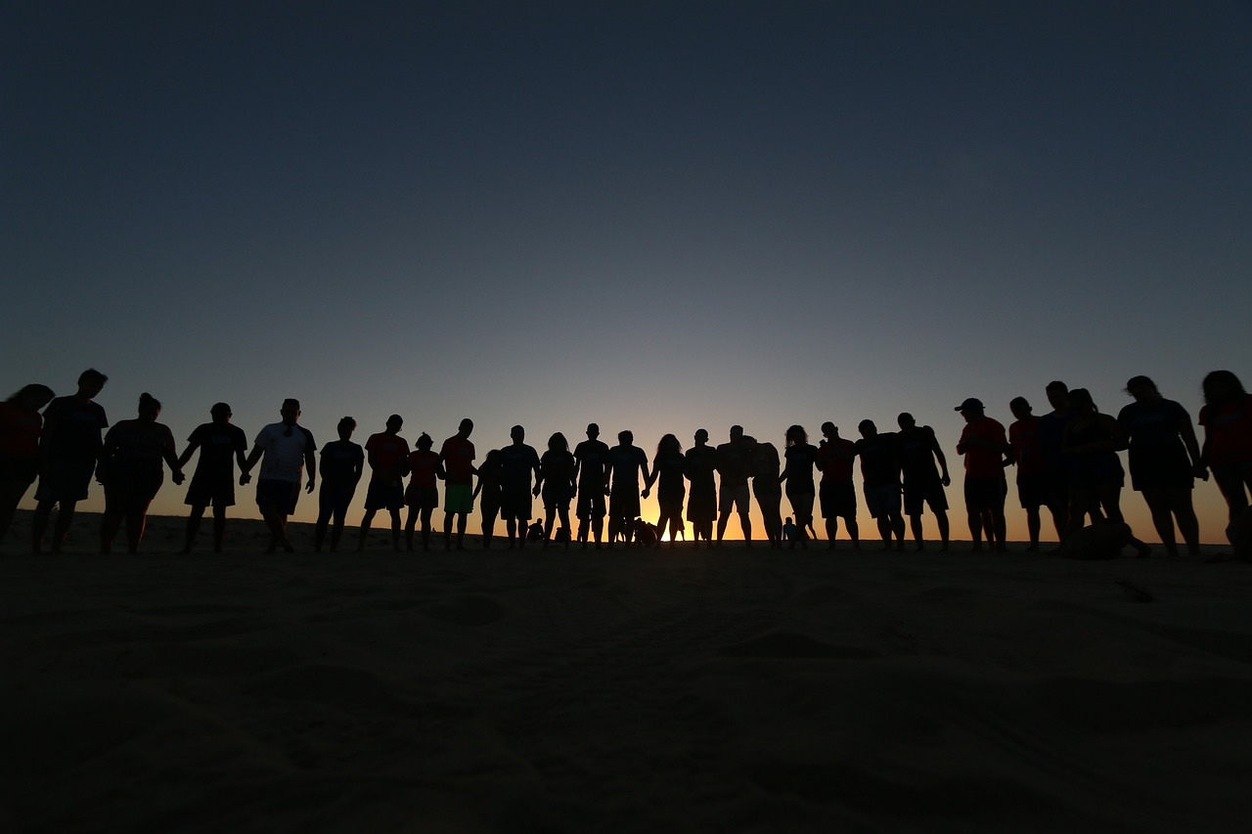

Slide 31
While we as Christians await the completion of God’s judgement on evil, we are blessed to be apart of His people, the new city of God, which is open to all who will enter.

Slide 32
John assured the Asian Christians that God would judge Rome, Satan, and sinners and that faithful saints would be rewarded. Until that final reward, we enjoy the spiritual benefits of His kingdom in the church.

