Slide 1
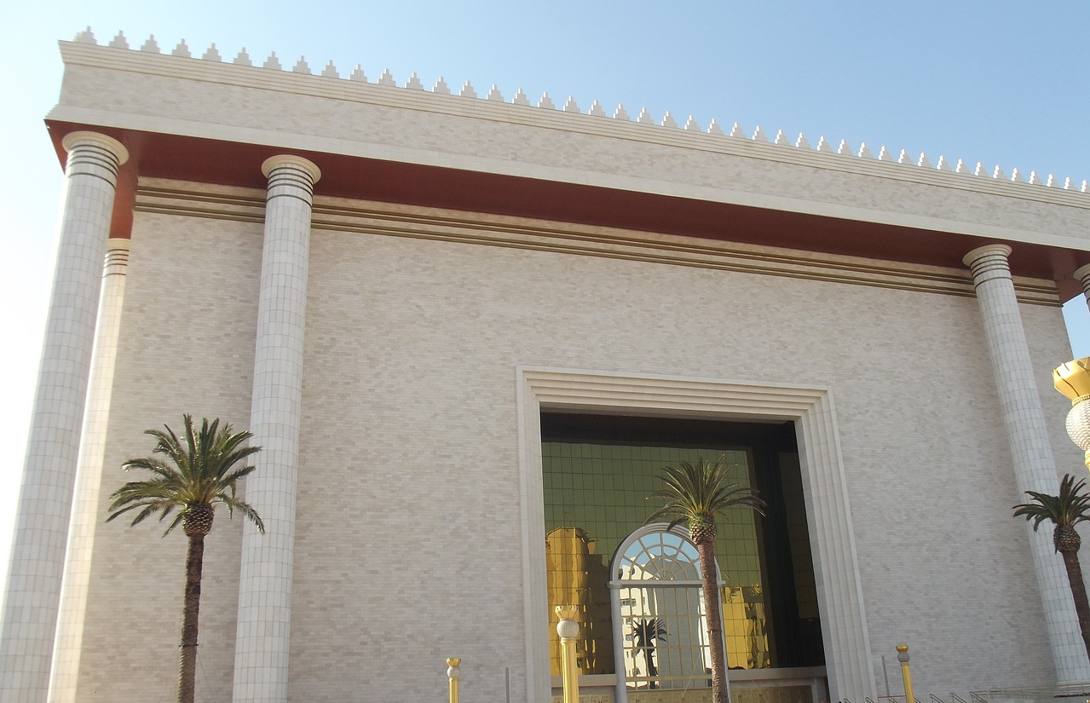
The End of Time According to Jesus

Slide 2
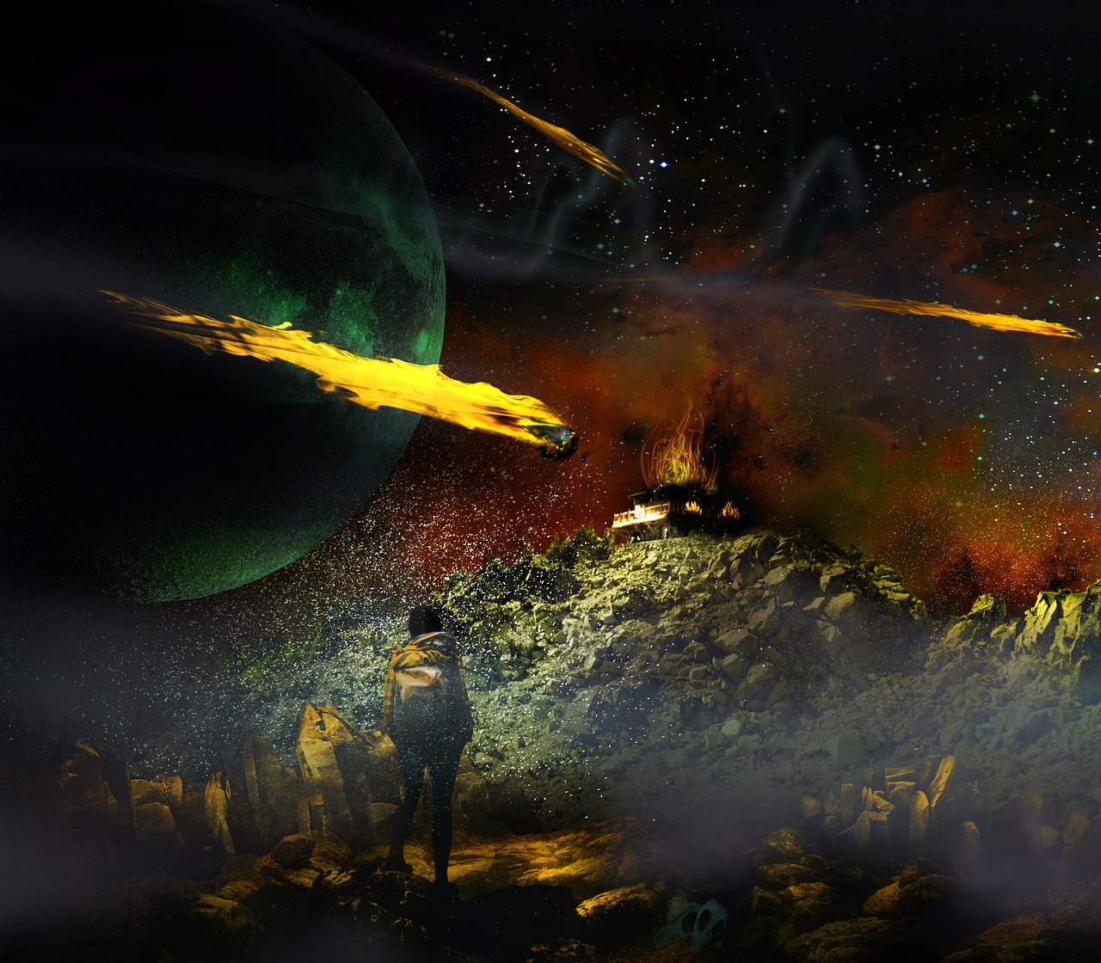
Jesus left the temple and was going away, when His disciples came to point out to Him the buildings of the temple. (Matt. 24:1)

Slide 3
But He answered them, “You see all these, do you not? Truly, I say to you, there will not be left here one stone upon another that will not be thrown down.” (Matt. 24:2)

Slide 4
As He sat on the Mount of Olives, the disciples came to Him privately, saying, “Tell us, when will these things be, and what will be the sign of Your coming and the end of the age?” (Matt. 24:3)

Slide 5
And the people of the Prince who is to come shall destroy the city and the sanctuary. Its end shall come with a flood, and to the end there shall be war. Desolations are decreed. (Dan. 9:26)

Slide 6
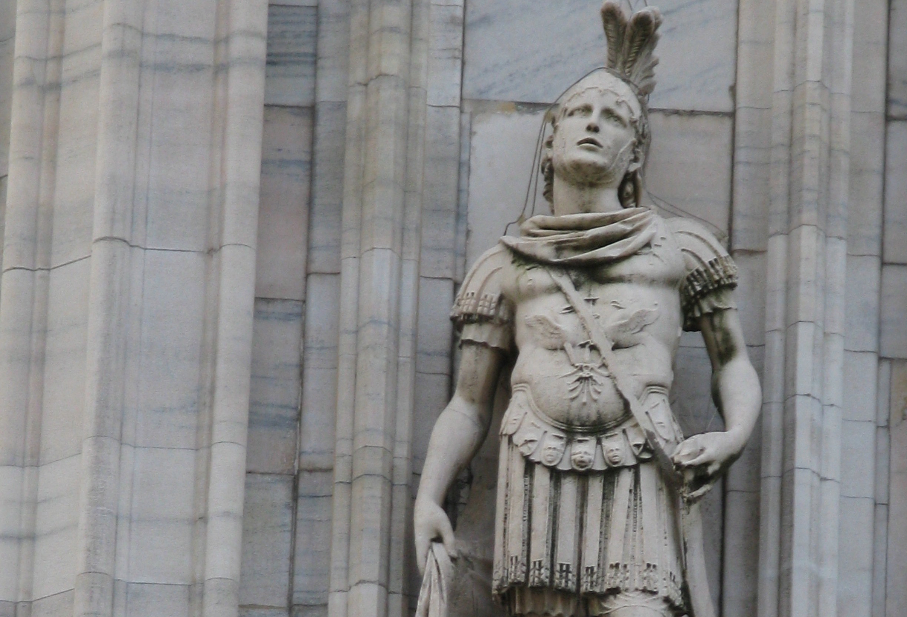
Credit: Yair Haklai

Slide 7
• False Messiahs • Political Unrest • Natural Disasters • Increased Persecution • Wavering Faith • Gospel Spreads
Signs of Something Coming

Slide 8
So when you see the abomination of desolation spoken of by the prophet Daniel, standing in the holy place (let the reader understand)… (Matt. 24:15)

Slide 9
And from the time that the regular burnt offering is taken away and the abomination that makes desolate is set up, there shall be 1,290 days. (Dan. 12:11)

Slide 10
• RUN. NOW. • Expect the Worst • Know This Will Be Temporary • Don’t Fall for False Saviors
How to Respond to These Signs

Slide 11
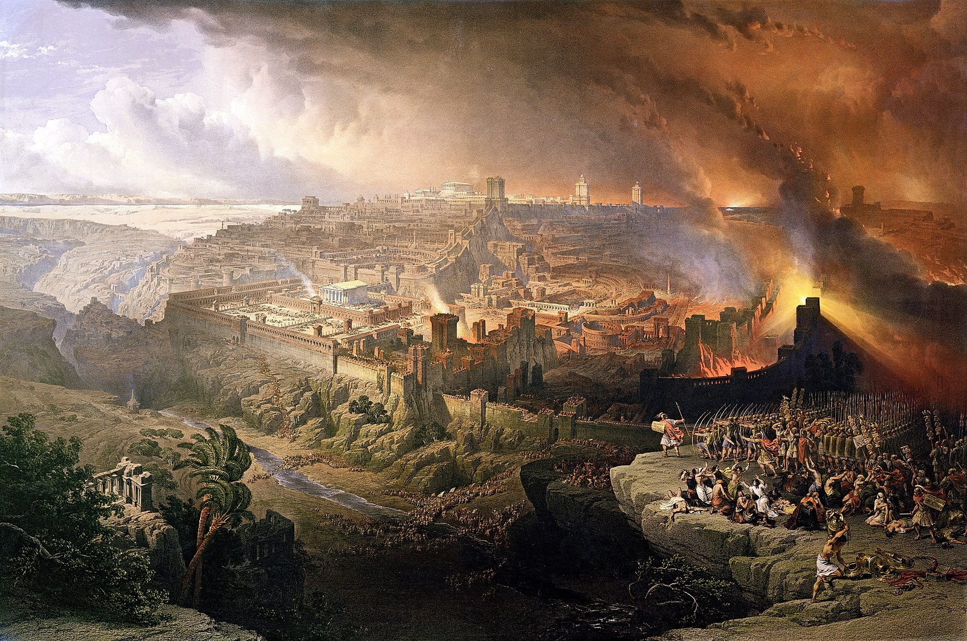

Slide 12
Immediately after the tribulation of those days the sun will be darkened, and the moon will not give its light, and the stars will fall from heaven, and the powers of the heavens will be shaken. (Matt. 24:29)

Slide 13
The sun shall be turned to darkness and the moon to blood, before the day of the Lord comes, the great and magnificent day. (Acts 2:20)

Slide 14
Then will appear in heaven the sign of the Son of Man, and then all the tribes of the earth will mourn, and they will see the Son of Man coming on the clouds of heaven with power and great glory. (Matt. 24:30)

Slide 15
I saw in the night visions, and behold, with the clouds of heaven there came one like a Son of Man, and He came to the Ancient of Days and was presented before Him. (Dan. 7:13)

Slide 16
And to Him was given dominion and glory and a kingdom, that all peoples, nations, and languages should serve Him; His dominion is an everlasting dominion, which shall not pass away, and His kingdom one that shall not be destroyed.. (Dan. 7:14)

Slide 17
And He will send out His angels with a loud trumpet call, and they will gather His elect from the four winds, from one end of heaven to the other. (Matt. 24:31)

Slide 18
So also, when you see all these things, you know that it is near, at the very gates. Truly, I say to you, this generation will not pass away until all these things take place. (Matt. 24:33-34)

Slide 20
Contrary to popular opinion, the first half of this chapter is not about the end of our world, but about what Jews would have seen as the end of their world!

Slide 21
But concerning that day and hour no one knows, not even the angels of heaven, nor the Son, but the Father only. (Matt. 24:36)

Slide 22
Then two men will be in the field; one will be taken and one left. Two women will be grinding at the mill; one will be taken and one left. (Matt. 24:40-41)

Slide 23
For as the lightning comes from the east and shines as far as the west, so will be the coming of the Son of Man. (Matt. 24:27)

Slide 24
Therefore, stay awake, for you do not know on what day your Lord is coming… Therefore you also must be ready, for the Son of Man is coming at an hour you do not expect. (Matt. 24:42-44)

Slide 25
Who then is the faithful and wise servant, whom his Master has set over His household… Blessed is that servant whom his Master will find so doing when He comes. (Matt. 24:45-46)

Slide 26
Jesus Himself does not give us many details except that the end of time will come without warning when He returns.

