Slide 1
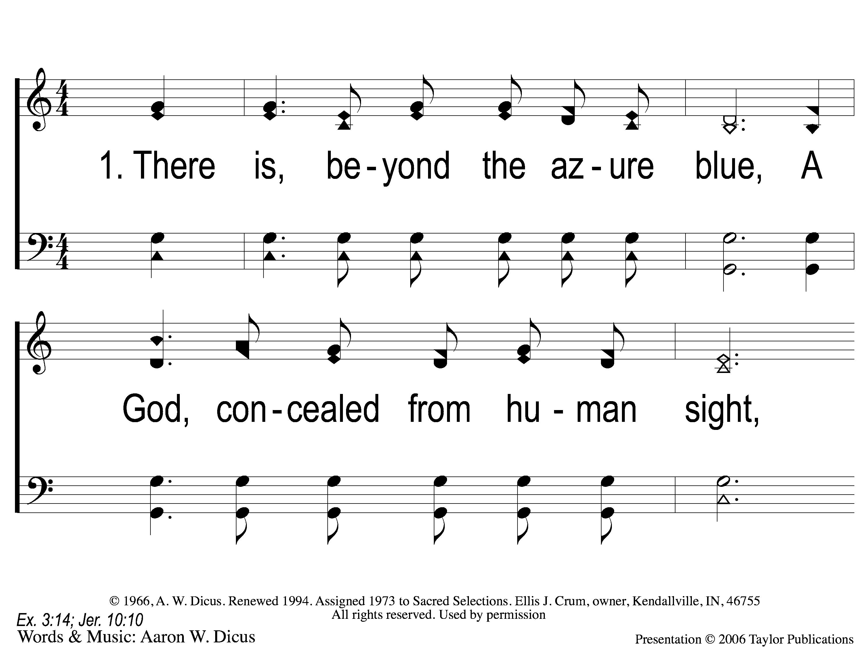
1-1 Our God He Is Alive
Our God, He Is Alive
23

Slide 2
1-2 Our God He Is Alive
Our God, He Is Alive
23

Slide 3
C-1 Our God He Is Alive
Our God, He Is Alive
23

Slide 4
C-2 Our God He Is Alive
Our God, He Is Alive
23

Slide 5
4-1 Our God He Is Alive
Our God, He Is Alive
23

Slide 6
4-2 Our God He Is Alive
Our God, He Is Alive
23

Slide 7
C-1 Our God He Is Alive
Our God, He Is Alive
23

Slide 8
C-2 Our God He Is Alive
Our God, He Is Alive
23

Slide 9
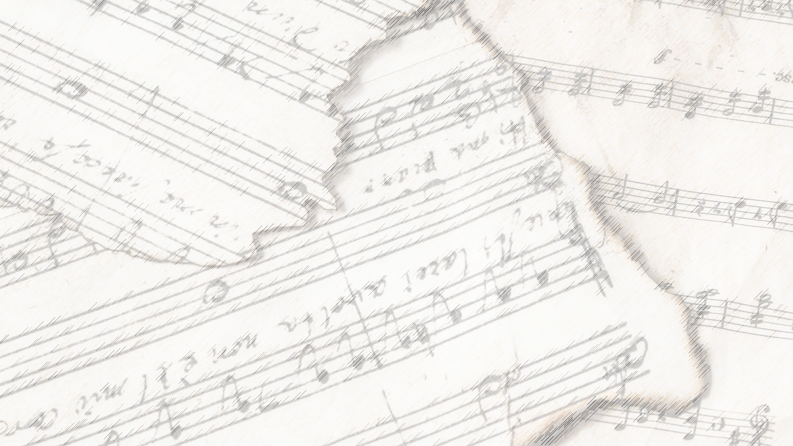
Welcome!
We Are Glad You Are Here

Slide 10
Jesus, Hold My Hand
#412

Slide 11
1-1 Jesus Hold My Hand
Jesus, Hold My Hand
412

Slide 12
1-2 Jesus Hold My Hand
Jesus, Hold My Hand
412

Slide 13
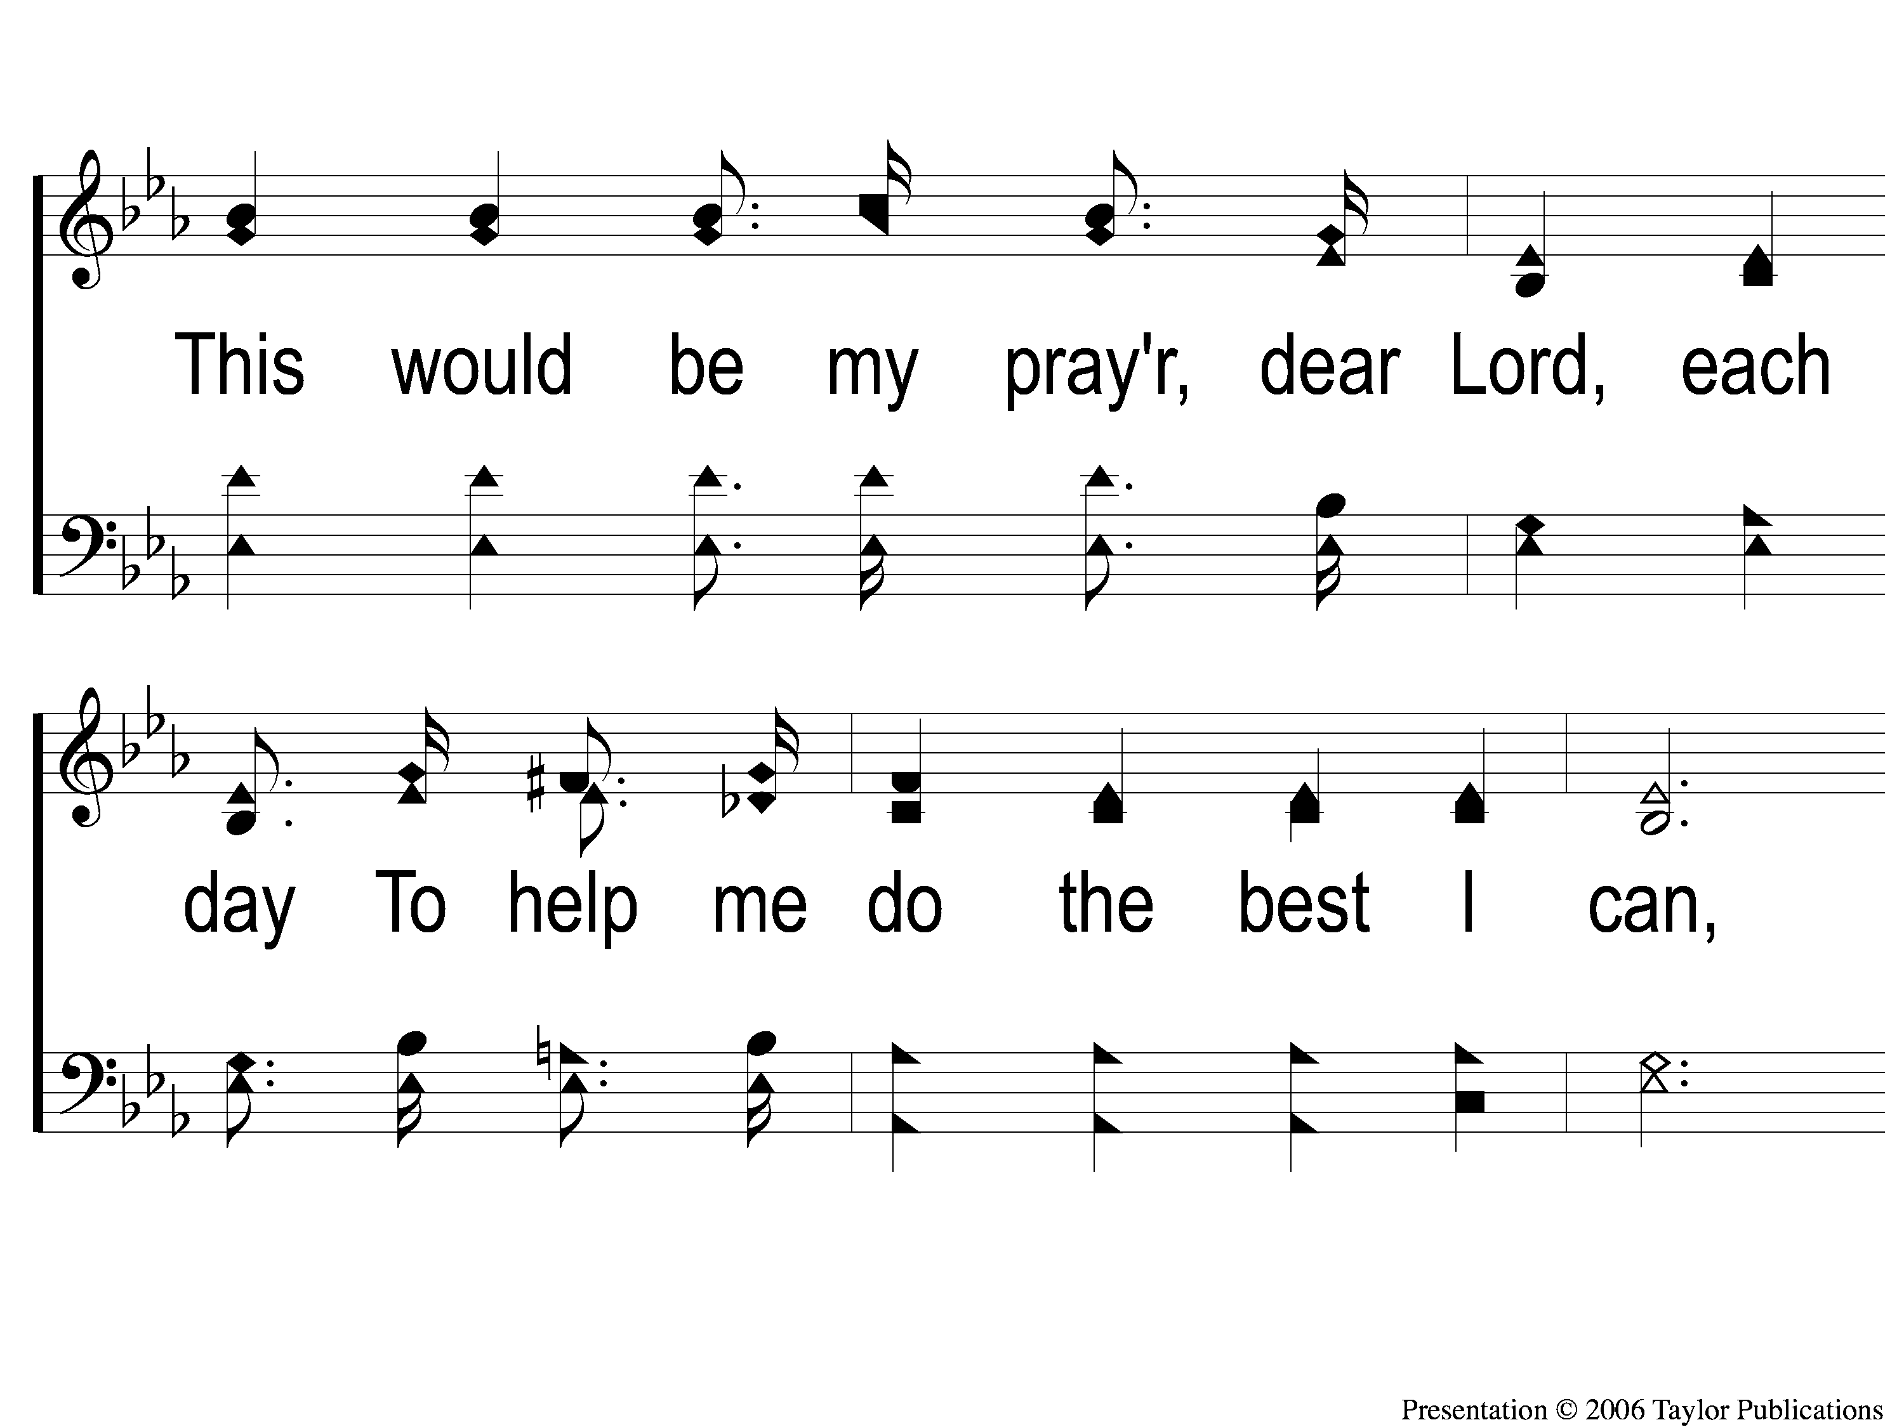
1-3 Jesus Hold My Hand
Jesus, Hold My Hand
412

Slide 14
1-4 Jesus Hold My Hand
Jesus, Hold My Hand
412

Slide 15
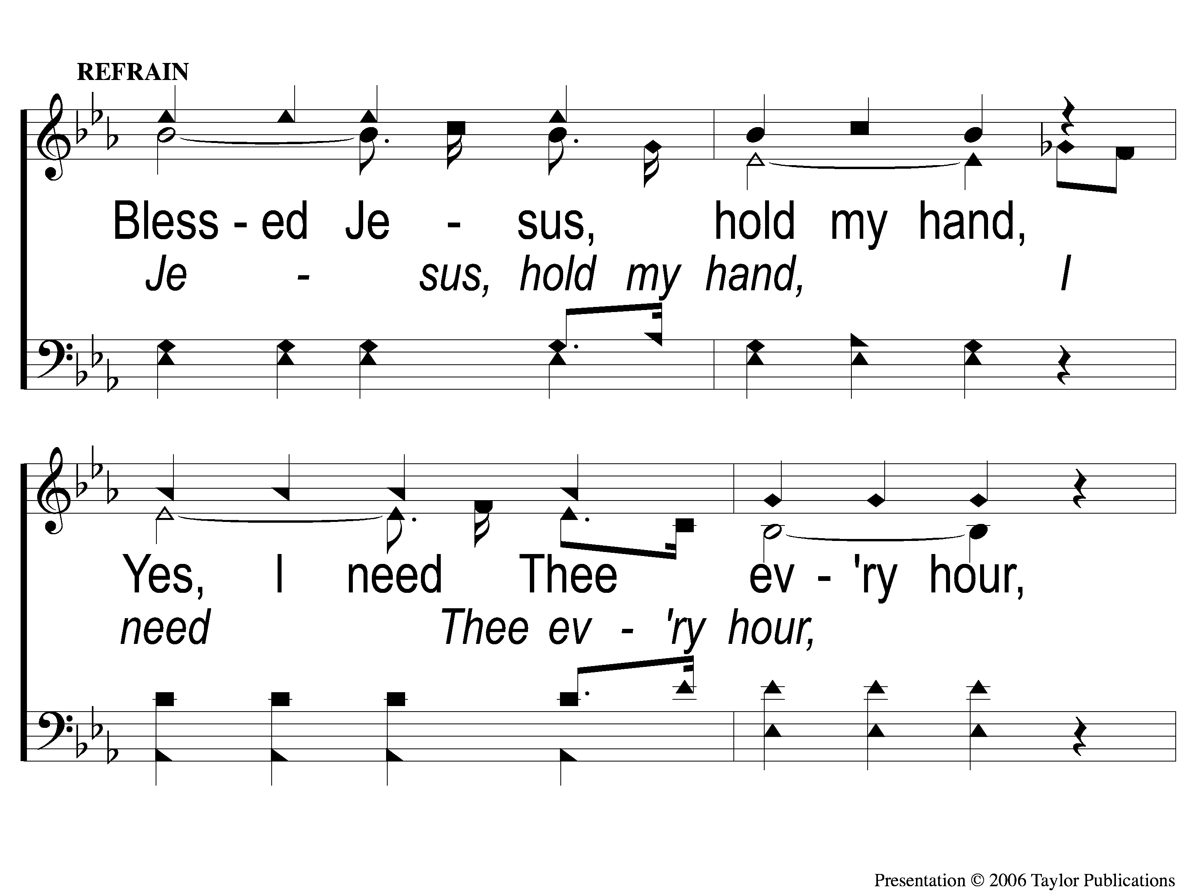
C-1 Jesus Hold My Hand
Jesus, Hold My Hand
412

Slide 16
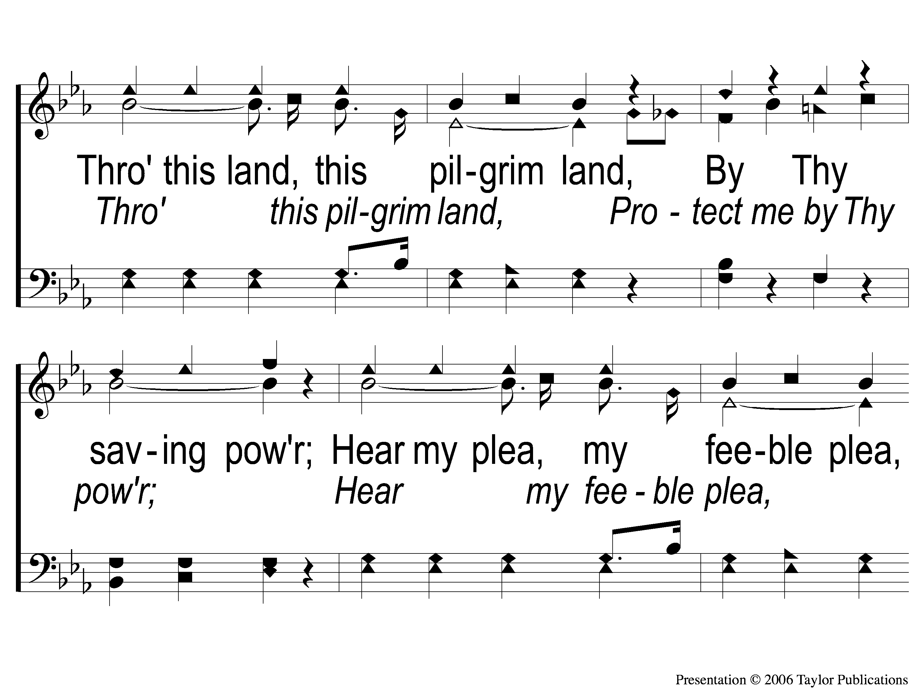
C-2 Jesus Hold My Hand
Jesus, Hold My Hand
412

Slide 17
C-3 Jesus Hold My Hand
Jesus, Hold My Hand
412

Slide 18
3-1 Jesus Hold My Hand
Jesus, Hold My Hand
412

Slide 19
3-2 Jesus Hold My Hand
Jesus, Hold My Hand
412

Slide 20
3-3 Jesus Hold My Hand
Jesus, Hold My Hand
412

Slide 21
3-4 Jesus Hold My Hand
Jesus, Hold My Hand
412

Slide 22
C-1 Jesus Hold My Hand
Jesus, Hold My Hand
412

Slide 23
C-2 Jesus Hold My Hand
Jesus, Hold My Hand
412

Slide 24
C-3 Jesus Hold My Hand
Jesus, Hold My Hand
412

Slide 25
1-1 Take My Hand Precious Lord
Take My Hand Precious Lord
786

Slide 26
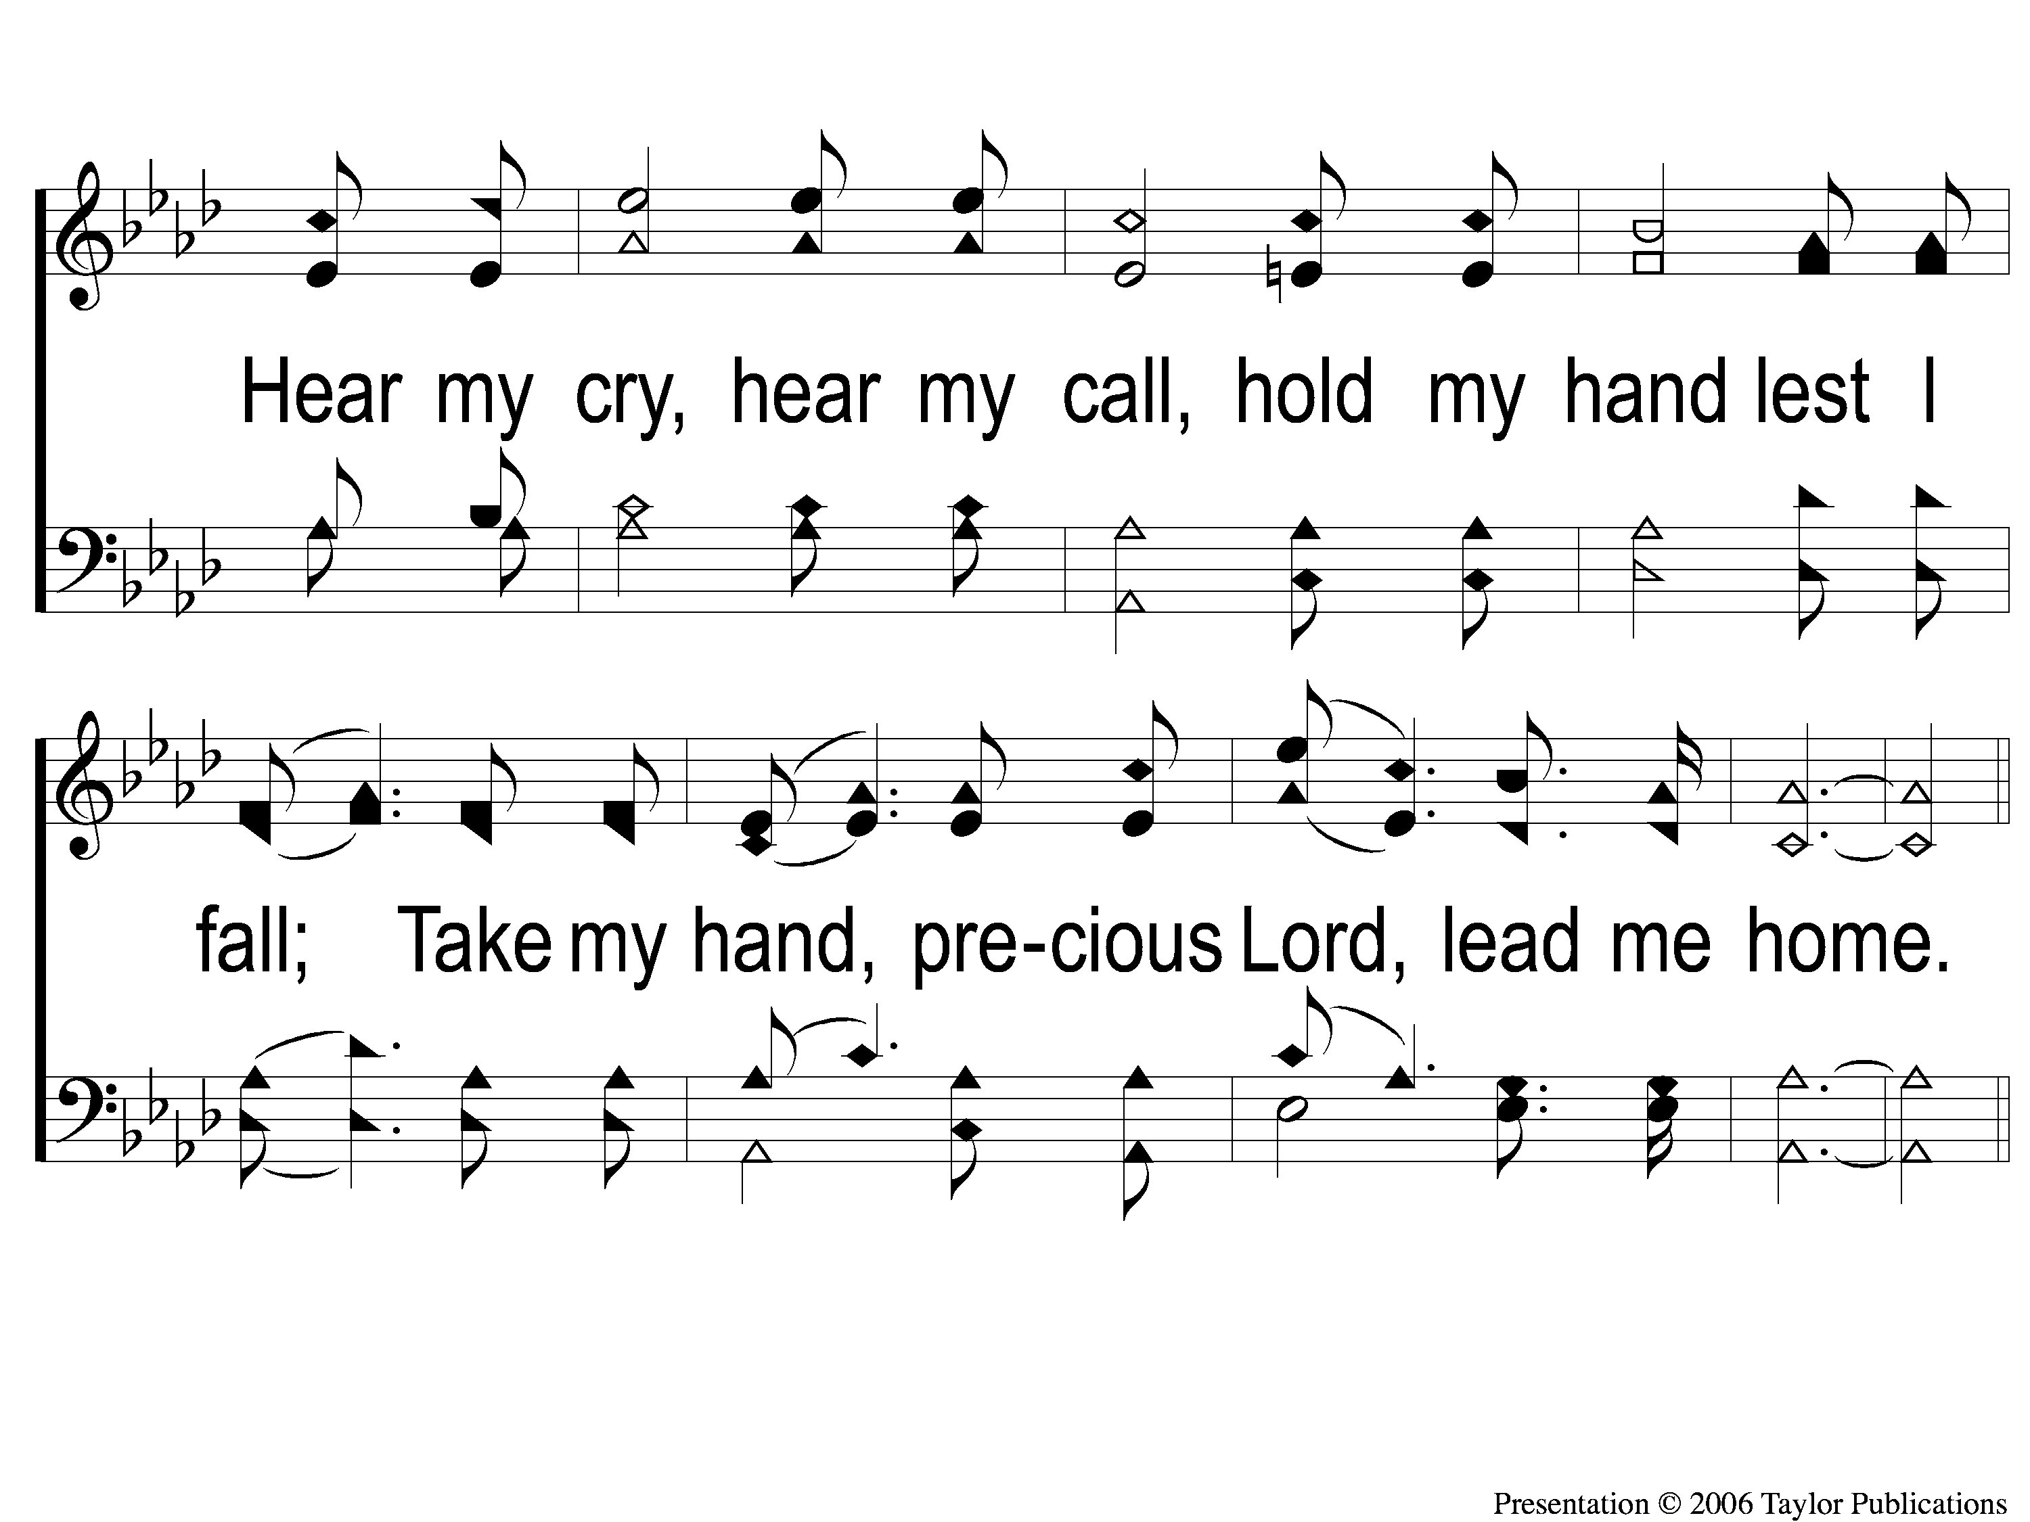
1-2 Take My Hand Precious Lord
Take My Hand Precious Lord
786

Slide 27
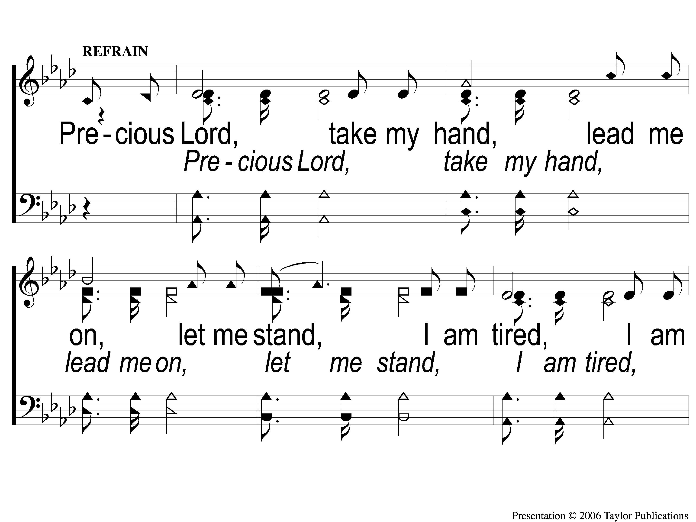
C-1 Take My Hand Precious Lord
Take My Hand Precious Lord
786

Slide 28
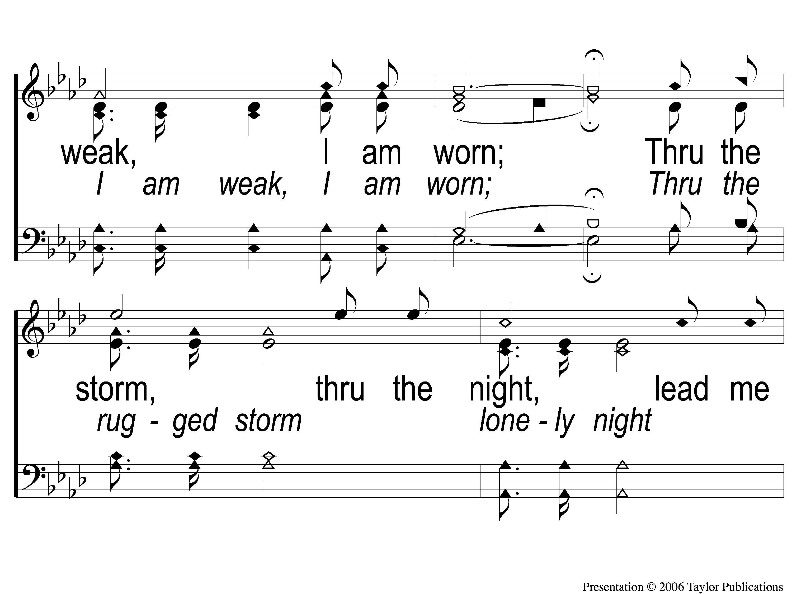
C-2 Take My Hand Precious Lord
Take My Hand Precious Lord
786

Slide 29
C-3 Take My Hand Precious Lord
Take My Hand Precious Lord
786

Slide 30
Savior Lead Me

Slide 31
1-1 Savior Lead Me
Savior Lead Me
409
ePraise Hymn Presentation © 2005 Taylor Publications
ePraise Hymn Presentation © 2005 Taylor Publications

Slide 32
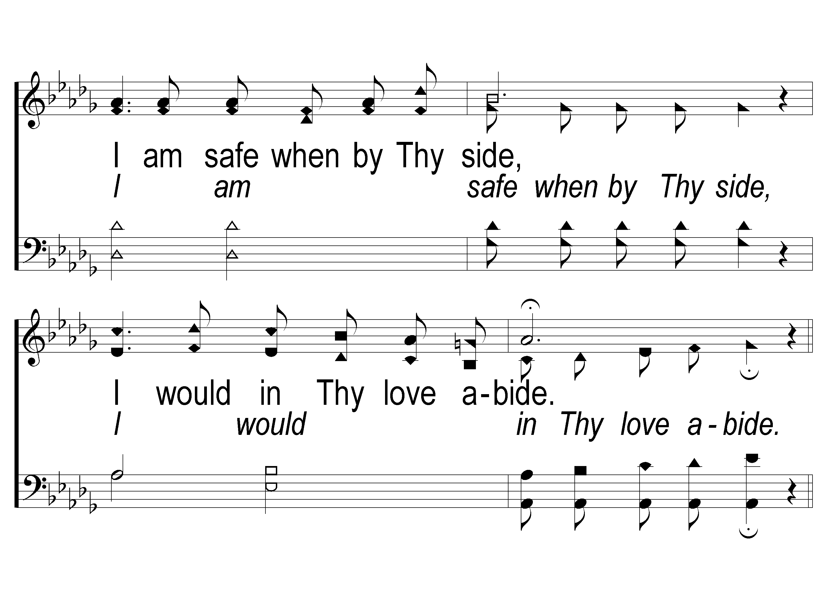
1-2 Savior Lead Me
Savior Lead Me
409
ePraise Hymn Presentation © 2005 Taylor Publications
ePraise Hymn Presentation © 2005 Taylor Publications

Slide 33
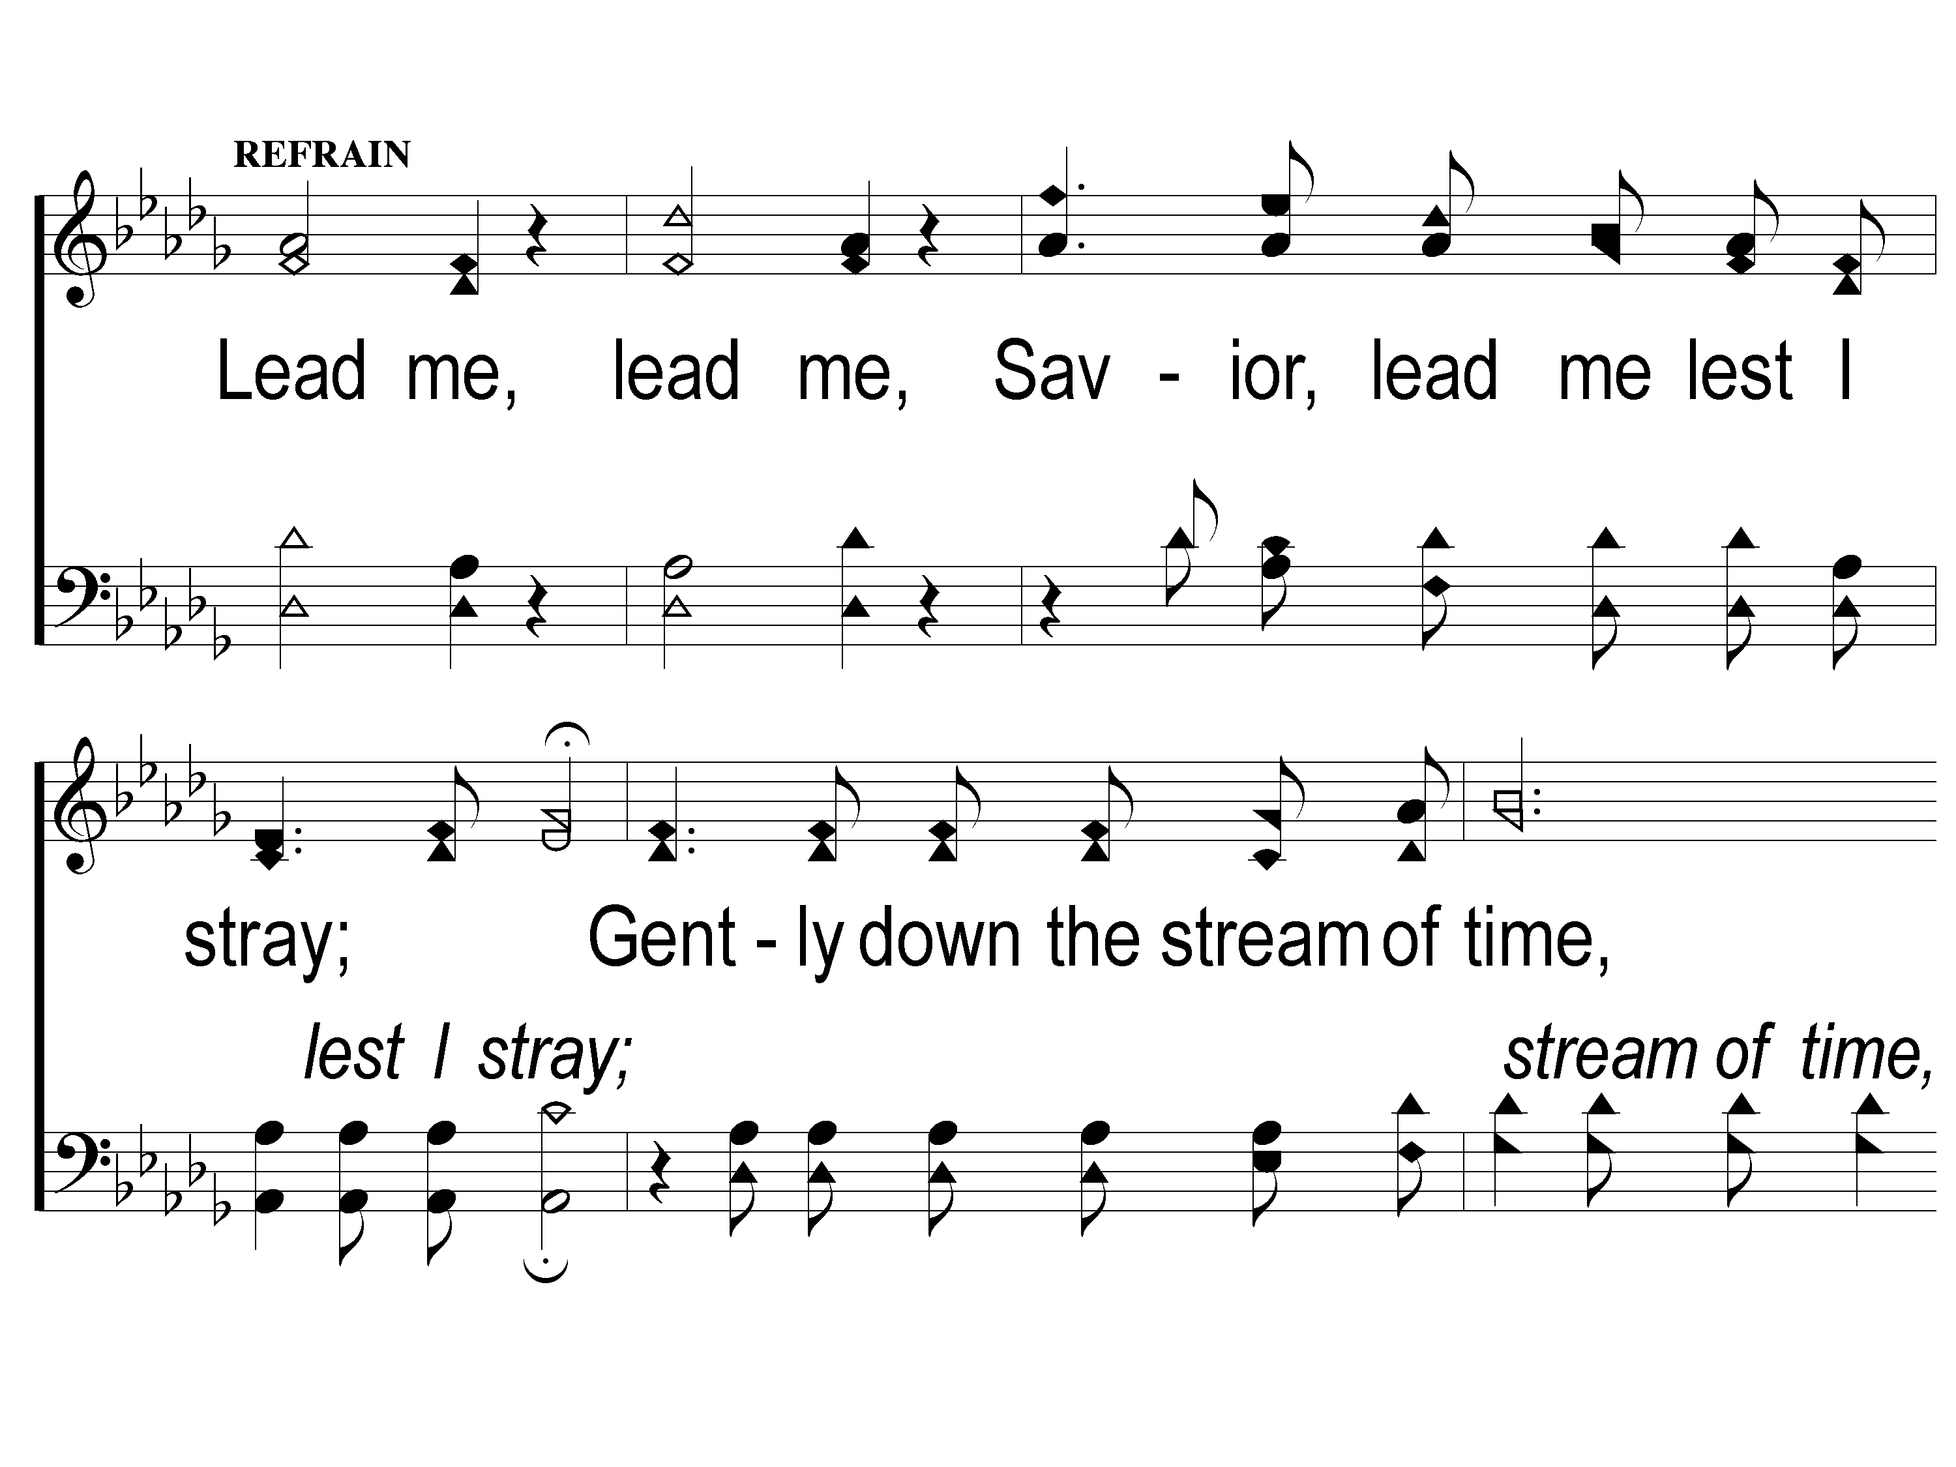
C-1 Savior Lead Me
Savior Lead Me
409
ePraise Hymn Presentation © 2005 Taylor Publications
ePraise Hymn Presentation © 2005 Taylor Publications

Slide 34
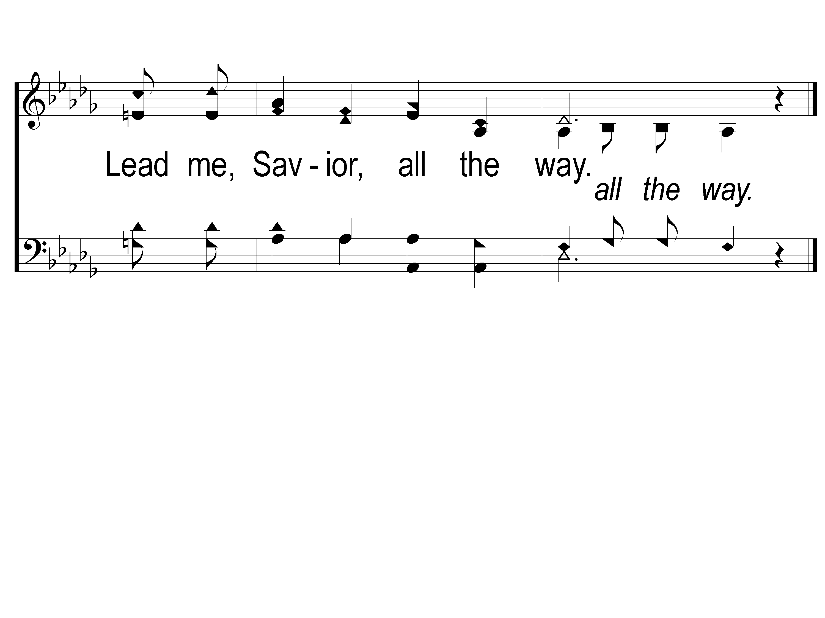
C-2 Savior Lead Me
Savior Lead Me
409
ePraise Hymn Presentation © 2005 Taylor Publications
ePraise Hymn Presentation © 2005 Taylor Publications

Slide 35
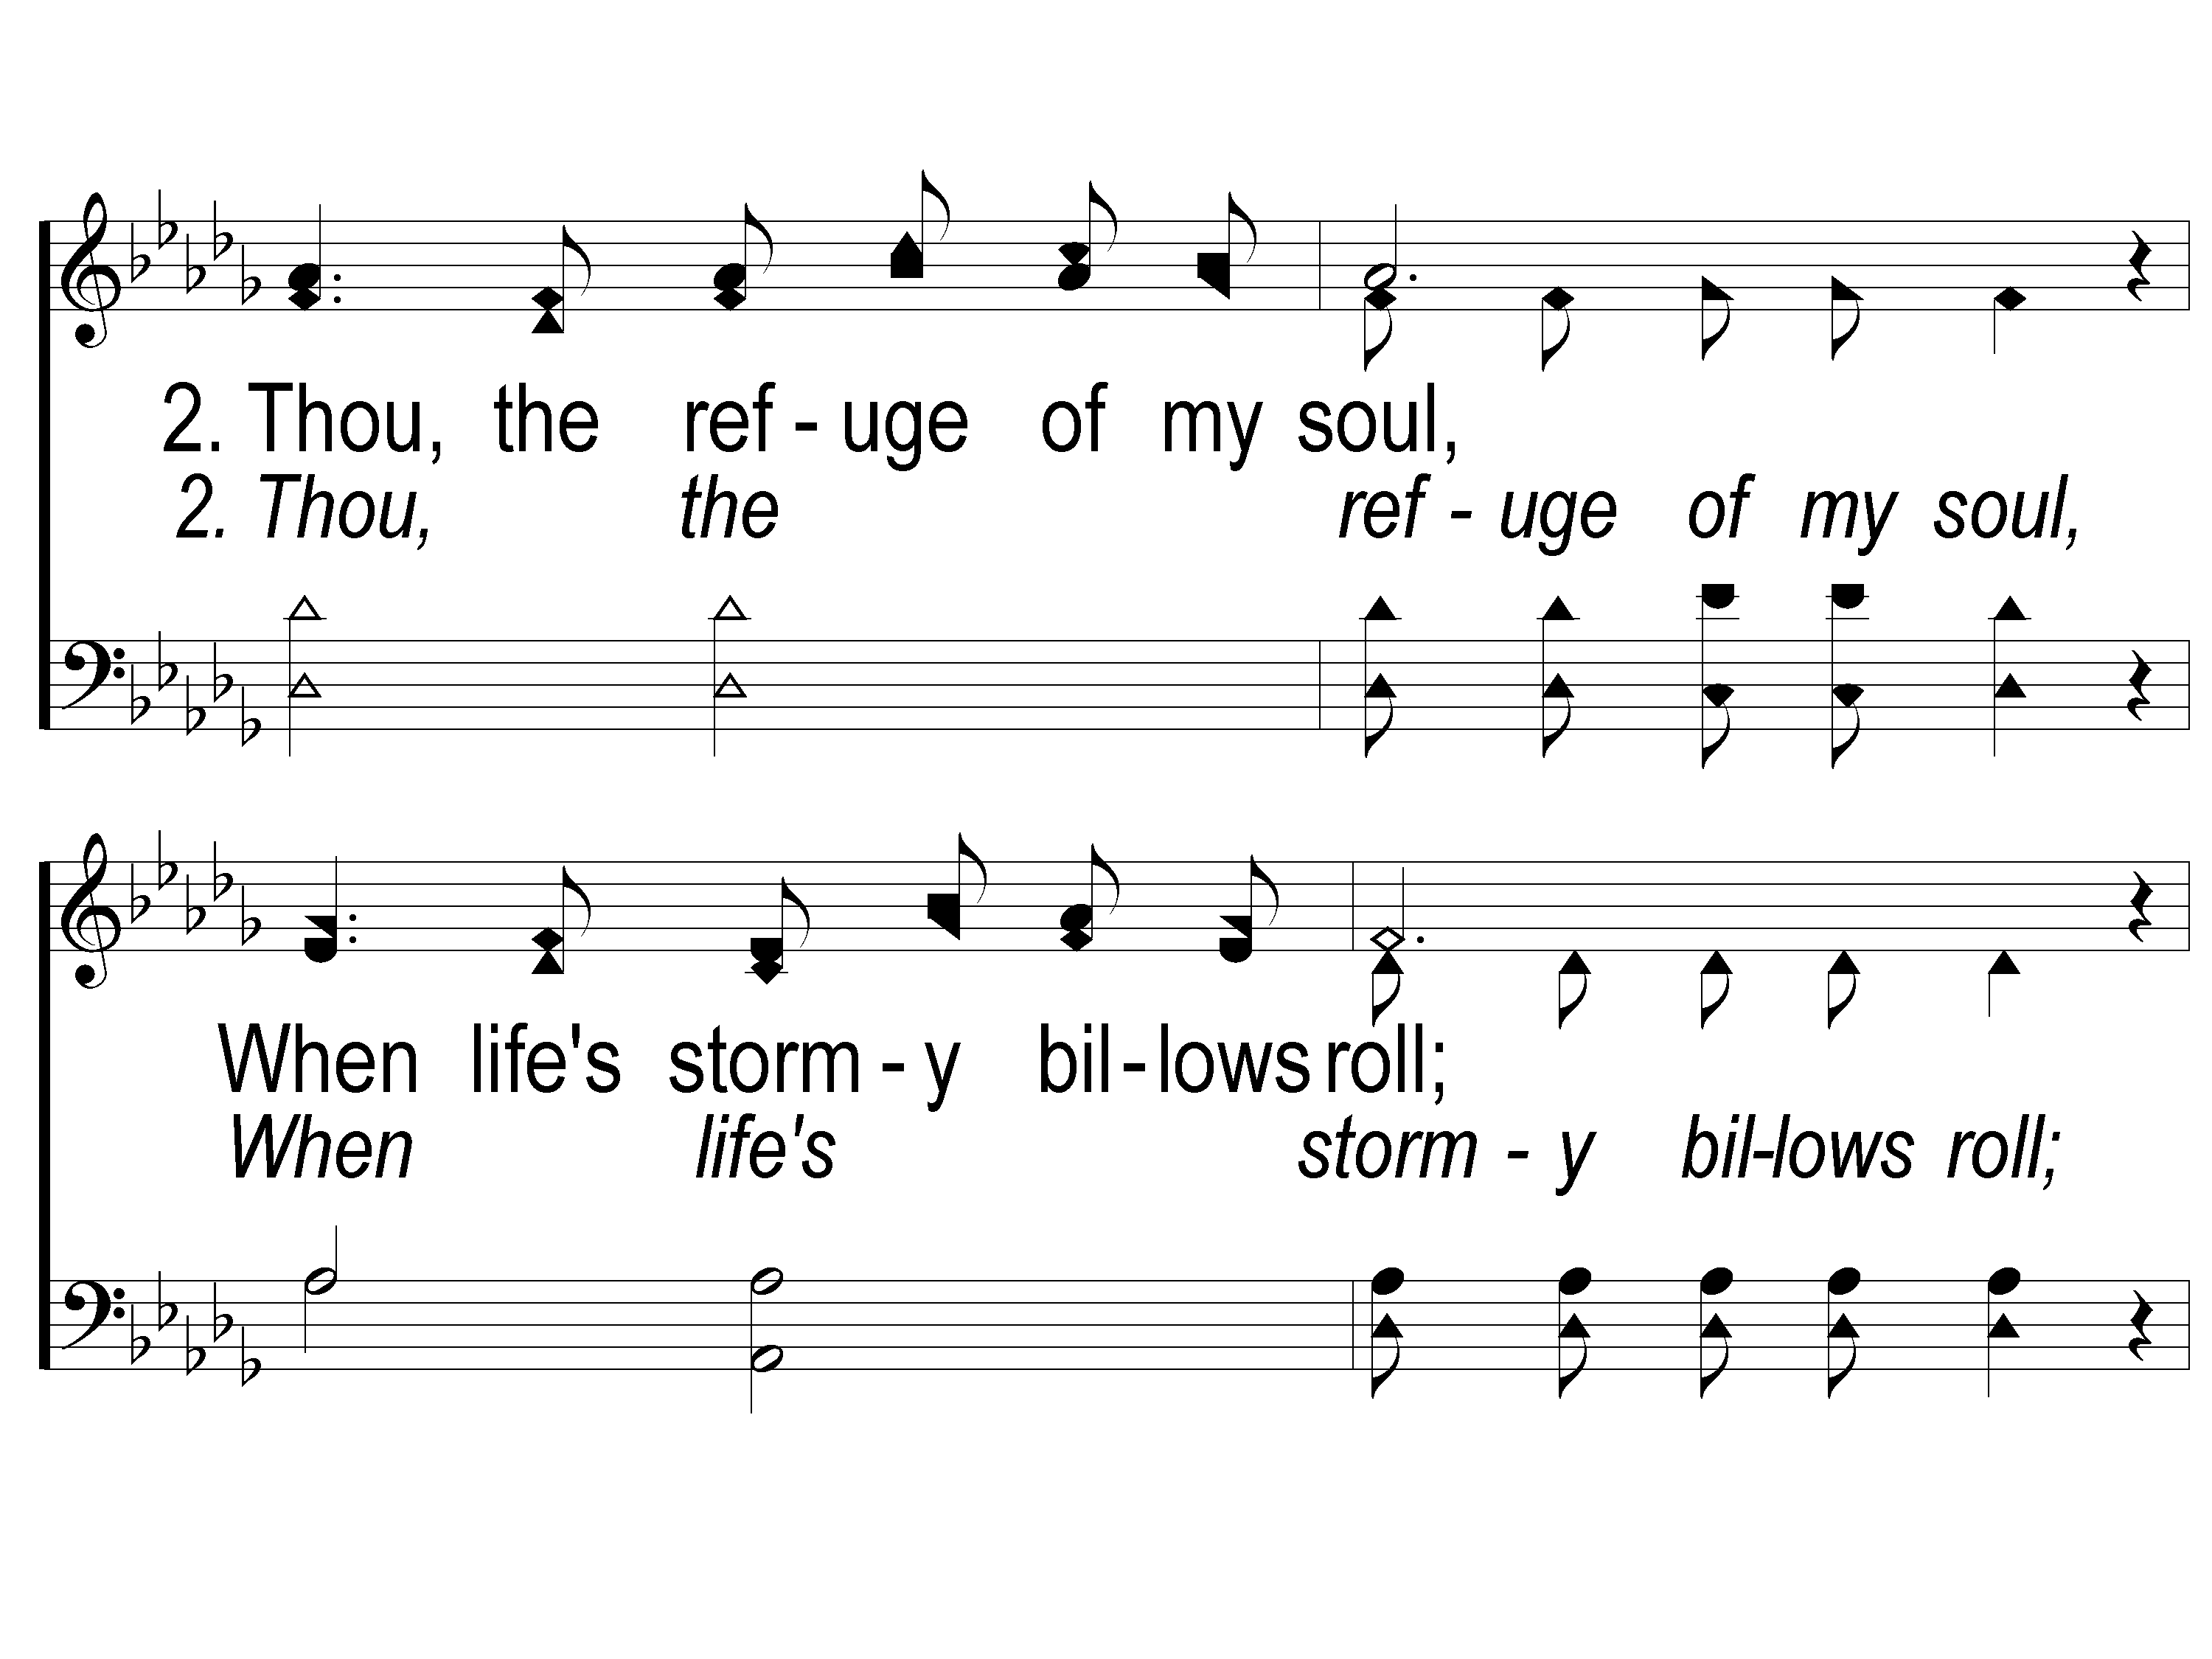
2-1 Savior Lead Me
Savior Lead Me
409
ePraise Hymn Presentation © 2005 Taylor Publications
ePraise Hymn Presentation © 2005 Taylor Publications

Slide 36
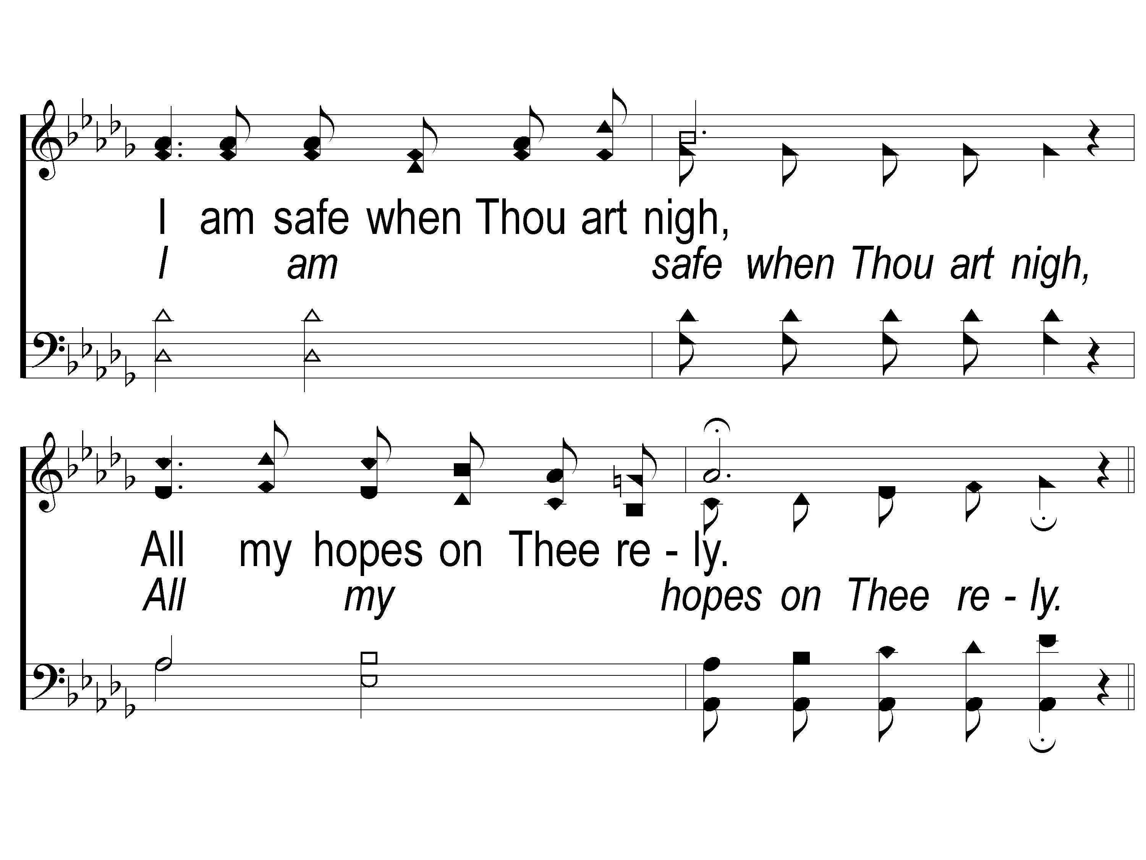
2-2 Savior Lead Me
Savior Lead Me
409
ePraise Hymn Presentation © 2005 Taylor Publications
ePraise Hymn Presentation © 2005 Taylor Publications

Slide 37
C-1 Savior Lead Me
Savior Lead Me
409
ePraise Hymn Presentation © 2005 Taylor Publications
ePraise Hymn Presentation © 2005 Taylor Publications

Slide 38
C-2 Savior Lead Me
Savior Lead Me
409
ePraise Hymn Presentation © 2005 Taylor Publications
ePraise Hymn Presentation © 2005 Taylor Publications

Slide 39
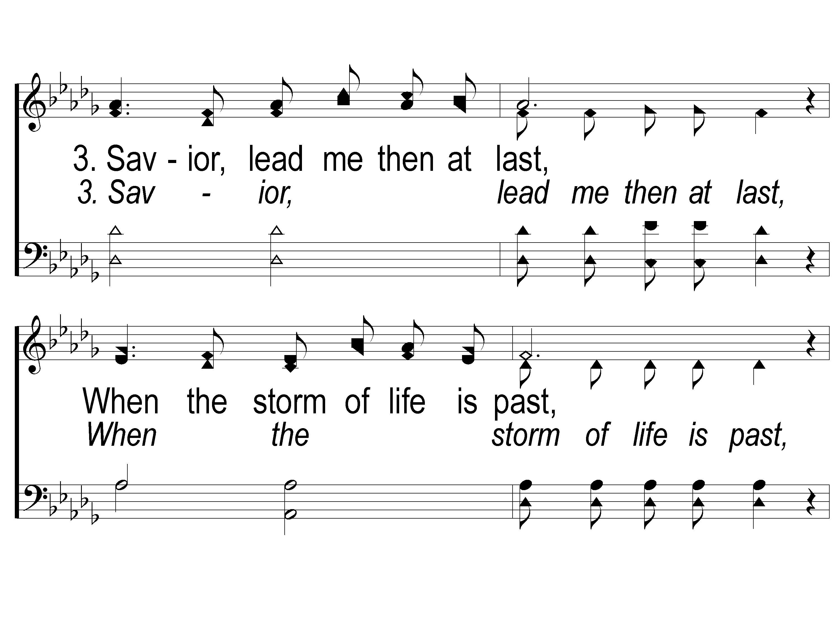
3-1 Savior Lead Me
Savior Lead Me
409
ePraise Hymn Presentation © 2005 Taylor Publications
ePraise Hymn Presentation © 2005 Taylor Publications

Slide 40
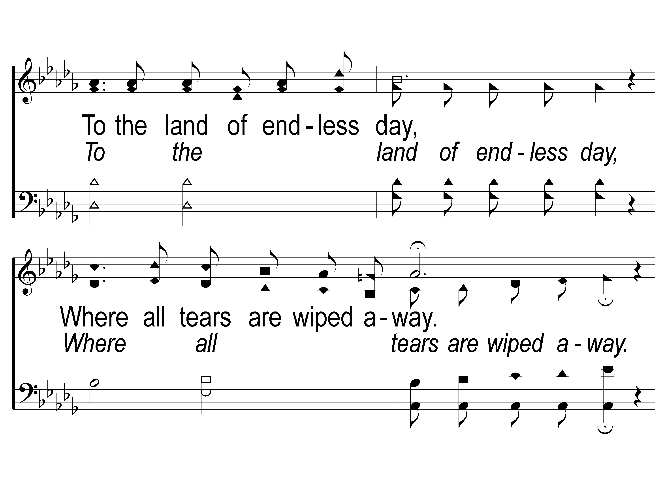
3-2 Savior Lead Me
Savior Lead Me
409
ePraise Hymn Presentation © 2005 Taylor Publications
ePraise Hymn Presentation © 2005 Taylor Publications

Slide 41
C-1 Savior Lead Me
Savior Lead Me
409
ePraise Hymn Presentation © 2005 Taylor Publications
ePraise Hymn Presentation © 2005 Taylor Publications

Slide 42
C-2 Savior Lead Me
Savior Lead Me
409
ePraise Hymn Presentation © 2005 Taylor Publications
ePraise Hymn Presentation © 2005 Taylor Publications

Slide 43
Opening Prayer

Slide 44
I Stand In Awe
#96

Slide 45
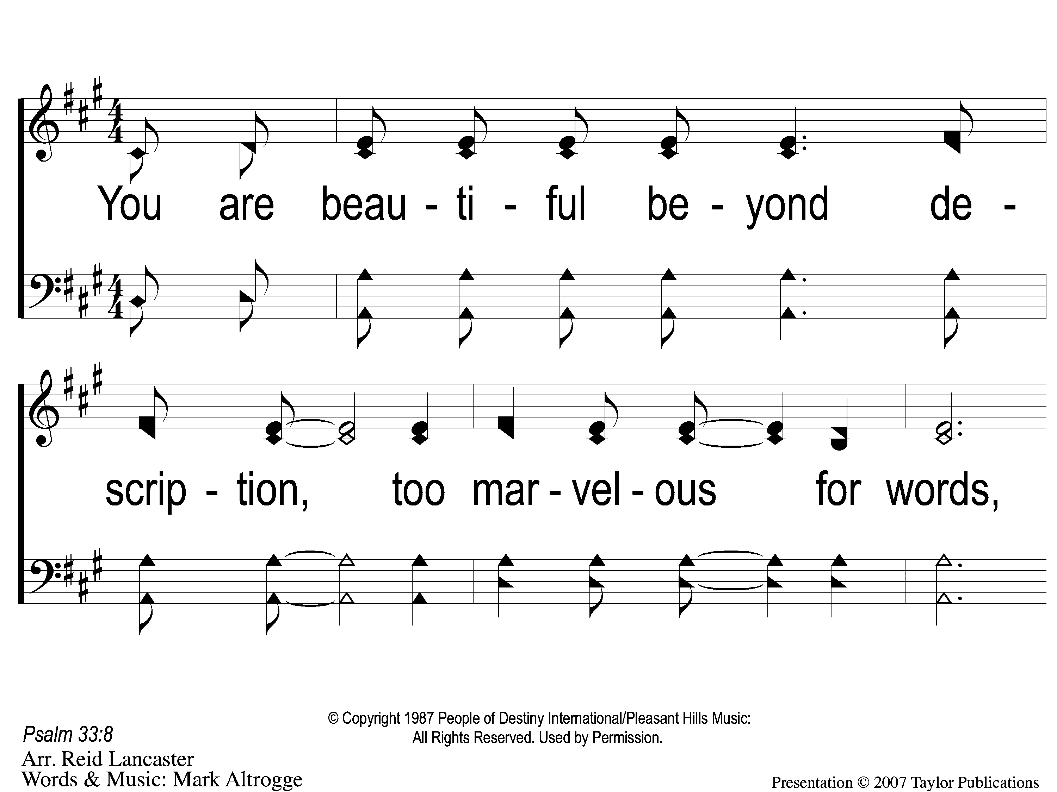
1 I Stand in Awe
I Stand in Awe
96

Slide 46
2 I Stand in Awe
I Stand in Awe
96

Slide 47
3 I Stand in Awe
I Stand in Awe
96

Slide 48
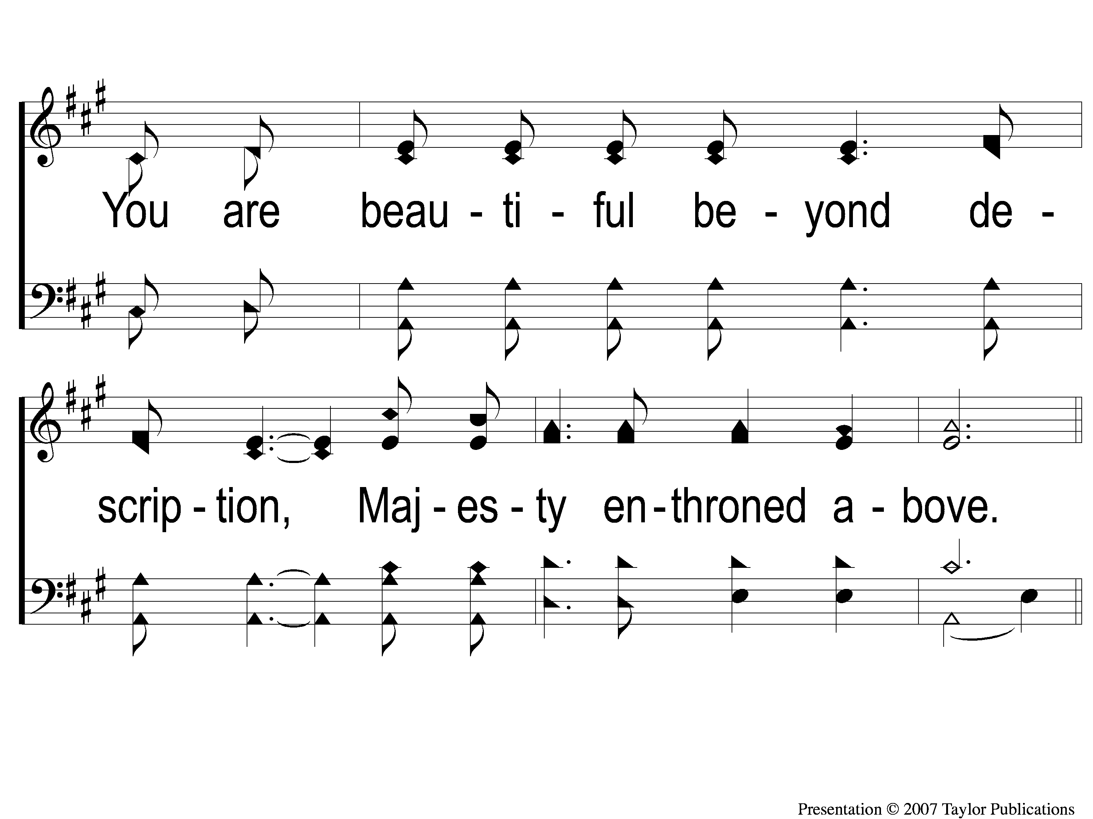
4 I Stand in Awe
I Stand in Awe
96

Slide 49
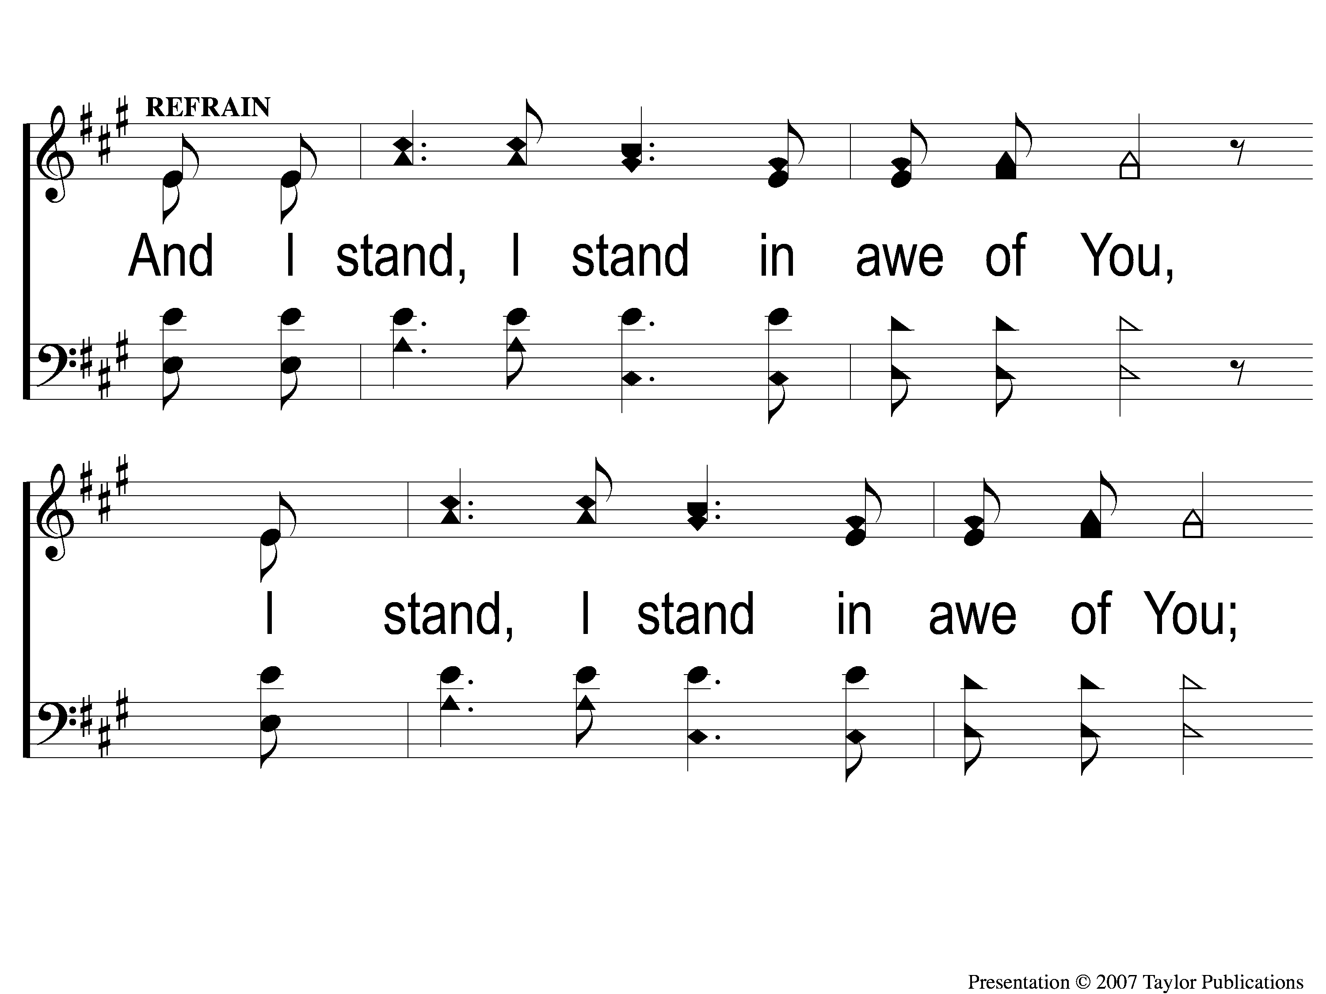
C-1 I Stand in Awe
I Stand in Awe
96

Slide 50
C-2 I Stand in Awe
I Stand in Awe
96

Slide 51
1 I Stand in Awe
I Stand in Awe
96

Slide 52
2 I Stand in Awe
I Stand in Awe
96

Slide 53
3 I Stand in Awe
I Stand in Awe
96

Slide 54
4 I Stand in Awe
I Stand in Awe
96

Slide 55
C-1 I Stand in Awe
I Stand in Awe
96

Slide 56
C-2 I Stand in Awe
I Stand in Awe
96

Slide 57
I Stand Amazed
#147

Slide 58
1-1 I Stand Amazed
I Stand Amazed
147

Slide 59
1-2 I Stand Amazed
I Stand Amazed
147

Slide 60
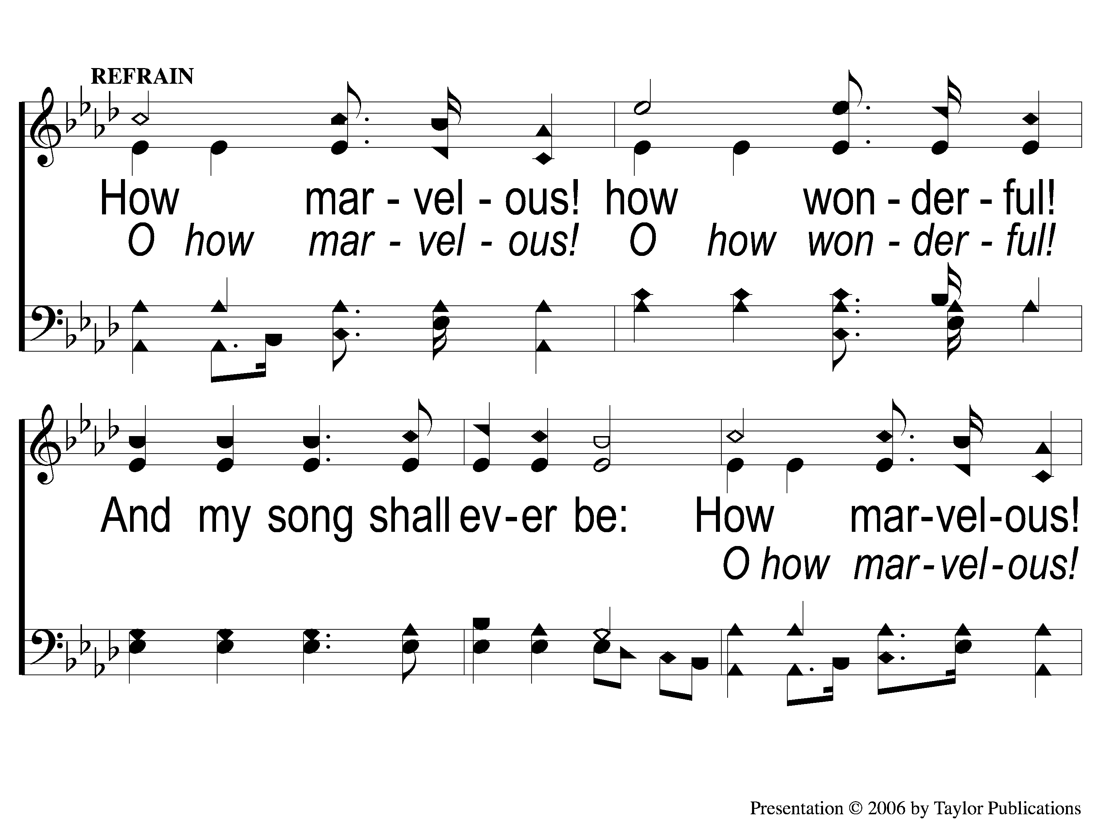
C-1 I Stand Amazed
I Stand Amazed
147

Slide 61
C-2 I Stand Amazed
I Stand Amazed
147

Slide 62
2-1 I Stand Amazed
I Stand Amazed
147

Slide 63
2-2 I Stand Amazed
I Stand Amazed
147

Slide 64
C-1 I Stand Amazed
I Stand Amazed
147

Slide 65
C-2 I Stand Amazed
I Stand Amazed
147

Slide 66
3-1 I Stand Amazed
I Stand Amazed
147

Slide 67
3-2 I Stand Amazed
I Stand Amazed
147

Slide 68
C-1 I Stand Amazed
I Stand Amazed
147

Slide 69
C-2 I Stand Amazed
I Stand Amazed
147

Slide 70
4-1 I Stand Amazed
I Stand Amazed
147

Slide 71
4-2 I Stand Amazed
I Stand Amazed
147

Slide 72
C-1 I Stand Amazed
I Stand Amazed
147

Slide 73
C-2 I Stand Amazed
I Stand Amazed
147

Slide 74
Scripture Reading:
Mark 1: 21-28

Slide 75
Songs About
Standing Firm

Slide 76
I Stand Amazed

Slide 77
Verse 1:
“I stand amazed in the presence
Of Jesus the Nazarene,
And wonder how He could love me,
A sinner, condemned, unclean."

Slide 78
Chorus:
“How marvelous! How wonderful!
And my song shall ever be:
How marvelous! How wonderful
Is my Savior’s love for me!"

Slide 79
Amazed at the Love of Jesus
His Descending
Matt. 1: 21, 21: 11
Jn. 18: 7, 19: 19
Acts 2: 22
Jn. 1: 14, 46

Slide 80
Verse 2:
"For me it was in the garden
He prayed, ‘Not My will, but Thine;’
He had no tears for His own griefs,
But sweat-drops of blood for mine."

Slide 81
Verse 3:
“In pity angels beheld Him,
And came from the world of light
To comfort Him in the sorrows
He bore for my soul that night."

Slide 82
Amazed at the Love of Jesus
His Agonizing
Heb. 5: 7
Lk. 22: 42-44
Isa. 53: 4

Slide 83
Verse 4:
"He took my sins and my sorrows,
He made them His very own;
He bore the burden to Calvary,
And suffered, and died alone."

Slide 84
Amazed at the Love of Jesus
His Bleeding
Isa. 53: 5-6, 10-11

Slide 85
Verse 5:
"When with the ransomed in glory
His face I at last shall see,
‘Twill be my joy through the ages
To sing of His love for me."

Slide 86
The Result of Amazement:

Slide 87
The Result of Amazement:
Action
Mk. 2: 12
Jms. 2: 18-19

Slide 88
Do You
Stand Amazed?

Slide 89
Invitation Song:
Love Lifted Me

Slide 90
1-1 Love Lifted Me
Love Lifted Me
453

Slide 91
1-2 Love Lifted Me
Love Lifted Me
453

Slide 92
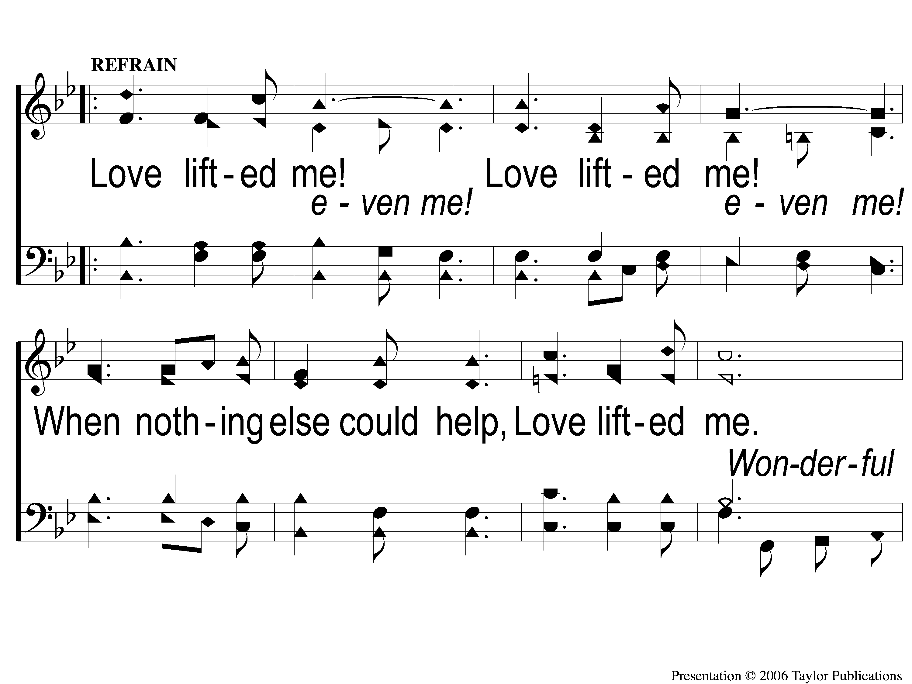
C-1 Love Lifted Me
Love Lifted Me
453

Slide 93
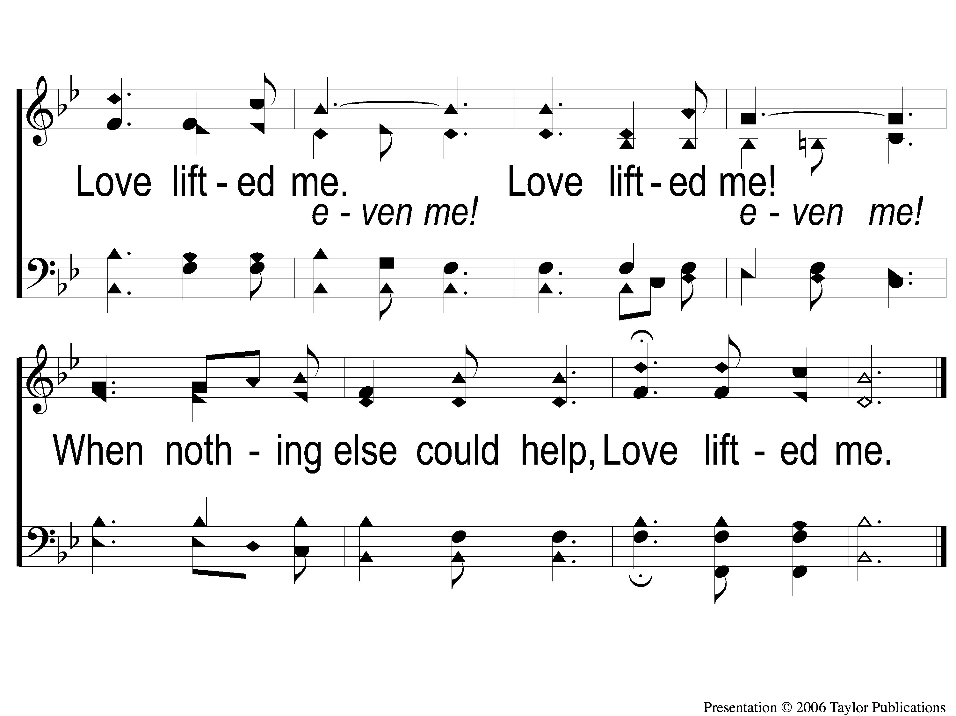
C-2 Love Lifted Me
Love Lifted Me
453

Slide 94
2-1 Love Lifted Me
Love Lifted Me
453

Slide 95
2-2 Love Lifted Me
Love Lifted Me
453

Slide 96
C-1 Love Lifted Me
Love Lifted Me
453

Slide 97
C-2 Love Lifted Me
Love Lifted Me
453

Slide 98
3-1 Love Lifted Me
Love Lifted Me
453

Slide 99
3-2 Love Lifted Me
Love Lifted Me
453

Slide 100
C-1 Love Lifted Me
Love Lifted Me
453

Slide 101
C-2 Love Lifted Me
Love Lifted Me
453

Slide 102
Above All

Slide 103
1 Above All
Above All

Slide 104
2 Above All
Above All

Slide 105
3 Above All
Above All

Slide 106
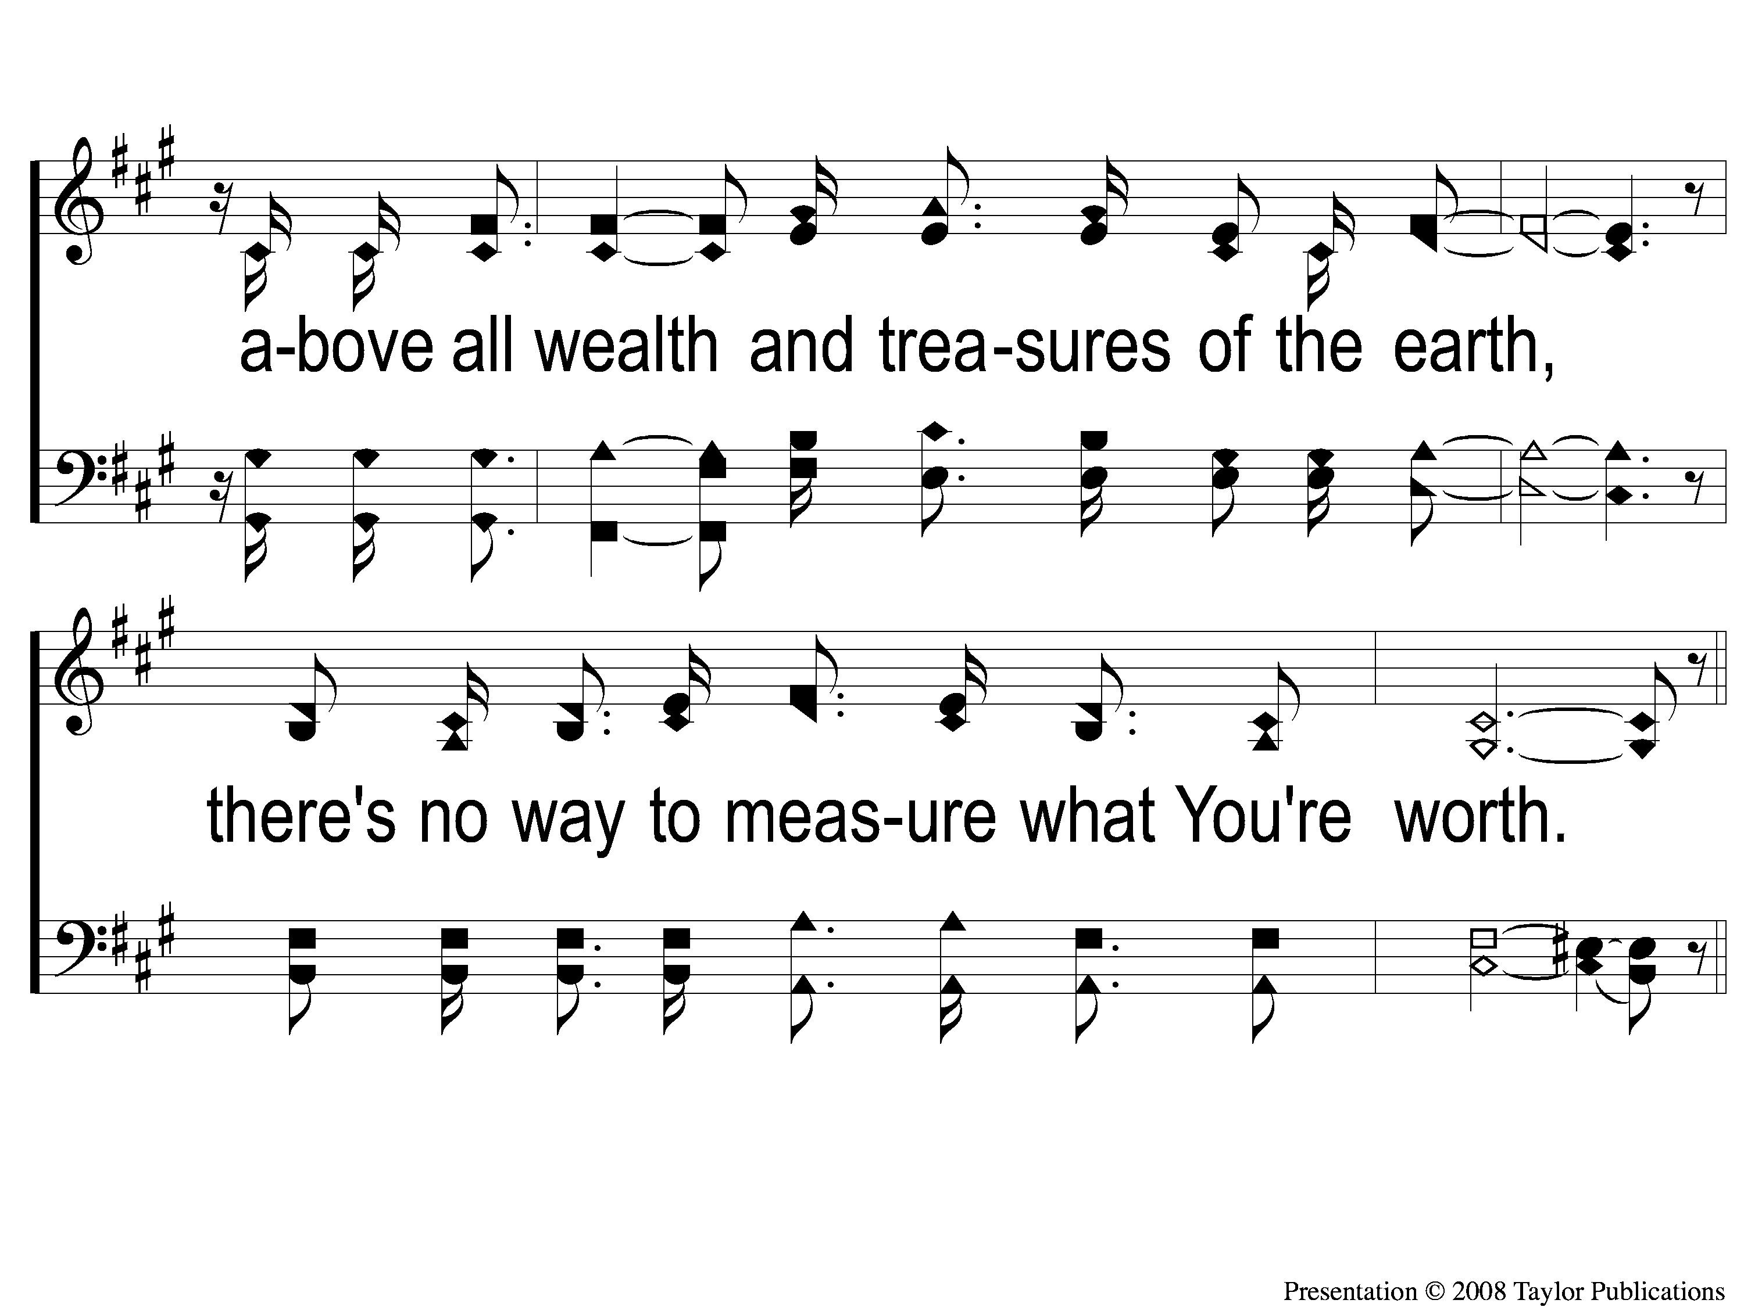
4 Above All
Above All

Slide 107
5 Above All
Above All

Slide 108
6 Above All
Above All

Slide 109
DC1 Above All
Above All

Slide 110
DC2 Above All
Above All

Slide 111
DC3 Above All
Above All

Slide 112
DC4 Above All
Above All

Slide 113
DC5 Above All
Above All

Slide 114
DC6 Above All
Above All

Slide 115
DS1 Above All
Above All

Slide 116
DS2 Above All
Above All

Slide 117
tag Above All
Above All

Slide 118
The Lord’s Supper
Acts 20:7

Slide 119
The Unleavened Bread
”Therefore, since Christ suffered for us in the flesh, arm yourselves also with the same mind, for he who has suffered in the flesh has ceased from sin, 2 that he no longer should live the rest of his time in the flesh for the lusts of men, but for the will of God.”
1 Peter 4: 1-2

Slide 120
The Fruit of the Vine
“And if you call on the Father, who without partiality judges according to each one’s work, conduct yourselves throughout the time of your stay here in fear; knowing that you were not redeemed with corruptible things, like silver or gold, from your aimless conduct received by tradition from your fathers, but with the precious blood of Christ, as of a lamb without blemish and without spot.” – 1 Peter 1: 17-19

Slide 121
Our Offering
“So let each one give as he purposes in his heart, not grudgingly or of necessity; for God loves a cheerful giver. And God is able to make all grace abound toward you, that you, always having all sufficiency in all things, may have an abundance for every good work.”– 2 Cor. 9: 7-8

Slide 122
Closing Prayer

Slide 123
This World Is
Not My Home
#957

Slide 124
1-1 This World is Not My Home
This World Is Not My Home
957

Slide 125
1-2 This World is Not My Home
This World Is Not My Home
957

Slide 126
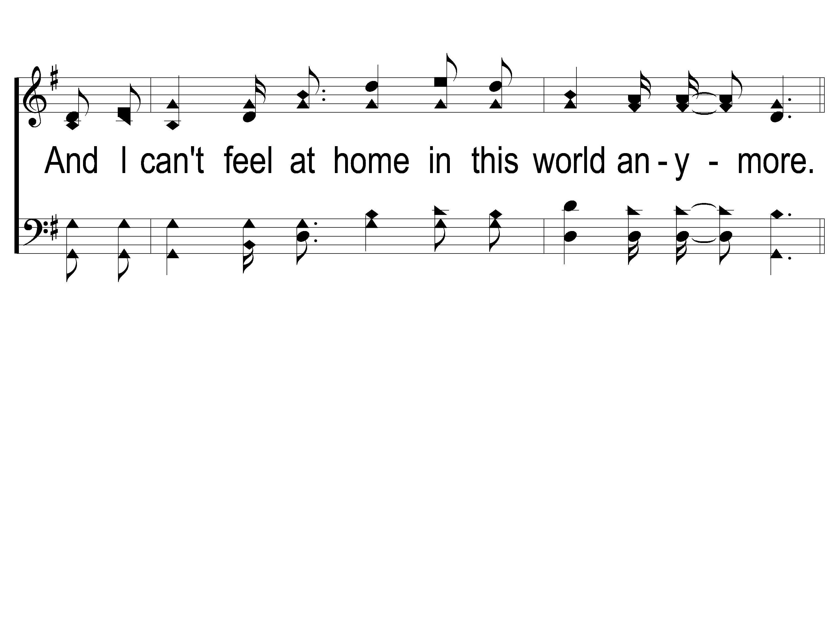
1-3 This World is Not My Home
This World Is Not My Home
957

Slide 127
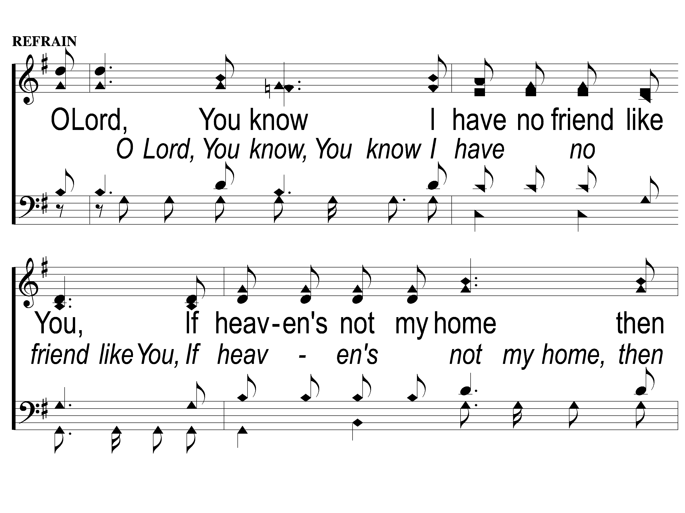
C-1 This World is Not My Home
This World Is Not My Home
957

Slide 128
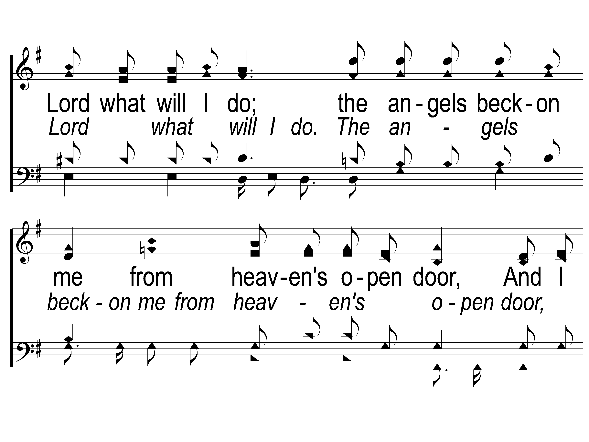
C-2 This World is Not My Home
This World Is Not My Home
957

Slide 129
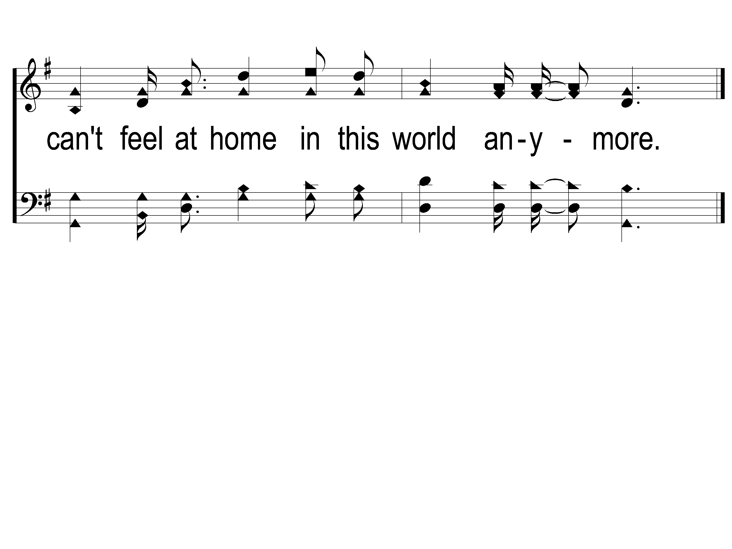
C-3 This World is Not My Home
This World Is Not My Home
957

Slide 130
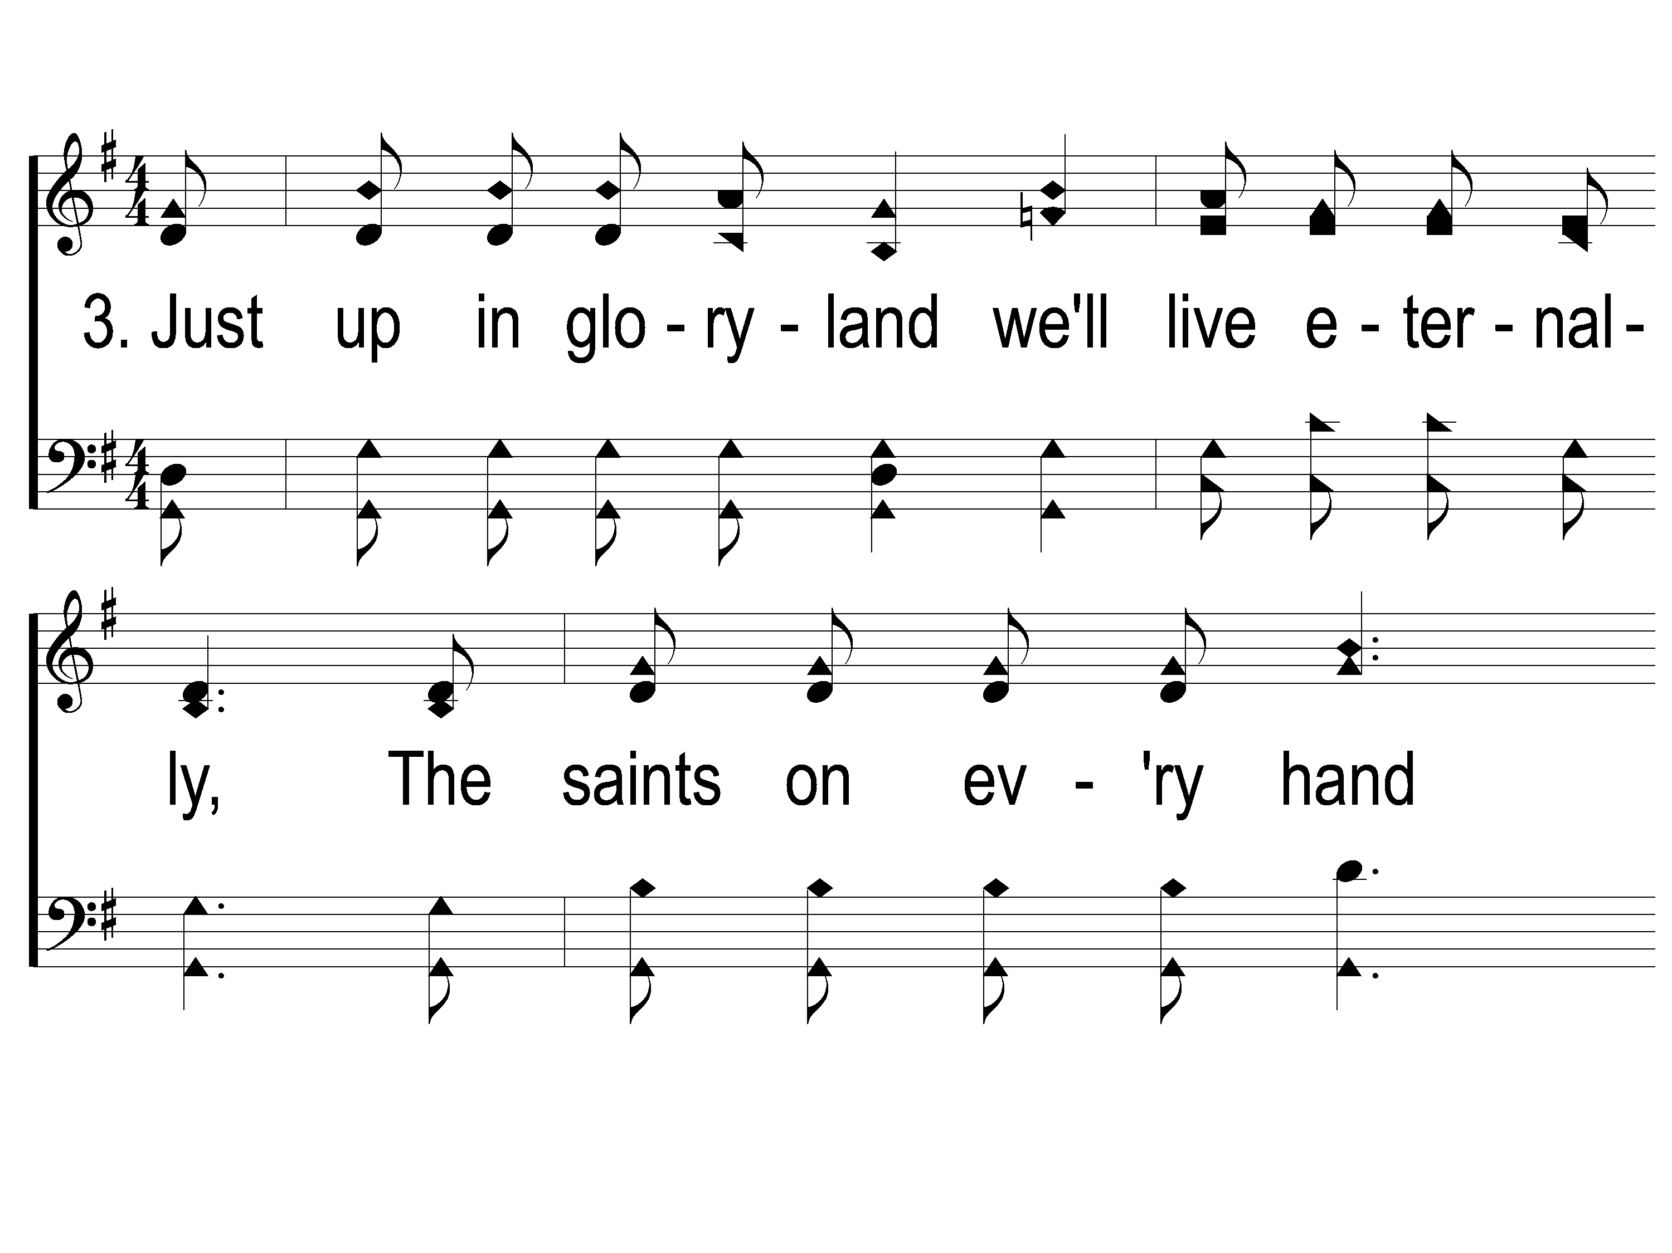
3-1 This World is Not My Home
This World Is Not My Home
957

Slide 131
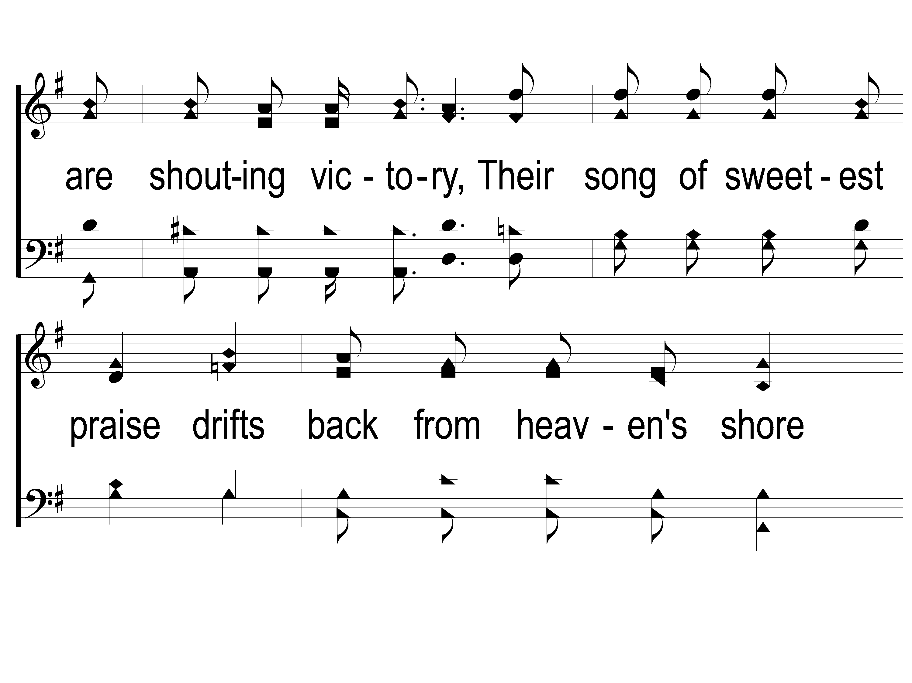
3-2 This World is Not My Home
This World Is Not My Home
957

Slide 132
3-3 This World is Not My Home
This World Is Not My Home
957

Slide 133
C-1 This World is Not My Home
This World Is Not My Home
957

Slide 134
C-2 This World is Not My Home
This World Is Not My Home
957

Slide 135
C-3 This World is Not My Home
This World Is Not My Home
957

Slide 136
Join us for
Evening Worship
Tonight
@ 6:00pm!

