Slide 1
RESTORE REBUILD RENEW
welcome
we are glad to
Have you with us
IN 2022
WHEELER
CHURCH
OF
CHRIST

Slide 2
Songs of Praise To God

Slide 3
Opening Prayer

Slide 4
Songs of Praise To God

Slide 5
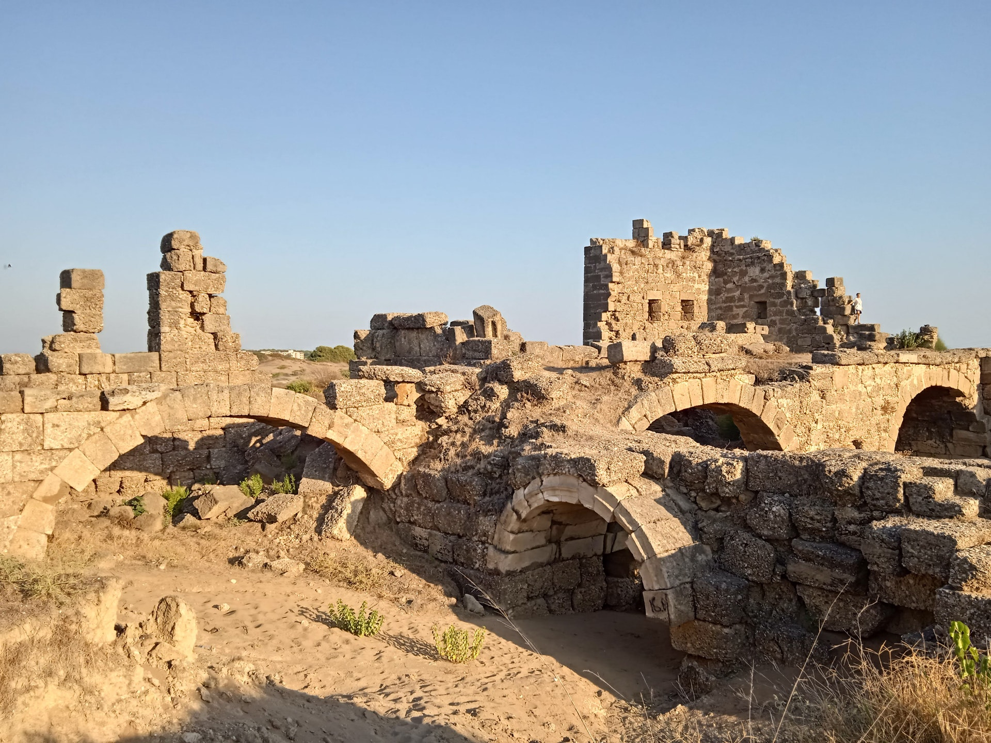
Rebuilding Jerusalem

Slide 6
MORE GIVING
Nehemiah Ch. 10

Slide 7
GIVING IN NEHEMIAH
Ch. 8 – Great Assembly
Ch. 9 – Great Confession
Ch. 10 – Great Repentance

Slide 8
GIVING IN THE LAW OF MOSES
Firstfruits
Ex. 23:19, 34:26
Lev. 19:23, Num. 18:12
Deut. 26:1-2

Slide 9
GIVING IN THE LAW OF MOSES
Firstborn Animals
Ex. 13:2, 12-13
Lev. 27:26-27
Num. 18:15-16

Slide 10
GIVING IN THE LAW OF MOSES
Provisions for Priest & Levites
Num. 3:3 – Priests = Sons of Aaron

Slide 11
GIVING IN THE LAW OF MOSES
Provisions for Priest & Levites
Num. 3:3 – Priests = Sons of Aaron
Gershonites → Num. 3:25-26
Kohathites → Num. 3:31
Merarites → Num. 3:36-37

Slide 12
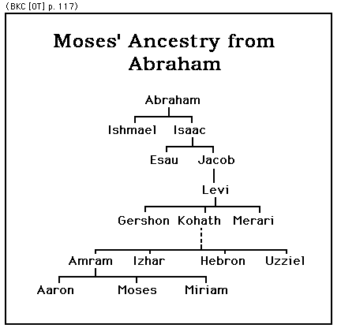

Slide 13
GIVING IN THE LAW OF MOSES
Provisions for Priest & Levites
Food – Deut. 18:1
Wages – Ex. 30:11-16, Matt. 17:24
Land – Josh. 13:33, Ch. 20-21

Slide 14
GIVING IN THE LAW OF CHRIST
Similarities
Christians Are Priests
1 Pet. 2:5, 9, Rom. 12:1-2

Slide 15
GIVING IN THE LAW OF CHRIST
Similarities
Commanded to Give
1 Cor. 16:1-2

Slide 16
GIVING IN THE LAW OF CHRIST
Similarities
Need To Give Correctly
2 Cor. 8:12, 9:6-8

Slide 17
GIVING IN THE LAW OF CHRIST
Differences
No Animal Sacrifices Nor Crops
Hebrews 9:11-15, 10:1-4

Slide 18
GIVING IN THE LAW OF CHRIST
Differences
New Holy Day Prescribed to Give
Acts 20:7

Slide 19
GIVING IN THE LAW OF CHRIST
Differences
No Amount Specified
1 Cor. 16:2
2 Cor. 9:6

Slide 20
Songs of Praise To God

Slide 21
The Lord’s Supper
Acts 20:7

Slide 22
Closing Prayer

Slide 23
Songs of Praise To God

Slide 24
RESTORE REBUILD RENEW
Wednesday
Family Night @ 6:30 PM
Home of Bill & Wanda Page
IN 2022
WHEELER
CHURCH
OF
CHRIST

