Slide 1
1-1 The Battle Belongs to the Lord
The Battle Belongs to the Lord
749

Slide 2
1-2 The Battle Belongs to the Lord
The Battle Belongs to the Lord
749

Slide 3
C-1 The Battle Belongs to the Lord
The Battle Belongs to the Lord
749

Slide 4
C-2 The Battle Belongs to the Lord
The Battle Belongs to the Lord
749

Slide 5
2-1 The Battle Belongs to the Lord
The Battle Belongs to the Lord
749

Slide 6
2-2 The Battle Belongs to the Lord
The Battle Belongs to the Lord
749

Slide 7
C-1 The Battle Belongs to the Lord
The Battle Belongs to the Lord
749

Slide 8
C-2 The Battle Belongs to the Lord
The Battle Belongs to the Lord
749

Slide 9
3-1 The Battle Belongs to the Lord
The Battle Belongs to the Lord
749

Slide 10
3-2 The Battle Belongs to the Lord
The Battle Belongs to the Lord
749

Slide 11
C-1 The Battle Belongs to the Lord
The Battle Belongs to the Lord
749

Slide 12
C-2 The Battle Belongs to the Lord
The Battle Belongs to the Lord
749

Slide 13
RESTORE REBUILD RENEW
welcome
we are glad to
Have you with us
IN 2022
WHEELER
CHURCH
OF
CHRIST

Slide 14
Song:
Sing & Be Happy
#587

Slide 15
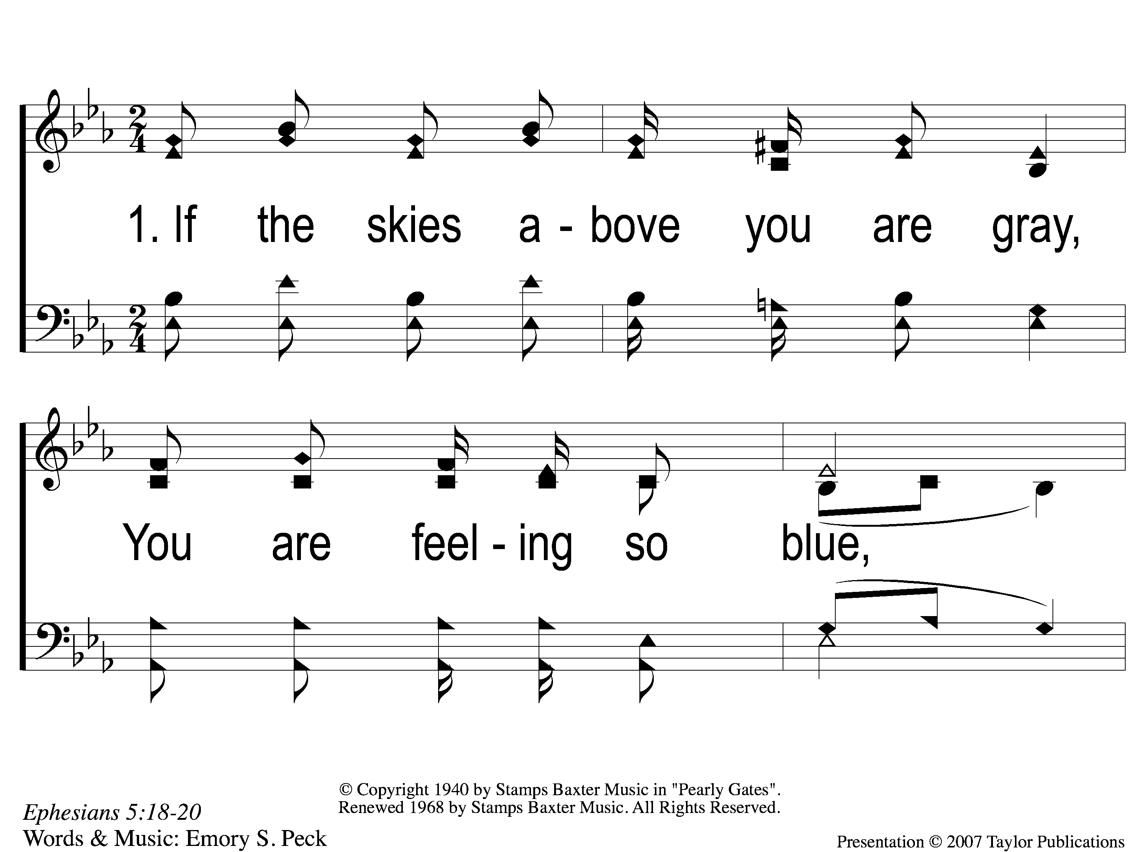
1-1 Sing and Be Happy
Sing and Be Happy
587

Slide 16
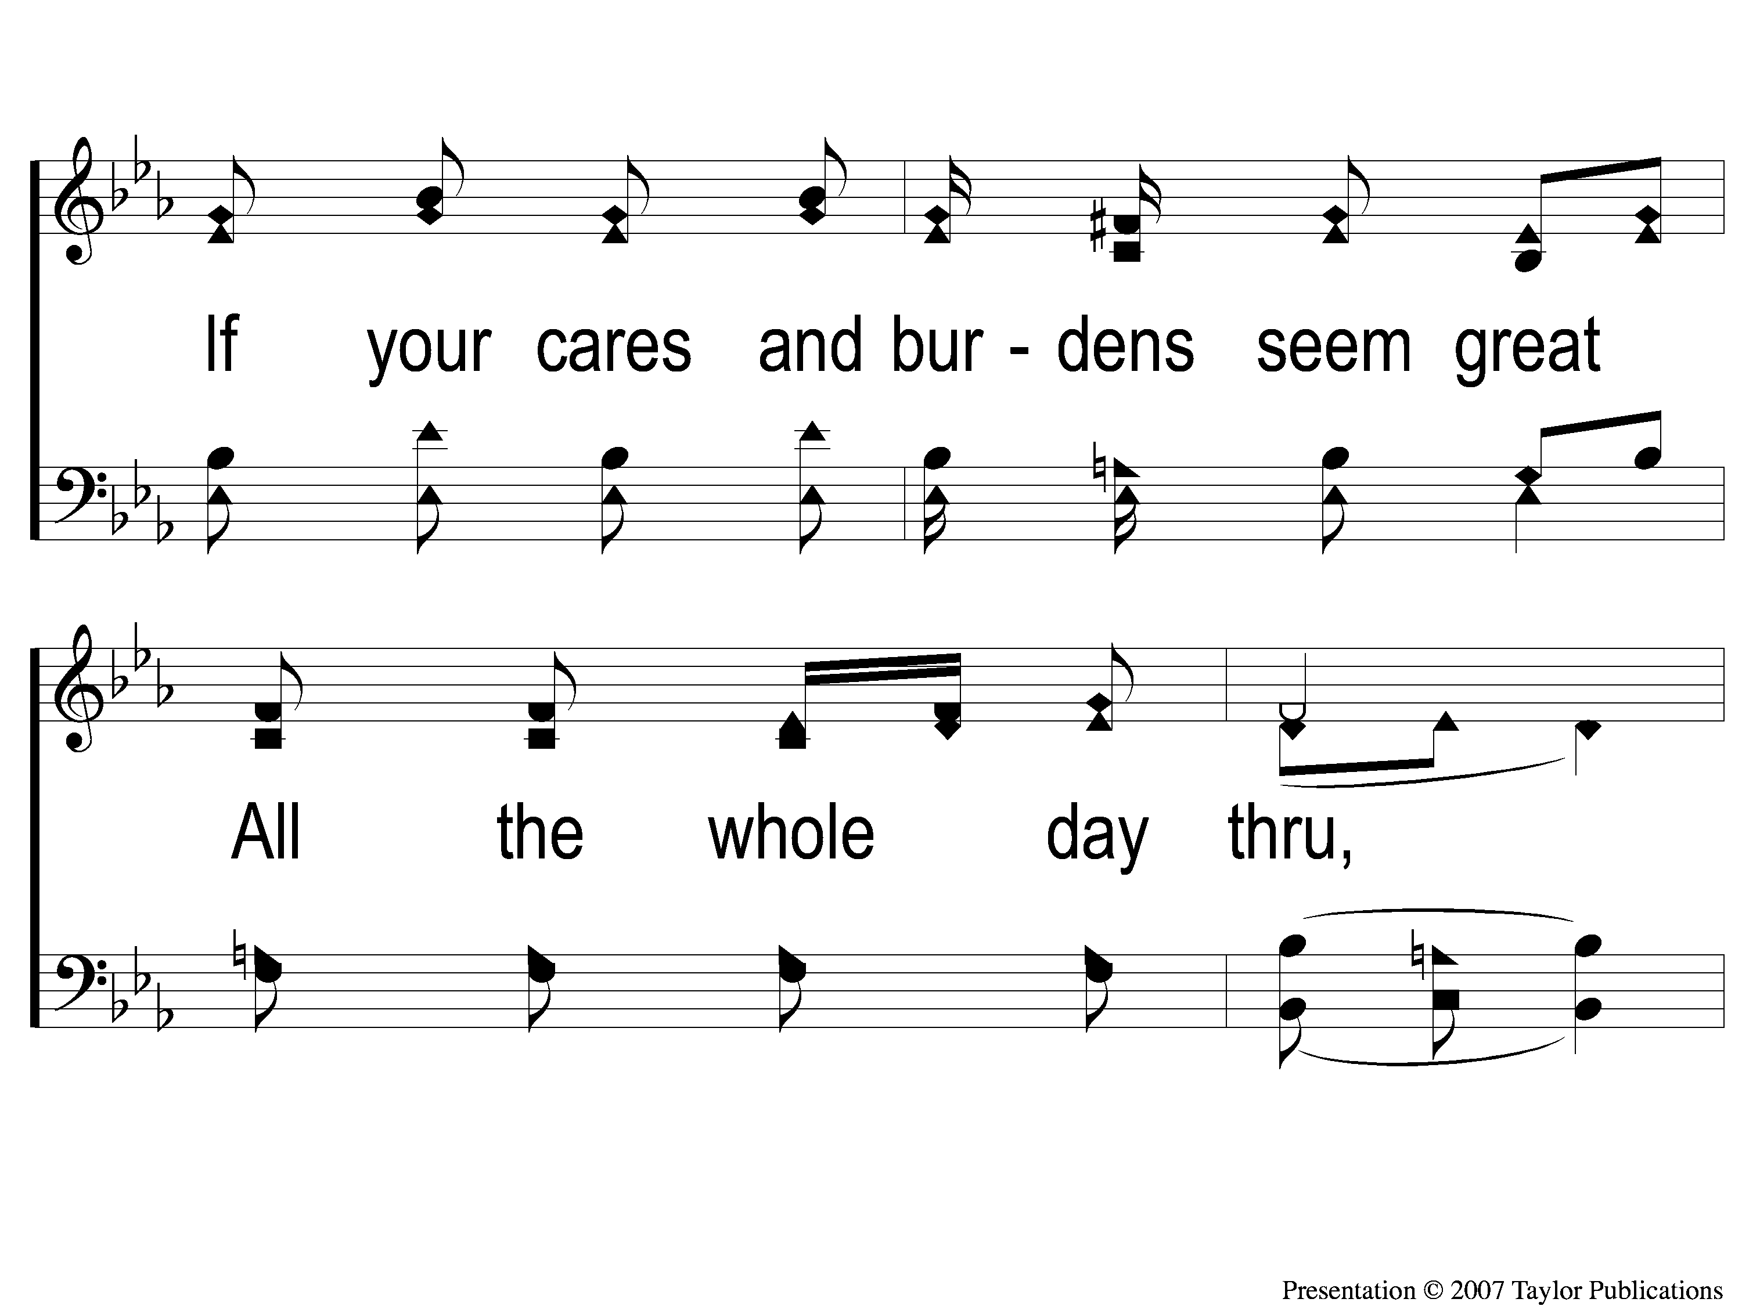
1-2 Sing and Be Happy
Sing and Be Happy
587

Slide 17
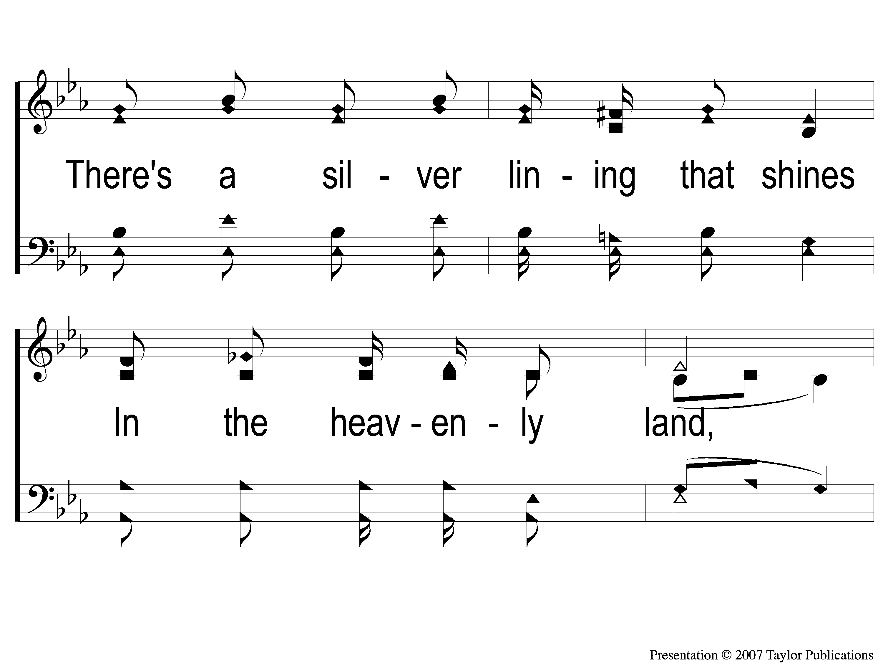
1-3 Sing and Be Happy
Sing and Be Happy
587

Slide 18
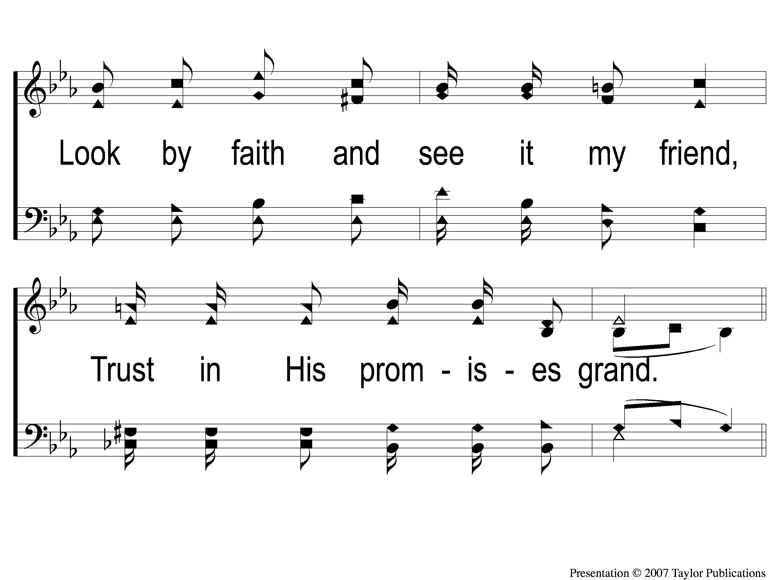
1-4 Sing and Be Happy
Sing and Be Happy
587

Slide 19
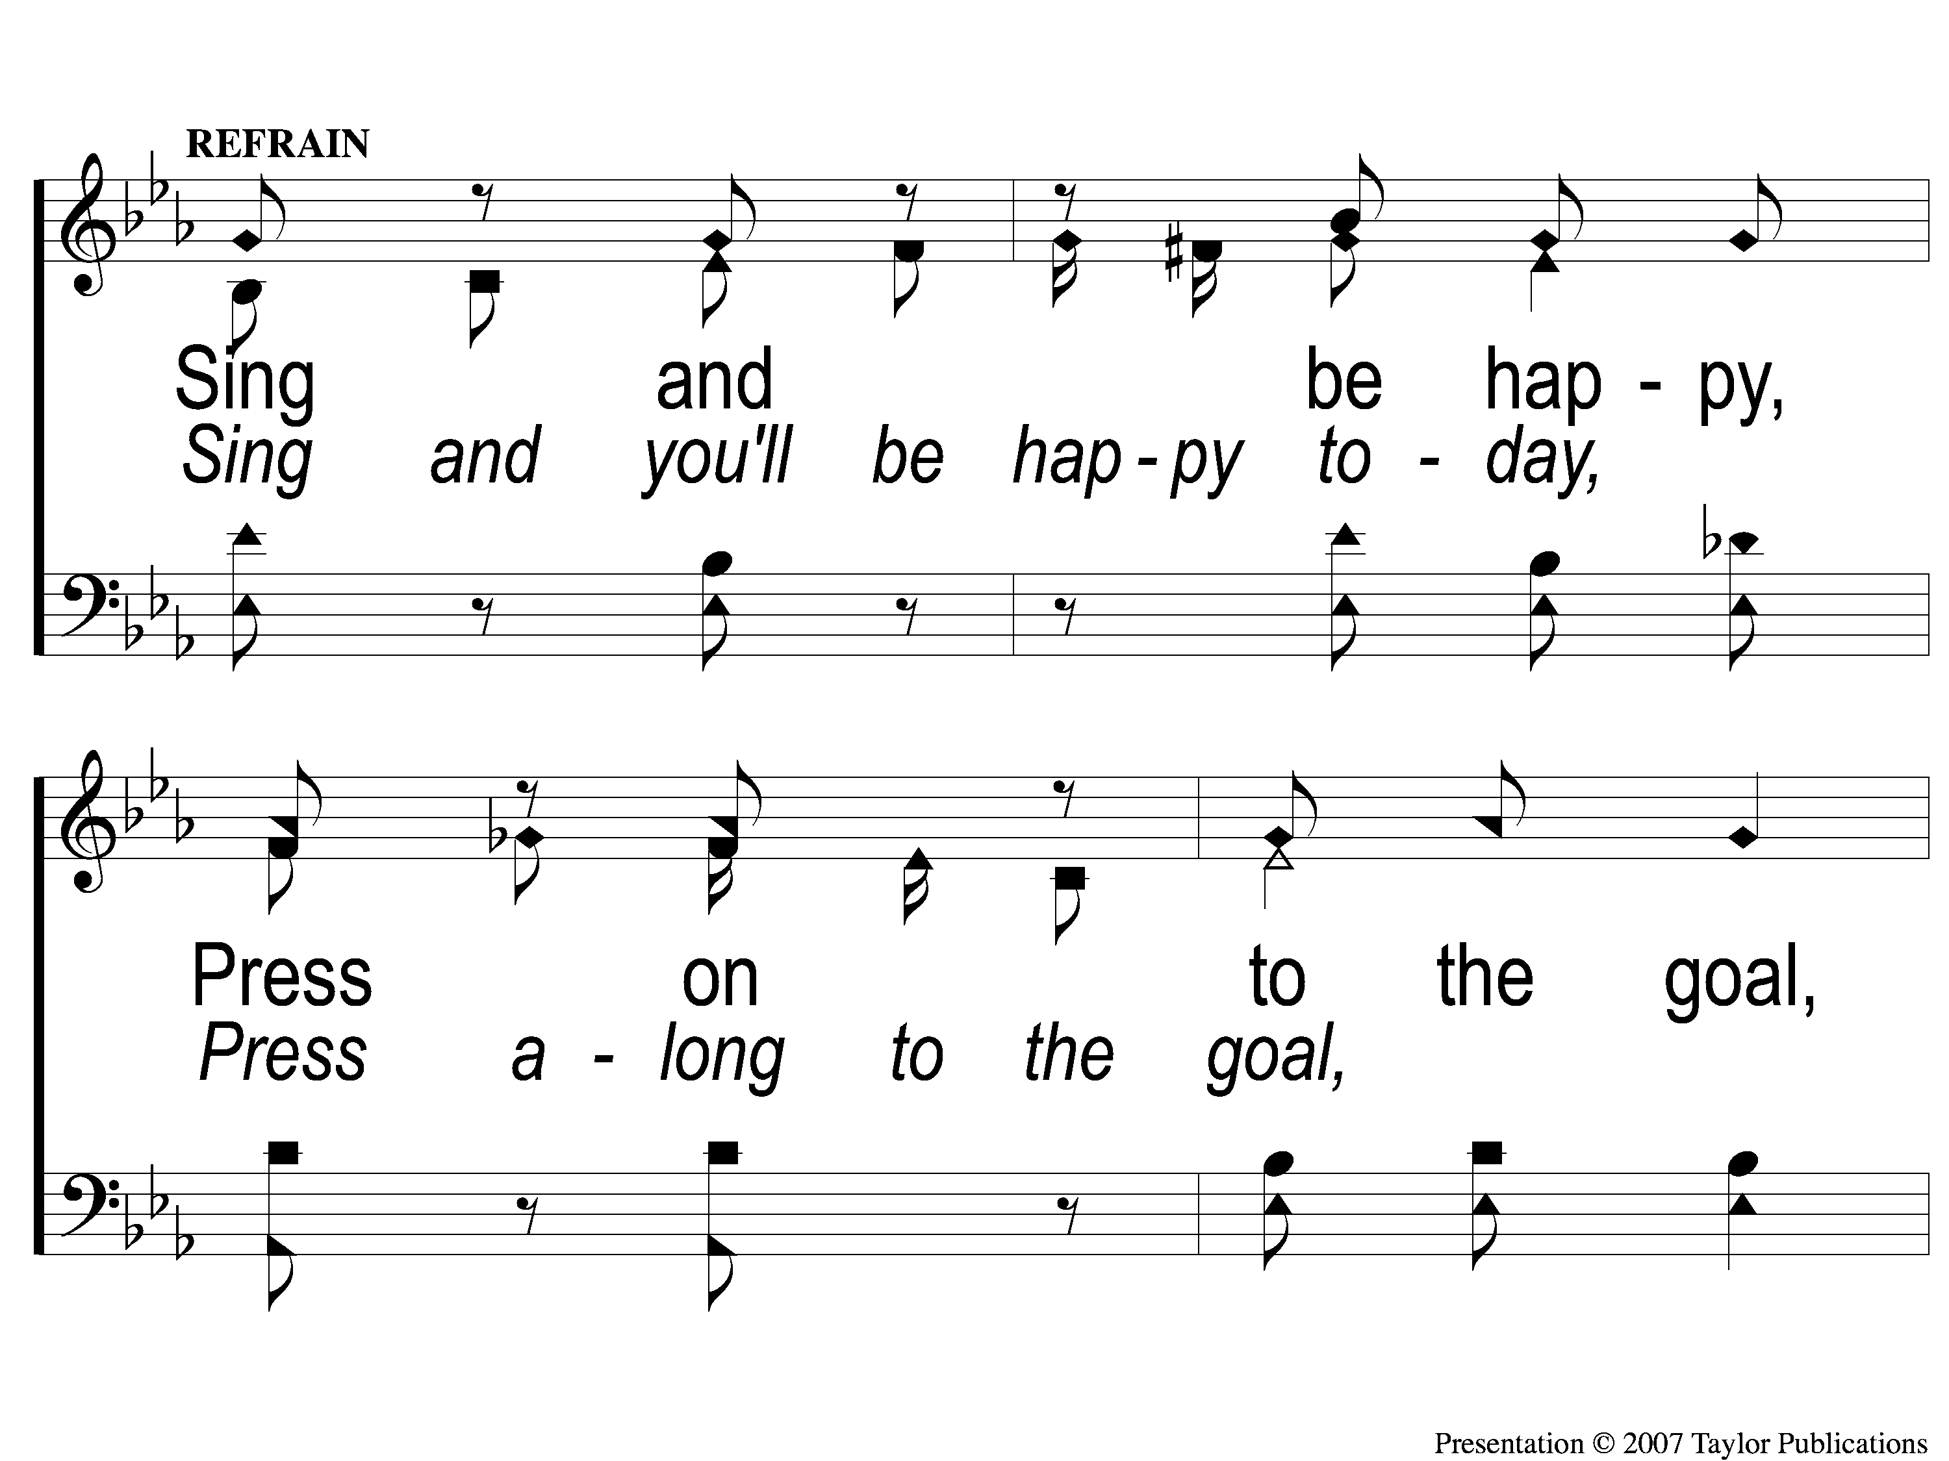
C-1 Sing and Be Happy
Sing and Be Happy
587

Slide 20
C-2 Sing and Be Happy
Sing and Be Happy
587

Slide 21
C-3 Sing and Be Happy
Sing and Be Happy
587

Slide 22
C-4 Sing and Be Happy
Sing and Be Happy
587

Slide 23
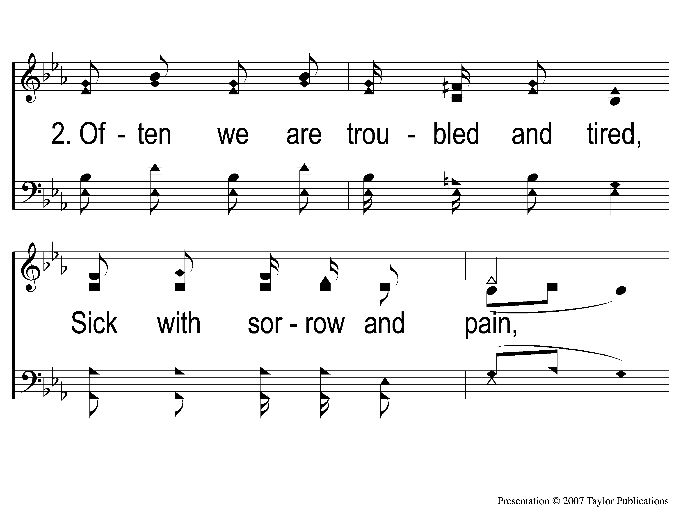
2-1 Sing and Be Happy
Sing and Be Happy
587

Slide 24
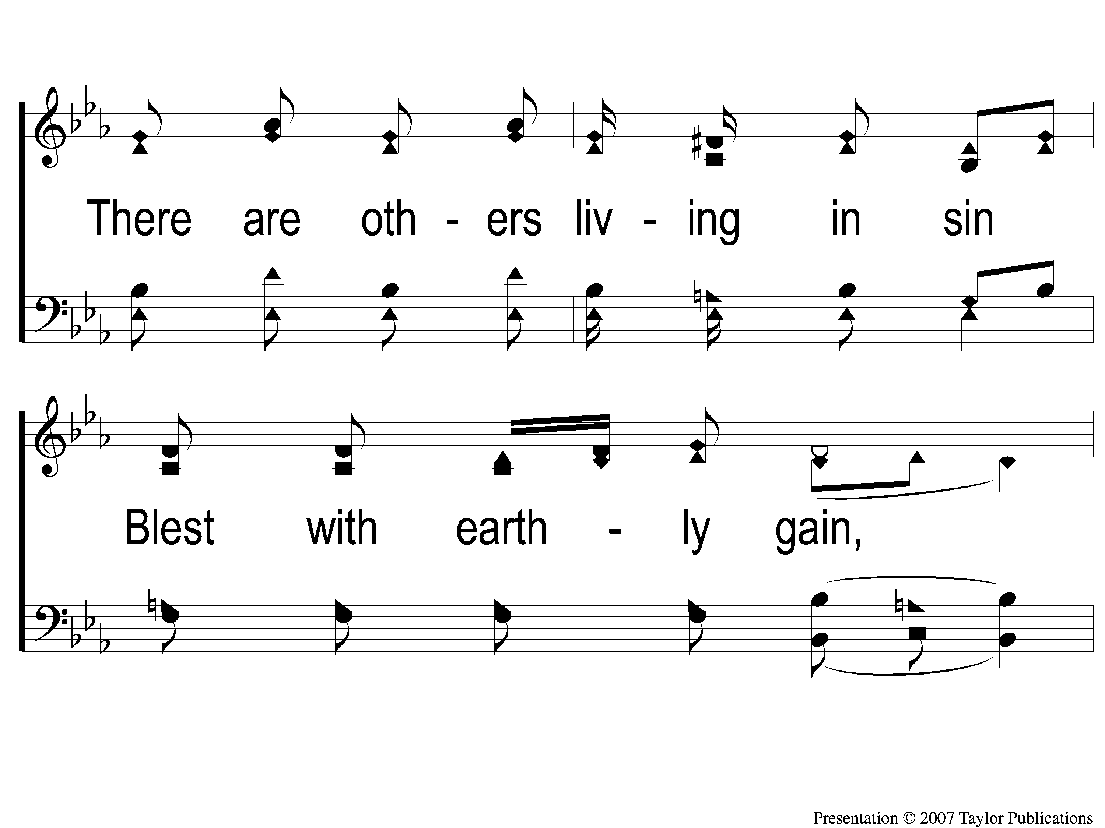
2-2 Sing and Be Happy
Sing and Be Happy
587

Slide 25
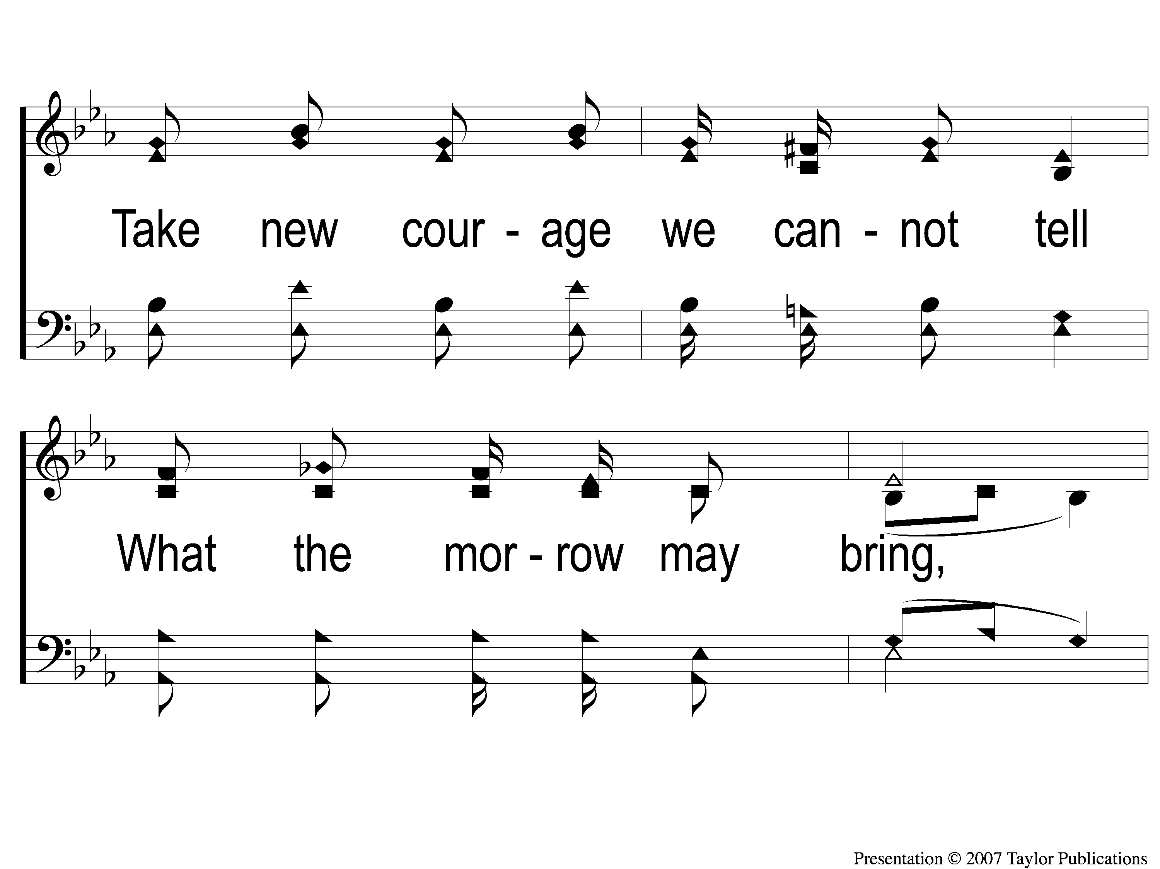
2-3 Sing and Be Happy
Sing and Be Happy
587

Slide 26
2-4 Sing and Be Happy
Sing and Be Happy
587

Slide 27
C-1 Sing and Be Happy
Sing and Be Happy
587

Slide 28
C-2 Sing and Be Happy
Sing and Be Happy
587

Slide 29
C-3 Sing and Be Happy
Sing and Be Happy
587

Slide 30
C-4 Sing and Be Happy
Sing and Be Happy
587

Slide 31
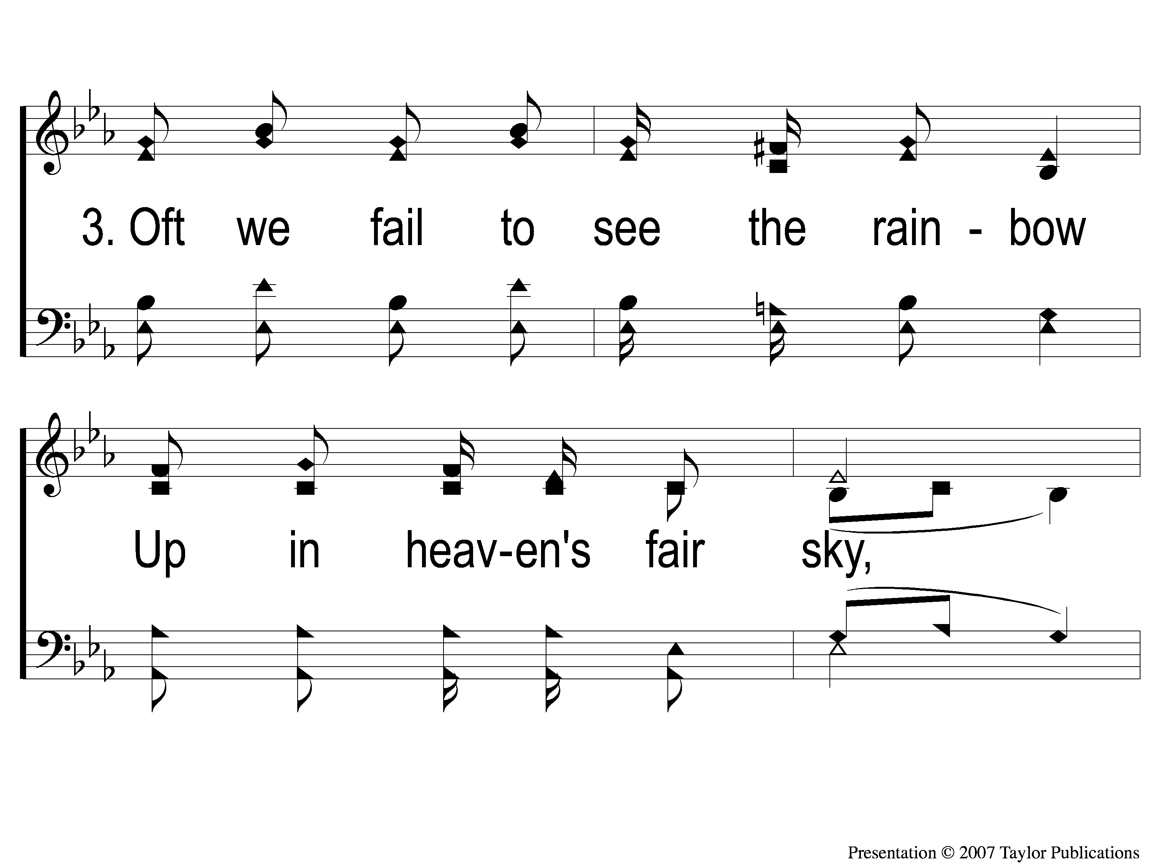
3-1 Sing and Be Happy
Sing and Be Happy
587

Slide 32
3-2 Sing and Be Happy
Sing and Be Happy
587

Slide 33
3-3 Sing and Be Happy
Sing and Be Happy
587

Slide 34
3-4 Sing and Be Happy
Sing and Be Happy
587

Slide 35
C-1 Sing and Be Happy
Sing and Be Happy
587

Slide 36
C-2 Sing and Be Happy
Sing and Be Happy
587

Slide 37
C-3 Sing and Be Happy
Sing and Be Happy
587

Slide 38
C-4 Sing and Be Happy
Sing and Be Happy
587

Slide 39
Song:
My Hope Is Built
#538

Slide 40
1-1 My Hope is Built
My Hope Is Built
538

Slide 41
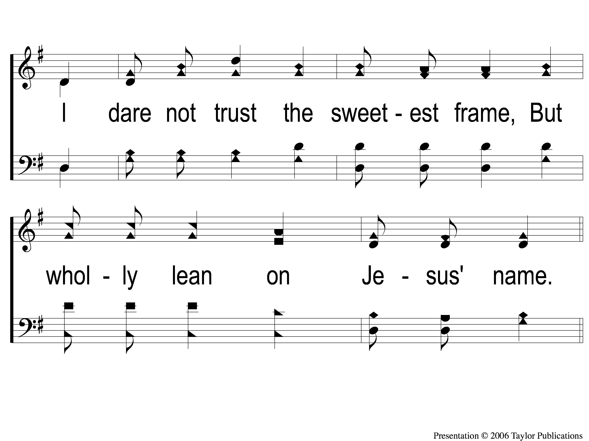
1-2 My Hope is Built
My Hope Is Built
538

Slide 42
c My Hope is Built
My Hope Is Built
538

Slide 43
2-1 My Hope is Built
My Hope Is Built
538

Slide 44
2-2 My Hope is Built
My Hope Is Built
538

Slide 45
c My Hope is Built
My Hope Is Built
538

Slide 46
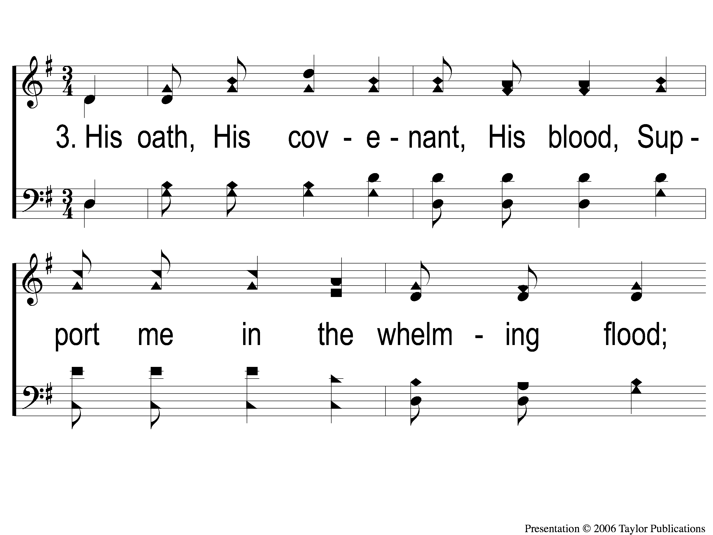
3-1 My Hope is Built
My Hope Is Built
538

Slide 47
3-2 My Hope is Built
My Hope Is Built
538

Slide 48
c My Hope is Built
My Hope Is Built
538

Slide 49
4-1 My Hope is Built
My Hope Is Built
538

Slide 50
4-2 My Hope is Built
My Hope Is Built
538

Slide 51
c My Hope is Built
My Hope Is Built
538

Slide 52
Opening Prayer

Slide 53
Song:
There Is A Habitation
#860

Slide 54
1 There is a Habitation
There Is A Habitation
860

Slide 55
c There is a Habitation
There Is A Habitation
860

Slide 56
2 There is a Habitation
There Is A Habitation
860

Slide 57
c There is a Habitation
There Is A Habitation
860

Slide 58
3 There is a Habitation
There Is A Habitation
860

Slide 59
c There is a Habitation
There Is A Habitation
860

Slide 60
4 There is a Habitation
There Is A Habitation
860

Slide 61
c There is a Habitation
There Is A Habitation
860

Slide 62
Song:
Lord, Reign In Me

Slide 63
1-1 Lord Reign in Me
Lord, Reign In Me

Slide 64
1-2 Lord Reign in Me
Lord, Reign In Me

Slide 65
C-1 Lord Reign in Me
Lord, Reign In Me

Slide 66
C-2 Lord Reign in Me
Lord, Reign In Me

Slide 67
2-1 Lord Reign in Me
Lord, Reign In Me

Slide 68
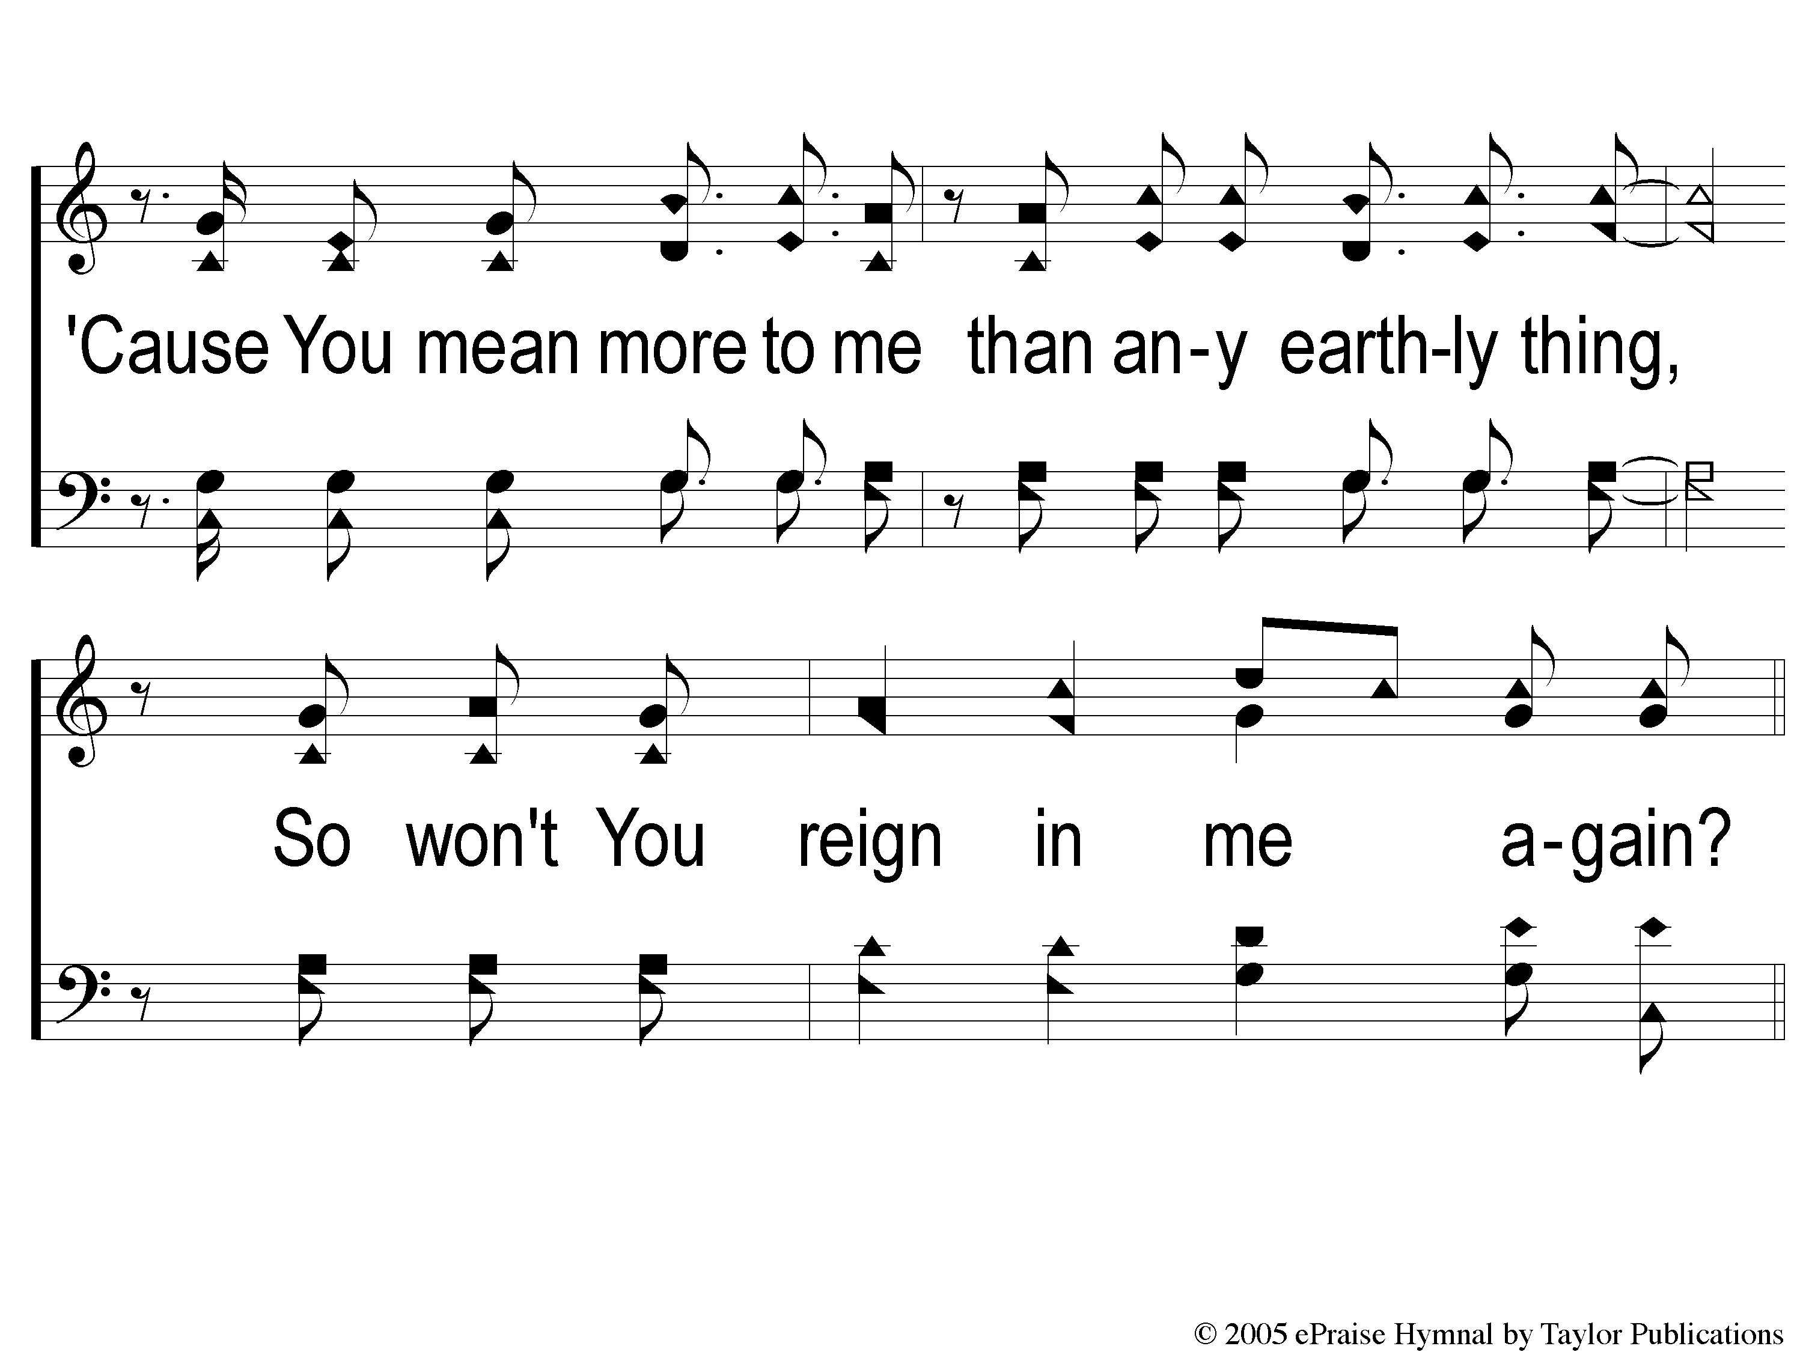
2-2 Lord Reign in Me
Lord, Reign In Me

Slide 69
2C-1 Lord Reign in Me
Lord, Reign In Me

Slide 70
2C-2 Lord Reign in Me
Lord, Reign In Me

Slide 71
Ds-1 Lord Reign in Me
Lord, Reign In Me

Slide 72
Ds-2 Lord Reign in Me
Lord, Reign In Me

Slide 73
Coda Lord Reign in Me
Lord, Reign In Me

Slide 74
Scripture Reading:
Nehemiah 8:1-9

Slide 75
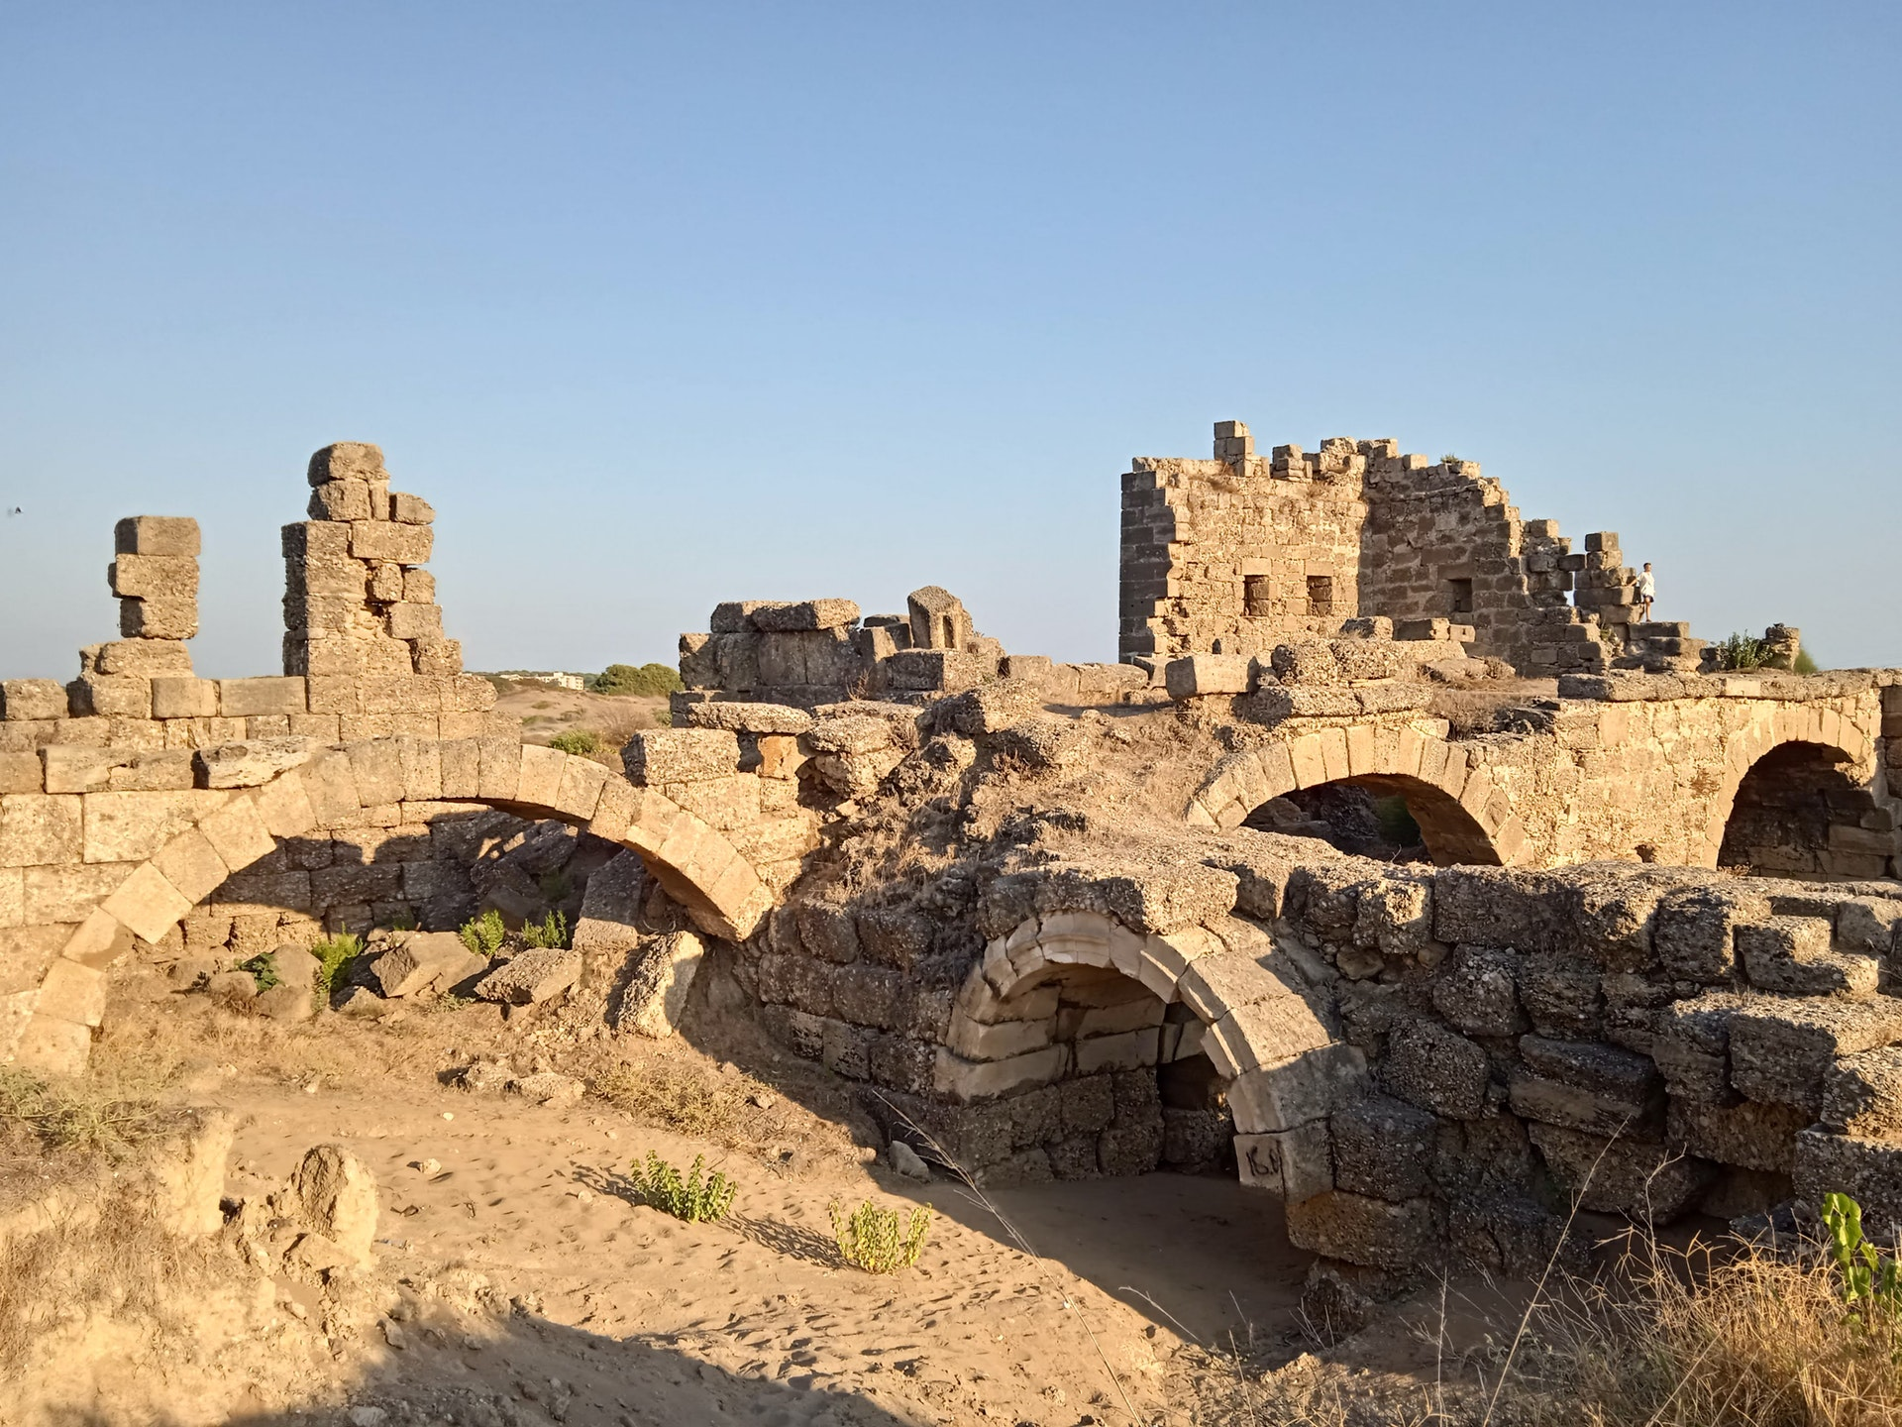
Rebuilding Jerusalem

Slide 76
More Attention to God’s Word
Nehemiah Chapter 8

Slide 77
Delighting in God’s Word
Psa. 1:2, 119:97, 111, 114, 127

Slide 78
Desperately Seeking God’s Word
Psa. 42:1

Slide 79
Nehemiah Chapter 8:
Giving Attention to God’s Word

Slide 80
Nehemiah Chapter 8
An Assembly of the People (v. 1-2)

Slide 81
1. An Assembly of the People
“all the people gathered together as one man” (v. 1)

Slide 82
1. An Assembly of the People
“all the people gathered together as one man” (v. 1)
“men and women and all who could hear with understanding” (v. 2)

Slide 83
1. An Assembly of the People
“all the people gathered together as one man” (v. 1)
“men and women and all who could hear with understanding” (v. 2)
Only Exception: Sickness (Num. 19:20)

Slide 84
Nehemiah Chapter 8
An Assembly of the People (v. 1-2)
Advising of the Law (v. 2, 8)

Slide 85
2. Advising of the Law
Ezra, a priest (v. 2) & a scribe (v. 1, 4)

Slide 86
2. Advising of the Law
Ezra, a priest (v. 2) & a scribe (v. 1, 4)
“The Book of the Law of Moses” (v. 1)

Slide 87
2. Advising of the Law
Ezra, a priest (v. 2) & a scribe (v. 1, 4)
“The Book of the Law of Moses” (v. 1)
“he read from it in the open square” (v. 3)
Deut. 31:9-13

Slide 88
2. Advising of the Law
How long did he read? (v. 3)

Slide 89
2. Advising of the Law
How long did he read? (v. 3)
Morning = 6:00 am

Slide 90
2. Advising of the Law
How long did he read? (v. 3)
Morning = 6:00 am
Midday = 12:00 pm
Total Reading Time: 6 Hours

Slide 91
2. Advising of the Law
Notice who helped Ezra (v. 4)

Slide 92
2. Advising of the Law
Notice who helped Ezra (v. 4)
Notice what else they did (v. 8)

Slide 93
Nehemiah Chapter 8
An Assembly of the People (v. 1-2)
Advising of the Law (v. 2, 8)
Attention to the Law (v. 3-5)

Slide 94
3. Attention to the Law
Respected God’s Law (v. 5)

Slide 95
3. Attention to the Law
Respected God’s Law (v. 5)
Received God’s Law (v. 3)

Slide 96
Nehemiah Chapter 8
An Assembly of the People (v. 1-2)
Advising of the Law (v. 2, 8)
Attention to the Law (v. 3-5)
An Answer to the Law (v. 6-9)

Slide 97
4. An Answer to the Law
The reading evoked a Response (v. 6)

Slide 98
4. An Answer to the Law
The reading evoked a Response (v. 6)
“Amen” = “surely it is true; a strong affirmation of what is declared”
Neh. 5:13, 1 Cor. 14:16

Slide 99
Are You Giving God’s Word Due Attention?

Slide 100
What A Day That Will Be
#916
Invitation
Song:

Slide 101
1-1 What a Day That Will Be
What a Day That Will Be
916

Slide 102
1-2 What a Day That Will Be
What a Day That Will Be
916

Slide 103
1-3 What a Day That Will Be
What a Day That Will Be
916

Slide 104
C-1 What a Day That Will Be
What a Day That Will Be
916

Slide 105
C-2 What a Day That Will Be
What a Day That Will Be
916

Slide 106
C-3 What a Day That Will Be
What a Day That Will Be
916

Slide 107
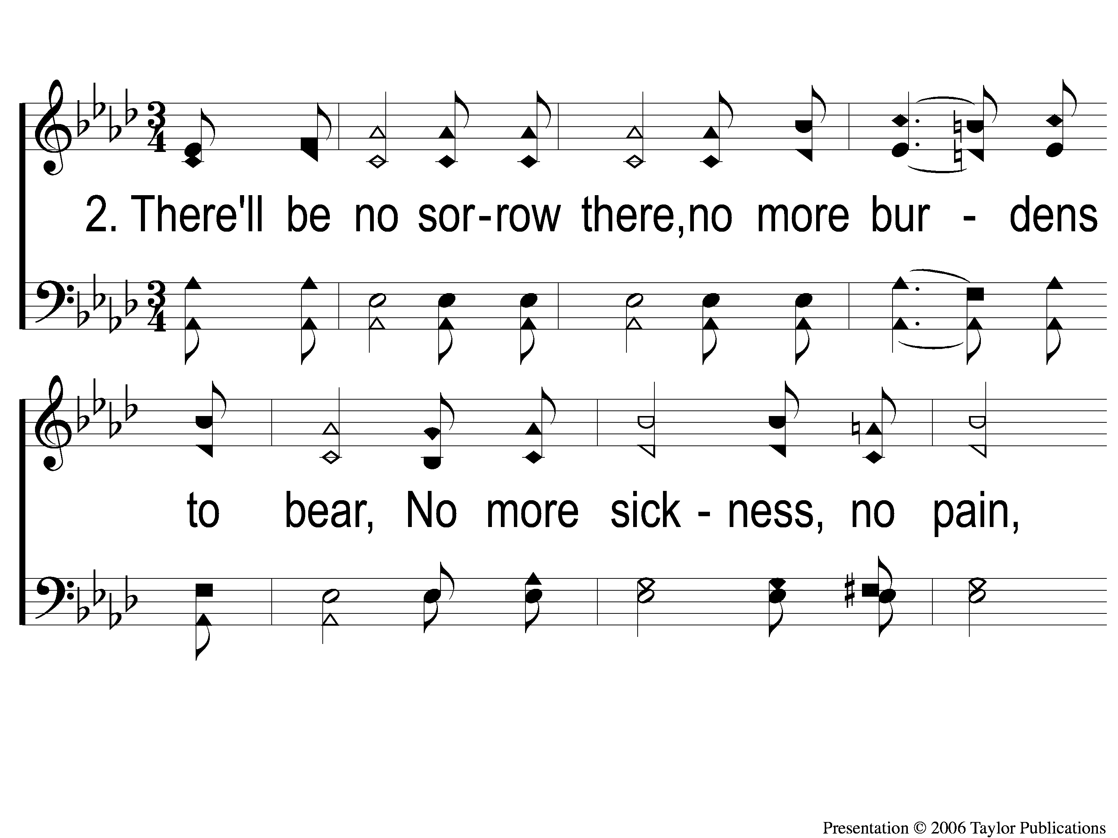
2-1 What a Day That Will Be
What a Day That Will Be
916

Slide 108
2-2 What a Day That Will Be
What a Day That Will Be
916

Slide 109
2-3 What a Day That Will Be
What a Day That Will Be
916

Slide 110
C-1 What a Day That Will Be
What a Day That Will Be
916

Slide 111
C-2 What a Day That Will Be
What a Day That Will Be
916

Slide 112
C-3 What a Day That Will Be
What a Day That Will Be
916

Slide 113
The Contribution:
2 Cor. 9:7-8
“So let each one give as he purposes in his heart, not grudgingly or of necessity; for God loves a cheerful giver. And God is able to make all grace abound toward you, that you, always having all sufficiency in all things, may have an abundance for every good work.”

Slide 114
Song:
Lamb Of God
#176

Slide 115
1-1 Lamb of God
Lamb of God
176

Slide 116
1-2 Lamb of God
Lamb of God
176

Slide 117
1-3 Lamb of God
Lamb of God
176

Slide 118
1-4 Lamb of God
Lamb of God
176

Slide 119
C-1 Lamb of God
Lamb of God
176

Slide 120
C-2 Lamb of God
Lamb of God
176

Slide 121
2-1 Lamb of God
Lamb of God
176

Slide 122
2-2 Lamb of God
Lamb of God
176

Slide 123
C-1 Lamb of God
Lamb of God
176

Slide 124
C-2 Lamb of God
Lamb of God
176

Slide 125
The Unleavened Bread
Hebrews 2:14-15
“Inasmuch then as the children have partaken of flesh and blood, He Himself likewise shared in the same, that through death He might destroy him who had the power of death, that is, the devil, and release those who through fear of death were all their lifetime subject to bondage.”

Slide 126
The Fruit
of the Vine
Hebrews 12:1-2
“Therefore we also, since we are surrounded by so great a cloud of witnesses, let us lay aside every weight, and the sin which so easily ensnares us, and let us run with endurance the race that is set before us, looking unto Jesus, the author and finisher of our faith, who for the joy that was set before Him endured the cross, despising the shame, and has sat down at the right hand of the throne of God.”

Slide 127
Closing Prayer

Slide 128
Song:
Just Over In The Glory Land

Slide 129
Today
Evening Worship @ 6:00 PM
Tuesday-Friday
VBS @ 9:00 AM
Wednesday
Worship & Bible Classes @ 6:30 PM
Thursday
VBS Parents’ Night @ 6:30 PM
RESTORE REBUILD RENEW
IN 2022
WHEELER
CHURCH
OF
CHRIST

