Slide 1
PLEASE STANDBY
OUR LIVESTREAM
WILL BEGIN SOON

Slide 2
1 Glorify Thy Name
Glorify Thy Name
77

Slide 3
C Glorify Thy Name
Glorify Thy Name
77

Slide 4
2 Glorify Thy Name
Glorify Thy Name
77

Slide 5
C Glorify Thy Name
Glorify Thy Name
77

Slide 6
3 Glorify Thy Name
Glorify Thy Name
77

Slide 7
C Glorify Thy Name
Glorify Thy Name
77

Slide 8
WELCOME
HAPPY MOTHER’S DAY!

Slide 9
#458
SONG:
Redeemed

Slide 10
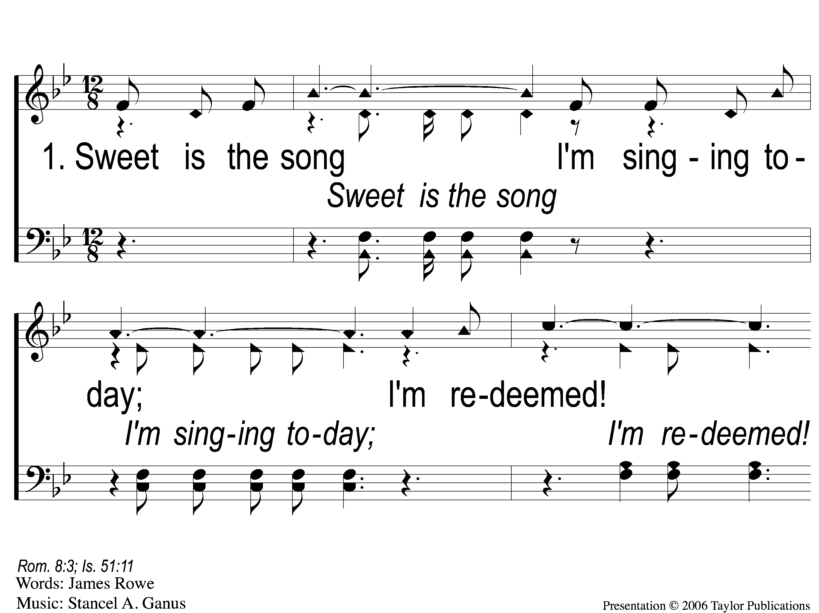
1-1 Redeemed - Sweet is the Song
Redeemed
458

Slide 11
1-2 Redeemed - Sweet is the Song
Redeemed
458

Slide 12
1-3 Redeemed - Sweet is the Song
Redeemed
458

Slide 13
C-1 Redeemed - Sweet is the Song
Redeemed
458

Slide 14
C-2 Redeemed - Sweet is the Song
Redeemed
458

Slide 15
2-1 Redeemed - Sweet is the Song

Slide 16
2-2 Redeemed - Sweet is the Song
Redeemed
458

Slide 17
2-3 Redeemed - Sweet is the Song
Redeemed
458

Slide 18
C-1 Redeemed - Sweet is the Song
Redeemed
458

Slide 19
C-2 Redeemed - Sweet is the Song
Redeemed
458

Slide 20
3-1 Redeemed - Sweet is the Song
Redeemed
458

Slide 21
3-2 Redeemed - Sweet is the Song
Redeemed
458

Slide 22
3-3 Redeemed - Sweet is the Song
Redeemed
458

Slide 23
C-1 Redeemed - Sweet is the Song
Redeemed
458

Slide 24
C-2 Redeemed - Sweet is the Song
Redeemed
458

Slide 25
#71
SONG:
As The Deer

Slide 26
1-1 As the Deer
As The Deer
71

Slide 27
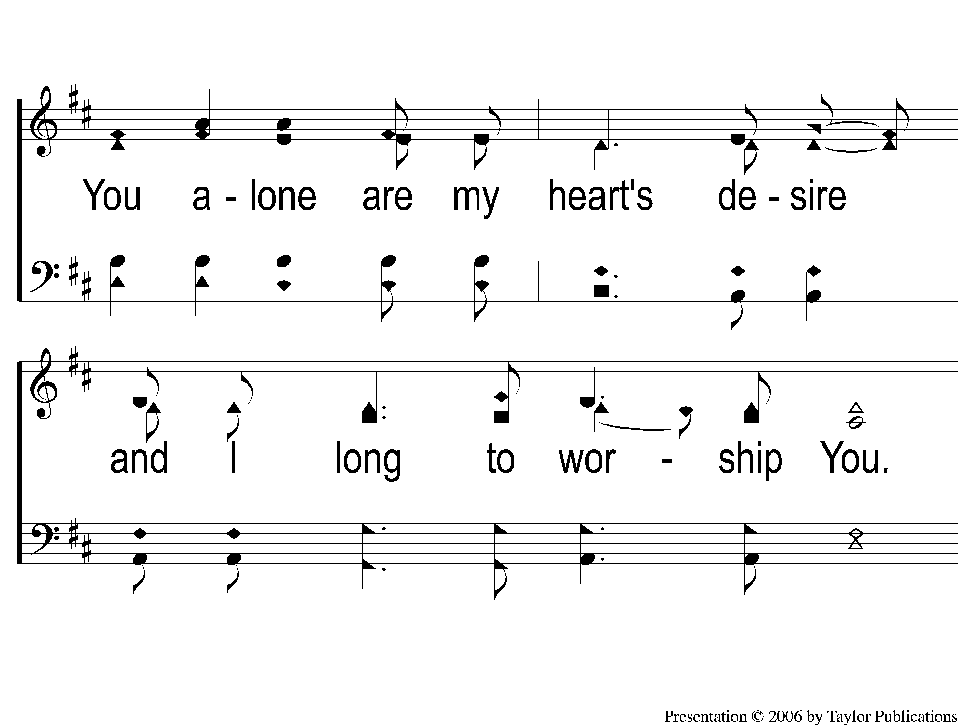
1-2 As the Deer
As The Deer
71

Slide 28
C-1 As the Deer
As The Deer
71

Slide 29
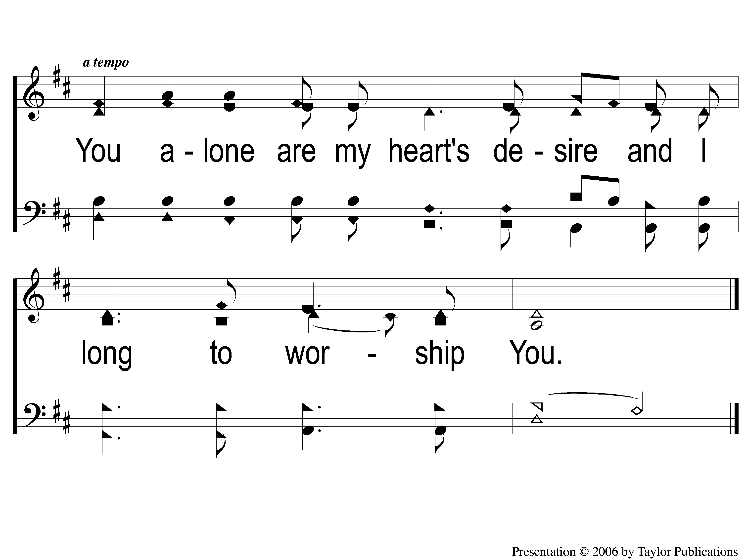
C-2 As the Deer
As The Deer
71

Slide 30
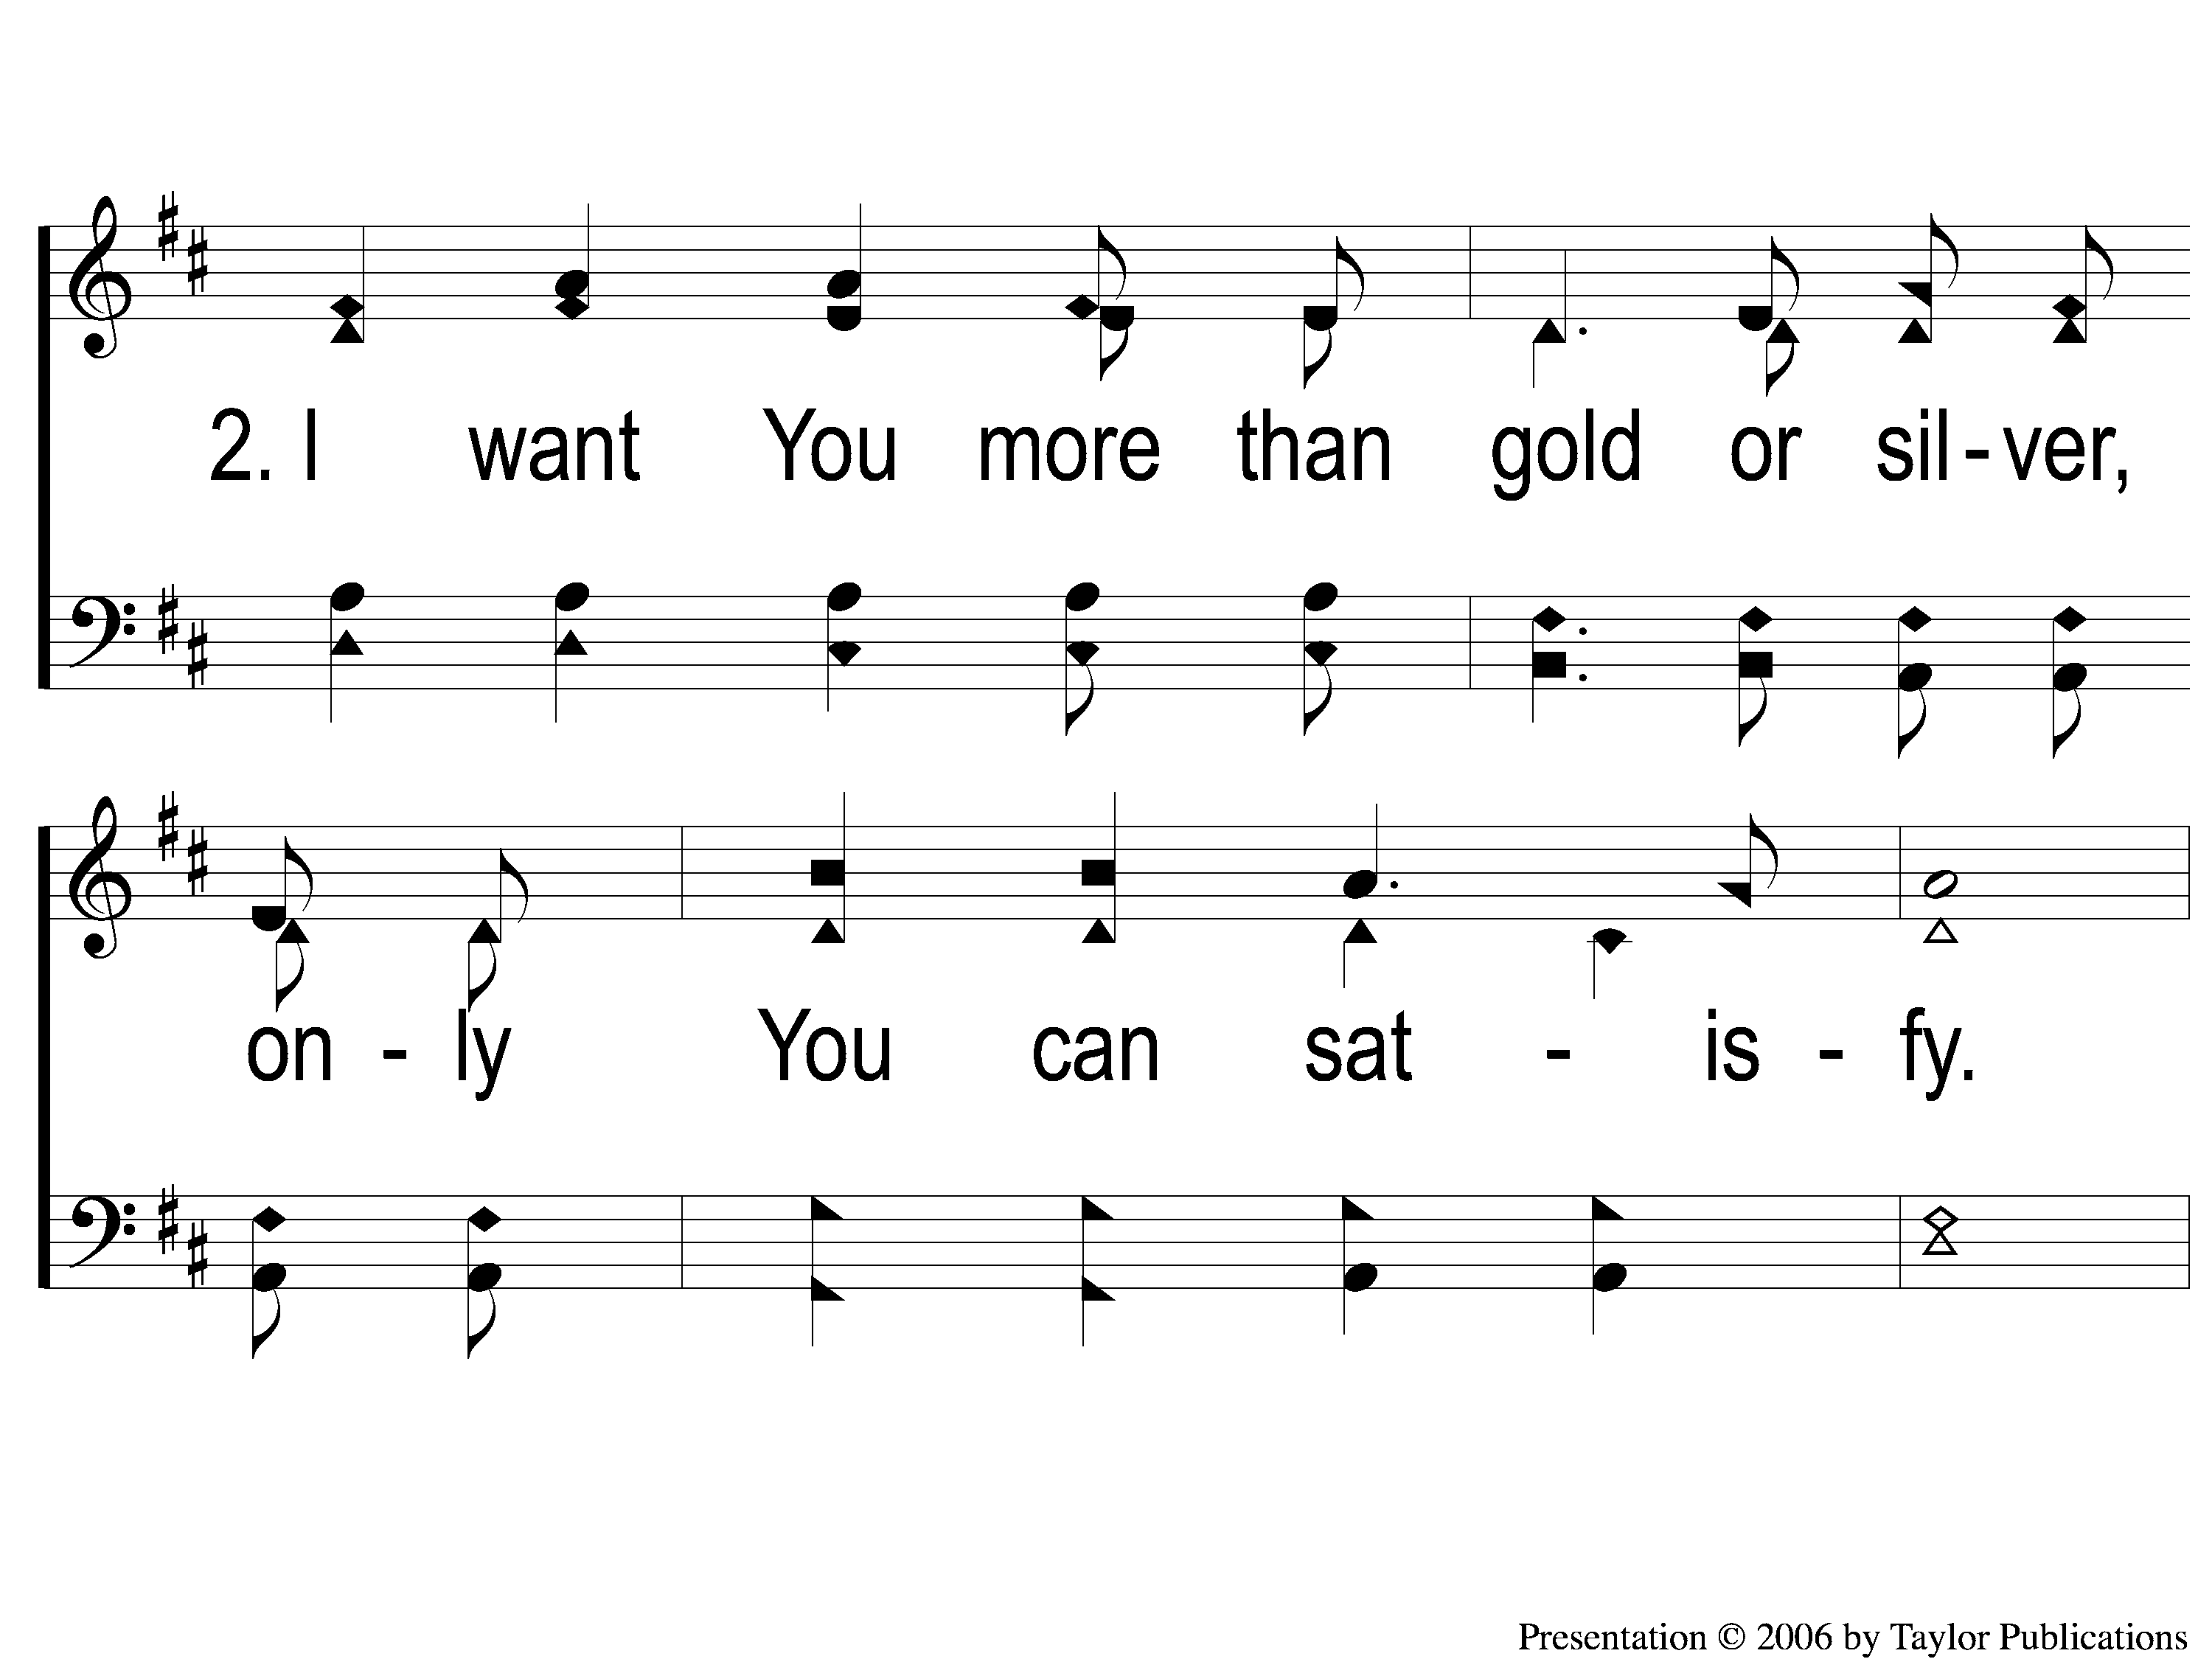
2-1 As the Deer
As The Deer
71

Slide 31
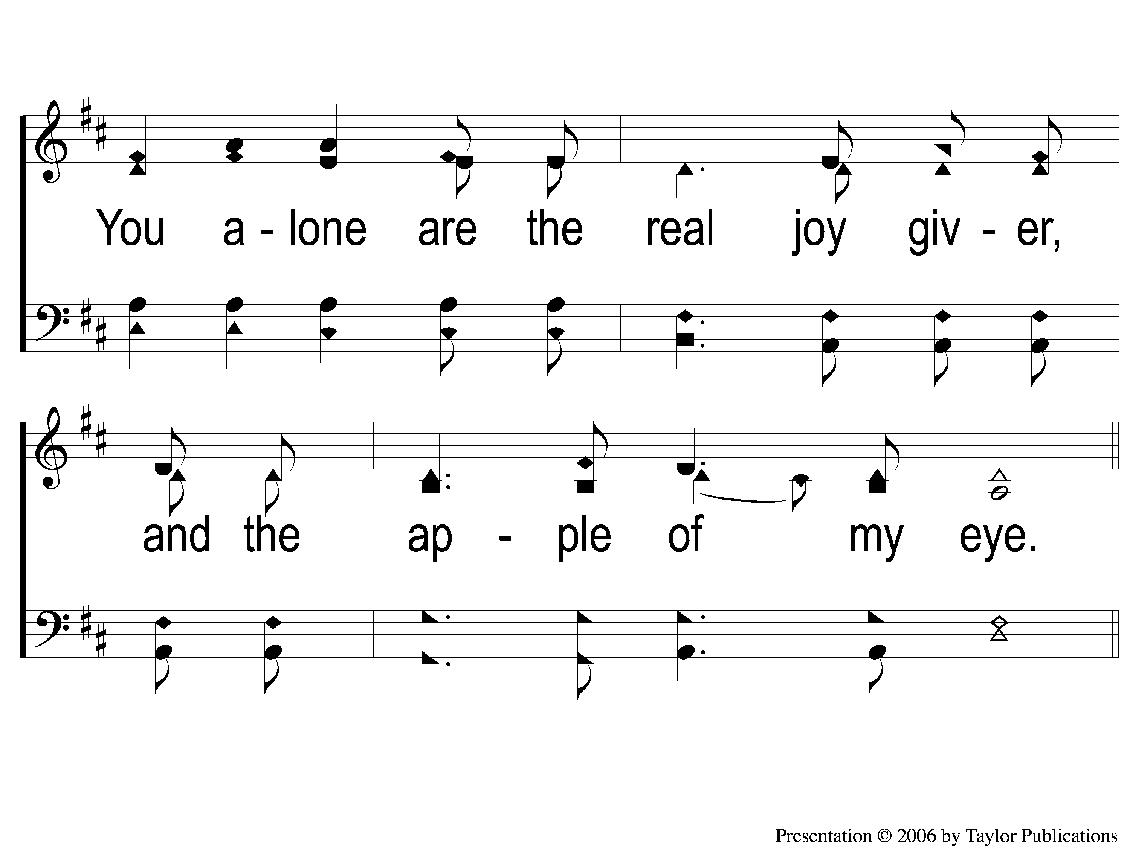
2-2 As the Deer
As The Deer
71

Slide 32
C-1 As the Deer
As The Deer
71

Slide 33
C-2 As the Deer
As The Deer
71

Slide 34
First PRAYER

Slide 35
#412
SONG:
Jesus, Hold My Hand

Slide 36
1-1 Jesus Hold My Hand
Jesus, Hold My Hand
412

Slide 37
1-2 Jesus Hold My Hand
Jesus, Hold My Hand
412

Slide 38
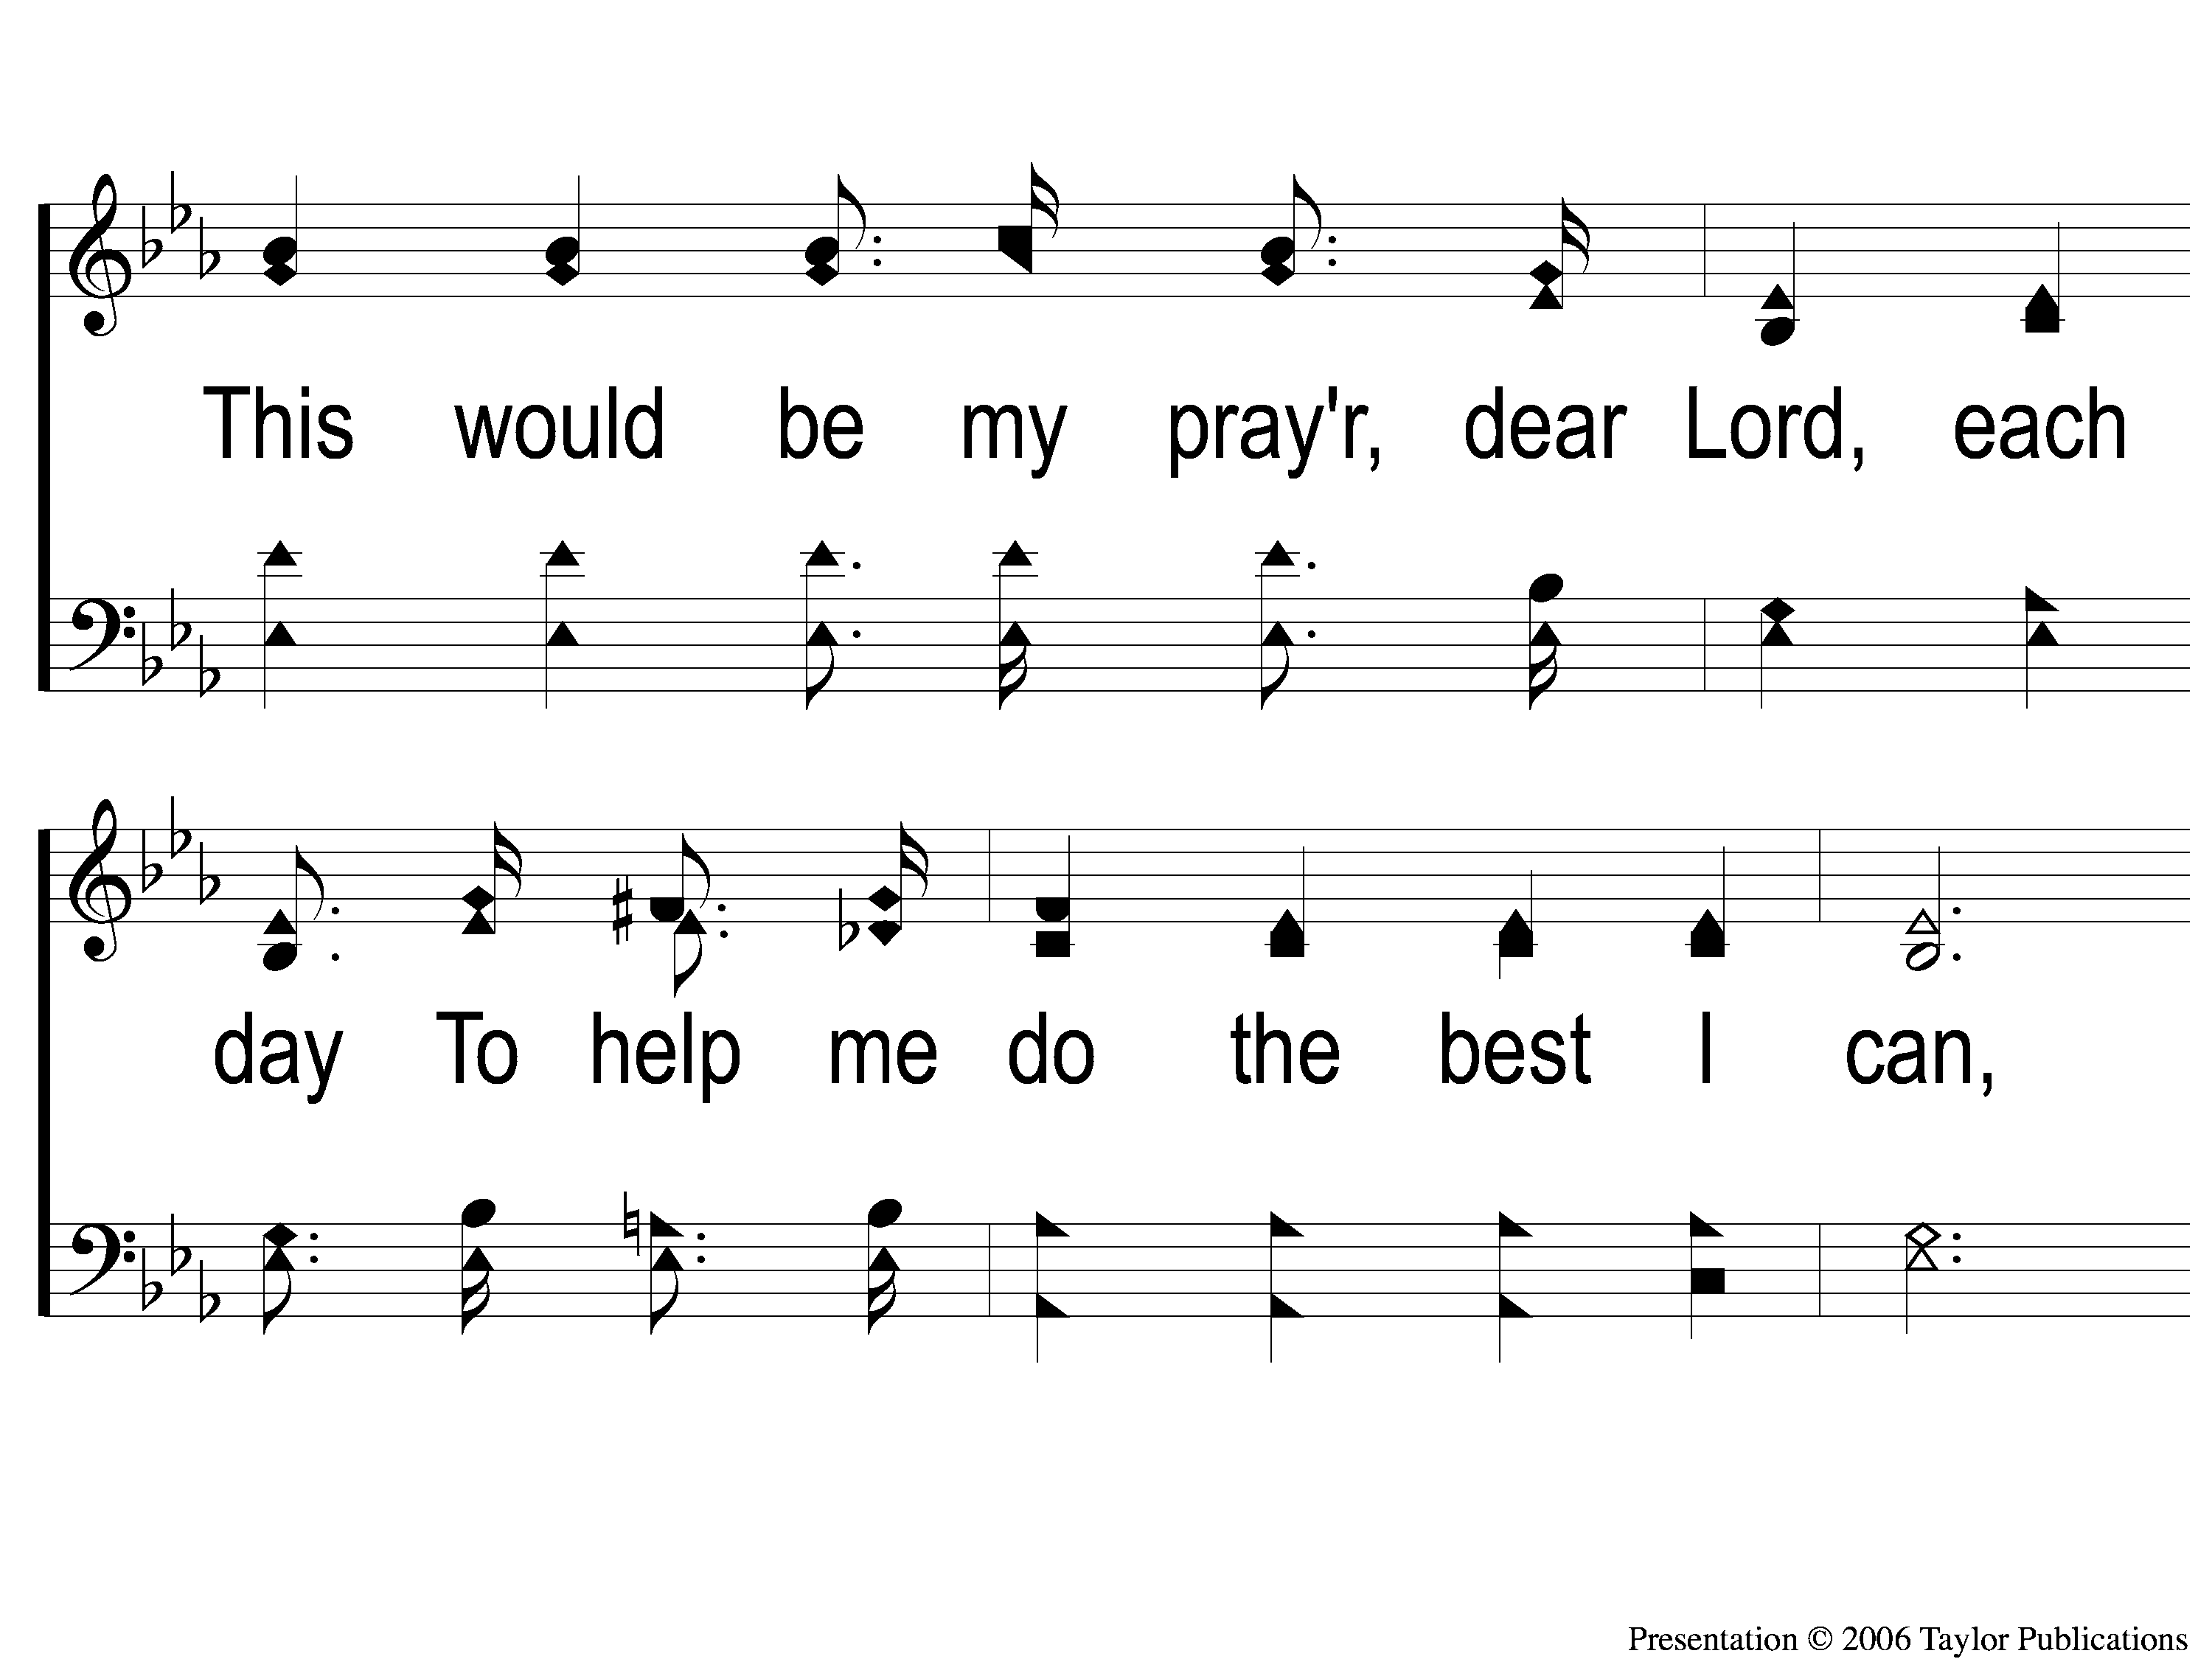
1-3 Jesus Hold My Hand
Jesus, Hold My Hand
412

Slide 39
1-4 Jesus Hold My Hand
Jesus, Hold My Hand
412

Slide 40
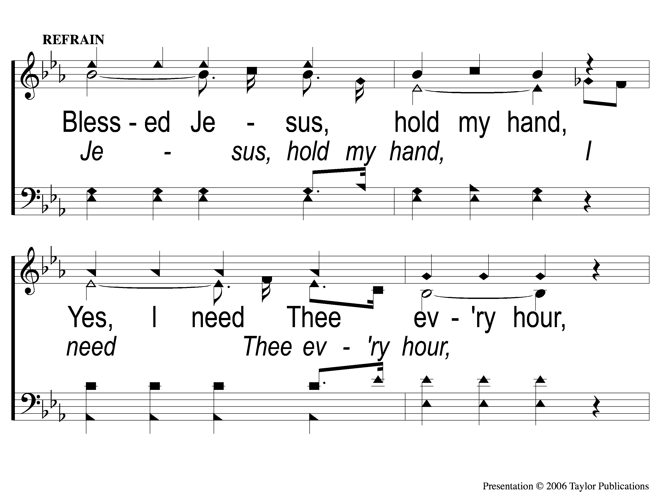
C-1 Jesus Hold My Hand
Jesus, Hold My Hand
412

Slide 41
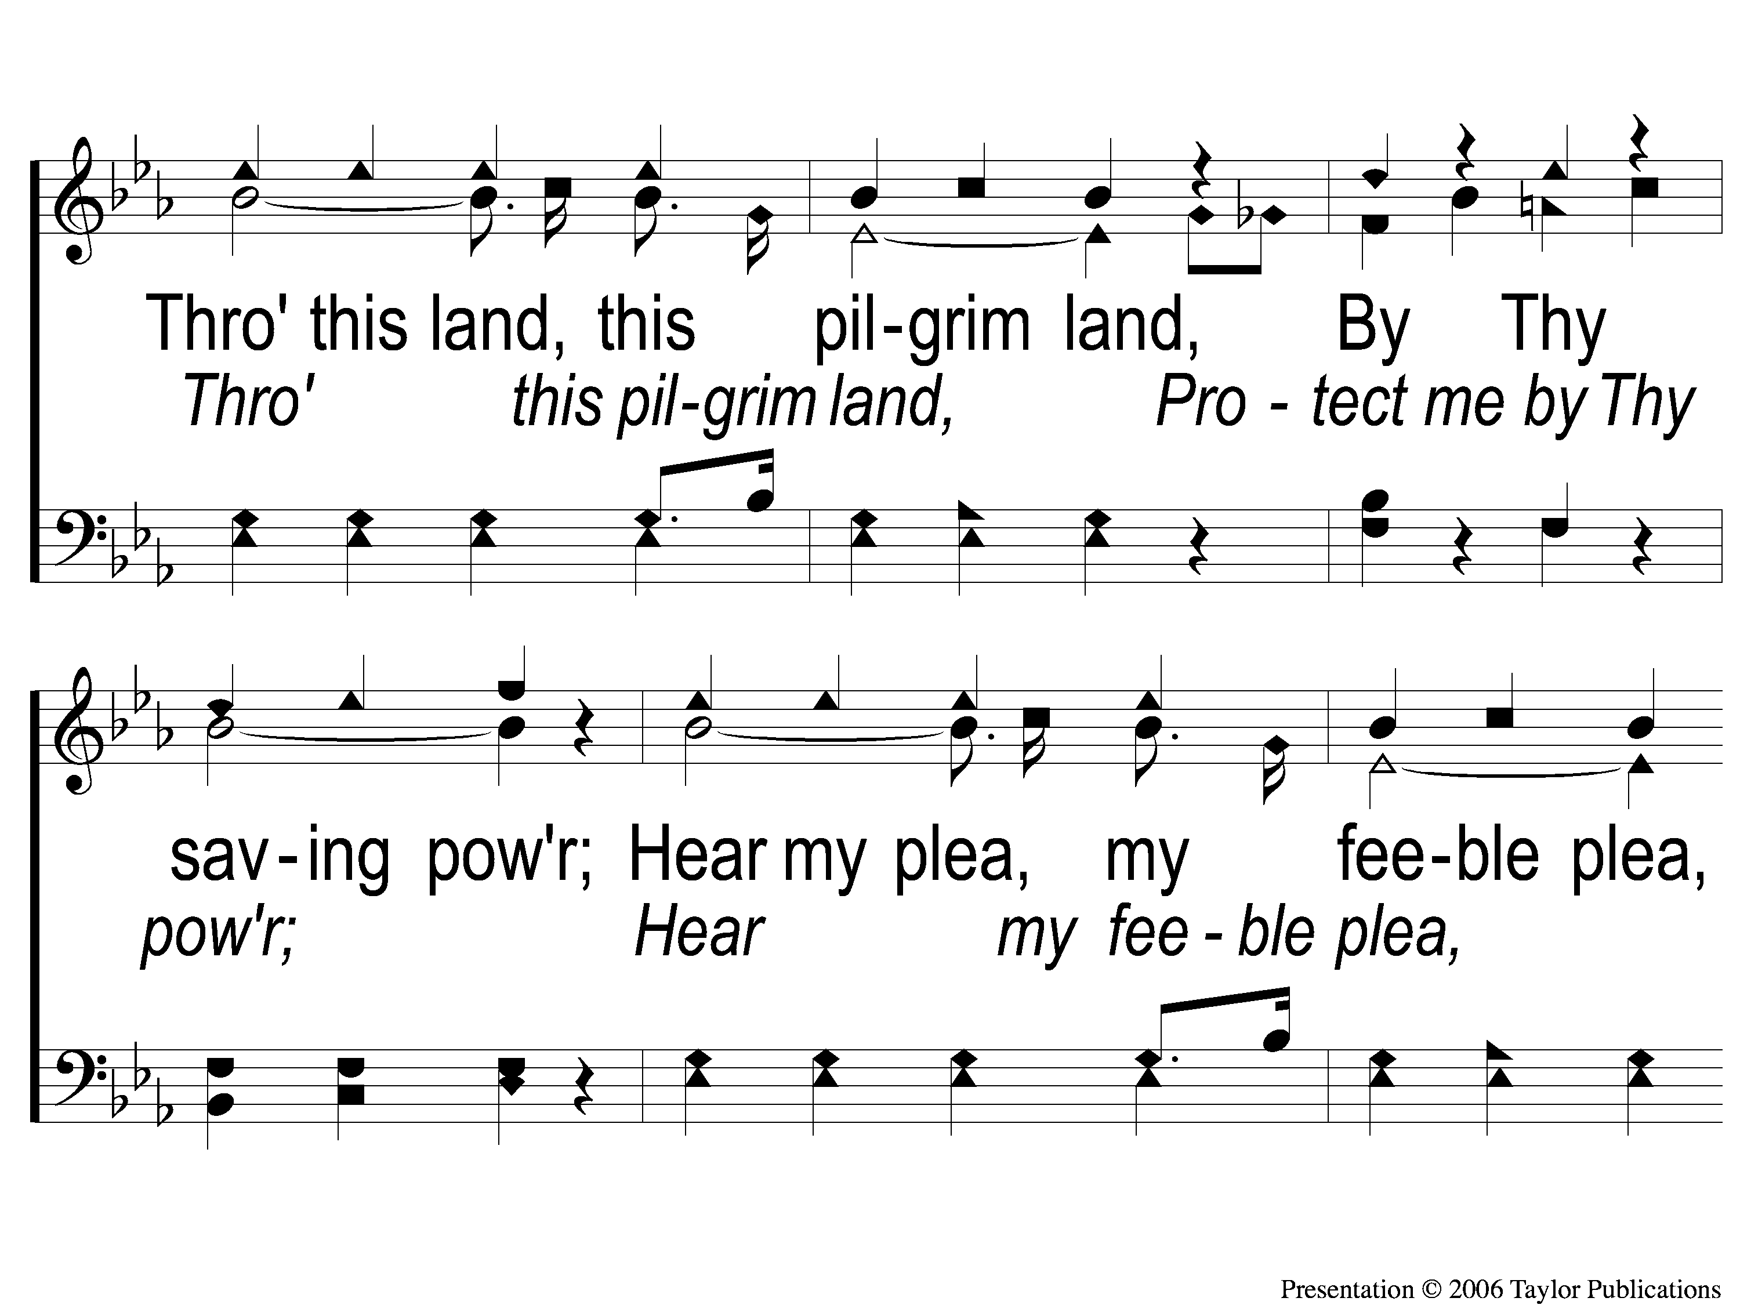
C-2 Jesus Hold My Hand
Jesus, Hold My Hand
412

Slide 42
C-3 Jesus Hold My Hand
Jesus, Hold My Hand
412

Slide 43
2-1 Jesus Hold My Hand
Jesus, Hold My Hand
412

Slide 44
2-2 Jesus Hold My Hand
Jesus, Hold My Hand
412

Slide 45
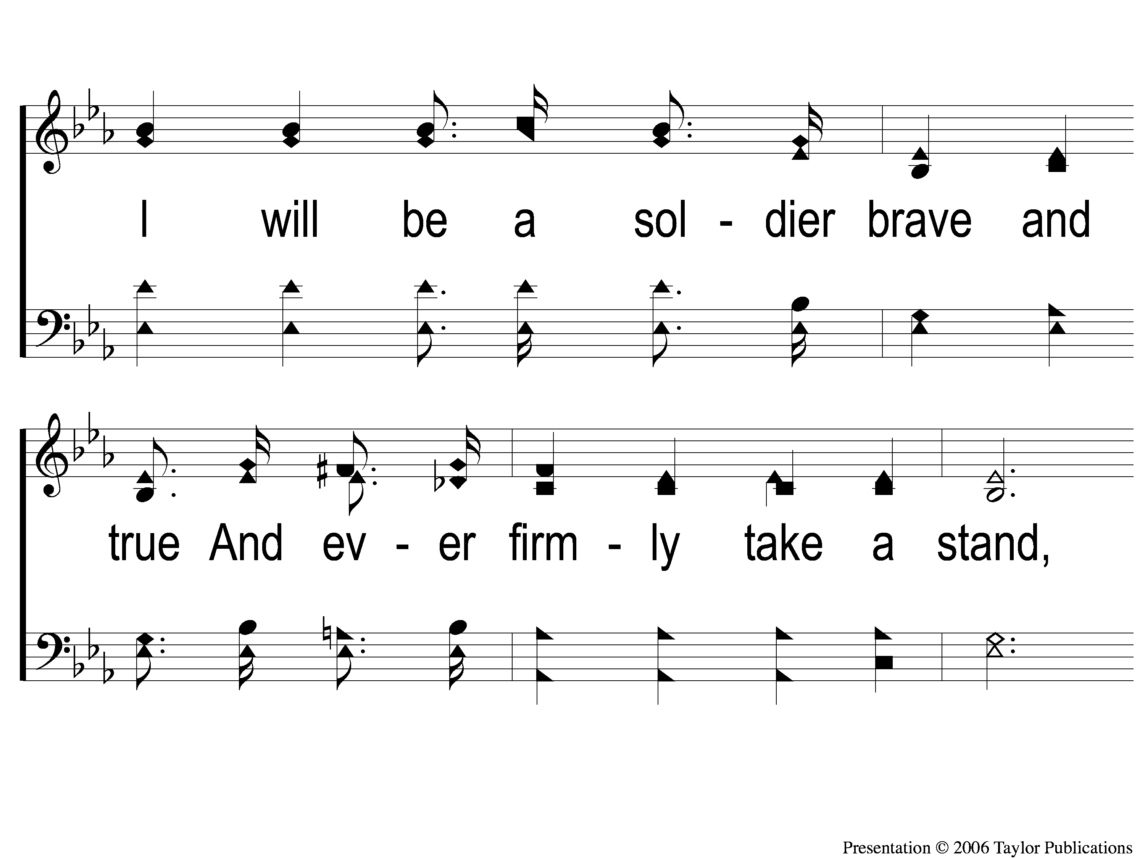
2-3 Jesus Hold My Hand
Jesus, Hold My Hand
412

Slide 46
2-4 Jesus Hold My Hand
Jesus, Hold My Hand
412

Slide 47
C-1 Jesus Hold My Hand
Jesus, Hold My Hand
412

Slide 48
C-2 Jesus Hold My Hand
Jesus, Hold My Hand
412

Slide 49
C-3 Jesus Hold My Hand
Jesus, Hold My Hand
412

Slide 50
3-1 Jesus Hold My Hand
Jesus, Hold My Hand
412

Slide 51
3-2 Jesus Hold My Hand
Jesus, Hold My Hand
412

Slide 52
3-3 Jesus Hold My Hand
Jesus, Hold My Hand
412

Slide 53
3-4 Jesus Hold My Hand
Jesus, Hold My Hand
412

Slide 54
C-1 Jesus Hold My Hand
Jesus, Hold My Hand
412

Slide 55
C-2 Jesus Hold My Hand
Jesus, Hold My Hand
412

Slide 56
C-3 Jesus Hold My Hand
Jesus, Hold My Hand
412

Slide 57
#624
SONG:
Seeking The Lost

Slide 58
1-1 Seeking the Lost
Seeking the Lost
624

Slide 59
1-2 Seeking the Lost
Seeking the Lost
624

Slide 60
C-1 Seeking the Lost
Seeking the Lost
624

Slide 61
C-2 Seeking the Lost
Seeking the Lost
624

Slide 62
2-1 Seeking the Lost
Seeking the Lost
624

Slide 63
2-2 Seeking the Lost
Seeking the Lost
624

Slide 64
C-1 Seeking the Lost
Seeking the Lost
624

Slide 65
C-2 Seeking the Lost
Seeking the Lost
624

Slide 66
3-1 Seeking the Lost
Seeking the Lost
624

Slide 67
3-2 Seeking the Lost
Seeking the Lost
624

Slide 68
C-1 Seeking the Lost
Seeking the Lost
624

Slide 69
C-2 Seeking the Lost
Seeking the Lost
624

Slide 70
SCRIPTURE:
John 19:23-25

Slide 71
Stand out!

Slide 72
Case Study: zacchaeus
Luke 19:1-10

Slide 73
Case Study:
a demon-possessed man
Mark 5:1-20

Slide 74
Case Study:
FOUR WOMEN with Jesus
John 19:25-20:18

Slide 75
Meeting the four women
John 19:25
Mt. 27:55
Mk. 15:40
Lk. 23:49

Slide 76
Meeting the four women
Mary Magdalene
From region of Magdala
Mt. 15:39

Slide 77
Meeting the four women
Mary Magdalene
From region of Magdala
Mt. 15:39
Previously demon-possessed
Mk. 16:9

Slide 78
Meeting the four women
“Mary…of Clopas”
Clopas / Cleopas
Lk. 24:18

Slide 79
Meeting the four women
“His Mother’s Sister”
Her Name: Salome
Mk. 15:40

Slide 80
Meeting the four women
“His Mother’s Sister”
Her Name: Salome
Mk. 15:40
Mother of James & John?
Mt. 20:20-28

Slide 81
Meeting the four women
Mary, Jesus’ Mother
Called to raise God’s Son
Lk. 1:26-33
Lk. 2:21-23, 39-41, 51-52

Slide 82
How do they stand out?

Slide 83
How do they stand out?
John 19:38-20:1
Lk. 23:55-24:1

Slide 84
Do you
stand out
to jesus?

Slide 85
#926
SONG:
What Will You
Do With Jesus?

Slide 86
1-1 What Will You Do With Jesus
What Will You Do With Jesus?
926
ePraise Hymn Presentation ©2005 by Taylor Publications

Slide 87
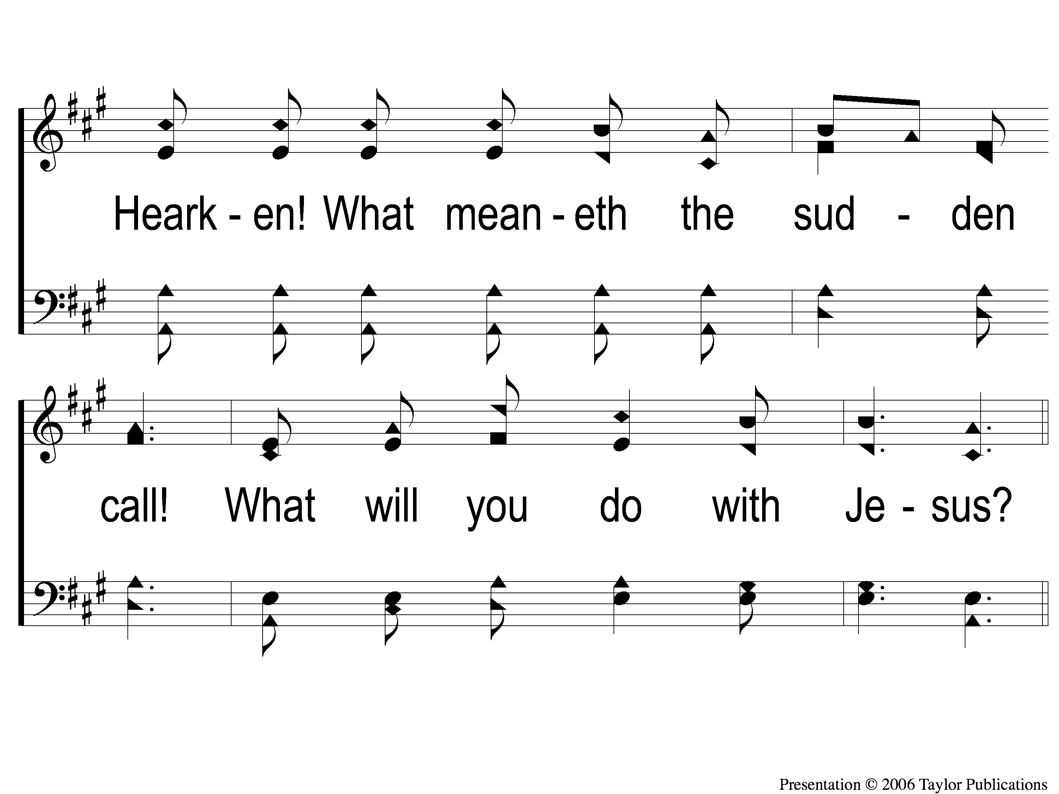
1-2 What Will You Do With Jesus
What Will You Do With Jesus?
926

Slide 88
C-1 What Will You Do With Jesus
What Will You Do With Jesus?
926
ePraise Hymn Presentation ©2005 by Taylor Publications

Slide 89
C-2 What Will You Do With Jesus
What Will You Do With Jesus?
926
ePraise Hymn Presentation ©2005 by Taylor Publications

Slide 90
2-1 What Will You Do With Jesus
What Will You Do With Jesus?
926
ePraise Hymn Presentation ©2005 by Taylor Publications

Slide 91
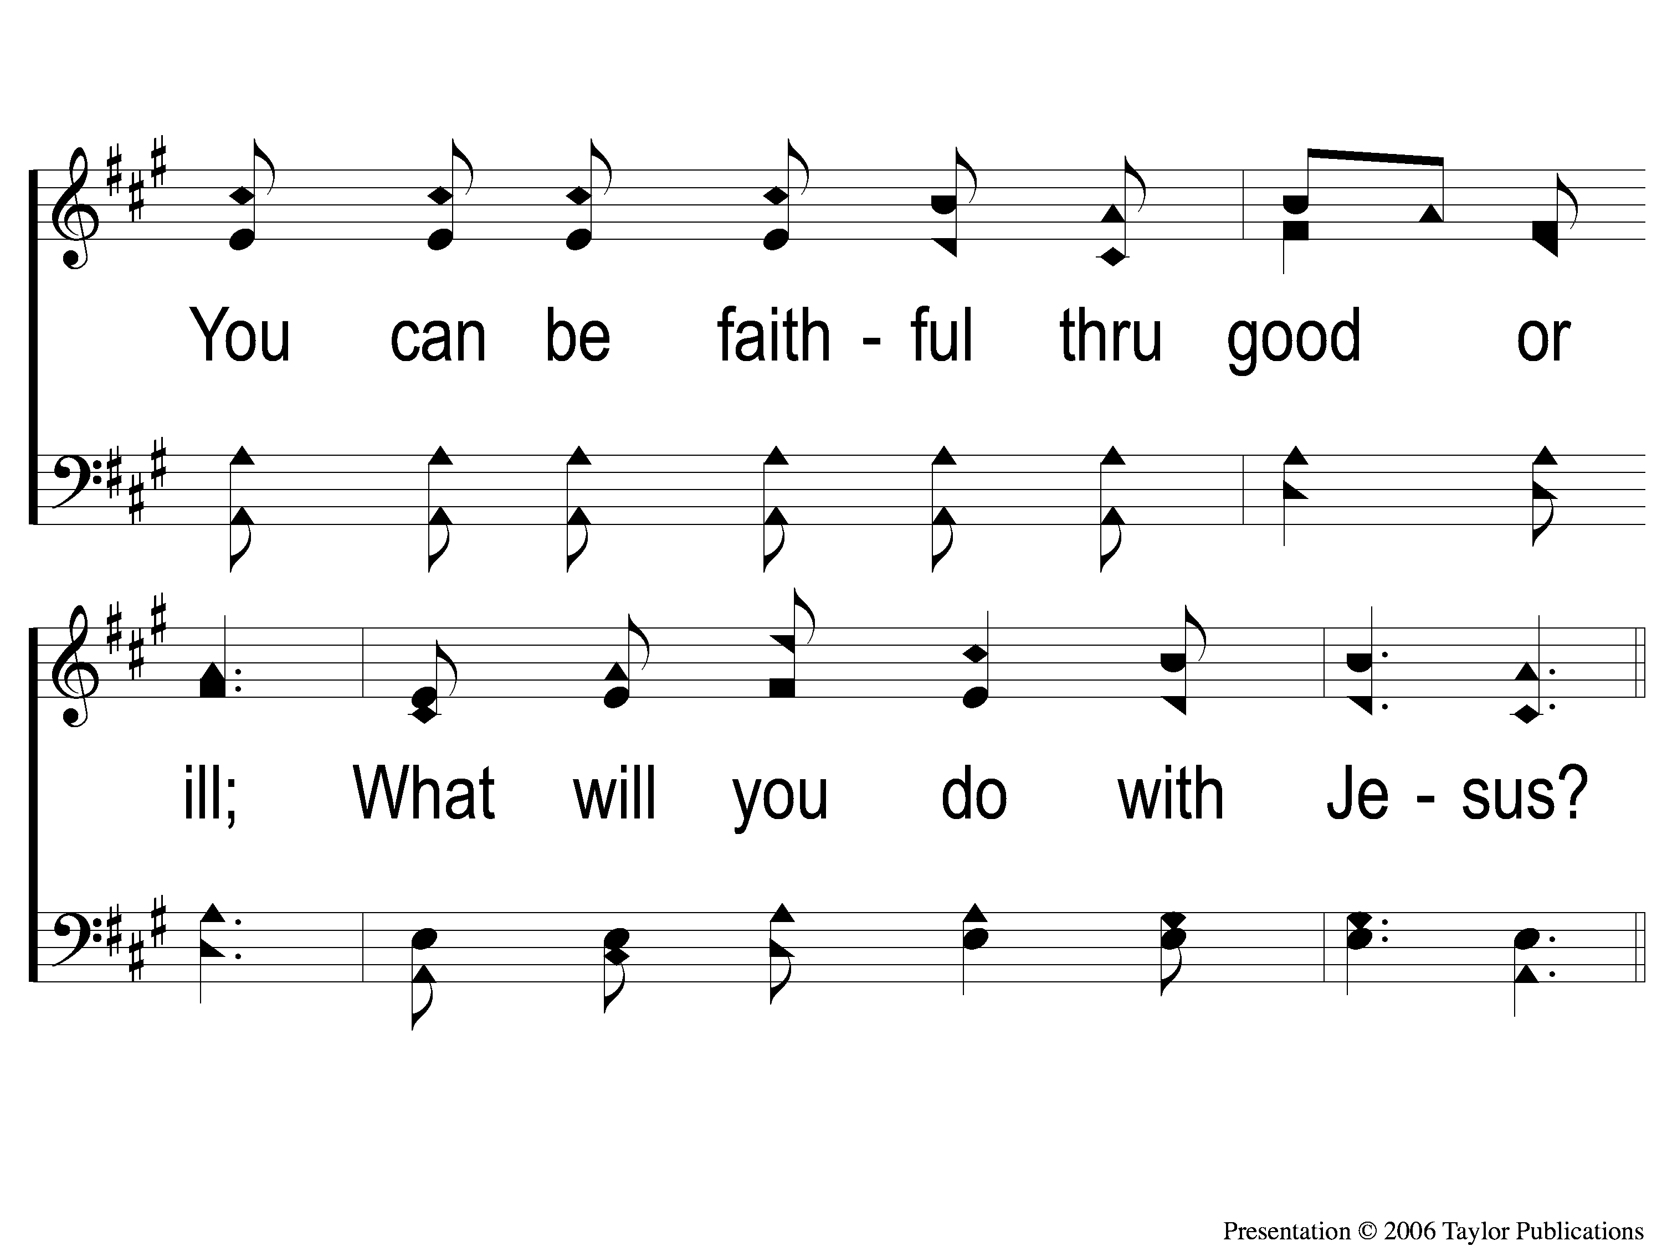
2-2 What Will You Do With Jesus
What Will You Do With Jesus?
926
ePraise Hymn Presentation ©2005 by Taylor Publications

Slide 92
C-1 What Will You Do With Jesus
What Will You Do With Jesus?
926
ePraise Hymn Presentation ©2005 by Taylor Publications

Slide 93
C-2 What Will You Do With Jesus
What Will You Do With Jesus?
926
ePraise Hymn Presentation ©2005 by Taylor Publications

Slide 94
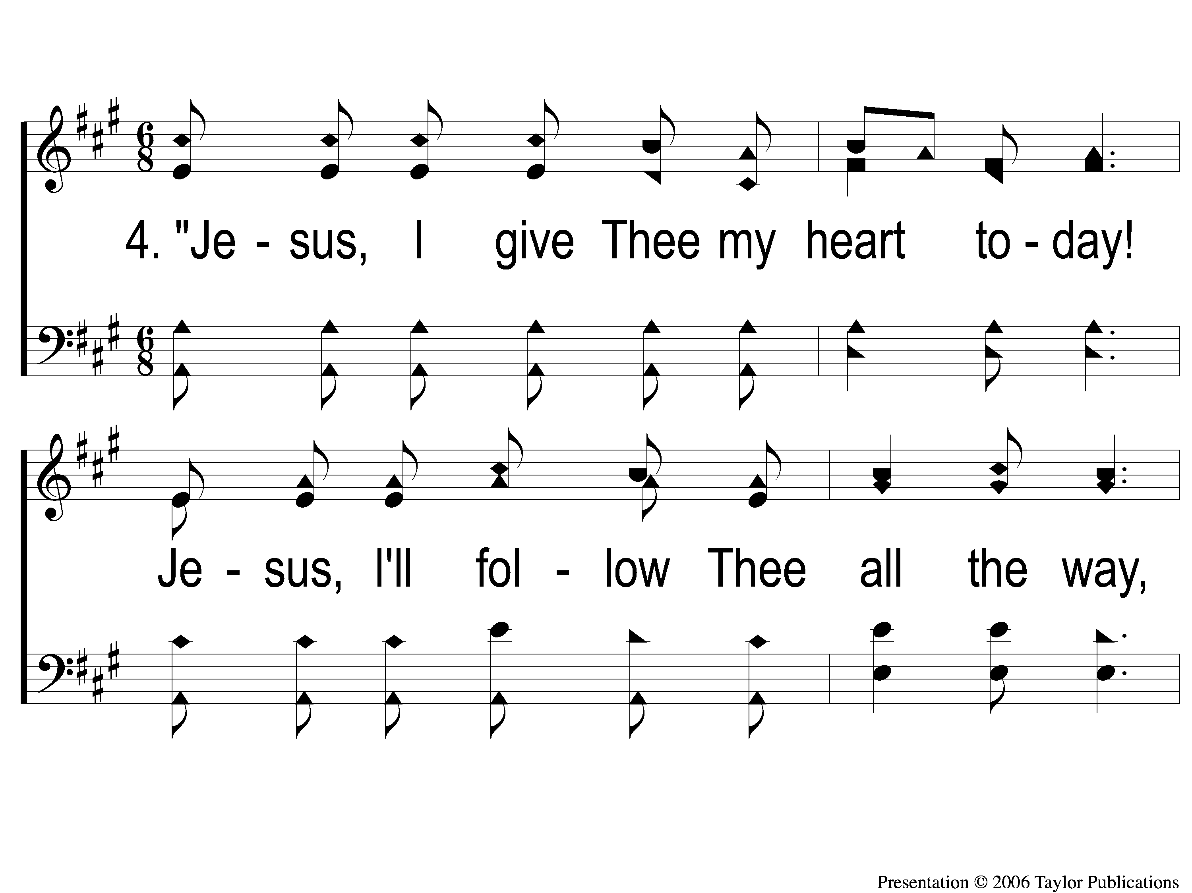
4-1 What Will You Do With Jesus
What Will You Do With Jesus?
926
ePraise Hymn Presentation ©2005 by Taylor Publications

Slide 95
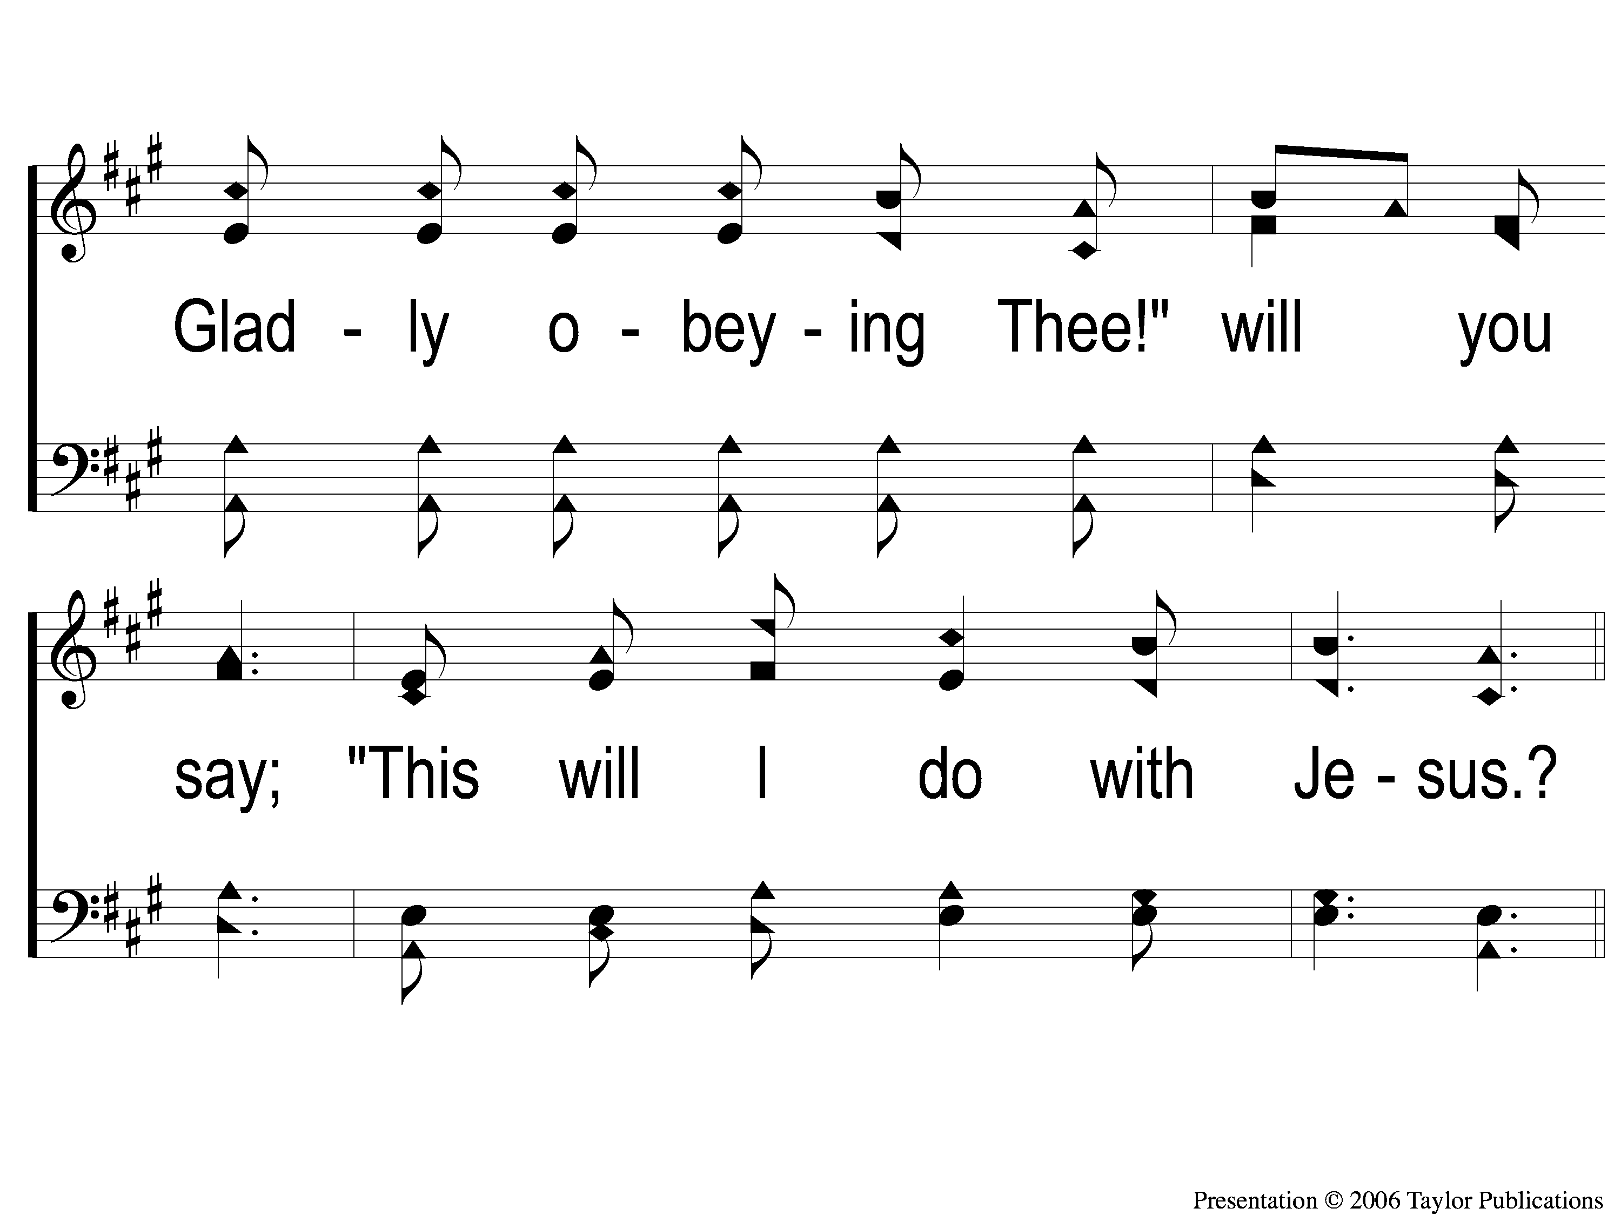
4-2 What Will You Do With Jesus
What Will You Do With Jesus?
926
ePraise Hymn Presentation ©2005 by Taylor Publications

Slide 96
C-1 What Will You Do With Jesus
What Will You Do With Jesus?
926
ePraise Hymn Presentation ©2005 by Taylor Publications

Slide 97
C-2 What Will You Do With Jesus
What Will You Do With Jesus?
926
ePraise Hymn Presentation ©2005 by Taylor Publications

Slide 98
SONG:
In Need

Slide 99
1 In Need
342
In Need
CCLI#645323

Slide 100
2 In Need
342
In Need

Slide 101
3 In Need
342
In Need

Slide 102
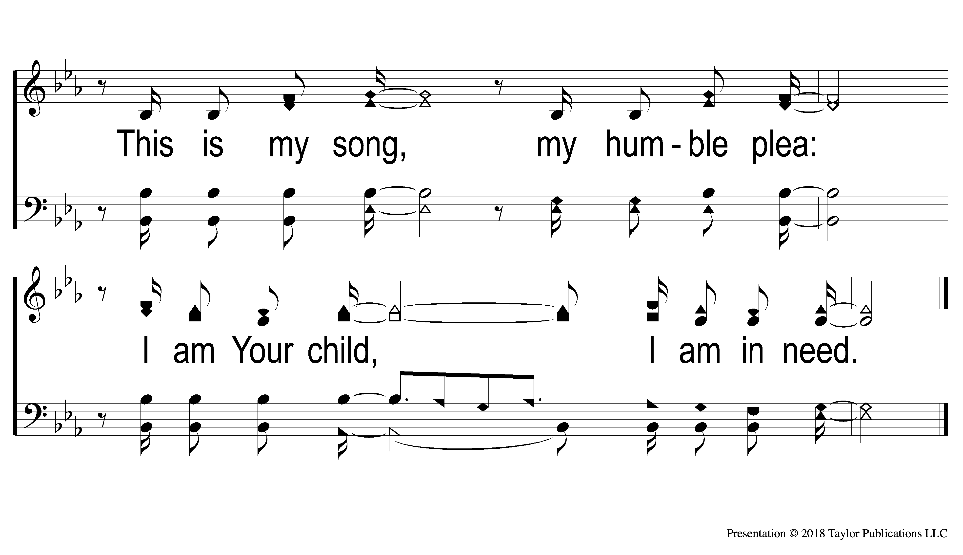
4 In Need
342
In Need

Slide 103
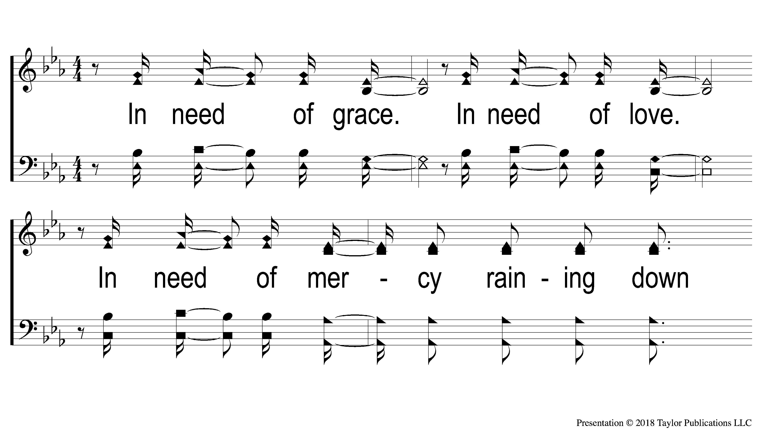
5 In Need
342
In Need

Slide 104
6 In Need
342
In Need

Slide 105
7 In Need
342
In Need

Slide 106
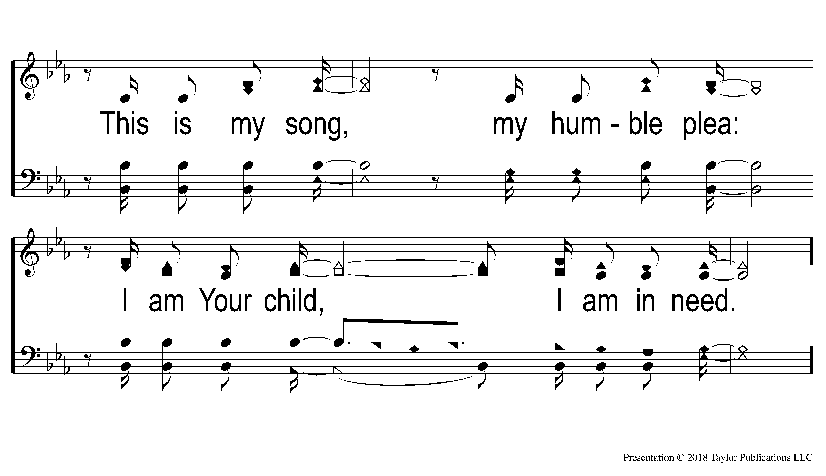
8 In Need
342
In Need

Slide 107
DS1 In Need
342
In Need

Slide 108
LORD’S SUPPER
The
Acts 20:7

Slide 109
Unleavened Bread
LORD’S SUPPER
¹⁷ And when I saw Him, I fell at His feet as dead. But He laid His right hand on me, saying to me, “Do not be afraid; I am the First and the Last. ¹⁸ I am He who lives, and was dead, and behold, I am alive forevermore.
Revelation 1:17-18a

Slide 110
Fruit of the Vine
LORD’S SUPPER
“And they sang a new song, saying: “You are worthy to take the scroll, And to open its seals; For You were slain, And have redeemed us to God by Your blood Out of every tribe and tongue and people and nation, And have made us kings and priests to our God; And we shall reign on the earth.”
Revelation 5:9-10

Slide 111
1 John 3:16-17
OFFERING
By this we know love, because He laid down His life for us. And we also ought to lay down our lives for the brethren. But whoever has this world’s goods, and sees his brother in need, and shuts up his heart from him, how does the love of God abide in him?

Slide 112
Closing PRAYER

Slide 113
#756
SONG:
Just Beyond The River

Slide 114
1-1 Just Beyond the Rolling River
Just Beyond the Rolling River
756

Slide 115
1-2 Just Beyond the Rolling River
Just Beyond the Rolling River
756

Slide 116
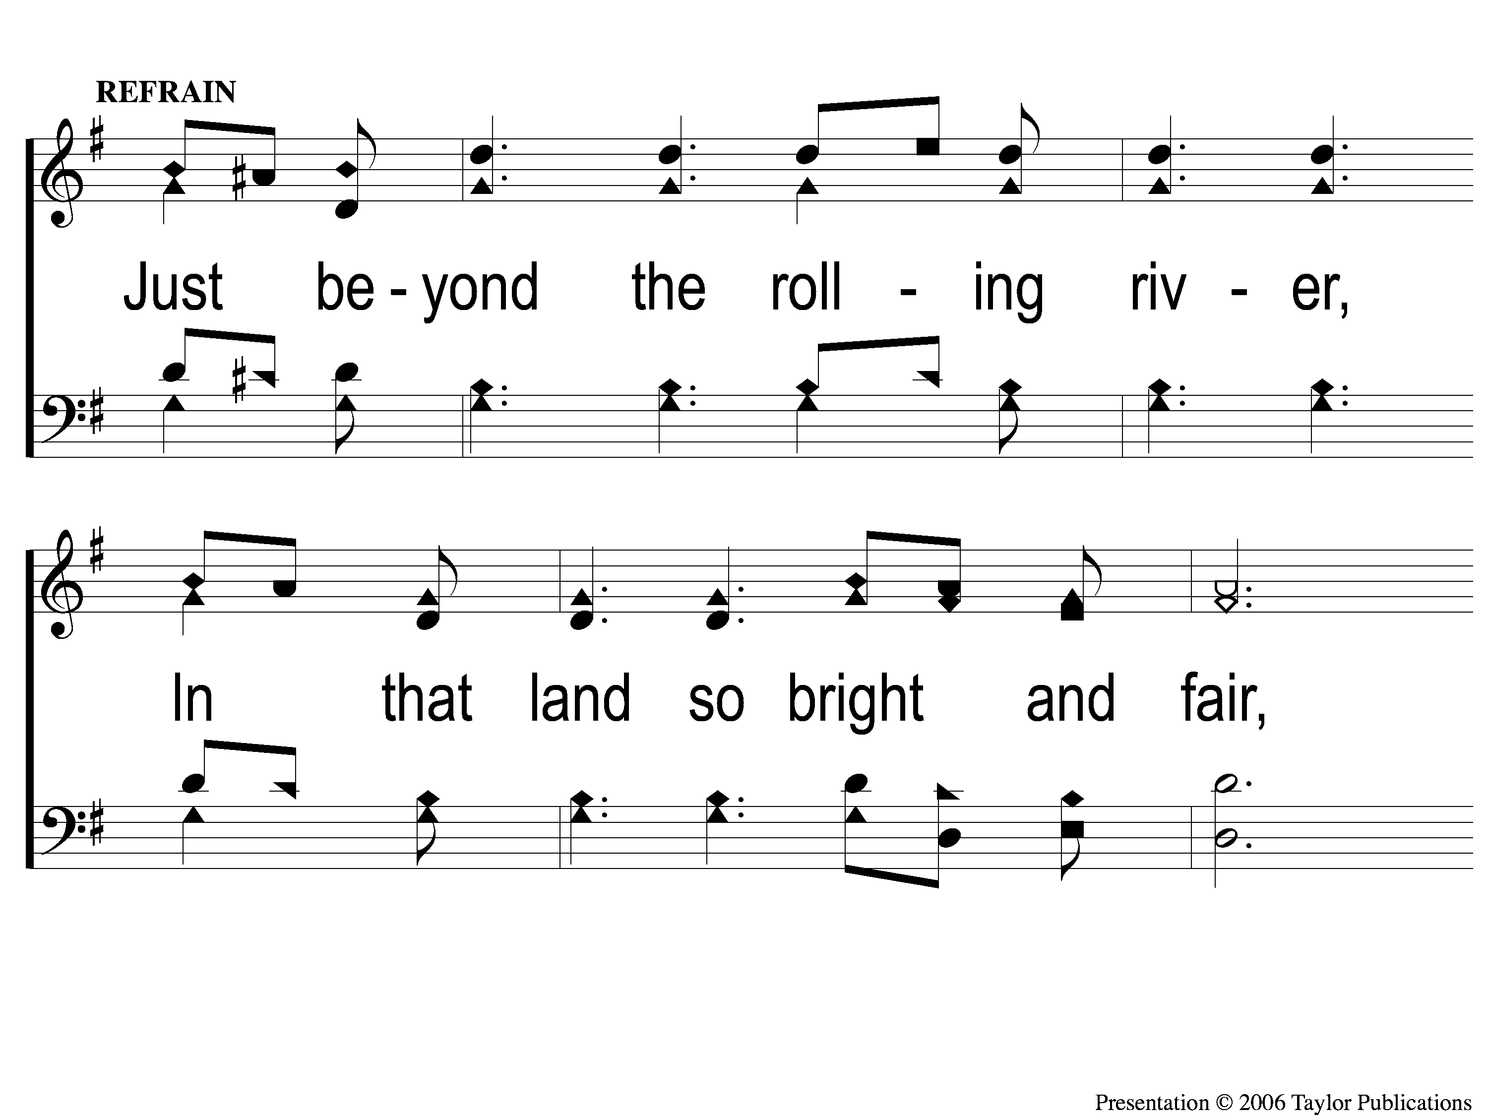
C-1 Just Beyond the Rolling River
Just Beyond the Rolling River
756

Slide 117
C-2 Just Beyond the Rolling River
Just Beyond the Rolling River
756

Slide 118
3-1 Just Beyond the Rolling River
Just Beyond the Rolling River
756

Slide 119
3-2 Just Beyond the Rolling River
Just Beyond the Rolling River
756

Slide 120
C-1 Just Beyond the Rolling River
Just Beyond the Rolling River
756

Slide 121
C-2 Just Beyond the Rolling River
Just Beyond the Rolling River
756

Slide 122
TONIGHT @ 6:00 pm
EVENING WORSHIP
HOPE TO SEE YOU THERE!

