Slide 1
1-1 Faithful Love
Faithful Love
18

Slide 2
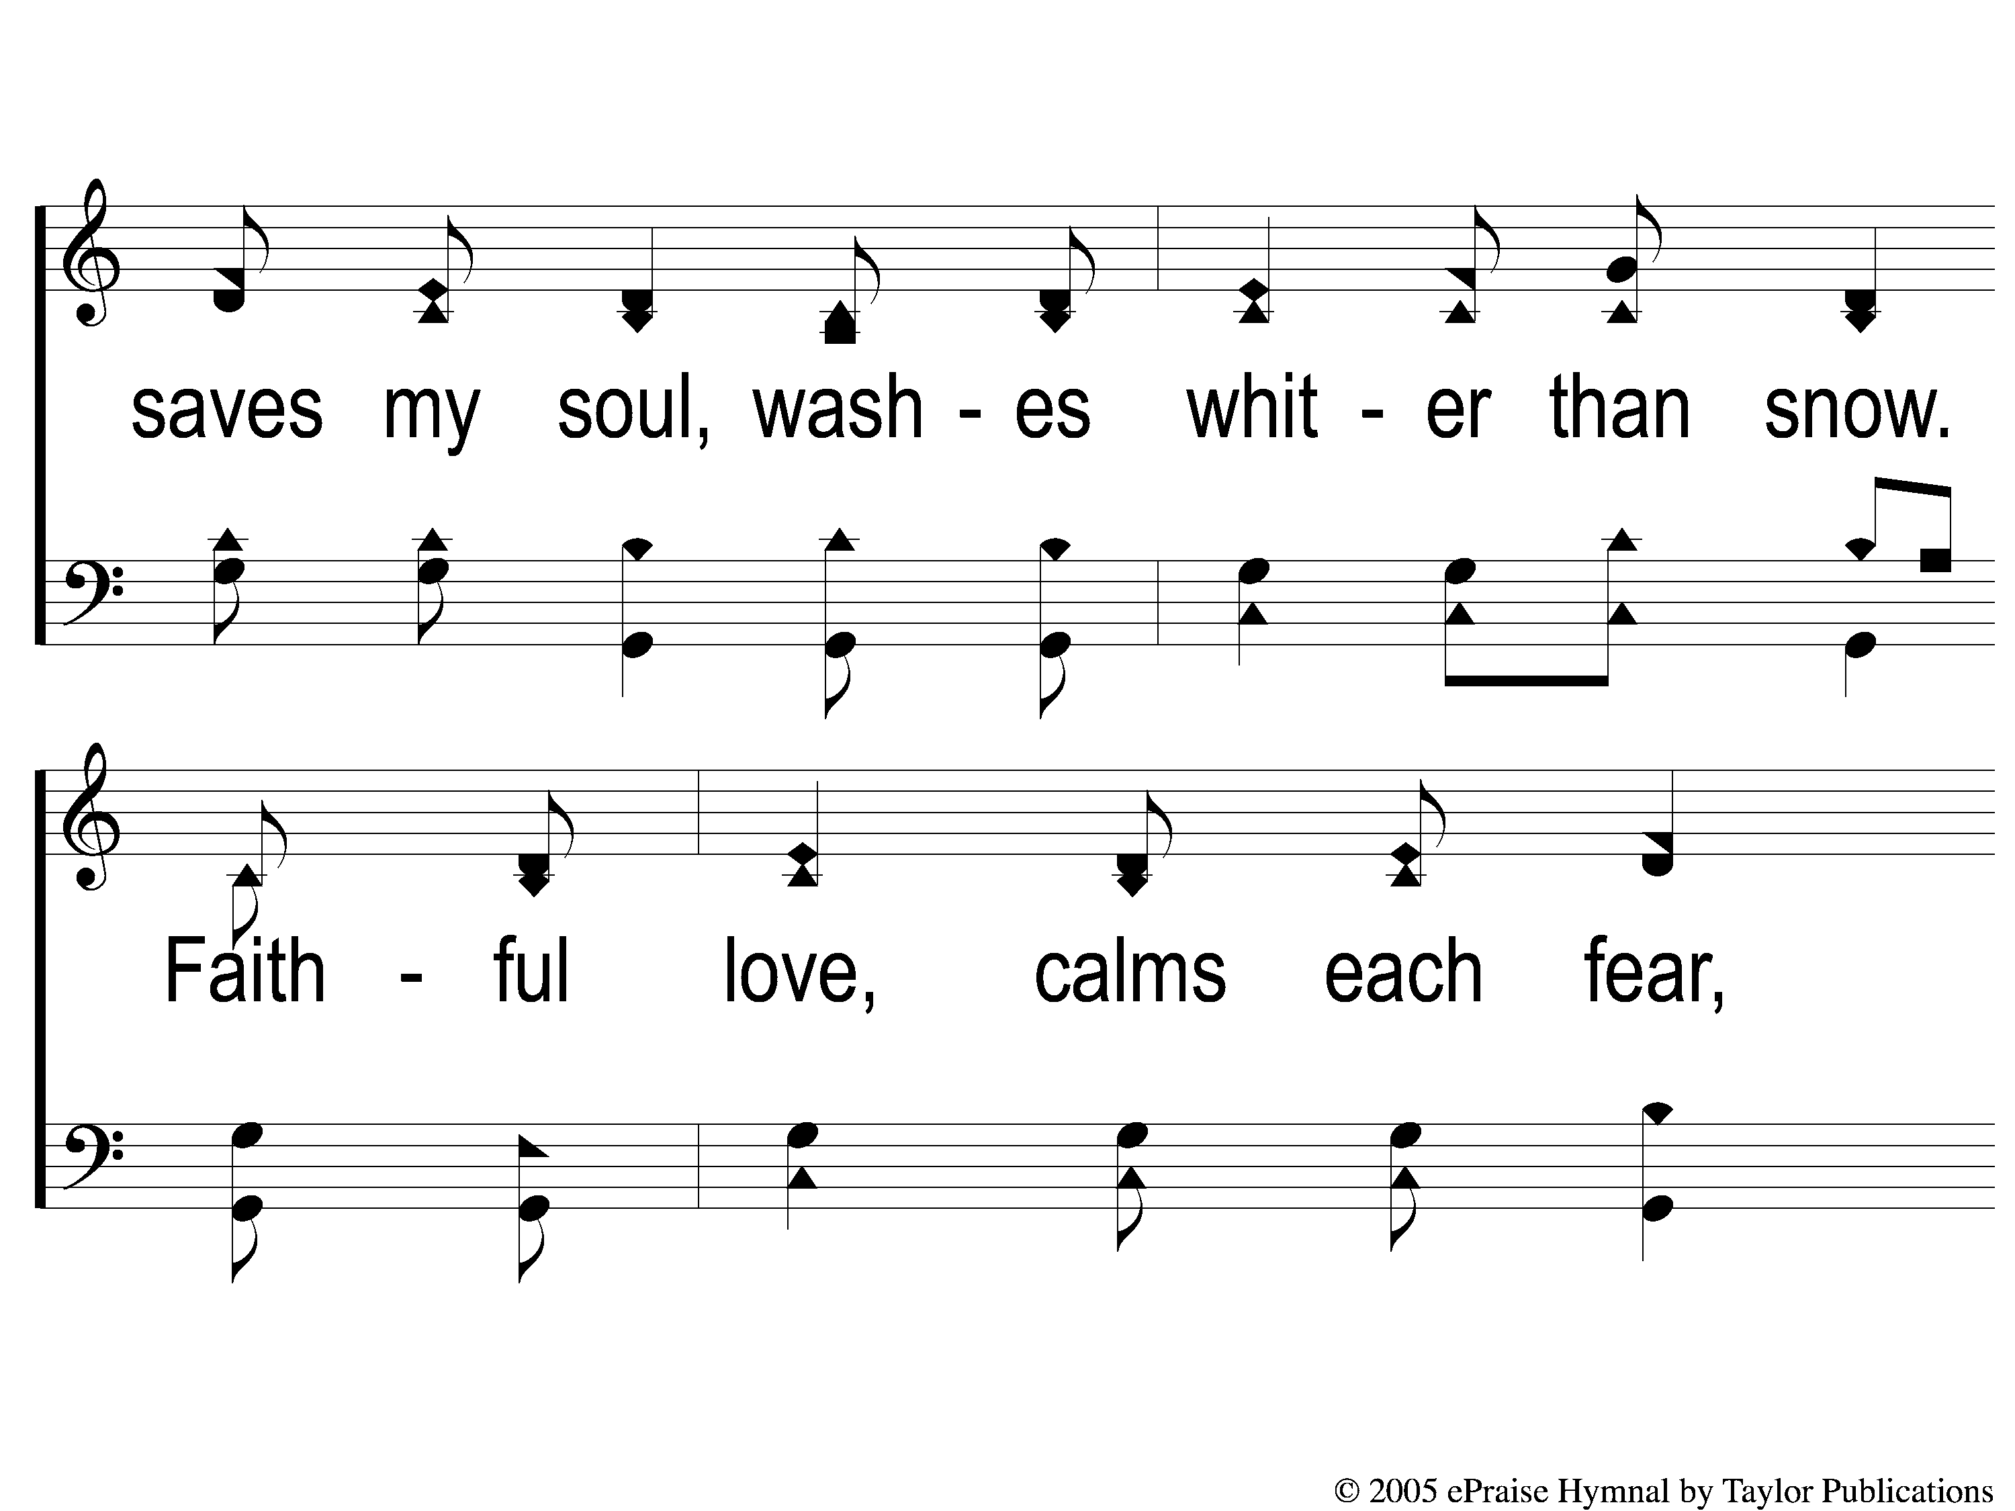
1-2 Faithful Love
Faithful Love
18

Slide 3
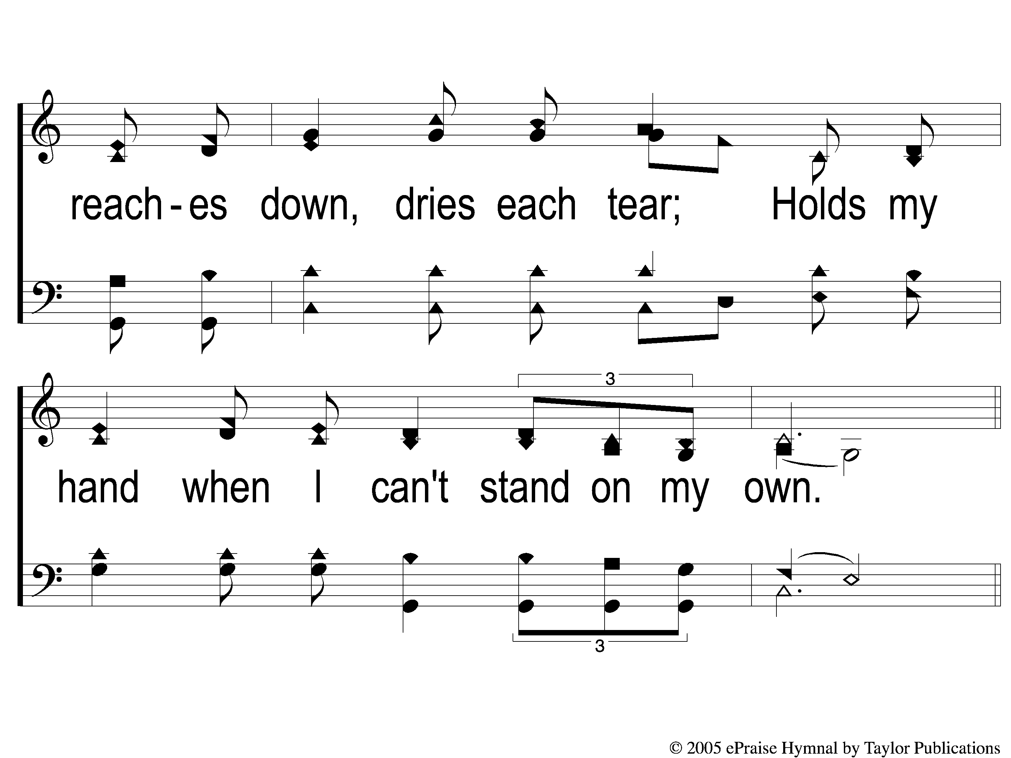
1-3 Faithful Love
Faithful Love
18

Slide 4
C-1 Faithful Love
Faithful Love
18

Slide 5
C-2 Faithful Love
Faithful Love
18

Slide 6
RESTORE REBUILD RENEW
welcome
we are glad to
Have you with us
IN 2022
WHEELER
CHURCH
OF
CHRIST

Slide 7
Song:
Jesus, Hold My Hand
#412

Slide 8
1-1 Jesus Hold My Hand
Jesus, Hold My Hand
412

Slide 9
1-2 Jesus Hold My Hand
Jesus, Hold My Hand
412

Slide 10
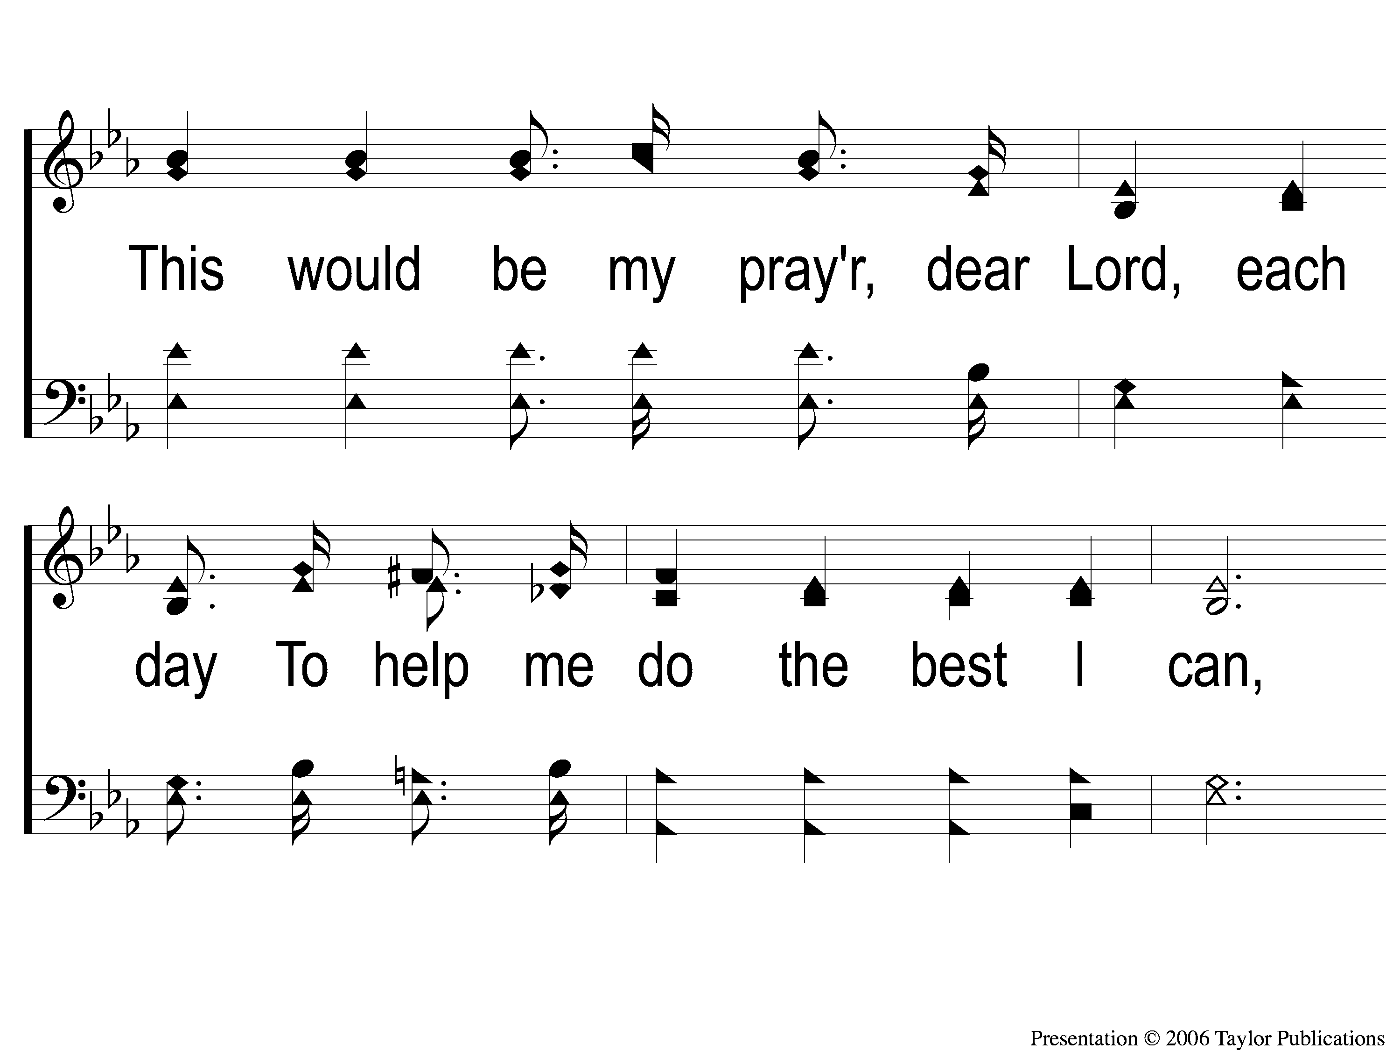
1-3 Jesus Hold My Hand
Jesus, Hold My Hand
412

Slide 11
1-4 Jesus Hold My Hand
Jesus, Hold My Hand
412

Slide 12
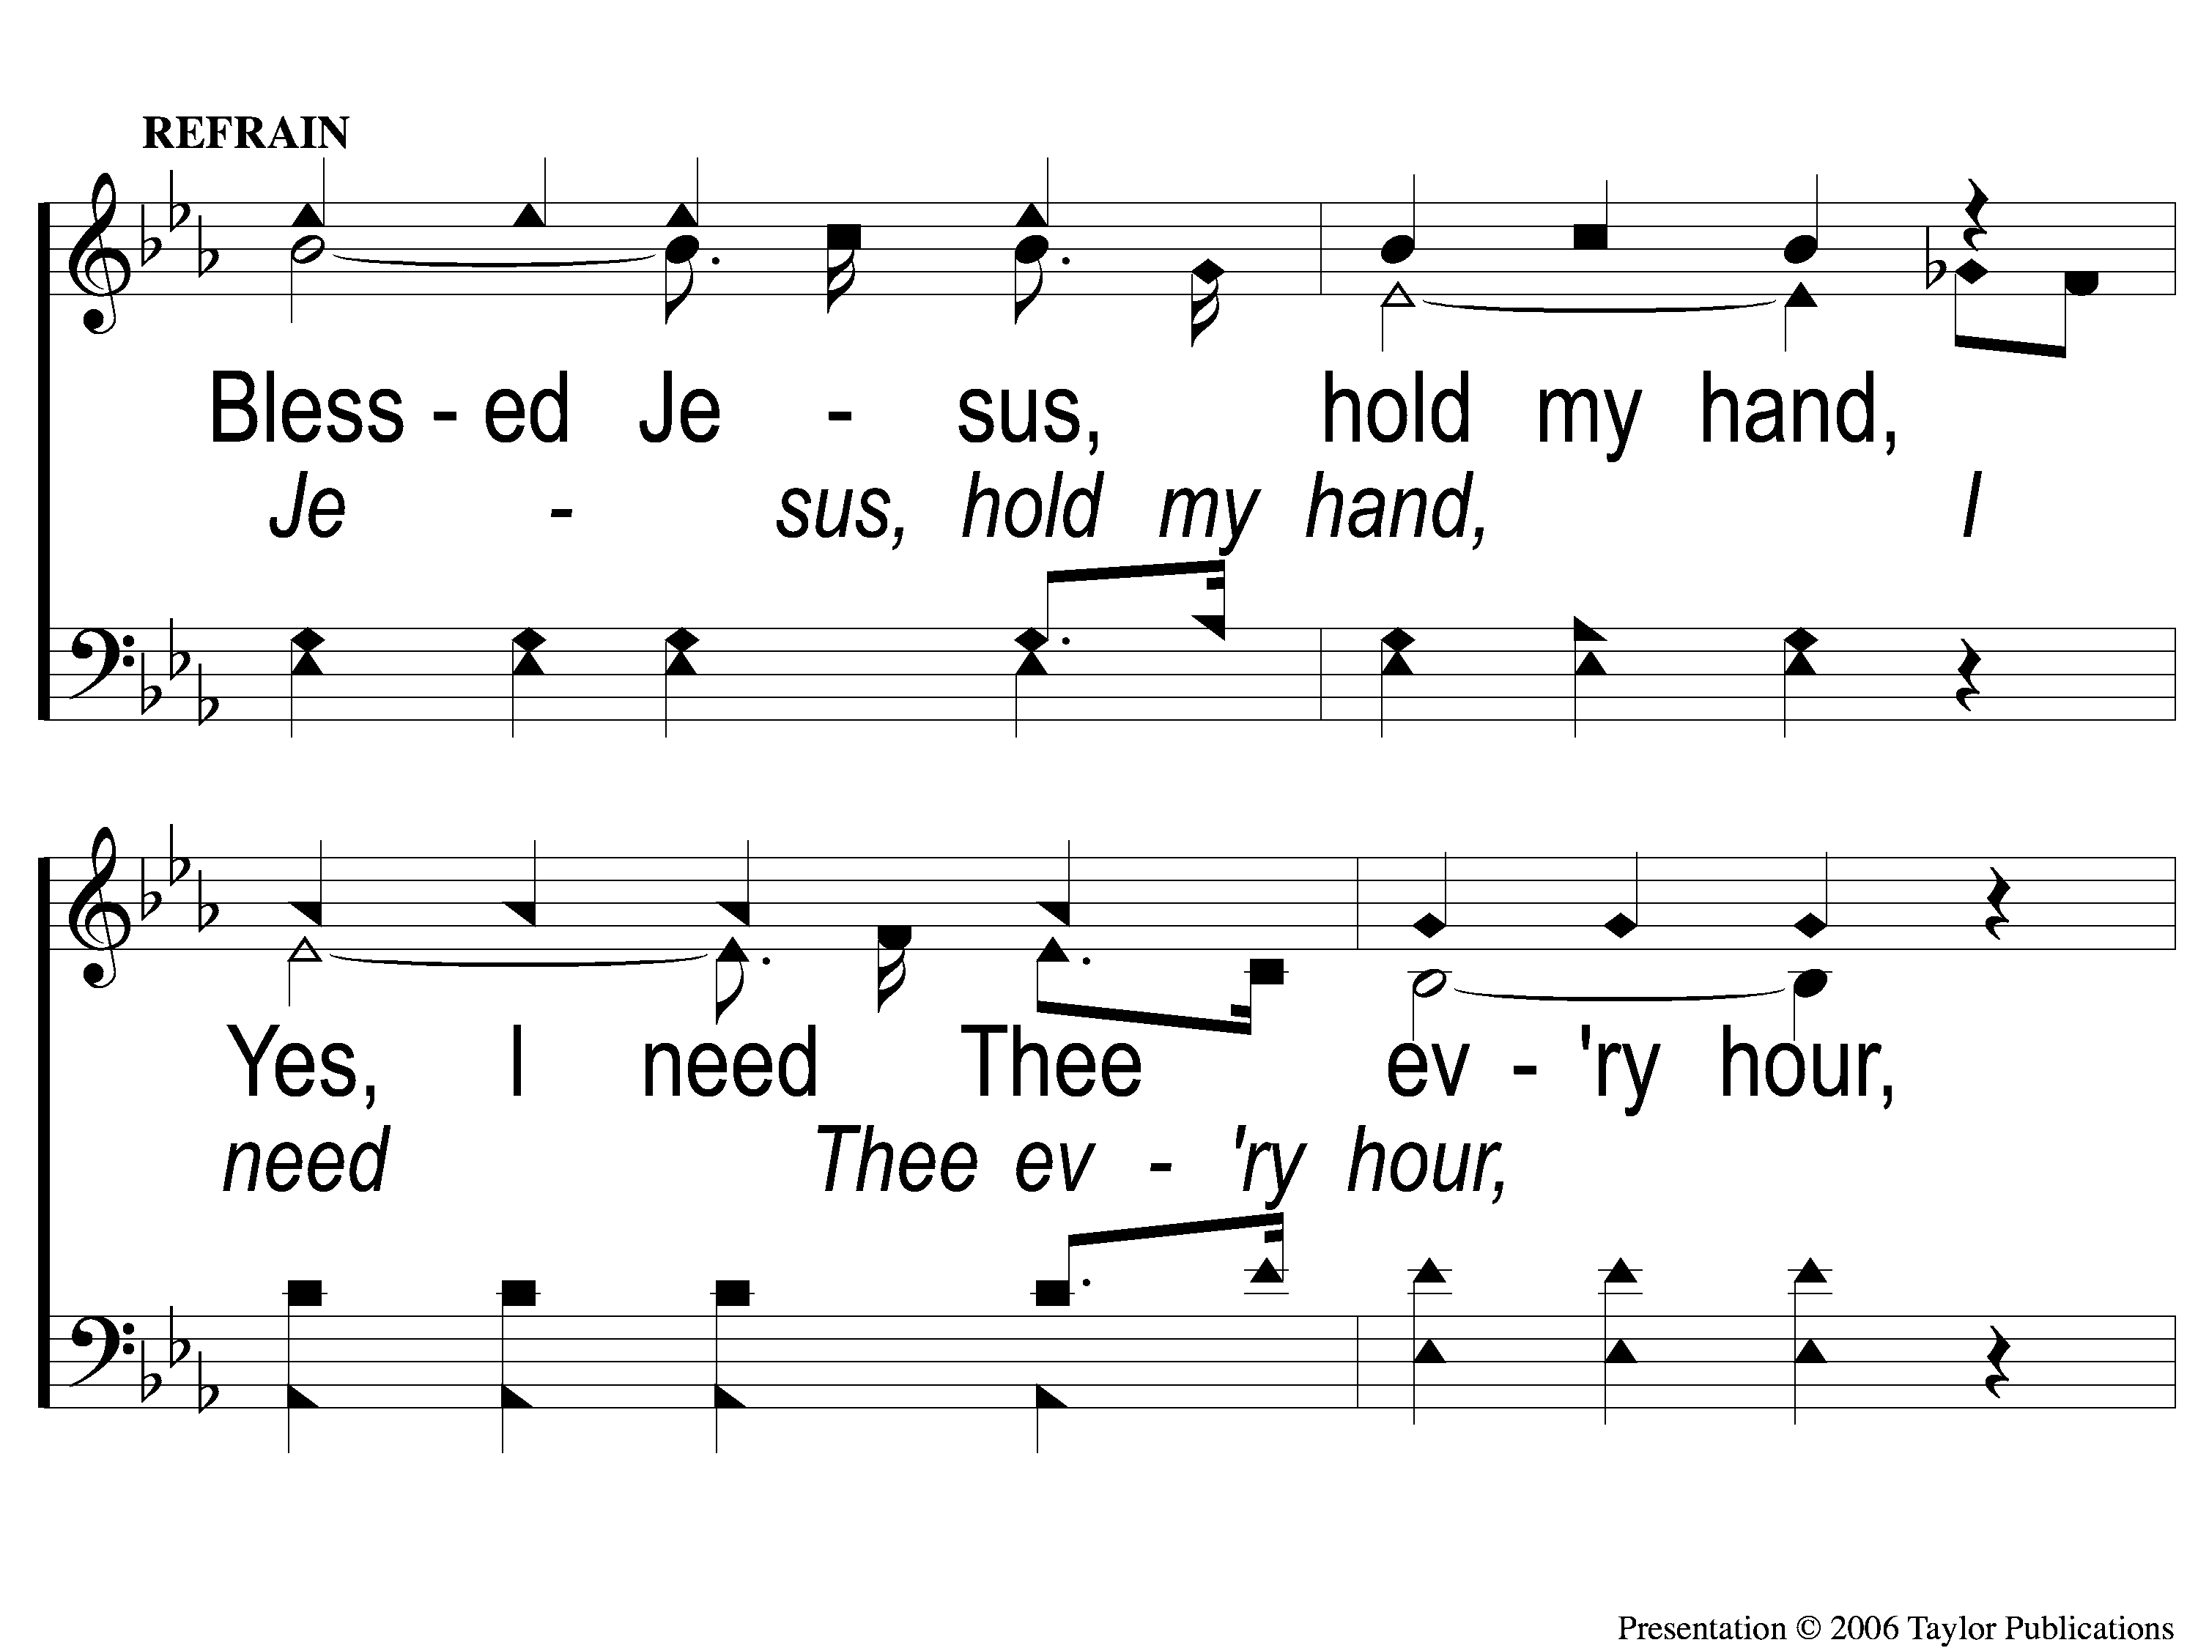
C-1 Jesus Hold My Hand
Jesus, Hold My Hand
412

Slide 13
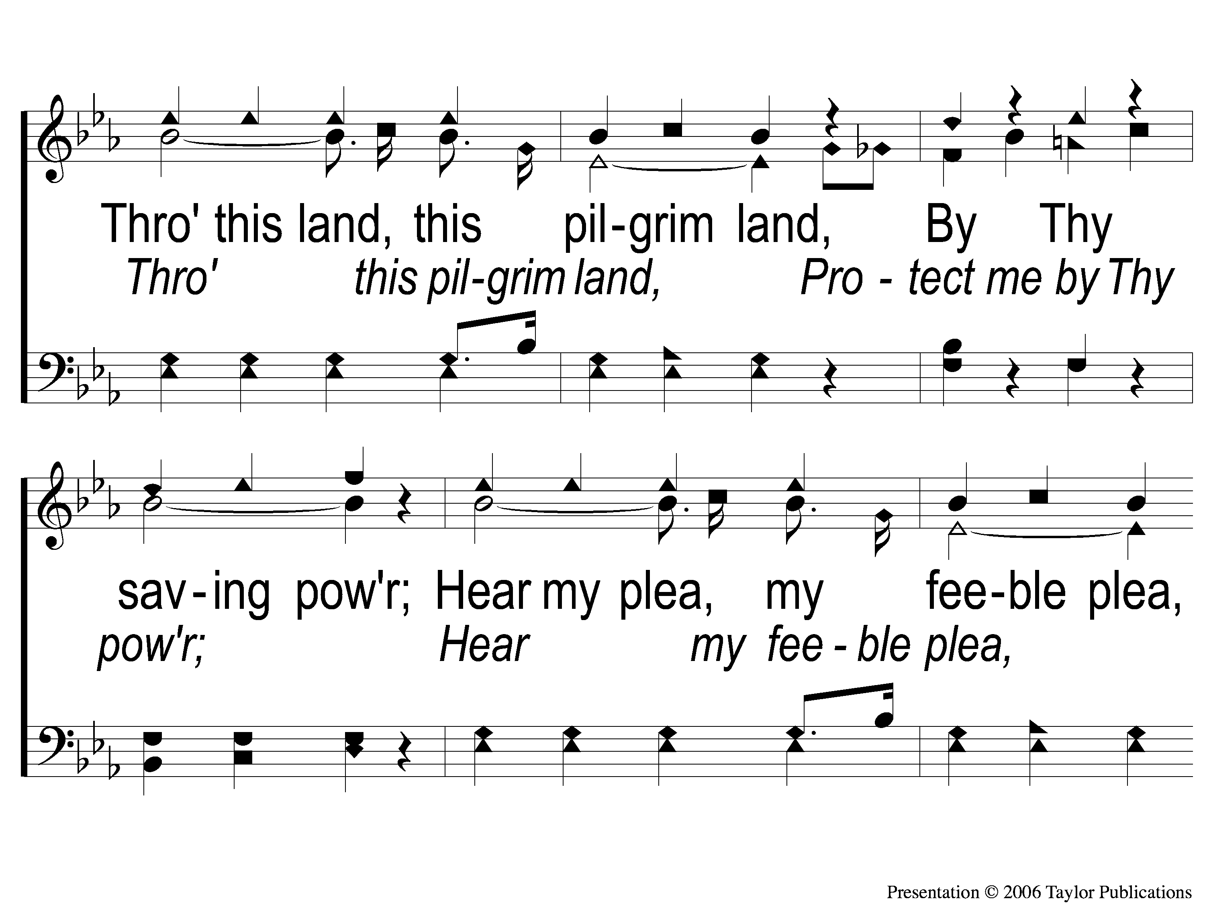
C-2 Jesus Hold My Hand
Jesus, Hold My Hand
412

Slide 14
C-3 Jesus Hold My Hand
Jesus, Hold My Hand
412

Slide 15
3-1 Jesus Hold My Hand
Jesus, Hold My Hand
412

Slide 16
3-2 Jesus Hold My Hand
Jesus, Hold My Hand
412

Slide 17
3-3 Jesus Hold My Hand
Jesus, Hold My Hand
412

Slide 18
3-4 Jesus Hold My Hand
Jesus, Hold My Hand
412

Slide 19
C-1 Jesus Hold My Hand
Jesus, Hold My Hand
412

Slide 20
C-2 Jesus Hold My Hand
Jesus, Hold My Hand
412

Slide 21
C-3 Jesus Hold My Hand
Jesus, Hold My Hand
412

Slide 22
Song:
Walking Alone At Eve
#874

Slide 23
1-1 Walking Alone at eve
Walking Alone At Eve
874

Slide 24
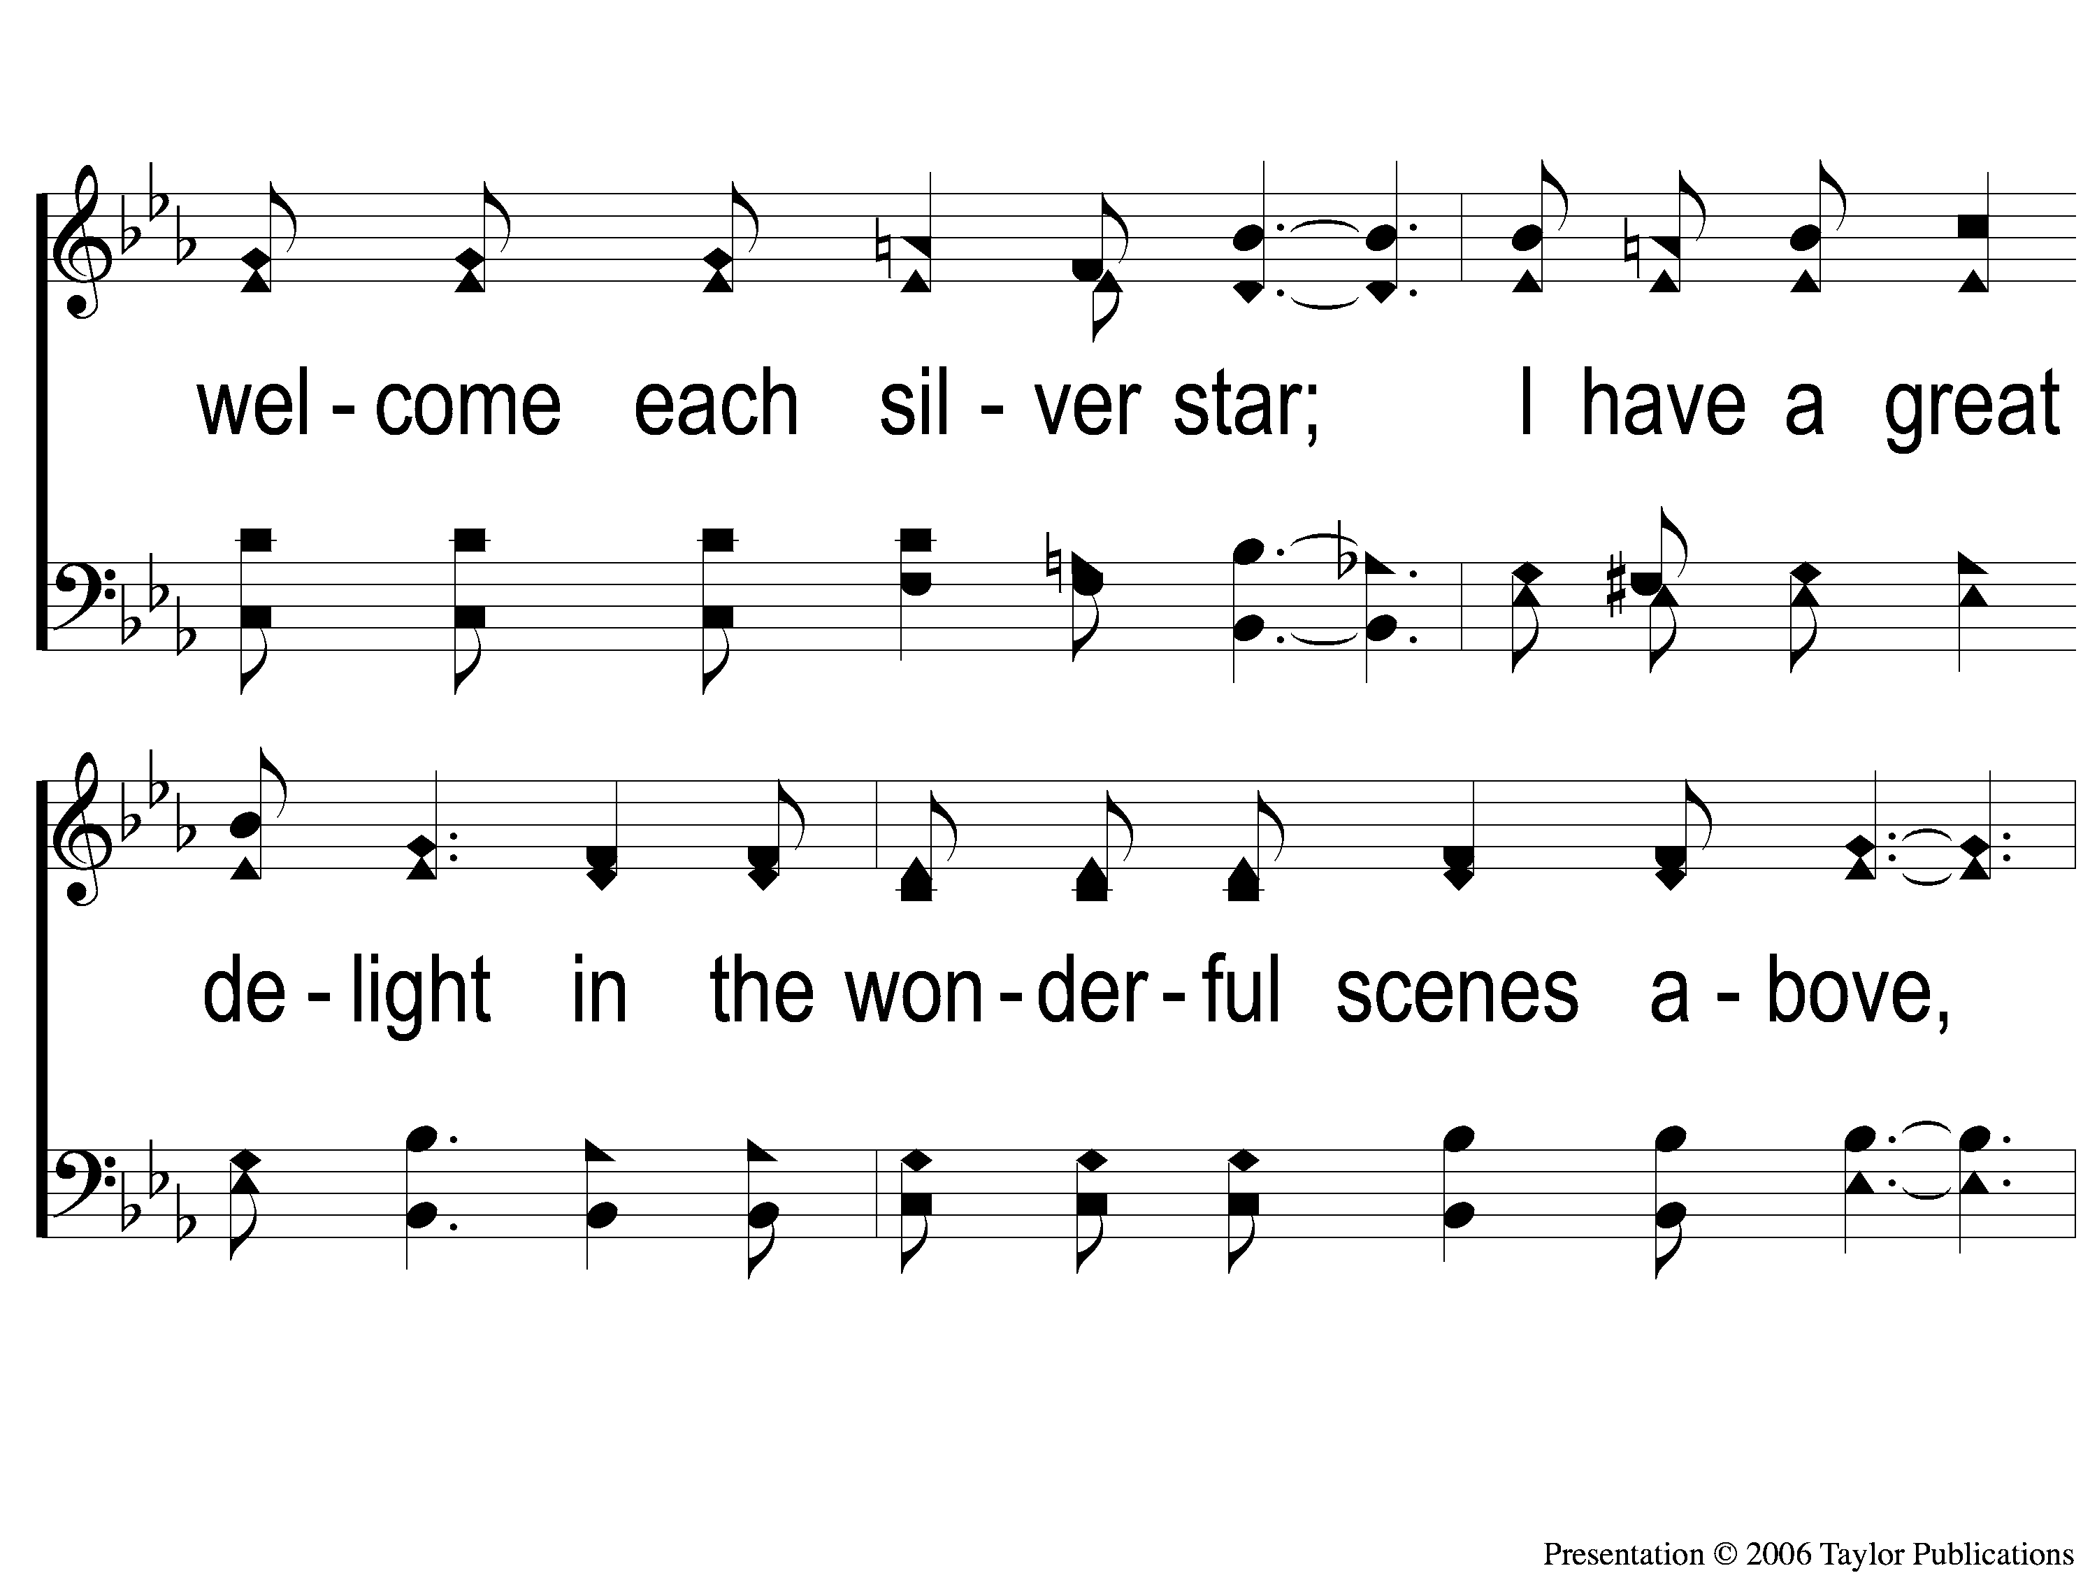
1-2 Walking Alone at eve
Walking Alone At Eve
874

Slide 25
1-3 Walking Alone at eve
Walking Alone At Eve
874

Slide 26
C-1 Walking Alone at eve
Walking Alone At Eve
874

Slide 27
C-2 Walking Alone at eve
Walking Alone At Eve
874

Slide 28
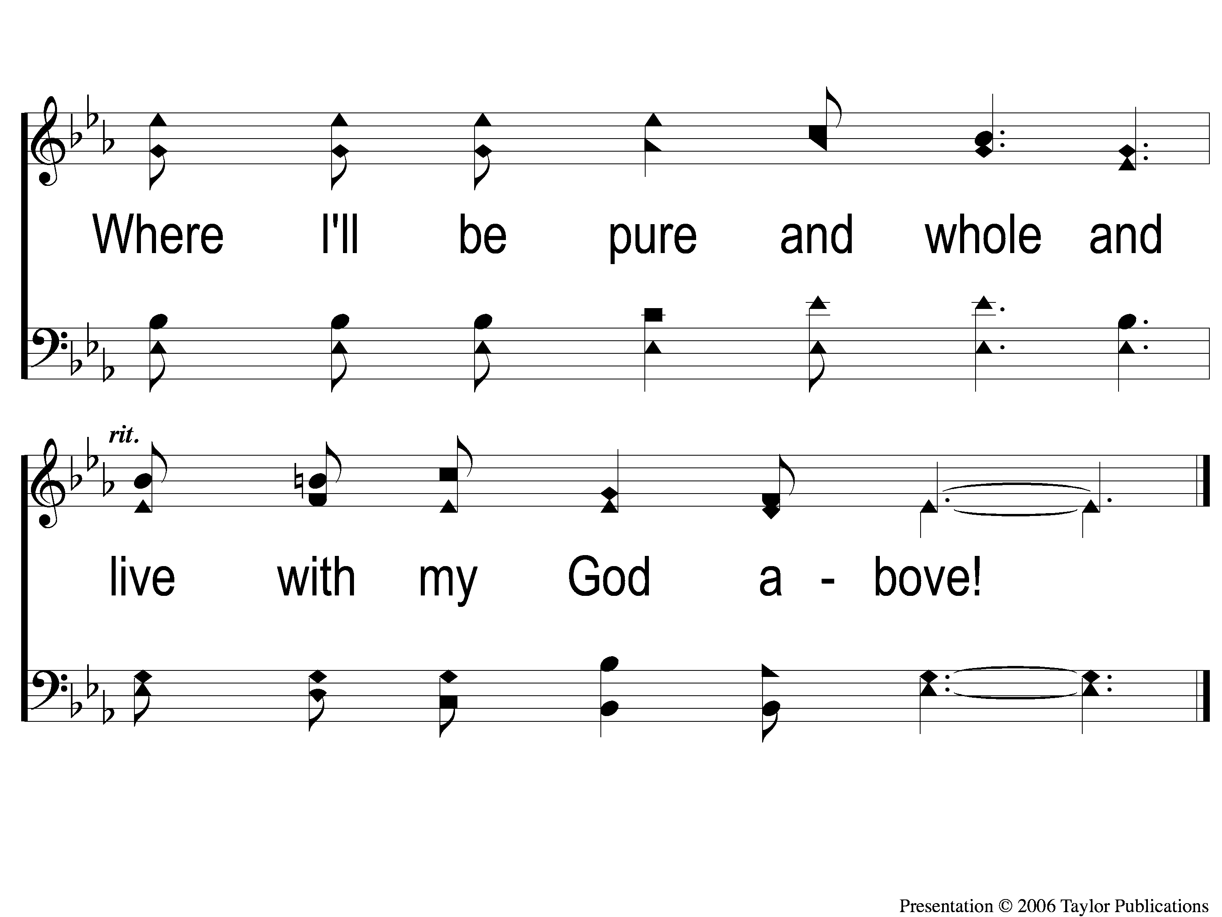
C-3 Walking Alone at eve
Walking Alone At Eve
874

Slide 29
2-1 Walking Alone at eve
Walking Alone At Eve
874

Slide 30
2-2 Walking Alone at eve
Walking Alone At Eve
874

Slide 31
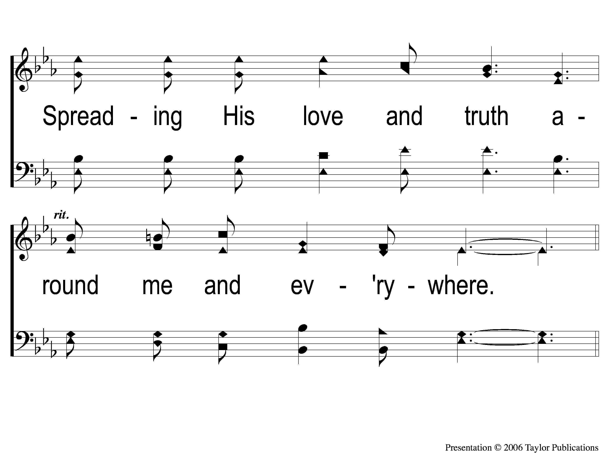
2-3 Walking Alone at eve
Walking Alone At Eve
874

Slide 32
C-1 Walking Alone at eve
Walking Alone At Eve
874

Slide 33
C-2 Walking Alone at eve
Walking Alone At Eve
874

Slide 34
C-3 Walking Alone at eve
Walking Alone At Eve
874

Slide 35
3-1 Walking Alone at eve
Walking Alone At Eve
874

Slide 36
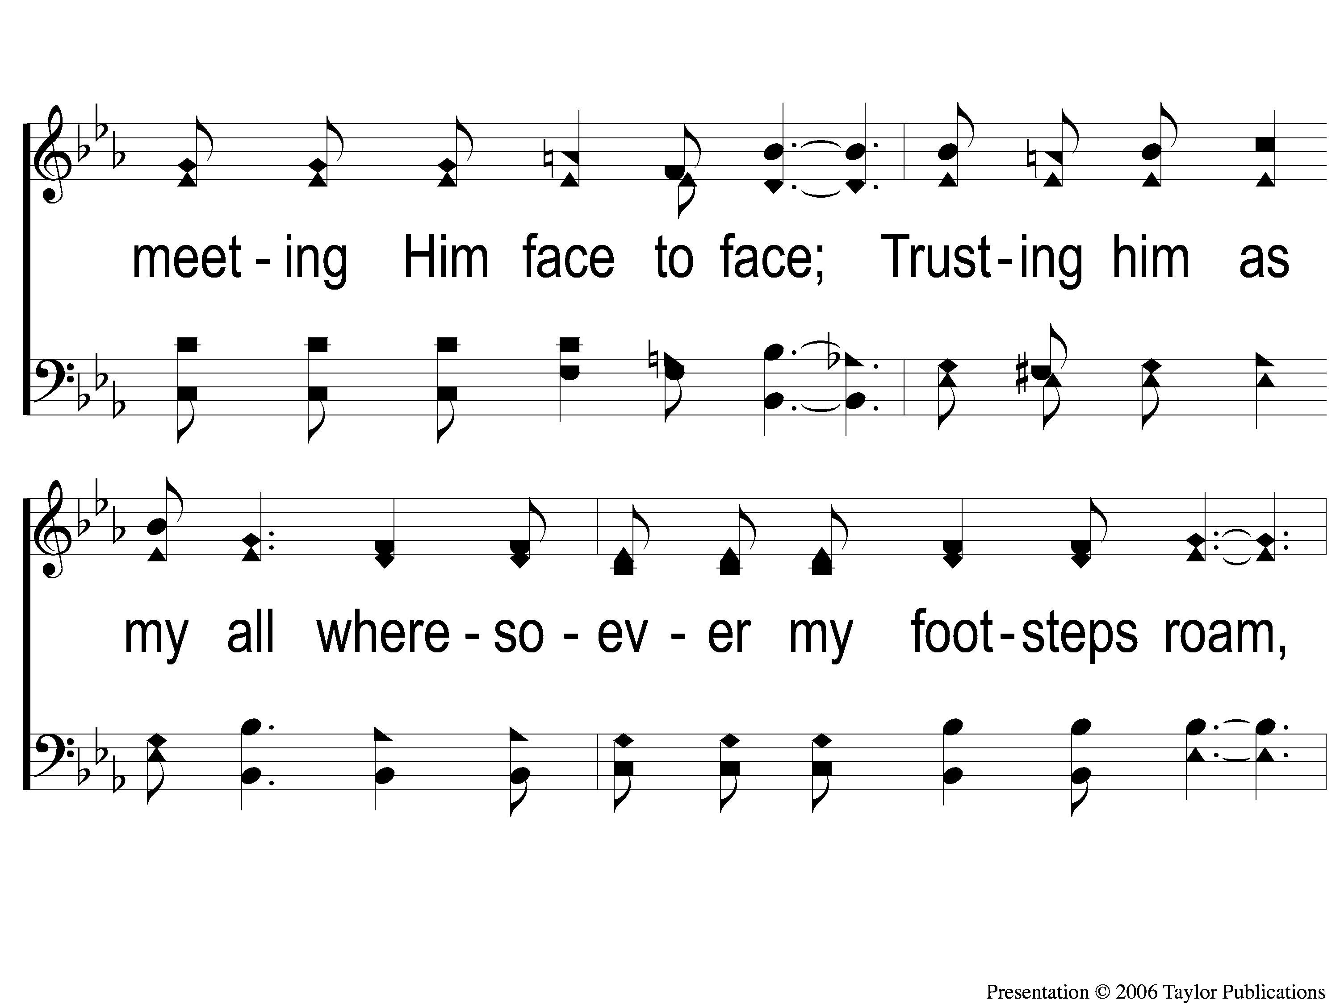
3-2 Walking Alone at eve
Walking Alone At Eve
874

Slide 37
3-3 Walking Alone at eve
Walking Alone At Eve
874

Slide 38
C-1 Walking Alone at eve
Walking Alone At Eve
874

Slide 39
C-2 Walking Alone at eve
Walking Alone At Eve
874

Slide 40
C-3 Walking Alone at eve
Walking Alone At Eve
874

Slide 41
Opening Prayer

Slide 42
Song:
Angry Words
#719

Slide 43
1-1 Angry Words
Angry Words
719

Slide 44
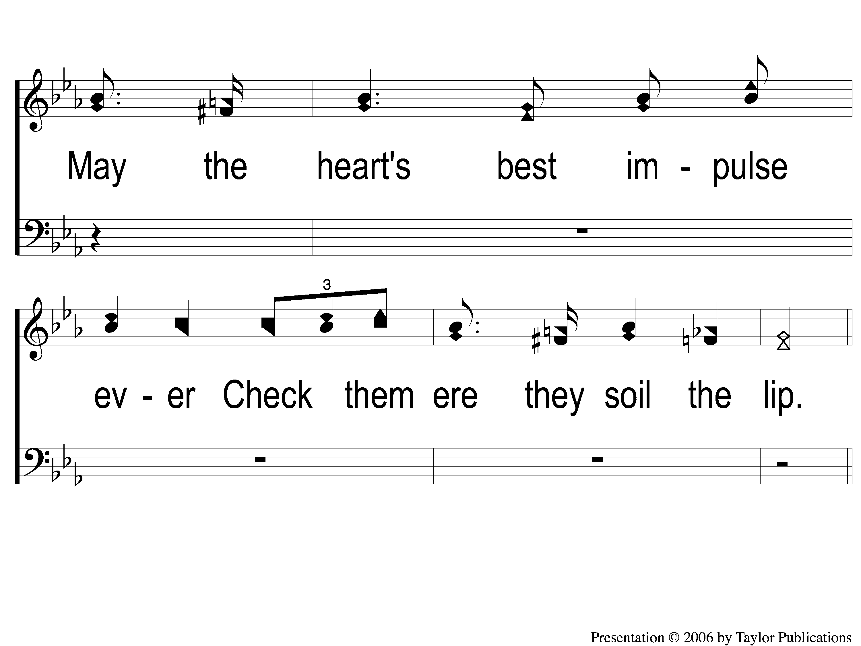
1-2 Angry Words
Angry Words
719

Slide 45
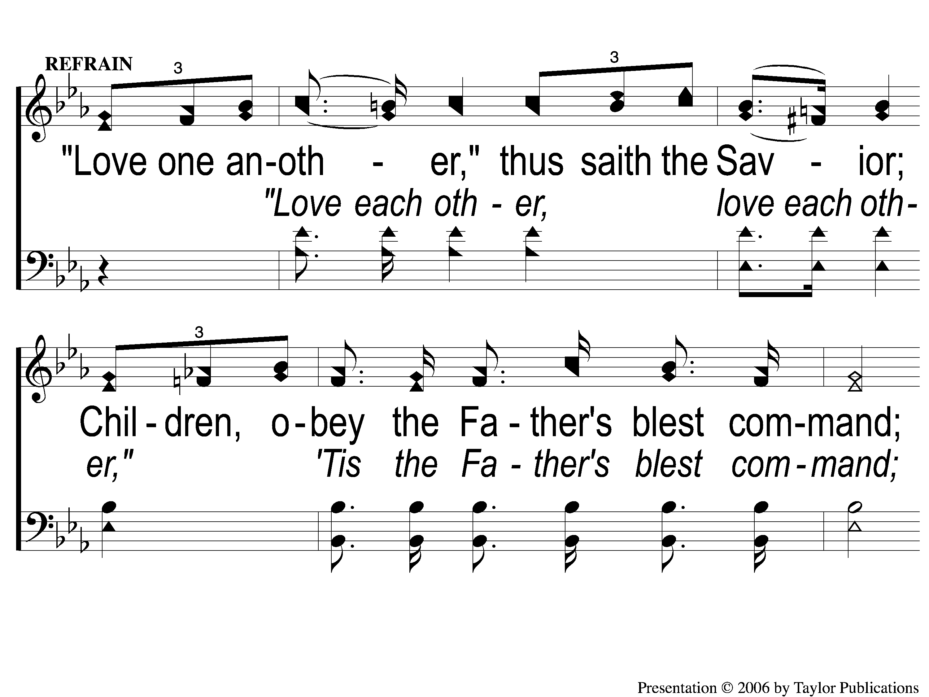
C-1 Angry Words
Angry Words
719

Slide 46
C-2 Angry Words
Angry Words
719

Slide 47
2-1 Angry Words
Angry Words
719

Slide 48
2-2 Angry Words
Angry Words
719

Slide 49
C-1 Angry Words
Angry Words
719

Slide 50
C-2 Angry Words
Angry Words
719

Slide 51
3-1 Angry Words
Angry Words
719

Slide 52
3-2 Angry Words
Angry Words
719

Slide 53
C-1 Angry Words
Angry Words
719

Slide 54
C-2 Angry Words
Angry Words
719

Slide 55
Song:
Farther Along
#753

Slide 56
1-1 Farther Along
Farther Along
753

Slide 57
1-2 Farther Along
Farther Along
753

Slide 58
C-1 Farther Along
Farther Along
753

Slide 59
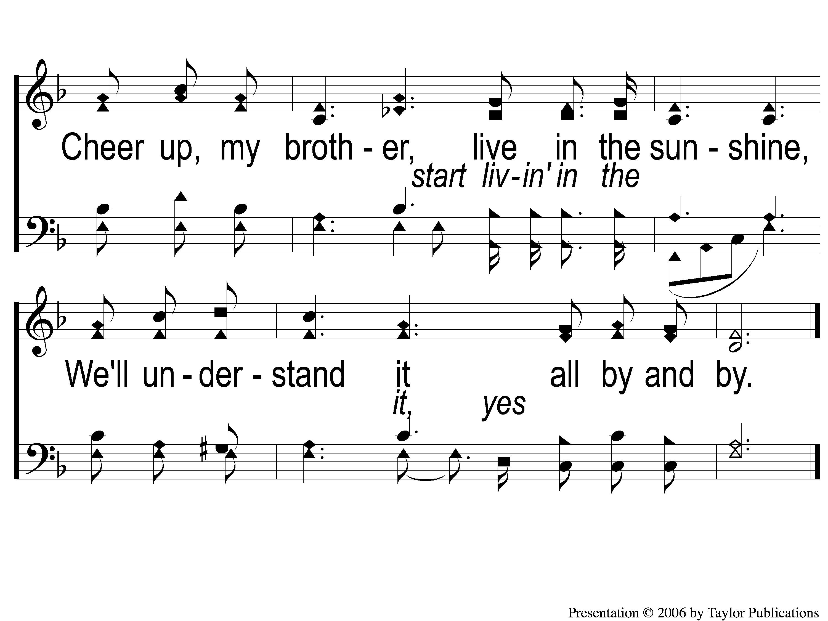
C-2 Farther Along
Farther Along
753

Slide 60
2-1 Farther Along
Farther Along
753

Slide 61
2-2 Farther Along
Farther Along
753

Slide 62
C-1 Farther Along
Farther Along
753

Slide 63
C-2 Farther Along
Farther Along
753

Slide 64
3-1 Farther Along
Farther Along
753

Slide 65
3-2 Farther Along
Farther Along
753

Slide 66
C-1 Farther Along
Farther Along
753

Slide 67
C-2 Farther Along
Farther Along
753

Slide 68
Scripture Reading:
Nehemiah 2:11-18

Slide 69
RESTORE REBUILD RENEW
IN 2022

Slide 70
RESTORE REBUILD RENEW
IN 2022

Slide 71
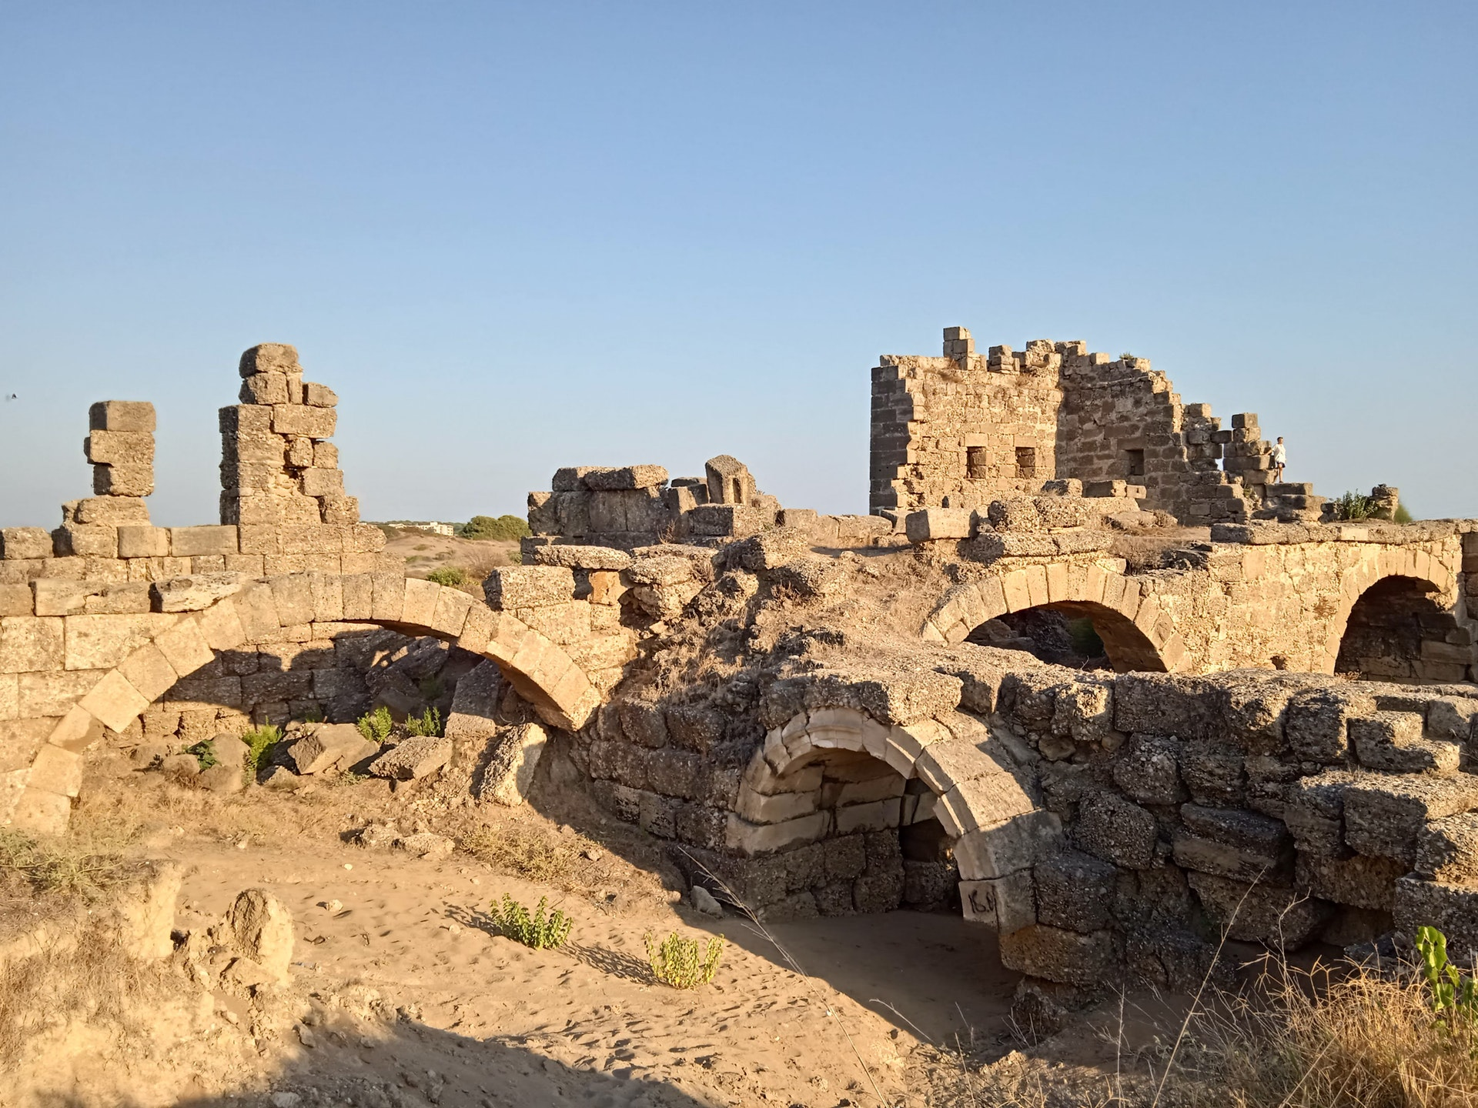
Rebuilding
the temple

Slide 72
Rebuilding Jerusalem

Slide 73
Rebuilding Jerusalem

Slide 74
Rebuilding Jerusalem

Slide 75
Rebuilding Jerusalem

Slide 76
Rebuilding Jerusalem

Slide 77
Rebuilding Jerusalem
Zerubbabel – 536 B.C. – Rebuild the Temple
Ezra – 458 B.C. – Restore the Law
Nehemiah – 444 B. C. – Rebuild the Walls

Slide 78
Rebuilding Needs…Unity

Slide 79
The Need For Unity
Neh. 2:17

Slide 80
The Need For Unity
Neh. 2:17
Distress = disaster, ruin
Reproach = a disgrace, a state of dishonor
1 Cor. 1:10

Slide 81
Unity Is Achieved Through…

Slide 82
Unity Is Achieved Through…
Preparation

Slide 83
Preparation
Neh. 1:4, 11, 2:4
Prayer was a Priority
Jn. 17:20-23

Slide 84
Unity Is Achieved Through…
Preparation
Organization

Slide 85
Organization
10 Sections
Sheep Gate (v.1-2)
Fish Gate (v. 3-5)
Old Gate (v. 6-12)
Valley Gate (v. 13)
Refuse Gate (v. 14)
Fountain Gate (v. 15-25)
Water Gate (v. 26-27)
Horse Gate (v. 28)
East Gate (v. 29-30)
Miphkad Gate (v. 31-32)

Slide 86
Organization
10 Sections
Sheep Gate (v.1-2)
Fish Gate (v. 3-5)
Old Gate (v. 6-12)
Valley Gate (v. 13)
Refuse Gate (v. 14)
Fountain Gate (v. 15-25)
Water Gate (v. 26-27)
Horse Gate (v. 28)
East Gate (v. 29-30)
Miphkad Gate (v. 31-32)
1 Cor. 12:6, 12, 27-28

Slide 87
Unity Is Achieved Through…
Preparation
Organization
Cooperation

Slide 88
Cooperation
= “the act of working together to one end”
Prefix “Co-” + Operation

Slide 89
Cooperation
Operation = working, producing

Slide 90
Cooperation
Operation = working, producing
In Chapter 3,
“built” 7 times
“made repairs” 40 times
Neh. 2:18

Slide 91
Unity Is Achieved Through…
Preparation
Organization
Cooperation
Dedication

Slide 92
Dedication
Neh. 4:6 – “a mind to work”

Slide 93
Dedication
Neh. 4:6 – “a mind to work”
Phili. 2:5 – “Let this mind be in you…”
Col. 3:2 – “Set your mind on…”
Eph. 4:3 – “endeavoring”

Slide 94
Unity Is Achieved Through…
Preparation
Organization
Cooperation
Dedication
Instruction

Slide 95
Instruction
Neh. 2:18, 20
“son / sons of” – 36 times

Slide 96
Instruction
Neh. 2:18, 20
“son / sons of” – 36 times
Neh. 8:8
Eph. 4:1-6

Slide 97
What Are The Results Of Unity?
Strengthening – Acts 14:22, 15:41, 16:5

Slide 98
What Are The Results Of Unity?
Strengthening – Acts 14:22, 15:41, 16:5
Peace Of Mind – Neh. 6:15, Phili. 4:7

Slide 99
What Are The Results Of Unity?
Strengthening – Acts 14:22, 15:41, 16:5
Peace Of Mind – Neh. 6:15, Phili. 4:7
Glory to God – Neh. 9:5, 12:24, Eph. 1:6

Slide 100
Are you resolved to
Be United?

Slide 101
Invitation
Song:
I Am Resolved
#948

Slide 102
1-1 I Am Resolved
I Am Resolved
948

Slide 103
1-2 I Am Resolved
I Am Resolved
948

Slide 104
C-1 I Am Resolved
I Am Resolved
948

Slide 105
C-2 I Am Resolved
I Am Resolved
948

Slide 106
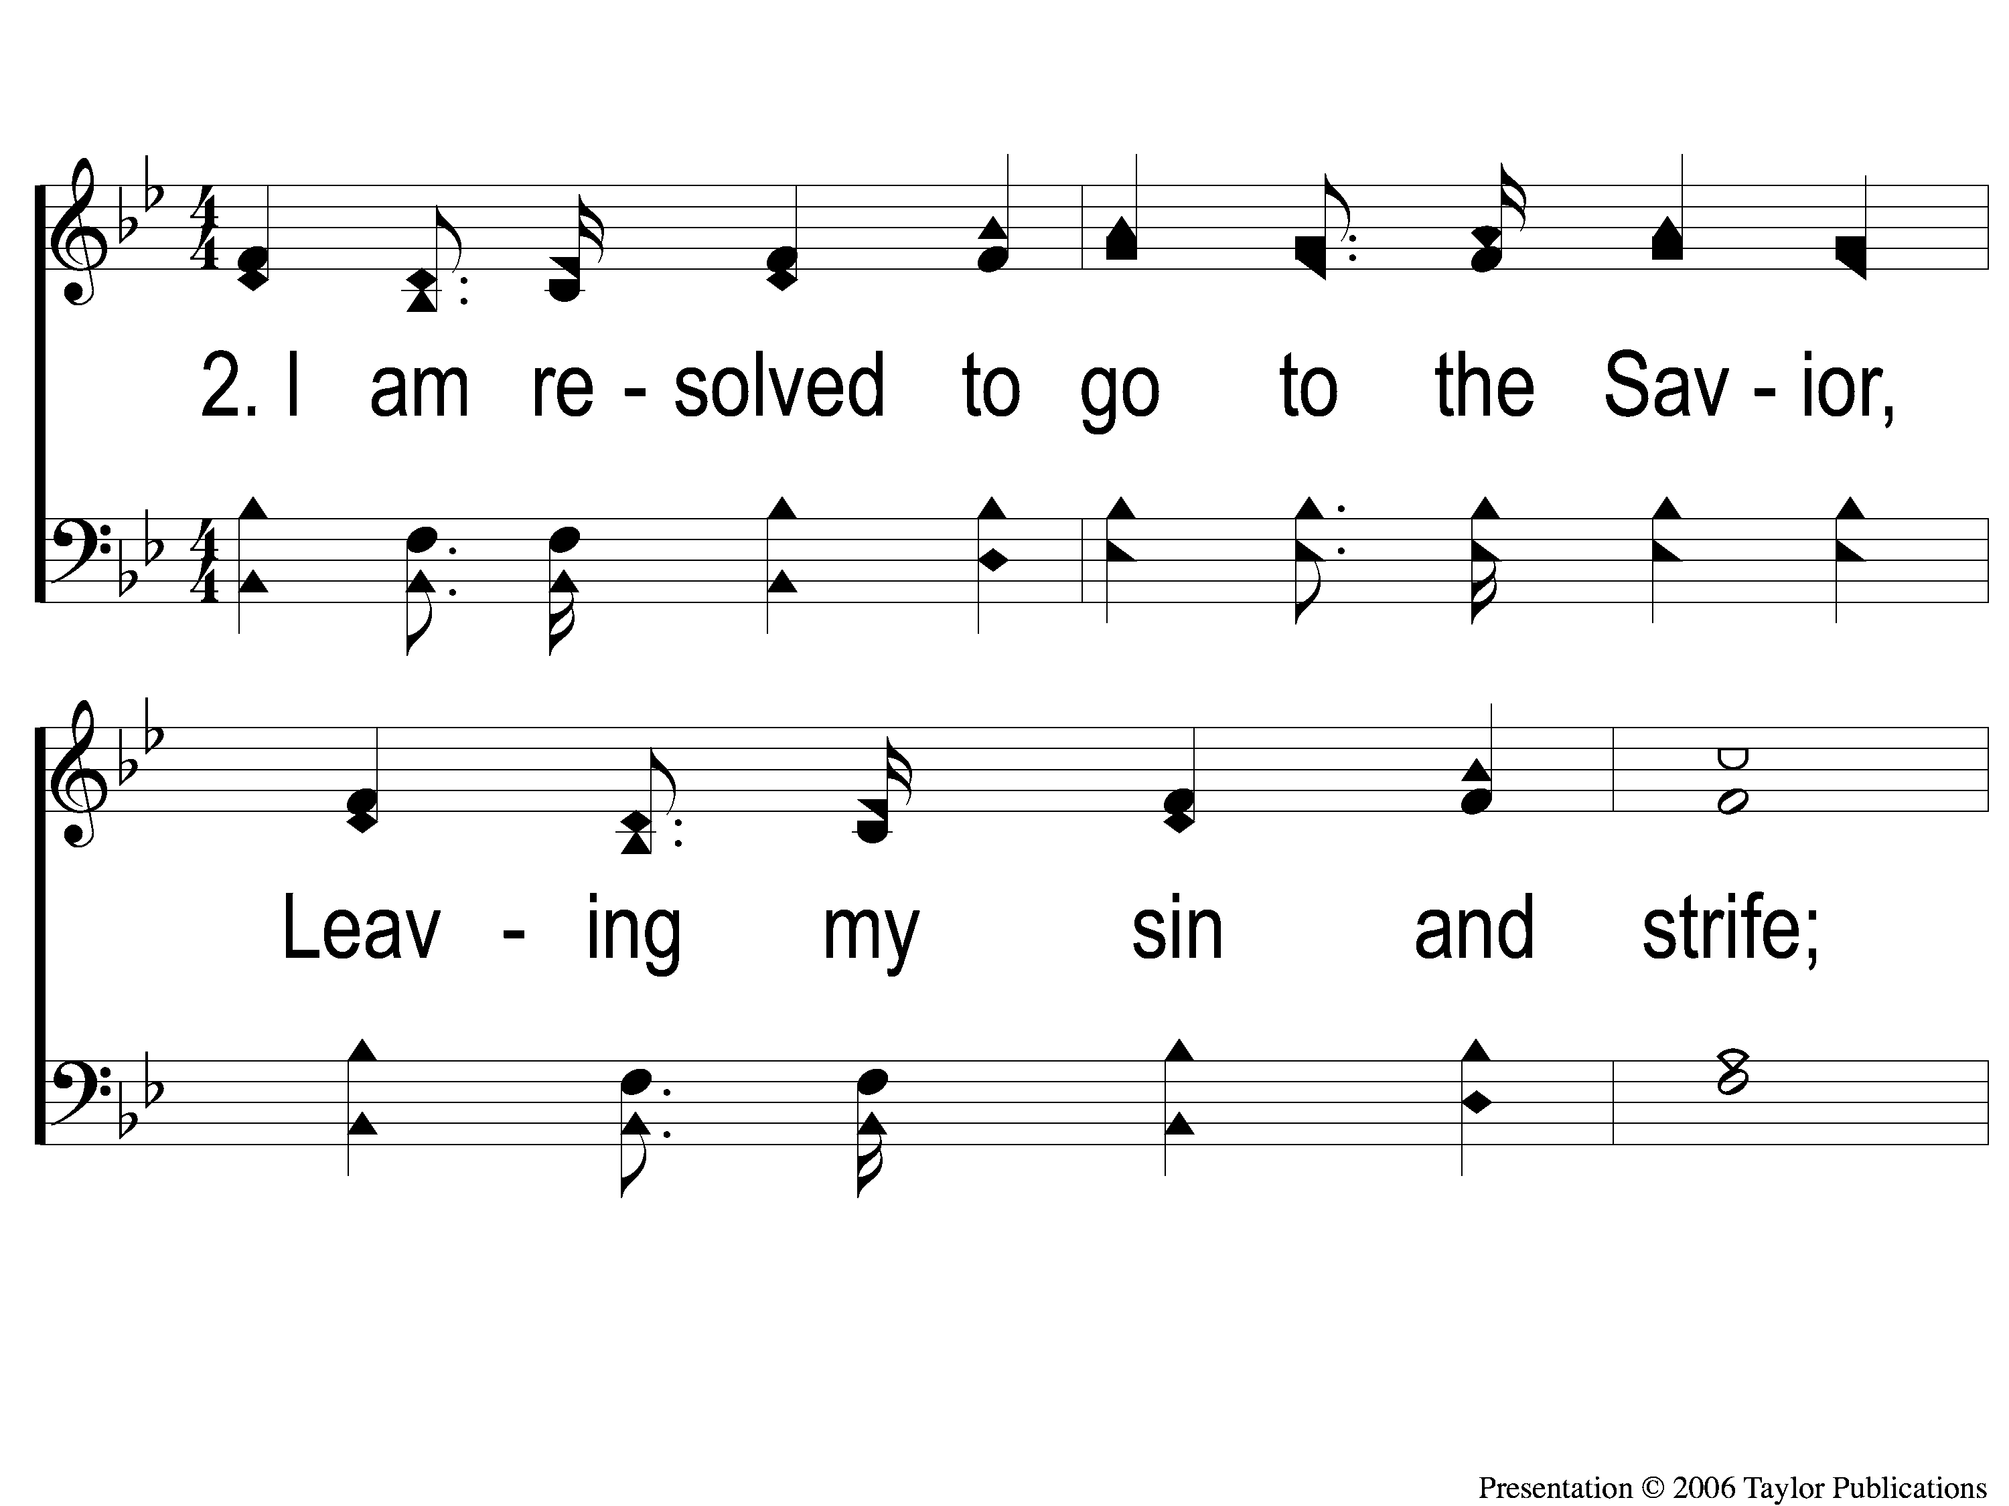
2-1 I Am Resolved
I Am Resolved
948

Slide 107
2-2 I Am Resolved
I Am Resolved
948

Slide 108
C-1 I Am Resolved
I Am Resolved
948

Slide 109
C-2 I Am Resolved
I Am Resolved
948

Slide 110
4-1 I Am Resolved
I Am Resolved
948

Slide 111
4-2 I Am Resolved
I Am Resolved
948

Slide 112
C-1 I Am Resolved
I Am Resolved
948

Slide 113
C-2 I Am Resolved
I Am Resolved
948

Slide 114
The Contribution:
1 Peter 4:10
“As each one has received a gift, minister it to one another, as good stewards of the manifold grace of God.”

Slide 115
Song:
If That Isn’t Love
#379

Slide 116
1-1 If That Isn’t Love
If That Isn’t Love
379

Slide 117
1-2 If That Isn’t Love
If That Isn’t Love
379

Slide 118
C-1 If That Isn’t Love
If That Isn’t Love
379

Slide 119
C-2 If That Isn’t Love
If That Isn’t Love
379

Slide 120
2-1 If That Isn’t Love
If That Isn’t Love
379

Slide 121
2-2 If That Isn’t Love
If That Isn’t Love
379

Slide 122
C-1 If That Isn’t Love
If That Isn’t Love
379

Slide 123
C-2 If That Isn’t Love
If That Isn’t Love
379

Slide 124
The Unleavened Bread
Eph. 5:11-13
“Therefore remember that you, once Gentiles in the flesh—who are called Uncircumcision by what is called the Circumcision made in the flesh by hands— that at that time you were without Christ, being aliens from the commonwealth of Israel and strangers from the covenants of promise, having no hope and without God in the world. But now in Christ Jesus you who once were far off have been brought near by the blood of Christ.”

Slide 125
The Fruit
of the Vine
Ephesians 1:7-10
“In Him we have redemption through His blood, the forgiveness of sins, according to the riches of His grace which He made to abound toward us in all wisdom and prudence, having made known to us the mystery of His will, according to His good pleasure which He purposed in Himself, that in the dispensation of the fullness of the times He might gather together in one all things in Christ, both which are in heaven and which are on earth—in Him.”

Slide 126
Closing Prayer

Slide 127
Song:
A Common Love
#705

Slide 128
1 A Common Love
A Common Love
705

Slide 129
2 A Common Love
A Common Love
705

Slide 130
3 A Common Love
A Common Love
705

Slide 131
1 A Common Love
A Common Love
705

Slide 132
2 A Common Love
A Common Love
705

Slide 133
3 A Common Love
A Common Love
705

Slide 134
Tonight
Worship @ 6:00 PM
Wednesday
Worship & Classes @ 6:30 pm
RESTORE REBUILD RENEW
IN 2022
WHEELER
CHURCH
OF
CHRIST

Slide 135
Today
Fellowship Meal @ Noon
Devo & Singing @ 1:00 PM
Wednesday
Worship & Classes @ 6:30 pm
RESTORE REBUILD RENEW
IN 2022
WHEELER
CHURCH
OF
CHRIST

