Slide 1
PLEASE STANDBY
OUR LIVESTREAM
WILL BEGIN SOON

Slide 2
1 Highest Place
Highest Place
155

Slide 3
2 Highest Place
Highest Place
155

Slide 4
3 Highest Place
Highest Place
155

Slide 5
4 Highest Place
Highest Place
155

Slide 6
5 Highest Place
Highest Place
155

Slide 7
Tag Highest Place
Highest Place
155

Slide 8
WELCOME
THANKS FOR JOINING US!

Slide 9
#875
SONG:
Home of the Soul

Slide 10
1-1 Home of the Soul
Home of the Soul
875

Slide 11
1-2 Home of the Soul
Home of the Soul
875

Slide 12
C-1 Home of the Soul
Home of the Soul
875

Slide 13
C-2 Home of the Soul
Home of the Soul
875

Slide 14
C-3 Home of the Soul
Home of the Soul
875

Slide 15
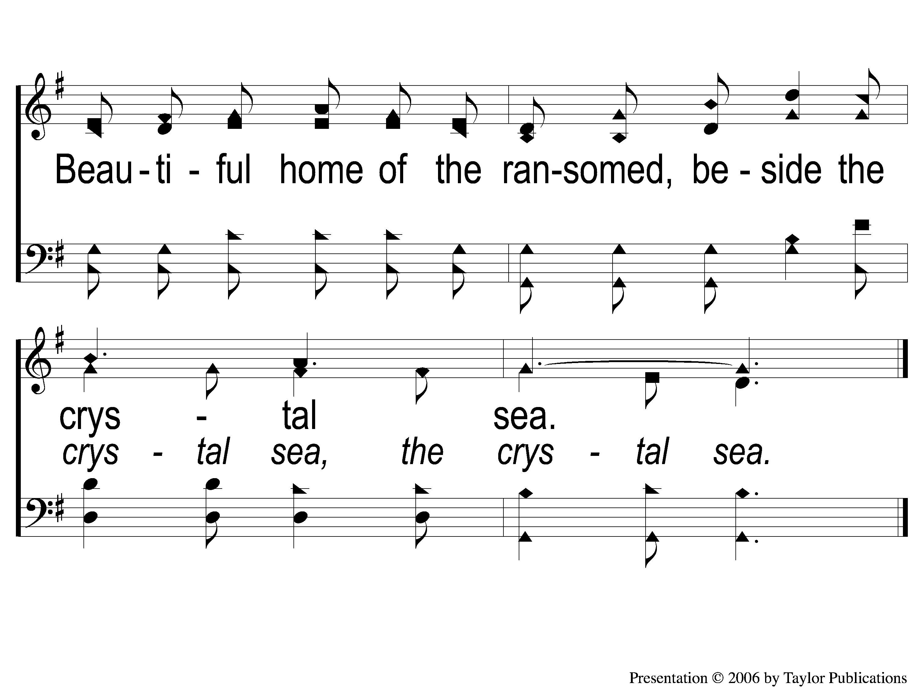
C-4 Home of the Soul
Home of the Soul
875

Slide 16
2-1 Home of the Soul
Home of the Soul
875

Slide 17
2-2 Home of the Soul
Home of the Soul
875

Slide 18
C-1 Home of the Soul
Home of the Soul
875

Slide 19
C-2 Home of the Soul
Home of the Soul
875

Slide 20
C-3 Home of the Soul
Home of the Soul
875

Slide 21
C-4 Home of the Soul
Home of the Soul
875

Slide 22
3-1 Home of the Soul
Home of the Soul
875

Slide 23
3-2 Home of the Soul
Home of the Soul
875

Slide 24
C-1 Home of the Soul
Home of the Soul
875

Slide 25
C-2 Home of the Soul
Home of the Soul
875

Slide 26
C-3 Home of the Soul
Home of the Soul
875

Slide 27
C-4 Home of the Soul
Home of the Soul
875

Slide 28
#624
SONG:
Seeking The Lost

Slide 29
1-1 Seeking the Lost
Seeking the Lost
624

Slide 30
1-2 Seeking the Lost
Seeking the Lost
624

Slide 31
C-1 Seeking the Lost
Seeking the Lost
624

Slide 32
C-2 Seeking the Lost
Seeking the Lost
624

Slide 33
3-1 Seeking the Lost
Seeking the Lost
624

Slide 34
3-2 Seeking the Lost
Seeking the Lost
624

Slide 35
C-1 Seeking the Lost
Seeking the Lost
624

Slide 36
C-2 Seeking the Lost
Seeking the Lost
624

Slide 37
Opening PRAYER

Slide 38
#450
SONG:
Give Me The Bible

Slide 39
1-1 Give Me the Bible
Give Me The Bible
450

Slide 40
1-2 Give Me the Bible
Give Me The Bible
450

Slide 41
C-1 Give Me the Bible
Give Me The Bible
450

Slide 42
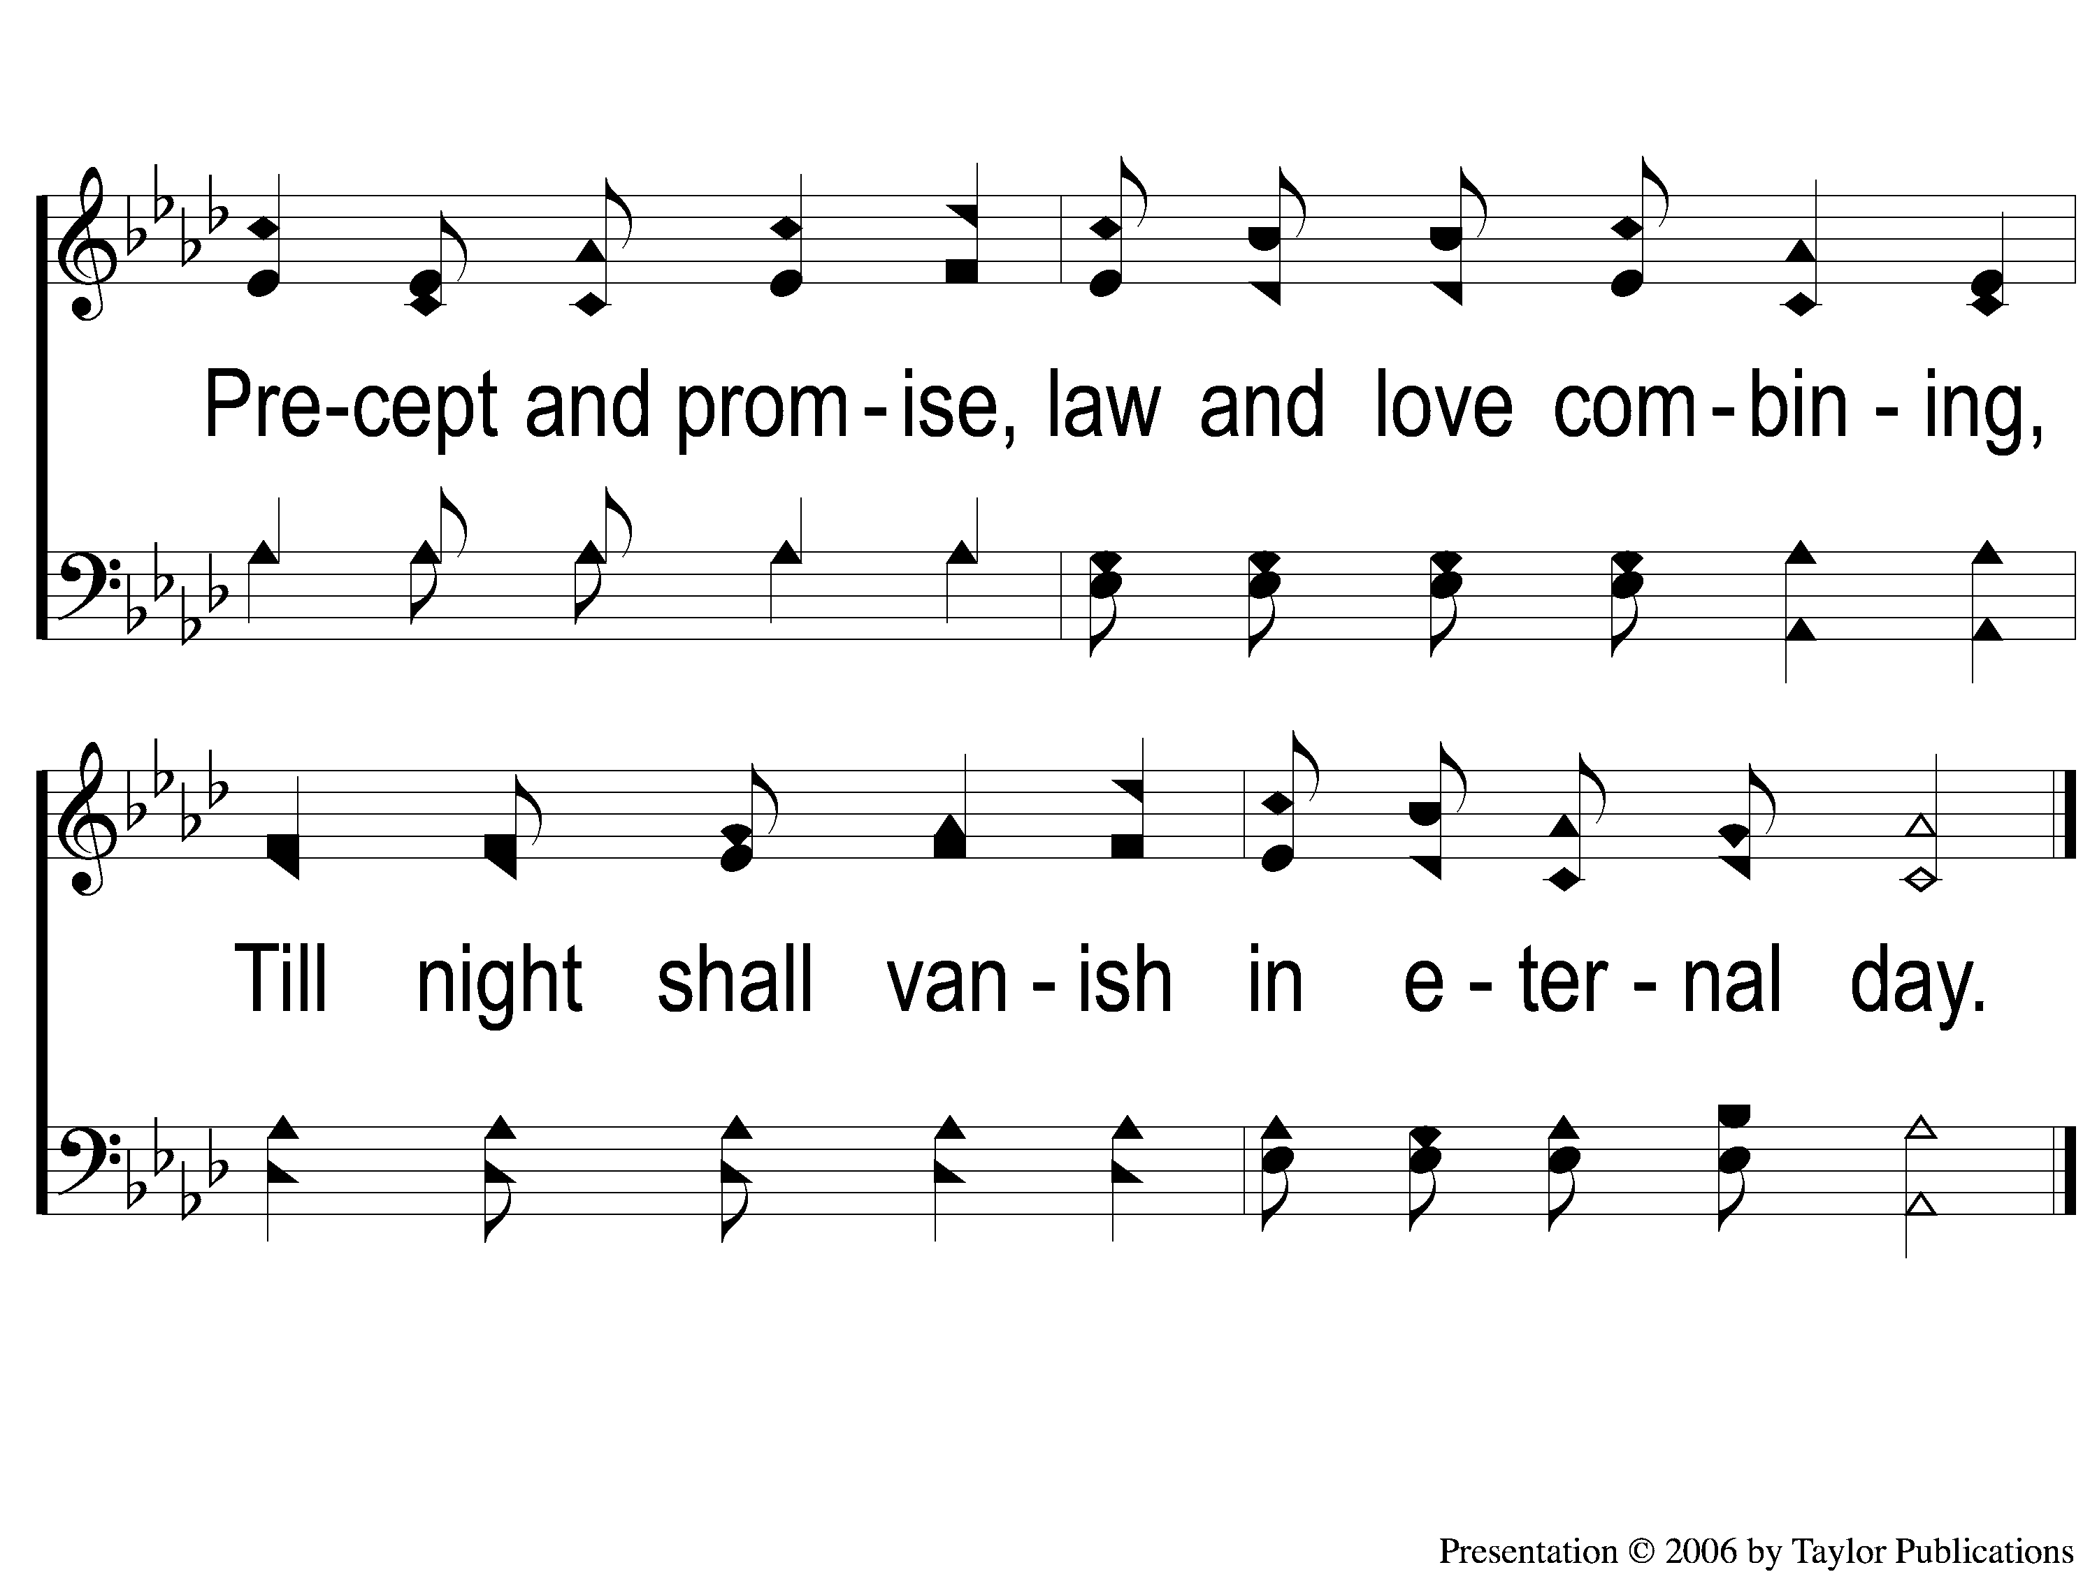
C-2 Give Me the Bible
Give Me The Bible
450

Slide 43
2-1 Give Me the Bible
Give Me The Bible
450

Slide 44
2-2 Give Me the Bible
Give Me The Bible
450

Slide 45
C-1 Give Me the Bible
Give Me The Bible
450

Slide 46
C-2 Give Me the Bible
Give Me The Bible
450

Slide 47
3-1 Give Me the Bible
Give Me The Bible
450

Slide 48
3-2 Give Me the Bible
Give Me The Bible
450

Slide 49
C-1 Give Me the Bible
Give Me The Bible
450

Slide 50
C-2 Give Me the Bible
Give Me The Bible
450

Slide 51
#622
SONG:
Ring Out The Message

Slide 52
1-1 Ring Out the Message
Ring Out the Message
622

Slide 53
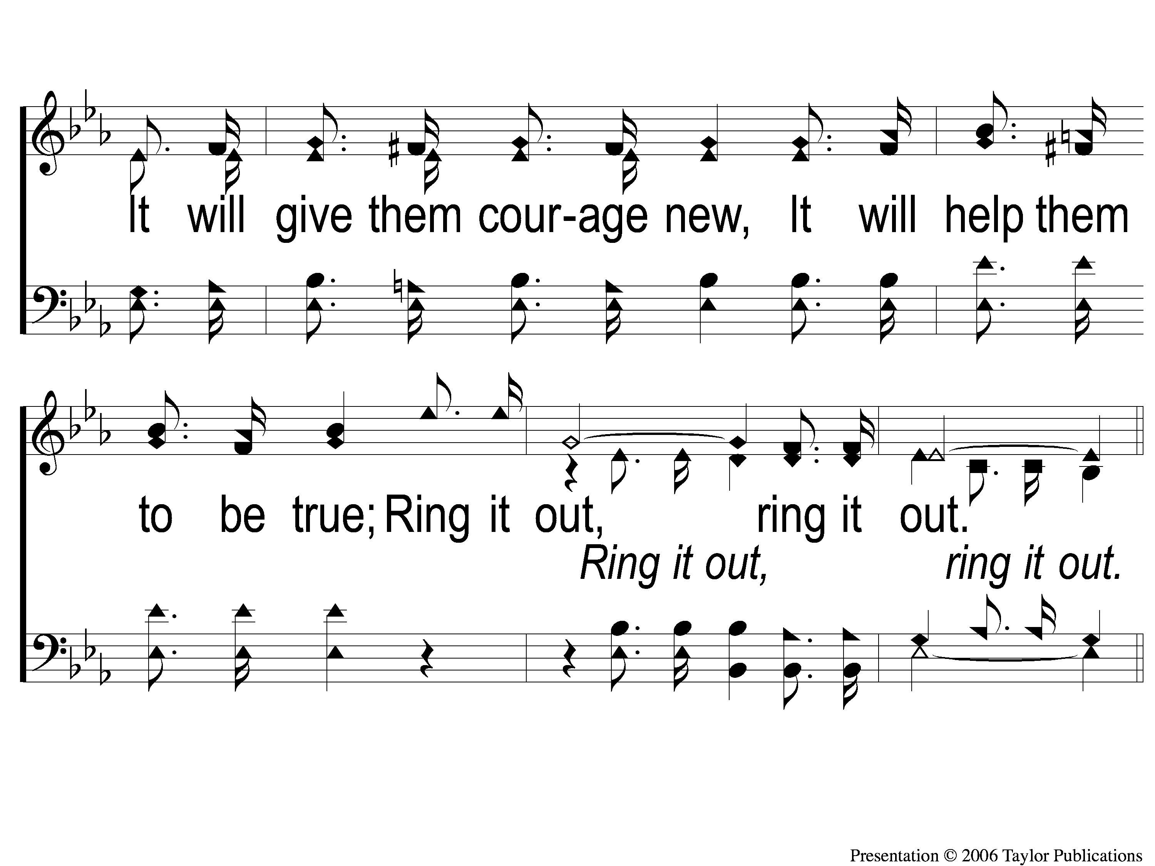
1-2 Ring Out the Message
Ring Out the Message
622

Slide 54
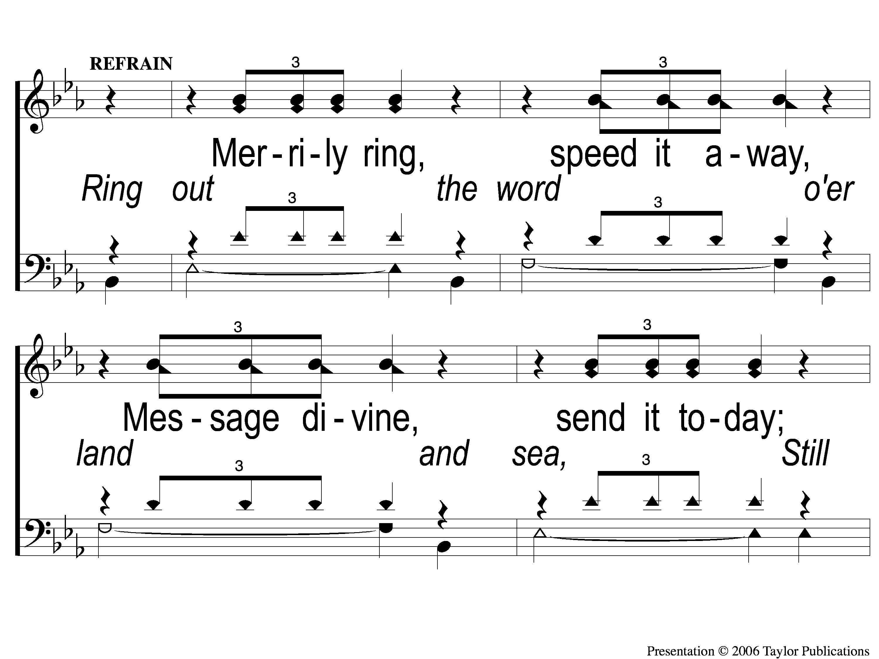
C-1 Ring Out the Message
Ring Out the Message
622

Slide 55
C-2 Ring Out the Message
Ring Out the Message
622

Slide 56
C-3 Ring Out the Message
Ring Out the Message
622

Slide 57
C-4 Ring Out the Message
Ring Out the Message
622

Slide 58
3-1 Ring Out the Message
Ring Out the Message
622

Slide 59
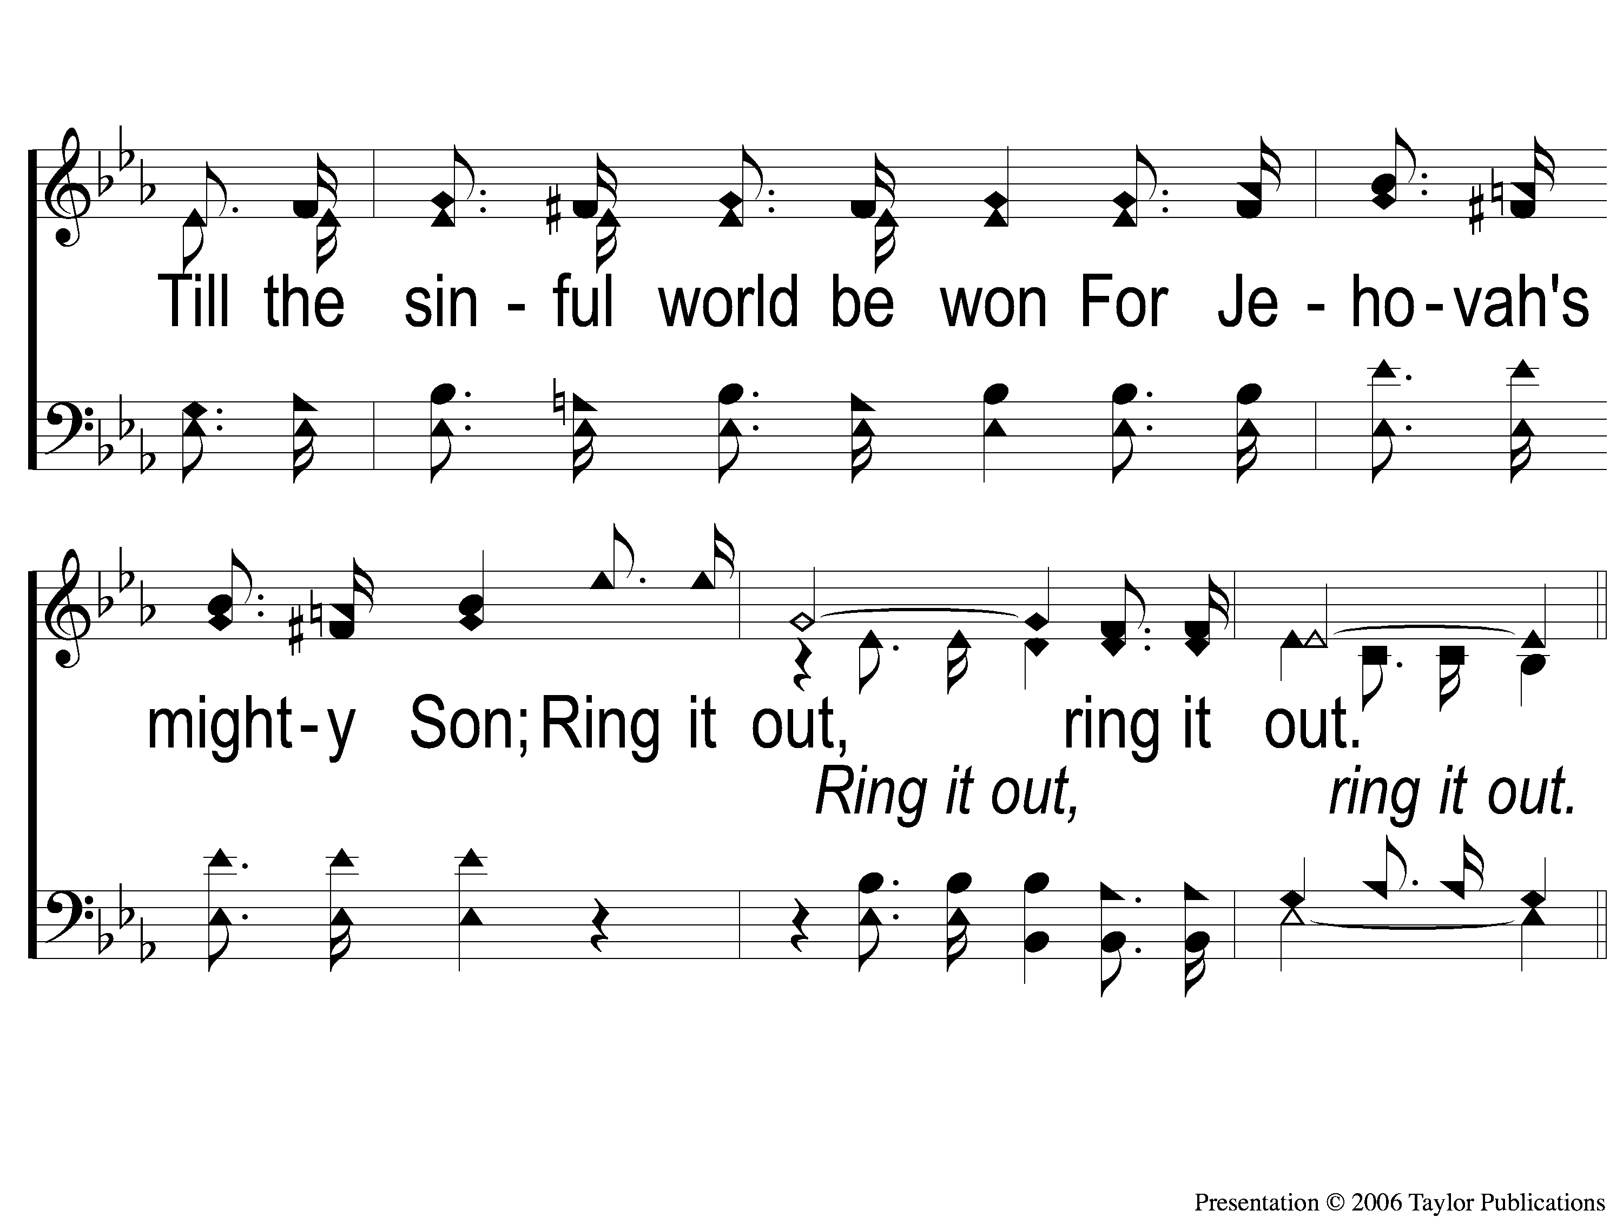
3-2 Ring Out the Message
Ring Out the Message
622

Slide 60
C-1 Ring Out the Message
Ring Out the Message
622

Slide 61
C-2 Ring Out the Message
Ring Out the Message
622

Slide 62
C-3 Ring Out the Message
Ring Out the Message
622

Slide 63
C-4 Ring Out the Message
Ring Out the Message
622

Slide 64
SCRIPTURE:
Mark 5:1-6

Slide 65
Stand out!

Slide 66
Case Study: zacchaeus
Luke 19:1-10

Slide 67
Case Study:
a demon-possessed man
Mark 5:1-20

Slide 68
The gospels
Matthew – Jewish
Luke – Gentile
John – Gnostic
Mark – Roman

Slide 69
Keywords:
“Say / Tell / Speak”
Lego – 207 times
Eipon – 101 times
Kerusso – 14 times

Slide 70
Jesus has power over:
Storms (4:35-41)
Spirits (5:1-20)
Sickness (5:21-43)

Slide 71
Mark chapter 5
Standing Out Improperly(v. 1-5)
Meeting Jesus (v. 6-13)
Standing Out Properly (v. 14-20)

Slide 72
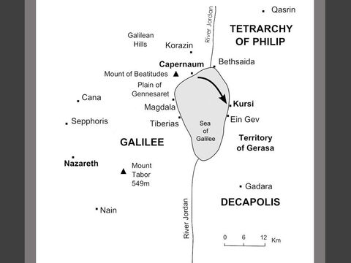
Mark 5:1

Slide 73
Mark 5:1

Slide 74
Mark 5:1

Slide 75
Mark 5:1

Slide 76
Standing out improperly
The Man (v. 2-5)

Slide 77
Standing out improperly
The Man (v. 2-5)
Lived “among the tombs”
“Could not be bound”

Slide 78
Meeting Jesus
When the man saw Jesus (v. 6)

Slide 79
Meeting Jesus
When the man saw Jesus (v. 6)
“He Ran” to Jesus
He Worshiped Jesus

Slide 80
Meeting Jesus
When the man met Jesus (v. 7-13)

Slide 81
Meeting Jesus
When the man met Jesus (v. 7-13)
The demons were sent out
The man was made clean

Slide 82
Standing out properly
Two Different Pleas (v. 14-20)
Plea of the Crowd (v. 14-17)
Plea of the Man (v. 18-20)

Slide 83
Standing out properly
The Plea of the Crowd (v. 14-17)

Slide 84
Standing out properly
The Plea of the Crowd (v. 14-17)
They begged Jesus to leave! (v. 17)

Slide 85
Standing out properly
The Plea of the Crowd (v. 14-17)
They begged Jesus to leave! (v. 17)
Jesus granted their request (v. 18)

Slide 86
Standing out properly
The Plea of the Man (v. 18)

Slide 87
Standing out properly
The Plea of the Man (v. 18)
Begged Jesus to stay with him!

Slide 88
Standing out properly
The Plea of the Man (v. 18)
Begged Jesus to stay with him!
Jesus did not stay (v. 19a)

Slide 89
Standing out properly
The Command from Jesus (v. 19-20)

Slide 90
Standing out properly
The Command from Jesus (v. 19-20)
“Go Home…”

Slide 91
Standing out properly
The Command from Jesus (v. 19-20)
“Go Home…”
“…And Tell”

Slide 92
Standing out properly
The Command from Jesus (v. 19-20)
“Go Home…”
“…And Tell”
Matt. 28:18-20

Slide 93
Standing out properly
What did he do?

Slide 94
Standing out properly
What did he do?
He proclaimed the Gospel

Slide 95
Standing out properly
What did he do?
He proclaimed the Gospel
He went outside his comfort zone

Slide 96
Standing out properly
What did he do?
He proclaimed the Gospel
He went outside his comfort zone
He told every detail – Acts 20:27

Slide 97
Standing out properly
What was the result?
“all marveled” (v. 20)
James 2:19

Slide 98
What is your reaction to Jesus?

Slide 99
#948
SONG:
I Am Resolved

Slide 100
1-1 I Am Resolved
I Am Resolved
948

Slide 101
1-2 I Am Resolved
I Am Resolved
948

Slide 102
C-1 I Am Resolved
I Am Resolved
948

Slide 103
C-2 I Am Resolved
I Am Resolved
948

Slide 104
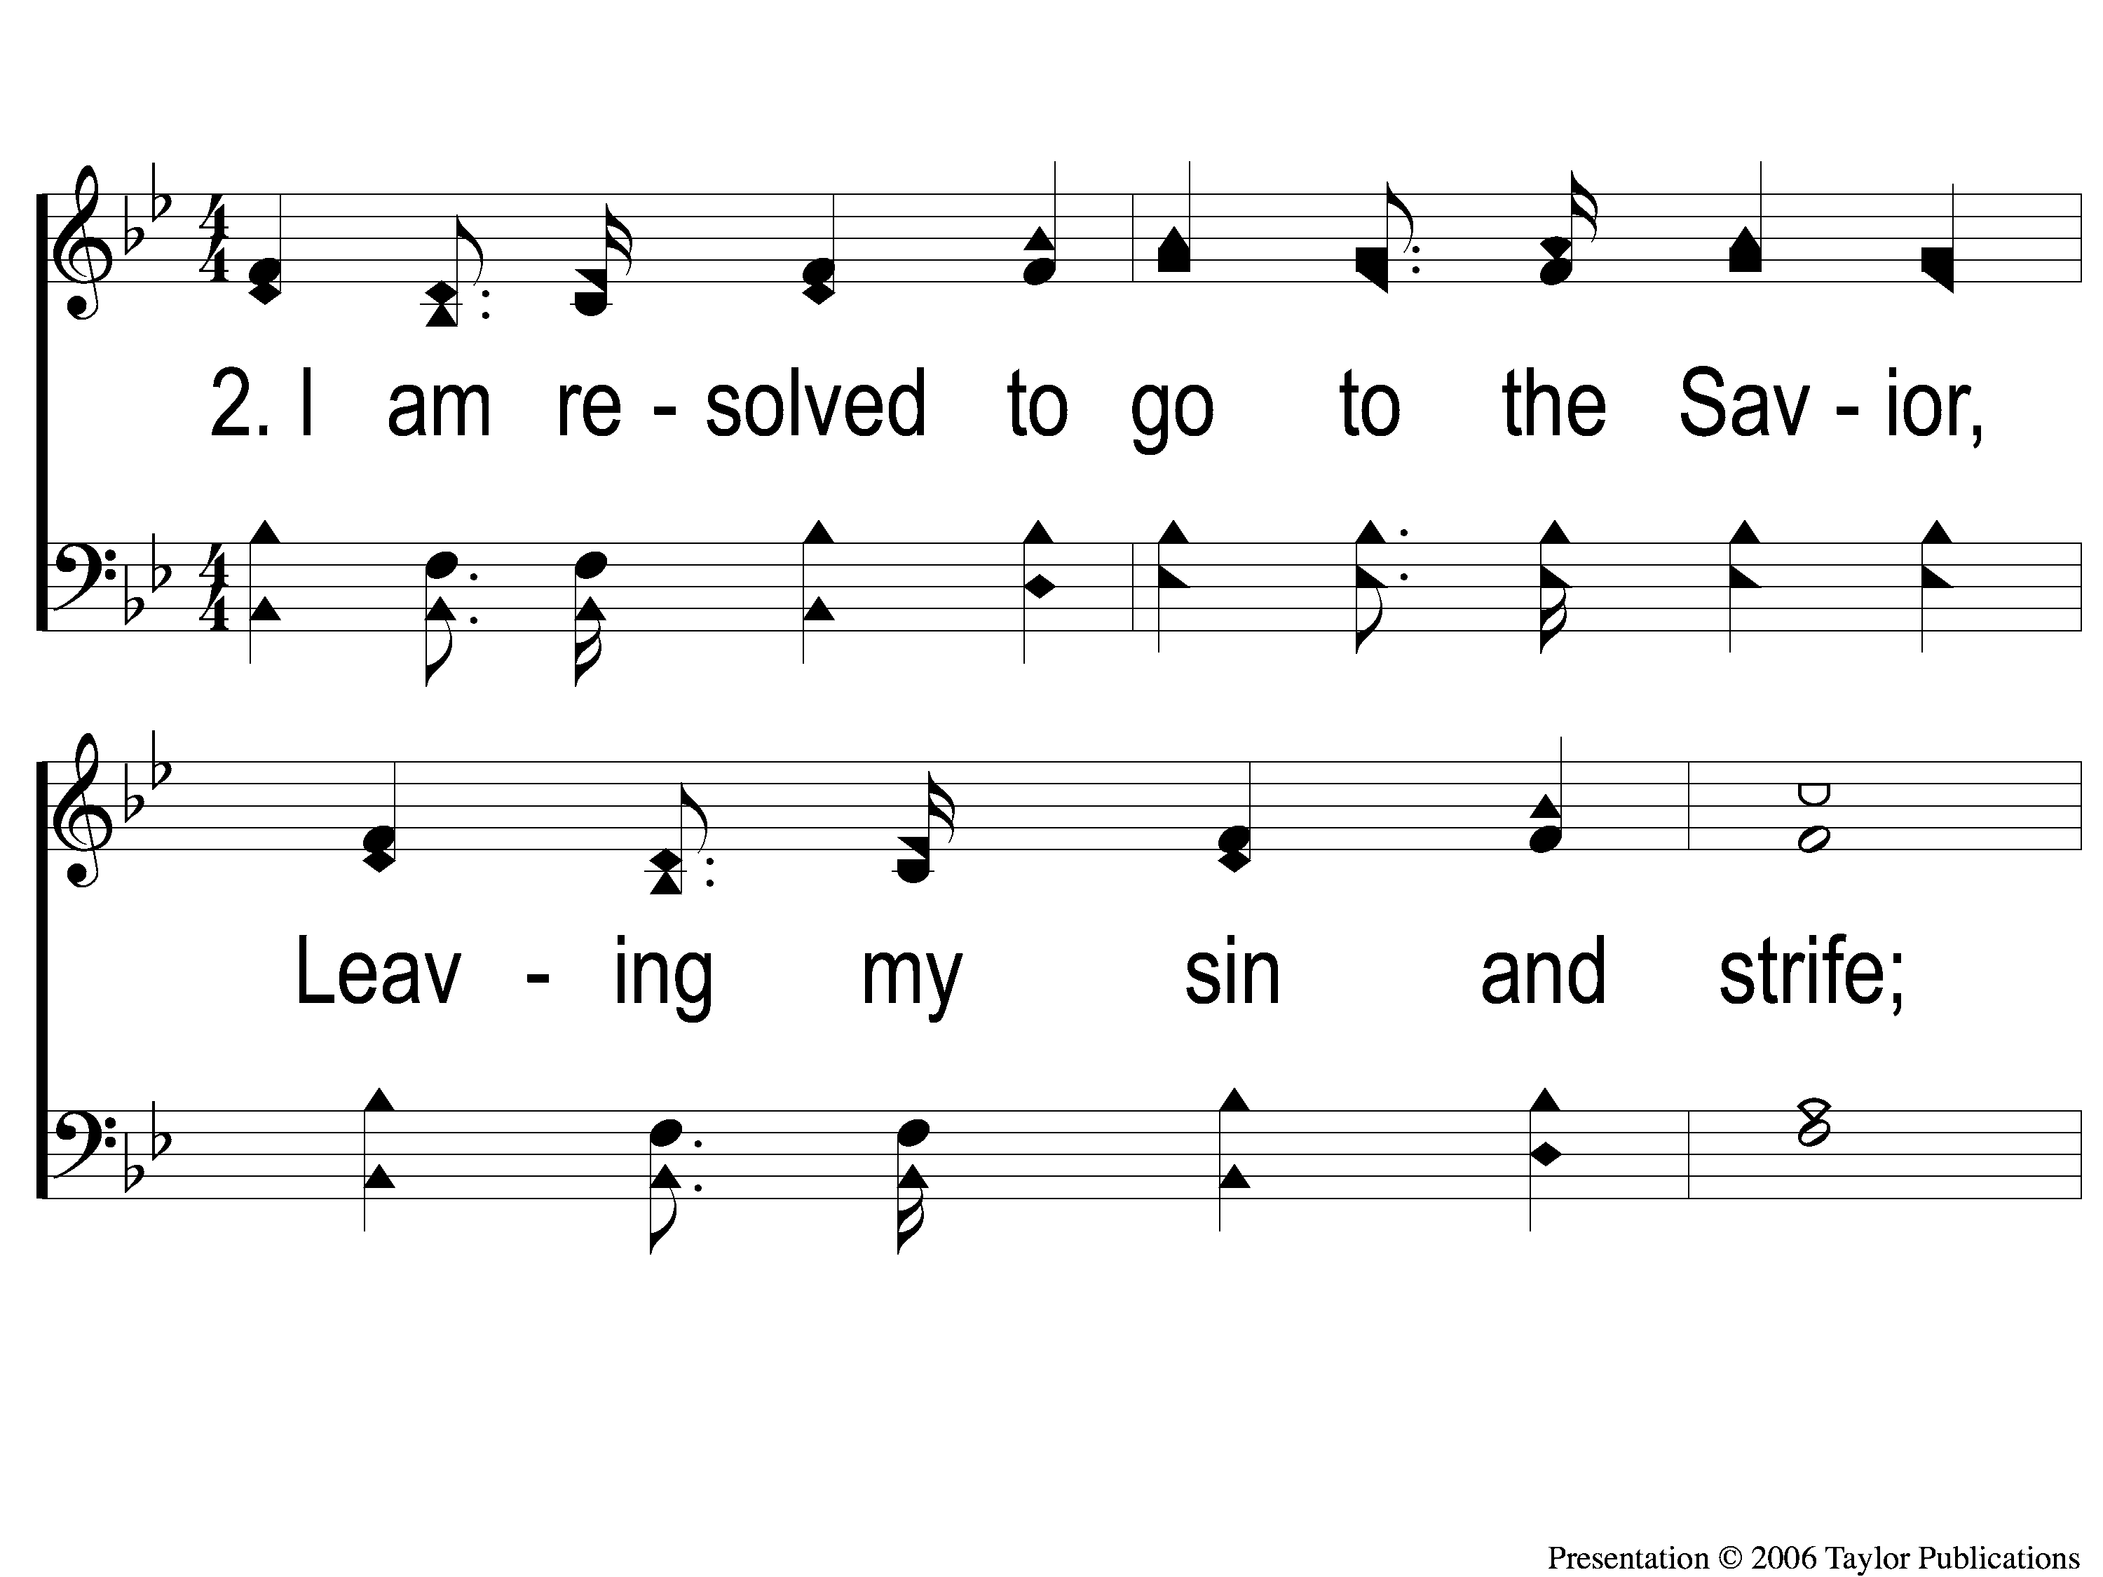
2-1 I Am Resolved
I Am Resolved
948

Slide 105
2-2 I Am Resolved
I Am Resolved
948

Slide 106
C-1 I Am Resolved
I Am Resolved
948

Slide 107
C-2 I Am Resolved
I Am Resolved
948

Slide 108
4-1 I Am Resolved
I Am Resolved
948

Slide 109
4-2 I Am Resolved
I Am Resolved
948

Slide 110
C-1 I Am Resolved
I Am Resolved
948

Slide 111
C-2 I Am Resolved
I Am Resolved
948

Slide 112
#382
SONG:
Why Did My Savior Come To Earth?

Slide 113
1-1 Why Did My Savior Come to Earth?
Why Did My Savior Come to Earth?
382

Slide 114
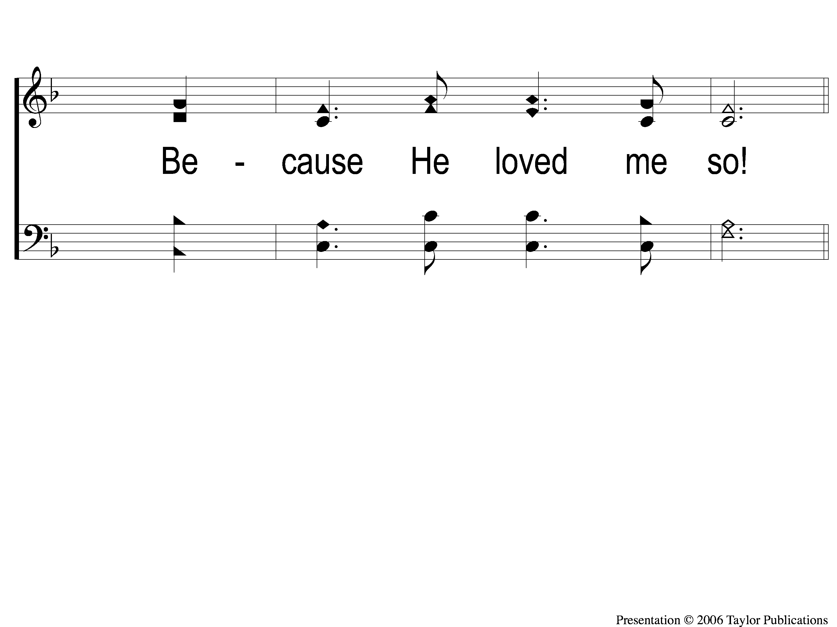
1-2 Why Did My Savior Come to Earth?
Why Did My Savior Come to Earth?
382

Slide 115
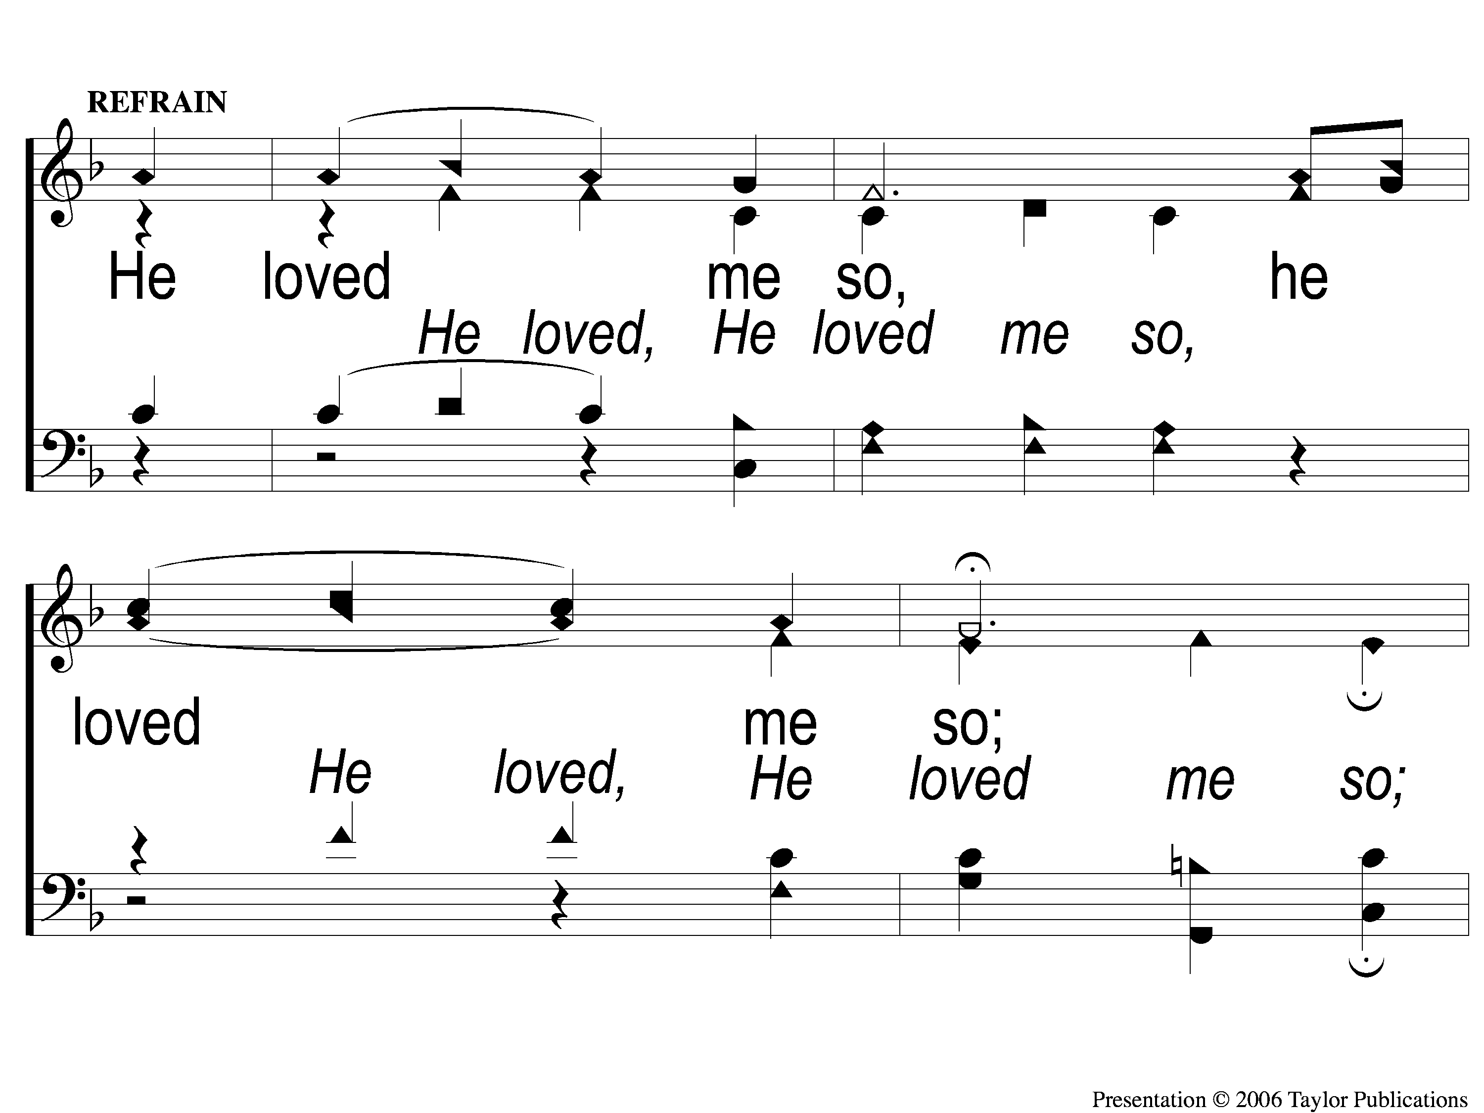
C-1 Why Did My Savior Come to Earth?
Why Did My Savior Come to Earth?
382

Slide 116
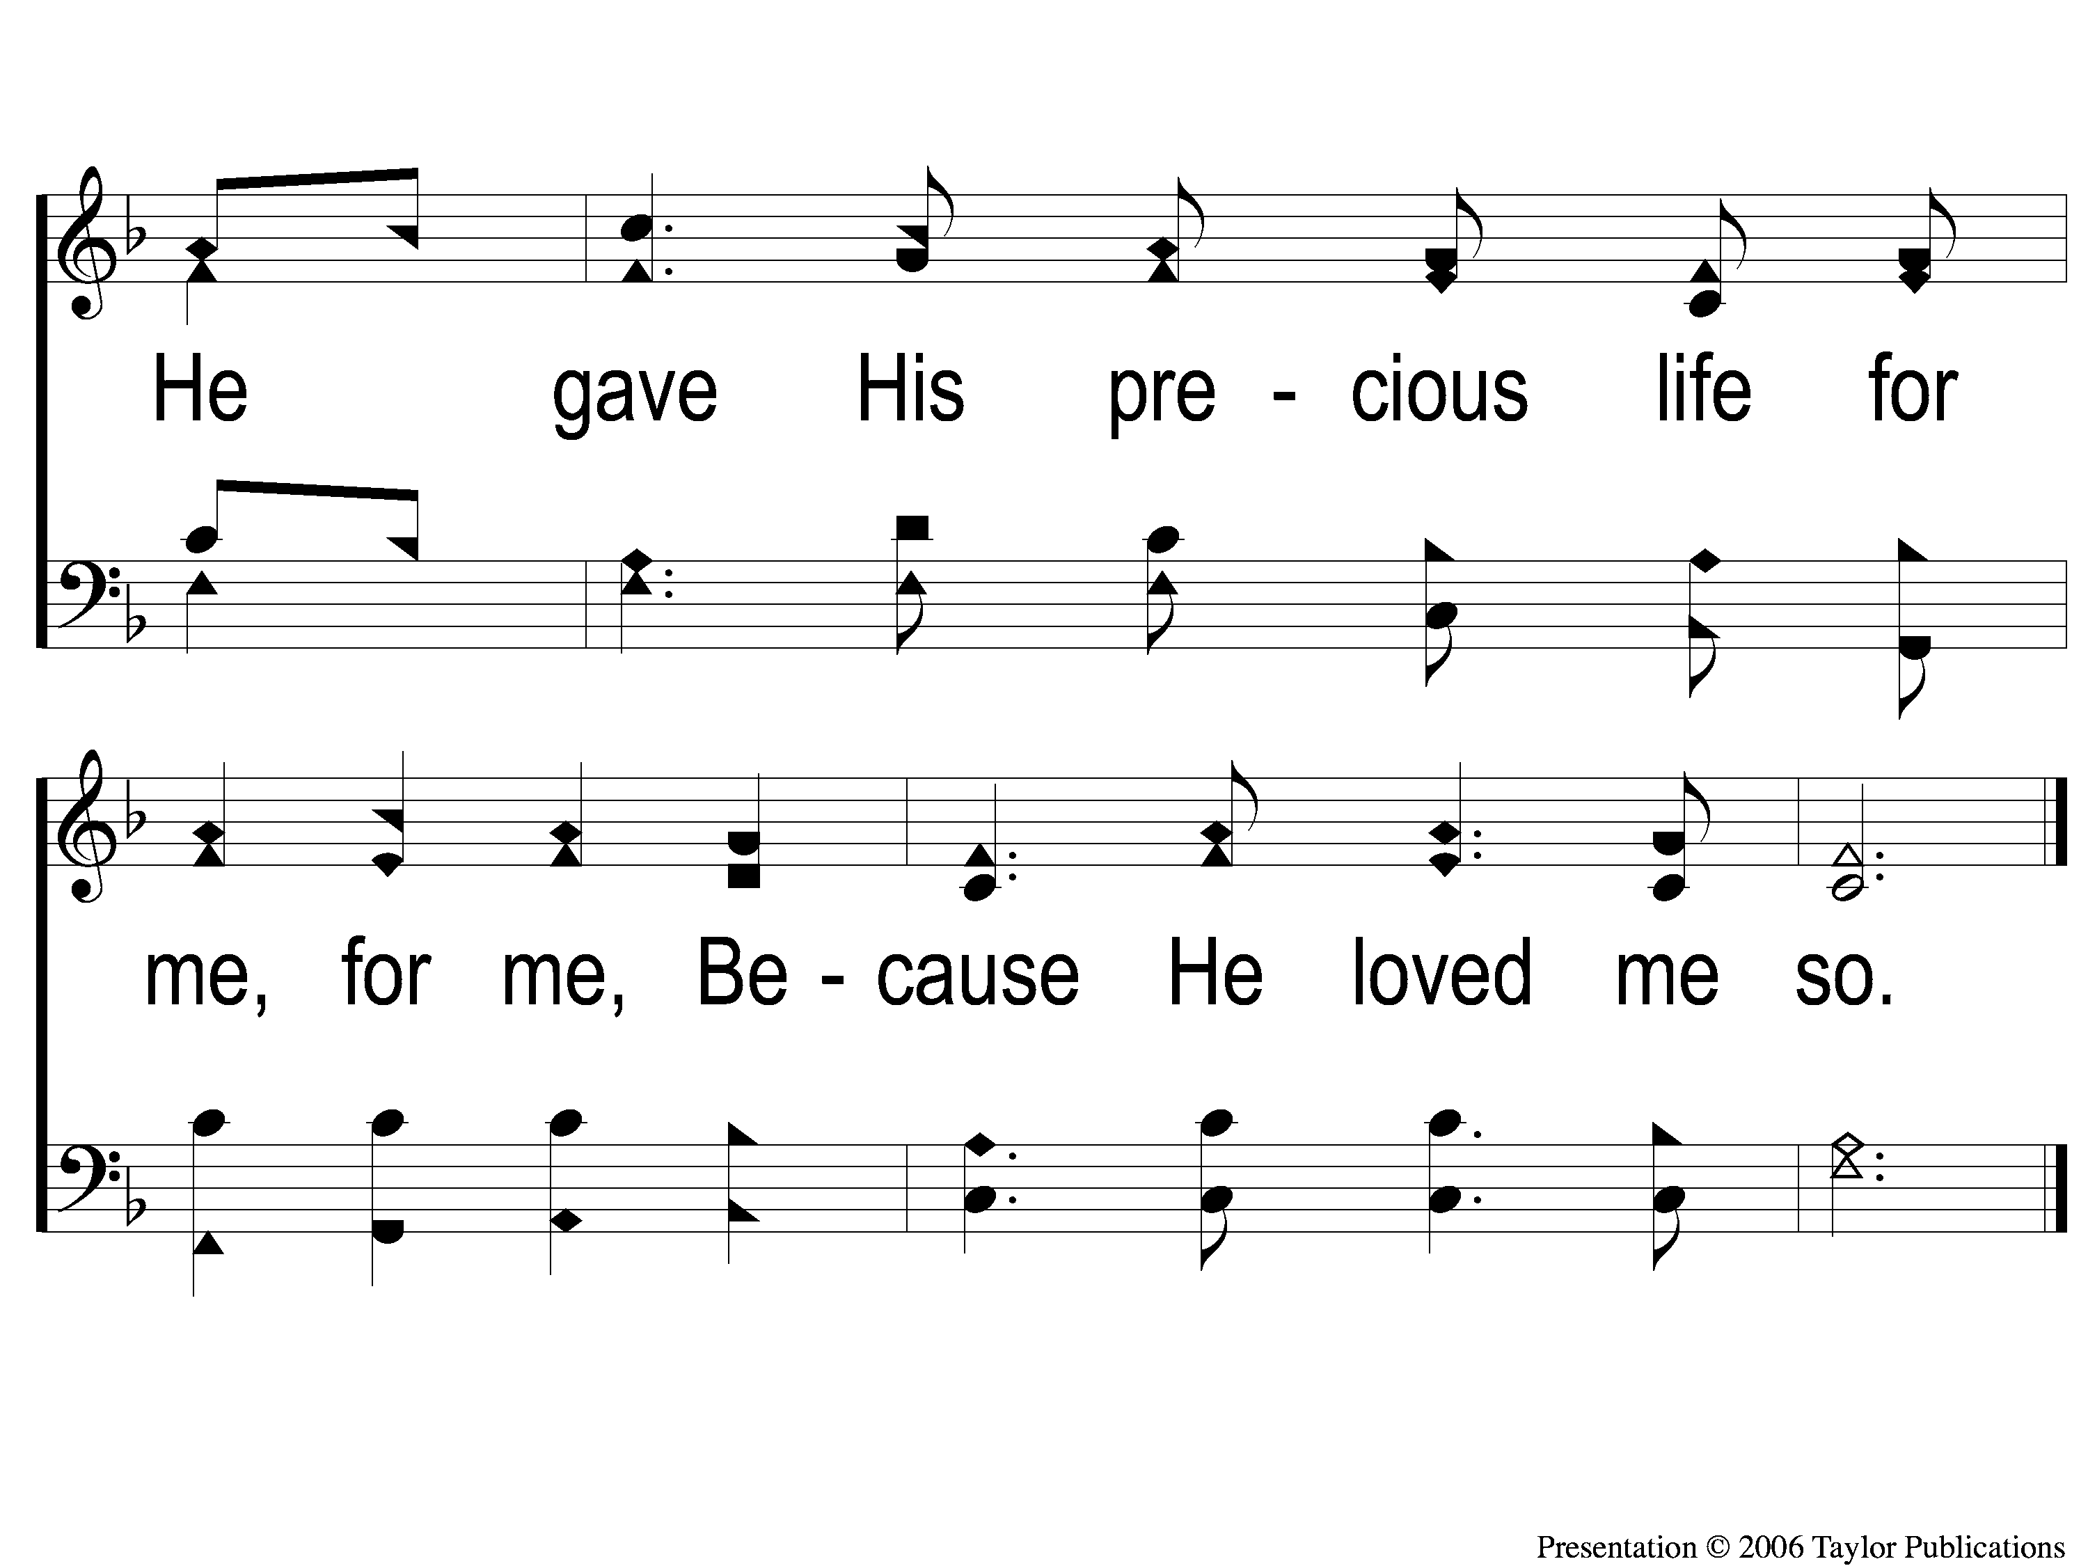
C-2 Why Did My Savior Come to Earth?
Why Did My Savior Come to Earth?
382

Slide 117
2-1 Why Did My Savior Come to Earth?
Why Did My Savior Come to Earth?
382

Slide 118
2-2 Why Did My Savior Come to Earth?
Why Did My Savior Come to Earth?
382

Slide 119
C-1 Why Did My Savior Come to Earth?
Why Did My Savior Come to Earth?
382

Slide 120
C-2 Why Did My Savior Come to Earth?
Why Did My Savior Come to Earth?
382

Slide 121
3-1 Why Did My Savior Come to Earth?
Why Did My Savior Come to Earth?
382

Slide 122
3-2 Why Did My Savior Come to Earth?
Why Did My Savior Come to Earth?
382

Slide 123
C-1 Why Did My Savior Come to Earth?
Why Did My Savior Come to Earth?
382

Slide 124
C-2 Why Did My Savior Come to Earth?
Why Did My Savior Come to Earth?
382

Slide 125
LORD’S SUPPER
The
Acts 20:7

Slide 126
Unleavened Bread
LORD’S SUPPER
²³ Then He said to them all, “If anyone desires to come after Me, let him deny himself, and take up his cross daily, and follow Me. ²⁴ For whoever desires to save his life will lose it, but whoever loses his life for My sake will save it.
.
Luke 9:23-24

Slide 127
Fruit of the Vine
LORD’S SUPPER
²⁵ For what profit is it to a man if he gains the whole world, and is himself destroyed or lost? ²⁶ For whoever is ashamed of Me and My words, of him the Son of Man will be ashamed when He comes in His own glory, and in His Father’s, and of the holy angels.
Luke 9:25-26

Slide 128
Luke 12:15
OFFERING
¹⁵ And He said to them, “Take heed and beware of covetousness, for one’s life does not consist in the abundance of the things he possesses.”

Slide 129
Closing PRAYER

Slide 130
#448
SONG:
The Greatest Command

Slide 131
1-1 The Greatest Commands-SFP
The Greatest Commands
448

Slide 132
1-2 The Greatest Commands-SFP
The Greatest Commands
448

Slide 133
1-3 The Greatest Commands-SFP
The Greatest Commands
448

Slide 134
1-4 The Greatest Commands-SFP
The Greatest Commands
448

Slide 135
2-1 The Greatest Commands-SFP
The Greatest Commands
448

Slide 136
2-2 The Greatest Commands-SFP
The Greatest Commands
448

Slide 137
2-3 The Greatest Commands-SFP
The Greatest Commands
448

Slide 138
2-4 The Greatest Commands-SFP
The Greatest Commands
448

Slide 139
3-1 The Greatest Commands-SFP
The Greatest Commands
448

Slide 140
3-2 The Greatest Commands-SFP
The Greatest Commands
448

Slide 141
3-3 The Greatest Commands-SFP
The Greatest Commands
448

Slide 142
3-4 The Greatest Commands-SFP
The Greatest Commands
448

Slide 143
4-1 The Greatest Commands-SFP
The Greatest Commands
448

Slide 144
4-2 The Greatest Commands-SFP
The Greatest Commands
448

Slide 145
4-3 The Greatest Commands-SFP
The Greatest Commands
448

Slide 146
4-4 The Greatest Commands-SFP
The Greatest Commands
448

Slide 147
FELLOWSHIP MEAL
Hope You Will Stay
for the
in the
Multi-purpose Building

