Slide 1
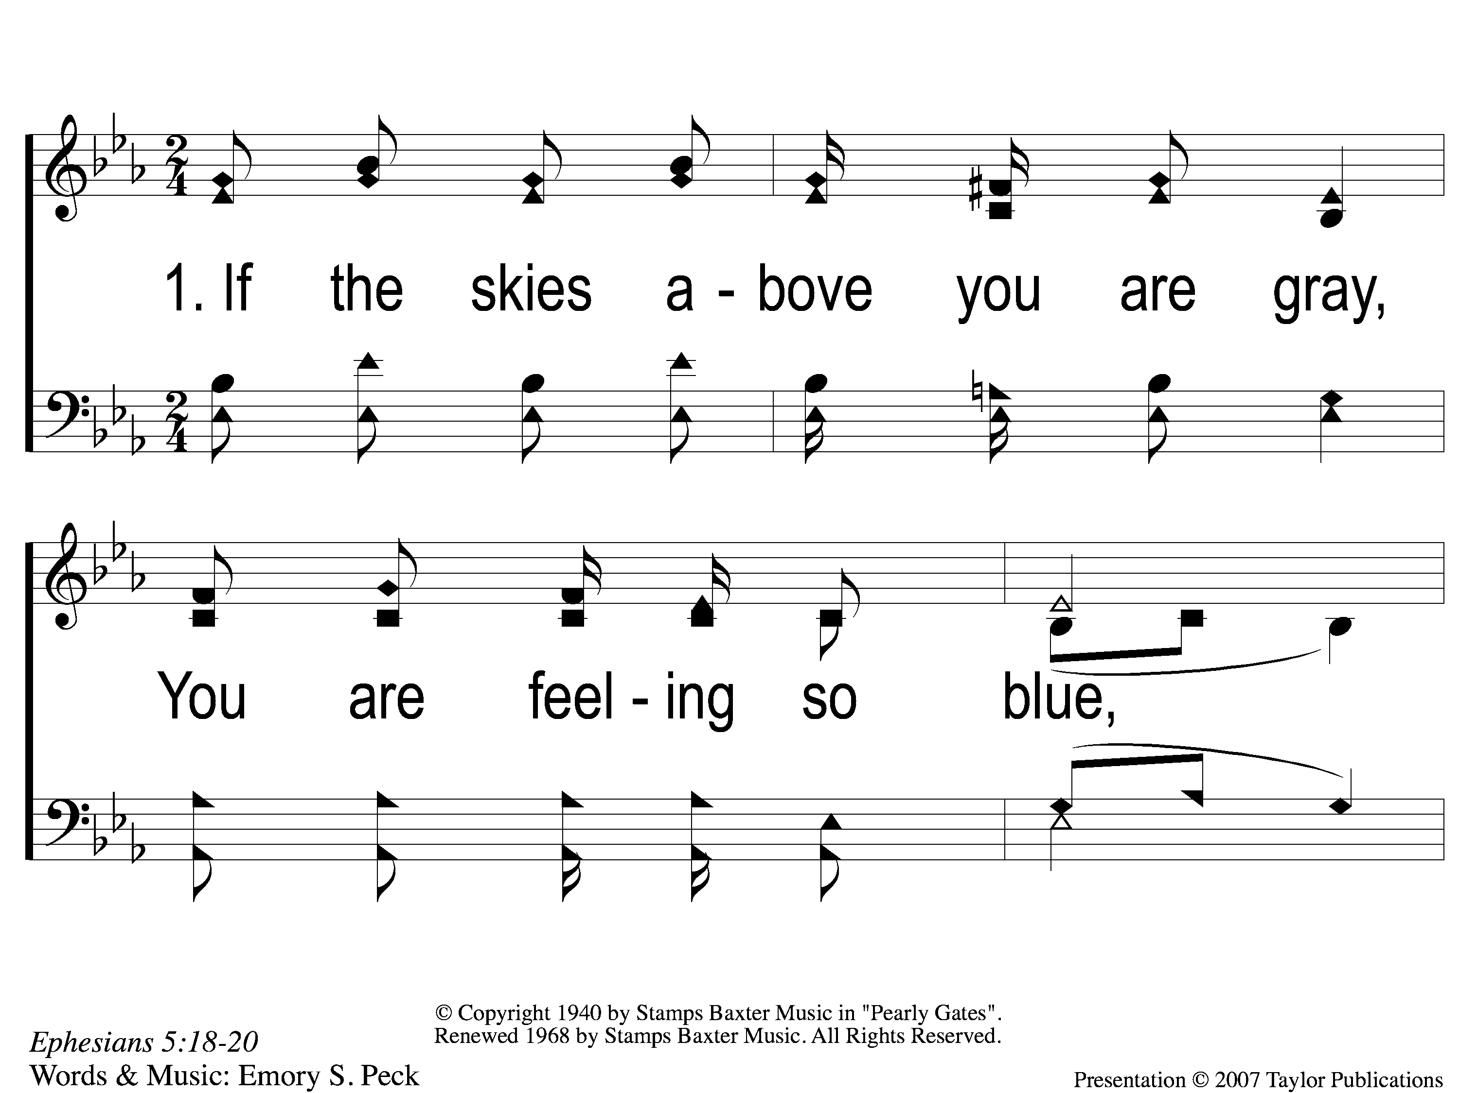
1-1 Sing and Be Happy
Sing and Be Happy
587

Slide 2
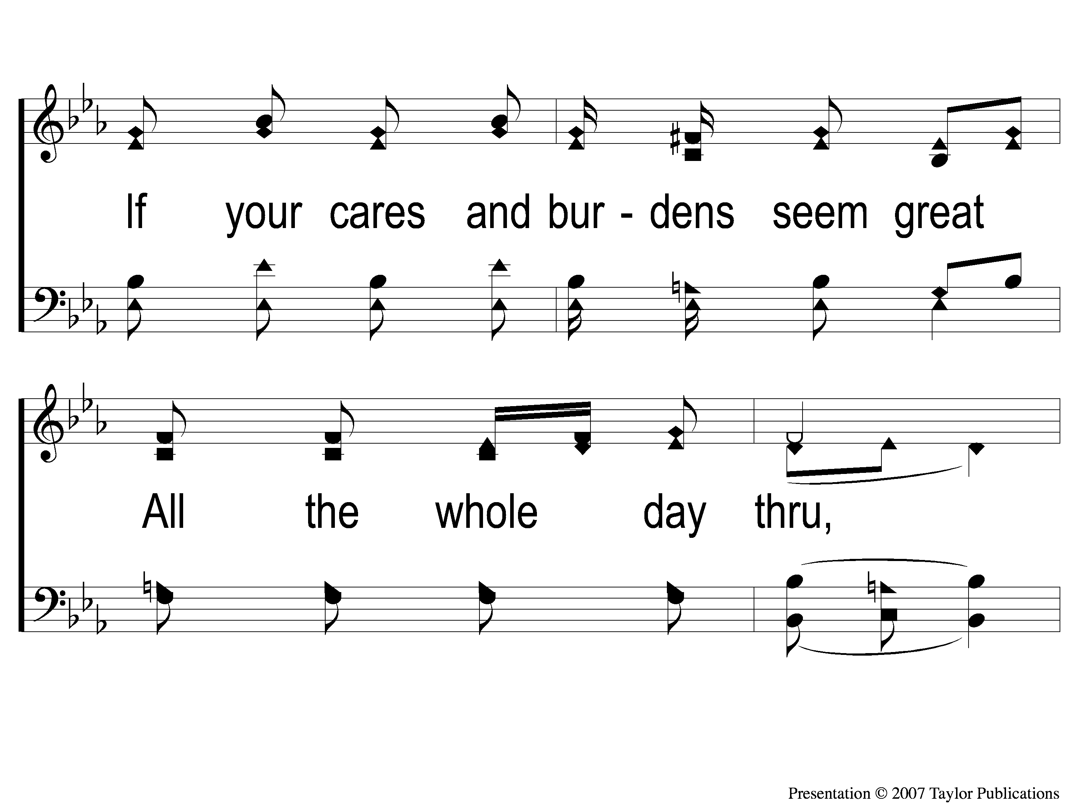
1-2 Sing and Be Happy
Sing and Be Happy
587

Slide 3
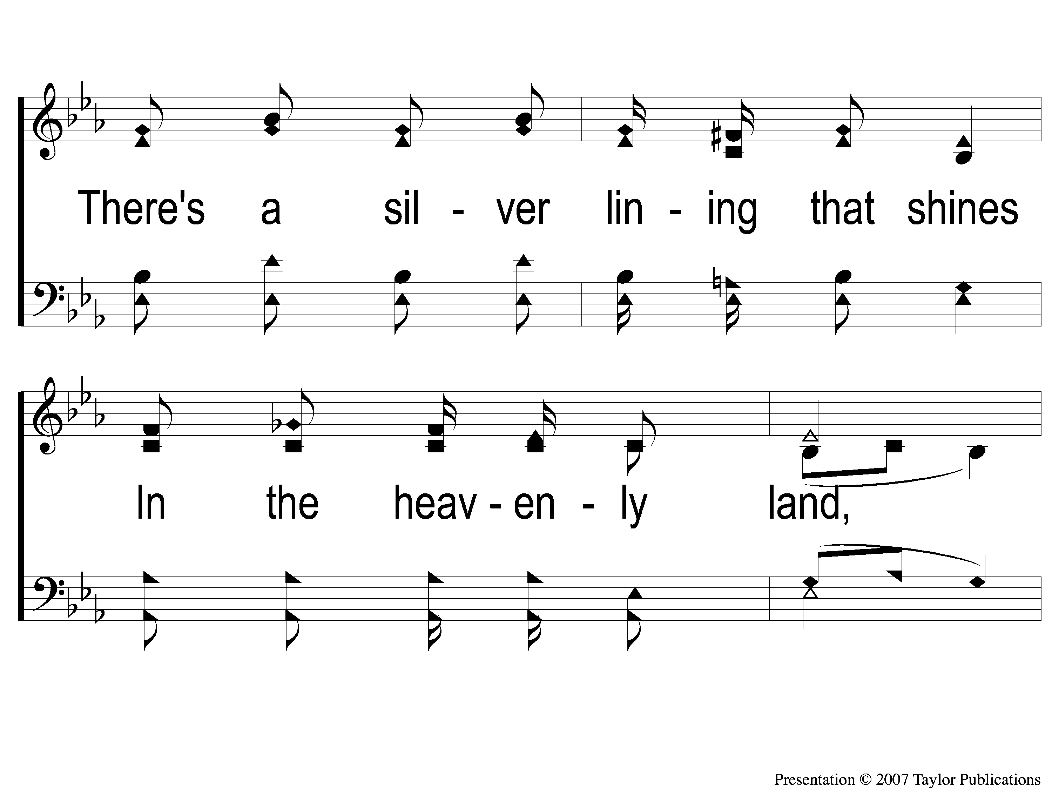
1-3 Sing and Be Happy
Sing and Be Happy
587

Slide 4
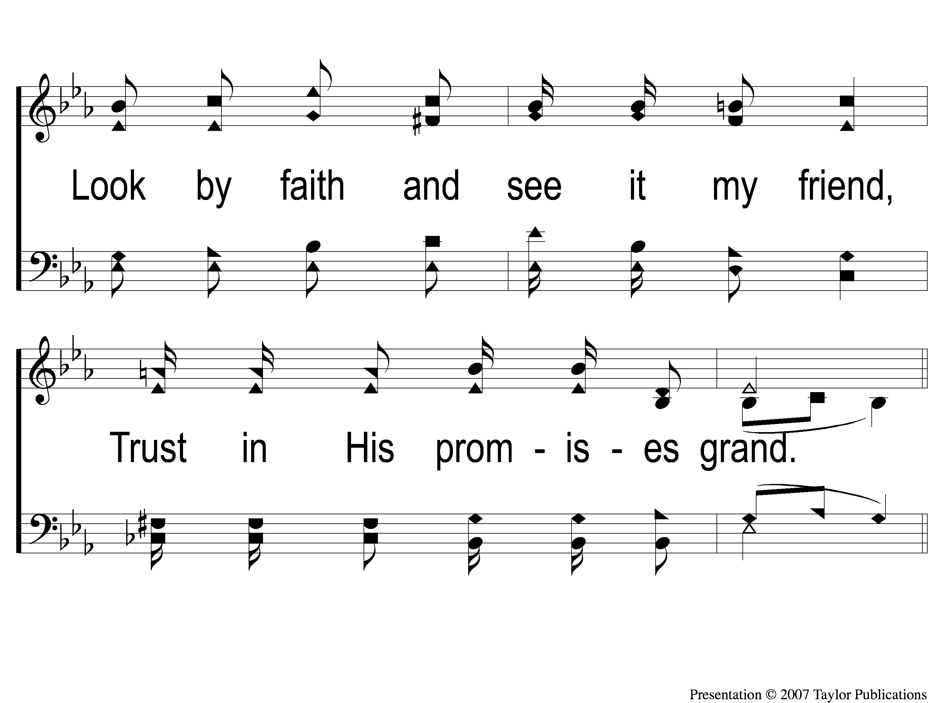
1-4 Sing and Be Happy
Sing and Be Happy
587

Slide 5
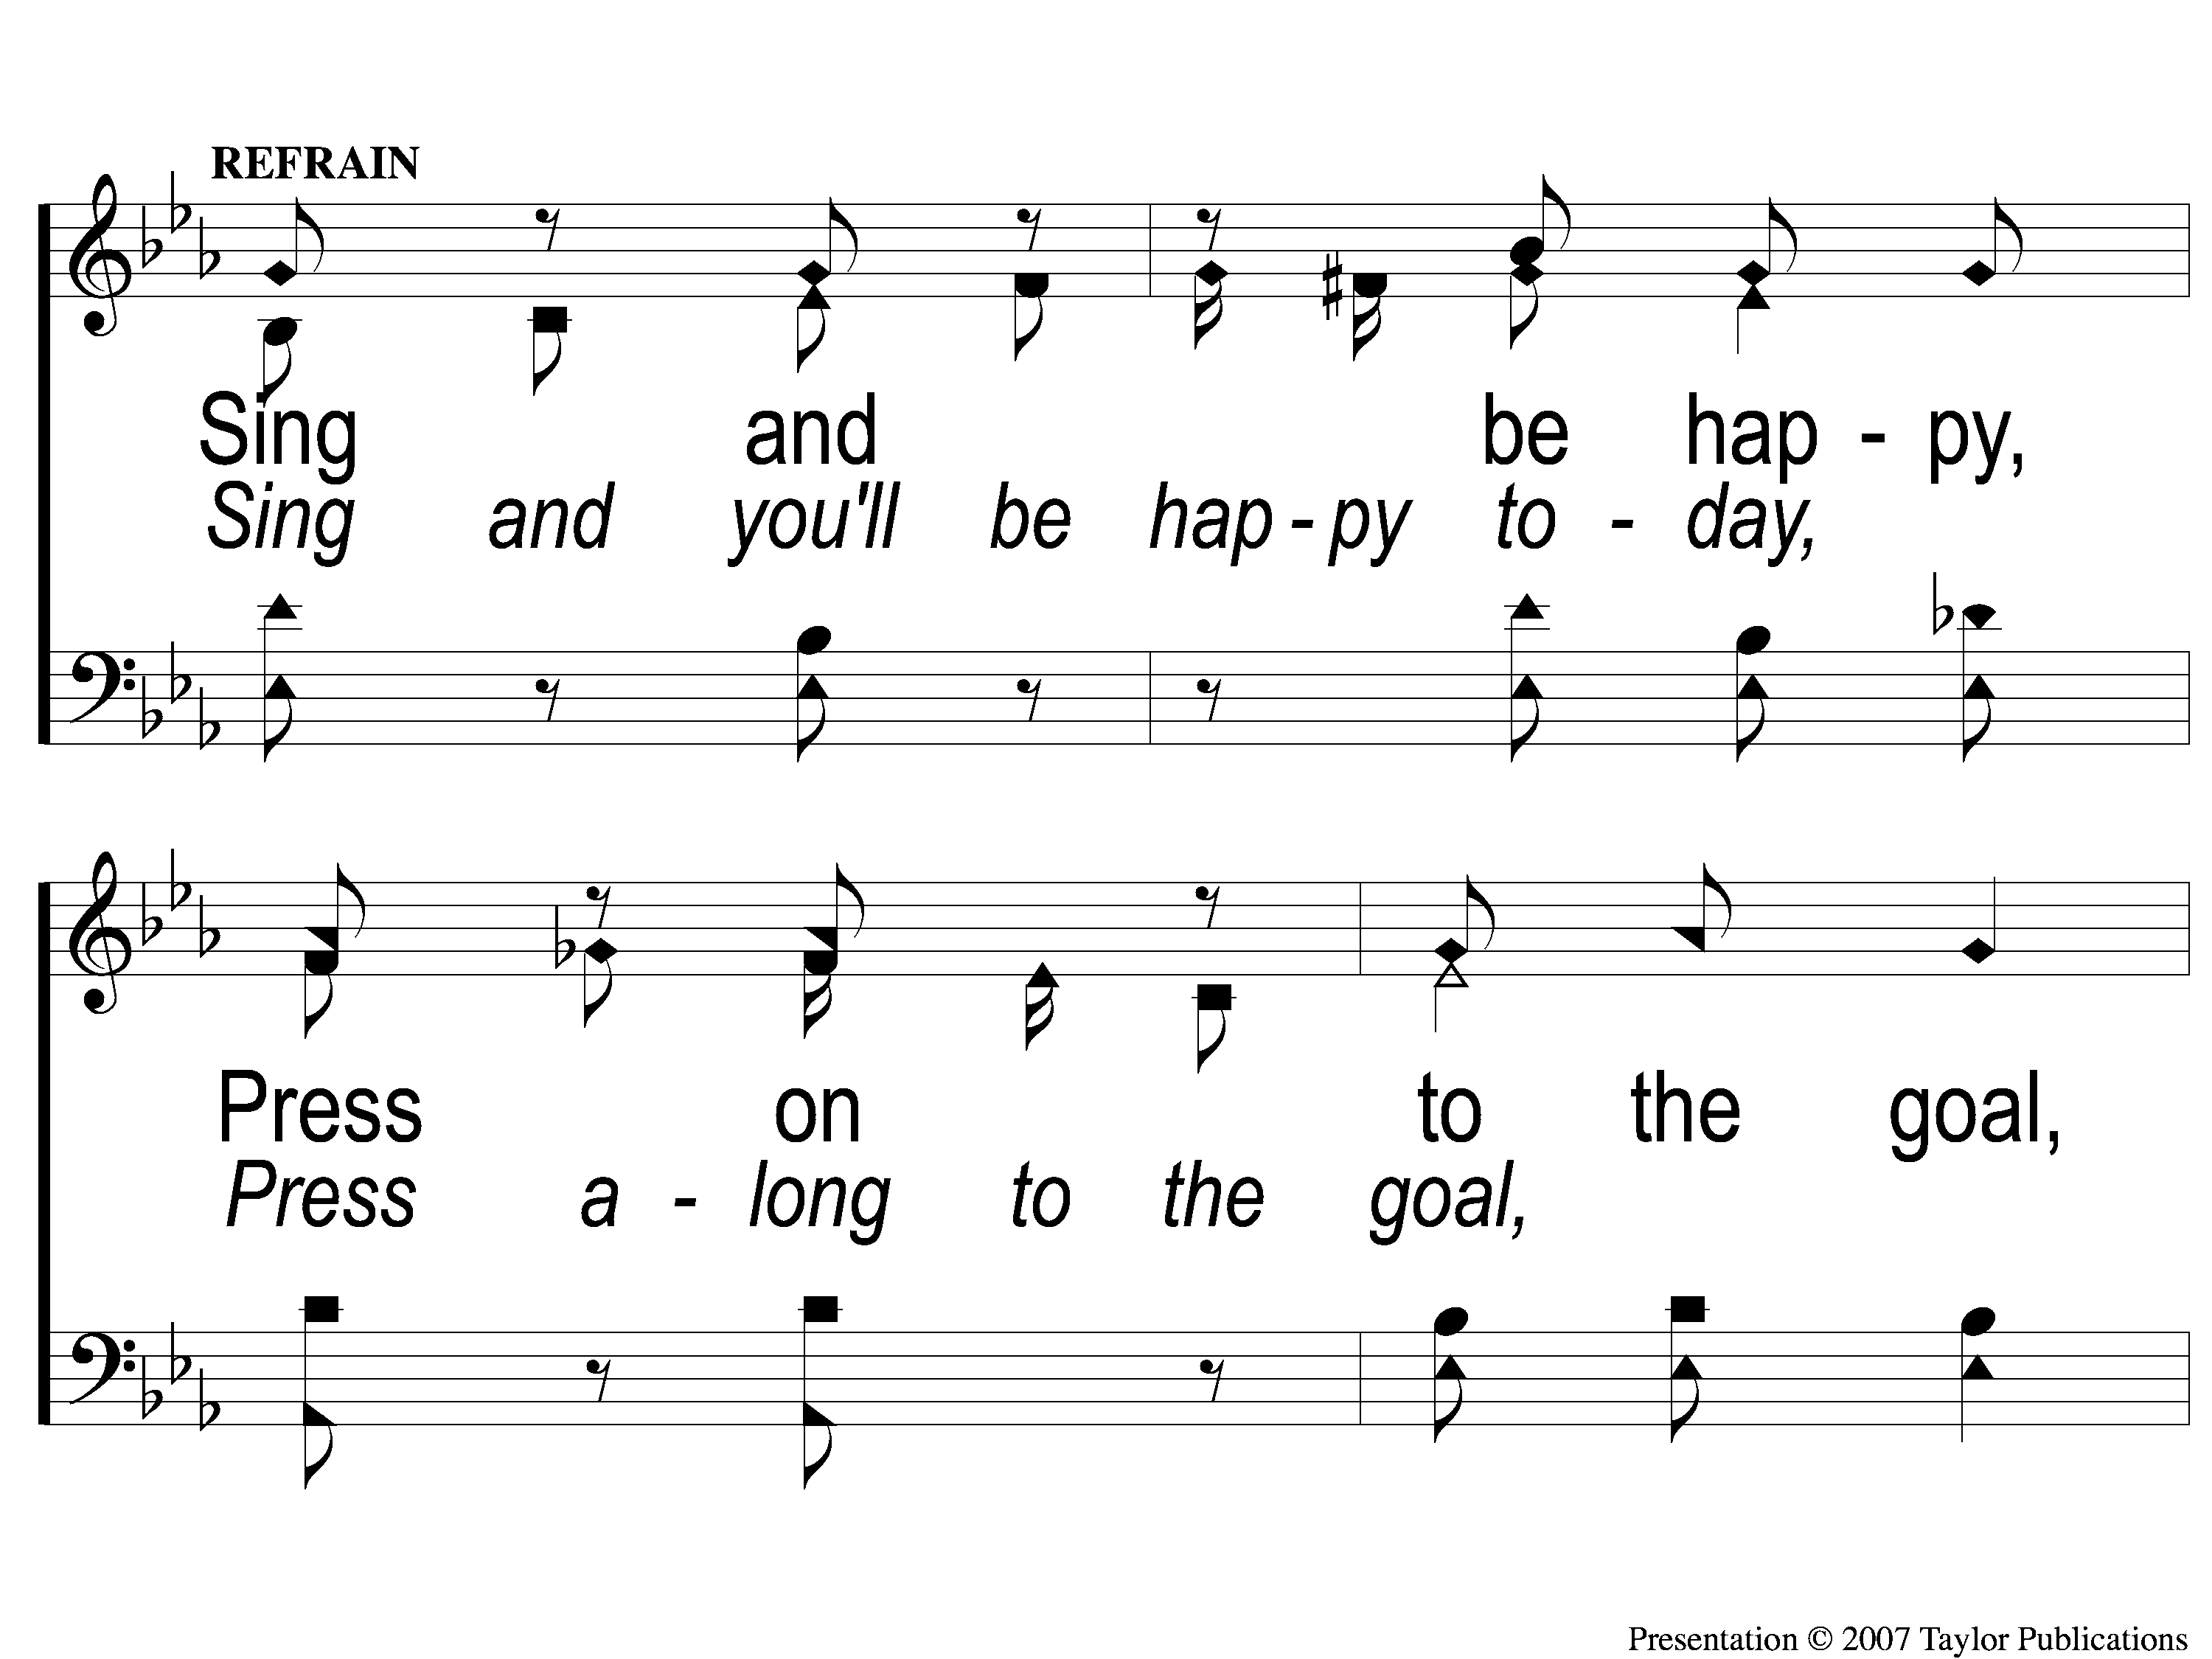
C-1 Sing and Be Happy
Sing and Be Happy
587

Slide 6
C-2 Sing and Be Happy
Sing and Be Happy
587

Slide 7
C-3 Sing and Be Happy
Sing and Be Happy
587

Slide 8
C-4 Sing and Be Happy
Sing and Be Happy
587

Slide 9
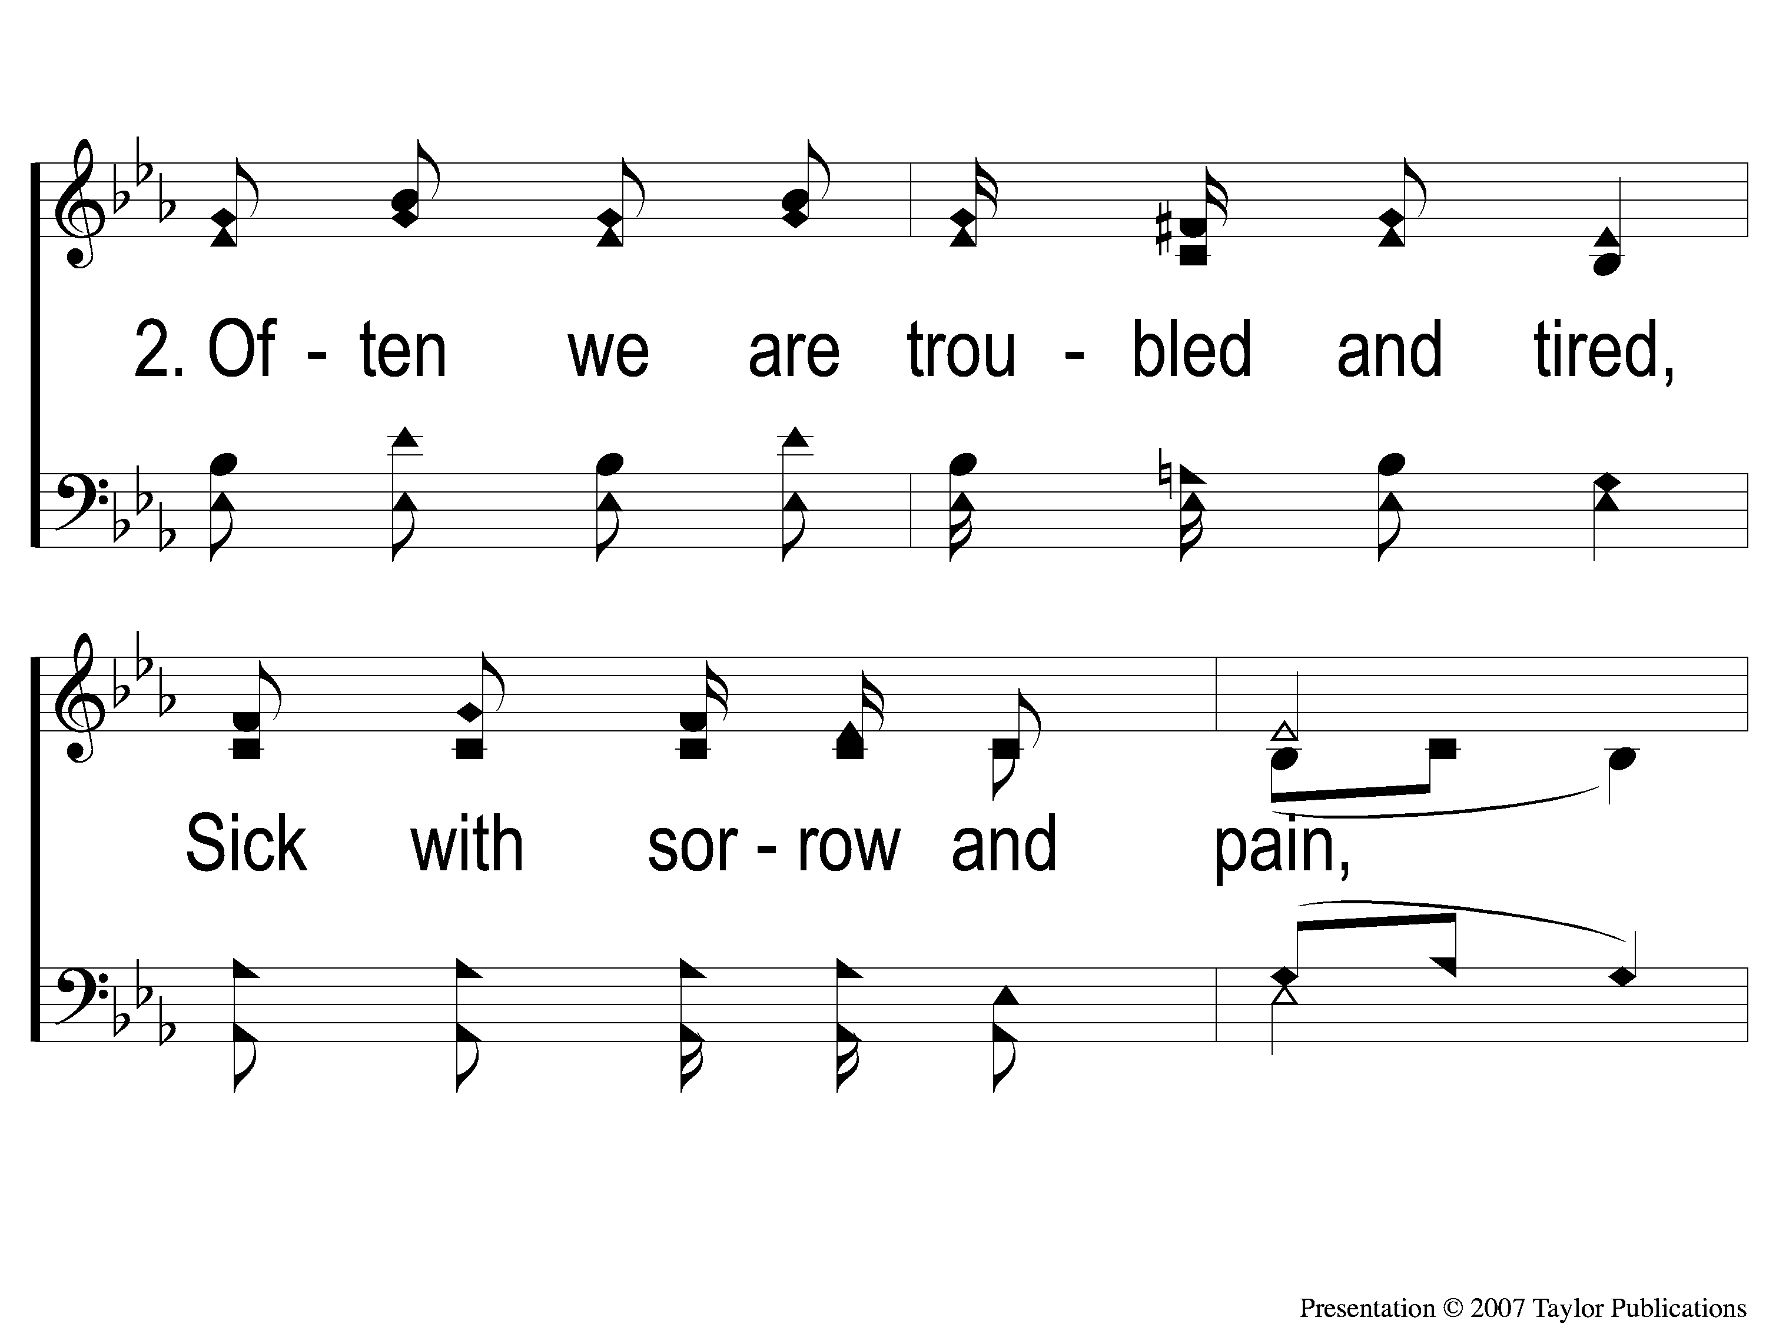
2-1 Sing and Be Happy
Sing and Be Happy
587

Slide 10
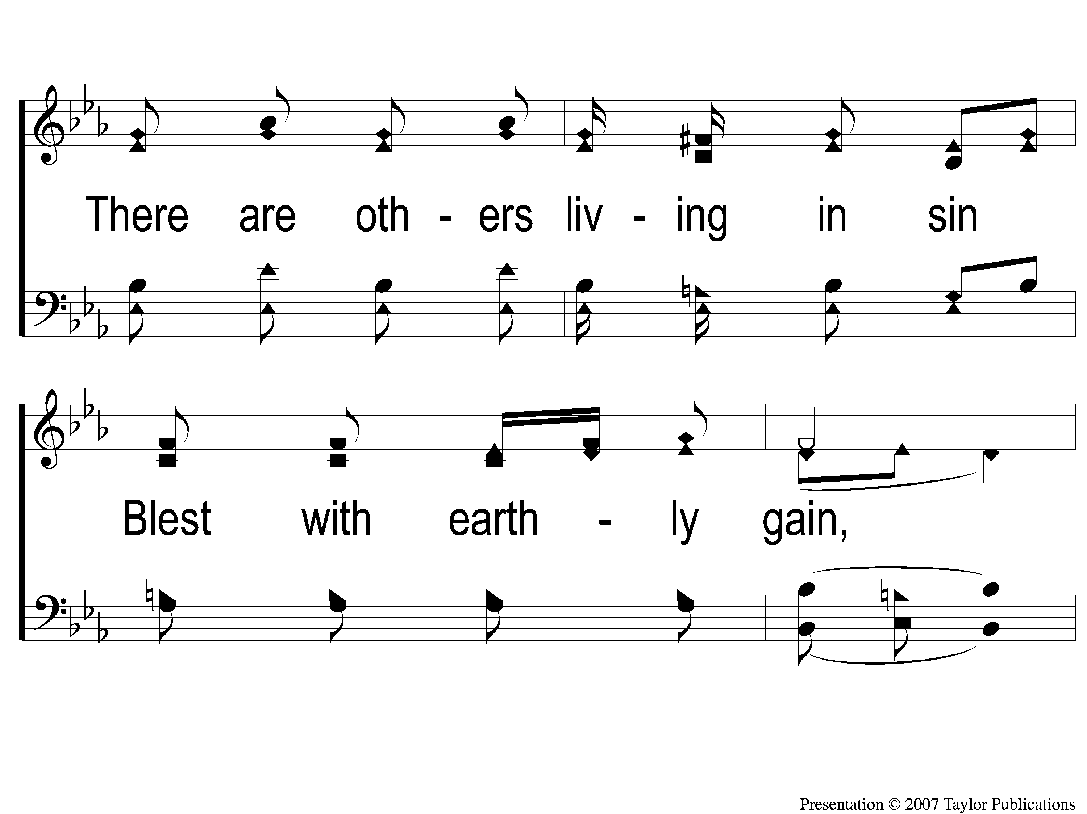
2-2 Sing and Be Happy
Sing and Be Happy
587

Slide 11
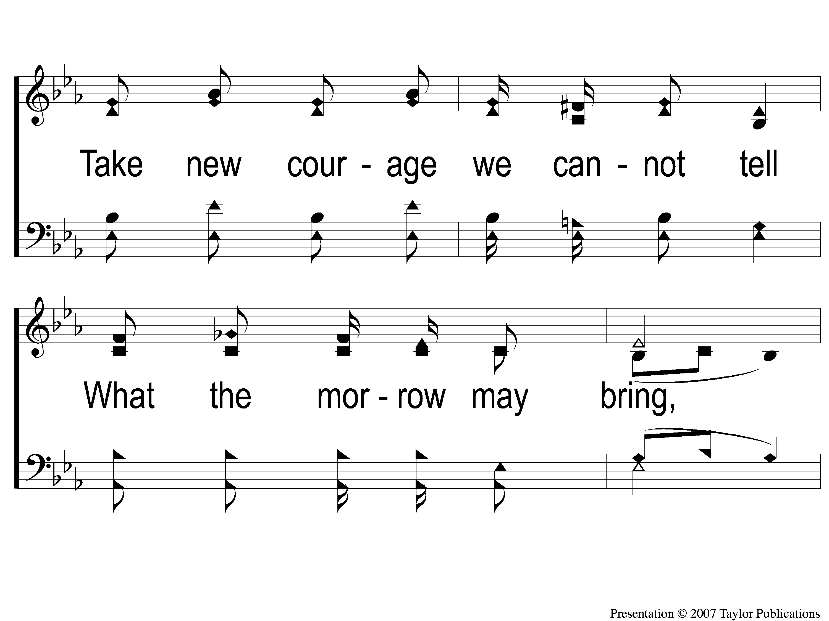
2-3 Sing and Be Happy
Sing and Be Happy
587

Slide 12
2-4 Sing and Be Happy
Sing and Be Happy
587

Slide 13
C-1 Sing and Be Happy
Sing and Be Happy
587

Slide 14
C-2 Sing and Be Happy
Sing and Be Happy
587

Slide 15
C-3 Sing and Be Happy
Sing and Be Happy
587

Slide 16
C-4 Sing and Be Happy
Sing and Be Happy
587

Slide 17
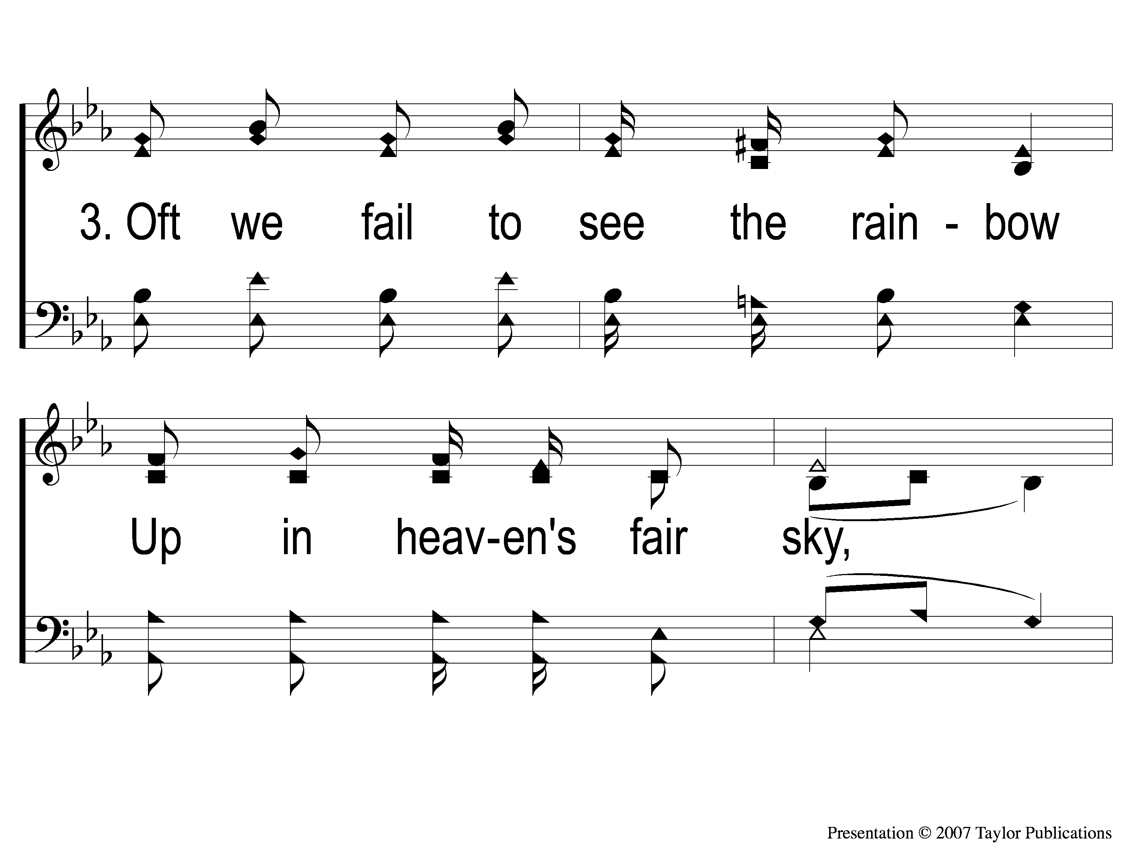
3-1 Sing and Be Happy
Sing and Be Happy
587

Slide 18
3-2 Sing and Be Happy
Sing and Be Happy
587

Slide 19
3-3 Sing and Be Happy
Sing and Be Happy
587

Slide 20
3-4 Sing and Be Happy
Sing and Be Happy
587

Slide 21
C-1 Sing and Be Happy
Sing and Be Happy
587

Slide 22
C-2 Sing and Be Happy
Sing and Be Happy
587

Slide 23
C-3 Sing and Be Happy
Sing and Be Happy
587

Slide 24
C-4 Sing and Be Happy
Sing and Be Happy
587

Slide 25
RESTORE REBUILD RENEW
welcome
we are glad to
Have you with us
IN 2022
WHEELER
CHURCH
OF
CHRIST

Slide 26
Song:
The Battle Belongs To The Lord
#749

Slide 27
1-1 The Battle Belongs to the Lord
The Battle Belongs to the Lord
749

Slide 28
1-2 The Battle Belongs to the Lord
The Battle Belongs to the Lord
749

Slide 29
C-1 The Battle Belongs to the Lord
The Battle Belongs to the Lord
749

Slide 30
C-2 The Battle Belongs to the Lord
The Battle Belongs to the Lord
749

Slide 31
2-1 The Battle Belongs to the Lord
The Battle Belongs to the Lord
749

Slide 32
2-2 The Battle Belongs to the Lord
The Battle Belongs to the Lord
749

Slide 33
C-1 The Battle Belongs to the Lord
The Battle Belongs to the Lord
749

Slide 34
C-2 The Battle Belongs to the Lord
The Battle Belongs to the Lord
749

Slide 35
3-1 The Battle Belongs to the Lord
The Battle Belongs to the Lord
749

Slide 36
3-2 The Battle Belongs to the Lord
The Battle Belongs to the Lord
749

Slide 37
C-1 The Battle Belongs to the Lord
The Battle Belongs to the Lord
749

Slide 38
C-2 The Battle Belongs to the Lord
The Battle Belongs to the Lord
749

Slide 39
Song:
Just A Little
Talk With Jesus
#959

Slide 40
1-1 Just A Little Talk With Jesus
Just A Little Talk With Jesus
959

Slide 41
1-2 Just A Little Talk With Jesus
Just A Little Talk With Jesus
959

Slide 42
C-1 Just A Little Talk With Jesus
Just A Little Talk With Jesus
959

Slide 43
C-2 Just A Little Talk With Jesus
Just A Little Talk With Jesus
959

Slide 44
C-3 Just A Little Talk With Jesus
Just A Little Talk With Jesus
959

Slide 45
2-1 Just A Little Talk With Jesus
Just A Little Talk With Jesus
959

Slide 46
2-2 Just A Little Talk With Jesus
Just A Little Talk With Jesus
959

Slide 47
C-1 Just A Little Talk With Jesus
Just A Little Talk With Jesus
959

Slide 48
C-2 Just A Little Talk With Jesus
Just A Little Talk With Jesus
959

Slide 49
C-3 Just A Little Talk With Jesus
Just A Little Talk With Jesus
959

Slide 50
3-1 Just A Little Talk With Jesus
Just A Little Talk With Jesus
959

Slide 51
3-2 Just A Little Talk With Jesus
Just A Little Talk With Jesus
959

Slide 52
C-1 Just A Little Talk With Jesus
Just A Little Talk With Jesus
959

Slide 53
C-2 Just A Little Talk With Jesus
Just A Little Talk With Jesus
959

Slide 54
C-3 Just A Little Talk With Jesus
Just A Little Talk With Jesus
959

Slide 55
Opening Prayer

Slide 56
Song:
As The Deer
#71

Slide 57
1-1 As the Deer
As The Deer
71

Slide 58
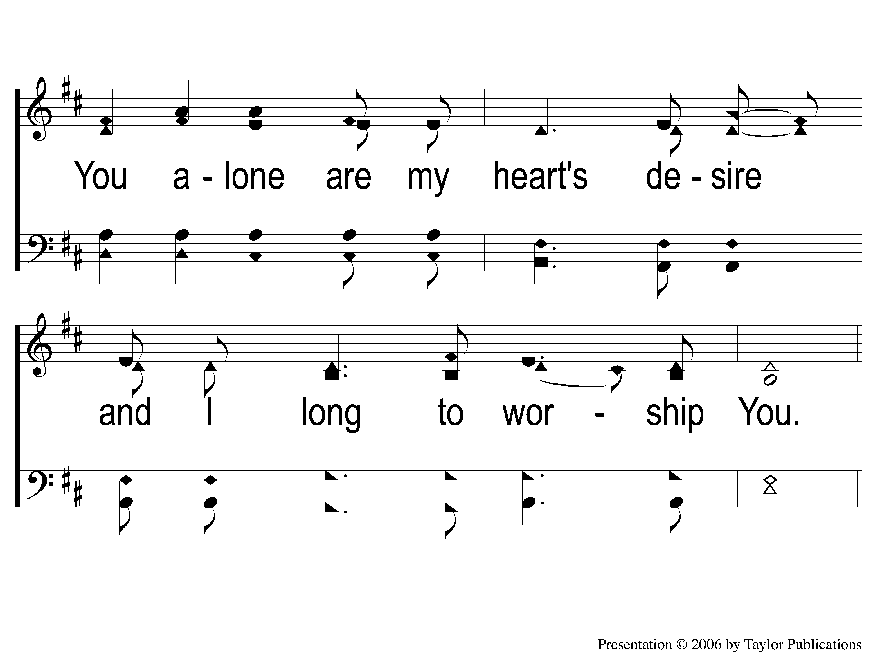
1-2 As the Deer
As The Deer
71

Slide 59
C-1 As the Deer
As The Deer
71

Slide 60
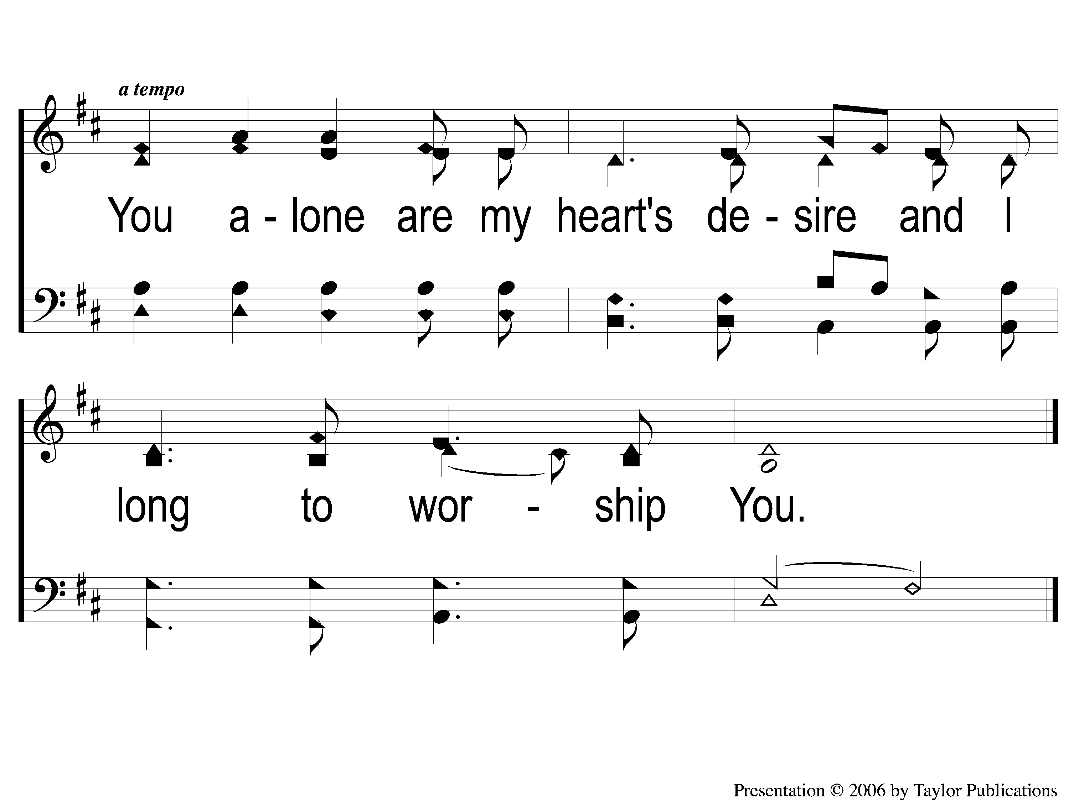
C-2 As the Deer
As The Deer
71

Slide 61
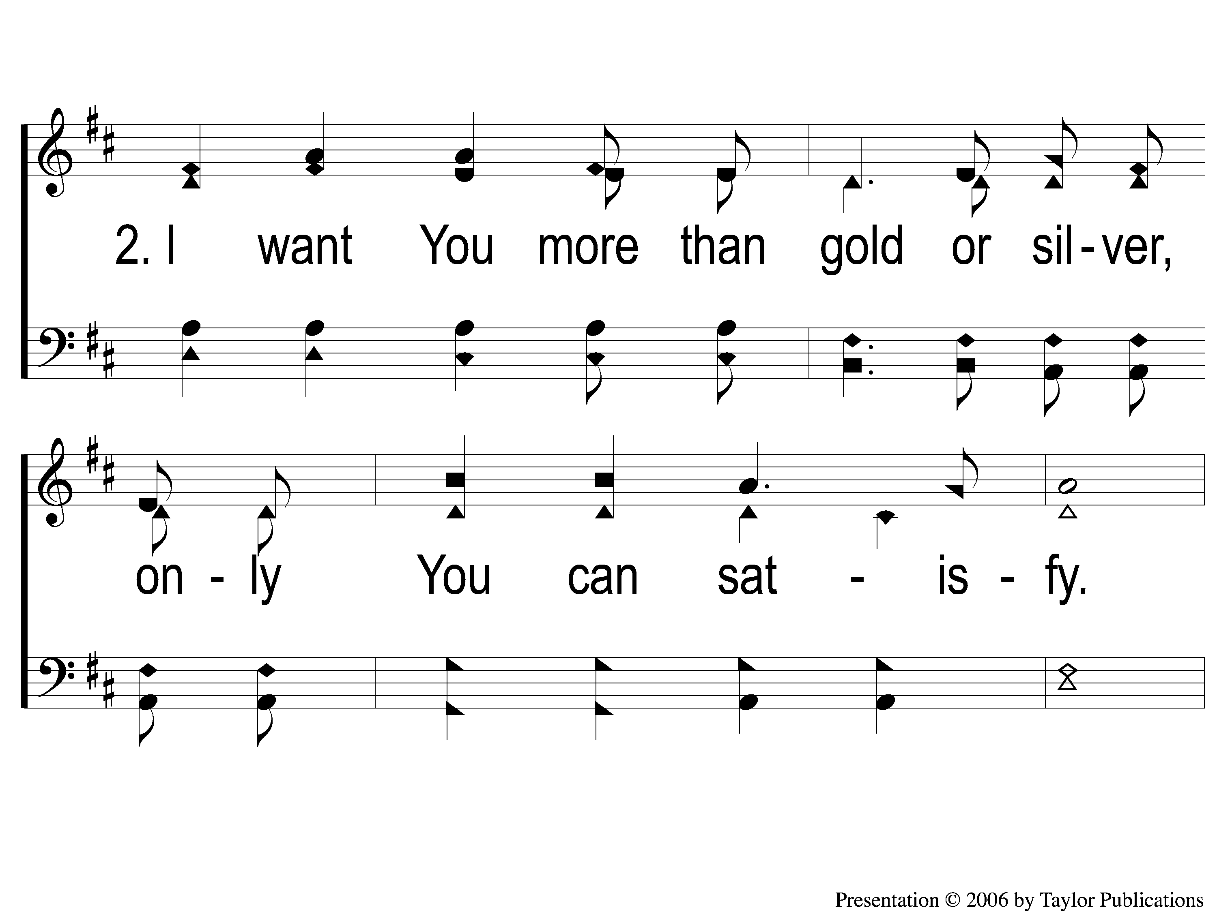
2-1 As the Deer
As The Deer
71

Slide 62
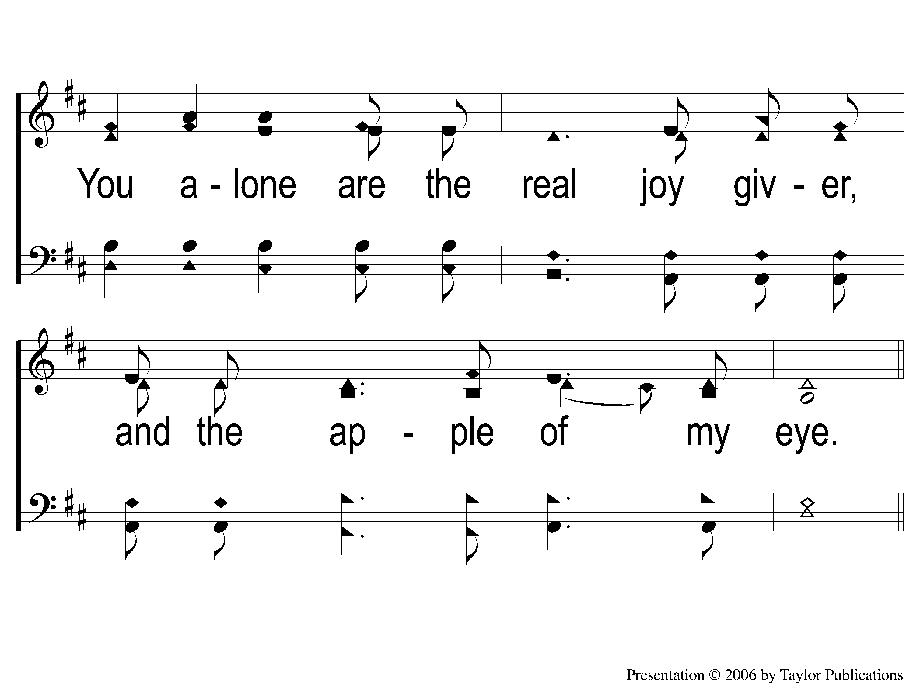
2-2 As the Deer
As The Deer
71

Slide 63
C-1 As the Deer
As The Deer
71

Slide 64
C-2 As the Deer
As The Deer
71

Slide 65
Song:
10,000 Reasons

Slide 66
Intro1 10,000 Reasons (Bless the Lord)
10,000 Reasons (Bless the Lord)

Slide 67
Intro2 10,000 Reasons (Bless the Lord)
10,000 Reasons (Bless the Lord)

Slide 68
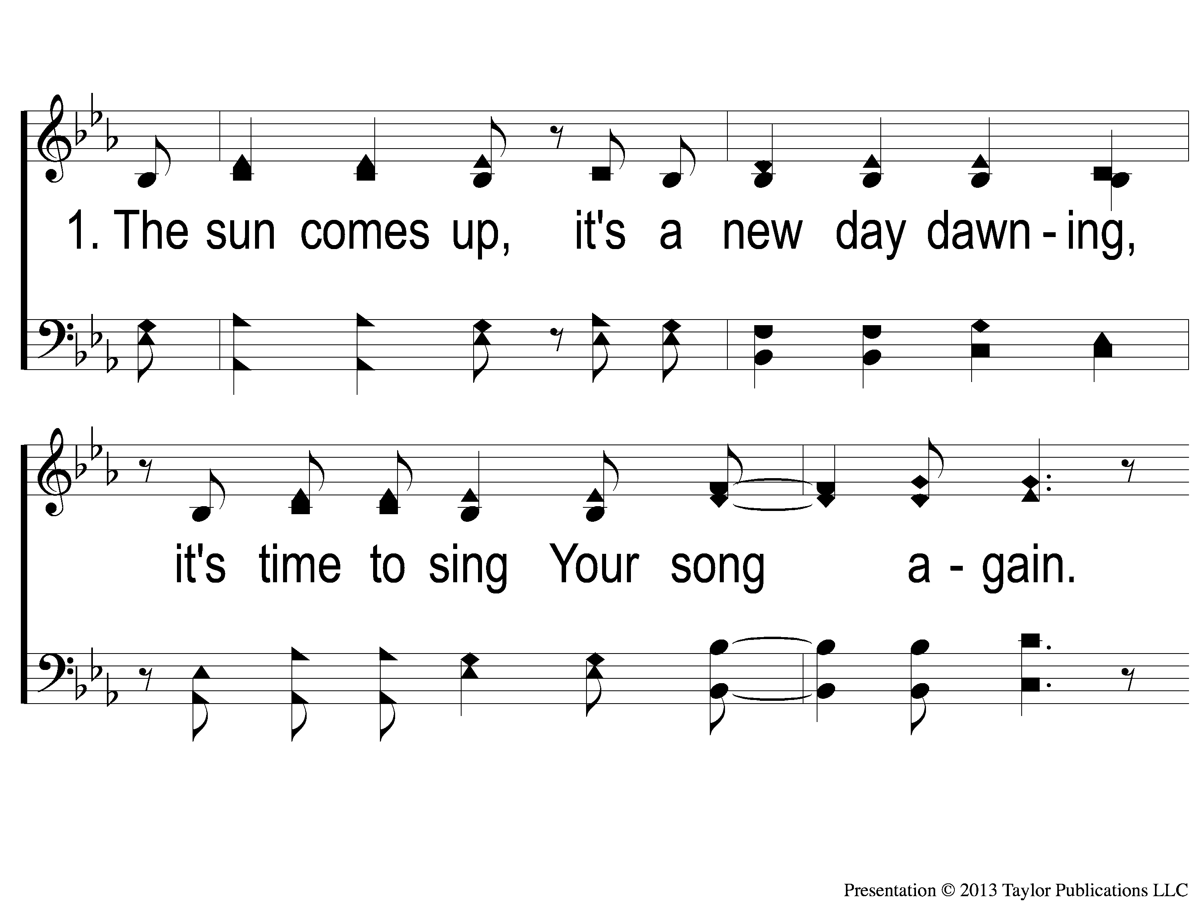
1-1 10,000 Reasons (Bless the Lord)
10,000 Reasons (Bless the Lord)

Slide 69
1-2 10,000 Reasons (Bless the Lord)
10,000 Reasons (Bless the Lord)

Slide 70
1c-1 10,000 Reasons (Bless the Lord)
10,000 Reasons (Bless the Lord)

Slide 71
1c-2 10,000 Reasons (Bless the Lord)
10,000 Reasons (Bless the Lord)

Slide 72
2-1 10,000 Reasons (Bless the Lord)
10,000 Reasons (Bless the Lord)

Slide 73
2-2 10,000 Reasons (Bless the Lord)
10,000 Reasons (Bless the Lord)

Slide 74
2c-1 10,000 Reasons (Bless the Lord)
10,000 Reasons (Bless the Lord)

Slide 75
2c-2 10,000 Reasons (Bless the Lord)
10,000 Reasons (Bless the Lord)

Slide 76
3-1 10,000 Reasons (Bless the Lord)
10,000 Reasons (Bless the Lord)

Slide 77
3-2 10,000 Reasons (Bless the Lord)
10,000 Reasons (Bless the Lord)

Slide 78
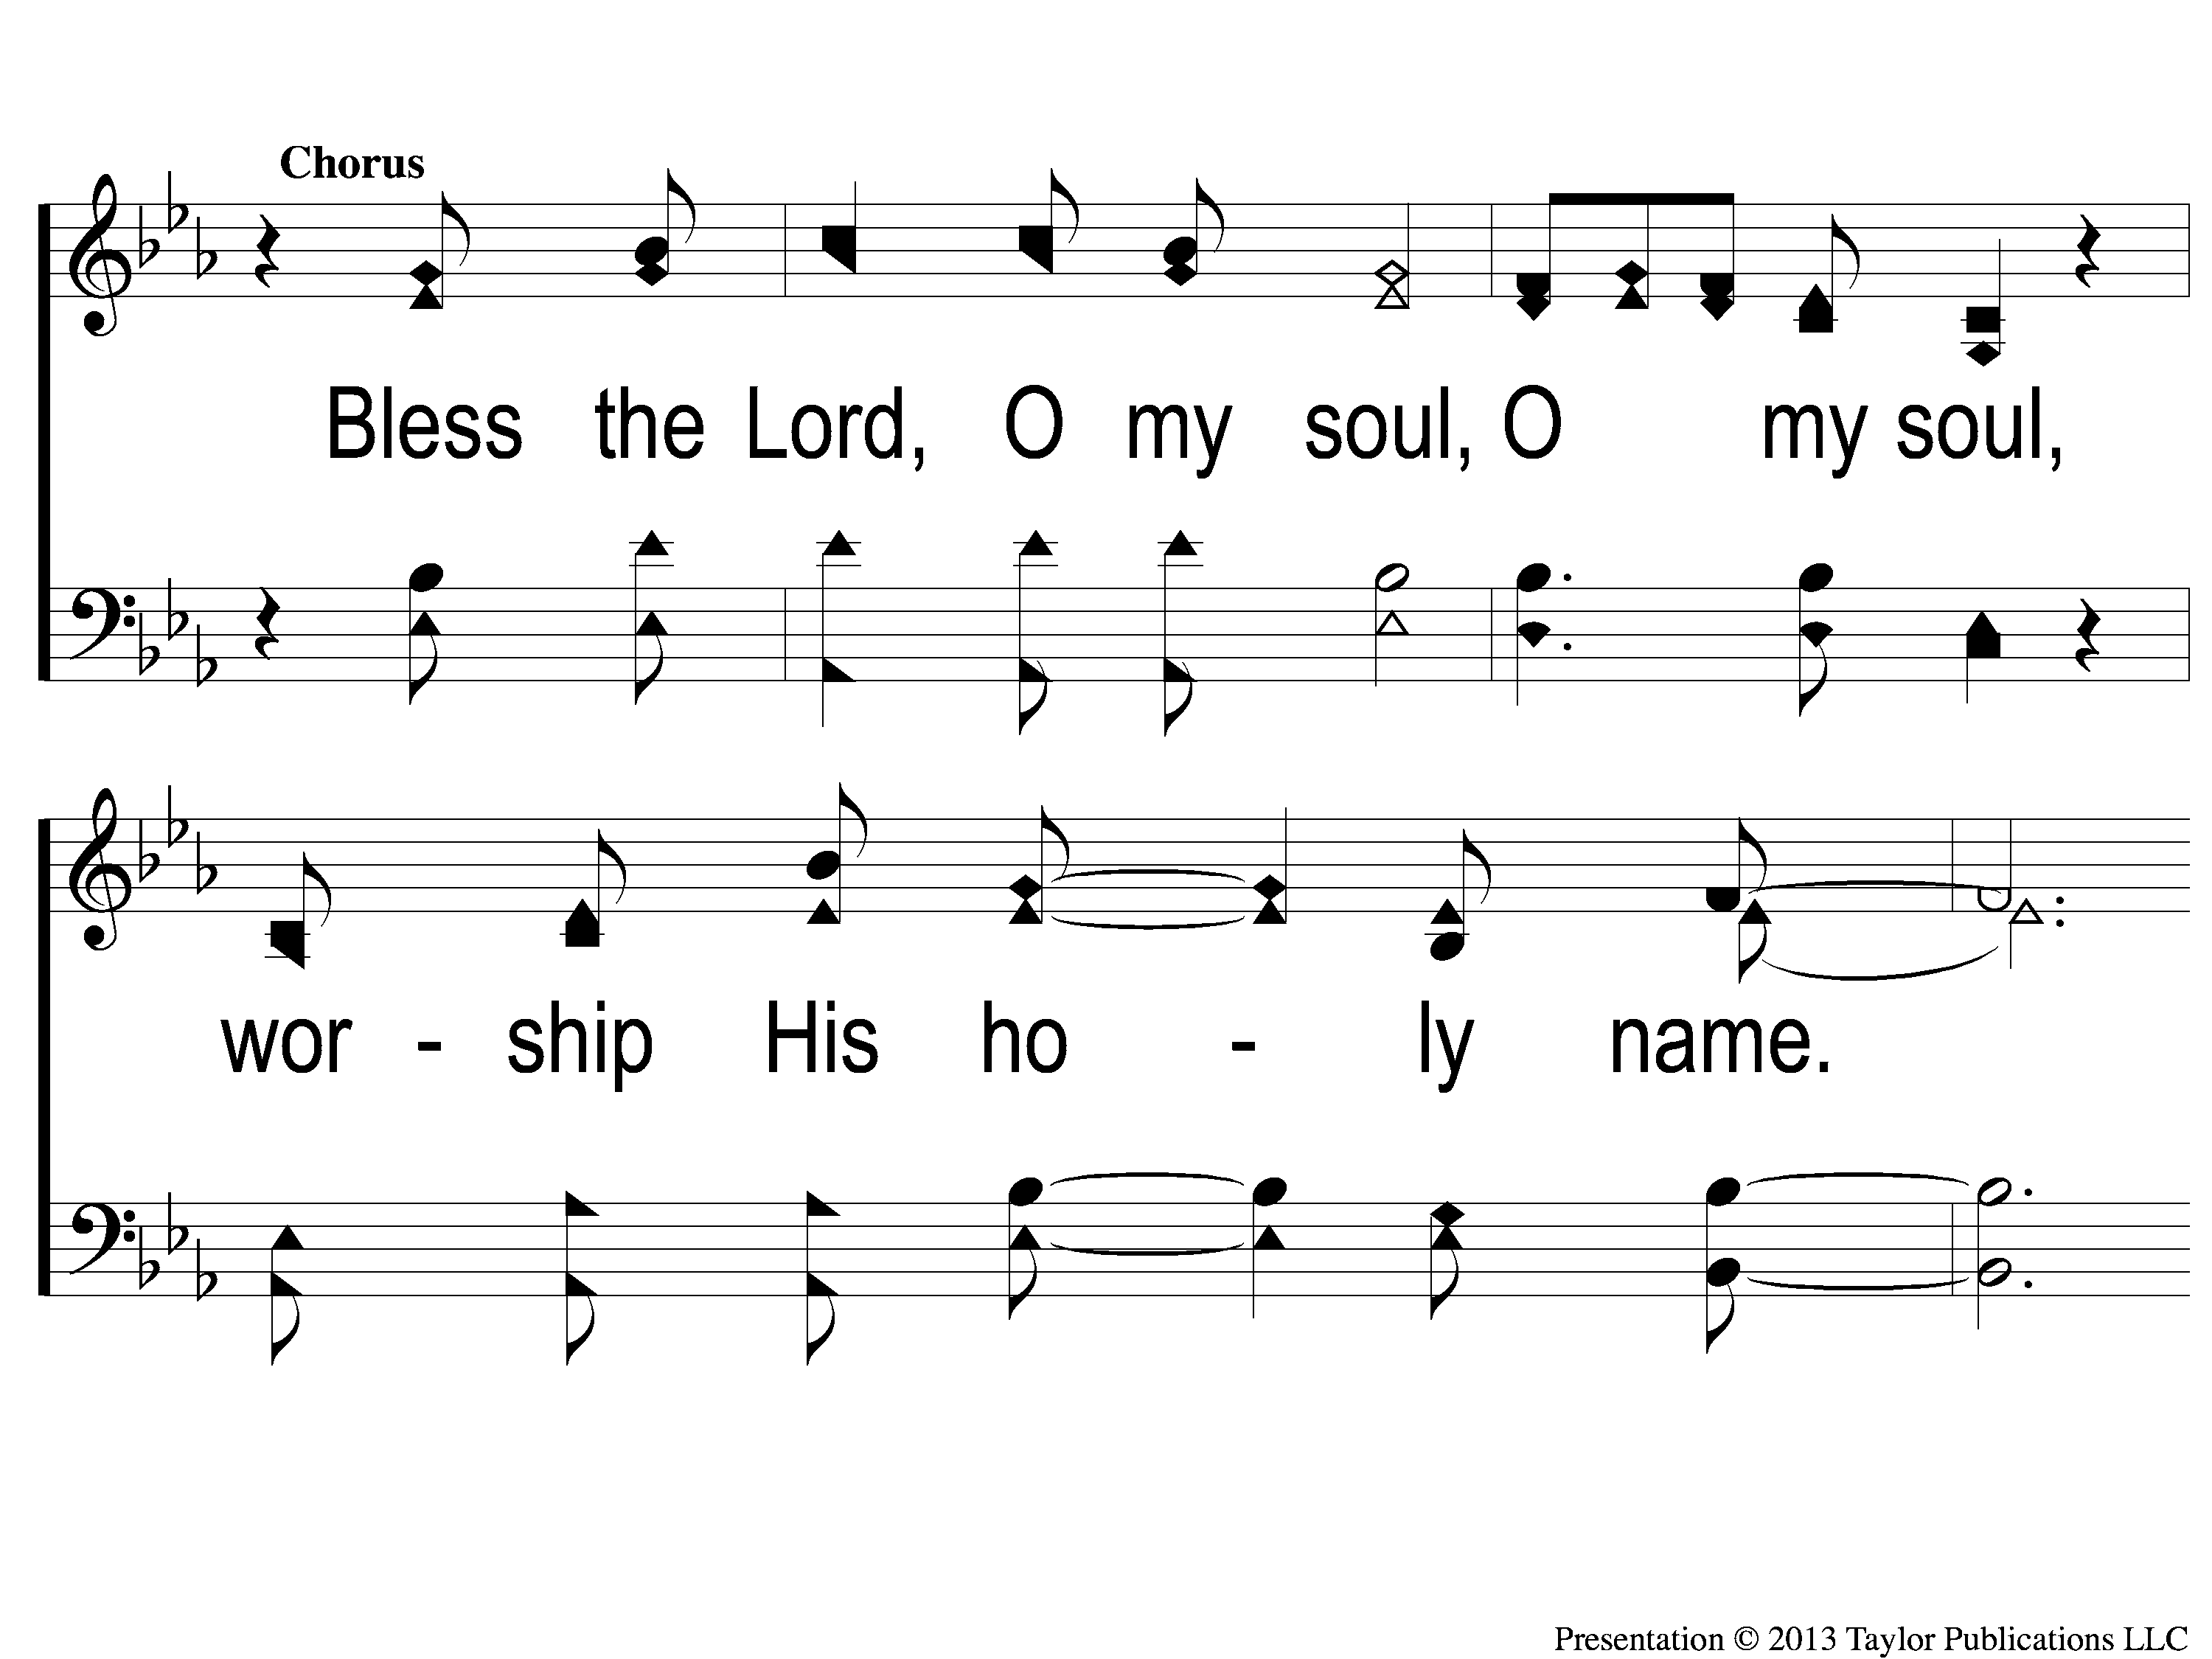
3c-1 10,000 Reasons (Bless the Lord)
10,000 Reasons (Bless the Lord)

Slide 79
3c-2 10,000 Reasons (Bless the Lord)
10,000 Reasons (Bless the Lord)

Slide 80
Scripture Reading:
Ezra 1:1-11

Slide 81
RESTORE REBUILD RENEW
IN 2022

Slide 82
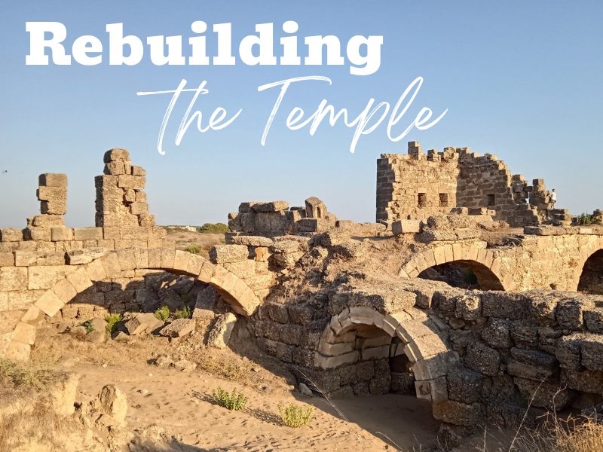

Slide 83
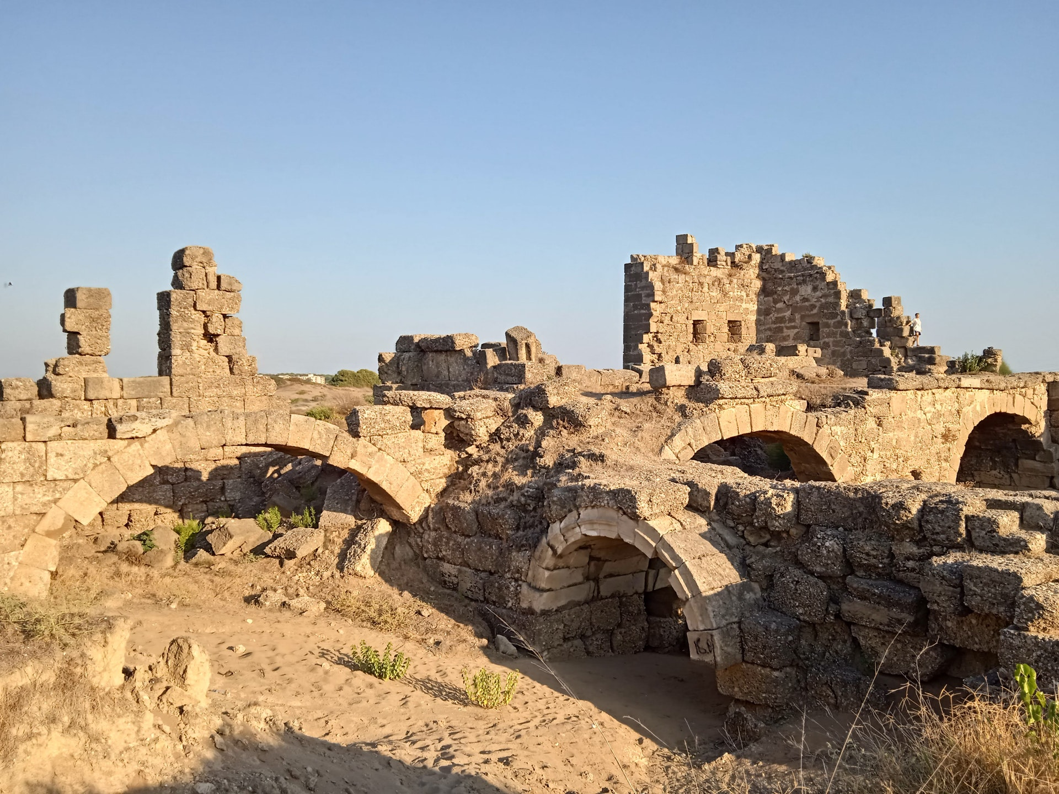
The Book of Ezra
536 B. C.
Jews are captive in Babylon
Cyrus the Great becomes King
Cyrus makes a Decree

Slide 84
The Book of Ezra
Cyrus makes a Decree:
“All the kingdoms of the earth the LORD God of heaven has given me. And He has commanded me to build Him a house at Jerusalem which is in Judah…May his God be with him, and let him go up to Jerusalem which is in Judah, and build the house of the LORD God of Israel (He is God), which is in Jerusalem.” (Ezra 1:2-3)

Slide 85
The Book of Ezra
Zerubbabel is Chosen to Lead (2:2)

Slide 86
The Book of Ezra
Zerubbabel is Chosen to Lead (2:2)
Many jews go back to Jerusalem (3:1)

Slide 87
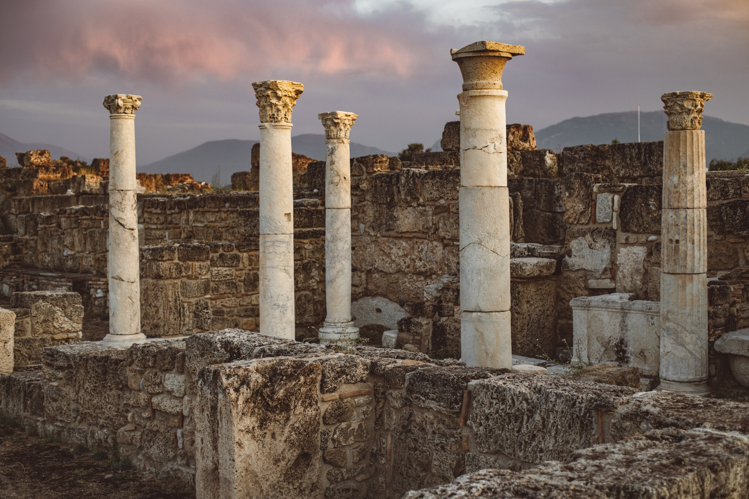

Slide 88
The Book of Ezra
Zerubbabel is Chosen to Lead (2:2)
Many jews go back to Jerusalem (3:1)
They lay the foundation of the Temple (3:8-9)

Slide 89
The Book of Ezra
Zerubbabel is Chosen to Lead (2:2)
Many jews go back to Jerusalem (3:1)
They lay the foundation of the Temple (3:8-9)
Opposition Appears (4:1-5)

Slide 90
The Book of Ezra
Zerubbabel is Chosen to Lead (2:2)
Many jews go back to Jerusalem (3:1)
They lay the foundation of the Temple (3:8-9)
Opposition Appears (4:1-5)
The work stops (4:24)

Slide 91
The Book of Ezra
Zerubbabel is Chosen to Lead (2:2)
Many jews go back to Jerusalem (3:1)
They lay the foundation of the Temple (3:8-9)
Opposition Appears (4:1-5)
The work stops (4:24)
Haggai and Zechariah Encourage the People (5:1-2)

Slide 92
The Temple of God Today
2 Cor. 5:1
1 Cor. 3:16-17, 6:19
Eph. 2:19-21
1 Pet. 2:5

Slide 93
3 Commands From God
Haggai 1:7-8

Slide 94
3 Commands From God
Haggai 1:7-8
Consider Your Ways

Slide 95
3 Commands From God
Haggai 1:7-8
Consider Your Ways
Go Up To The Mountains

Slide 96
3 Commands From God
Haggai 1:7-8
Consider Your Ways
Go Up To The Mountains
Build The Temple

Slide 97
3 Commands From God
1. Consider Your Ways
“Consider” – 5 times in Haggai

Slide 98
3 Commands From God
1. Consider Your Ways
“Consider” – 5 times in Haggai
Survey the Present, Not the Past
2 Cor 6:16, 1 Cor. 10:14

Slide 99
3 Commands From God
2. Go Up To The Mountain
“Go up” = ascend, move toward

Slide 100
3 Commands From God
2. Go Up To The Mountain
“Go up” = ascend, move toward
Make The Necessary Preparations
Lk. 9:62, 17:32

Slide 101
3 Commands From God
3. Build The Temple
Fear God & Keep His Commandments

Slide 102
3 Commands From God
3. Build The Temple
Fear God & Keep His Commandments
Israelites Pre-captivity vs. Post-captivity
Ezra 5:2, 6:14-15, Neh. 4:6

Slide 103
Are you Ready to
Rebuild?

Slide 104
Invitation
Song:
What A Day That Will Be
#916

Slide 105
1-1 What a Day That Will Be
What a Day That Will Be
916

Slide 106
1-2 What a Day That Will Be
What a Day That Will Be
916

Slide 107
1-3 What a Day That Will Be
What a Day That Will Be
916

Slide 108
C-1 What a Day That Will Be
What a Day That Will Be
916

Slide 109
C-2 What a Day That Will Be
What a Day That Will Be
916

Slide 110
C-3 What a Day That Will Be
What a Day That Will Be
916

Slide 111
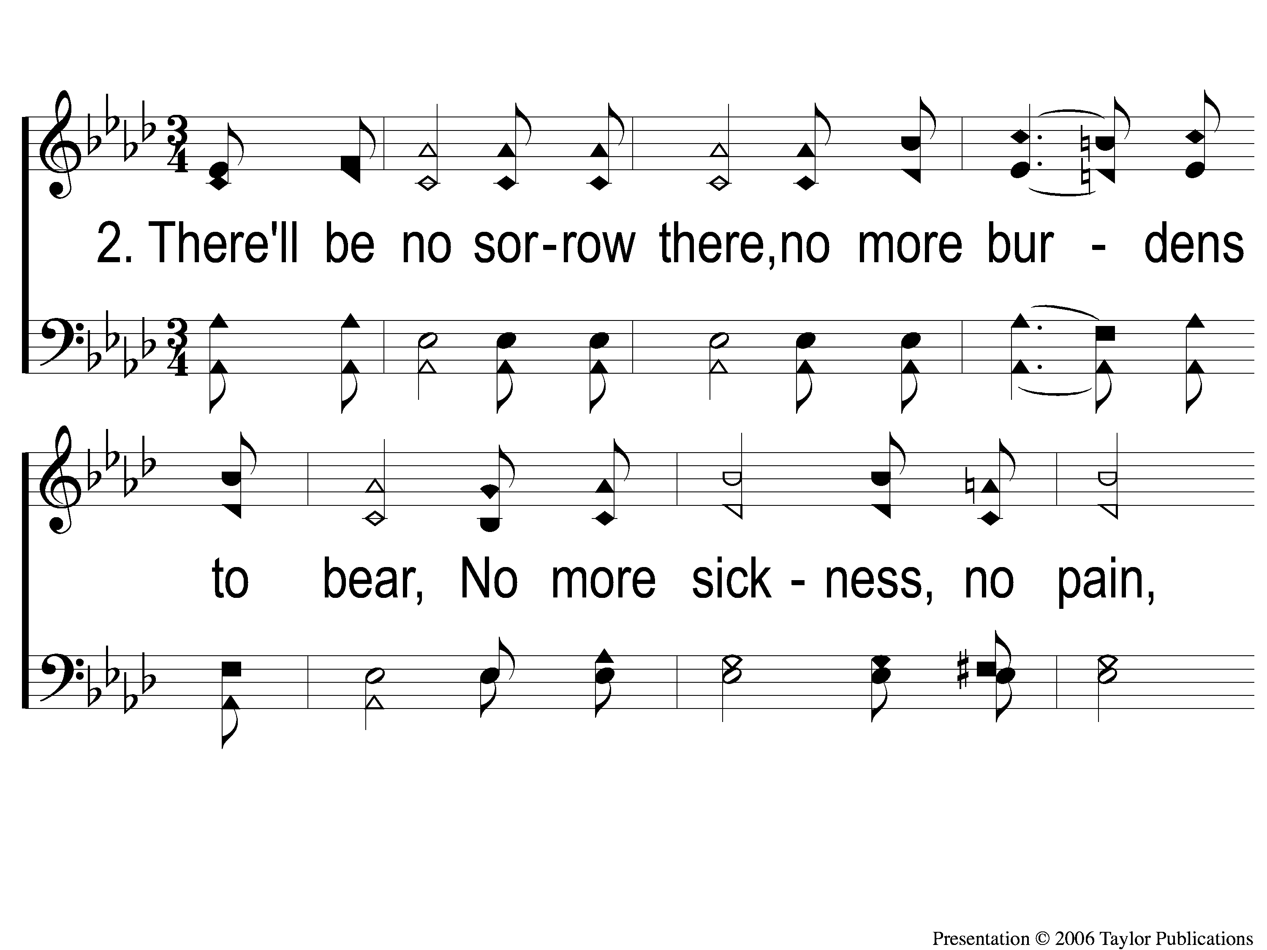
2-1 What a Day That Will Be
What a Day That Will Be
916

Slide 112
2-2 What a Day That Will Be
What a Day That Will Be
916

Slide 113
2-3 What a Day That Will Be
What a Day That Will Be
916

Slide 114
C-1 What a Day That Will Be
What a Day That Will Be
916

Slide 115
C-2 What a Day That Will Be
What a Day That Will Be
916

Slide 116
C-3 What a Day That Will Be
What a Day That Will Be
916

Slide 117
The Contribution:
Romans 9:6-8
“The point is this: whoever sows sparingly will also reap sparingly, and whoever sows bountifully will also reap bountifully. Each one must give as he has decided in his heart, not reluctantly or under compulsion, for God loves a cheerful giver. And God is able to make all grace abound to you, so that having all sufficiency in all things at all times, you may abound in every good work.”

Slide 118
Song:
Lead Me To Calvary
#332

Slide 119
1-1 Lead Me To Calvary
Lead Me To Calvary
332

Slide 120
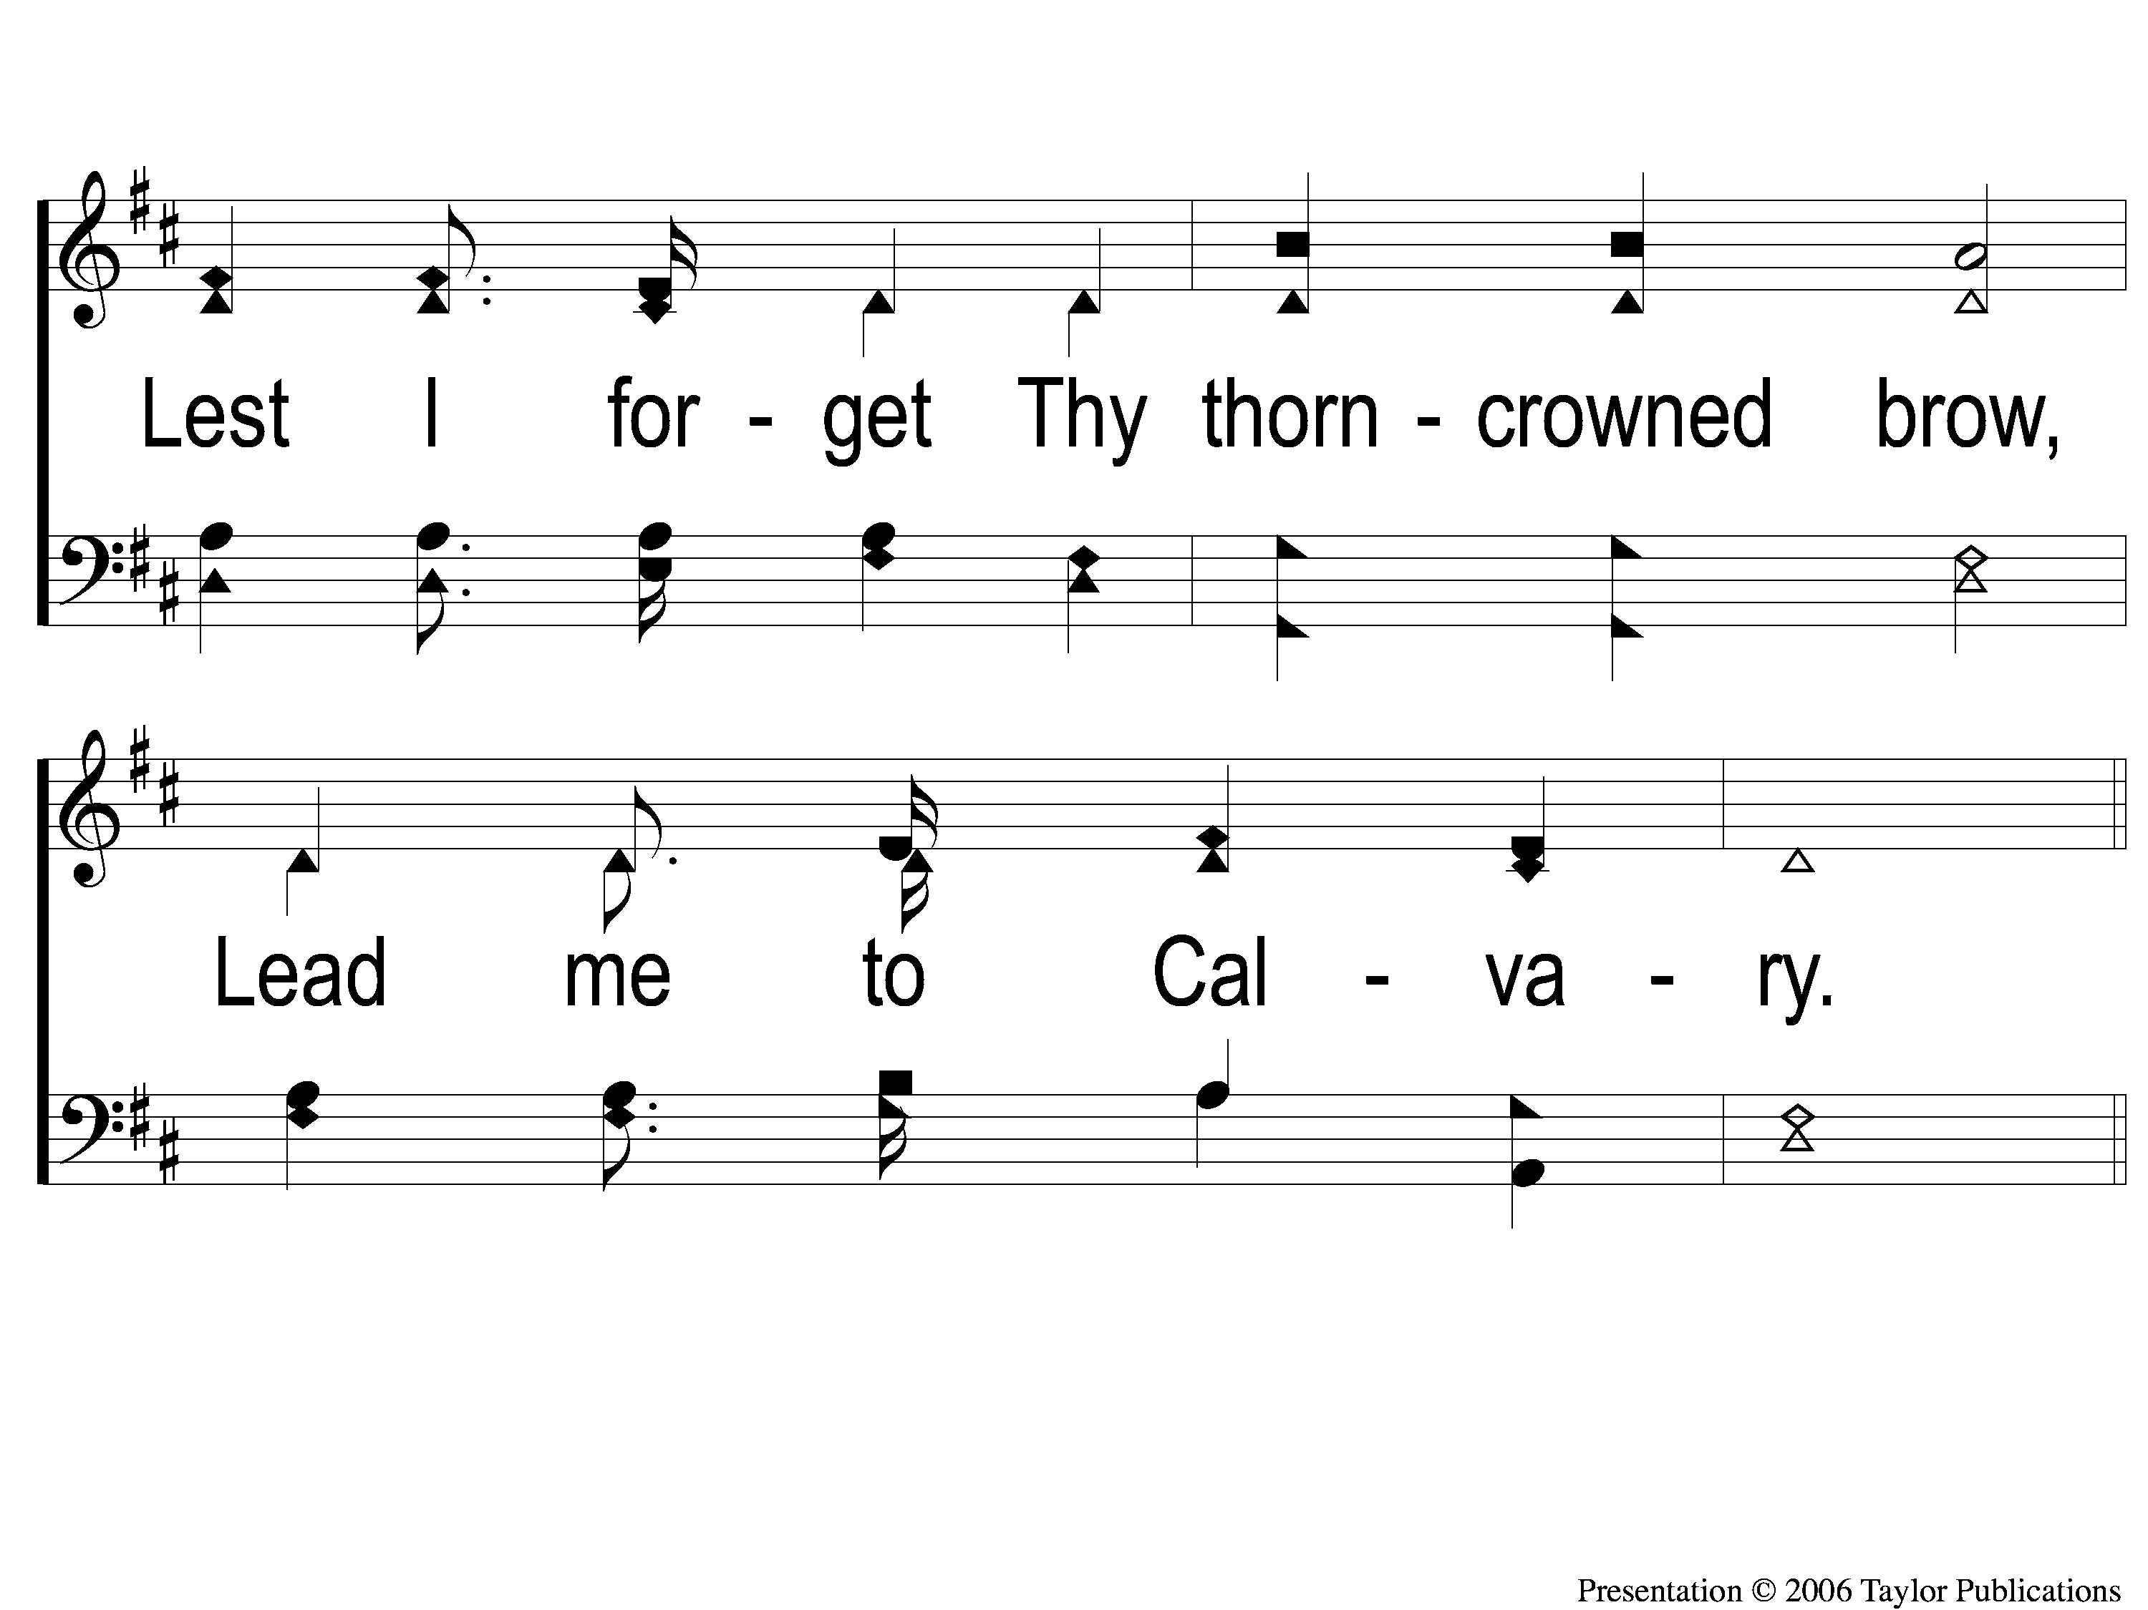
1-2 Lead Me To Calvary
Lead Me To Calvary
332

Slide 121
C-1 Lead Me To Calvary
Lead Me To Calvary
332

Slide 122
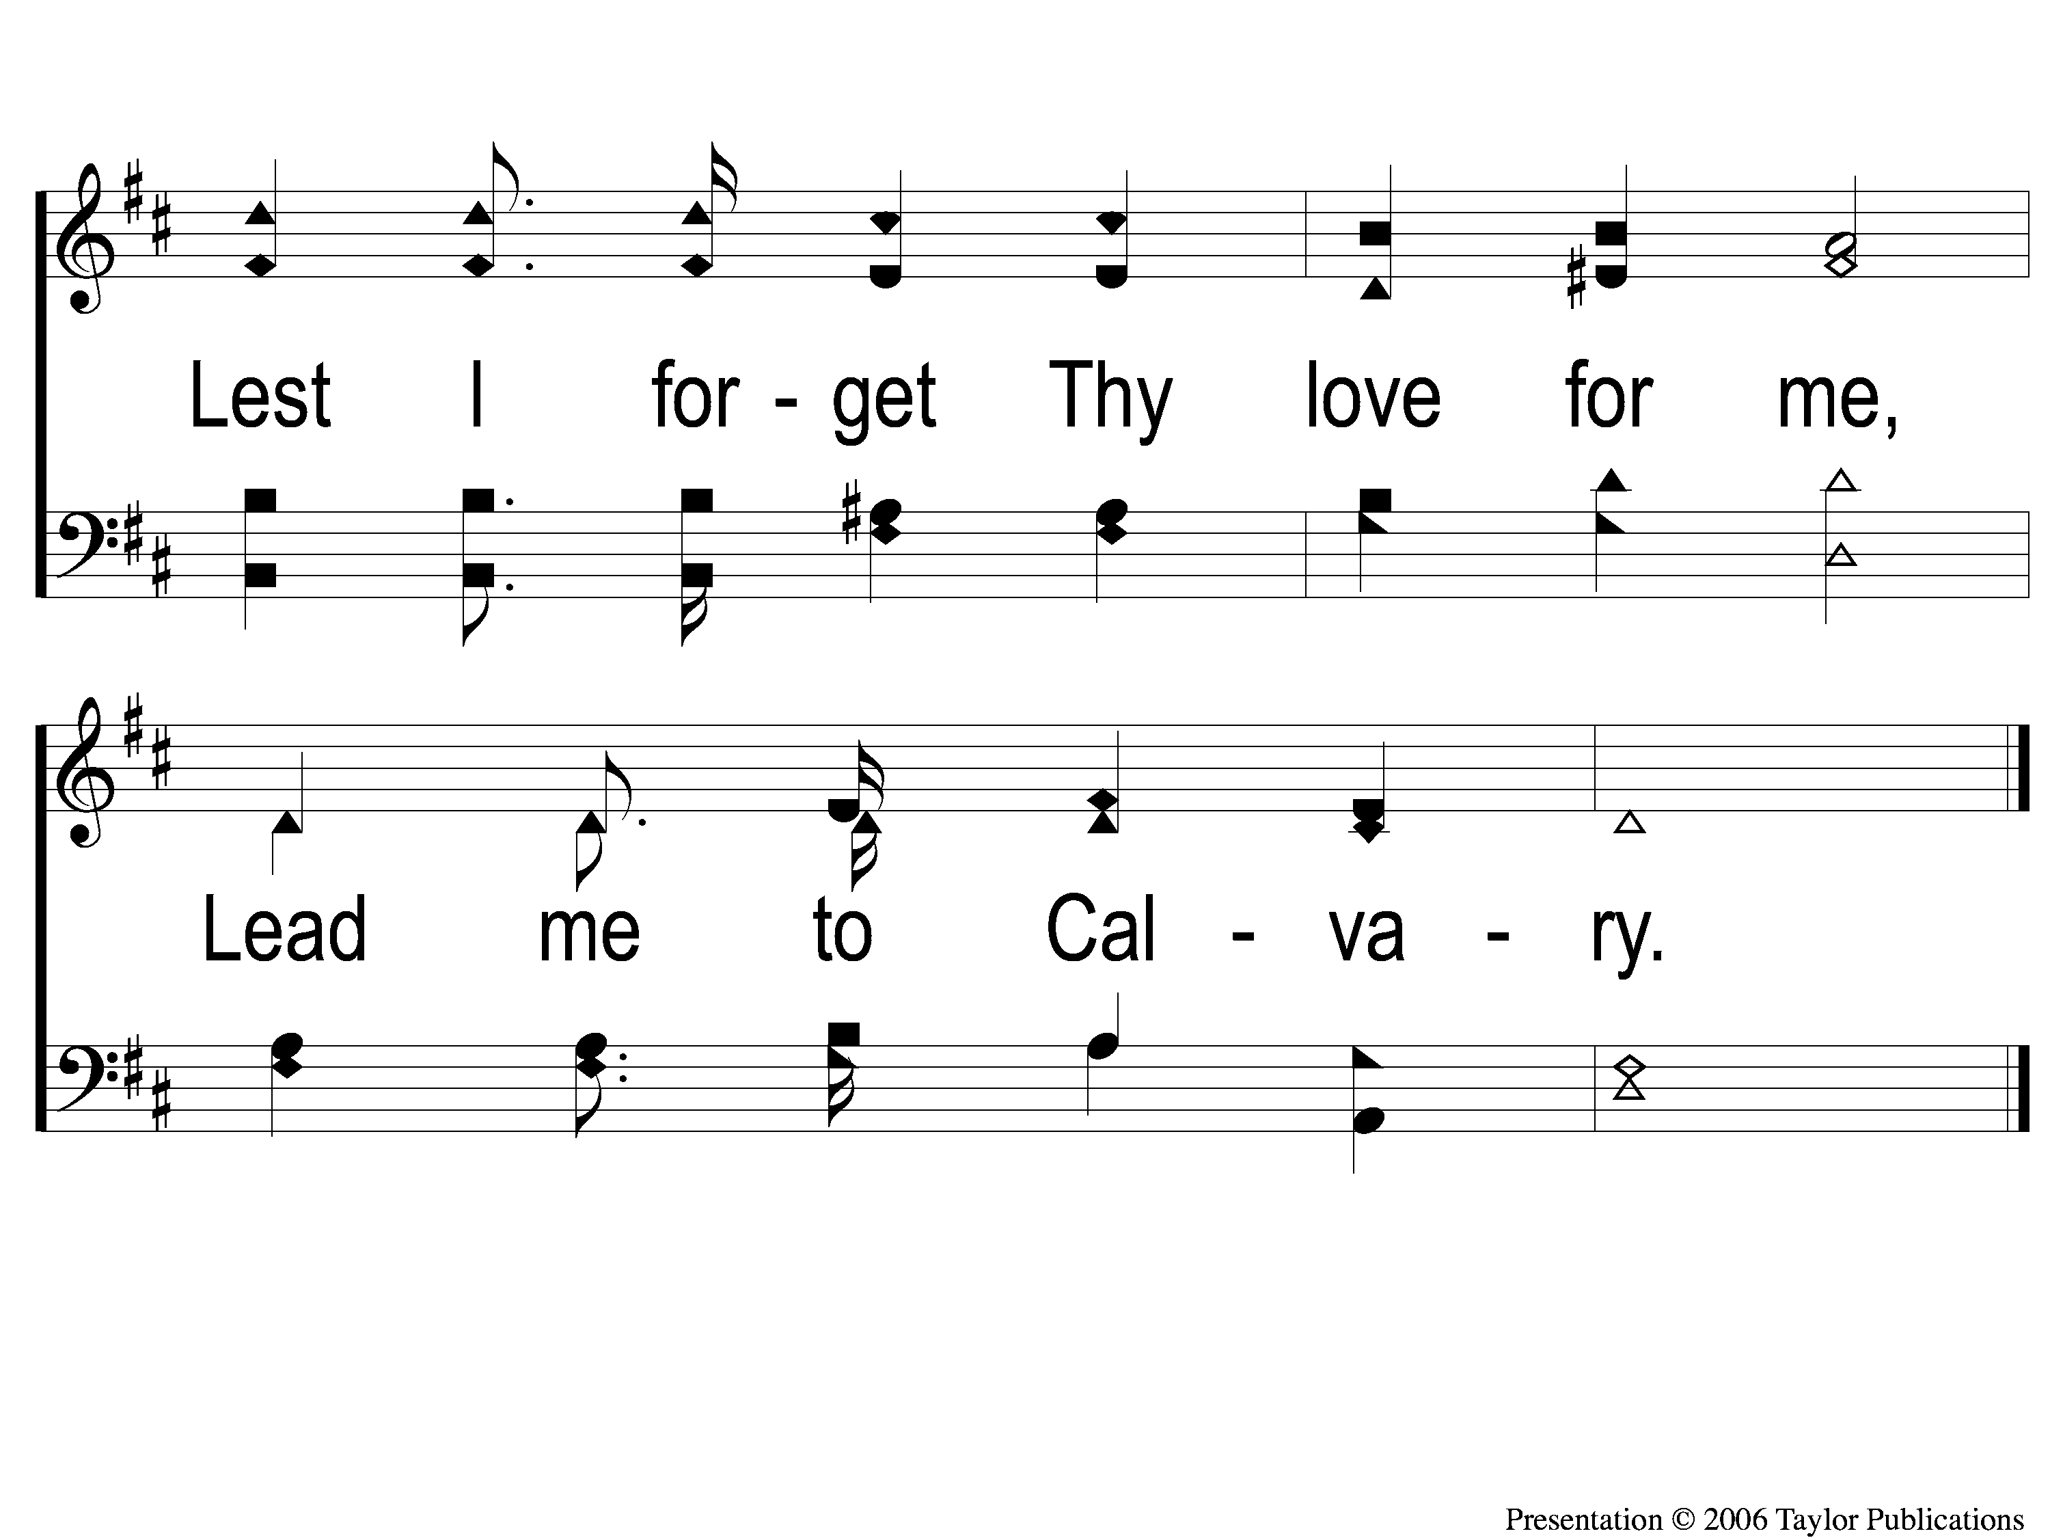
C-2 Lead Me To Calvary
Lead Me To Calvary
332

Slide 123
2-1 Lead Me To Calvary
Lead Me To Calvary
332

Slide 124
2-2 Lead Me To Calvary
Lead Me To Calvary
332

Slide 125
C-1 Lead Me To Calvary
Lead Me To Calvary
332

Slide 126
C-2 Lead Me To Calvary
Lead Me To Calvary
332

Slide 127
3-1 Lead Me To Calvary
Lead Me To Calvary
332

Slide 128
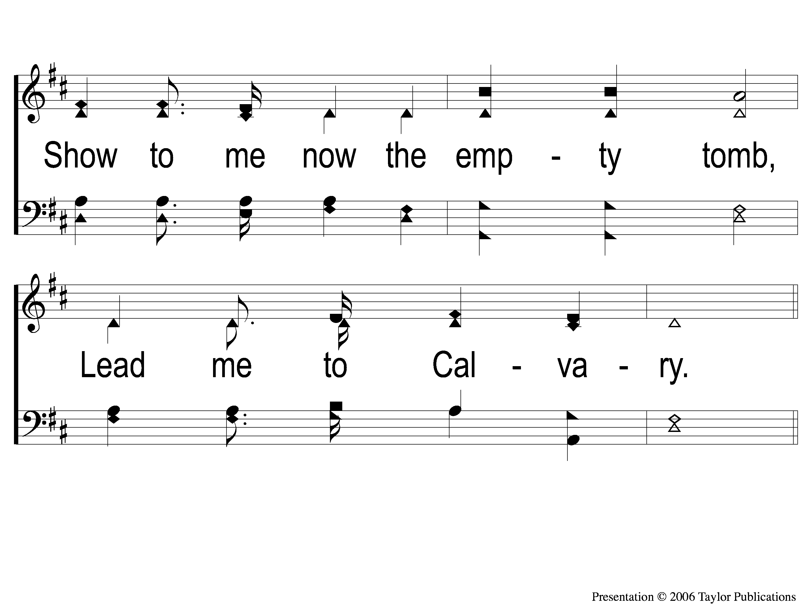
3-2 Lead Me To Calvary
Lead Me To Calvary
332

Slide 129
C-1 Lead Me To Calvary
Lead Me To Calvary
332

Slide 130
C-2 Lead Me To Calvary
Lead Me To Calvary
332

Slide 131
4-1 Lead Me To Calvary
Lead Me To Calvary
332

Slide 132
4-2 Lead Me To Calvary
Lead Me To Calvary
332

Slide 133
C-1 Lead Me To Calvary
Lead Me To Calvary
332

Slide 134
C-2 Lead Me To Calvary
Lead Me To Calvary
332

Slide 135
The Unleavened Bread
Romans 5:18-19
“Therefore, as through one man’s offense judgment came to all men, resulting in condemnation, even so through one Man’s righteous act the free gift came to all men, resulting in justification of life. For as by one man’s disobedience many were made sinners, so also by one Man’s obedience many will be made righteous.”

Slide 136
The Fruit
of the Vine
Romans 5:9-11
“Since, therefore, we have now been justified by his blood, much more shall we be saved by him from the wrath of God. For if while we were enemies we were reconciled to God by the death of his Son, much more, now that we are reconciled, shall we be saved by his life. More than that, we also rejoice in God through our Lord Jesus Christ, through whom we have now received reconciliation.”

Slide 137
Closing Prayer

Slide 138
Song:
The Greatest Commands
#448

Slide 139
1-1 The Greatest Commands-SFP
The Greatest Commands
448

Slide 140
1-2 The Greatest Commands-SFP
The Greatest Commands
448

Slide 141
1-3 The Greatest Commands-SFP
The Greatest Commands
448

Slide 142
1-4 The Greatest Commands-SFP
The Greatest Commands
448

Slide 143
2-1 The Greatest Commands-SFP
The Greatest Commands
448

Slide 144
2-2 The Greatest Commands-SFP
The Greatest Commands
448

Slide 145
2-3 The Greatest Commands-SFP
The Greatest Commands
448

Slide 146
2-4 The Greatest Commands-SFP
The Greatest Commands
448

Slide 147
3-1 The Greatest Commands-SFP
The Greatest Commands
448

Slide 148
3-2 The Greatest Commands-SFP
The Greatest Commands
448

Slide 149
3-3 The Greatest Commands-SFP
The Greatest Commands
448

Slide 150
3-4 The Greatest Commands-SFP
The Greatest Commands
448

Slide 151
4-1 The Greatest Commands-SFP
The Greatest Commands
448

Slide 152
4-2 The Greatest Commands-SFP
The Greatest Commands
448

Slide 153
4-3 The Greatest Commands-SFP
The Greatest Commands
448

Slide 154
4-4 The Greatest Commands-SFP
The Greatest Commands
448

Slide 155
Tonight
Worship @ 6:00 PM
Wednesday
Worship/Classes @ 6:30 pm
RESTORE REBUILD RENEW
IN 2022
WHEELER
CHURCH
OF
CHRIST

Slide 156
Today
Fellowship Meal @ Noon
Devo & Singing @ 1:00 PM
Wednesday
Worship & Classes @ 6:30 pm
RESTORE REBUILD RENEW
IN 2022
WHEELER
CHURCH
OF
CHRIST

