Slide 1
PLEASE STANDBY
OUR LIVESTREAM
WILL BEGIN SOON

Slide 2
WELCOME
THANKS FOR JOINING US!

Slide 3
#351
SONG:
He Bore It All

Slide 4
1-1 He Bore It All
He Bore It All
351

Slide 5
1-2 He Bore It All
He Bore It All
351

Slide 6
C-1 He Bore It All
He Bore It All
351

Slide 7
C-2 He Bore It All
He Bore It All
351

Slide 8
C-3 He Bore It All
He Bore It All
351

Slide 9
2-1 He Bore It All
He Bore It All
351

Slide 10
2-2 He Bore It All
He Bore It All
351

Slide 11
C-1 He Bore It All
He Bore It All
351

Slide 12
C-2 He Bore It All
He Bore It All
351

Slide 13
C-3 He Bore It All
He Bore It All
351

Slide 14
3-1 He Bore It All
He Bore It All
351

Slide 15
3-2 He Bore It All
He Bore It All
351

Slide 16
C-1 He Bore It All
He Bore It All
351

Slide 17
C-2 He Bore It All
He Bore It All
351

Slide 18
C-3 He Bore It All
He Bore It All
351

Slide 19
#497
SONG:
Whispering Hope

Slide 20
1-1 Whispering Hope
Whispering Hope
497

Slide 21
1-2 Whispering Hope
Whispering Hope
497

Slide 22
1-3 Whispering Hope
Whispering Hope
497

Slide 23
C-1 Whispering Hope
Whispering Hope
497

Slide 24
C-2 Whispering Hope
Whispering Hope
497

Slide 25
3-1 Whispering Hope
Whispering Hope
497

Slide 26
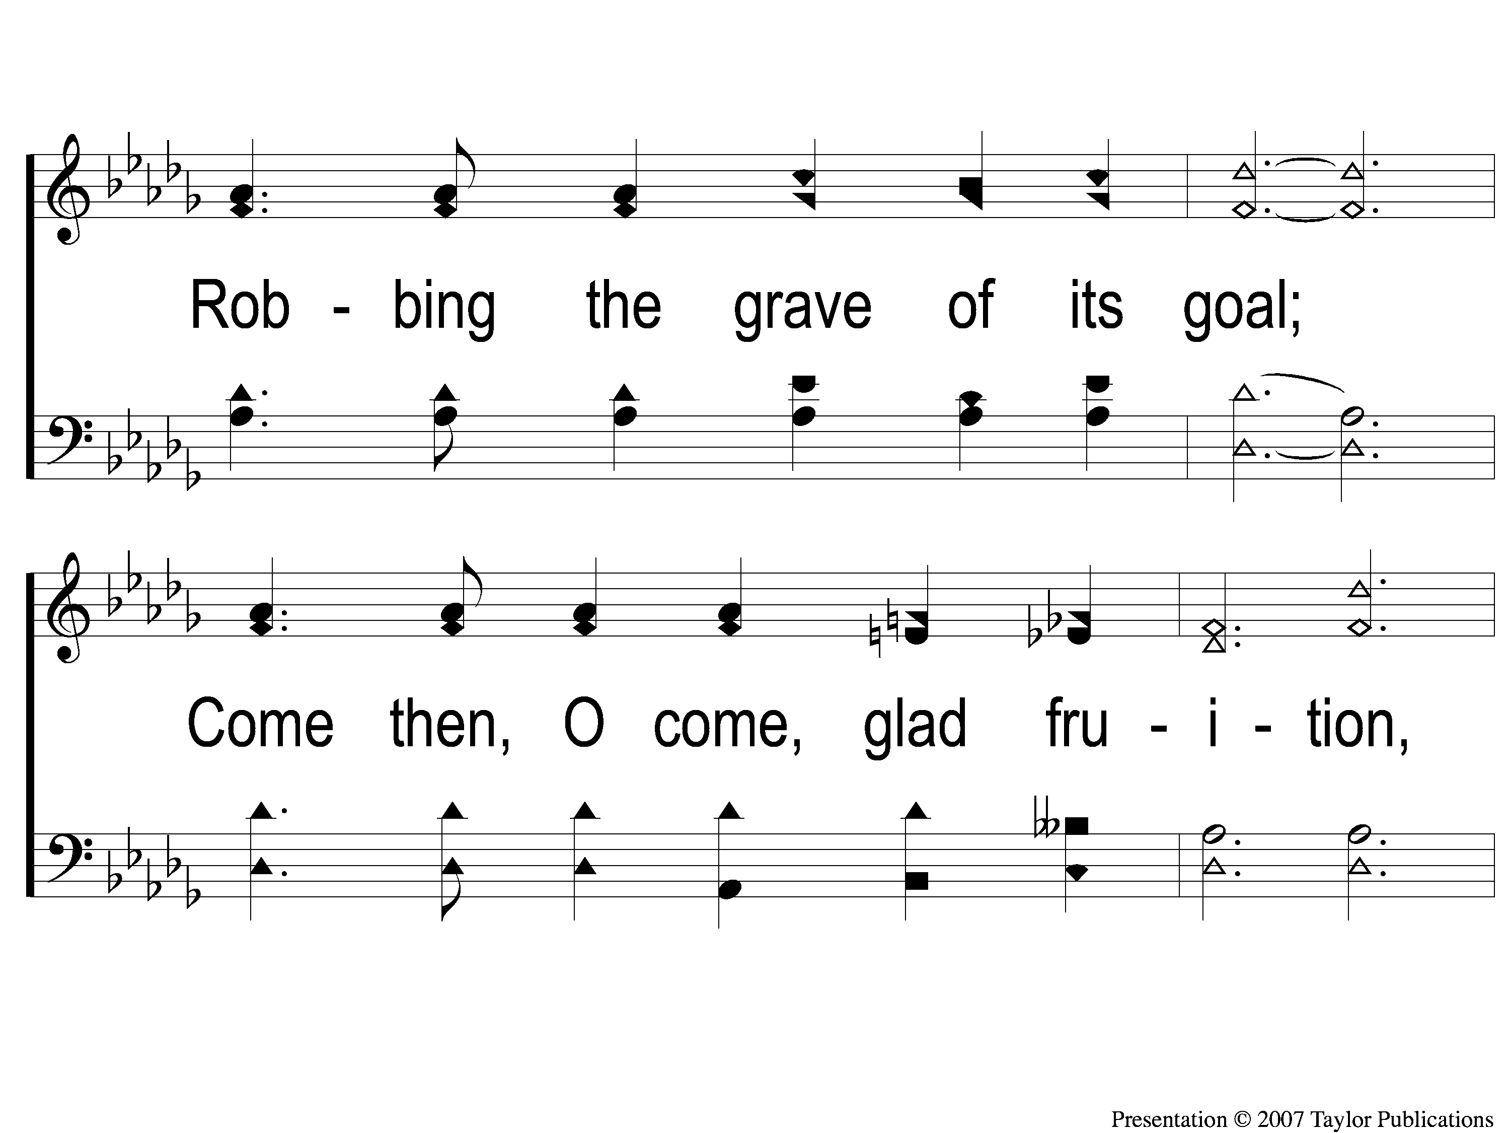
3-2 Whispering Hope
Whispering Hope
497

Slide 27
3-3 Whispering Hope
Whispering Hope
497

Slide 28
C-1 Whispering Hope
Whispering Hope
497

Slide 29
C-2 Whispering Hope
Whispering Hope
497

Slide 30
Opening PRAYER

Slide 31
#421
SONG:
Sweet, Sweet Spirit

Slide 32
1-1 Sweet Sweet Spirit
Sweet, Sweet Spirit
421

Slide 33
1-2 Sweet Sweet Spirit
Sweet, Sweet Spirit
421

Slide 34
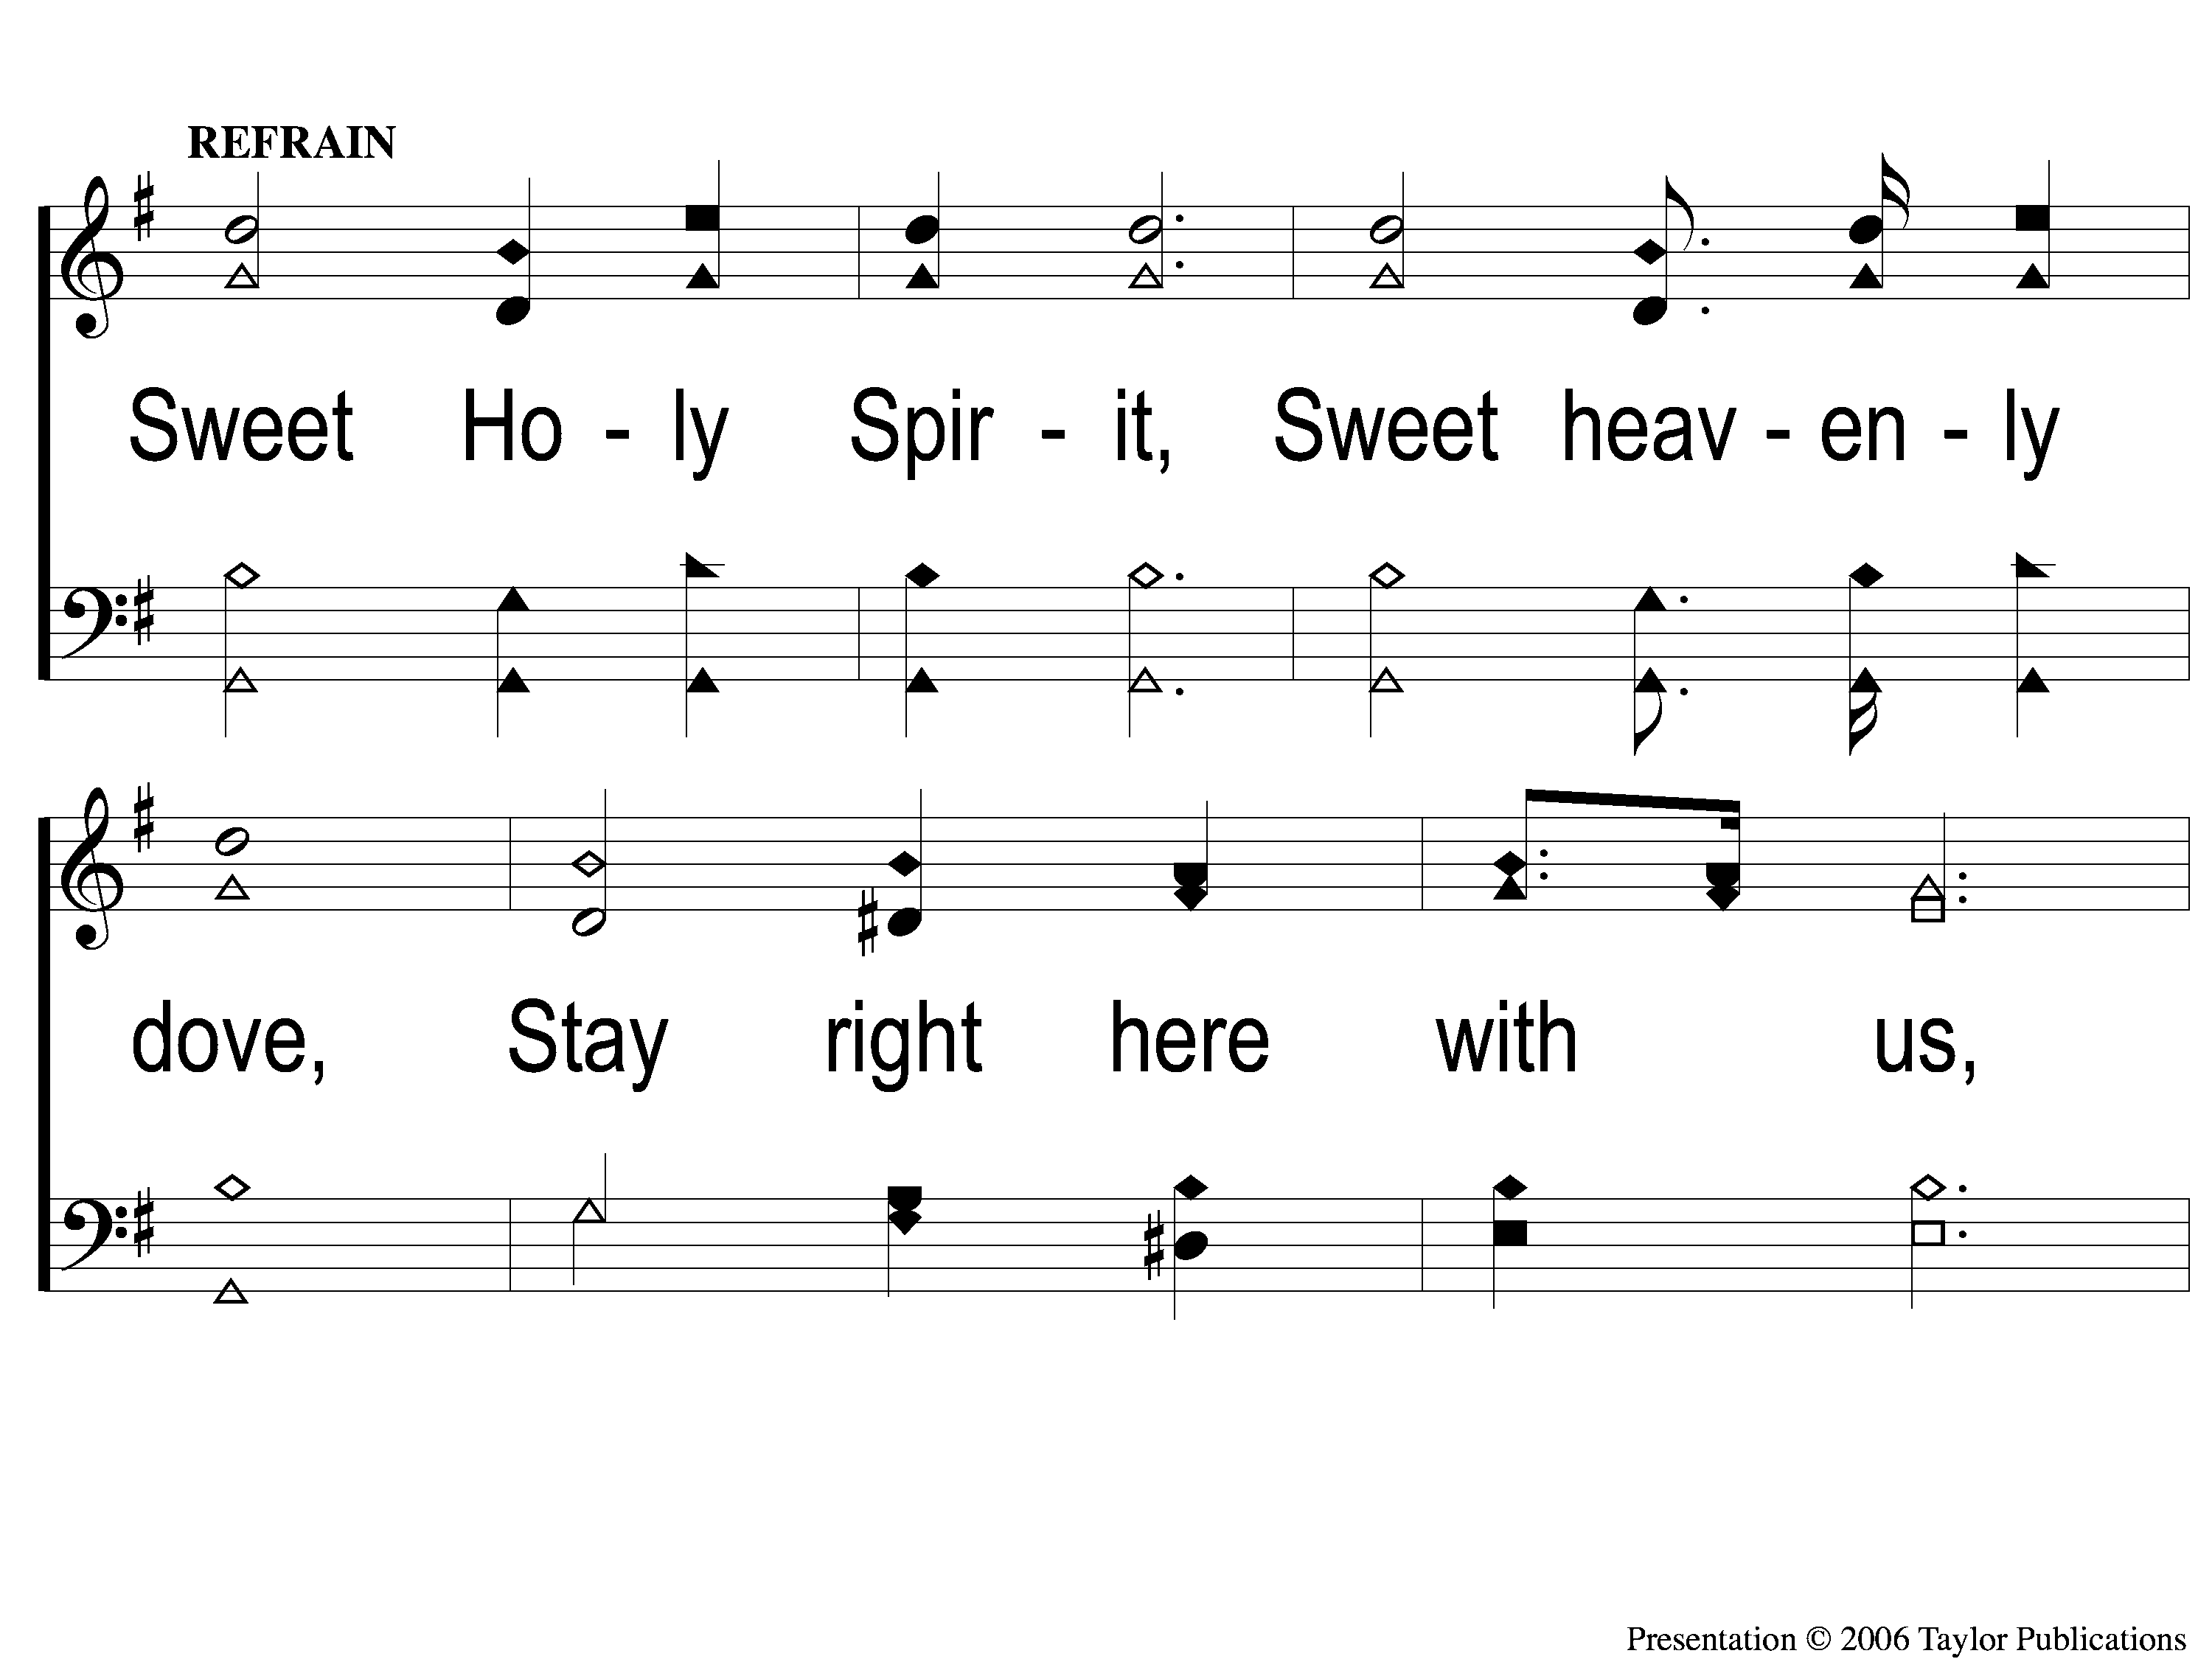
C-1 Sweet Sweet Spirit
Sweet, Sweet Spirit
421

Slide 35
C-2 Sweet Sweet Spirit
Sweet, Sweet Spirit
421

Slide 36
C-3 Sweet Sweet Spirit
Sweet, Sweet Spirit
421

Slide 37
2-1 Sweet Sweet Spirit
Sweet, Sweet Spirit
421

Slide 38
2-2 Sweet Sweet Spirit
Sweet, Sweet Spirit
421

Slide 39
C-1 Sweet Sweet Spirit
Sweet, Sweet Spirit
421

Slide 40
C-2 Sweet Sweet Spirit
Sweet, Sweet Spirit
421

Slide 41
C-3 Sweet Sweet Spirit
Sweet, Sweet Spirit
421

Slide 42
#344
SONG:
Low In The
Grave He Lay

Slide 43
1 Low in the Grave He Lay
Low in the Grave He Lay
344

Slide 44
C-1 Low in the Grave He Lay
Low in the Grave He Lay
344

Slide 45
C-2 Low in the Grave He Lay
Low in the Grave He Lay
344

Slide 46
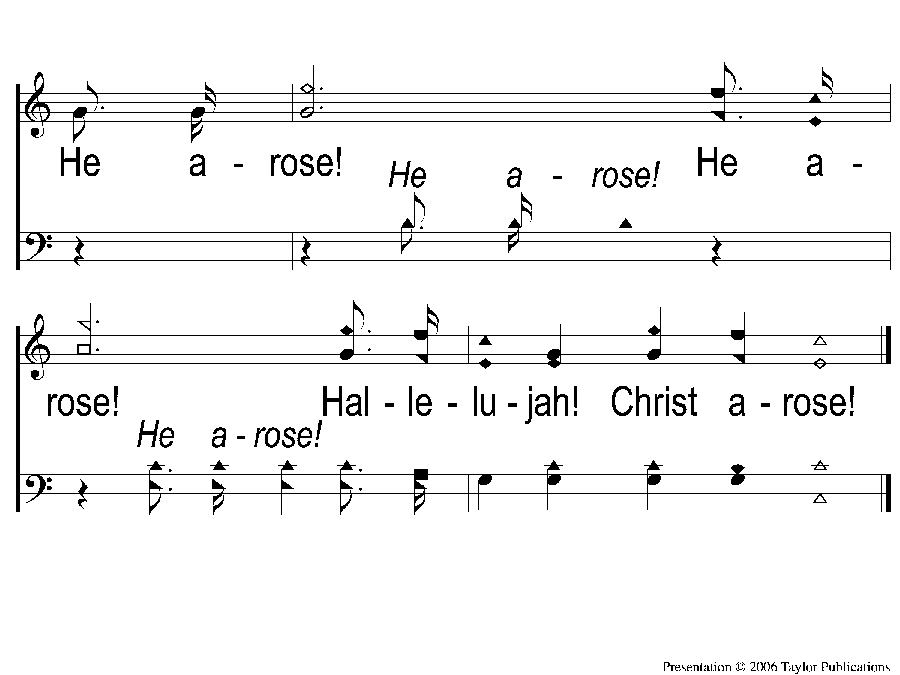
C-3 Low in the Grave He Lay
Low in the Grave He Lay
344

Slide 47
2 Low in the Grave He Lay
Low in the Grave He Lay
344

Slide 48
C-1 Low in the Grave He Lay
Low in the Grave He Lay
344

Slide 49
C-2 Low in the Grave He Lay
Low in the Grave He Lay
344

Slide 50
C-3 Low in the Grave He Lay
Low in the Grave He Lay
344

Slide 51
3 Low in the Grave He Lay
Low in the Grave He Lay
344

Slide 52
C-1 Low in the Grave He Lay
Low in the Grave He Lay
344

Slide 53
C-2 Low in the Grave He Lay
Low in the Grave He Lay
344

Slide 54
C-3 Low in the Grave He Lay
Low in the Grave He Lay
344

Slide 55
SCRIPTURE:
Revelation 15:14-16

Slide 56
THE REVELATION OF JESUS CHRIST
“WHO IS ABLE TO STAND?”
REVELATION 6:17 (NKJV)

Slide 57
THE REVELATION OF JESUS CHRIST
“POUR OUT THE BOWLS OF THE WRATH OF GOD”
REVELATION 16:1 (NKJV)

Slide 58
Two Challenges:
Read through all of the book
Write a one-sentence summary of the book

Slide 59
REVIEW
Ch. 1 – Setting: John’s Exile
Ch. 2-3 –The Messages to the 7 Churches
Ch. 4-7 – The 7 Seals Opened
Ch. 8-11 – The 7 Trumpets Sound
Ch. 12-14 – Visions of the Past, Present, & Future

Slide 60
REVIEW
Ch. 1 – Setting: John’s Exile
Ch. 2-3 –The Messages to the 7 Churches
Ch. 4-7 – The 7 Seals Opened
Ch. 8-11 – The 7 Trumpets Sound
Ch. 12-14 – Visions of the Past, Present, & Future
Ch. 15-16 – The 7 Bowls of God’s Wrath

Slide 61
Ch. 14 – Victory & Punishment
Victory for God’s Faithful (v. 1-13)

Slide 62
Ch. 14 – Victory & Punishment
Victory for God’s Faithful (v. 1-13)
Punishment to the Unrepentant (v. 14-20)

Slide 63
Ch. 14 – Victory & Punishment
Rev. 14:14-20
One “like the Son of Man” seen (Ch. 1)
3 angels with sickles (Joel 3:13, Jer. 51:33)
Complete Judgment executed (v. 20)

Slide 64
Ch. 15 – Prelude to Judgment
God’s People (v.1-4)

Slide 65
Ch. 15 – Prelude to Judgment
God’s People (v.1-4)
Victorious over:

Slide 66
Ch. 15 – Prelude to Judgment
God’s People (v.1-4)
Victorious over:
The Beast
The Beast’s Image
The Beast’s Mark
The Number of the Beast’s name

Slide 67
Ch. 15 – Prelude to Judgment
God’s People (v.1-4)
Singing a New Song

Slide 68
Ch. 15 – Prelude to Judgment
God’s People (v.1-4)
Singing a New Song
Of Moses → Victory over Egypt & Oppression

Slide 69
Ch. 15 – Prelude to Judgment
God’s People (v.1-4)
Singing a New Song
Of Moses → Victory over Egypt & Oppression
Of the Lamb → Victory over death! (5:9-12)

Slide 70
Ch. 15 – Prelude to Judgment
God’s Presence (v.5-8)

Slide 71
Ch. 15 – Prelude to Judgment
God’s Presence (v.5-8)
Inner Sanctuary of the Tabernacle Opened

Slide 72
Ch. 15 – Prelude to Judgment
God’s Presence (v.5-8)
Inner Sanctuary of the Tabernacle Opened
Filled with Smoke = God’s Presence

Slide 73
Ch. 15 – Prelude to Judgment
God’s Presence (v.5-8)
Inner Sanctuary of the Tabernacle Opened
Filled with Smoke = God’s Presence
Comfort for God’s People
Wrath for Everyone Else

Slide 74
Ch. 16 – The 7 Bowls of God’s Wrath
First (v. 2)

Slide 75
Ch. 16 – The 7 Bowls of God’s Wrath
First (v. 2) – Sores – Ex. 9:9-11

Slide 76
Ch. 16 – The 7 Bowls of God’s Wrath
First (v. 2) – Sores – Ex. 9:9-11
Second (v. 3)

Slide 77
Ch. 16 – The 7 Bowls of God’s Wrath
First (v. 2) – Sores – Ex. 9:9-11
Second (v. 3) – Sea → Blood – Ex. 7:17-21

Slide 78
Ch. 16 – The 7 Bowls of God’s Wrath
First (v. 2) – Sores – Ex. 9:9-11
Second (v. 3) – Sea → Blood – Ex. 7:17-21
Third (v. 4-7)

Slide 79
Ch. 16 – The 7 Bowls of God’s Wrath
First (v. 2) – Sores – Ex. 9:9-11
Second (v. 3) – Sea → Blood – Ex. 7:17-21
Third (v. 4-7) – Rivers/Springs → Blood

Slide 80
Ch. 16 – The 7 Bowls of God’s Wrath
First (v. 2) – Sores – Ex. 9:9-11
Second (v. 3) – Sea → Blood – Ex. 7:17-21
Third (v. 4-7) – Rivers/Springs → Blood
Fourth (v. 8-9)

Slide 81
Ch. 16 – The 7 Bowls of God’s Wrath
First (v. 2) – Sores – Ex. 9:9-11
Second (v. 3) – Sea → Blood – Ex. 7:17-21
Third (v. 4-7) – Rivers/Springs → Blood
Fourth (v. 8-9) – Sun scorched mankind

Slide 82
Ch. 16 – The 7 Bowls of God’s Wrath
First (v. 2) – Sores – Ex. 9:9-11
Second (v. 3) – Sea → Blood – Ex. 7:17-21
Third (v. 4-7) – Rivers/Springs → Blood
Fourth (v. 8-9) – Sun scorched mankind
Fifth (v. 10-11)

Slide 83
Ch. 16 – The 7 Bowls of God’s Wrath
First (v. 2) – Sores – Ex. 9:9-11
Second (v. 3) – Sea → Blood – Ex. 7:17-21
Third (v. 4-7) – Rivers/Springs → Blood
Fourth (v. 8-9) – Sun scorched mankind
Fifth (v. 10-11) – Beast’s kingdom → Dark – Ex. 10:23

Slide 84
Ch. 16 – The 7 Bowls of God’s Wrath
Sixth Bowl (v. 12-16)

Slide 85
Ch. 16 – The 7 Bowls of God’s Wrath
Sixth Bowl (v. 12-16)
Euphrates dried up → Access for Parthian Empire

Slide 86
Ch. 16 – The 7 Bowls of God’s Wrath
Sixth Bowl (v. 12-16)
Euphrates dried up → Access for Parthian Empire
3 unclean spirits gather kings for battle at a place: “Armageddon”
Har + Megiddo = Mount Megiddo

Slide 87
Ch. 16 – The 7 Bowls of God’s Wrath
Sixth Bowl (v. 12-16)
Euphrates dried up → Access for Parthian Empire
3 unclean spirits gather kings for battle at a place: “Armageddon”
Har + Megiddo = Mount Megiddo
Valley of Megiddo → Great battles fought!
Psa. 2:2

Slide 88
Ch. 16 – The 7 Bowls of God’s Wrath
Seventh Bowl (v. 17-21)
“It is done!”
Earthquake unlike no other before
“Great City” split in three
Islands/Mountains removed
Hail from Heaven (talent weight = 70-100 lbs)

Slide 89
The Application
1. God’s Judgment is Final
We cannot change His mind
Rome was prophesied to fall before it ever rose to power (Dan. 2:44, Ch. 7)

Slide 90
The Application
2. Judgment Day will be one of these two for all:
Victory
OR
Defeat

Slide 91
Have I Been Buried
& Raised with Christ?

Slide 92
#517
SONG:
Heaven Came Down

Slide 93
1-1 Heaven Came Down
Heaven Came Down
517

Slide 94
1-2 Heaven Came Down
Heaven Came Down
517

Slide 95
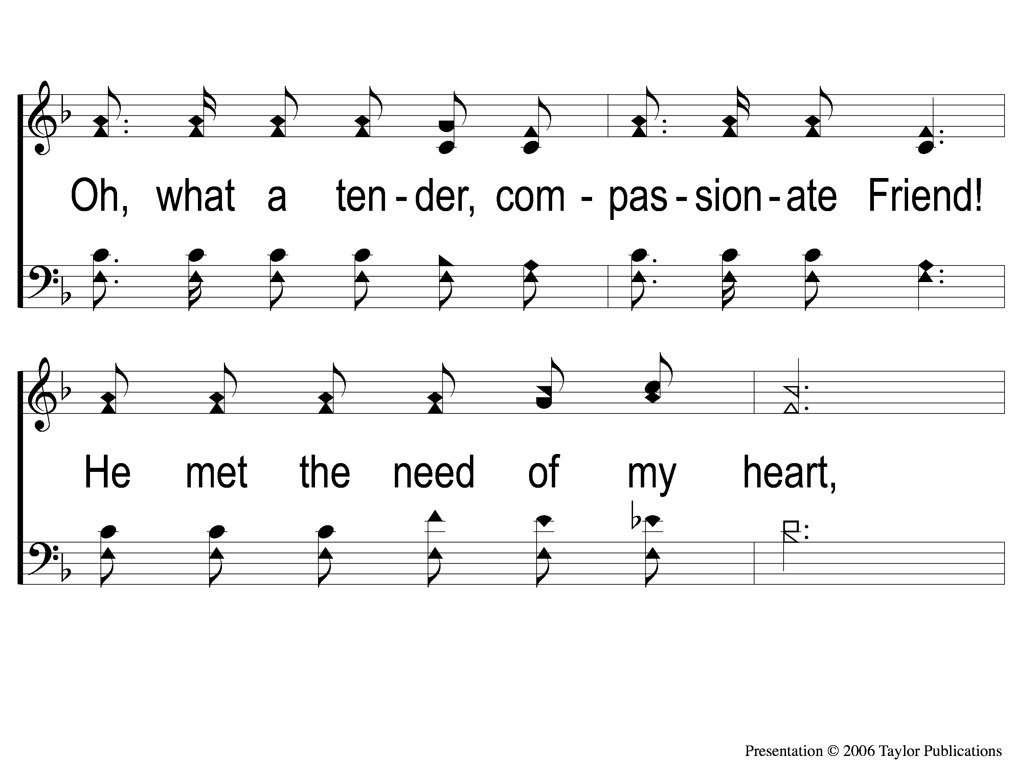
1-3 Heaven Came Down
Heaven Came Down
517

Slide 96
1-4 Heaven Came Down
Heaven Came Down
517

Slide 97
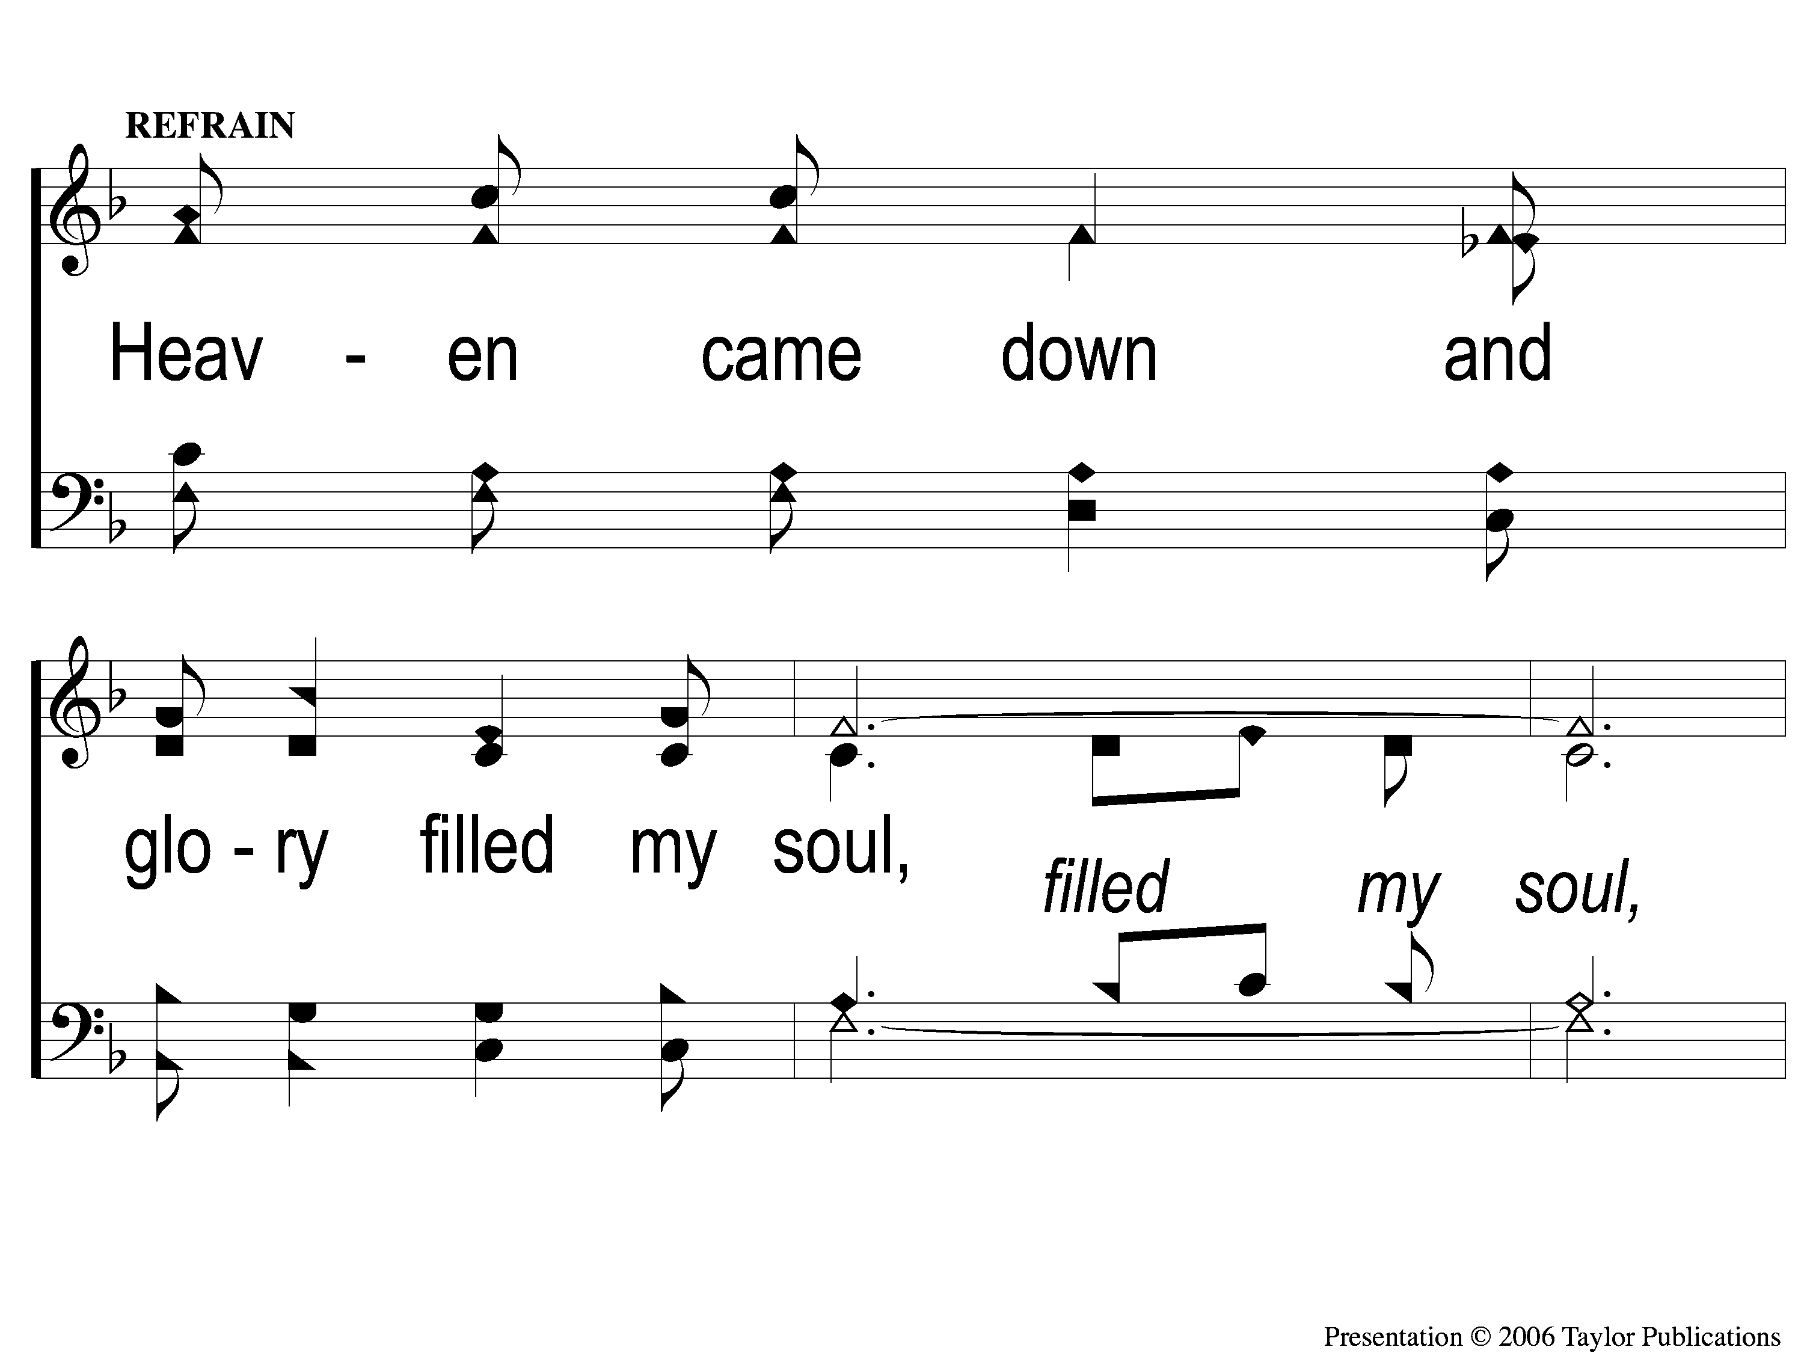
C-1 Heaven Came Down
Heaven Came Down
517

Slide 98
C-2 Heaven Came Down
Heaven Came Down
517

Slide 99
C-3 Heaven Came Down
Heaven Came Down
517

Slide 100
3-1 Heaven Came Down
Heaven Came Down
517

Slide 101
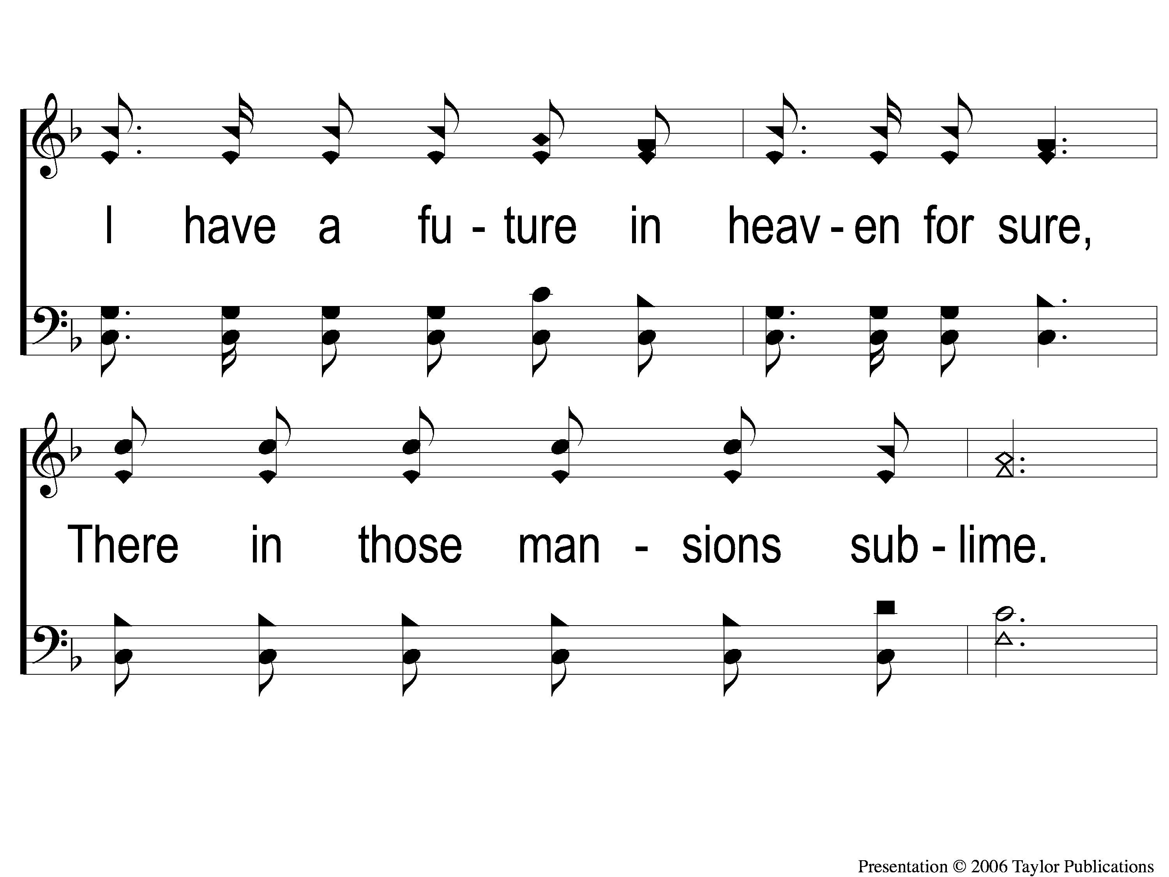
3-2 Heaven Came Down
Heaven Came Down
517

Slide 102
3-3 Heaven Came Down
Heaven Came Down
517

Slide 103
3-4 Heaven Came Down
Heaven Came Down
517

Slide 104
C-1 Heaven Came Down
Heaven Came Down
517

Slide 105
C-2 Heaven Came Down
Heaven Came Down
517

Slide 106
C-3 Heaven Came Down
Heaven Came Down
517

Slide 107
#315
SONG:
When I Survey
The Wondrous Cross

Slide 108
1-1 When I Survey the Wondrous Cross
When I Survey the Wondrous Cross
315

Slide 109
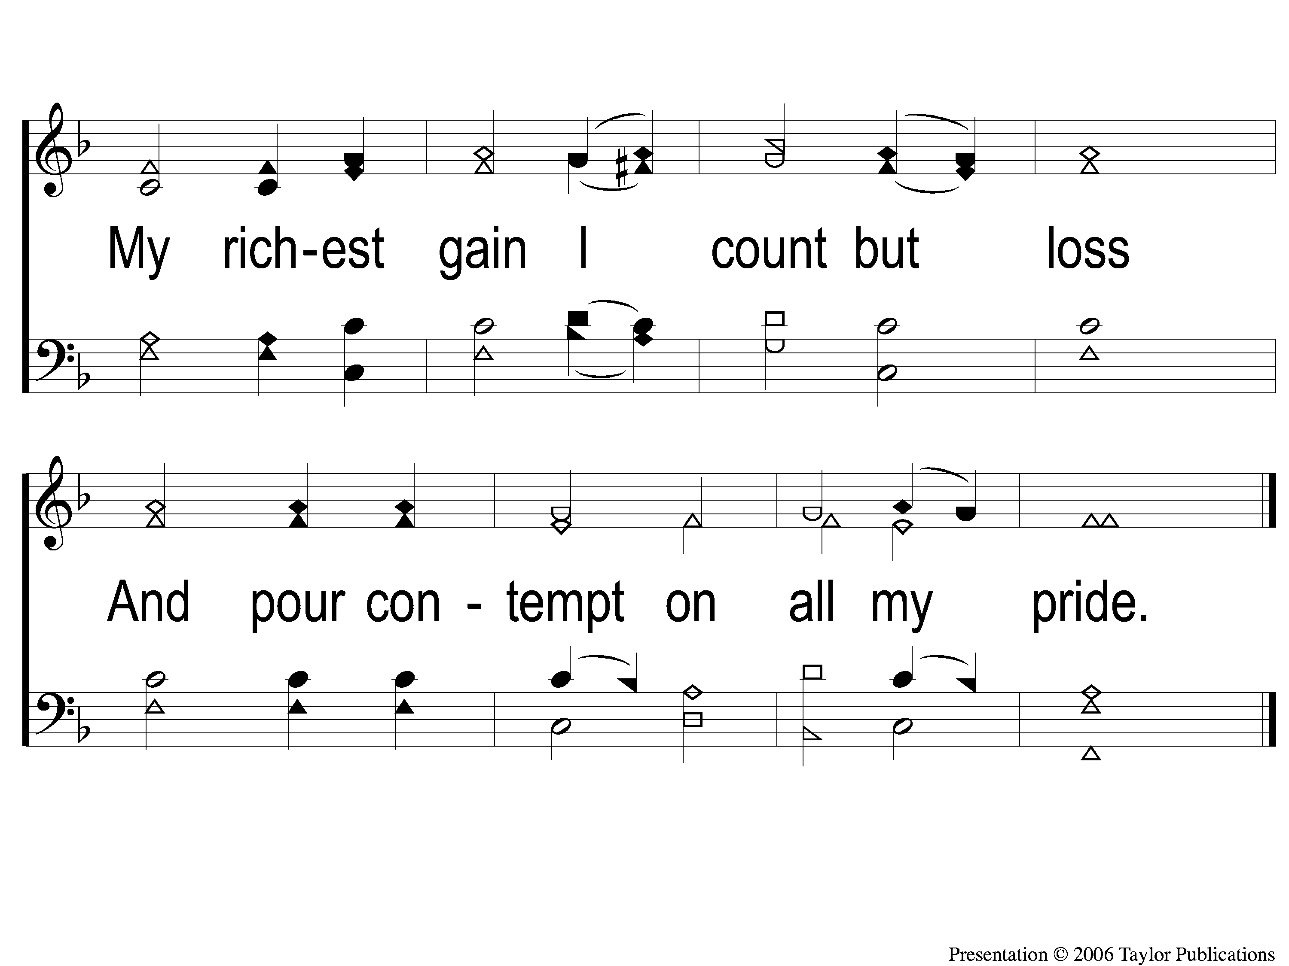
1-2 When I Survey the Wondrous Cross
When I Survey the Wondrous Cross
315

Slide 110
2-1 When I Survey the Wondrous Cross
When I Survey the Wondrous Cross
315

Slide 111
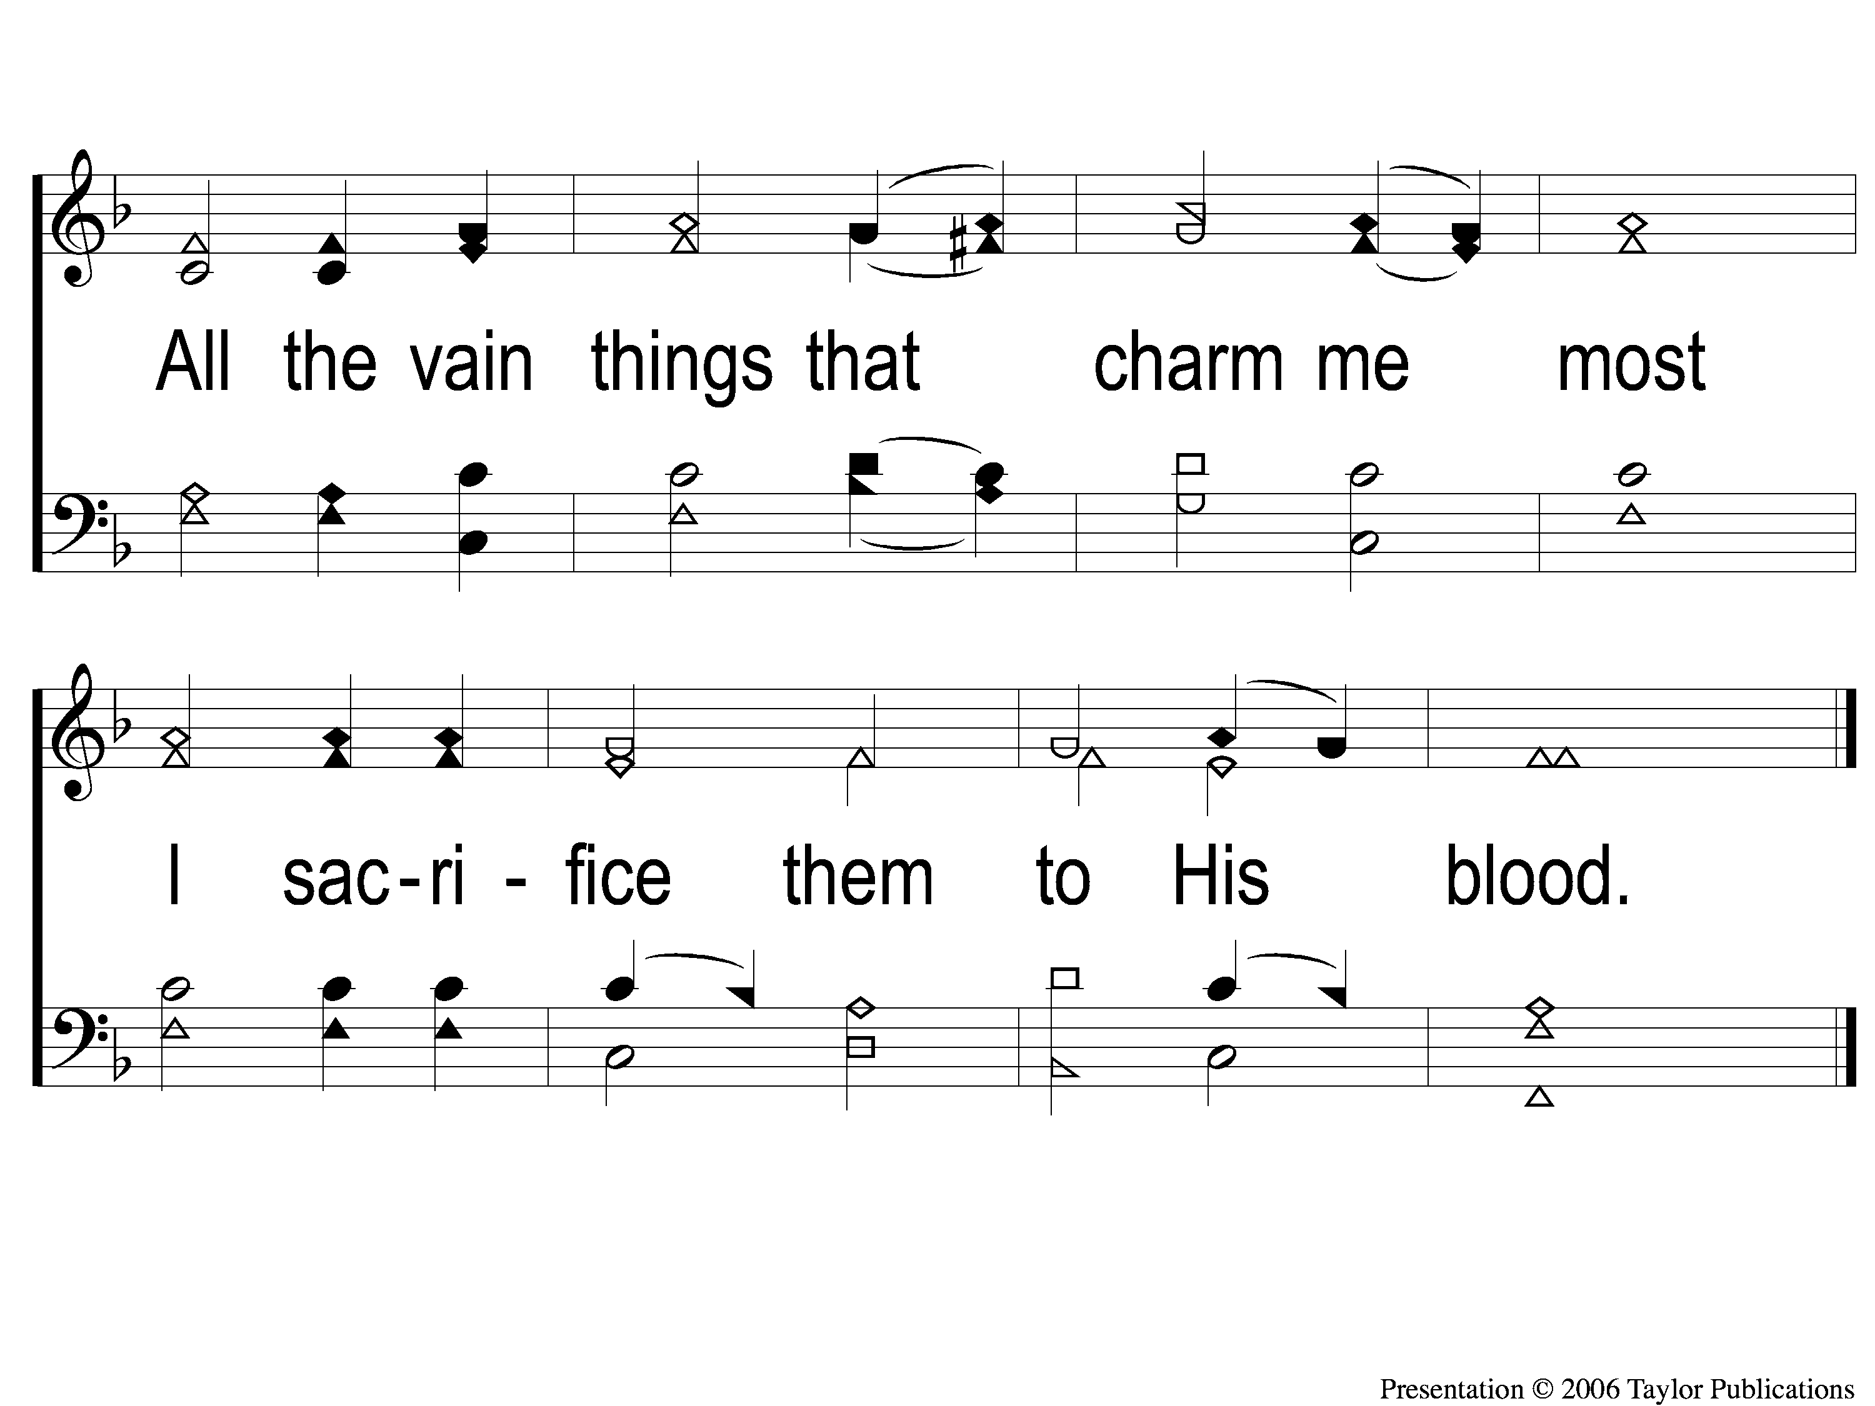
2-2 When I Survey the Wondrous Cross
When I Survey the Wondrous Cross
315

Slide 112
3-1 When I Survey the Wondrous Cross
When I Survey the Wondrous Cross
315

Slide 113
3-2 When I Survey the Wondrous Cross
When I Survey the Wondrous Cross
315

Slide 114
4-1 When I Survey the Wondrous Cross
When I Survey the Wondrous Cross
315

Slide 115
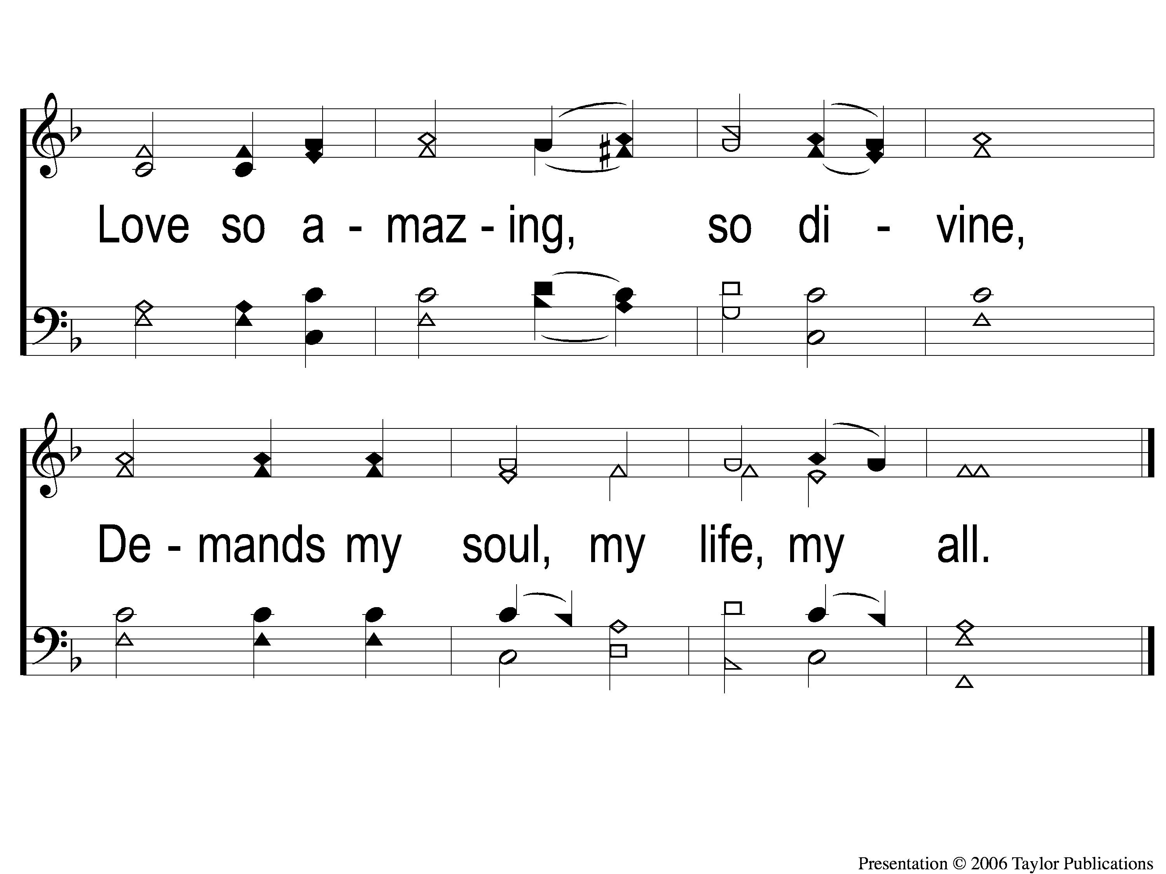
4-2 When I Survey the Wondrous Cross
When I Survey the Wondrous Cross
315

Slide 116
LORD’S SUPPER
The
1 Cor. 11:23-26

Slide 117
Unleavened Bread
LORD’S SUPPER
Therefore, since Christ suffered for us in the flesh, arm yourselves also with the same mind, for he who has suffered in the flesh has ceased from sin, ² that he no longer should live the rest of his time in the flesh for the lusts of men, but for the will of God.
.
1 Peter 4:1-2

Slide 118
Fruit of the Vine
LORD’S SUPPER
And if you call on the Father, who without partiality judges according to each one’s work, conduct yourselves throughout the time of your stay here in fear; ¹⁸ knowing that you were not redeemed with corruptible things, like silver or gold, from your aimless conduct received by tradition from your fathers, ¹⁹ but with the precious blood of Christ, as of a lamb without blemish and without spot.
1 Peter 1:17-19

Slide 119
2 Corinthians 9:7-8
OFFERING
⁷ So let each one give as he purposes in his heart, not grudgingly or of necessity; for God loves a cheerful giver. ⁸ And God is able to make all grace abound toward you, that you, always having all sufficiency in all things, may have an abundance for every good work.

Slide 120
Closing PRAYER

Slide 121
#859
SONG:
When All of God’s Singers Get Home

Slide 122
1-1 When all of God’s Singers get Home
When All Of God’s Singers Get Home
859

Slide 123
1-2 When all of God’s Singers get Home
When All Of God’s Singers Get Home
859

Slide 124
C-1 When all of God’s Singers get Home
When All Of God’s Singers Get Home
859

Slide 125
C-2 When all of God’s Singers get Home
When All Of God’s Singers Get Home
859

Slide 126
2-1 When all of God’s Singers get Home
When All Of God’s Singers Get Home
859

Slide 127
2-2 When all of God’s Singers get Home
When All Of God’s Singers Get Home
859

Slide 128
C-1 When all of God’s Singers get Home
When All Of God’s Singers Get Home
859

Slide 129
C-2 When all of God’s Singers get Home
When All Of God’s Singers Get Home
859

Slide 130
3-1 When all of God’s Singers get Home
When All Of God’s Singers Get Home
859

Slide 131
3-2 When all of God’s Singers get Home
When All Of God’s Singers Get Home
859

Slide 132
C-1 When all of God’s Singers get Home
When All Of God’s Singers Get Home
859

Slide 133
C-2 When all of God’s Singers get Home
When All Of God’s Singers Get Home
859

Slide 134
TONIGHT @ 6:00 pm
JOIN US
HOPE TO SEE YOU THERE!

