Slide 1
1-1 Anywhere with Jesus
Anywhere With Jesus
414

Slide 2
1-2 Anywhere with Jesus
Anywhere With Jesus
414

Slide 3
C-1 Anywhere with Jesus
Anywhere With Jesus
414

Slide 4
4-1 Anywhere with Jesus
Anywhere With Jesus
414

Slide 5
4-2 Anywhere with Jesus
Anywhere With Jesus
414

Slide 6
C-1 Anywhere with Jesus
Anywhere With Jesus
414

Slide 7
RESTORE REBUILD RENEW
welcome
we are glad to
Have you with us
IN 2022
WHEELER
CHURCH
OF
CHRIST

Slide 8
Song:
I Know That My
Redeemer Lives
#528

Slide 9
1-1 I Know That My Redeemer Lives
I Know That My Redeemer Lives
528

Slide 10
1-2 I Know That My Redeemer Lives
I Know That My Redeemer Lives
528

Slide 11
C-1 I Know That My Redeemer Lives
I Know That My Redeemer Lives
528

Slide 12
C-2 I Know That My Redeemer Lives
I Know That My Redeemer Lives
528

Slide 13
2-1 I Know That My Redeemer Lives
I Know That My Redeemer Lives
528

Slide 14
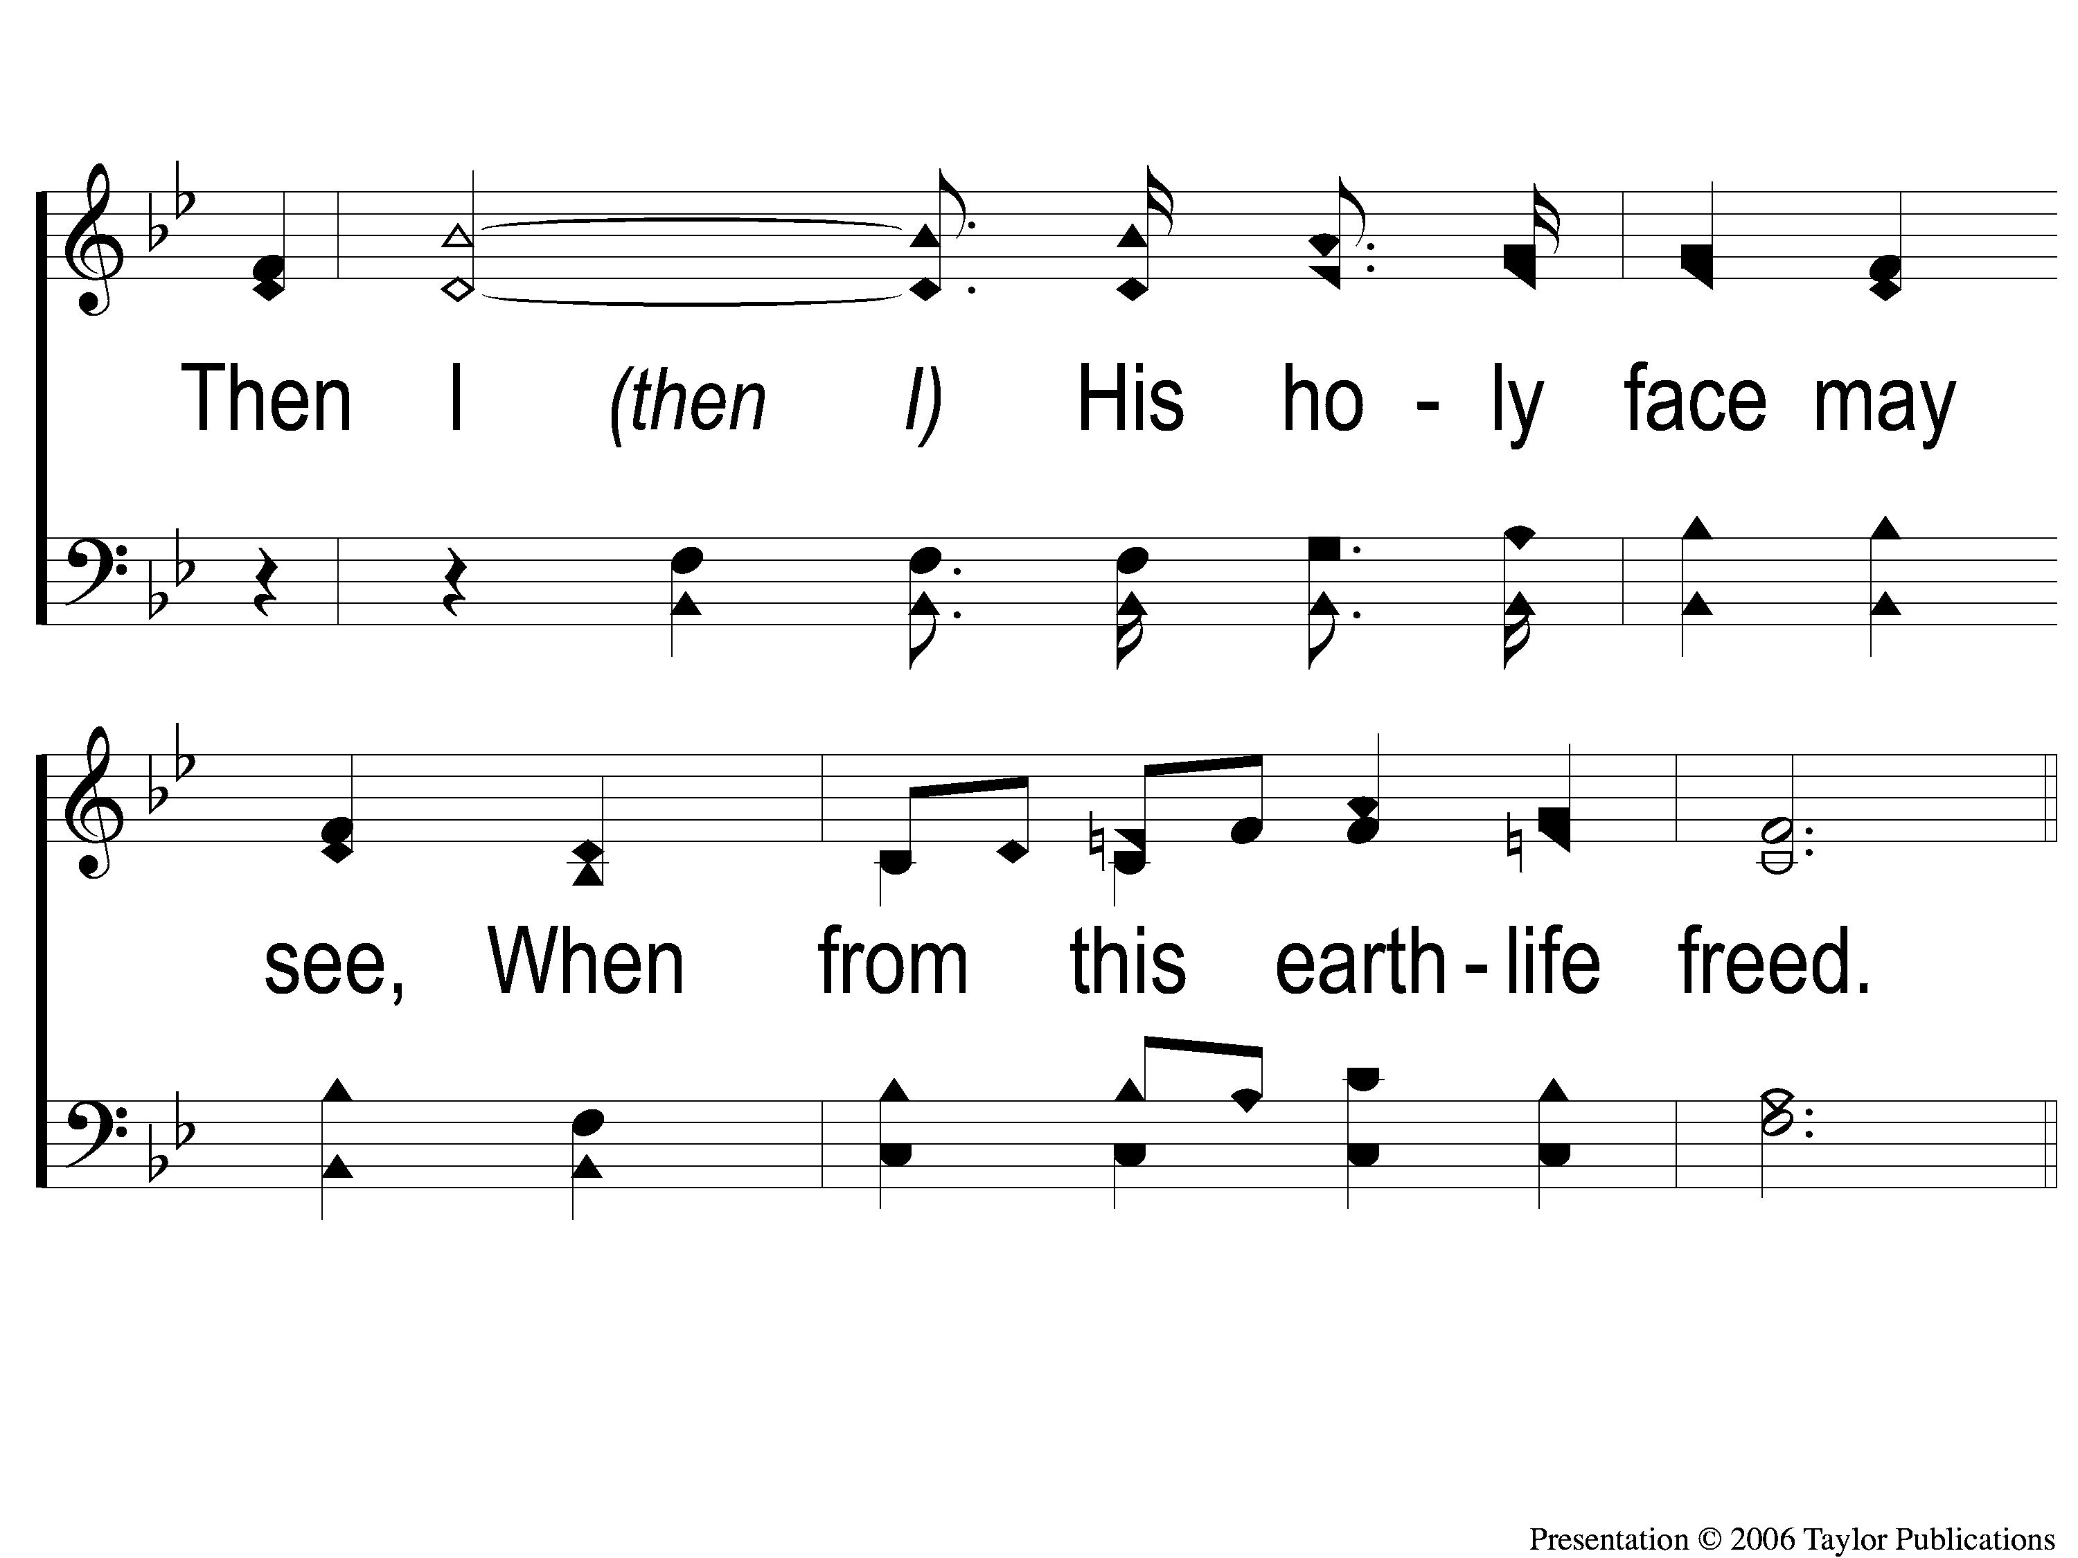
2-2 I Know That My Redeemer Lives
I Know That My Redeemer Lives
528

Slide 15
C-1 I Know That My Redeemer Lives
I Know That My Redeemer Lives
528

Slide 16
C-2 I Know That My Redeemer Lives
I Know That My Redeemer Lives
528

Slide 17
4-1 I Know That My Redeemer Lives
I Know That My Redeemer Lives
528

Slide 18
4-2 I Know That My Redeemer Lives
I Know That My Redeemer Lives
528

Slide 19
C-1 I Know That My Redeemer Lives
I Know That My Redeemer Lives
528

Slide 20
C-2 I Know That My Redeemer Lives
I Know That My Redeemer Lives
528

Slide 21
Song:
Walking Alone At Eve
#874

Slide 22
1-1 Walking Alone at eve
Walking Alone At Eve
874

Slide 23
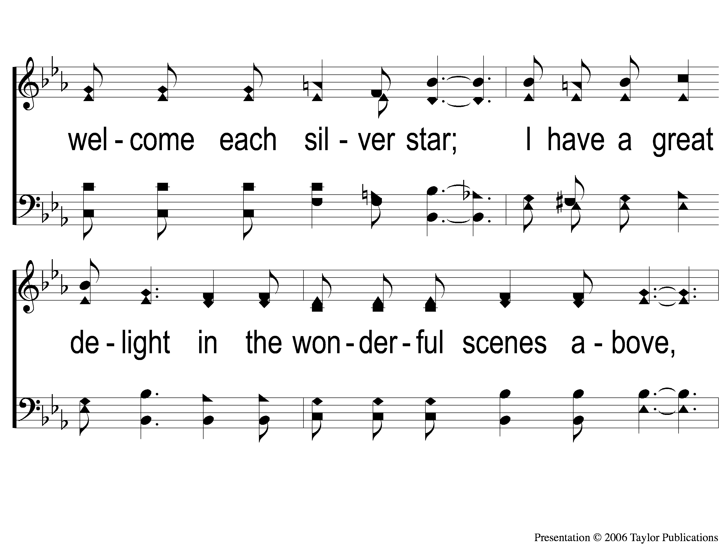
1-2 Walking Alone at eve
Walking Alone At Eve
874

Slide 24
1-3 Walking Alone at eve
Walking Alone At Eve
874

Slide 25
C-1 Walking Alone at eve
Walking Alone At Eve
874

Slide 26
C-2 Walking Alone at eve
Walking Alone At Eve
874

Slide 27
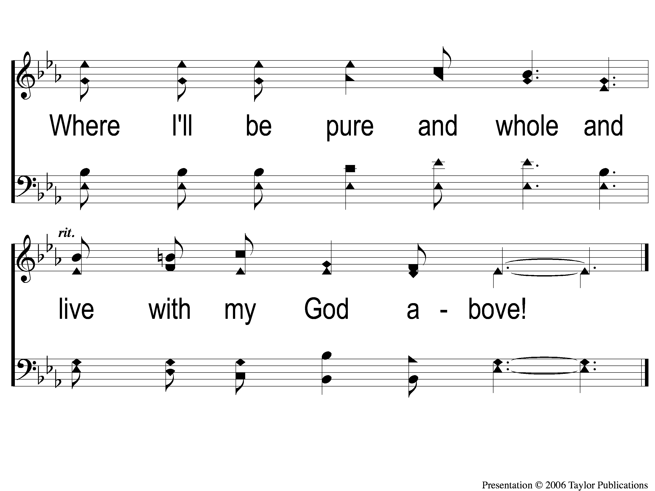
C-3 Walking Alone at eve
Walking Alone At Eve
874

Slide 28
3-1 Walking Alone at eve
Walking Alone At Eve
874

Slide 29
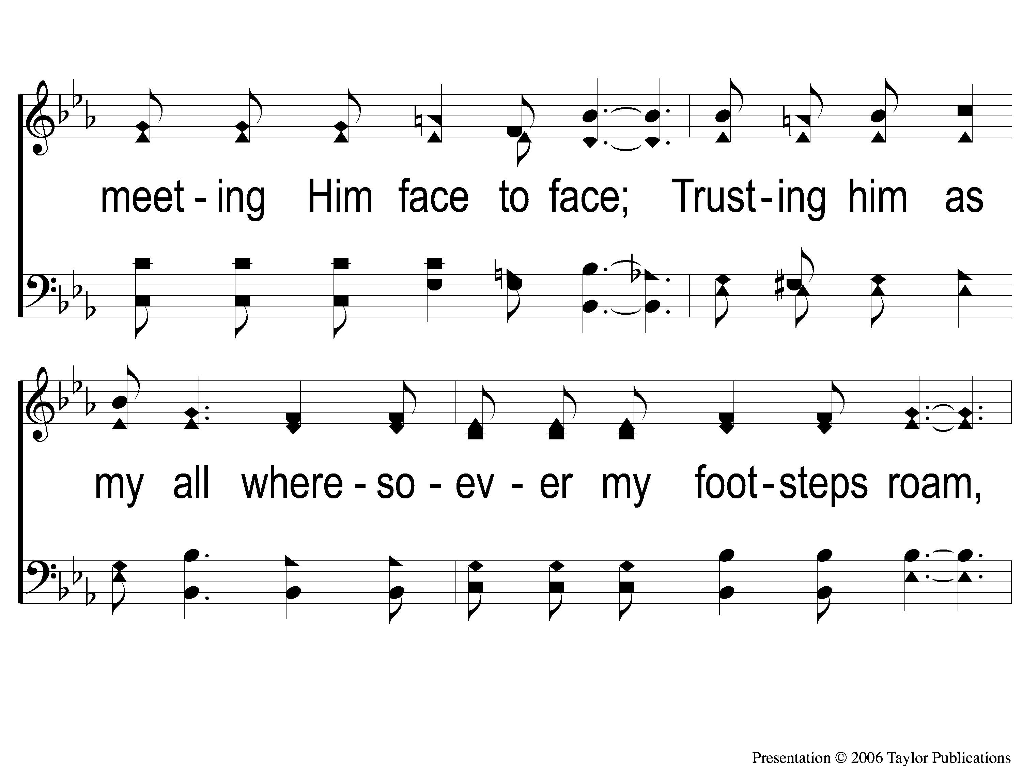
3-2 Walking Alone at eve
Walking Alone At Eve
874

Slide 30
3-3 Walking Alone at eve
Walking Alone At Eve
874

Slide 31
C-1 Walking Alone at eve
Walking Alone At Eve
874

Slide 32
C-2 Walking Alone at eve
Walking Alone At Eve
874

Slide 33
C-3 Walking Alone at eve
Walking Alone At Eve
874

Slide 34
Opening Prayer

Slide 35
Song:
When We All Get To Heaven
#853

Slide 36
1-1 When We All Get To Heaven
When We All Get To Heaven
853

Slide 37
1-2 When We All Get To Heaven
When We All Get To Heaven
853

Slide 38
C-1 When We All Get To Heaven
When We All Get To Heaven
853

Slide 39
C-2 When We All Get To Heaven
When We All Get To Heaven
853

Slide 40
3-1 When We All Get To Heaven
When We All Get To Heaven
853

Slide 41
3-2 When We All Get To Heaven
When We All Get To Heaven
853

Slide 42
C-1 When We All Get To Heaven
When We All Get To Heaven
853

Slide 43
C-2 When We All Get To Heaven
When We All Get To Heaven
853

Slide 44
Song:
The Battle Belongs To The Lord
#749

Slide 45
1-1 The Battle Belongs to the Lord
The Battle Belongs to the Lord
749

Slide 46
1-2 The Battle Belongs to the Lord
The Battle Belongs to the Lord
749

Slide 47
C-1 The Battle Belongs to the Lord
The Battle Belongs to the Lord
749

Slide 48
C-2 The Battle Belongs to the Lord
The Battle Belongs to the Lord
749

Slide 49
2-1 The Battle Belongs to the Lord
The Battle Belongs to the Lord
749

Slide 50
2-2 The Battle Belongs to the Lord
The Battle Belongs to the Lord
749

Slide 51
C-1 The Battle Belongs to the Lord
The Battle Belongs to the Lord
749

Slide 52
C-2 The Battle Belongs to the Lord
The Battle Belongs to the Lord
749

Slide 53
3-1 The Battle Belongs to the Lord
The Battle Belongs to the Lord
749

Slide 54
3-2 The Battle Belongs to the Lord
The Battle Belongs to the Lord
749

Slide 55
C-1 The Battle Belongs to the Lord
The Battle Belongs to the Lord
749

Slide 56
C-2 The Battle Belongs to the Lord
The Battle Belongs to the Lord
749

Slide 57
Scripture Reading:
2 Corinthians 4:1-4

Slide 58
RESTORE REBUILD RENEW
IN 2022

Slide 59
Tonight:
Restoring the
erring
Galatians 6:1

Slide 60
RESTORE REBUILD RENEW
IN 2022

Slide 61
RESTORE OUR SIGHT

Slide 62
does not want you to see
What the
devil

Slide 63
The devil & his dominion
John 12:31 – “ruler of this world”
Eph. 2:2 – “prince of the power of the air”
2 Cor. 4:4 – “the god of this age”

Slide 64
Jesus & his dominion
Acts 3:15 – “the Prince of Life”
Rev. 19:14 – “King of Kings”
Jn. 1:34 – “the Son of God”

Slide 65
Jesus & his work
He gave Truth – Jn. 1:14
He opens Ears – Mk. 7:35
He gives Sight – Matt. 9:29-30
Isa. 29:18, 35:5

Slide 66
The devil & his work
He Lies – Jn. 8:42-44
He Deafens – Jn. 8:47
He Blinds – 2 Cor. 4:4

Slide 67
The devil does not want you to see:

Slide 68
The devil does not want you to see:
The Folly of Sin

Slide 69
The Folly of Sin
Sin’s Short-lived Pleasures – Heb. 11:25

Slide 70
The Folly of Sin
Sin’s Short-lived Pleasures – Heb. 11:25
Sin’s Effects On Others – Josh. 7:1ff

Slide 71
The Folly of Sin
Sin’s Short-lived Pleasures – Heb. 11:25
Sin’s Effects On Others – Josh. 7:1ff
Sin’s Progressive Nature – Jms. 1:14-15

Slide 72
The Folly of Sin
Sin’s Short-lived Pleasures – Heb. 11:25
Sin’s Effects On Others – Josh. 7:1ff
Sin’s Progressive Nature – Jms. 1:14-15
Where Sin Leads – Matt. 25:41

Slide 73
The devil does not want you to see:
The Folly of Sin
The Glory of Heaven – 2 Cor. 4:4, 6

Slide 74
The Glory of Heaven
The Rapture of the Saved – Matt. 25:21

Slide 75
The Glory of Heaven
The Rapture of the Saved – Matt. 25:21
The Residence of God – Heb. 9;24

Slide 76
The Glory of Heaven
The Rapture of the Saved – Matt. 25:21
The Residence of God – Heb. 9;24
The Raising of Voices – Rev. 7:9-15

Slide 77
The Glory of Heaven
The Rapture of the Saved – Matt. 25:21
The Residence of God – Heb. 9;24
The Raising of Voices – Rev. 7:9-15
The Reality of Heaven – Jn. 14:1-3

Slide 78
The Glory of Heaven
The Rapture of the Saved – Matt. 25:21
The Residence of God – Heb. 9;24
The Raising of Voices – Rev. 7:9-15
The Reality of Heaven – Jn. 14:1-3
The Relief from Suffering – 2 Cor. 4:17

Slide 79
The devil does not want you to see:
The Folly of Sin
The Glory of Heaven
The Beauty of Fellowship

Slide 80
The Beauty of Fellowship
Its Goodness – Psa. 133, Acts 2:46

Slide 81
The Beauty of Fellowship
Its Goodness – Psa. 133, Acts 2:46
Its Encouragement – Heb. 10:24-25

Slide 82
The Beauty of Fellowship
Its Goodness – Psa. 133, Acts 2:46
Its Encouragement – Heb. 10:24-25
The Possible Discouragement

Slide 83
The devil does not want you to see:
The Folly of Sin
The Glory of Heaven
The Beauty of Fellowship
The Hurry of God’s Forgiveness

Slide 84
The Hurry of God’s Forgiveness
God Is Ready To Forgive Any Sin
Psa. 86:5, Lk. 15:20-24

Slide 85
The Hurry of God’s Forgiveness
God Is Ready To Forgive Any Sin
Psa. 86:5a, Lk. 15:20-24
God Is Able To Forgive Any Sin
Psa. 86:5b

Slide 86
The devil does not want you to see:
The Folly of Sin
The Glory of Heaven
The Beauty of Fellowship
The Hurry of God’s Forgiveness

Slide 87
God Is Ready To Forgive;
Are You Ready?

Slide 88
Invitation
Song:
Sowing The Seed
Of The Kingdom
#643

Slide 89
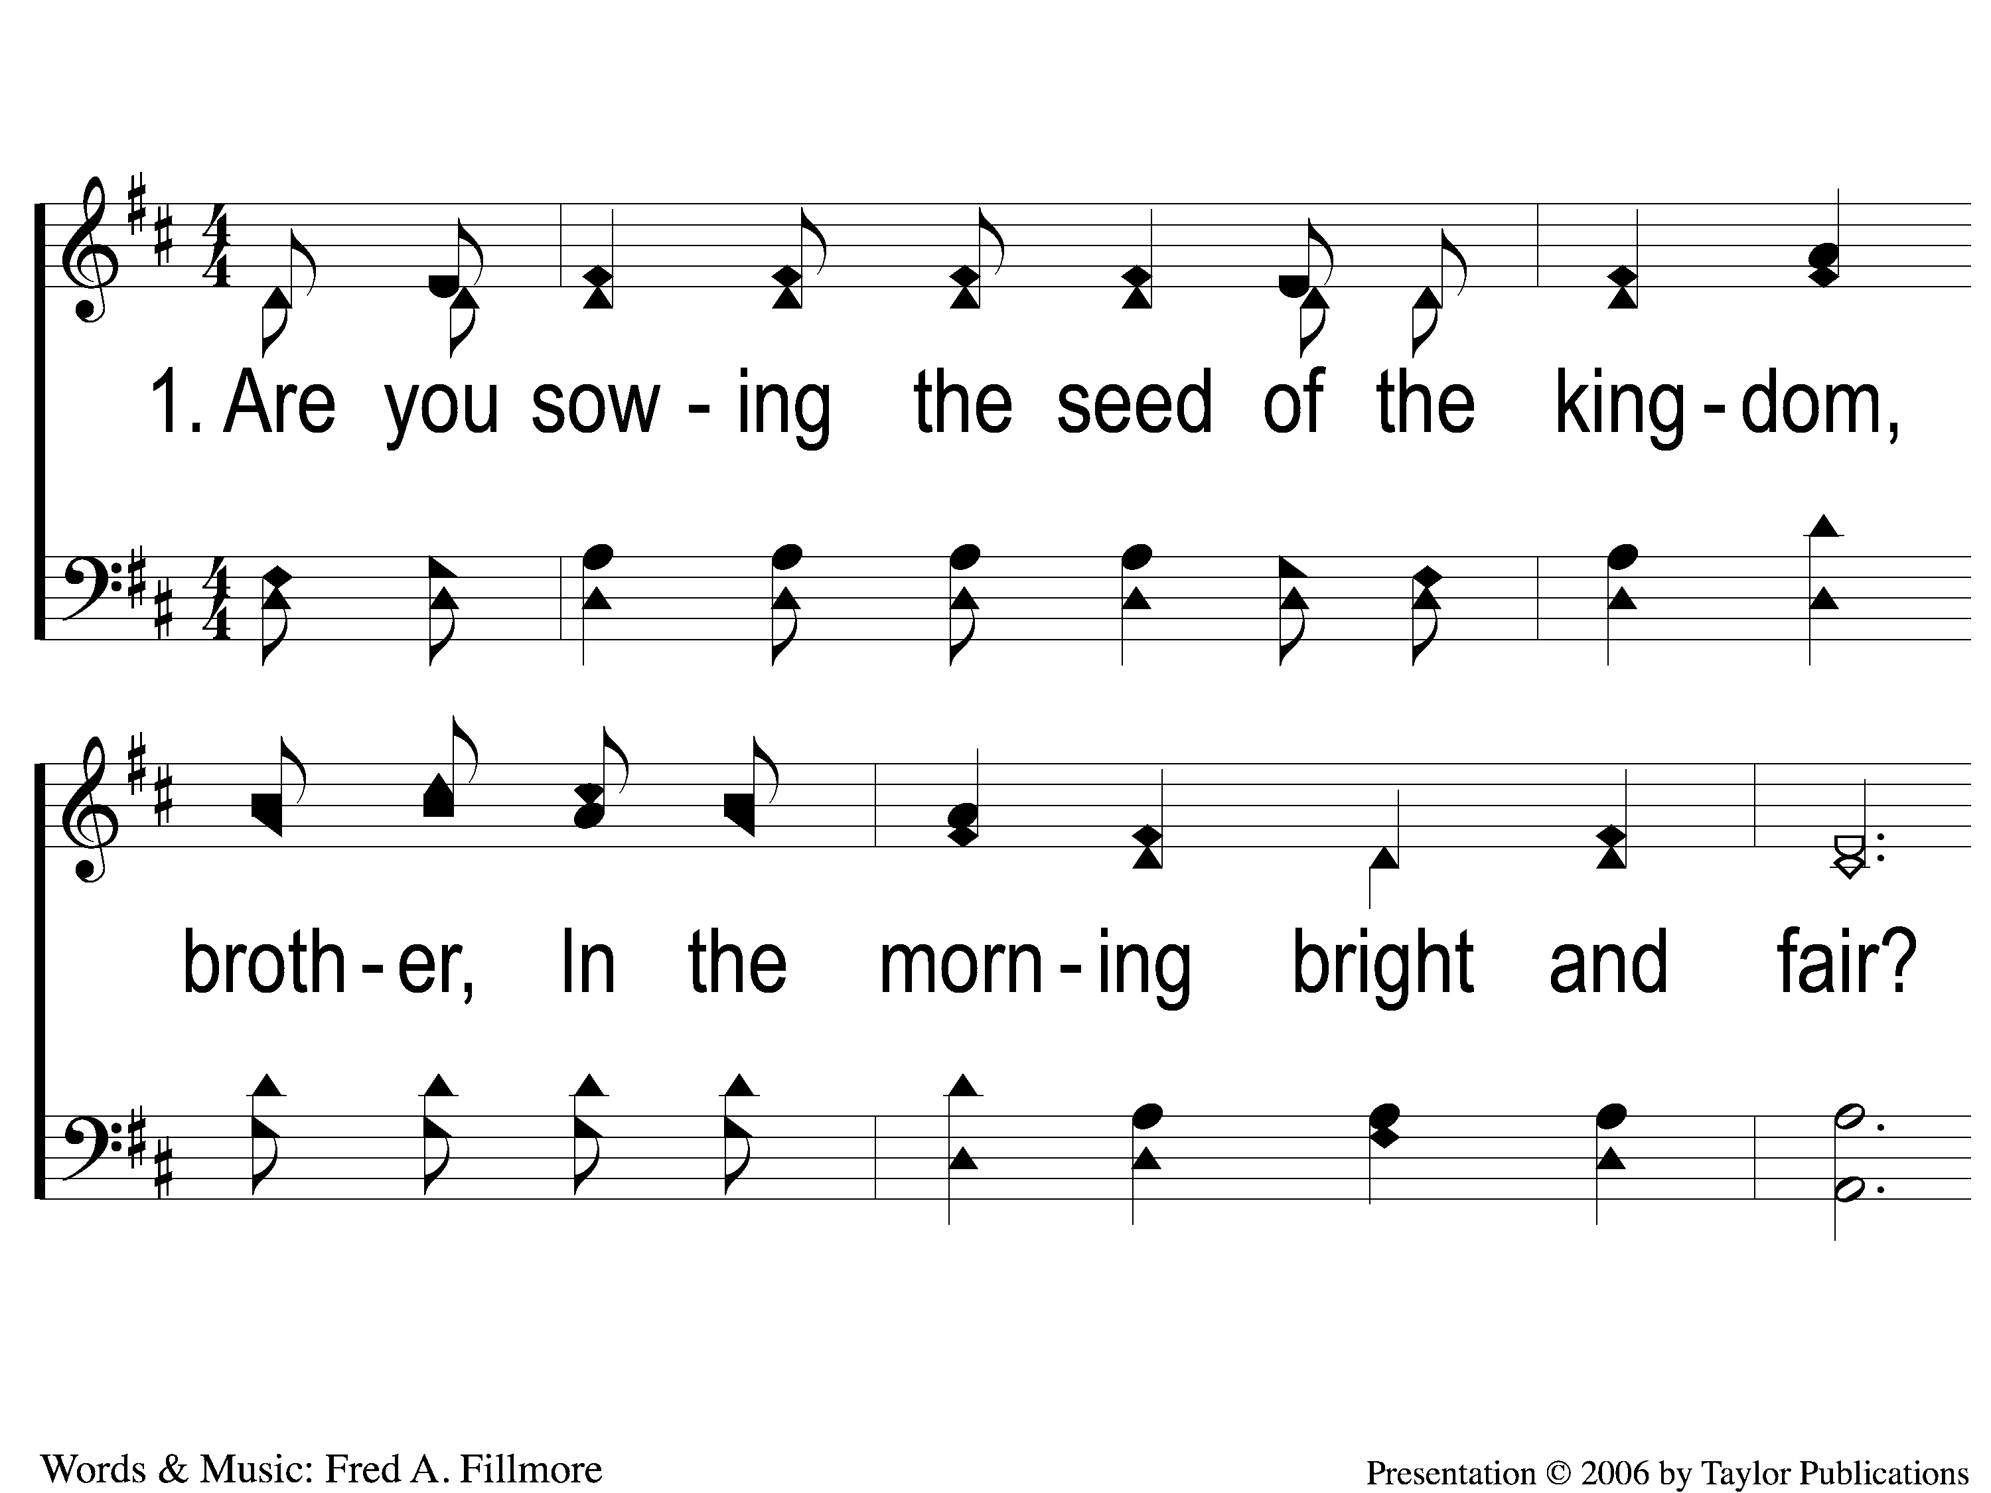
1-1 Sowing the Seed of the Kingdom
Sowing The Seed Of The Kingdom
643

Slide 90
1-2 Sowing the Seed of the Kingdom
Sowing The Seed Of The Kingdom
643

Slide 91
C-1 Sowing the Seed of the Kingdom
Sowing The Seed Of The Kingdom
643

Slide 92
C-2 Sowing the Seed of the Kingdom
Sowing The Seed Of The Kingdom
643

Slide 93
3-1 Sowing the Seed of the Kingdom
Sowing The Seed Of The Kingdom
643

Slide 94
3-2 Sowing the Seed of the Kingdom
Sowing The Seed Of The Kingdom
643

Slide 95
C-1 Sowing the Seed of the Kingdom
Sowing The Seed Of The Kingdom
643

Slide 96
C-2 Sowing the Seed of the Kingdom
Sowing The Seed Of The Kingdom
643

Slide 97
The Contribution:
Acts 20:35
“I have shown you in every way, rby laboring like this, that you must support the weak. And remember the words of the Lord Jesus, that He said, ‘It is more blessed to give than to receive.’ ”

Slide 98
Song:
By Christ Redeemed
#366

Slide 99
1-1 By Christ Redeemed
By Christ Redeemed
366

Slide 100
1-2 By Christ Redeemed
By Christ Redeemed
366

Slide 101
2-1 By Christ Redeemed
By Christ Redeemed
366

Slide 102
2-2 By Christ Redeemed
By Christ Redeemed
366

Slide 103
3-1 By Christ Redeemed
By Christ Redeemed
366

Slide 104
3-2 By Christ Redeemed
By Christ Redeemed
366

Slide 105
The Unleavened Bread
Acts 2:42
“And they continued steadfastly in the apostles’ doctrine and fellowship, in the breaking of bread, and in prayers.”

Slide 106
The Fruit
of the Vine
1 Cor. 11:23-26
“The Lord Jesus on the same night in which He was betrayed took bread…In the same manner He also took the cup after supper, saying, ‘This cup is the new covenant in My blood. This do, as often as you drink it, in remembrance of Me.’ For as often as you eat this bread and drink this cup, you proclaim the Lord’s death till He comes.

Slide 107
Closing Prayer

Slide 108
Song:
He Keeps Me Singing
#615

Slide 109
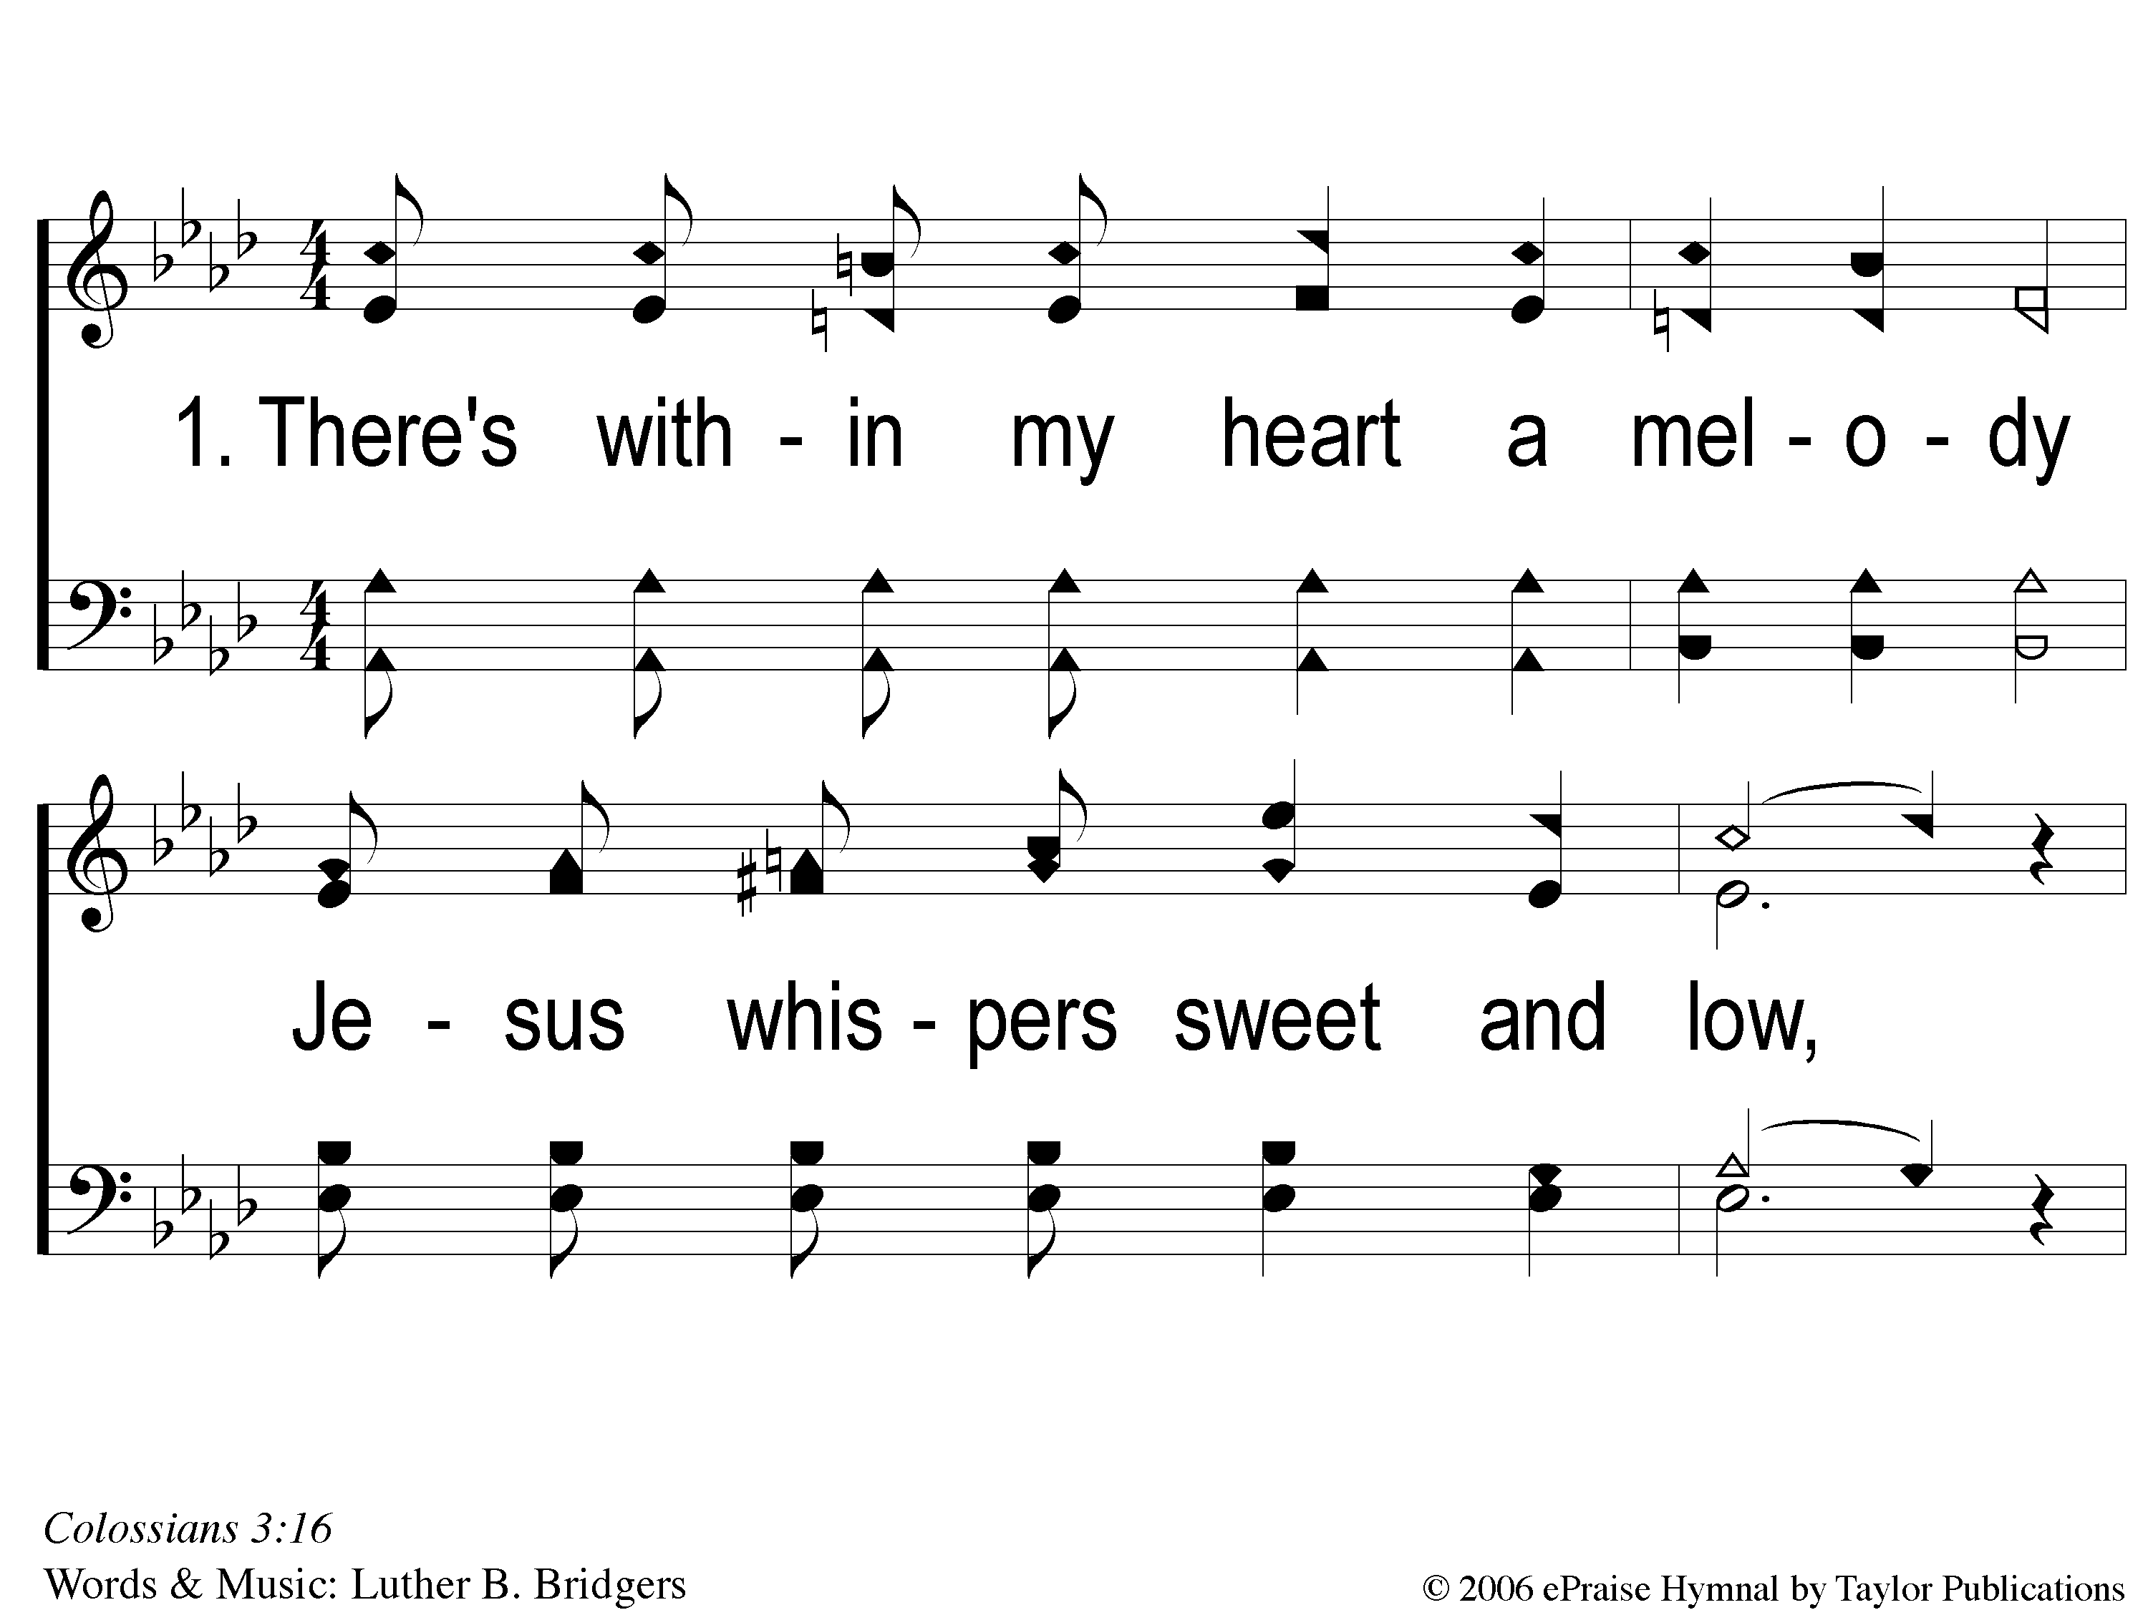
1-1 He Keeps Me Singing
He Keeps Me Singing
615

Slide 110
1-2 He Keeps Me Singing
He Keeps Me Singing
615

Slide 111
C-1 He Keeps Me Singing
He Keeps Me Singing
615

Slide 112
3-1 He Keeps Me Singing
He Keeps Me Singing
615

Slide 113
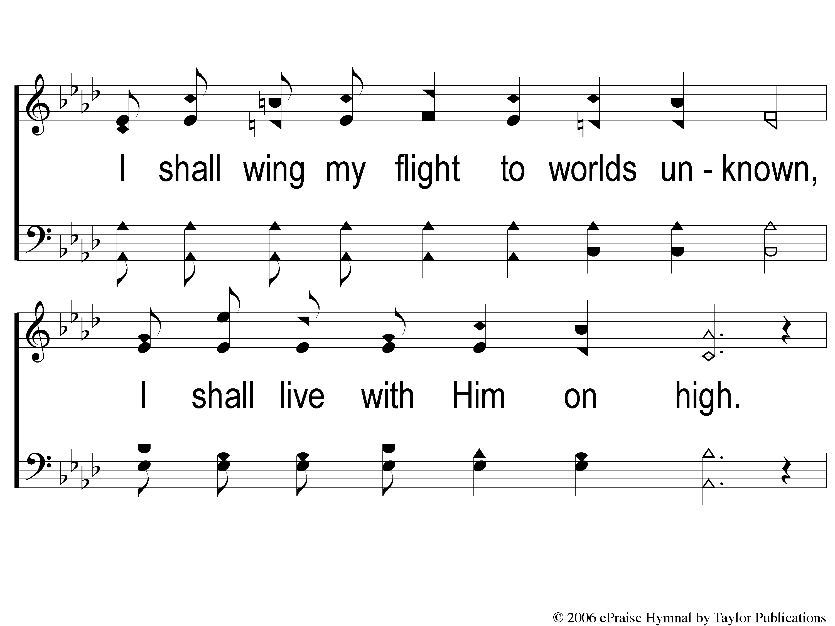
3-2 He Keeps Me Singing
He Keeps Me Singing
615

Slide 114
C-1 He Keeps Me Singing
He Keeps Me Singing
615

Slide 115
Tonight
Worship @ 6:00 PM
Wednesday
Worship/Classes @ 6:30 pm
RESTORE REBUILD RENEW
IN 2022
WHEELER
CHURCH
OF
CHRIST

