Slide 1
1-1 In the Garden
I Come to the Garden Alone
595

Slide 2
1-2 In the Garden
I Come to the Garden Alone
595

Slide 3
C-1 In the Garden
I Come to the Garden Alone
595

Slide 4
C-2 In the Garden
I Come to the Garden Alone
595

Slide 5
3-1 In the Garden
I Come to the Garden Alone
595

Slide 6
3-2 In the Garden
I Come to the Garden Alone
595

Slide 7
C-1 In the Garden
I Come to the Garden Alone
595

Slide 8
C-2 In the Garden
I Come to the Garden Alone
595

Slide 9
WELCOME
To the Wheeler church of Christ

Slide 10
SONG:
This world is not my home
#957

Slide 11
1-1 This World is Not My Home
This World Is Not My Home
957

Slide 12
1-2 This World is Not My Home
This World Is Not My Home
957

Slide 13
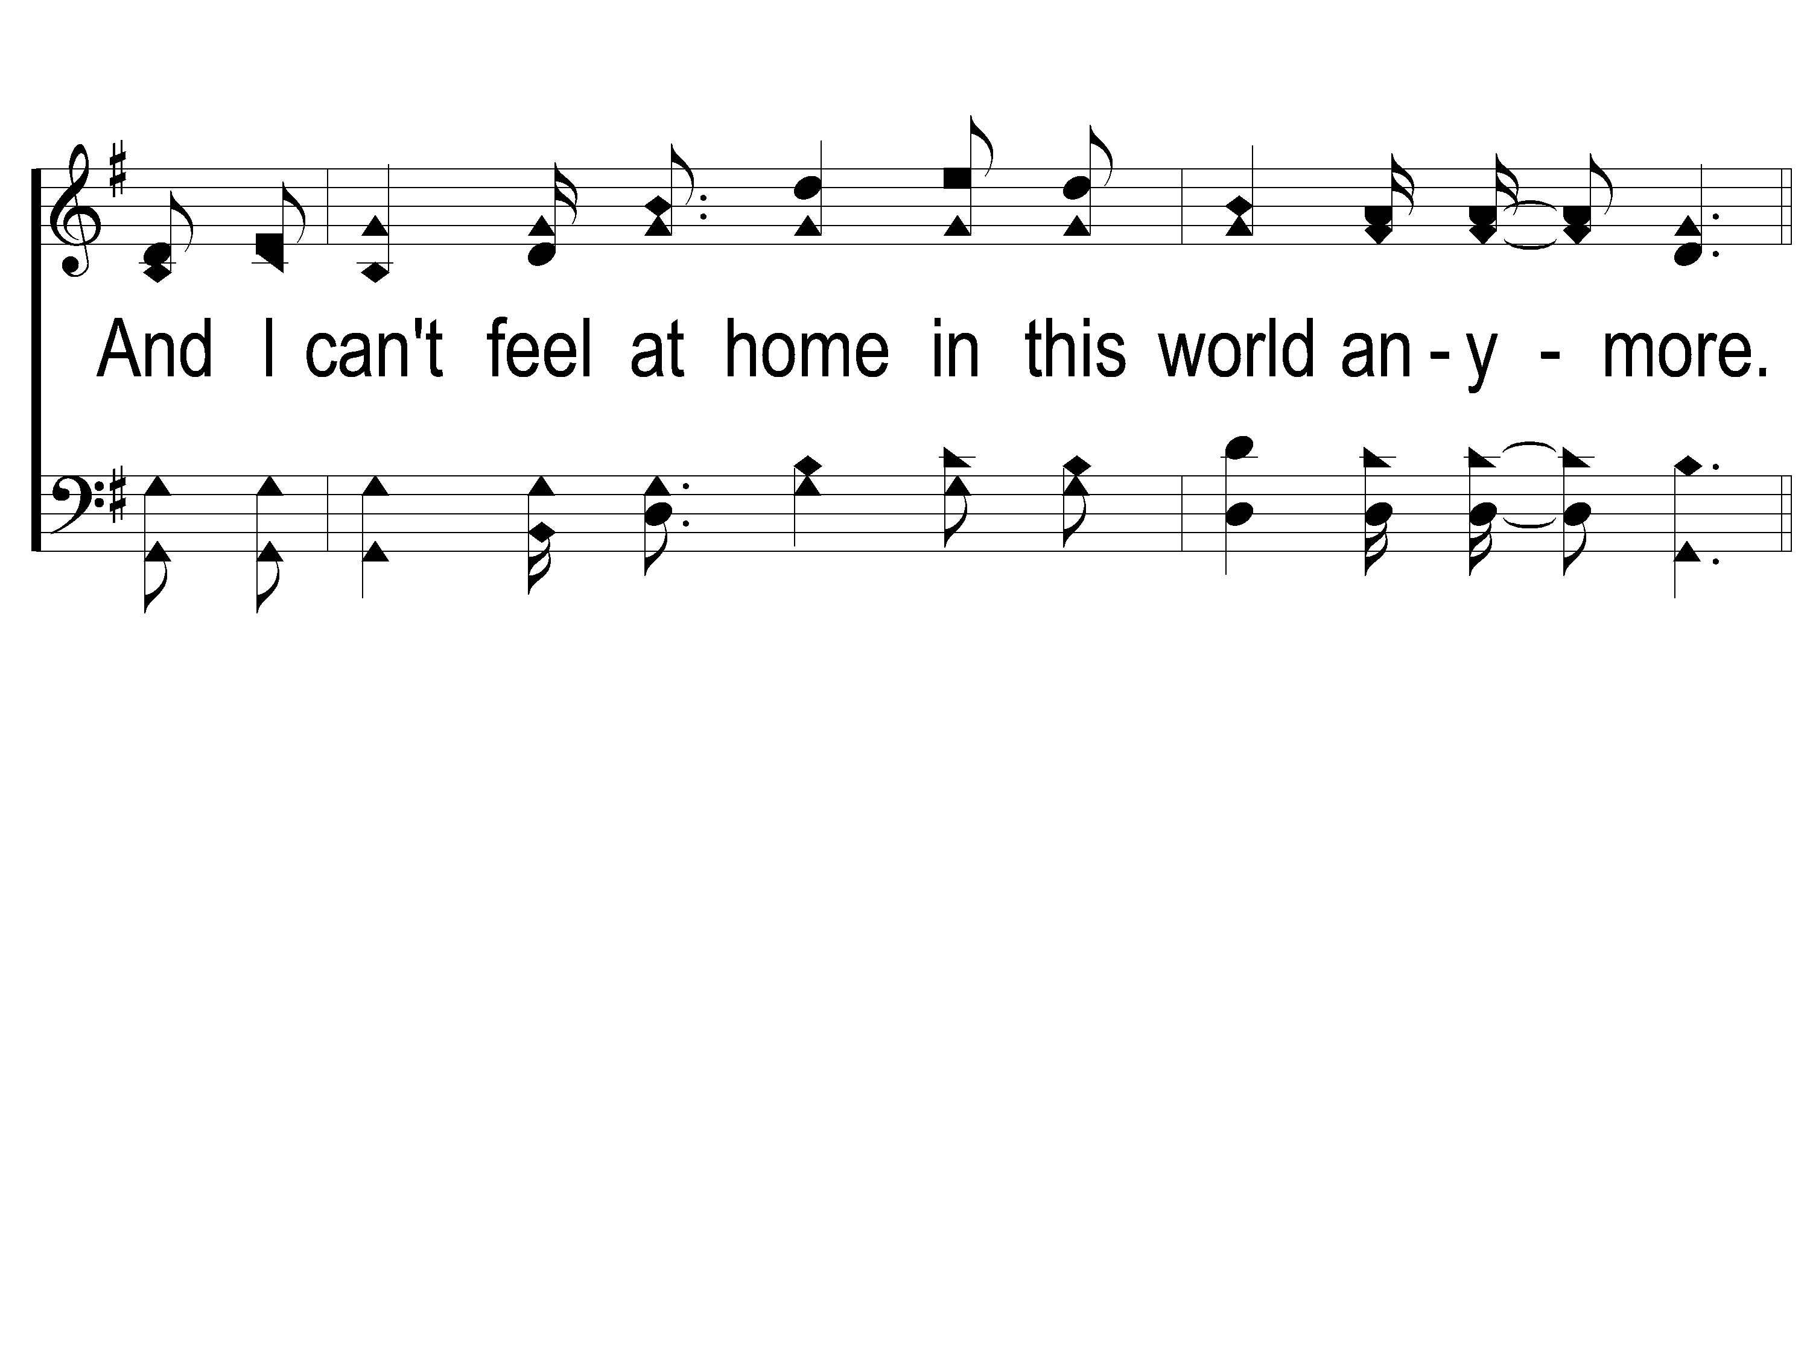
1-3 This World is Not My Home
This World Is Not My Home
957

Slide 14
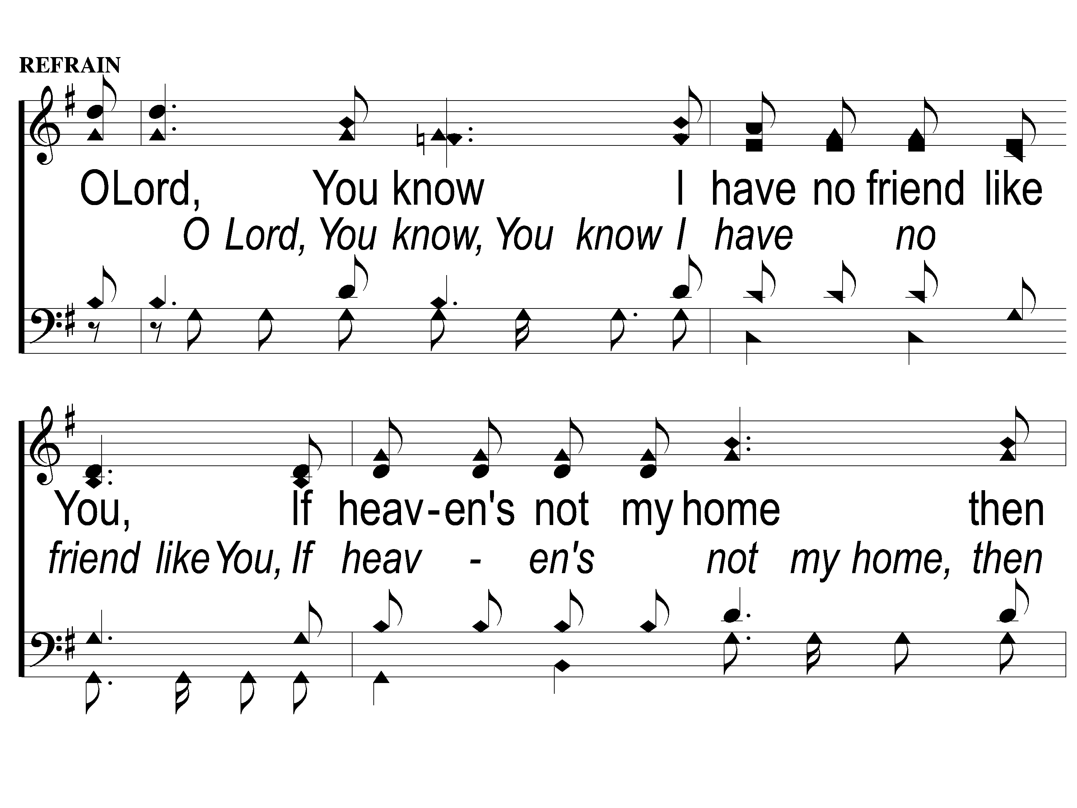
C-1 This World is Not My Home
This World Is Not My Home
957

Slide 15
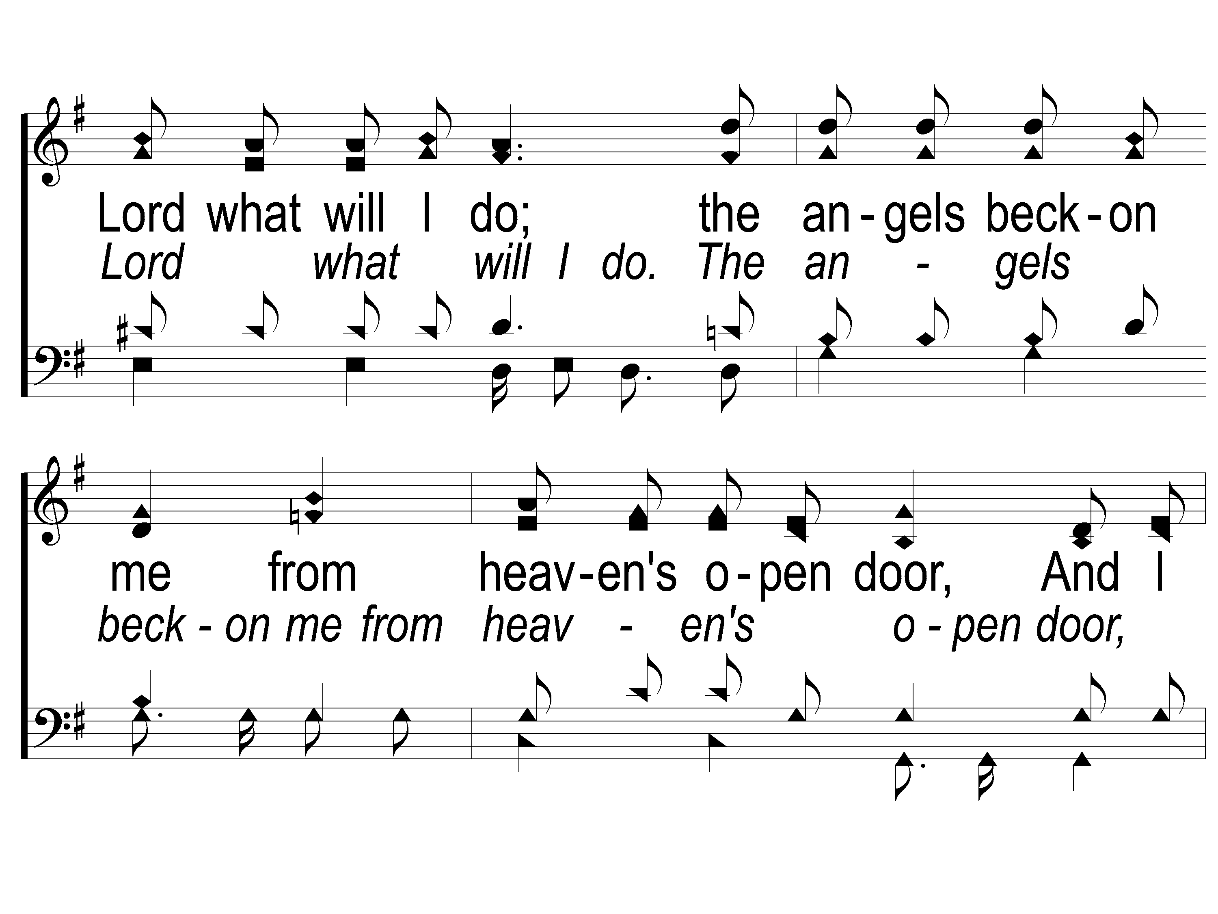
C-2 This World is Not My Home
This World Is Not My Home
957

Slide 16
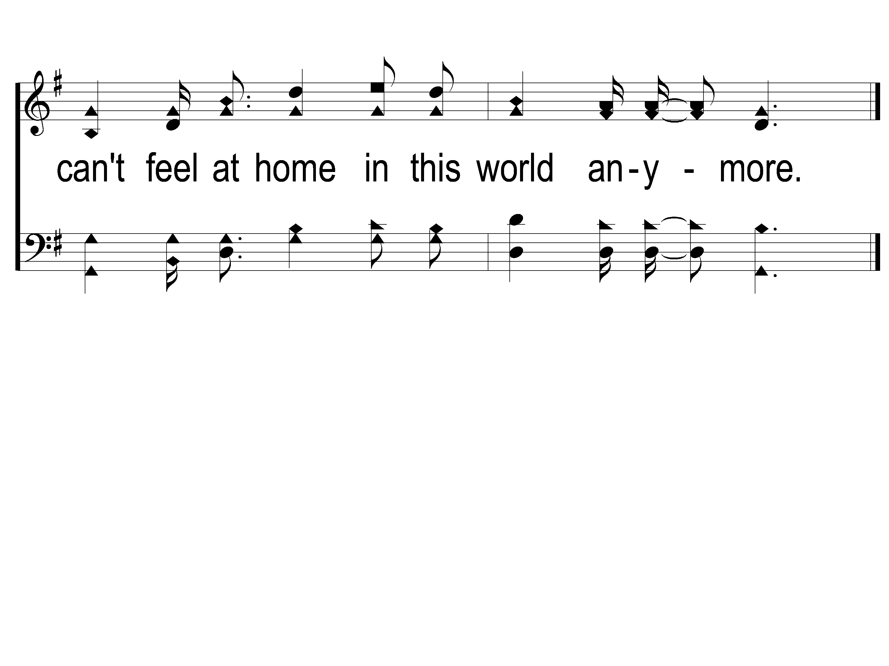
C-3 This World is Not My Home
This World Is Not My Home
957

Slide 17
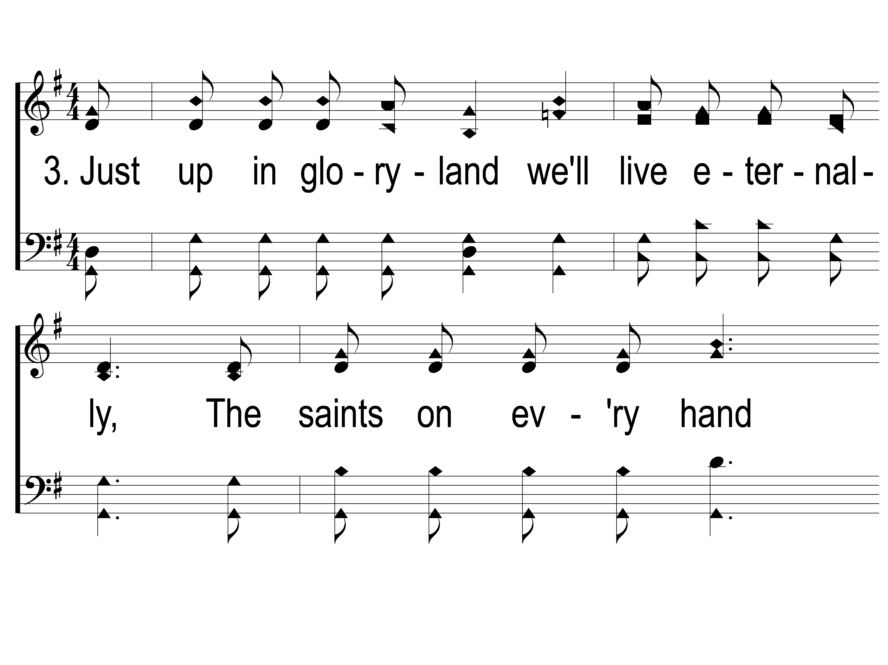
3-1 This World is Not My Home
This World Is Not My Home
957

Slide 18
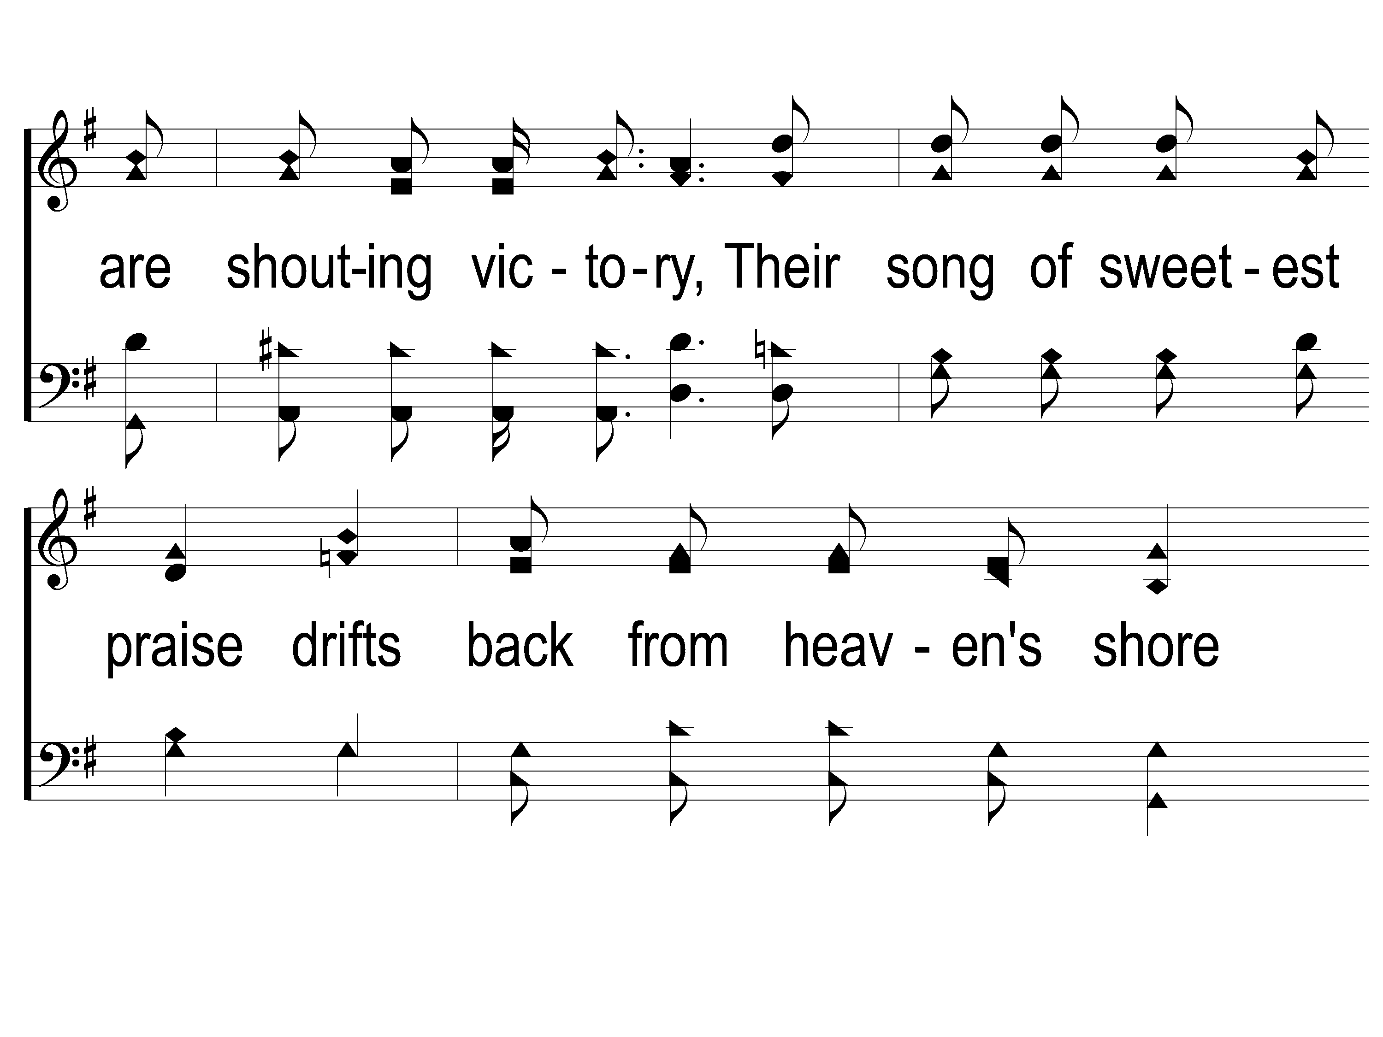
3-2 This World is Not My Home
This World Is Not My Home
957

Slide 19
3-3 This World is Not My Home
This World Is Not My Home
957

Slide 20
C-1 This World is Not My Home
This World Is Not My Home
957

Slide 21
C-2 This World is Not My Home
This World Is Not My Home
957

Slide 22
C-3 This World is Not My Home
This World Is Not My Home
957

Slide 23
SONG:
To canaan’s land
#867

Slide 24
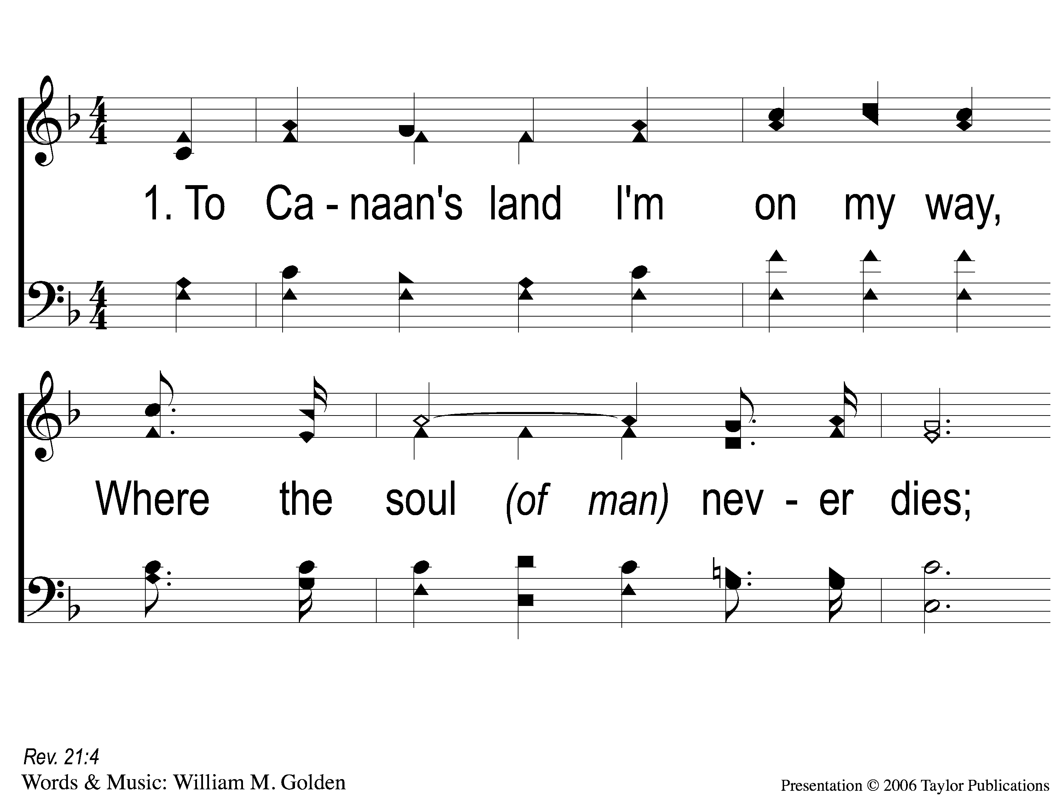
1-1 To Canaan’s Land
To Canaan’s Land I’m On My Way
867

Slide 25
1-2 To Canaan’s Land
To Canaan’s Land I’m On My Way
867

Slide 26
C-1 To Canaan’s Land
To Canaan’s Land I’m On My Way
867

Slide 27
C-2 To Canaan’s Land
To Canaan’s Land I’m On My Way
867

Slide 28
2-1 To Canaan’s Land
To Canaan’s Land I’m On My Way
867

Slide 29
2-2 To Canaan’s Land
To Canaan’s Land I’m On My Way
867

Slide 30
C-1 To Canaan’s Land
To Canaan’s Land I’m On My Way
867

Slide 31
C-2 To Canaan’s Land
To Canaan’s Land I’m On My Way
867

Slide 32
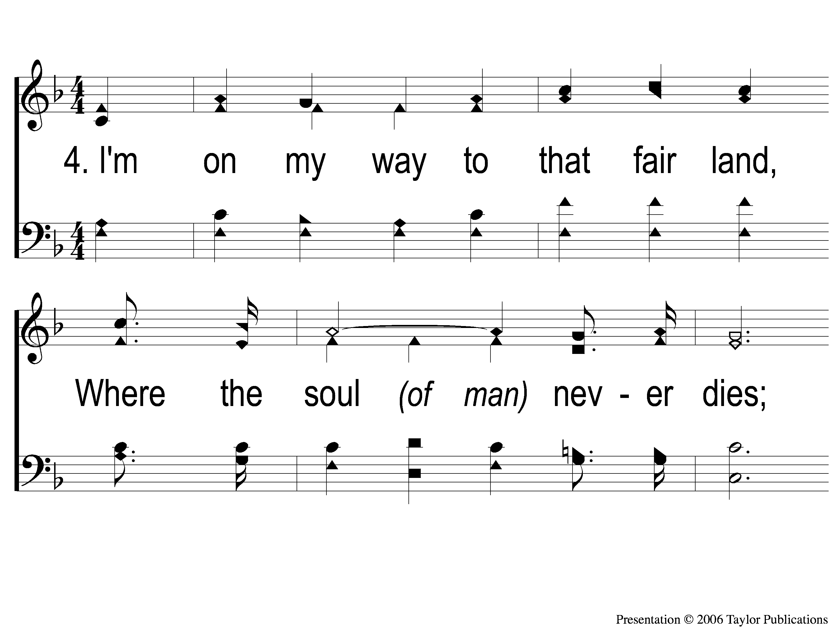
4-1 To Canaan’s Land
To Canaan’s Land I’m On My Way
867

Slide 33
4-2 To Canaan’s Land
To Canaan’s Land I’m On My Way
867

Slide 34
C-1 To Canaan’s Land
To Canaan’s Land I’m On My Way
867

Slide 35
C-2 To Canaan’s Land
To Canaan’s Land I’m On My Way
867

Slide 36
OPENING PRAYER

Slide 37
SONG:
When we all get to heaven
#853

Slide 38
1-1 When We All Get To Heaven
When We All Get To Heaven
853

Slide 39
1-2 When We All Get To Heaven
When We All Get To Heaven
853

Slide 40
C-1 When We All Get To Heaven
When We All Get To Heaven
853

Slide 41
C-2 When We All Get To Heaven
When We All Get To Heaven
853

Slide 42
2-1 When We All Get To Heaven
When We All Get To Heaven
853

Slide 43
2-2 When We All Get To Heaven
When We All Get To Heaven
853

Slide 44
C-1 When We All Get To Heaven
When We All Get To Heaven
853

Slide 45
C-2 When We All Get To Heaven
When We All Get To Heaven
853

Slide 46
3-1 When We All Get To Heaven
When We All Get To Heaven
853

Slide 47
3-2 When We All Get To Heaven
When We All Get To Heaven
853

Slide 48
C-1 When We All Get To Heaven
When We All Get To Heaven
853

Slide 49
C-2 When We All Get To Heaven
When We All Get To Heaven
853

Slide 50
SONG:
On bended knee
#791

Slide 51
1-1 On Bended Knee
On Bended Knee
791

Slide 52
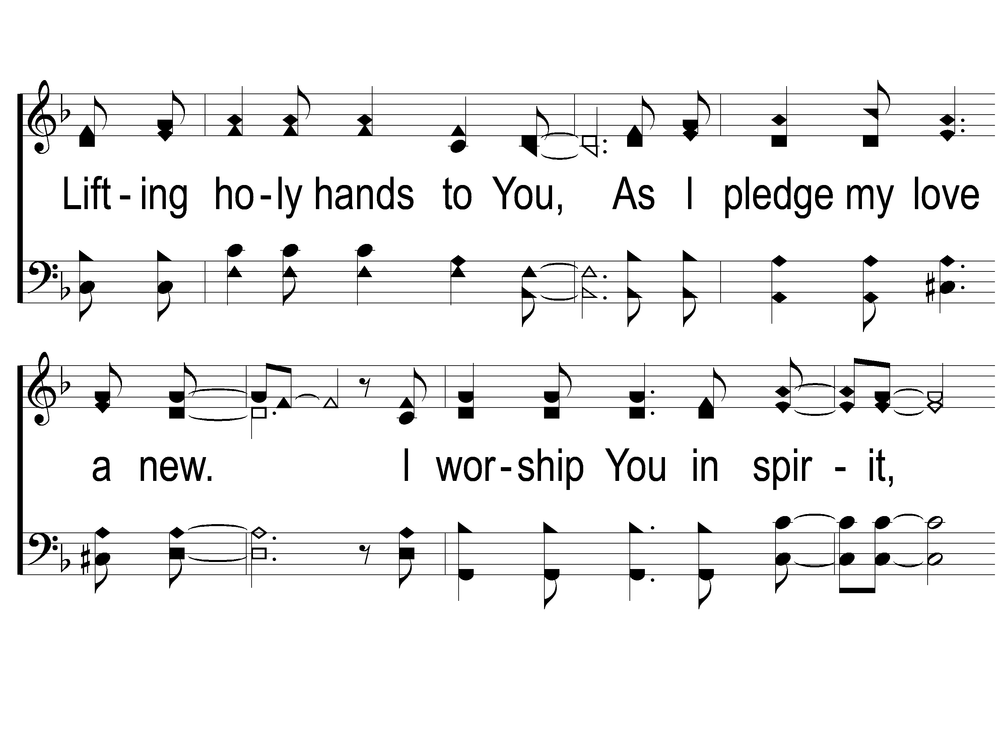
1-2 On Bended Knee
On Bended Knee
791

Slide 53
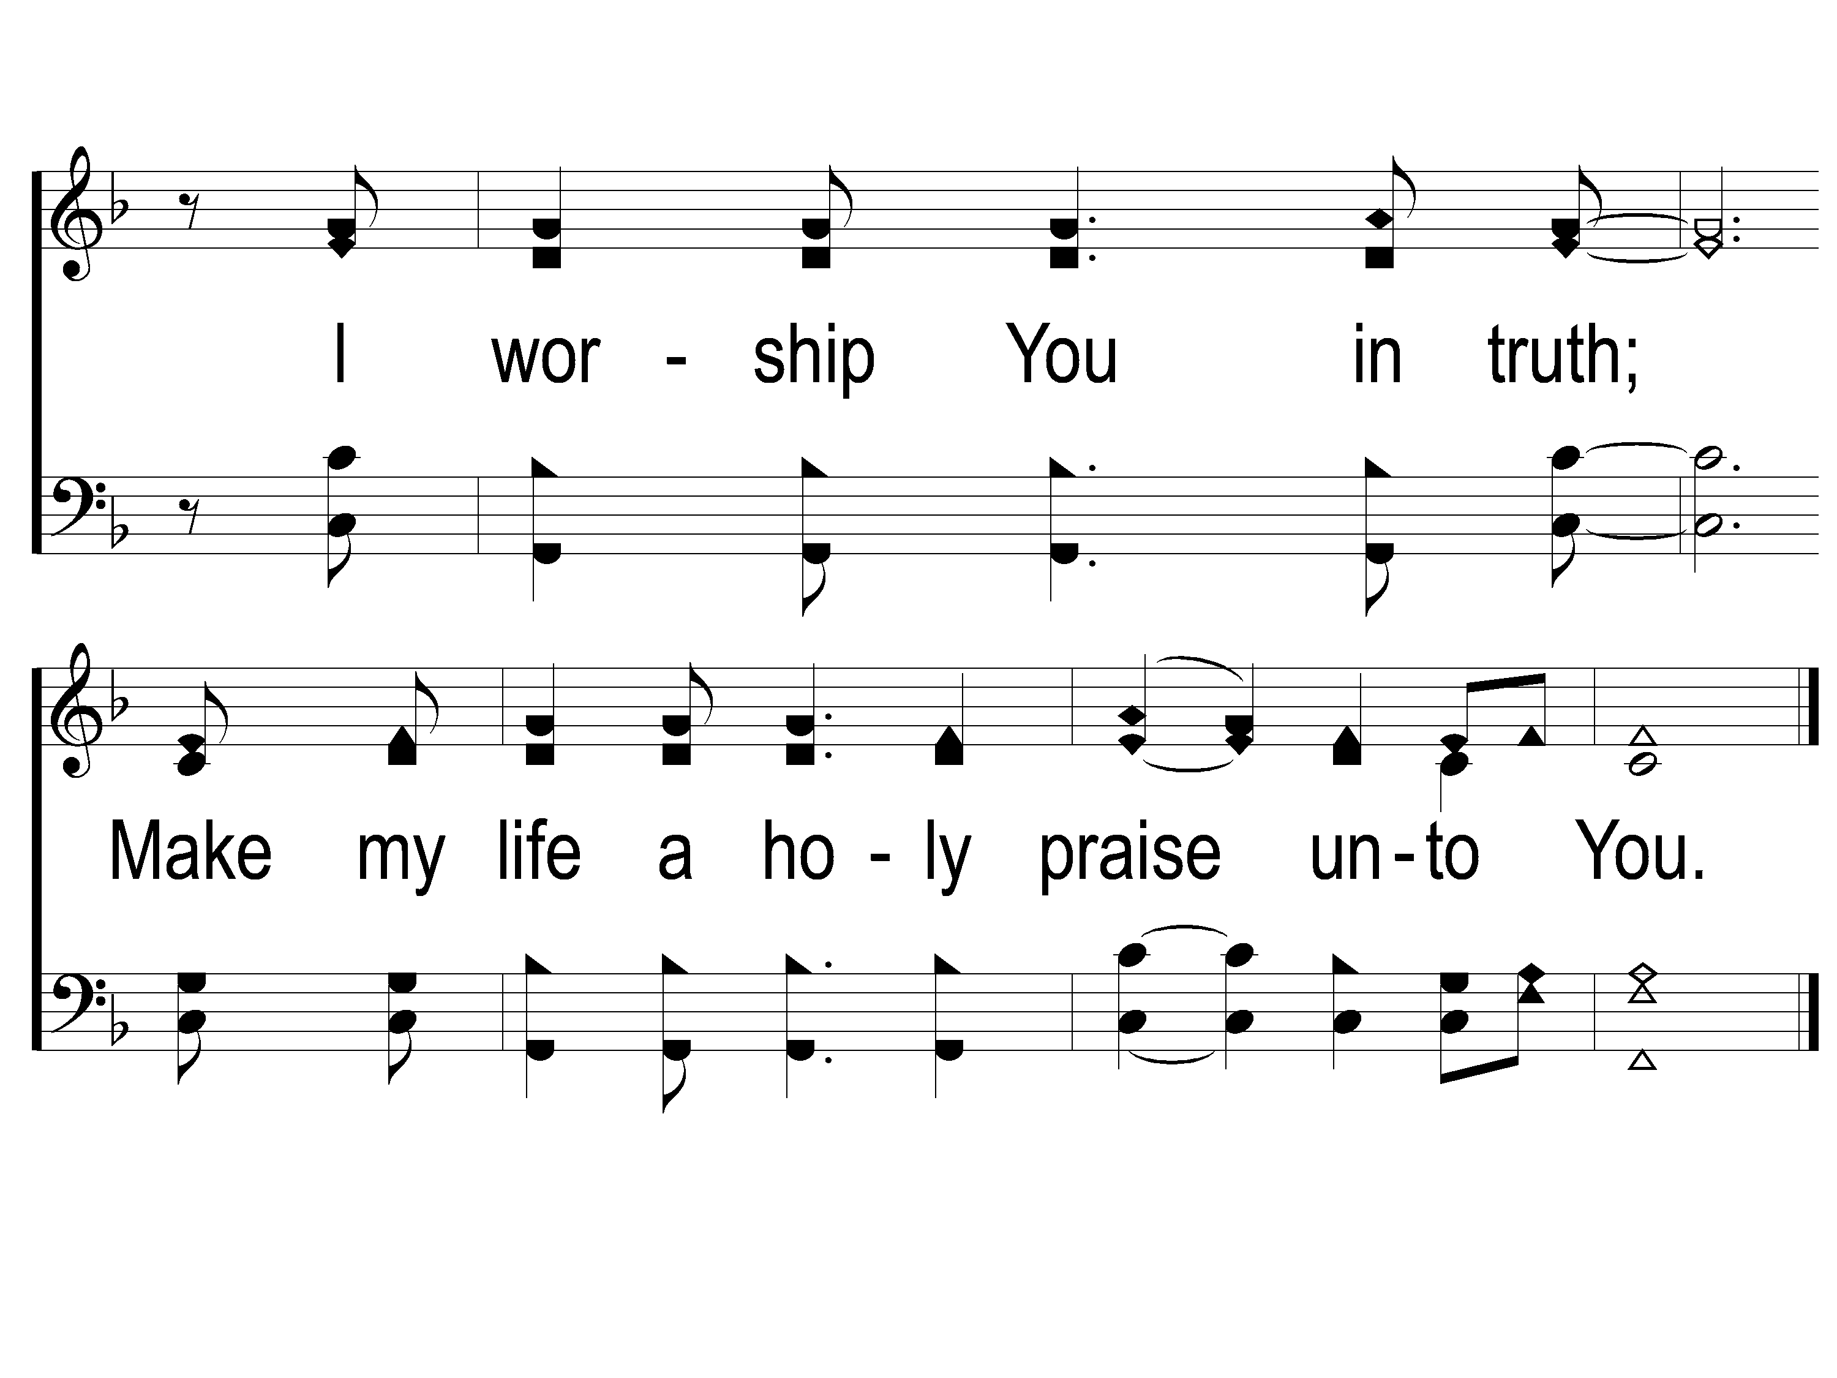
1-3 On Bended Knee
On Bended Knee
791

Slide 54
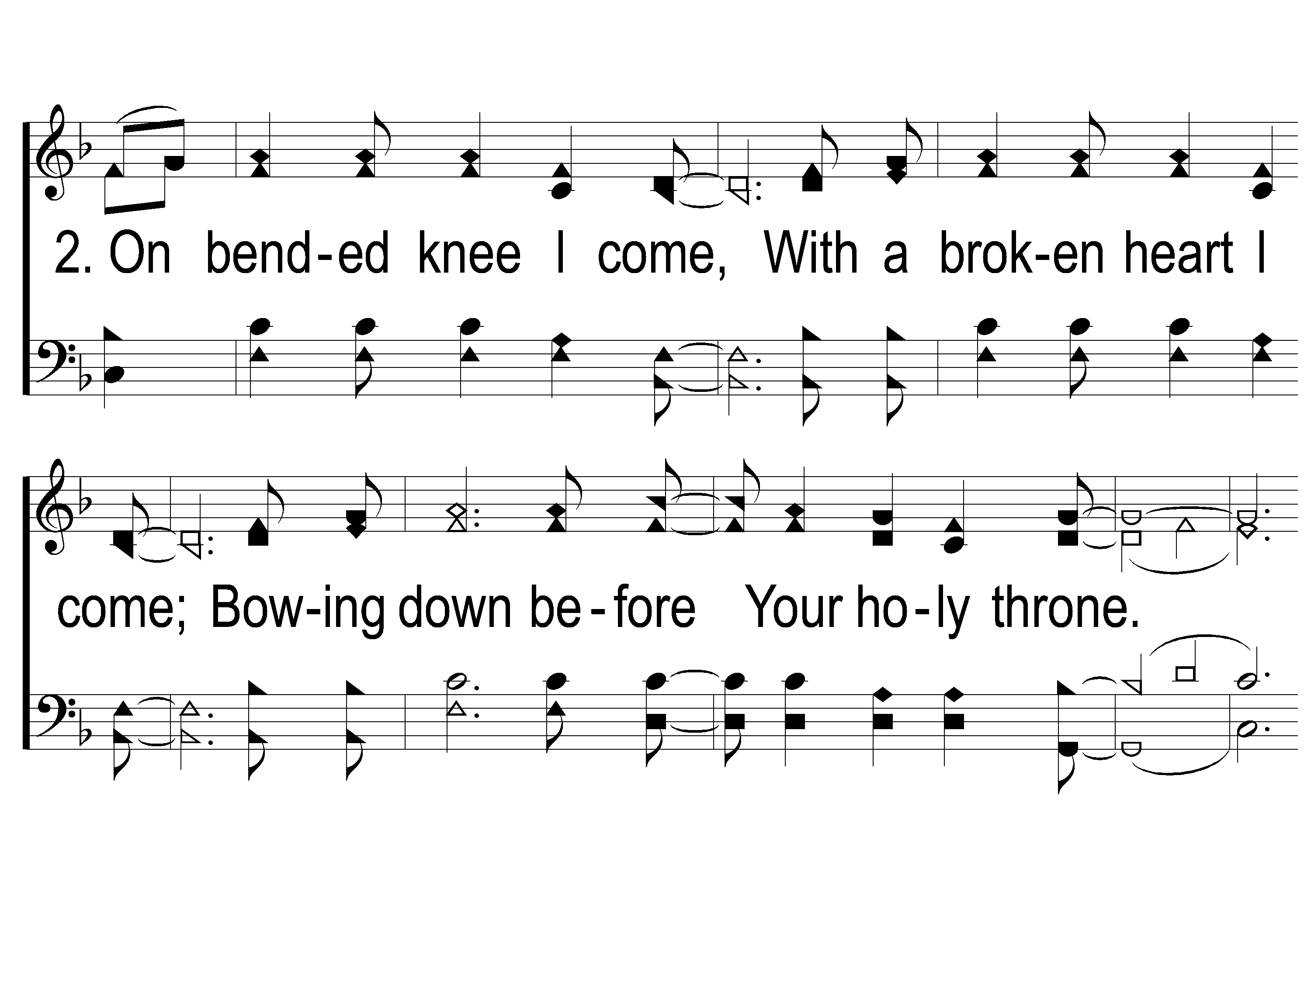
2-1 On Bended Knee
On Bended Knee
791

Slide 55
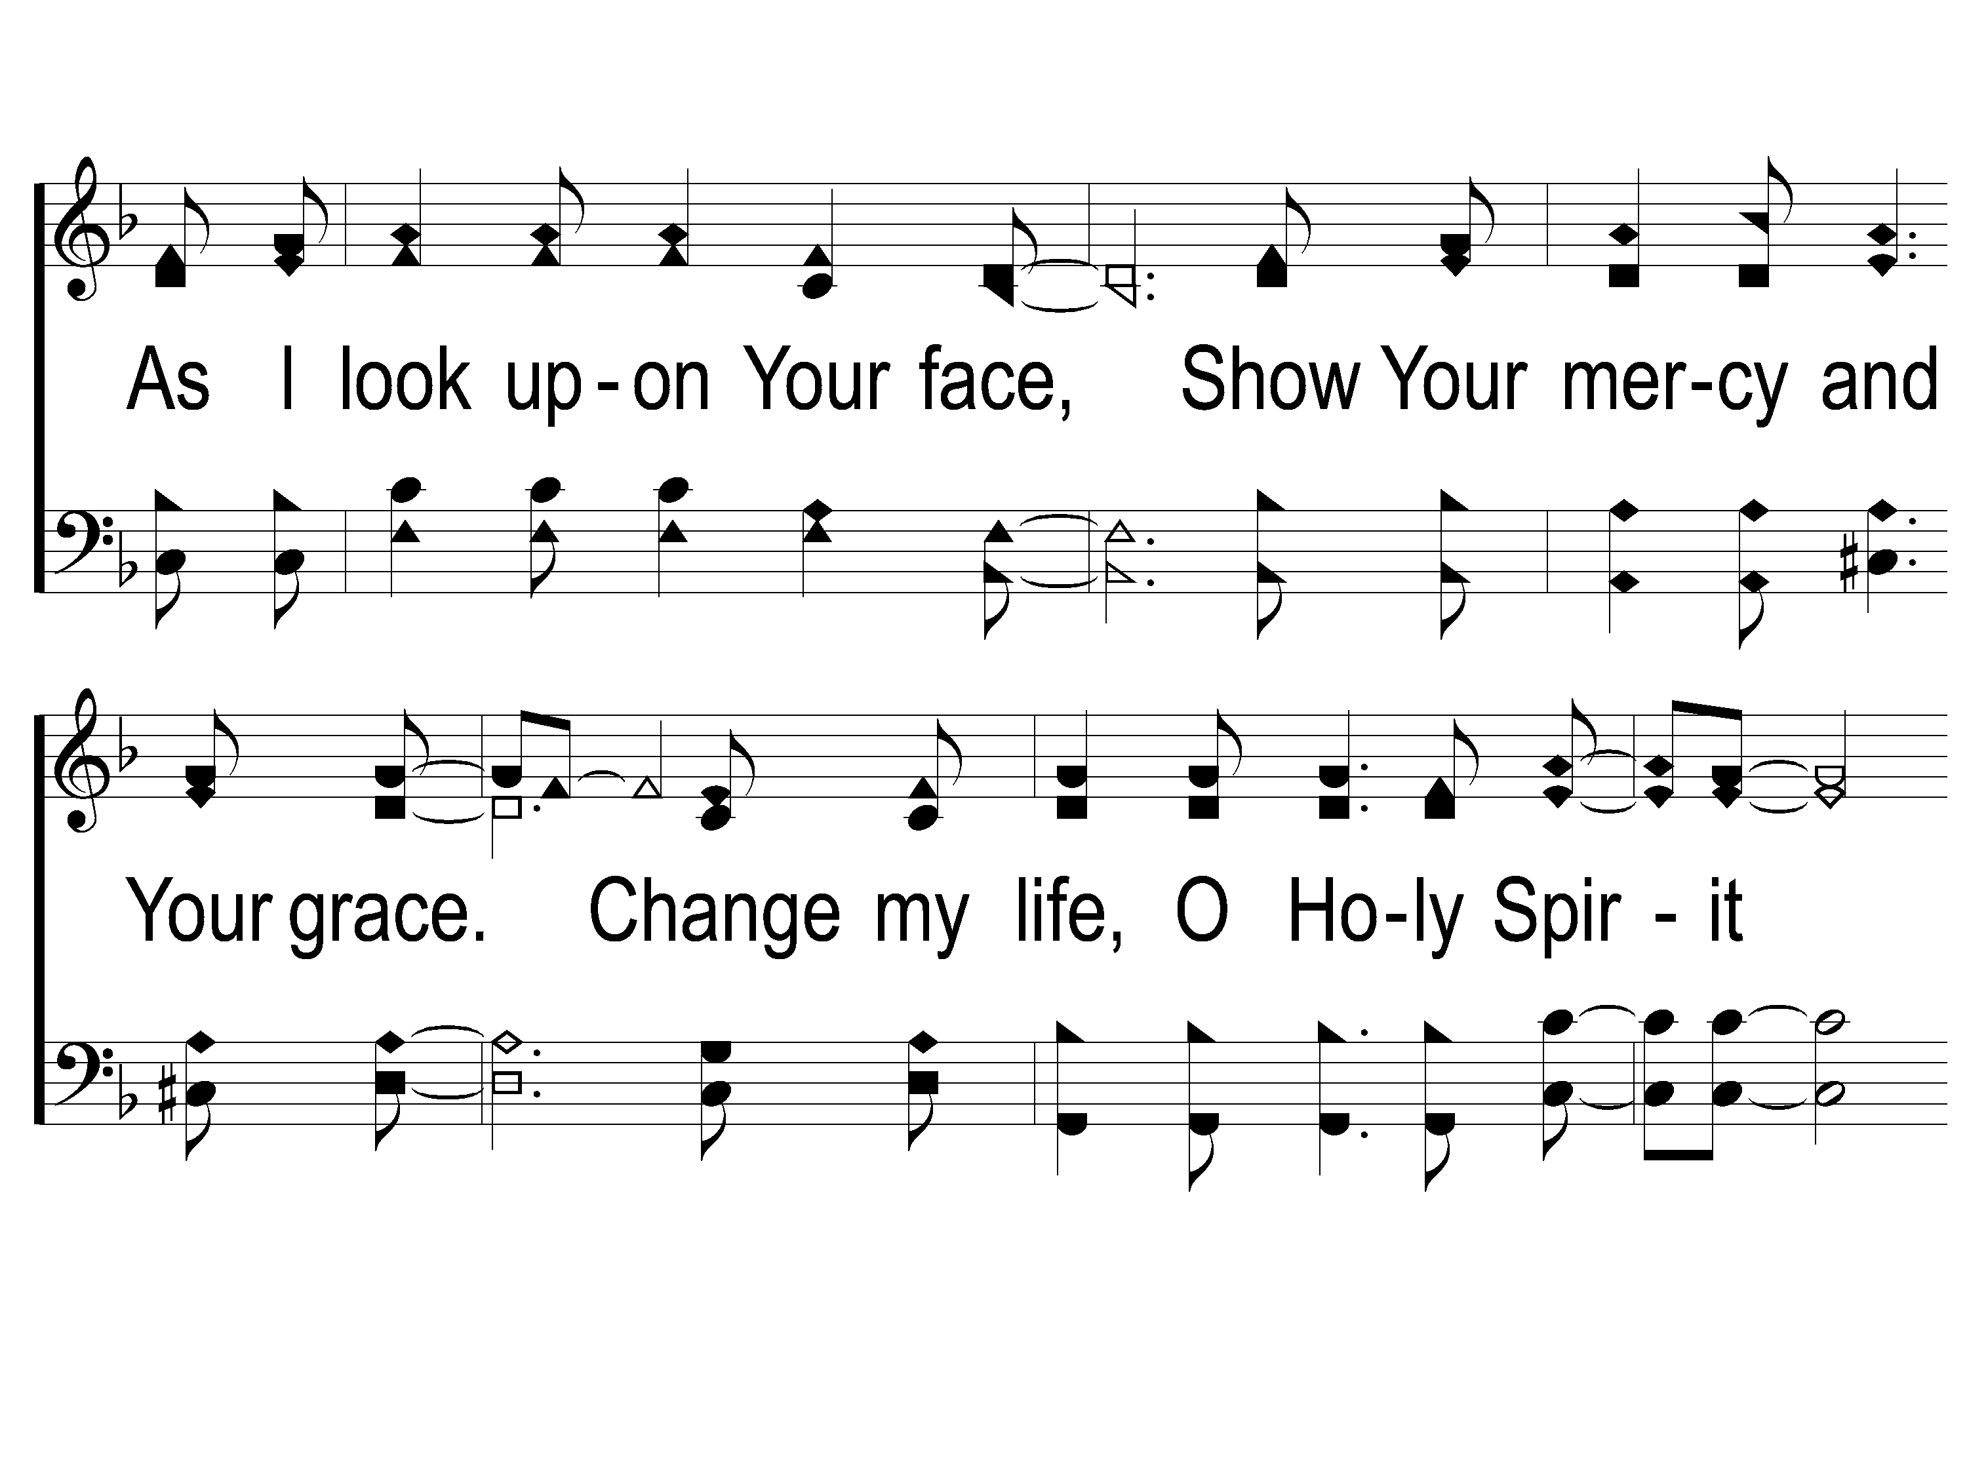
2-2 On Bended Knee
On Bended Knee
791

Slide 56
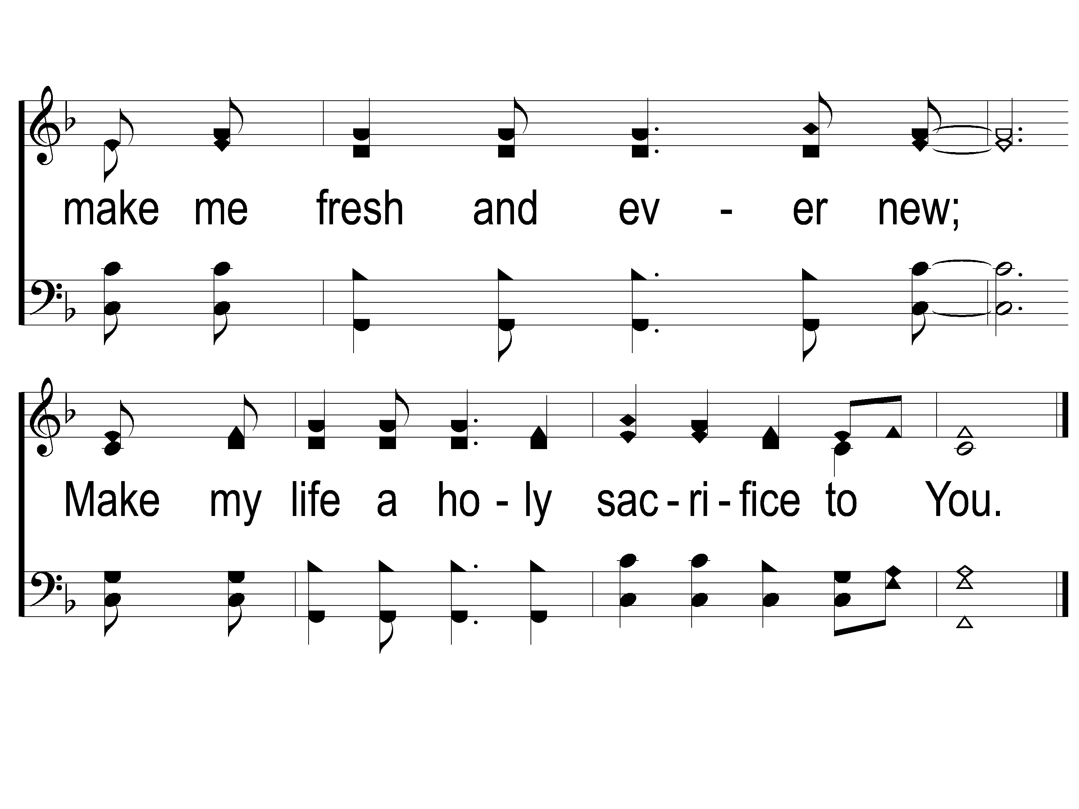
2-3 On Bended Knee
On Bended Knee
791

Slide 57
SCRIPTURE READING:
Proverbs 3:7

Slide 58
IN PURSUIT
2023

Slide 59
IN PURSUIT
OF THE KINGDOM

Slide 60
Godly wisdom
IN PURSUIT OF

Slide 61
proverbs
GOD’S WISDOM FOR LIVING

Slide 62
Five books of wisdom literature
Job
Psalms
Proverbs
Ecclesiastes
Song of Solomon

Slide 63
What is wisdom?
Knowledge vs. Wisdom

Slide 64
What is wisdom?
Knowledge vs. Wisdom
“Knowledge is knowing that a tomato is a fruit; wisdom is not putting it in a fruit salad.”

Slide 65
The NEED FOR GODLY WISDOM

Slide 66
The NEED FOR GODLY WISDOM
Hearts Become Deceitful
Jer. 17:9
Jdgs. 21:25
Matt. 15:19
Prov. 12:15, 21:2, 26:12, 30:12

Slide 67
The NEED FOR GODLY WISDOM
God Wants Us To Be Wise
Prov. 3:7, 4:7, 9:10, 12:1, 23:19

Slide 68
The BENEFITS OF GODLY WISDOM

Slide 69
The BENEFITS OF GODLY WISDOM
Quantity of Life
Prov. 3:7-8, 4:4, 6, 21-22, 8:34, 9:11

Slide 70
The BENEFITS OF GODLY WISDOM
Quantity of Life
Prov. 3:5-6, 4:11

Slide 71
The BENEFITS OF GODLY WISDOM
Quality of Life
Prov. 1:5, 3:13-14, 8:17, 10:1, 13:1

Slide 72
The SOURCE OF GODLY WISDOM

Slide 73
The SOURCE OF GODLY WISDOM
MANKIND
Job 32:9
Psa. 94:11

Slide 74
The SOURCE OF GODLY WISDOM
GOD HIMSELF
Job 32:8-9, Jms. 3:17, 4:8
2 Pet. 1:3
2 Tim. 3:16-17

Slide 75
The “getting” OF GODLY WISDOM
A Disposition

Slide 76
The “getting” OF GODLY WISDOM
A Disposition
Humility – Prov. 3:5, 14:12, 23:19

Slide 77
The “getting” OF GODLY WISDOM
A Disposition
Humility – Prov. 3:5, 14:12, 23:19
Love – Isa. 30:12, Jn. 14:15

Slide 78
The “getting” OF GODLY WISDOM
A Disposition
A Consideration

Slide 79
The “getting” OF GODLY WISDOM
A Consideration
Prov. 4:7 – “get” = buy, purchase

Slide 80
The “getting” OF GODLY WISDOM
A Disposition
A Consideration
A Resolution

Slide 81
The “getting” OF GODLY WISDOM
A Resolution
Prov. 23:23

Slide 82
RESOLVED?
ARE YOU

Slide 83
1-1 I Am Resolved
I Am Resolved
948

Slide 84
1-2 I Am Resolved
I Am Resolved
948

Slide 85
C-1 I Am Resolved
I Am Resolved
948

Slide 86
C-2 I Am Resolved
I Am Resolved
948

Slide 87
4-1 I Am Resolved
I Am Resolved
948

Slide 88
4-2 I Am Resolved
I Am Resolved
948

Slide 89
C-1 I Am Resolved
I Am Resolved
948

Slide 90
C-2 I Am Resolved
I Am Resolved
948

Slide 91
OUR CONTRIBUTION
Luke 9:23-24
Then He said to them all, “If anyone desires to come after Me, let him deny himself, and take up his cross daily, and follow Me. For whoever desires to save his life will lose it, but whoever loses his life for My sake will save it.”

Slide 92
SONG:
When my love to christ grows weak
#350

Slide 93
1-1 When My Love To Christ Grows Weak
When My Love to Christ Grows Weak
350

Slide 94
1-2 When My Love To Christ Grows Weak
When My Love to Christ Grows Weak
350

Slide 95
2-1 When My Love To Christ Grows Weak
When My Love to Christ Grows Weak
350

Slide 96
2-2 When My Love To Christ Grows Weak
When My Love to Christ Grows Weak
350

Slide 97
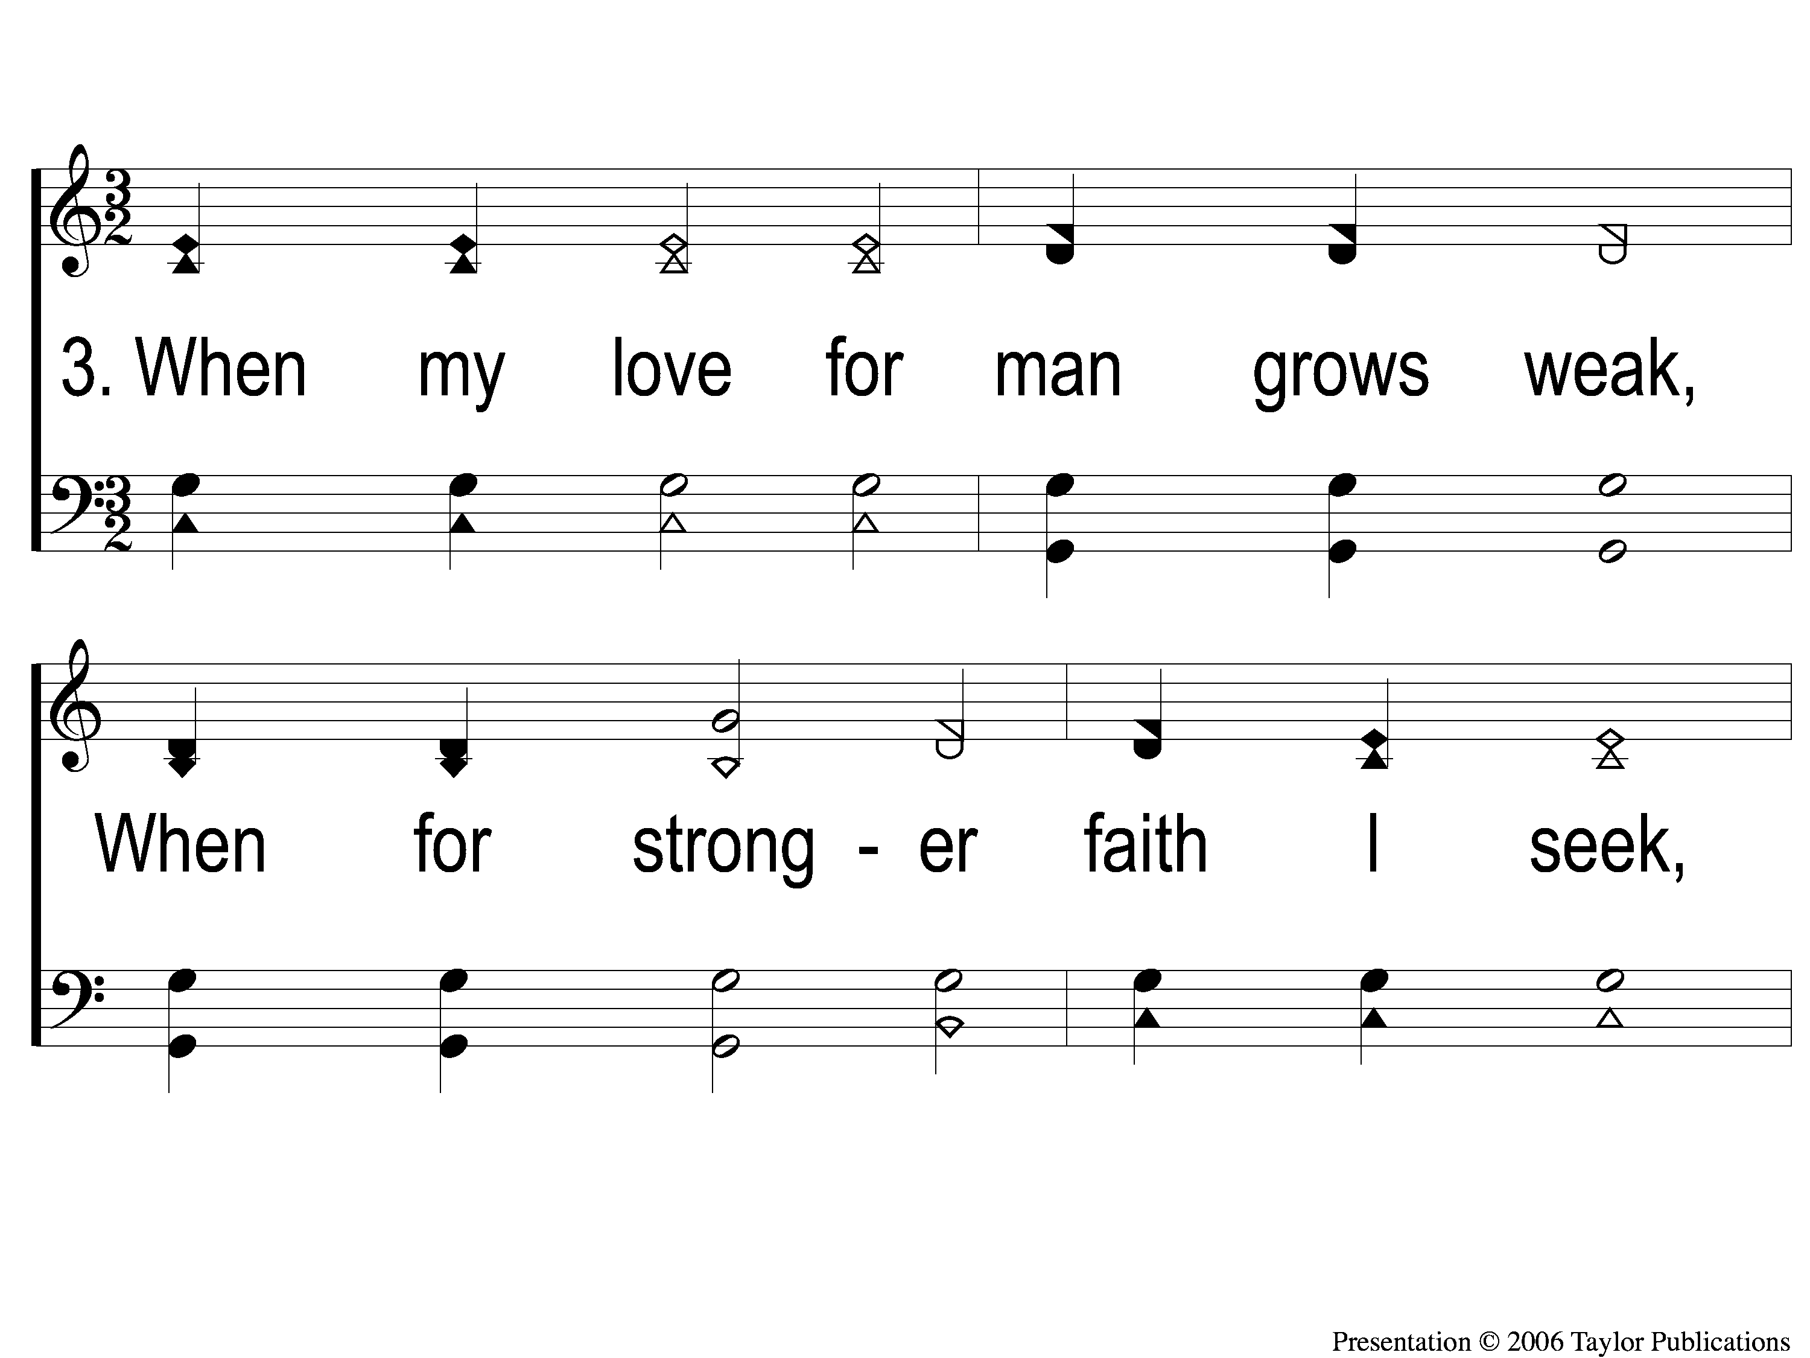
3-1 When My Love To Christ Grows Weak
When My Love to Christ Grows Weak
350

Slide 98
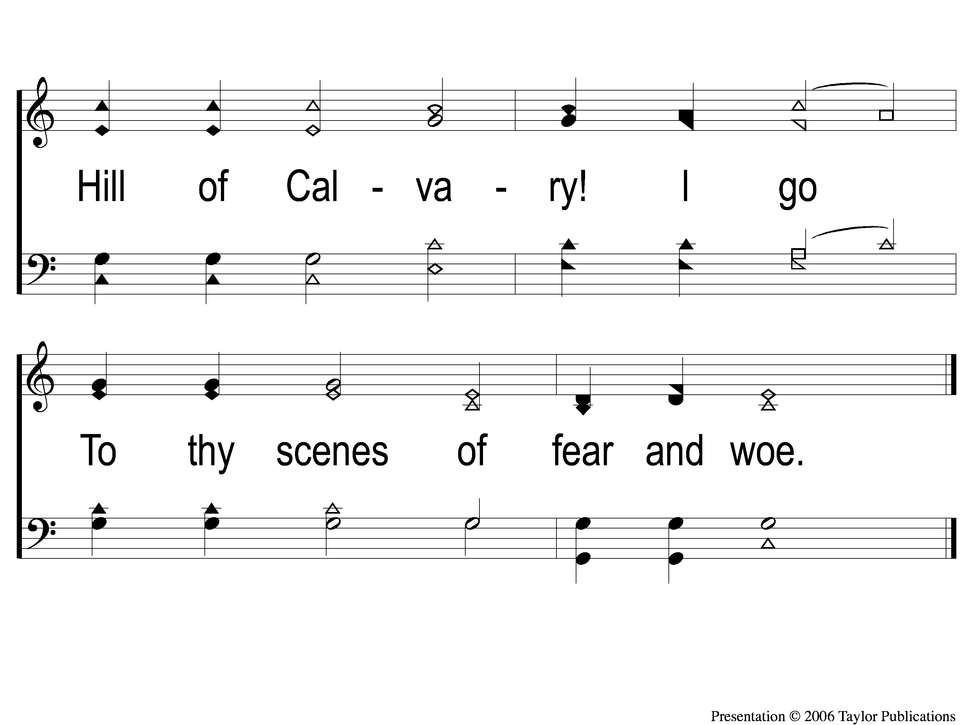
3-2 When My Love To Christ Grows Weak
When My Love to Christ Grows Weak
350

Slide 99
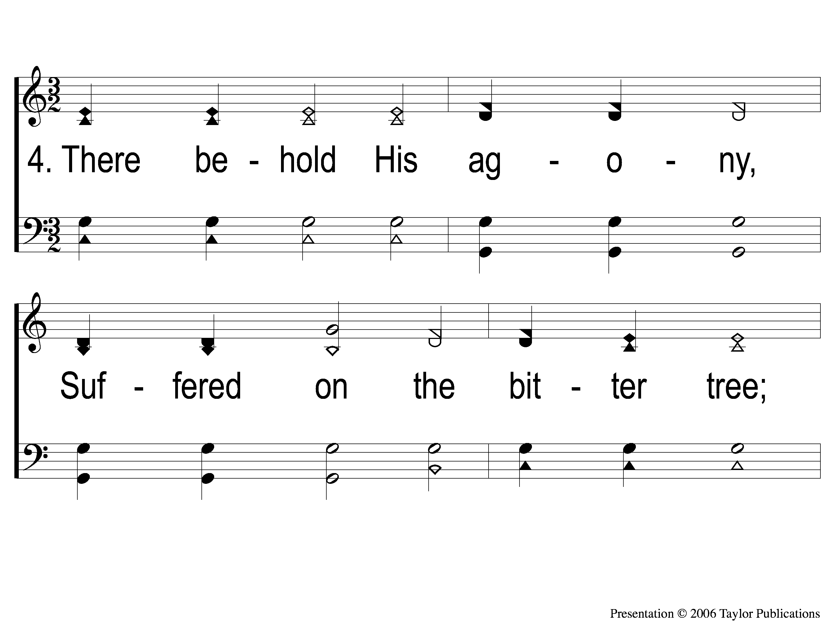
4-1 When My Love To Christ Grows Weak
When My Love to Christ Grows Weak
350

Slide 100
4-2 When My Love To Christ Grows Weak
When My Love to Christ Grows Weak
350

Slide 101
5-1 When My Love To Christ Grows Weak
When My Love to Christ Grows Weak
350

Slide 102
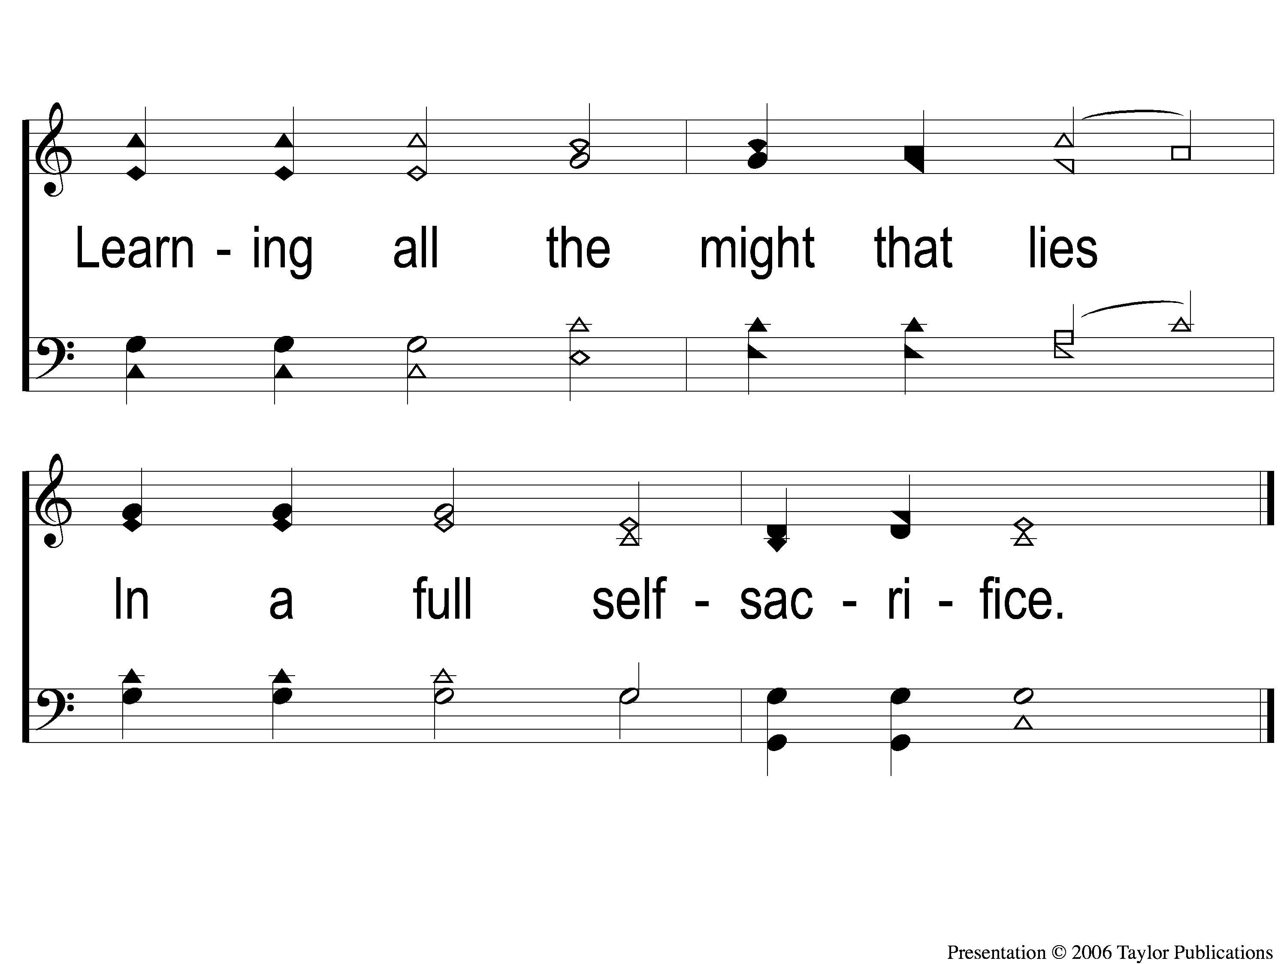
5-2 When My Love To Christ Grows Weak
When My Love to Christ Grows Weak
350

Slide 103
THE UNLEAVENED BREAD
Hebrews 2:14-15
“Inasmuch then as the children have partaken of flesh and blood, He Himself likewise shared in the same, that through death He might destroy him who had the power of death, that is, the devil, and release those who through fear of death were all their lifetime subject to bondage.”

Slide 104
THE FRUIT OF THE VINE
Hebrews 12:1-2
“Therefore we also, since we are surrounded by so great a cloud of witnesses, let us lay aside every weight, and the sin which so easily ensnares us, and let us run with endurance the race that is set before us, looking unto Jesus, the author and finisher of our faith, who for the joy that was set before Him endured the cross, despising the shame, and has sat down at the right hand of the throne of God.”

Slide 105
closing PRAYER

Slide 106
SONG:
Stand up, stand up for jesus
#648

Slide 107
1-1 Stand up Stand Up for Jesus
Stand Up, Stand Up For Jesus
648

Slide 108
1-2 Stand up Stand Up for Jesus
Stand Up, Stand Up For Jesus
648

Slide 109
Today
Fellowship meal in the mpb
Wednesday
Worship & Bible classes @ 6:30

