Slide 1
1-1 We Bow Down
We Bow Down
577

Slide 2
1-2 We Bow Down
We Bow Down
577

Slide 3
1-3 We Bow Down
We Bow Down
577

Slide 4
1-4 We Bow Down
We Bow Down
577

Slide 5
2-1 We Bow Down
We Bow Down
577

Slide 6
2-2 We Bow Down
We Bow Down
577

Slide 7
2-3 We Bow Down
We Bow Down
577

Slide 8
2-4 We Bow Down
We Bow Down
577

Slide 9
WELCOME
To the Wheeler church of Christ

Slide 10
SONG:
How great thou art
#76

Slide 11
1-1 How Great Thou Art
How Great Thou Art
76

Slide 12
1-2 How Great Thou Art
How Great Thou Art
76

Slide 13
C-1 How Great Thou Art
How Great Thou Art
76

Slide 14
C-2 How Great Thou Art
How Great Thou Art
76

Slide 15
4-1 How Great Thou Art
How Great Thou Art
76

Slide 16
4-2 How Great Thou Art
How Great Thou Art
76

Slide 17
C-1 How Great Thou Art
How Great Thou Art
76

Slide 18
C-2 How Great Thou Art
How Great Thou Art
76

Slide 19
SONG:
What a friend we have in jesus
#800

Slide 20
1-1 What A Friend We Have in Jesus
What a Friend We Have in Jesus
800

Slide 21
1-2 What A Friend We Have in Jesus
What a Friend We Have in Jesus
800

Slide 22
1-3 What A Friend We Have in Jesus
What a Friend We Have in Jesus
800

Slide 23
1-4 What A Friend We Have in Jesus
What a Friend We Have in Jesus
800

Slide 24
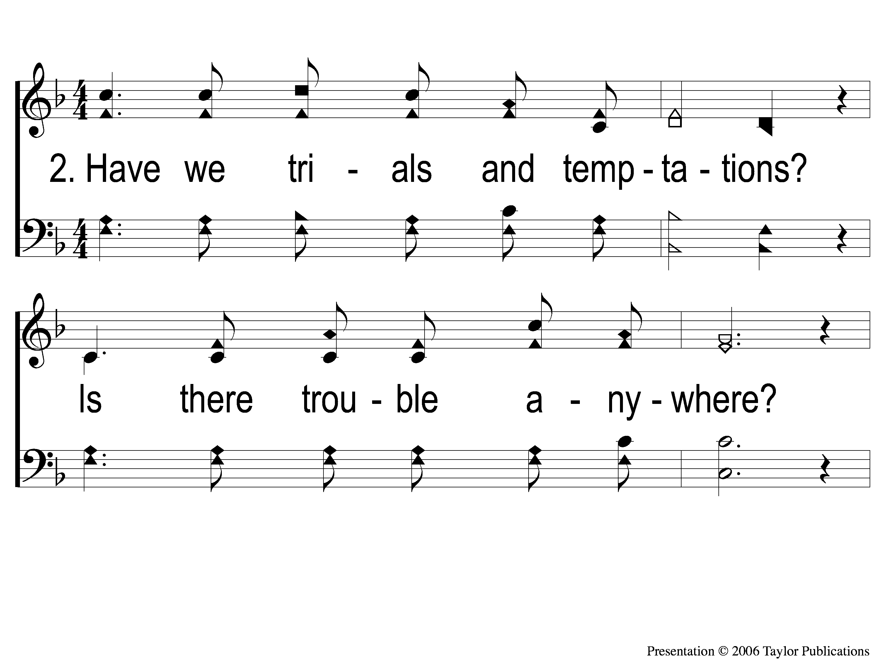
2-1 What A Friend We Have in Jesus
What a Friend We Have in Jesus
800

Slide 25
2-2 What A Friend We Have in Jesus
What a Friend We Have in Jesus
800

Slide 26
2-3 What A Friend We Have in Jesus
What a Friend We Have in Jesus
800

Slide 27
2-4 What A Friend We Have in Jesus
What a Friend We Have in Jesus
800

Slide 28
3-1 What A Friend We Have in Jesus
What a Friend We Have in Jesus
800

Slide 29
3-2 What A Friend We Have in Jesus
What a Friend We Have in Jesus
800

Slide 30
3-3 What A Friend We Have in Jesus
What a Friend We Have in Jesus
800

Slide 31
3-4 What A Friend We Have in Jesus
What a Friend We Have in Jesus
800

Slide 32
OPENING PRAYER

Slide 33
SONG:
I am mine no more
#683

Slide 34
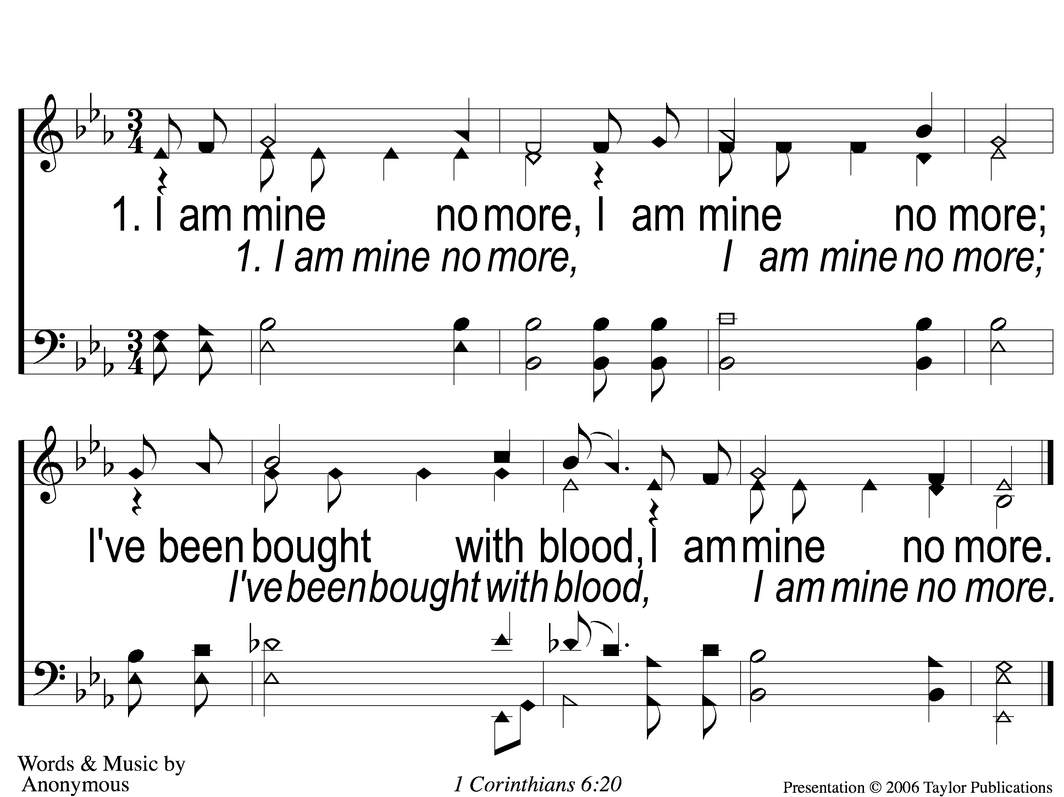
1-I Am Mine No More
I Am Mine No More
683

Slide 35
2-I Am Mine No More
I Am Mine No More
683

Slide 36
3-I Am Mine No More
I Am Mine No More
683

Slide 37
4-I Am Mine No More
I Am Mine No More
683

Slide 38
SONG:
Jesus is coming soon
#712

Slide 39
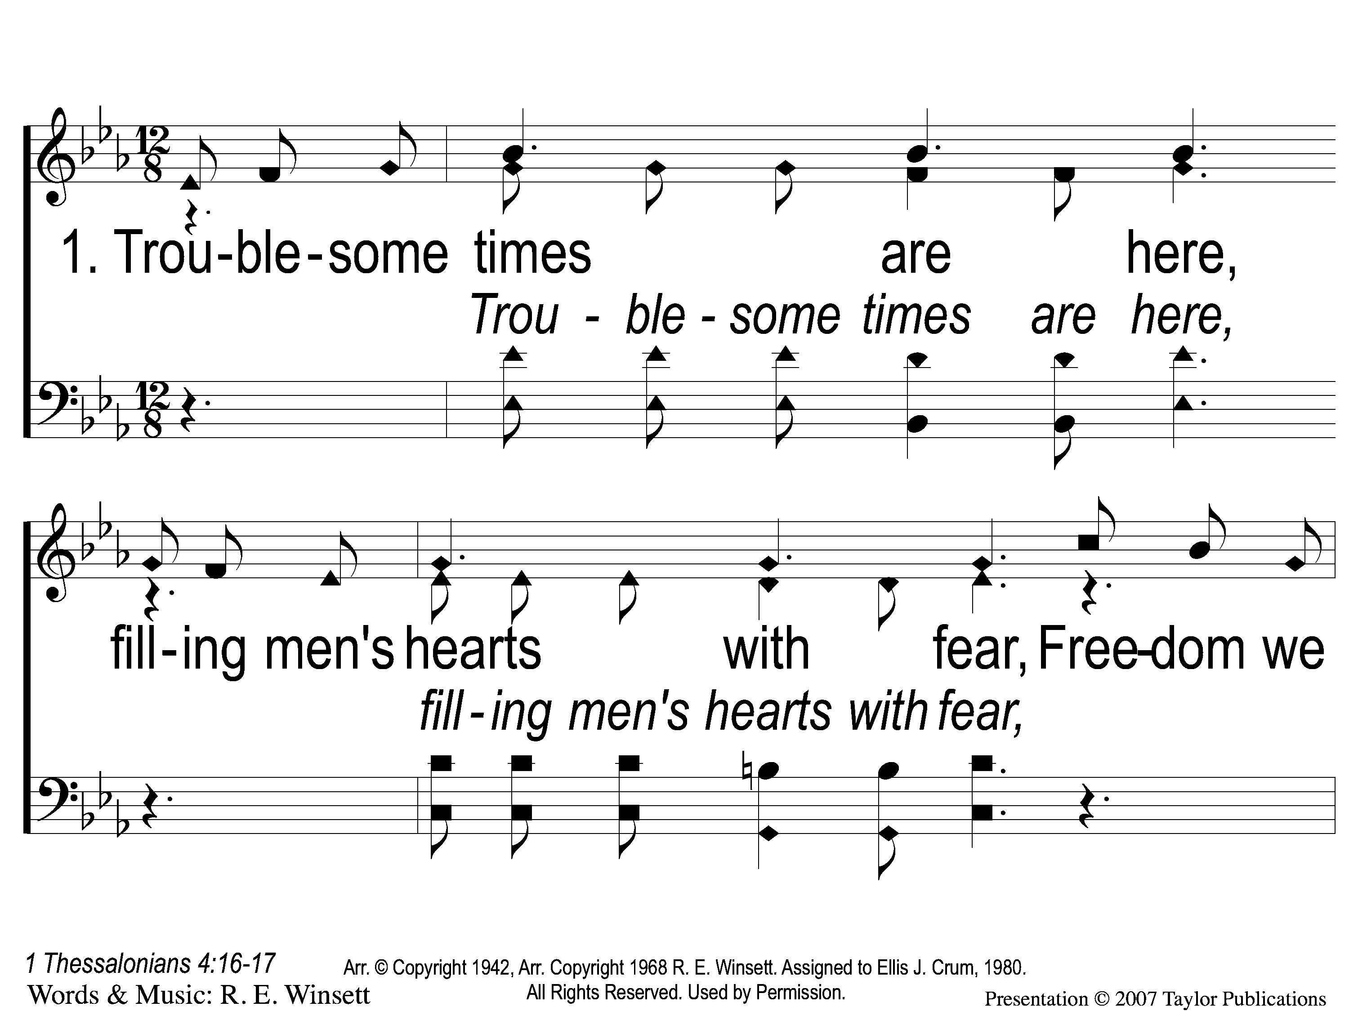
1-1 Jesus is Coming Soon
Jesus is Coming Soon
712

Slide 40
1-2 Jesus is Coming Soon
Jesus is Coming Soon
712

Slide 41
1-3 Jesus is Coming Soon
Jesus is Coming Soon
712

Slide 42
C-1 Jesus is Coming Soon
Jesus is Coming Soon
712

Slide 43
C-2 Jesus is Coming Soon
Jesus is Coming Soon
712

Slide 44
C-3 Jesus is Coming Soon
Jesus is Coming Soon
712

Slide 45
C-4 Jesus is Coming Soon
Jesus is Coming Soon
712

Slide 46
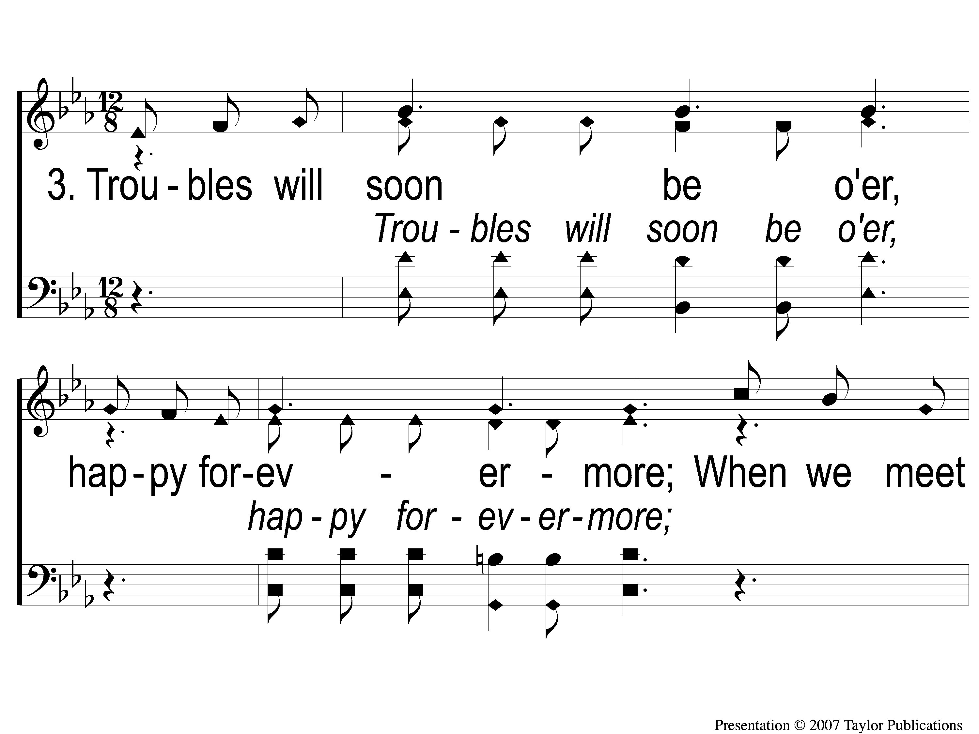
3-1 Jesus is Coming Soon
Jesus is Coming Soon
712

Slide 47
3-2 Jesus is Coming Soon
Jesus is Coming Soon
712

Slide 48
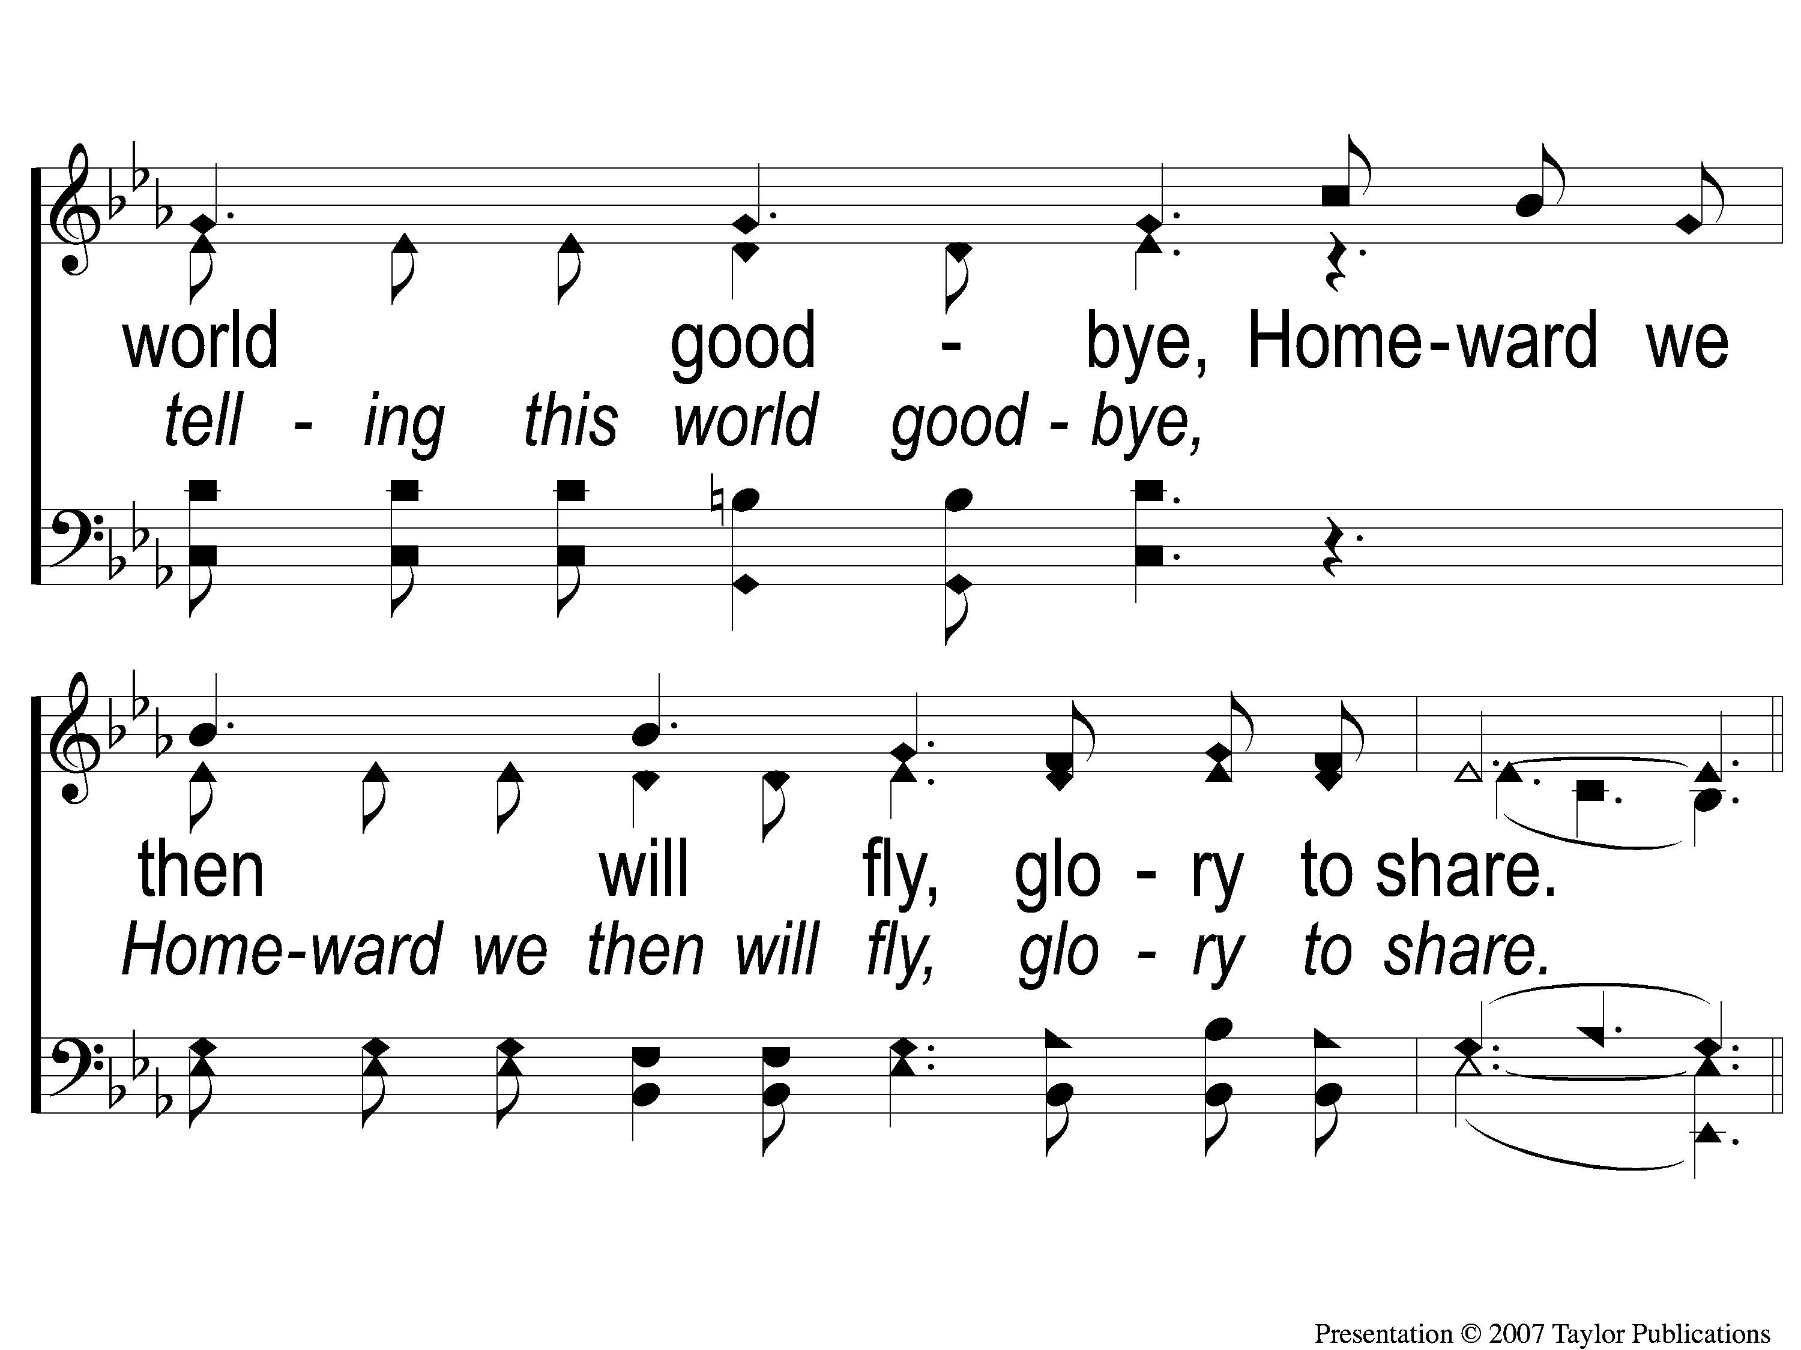
3-3 Jesus is Coming Soon
Jesus is Coming Soon
712

Slide 49
C-1 Jesus is Coming Soon
Jesus is Coming Soon
712

Slide 50
C-2 Jesus is Coming Soon
Jesus is Coming Soon
712

Slide 51
C-3 Jesus is Coming Soon
Jesus is Coming Soon
712

Slide 52
C-4 Jesus is Coming Soon
Jesus is Coming Soon
712

Slide 53
SCRIPTURE READING:
Matthew 24:36-39

Slide 54
Who is Jesus?

Slide 55
WHAT DID JESUS TEACH?

Slide 56
WHAT DID JESUS TEACH?
IN MATTHEW 24-25

Slide 57
What did jesus teach?
5 teaching sections:
5-7 – kingdom people
10 – kingdom purpose
13 – kingdom priority
18 – kingdom principles
23-25 – kingdom pending

Slide 58
SIGNS OF THE END?
Matthew 24-25

Slide 59
PREDICTIONS OF THE END OF THE WORLD:
Pope Innocent III – 1284

Slide 60
PREDICTIONS OF THE END OF THE WORLD:
Pope Innocent III – 1284
Martin Luther – 1600

Slide 61
PREDICTIONS OF THE END OF THE WORLD:
Pope Innocent III – 1284
Martin Luther – 1600
Christopher Columbus – 1656

Slide 62
PREDICTIONS OF THE END OF THE WORLD:
Pope Innocent III – 1284
Martin Luther – 1600
Christopher Columbus – 1656
Jim Jones – 1967

Slide 63
PREDICTIONS OF THE END OF THE WORLD:
Harold Camping
Sept. 6, 1994

Slide 64
PREDICTIONS OF THE END OF THE WORLD:
Harold Camping
Sept. 6, 1994
Sept. 29, 1994
Oct. 2, 1994

Slide 65
PREDICTIONS OF THE END OF THE WORLD:
Harold Camping
May 21, 2011 – The Rapture
Oct. 21, 2011 – The End

Slide 66
TWO THINGS JESUS PREDICTED:
1. THE END OF JERUSALEM (24:1-35)
2. THE END OF TIME (24:36-25:46)

Slide 67
THE END OF JERUSALEM
NON-SIGNS:

Slide 68
THE END OF JERUSALEM
NON-SIGNS:
False Messiahs

Slide 69
THE END OF JERUSALEM
NON-SIGNS:
False Messiahs
Wars & Rumors of Wars

Slide 70
THE END OF JERUSALEM
NON-SIGNS:
False Messiahs
Wars & Rumors of Wars
Famines

Slide 71
THE END OF JERUSALEM
NON-SIGNS:
False Messiahs
Wars & Rumors of Wars
Famines
Plagues

Slide 72
THE END OF JERUSALEM
NON-SIGNS:
False Messiahs
Wars & Rumors of Wars
Famines
Plagues
Earthquakes

Slide 73
THE END OF JERUSALEM
NON-SIGNS:
False Messiahs
Wars & Rumors of Wars
Famines
Plagues
Earthquakes
Persecutions

Slide 74
THE END OF JERUSALEM
NON-SIGNS:
False Messiahs
Wars & Rumors of Wars
Famines
Plagues
Earthquakes
Persecutions
False Teachers & False Teachings

Slide 75
THE END OF JERUSALEM
NON-SIGNS:
False Messiahs
Wars & Rumors of Wars
Famines
Plagues
Earthquakes
Persecutions
False Teachers & False Teachings
Lawlessness Abounding

Slide 76
THE END OF JERUSALEM
WHEN WOULD IT OCCUR?
After The Sign: “The Abomination of Desolation” (v. 15)

Slide 77
THE END OF JERUSALEM
WHEN WOULD IT OCCUR?
“This generation will by no means pass away till all these things take place.”

Slide 78
THE END OF TIME

Slide 79
THE END OF TIME
NO SIGNS!
Matt. 24:36-44

Slide 80
THE END OF TIME
NO SIGNS!
Matt. 24:36-44
1 Thess. 5:2
2 Pet. 3:10

Slide 81
4 Key Teachings of Jesus:
Jerusalem would be destroyed in the Apostles’ lifetimes
There would be 1 sign before the destruction of Jerusalem
The end of time will occur at Jesus’ Return
The end of time will have NO Signs

Slide 82
ARE YOU READY
FOR THE JUDGMENT DAY?

Slide 83
Invitation SONG:
There’s a great day coming

Slide 84
1-1 There’s A Great Day Coming
There’s A Great Day Coming

Slide 85
1-2 There’s A Great Day Coming
There’s A Great Day Coming

Slide 86
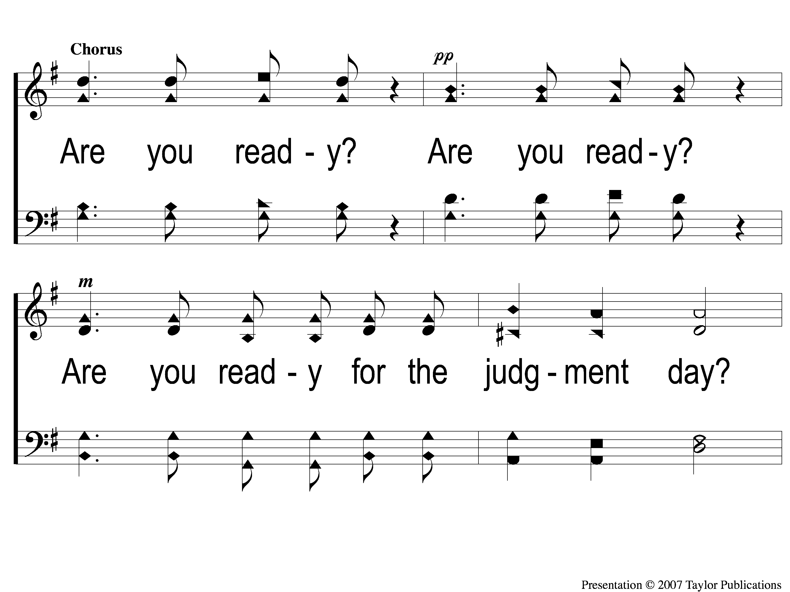
C-1 There’s A Great Day Coming
There’s A Great Day Coming

Slide 87
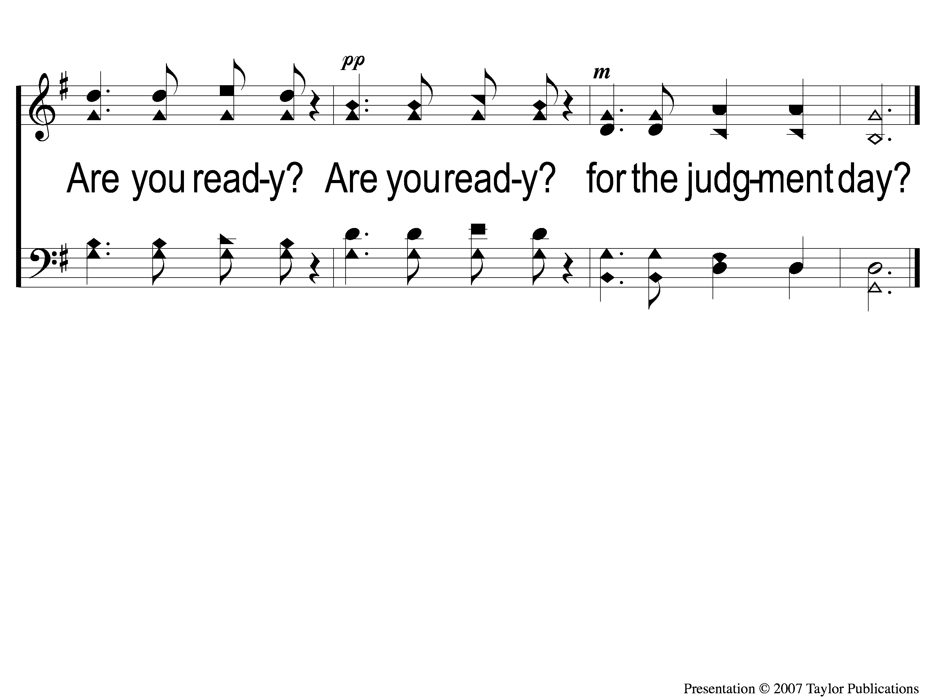
C-2 There’s A Great Day Coming
There’s A Great Day Coming

Slide 88
2-1 There’s A Great Day Coming
There’s A Great Day Coming

Slide 89
2-2 There’s A Great Day Coming
There’s A Great Day Coming

Slide 90
C-1 There’s A Great Day Coming
There’s A Great Day Coming

Slide 91
C-2 There’s A Great Day Coming
There’s A Great Day Coming

Slide 92
3-1 There’s A Great Day Coming
There’s A Great Day Coming

Slide 93
3-2 There’s A Great Day Coming
There’s A Great Day Coming

Slide 94
C-1 There’s A Great Day Coming
There’s A Great Day Coming

Slide 95
C-2 There’s A Great Day Coming
There’s A Great Day Coming

Slide 96
OUR CONTRIBUTION
2 Corinthians 9:7-8
“So let each one give as he purposes in his heart, not grudgingly or of necessity; for God loves a cheerful giver. And God is able to make all grace abound toward you, that you, always having all sufficiency in all things, may have an abundance for every good work.”

Slide 97
SONG:
One day
#353

Slide 98
1-1 One Day
One Day
353

Slide 99
1-2 One Day
One Day
353

Slide 100
C-1 One Day
One Day
353

Slide 101
C-2 One Day
One Day
353

Slide 102
2-1 One Day
One Day
353

Slide 103
2-2 One Day
One Day
353

Slide 104
C-1 One Day
One Day
353

Slide 105
C-2 One Day
One Day
353

Slide 106
4-1 One Day
One Day
353

Slide 107
4-2 One Day
One Day
353

Slide 108
C-1 One Day
One Day
353

Slide 109
C-2 One Day
One Day
353

Slide 110
5-1 One Day
One Day
353

Slide 111
5-2 One Day
One Day
353

Slide 112
C-1 One Day
One Day
353

Slide 113
C-2 One Day
One Day
353

Slide 114
THE UNLEAVENED BREAD
1 Peter 4:1-2
“Therefore, since Christ suffered for us in the flesh, arm yourselves also with the same mind, for he who has suffered in the flesh has ceased from sin, that he no longer should live the rest of his time in the flesh for the lusts of men, but for the will of God.”

Slide 115
THE FRUIT OF THE VINE
1 Peter 1:17-19
“And if you call on the Father, who without partiality judges according to each one’s work, conduct yourselves throughout the time of your stay here in fear; knowing that you were not redeemed with corruptible things, like silver or gold, from your aimless conduct received by tradition from your fathers, but with the precious blood of Christ, as of a lamb without blemish and without spot. ”

Slide 116
closing PRAYER

Slide 117
SONG:
Sweet by and by
#878

Slide 118
1-1 Sweet By And By
Sweet By and By
878

Slide 119
1-2 Sweet By And By
Sweet By and By
878

Slide 120
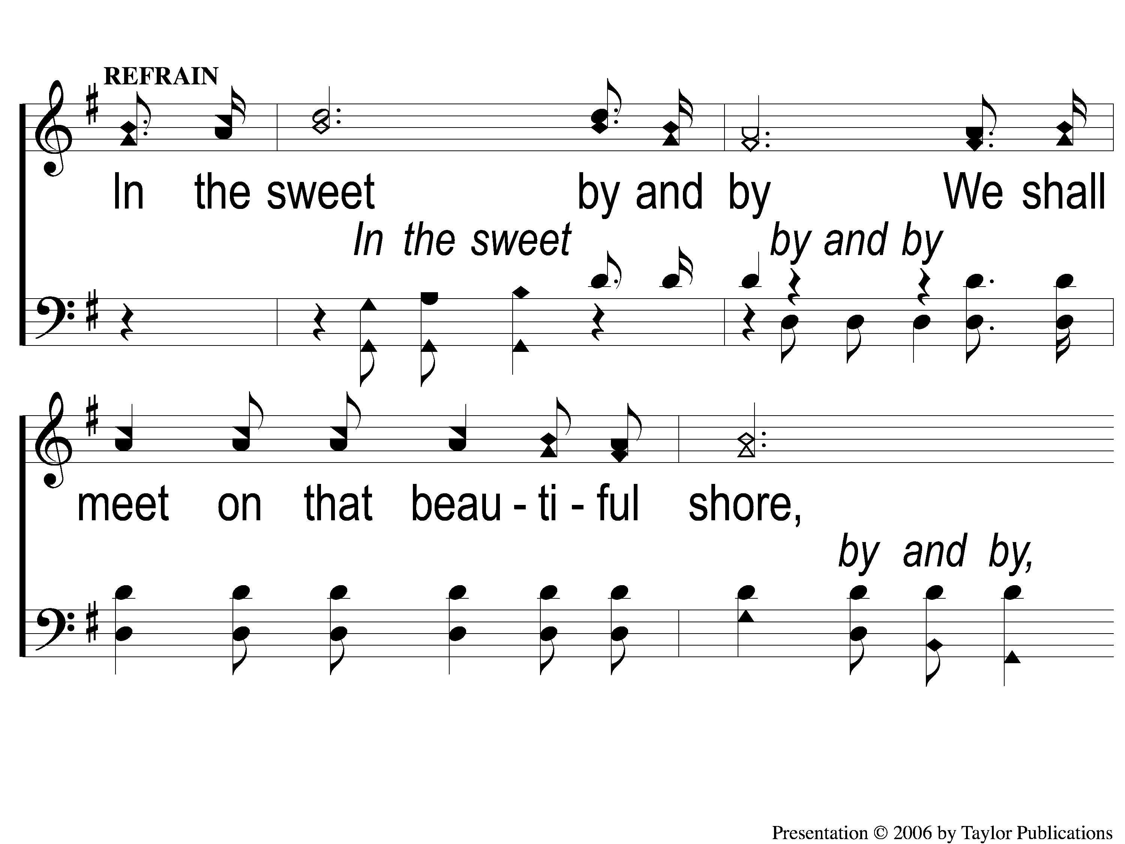
C-1 Sweet By And By
Sweet By and By
878

Slide 121
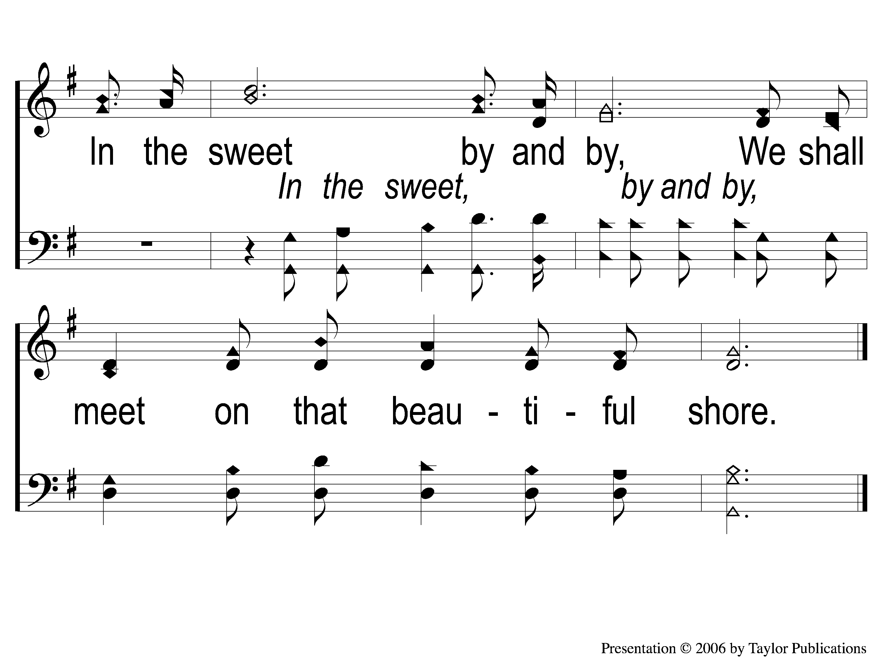
C-2 Sweet By And By
Sweet By and By
878

Slide 122
2-1 Sweet By And By
Sweet By and By
878

Slide 123
2-2 Sweet By And By
Sweet By and By
878

Slide 124
C-1 Sweet By And By
Sweet By and By
878

Slide 125
C-2 Sweet By And By
Sweet By and By
878

Slide 126
3-1 Sweet By And By
Sweet By and By
878

Slide 127
3-2 Sweet By And By
Sweet By and By
878

Slide 128
C-1 Sweet By And By
Sweet By and By
878

Slide 129
C-2 Sweet By And By
Sweet By and By
878

Slide 130
Today
WORSHIP @ 6 Pm
MEN’S BUSINESS MEETING
AFTERWARDS
wEDNESDAY
FAMILY MEAL @ 5:30 pm
WORSHIP & BIBLE CLASSES
@ 6:30 PM

Slide 131
Today
FELLOWSHIP MEAL @ NOON
DEVO & SINGING @ 1 PM
wEDNESDAY
WORSHIP & BIBLE CLASSES @ 6 PM

