Slide 1
1 Words and Music
Words and Music
238

Slide 2
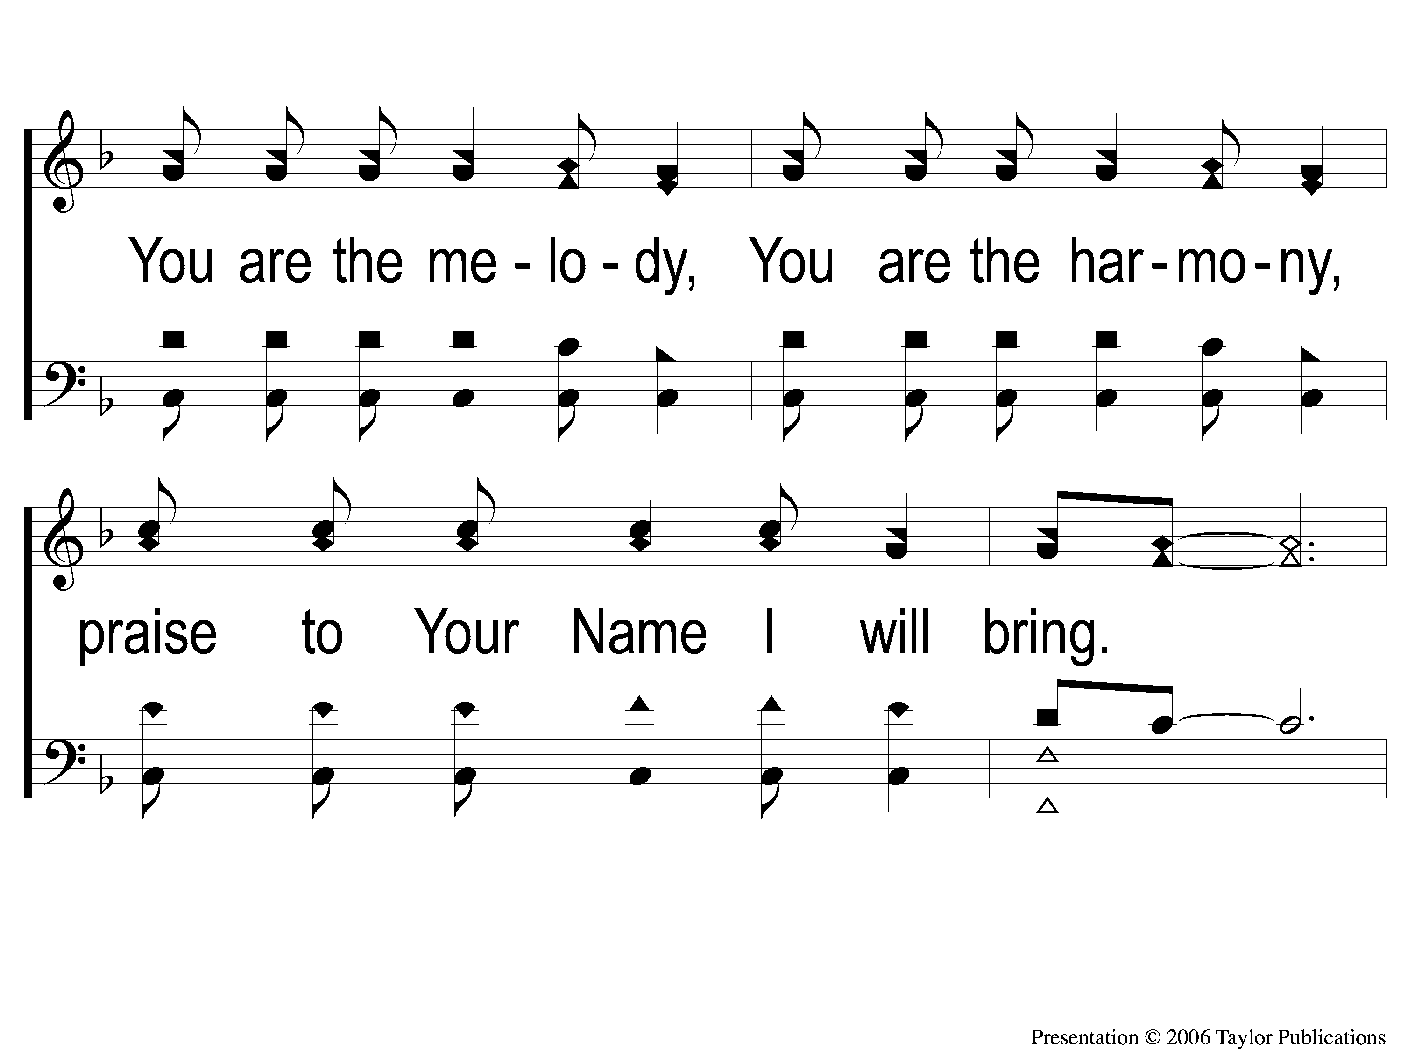
2 Words and Music
Words and Music
238

Slide 3
3 Words and Music
Words and Music
238

Slide 4
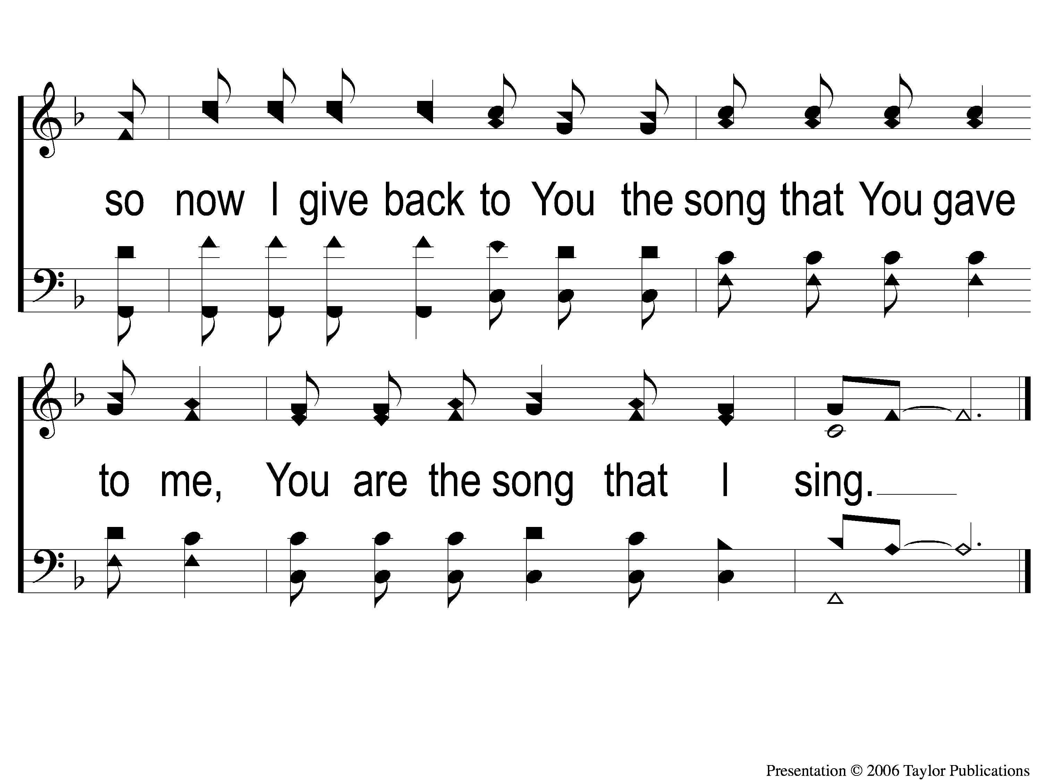
4 Words and Music
Words and Music
238

Slide 5
RESTORE REBUILD RENEW
welcome
we are glad to
Have you with us
IN 2022
WHEELER
CHURCH
OF
CHRIST

Slide 6
Song:
Redeemed
#458

Slide 7
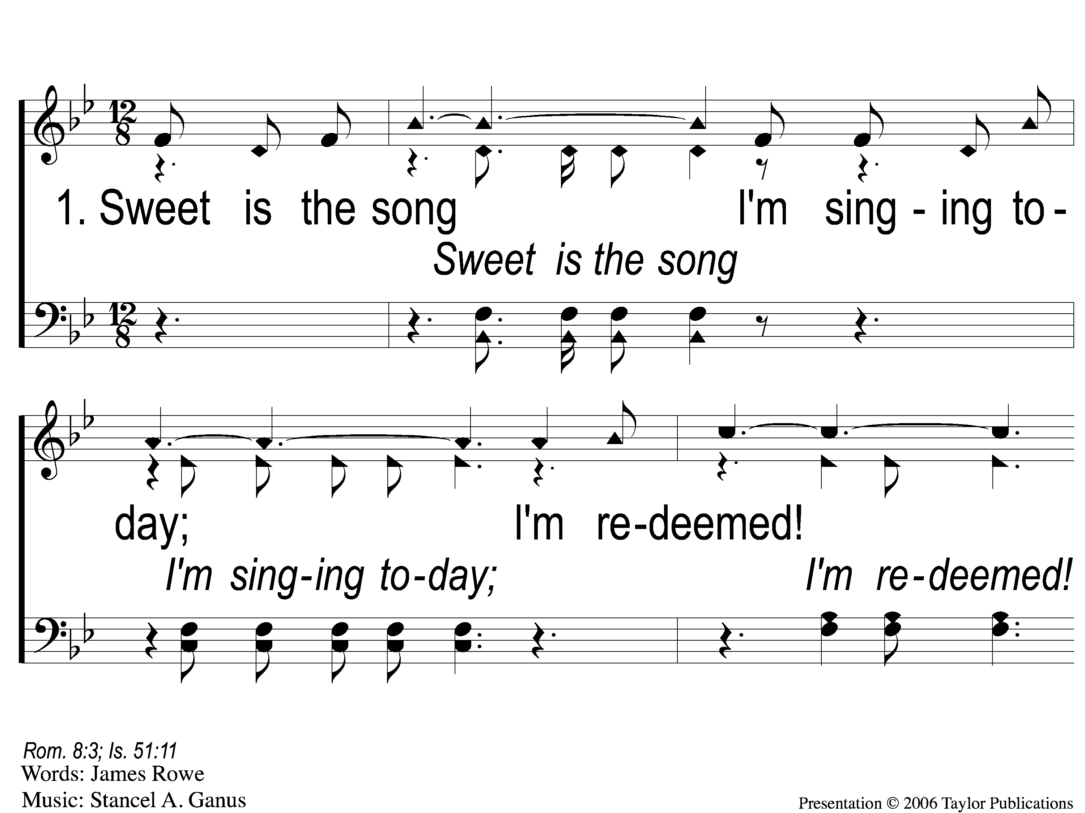
1-1 Redeemed - Sweet is the Song
Redeemed
458

Slide 8
1-2 Redeemed - Sweet is the Song
Redeemed
458

Slide 9
1-3 Redeemed - Sweet is the Song
Redeemed
458

Slide 10
C-1 Redeemed - Sweet is the Song
Redeemed
458

Slide 11
C-2 Redeemed - Sweet is the Song
Redeemed
458

Slide 12
2-1 Redeemed - Sweet is the Song

Slide 13
2-2 Redeemed - Sweet is the Song
Redeemed
458

Slide 14
2-3 Redeemed - Sweet is the Song
Redeemed
458

Slide 15
C-1 Redeemed - Sweet is the Song
Redeemed
458

Slide 16
C-2 Redeemed - Sweet is the Song
Redeemed
458

Slide 17
3-1 Redeemed - Sweet is the Song
Redeemed
458

Slide 18
3-2 Redeemed - Sweet is the Song
Redeemed
458

Slide 19
3-3 Redeemed - Sweet is the Song
Redeemed
458

Slide 20
C-1 Redeemed - Sweet is the Song
Redeemed
458

Slide 21
C-2 Redeemed - Sweet is the Song
Redeemed
458

Slide 22
Song:
Jesus, Let Us
Come To Know You
#768

Slide 23
Song:
A Common Love
#705

Slide 24
1 A Common Love
A Common Love
705

Slide 25
2 A Common Love
A Common Love
705

Slide 26
3 A Common Love
A Common Love
705

Slide 27
Opening Prayer

Slide 28
Song:
No, Not One
#396

Slide 29
1-1 No Not One
No, Not One
396

Slide 30
1-2 No Not One
No, Not One
396

Slide 31
C-1 No Not One
No, Not One
396

Slide 32
C-2 No Not One
No, Not One
396

Slide 33
3-1 No Not One
No, Not One
396

Slide 34
3-2 No Not One
No, Not One
396

Slide 35
C-1 No Not One
No, Not One
396

Slide 36
C-2 No Not One
No, Not One
396

Slide 37
Song:
He Gave Me A Song
#608

Slide 38
1-1 He Gave Me A Song
He Gave Me A Song
608

Slide 39
1-2 He Gave Me A Song
He Gave Me A Song
608

Slide 40
1-3 He Gave Me A Song
He Gave Me A Song
608

Slide 41
C-1 He Gave Me A Song
He Gave Me A Song
608

Slide 42
C-2 He Gave Me A Song
He Gave Me A Song
608

Slide 43
C-3 He Gave Me A Song
He Gave Me A Song
608

Slide 44
3-1 He Gave Me A Song
He Gave Me A Song
608

Slide 45
3-2 He Gave Me A Song
He Gave Me A Song
608

Slide 46
3-3 He Gave Me A Song
He Gave Me A Song
608

Slide 47
C-1 He Gave Me A Song
He Gave Me A Song
608

Slide 48
C-2 He Gave Me A Song
He Gave Me A Song
608

Slide 49
C-3 He Gave Me A Song
He Gave Me A Song
608

Slide 50
Scripture Reading:
Micah 7:18-20

Slide 51
Risen Savior
Life With The

Slide 52
Christianity
Joys
The of

Slide 53
Joy & The Christian
Gal. 5:19-22
Psa. 144:15

Slide 54
Forgiveness
Joy
The of

Slide 55
The Need For Forgiveness
The Innocent
Gen. 1:27, 31; Matt. 19:14

Slide 56
The Need For Forgiveness
The Guilty
Ezek. 18:4
Rom. 3:9, 23

Slide 57
The God Who Forgives
Old Testament
Ex. 34:5-7
Psa. 32:1-2, 5; 78:38, 99:8
Mic. 7:18-20

Slide 58
The God Who Forgives
New Testament
Lk. 5:24
Matt. 18:23-35

Slide 59
The Benefits of Forgiveness

Slide 60
The Benefits of Forgiveness
Physical

Slide 61
The Benefits of Forgiveness
Physical
“Headaches, insomnia, upset stomachs, heart disease, and asthma are all known to occur more commonly in those living under high levels of stress,”

Slide 62
The Benefits of Forgiveness
Physical
Psychological

Slide 63
The Benefits of Forgiveness
Psychological
“…harboring anger will, generally, just make you feel angrier. Instead of accepting and moving on from a negative experience or finding an acceptable resolution, holding on can trap you in a loop of resentment, bitterness, hopelessness, emptiness, or enragement.”

Slide 64
The Benefits of Forgiveness
Physical
Psychological
Spiritual

Slide 65
The Benefits of Forgiveness
Spiritual
Peace with God – Rom. 5:1, Mic. 7:18-20
Peace with Others – Rom. 14:19

Slide 66
The Requirements of Forgiveness
Requirements?

Slide 67
The Requirements of Forgiveness
A Forgiving Heart – Mt. 6:12, 14-15, 18:21-22

Slide 68
The Requirements of Forgiveness
A Forgiving Heart – Mt. 6:12, 14-15, 18:21-22
An Obedient Heart – Acts 2:38, Gal. 3:26-27

Slide 69
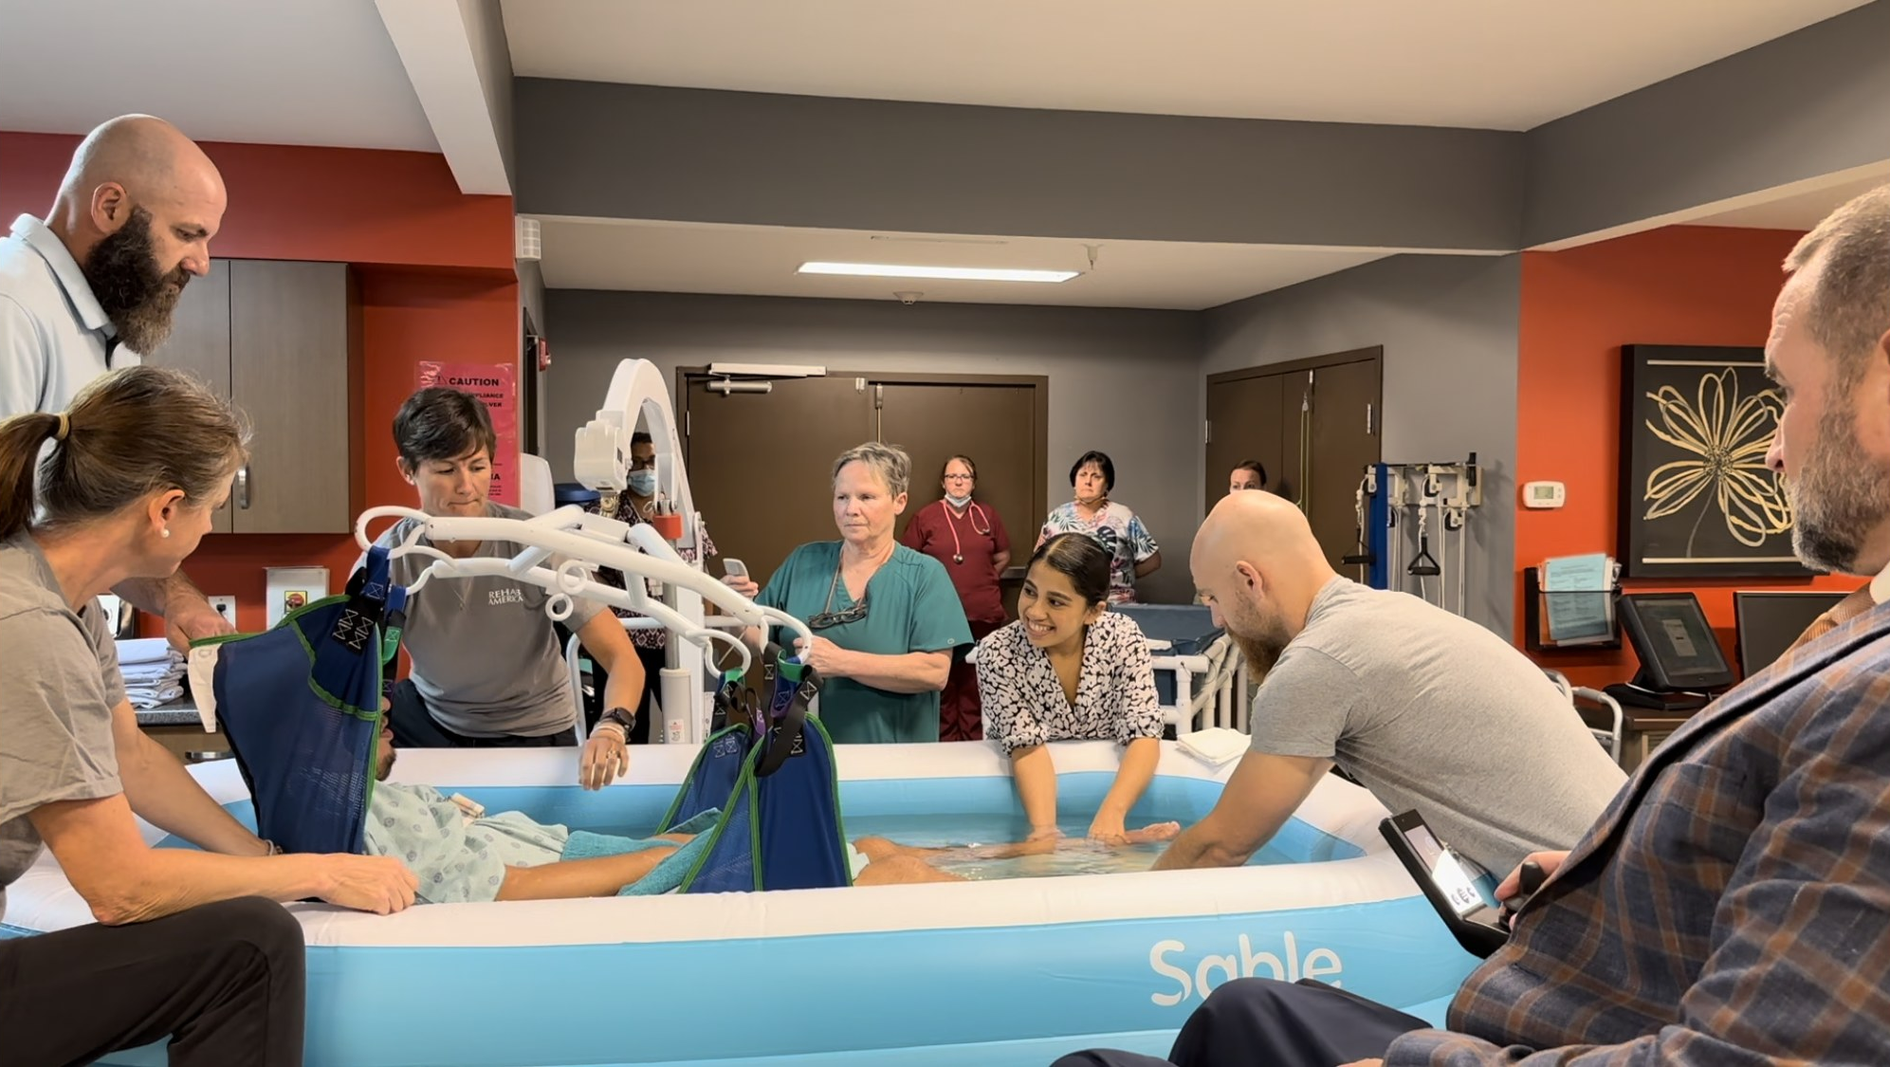
The God Who Forgives
Endurance Renews Our Joy
Jn. 16:20-22, 20:20
Matt. 28:5-8

Slide 70
Are You
Forgiven?

Slide 71
Jesus Keep Me Near The Cross
#383
Invitation
Song:

Slide 72
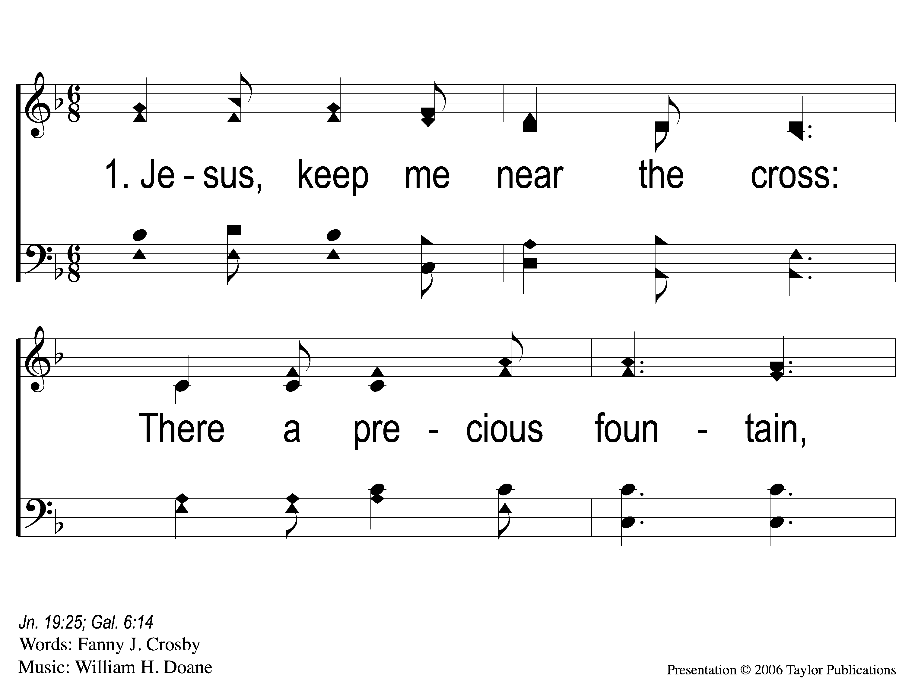
1-1 Jesus Keep Me Near the Cross
Jesus Keep Me Near The Cross
383

Slide 73
1-2 Jesus Keep Me Near the Cross
Jesus Keep Me Near The Cross
383

Slide 74
C Jesus Keep Me Near the Cross
Jesus Keep Me Near The Cross
383

Slide 75
3-1 Jesus Keep Me Near the Cross
Jesus Keep Me Near The Cross
383

Slide 76
3-2 Jesus Keep Me Near the Cross
Jesus Keep Me Near The Cross
383

Slide 77
C Jesus Keep Me Near the Cross
Jesus Keep Me Near The Cross
383

Slide 78
Our Contribution:
1 John 3:16-17
“By this we know love, because He laid down His life for us. And we also ought to lay down our lives for the brethren. But whoever has this world’s goods, and sees his brother in need, and shuts up his heart from him, how does the love of God abide in him?”

Slide 79
Song:
Lamb Of God
#176

Slide 80
1-1 Lamb of God
Lamb of God
176

Slide 81
1-2 Lamb of God
Lamb of God
176

Slide 82
1-3 Lamb of God
Lamb of God
176

Slide 83
1-4 Lamb of God
Lamb of God
176

Slide 84
C-1 Lamb of God
Lamb of God
176

Slide 85
C-2 Lamb of God
Lamb of God
176

Slide 86
2-1 Lamb of God
Lamb of God
176

Slide 87
2-2 Lamb of God
Lamb of God
176

Slide 88
C-1 Lamb of God
Lamb of God
176

Slide 89
C-2 Lamb of God
Lamb of God
176

Slide 90
The Unleavened Bread
Revelation 1:17-18
“And when I saw Him, I fell at His feet as dead. But He laid His right hand on me, saying to me, ‘Do not be afraid; I am the First and the Last. I am He who lives, and was dead, and behold, I am alive forevermore.’ ”

Slide 91
The Fruit
of the Vine
Revelation 5:9-10
“And they sang a new song, saying: ‘You are worthy to take the scroll, And to open its seals; For You were slain, And have redeemed us to God by Your blood Out of every tribe and tongue and people and nation, And have made us kings and priests to our God; And we shall reign on the earth.’ ”

Slide 92
Closing Prayer

Slide 93
Song:
God Will Take Care Of You
#461

Slide 94
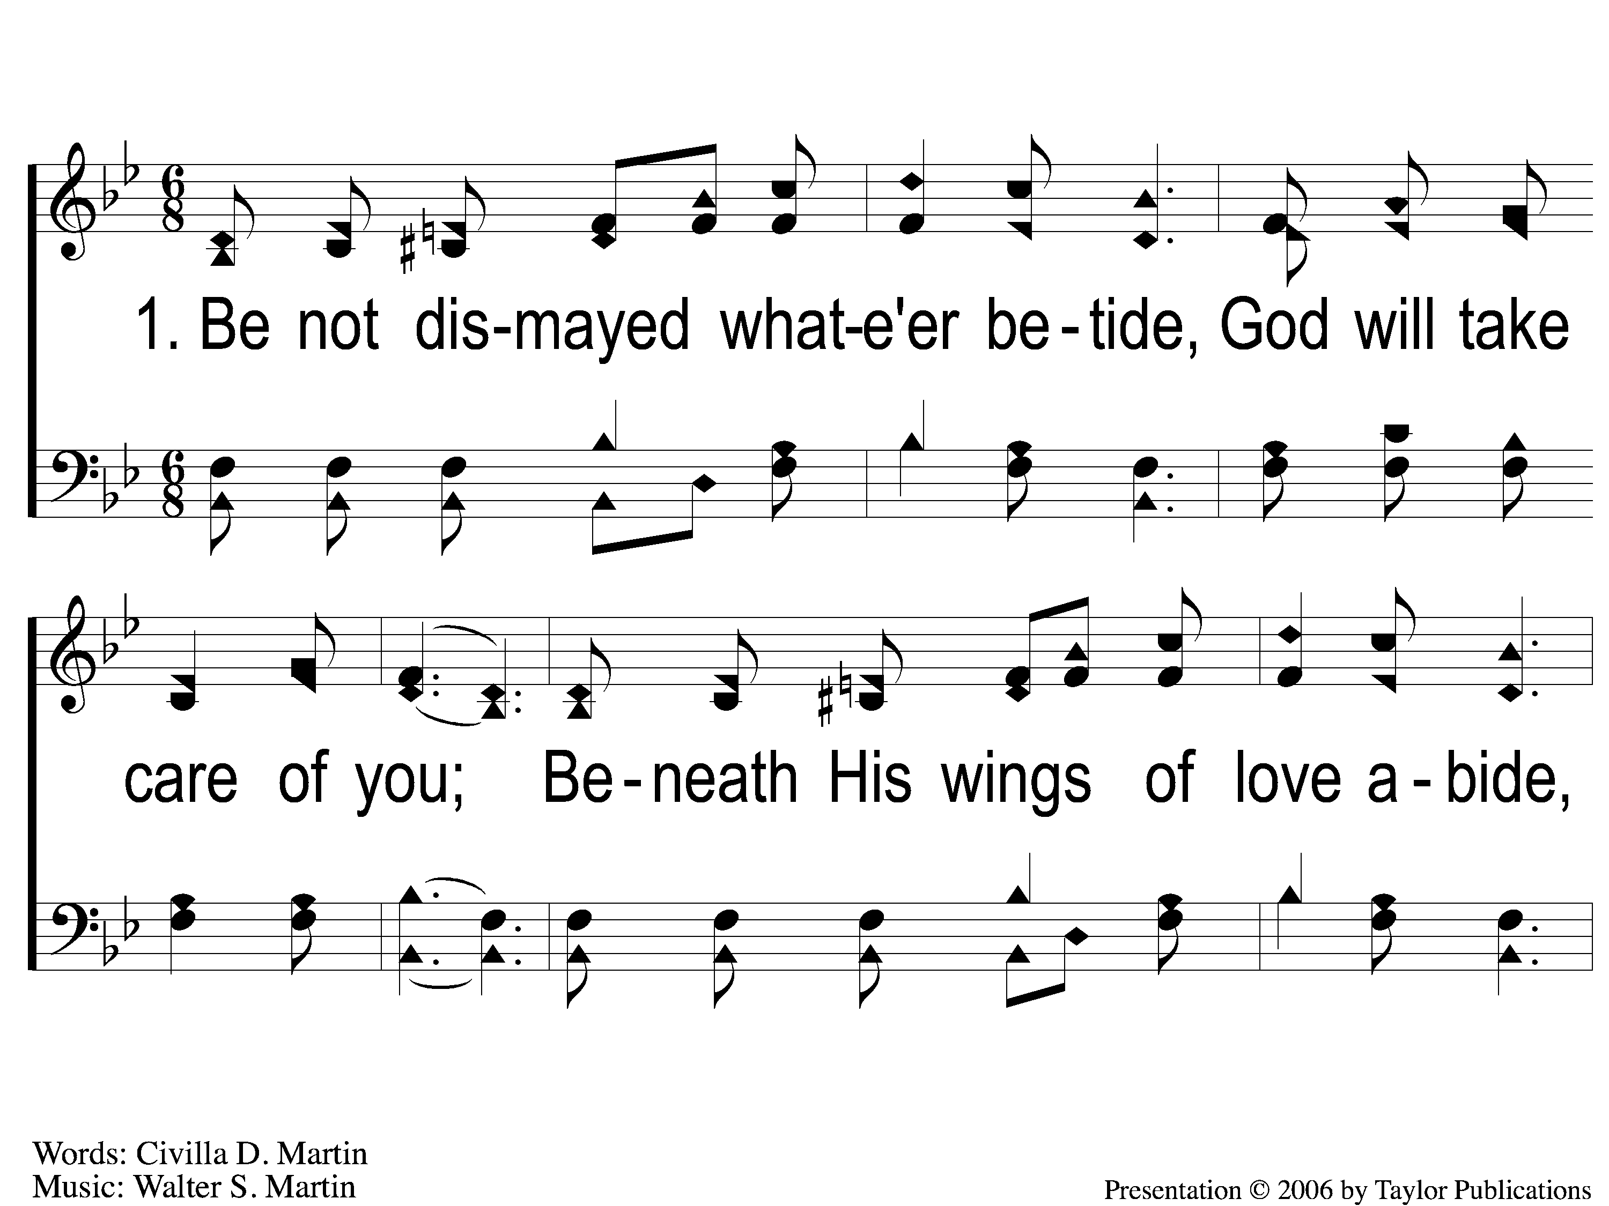
1-1 God Will Take Care Of You
God Will Take Care Of You
461

Slide 95
1-2 God Will Take Care Of You
God Will Take Care Of You
461

Slide 96
C-1 God Will Take Care Of You
God Will Take Care Of You
461

Slide 97
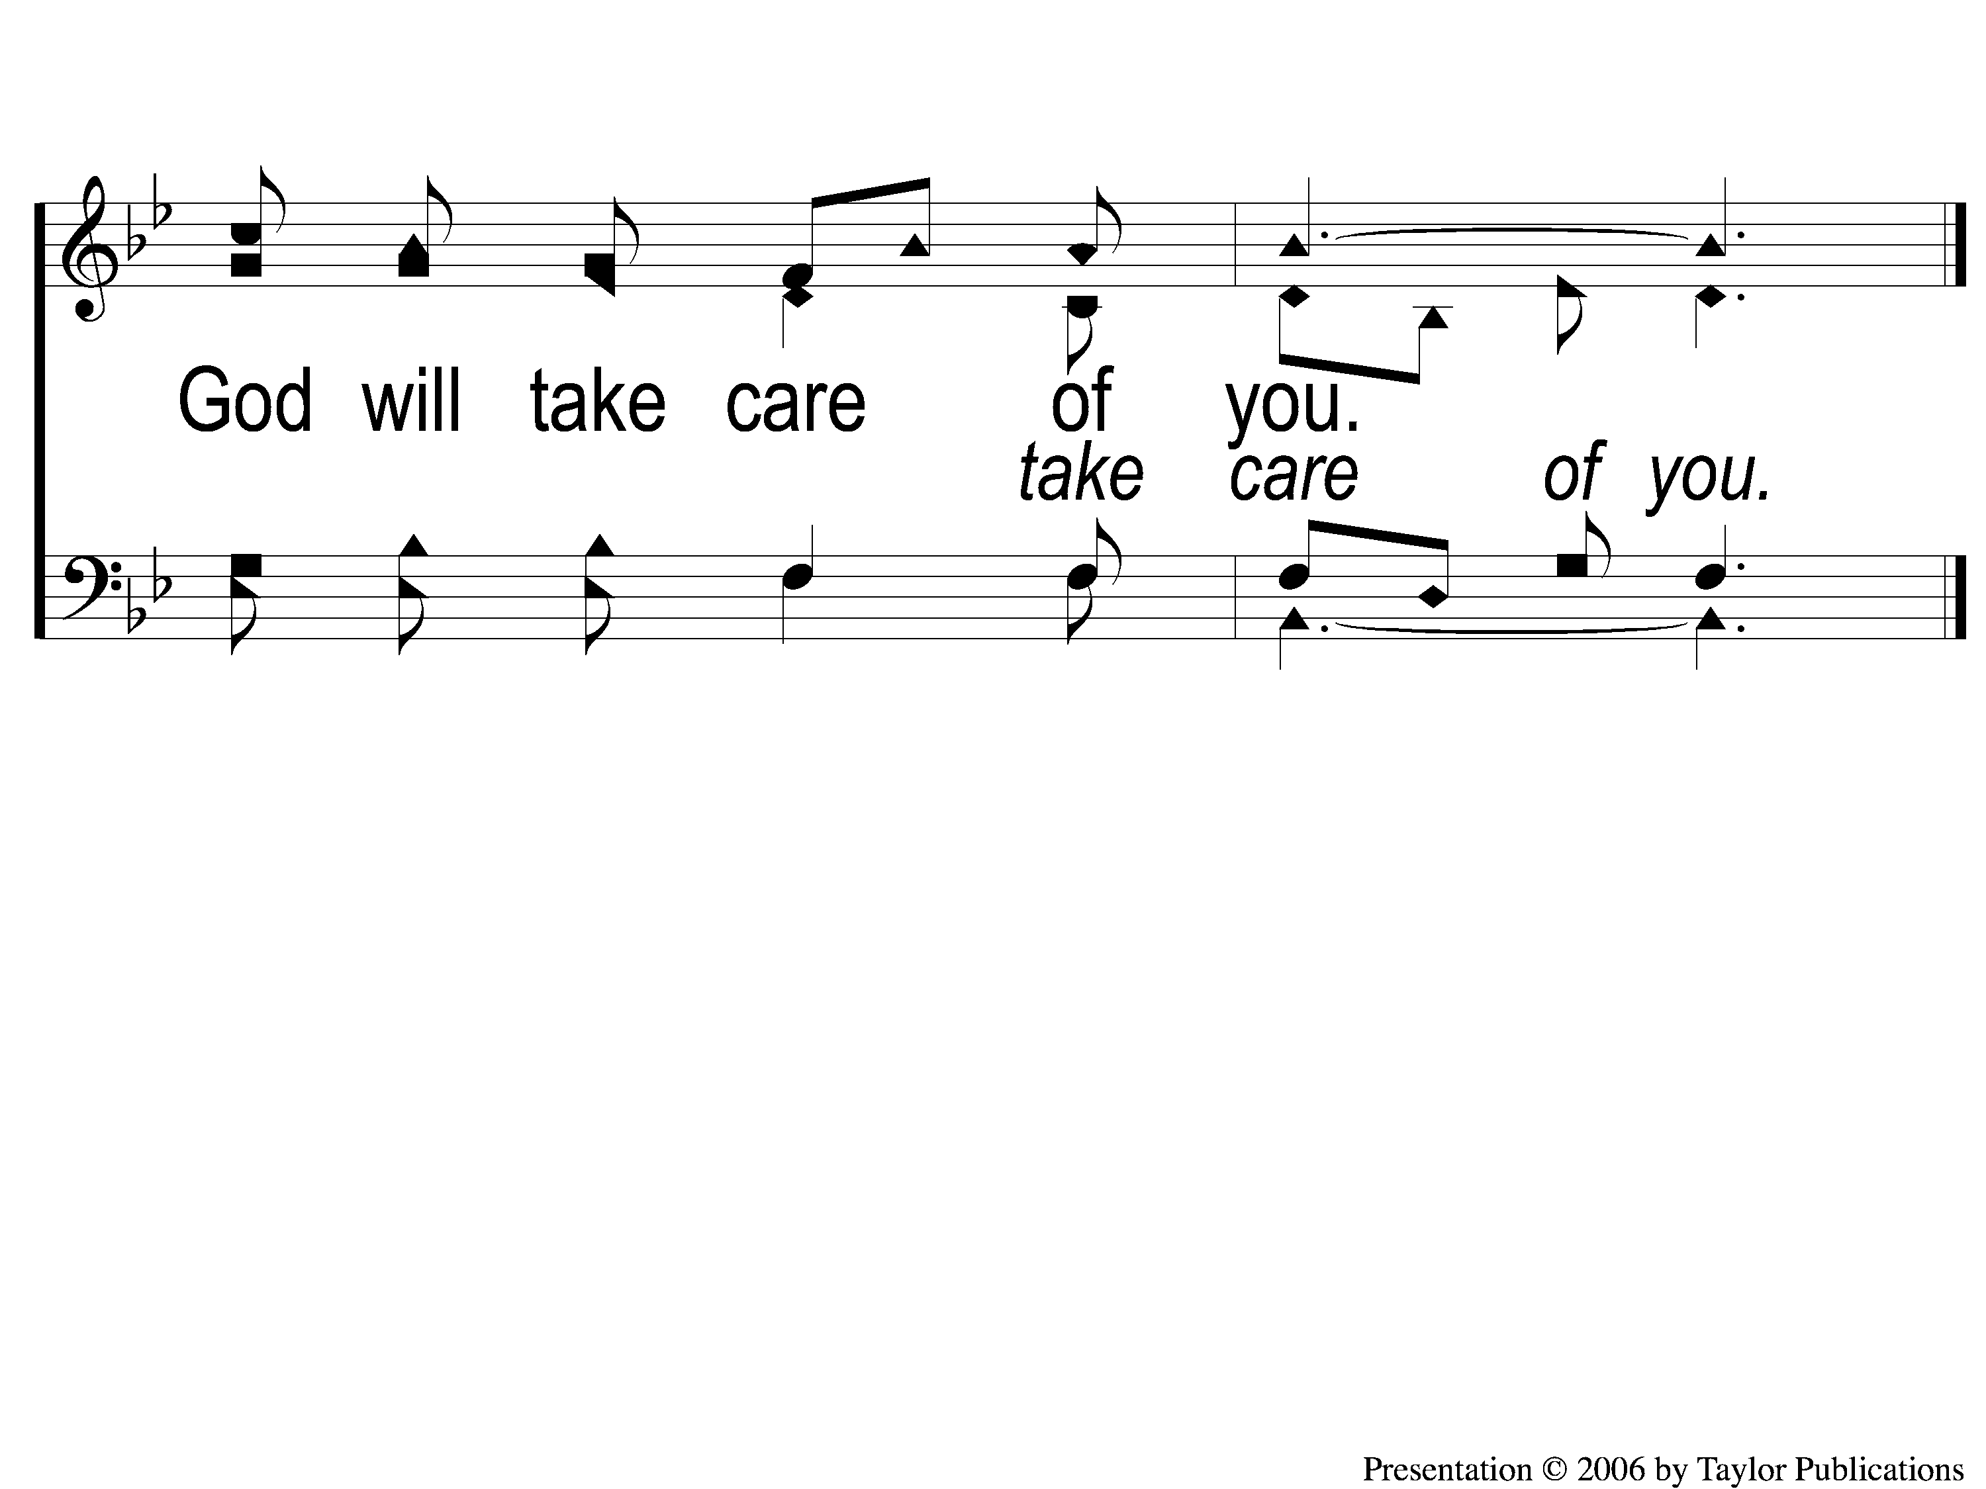
C-2 God Will Take Care Of You
God Will Take Care Of You
461

Slide 98
4-1 God Will Take Care Of You
God Will Take Care Of You
461

Slide 99
4-2 God Will Take Care Of You
God Will Take Care Of You
461

Slide 100
C-1 God Will Take Care Of You
God Will Take Care Of You
461

Slide 101
C-2 God Will Take Care Of You
God Will Take Care Of You
461

Slide 102
Today
LTC @ 4:30 PM
Worship @ 6:00 PM
Wednesday
LTC @ 5:30 PM
Worship & Bible Classes @ 6:30 PM
RESTORE REBUILD RENEW
IN 2022
WHEELER
CHURCH
OF
CHRIST

