Slide 1
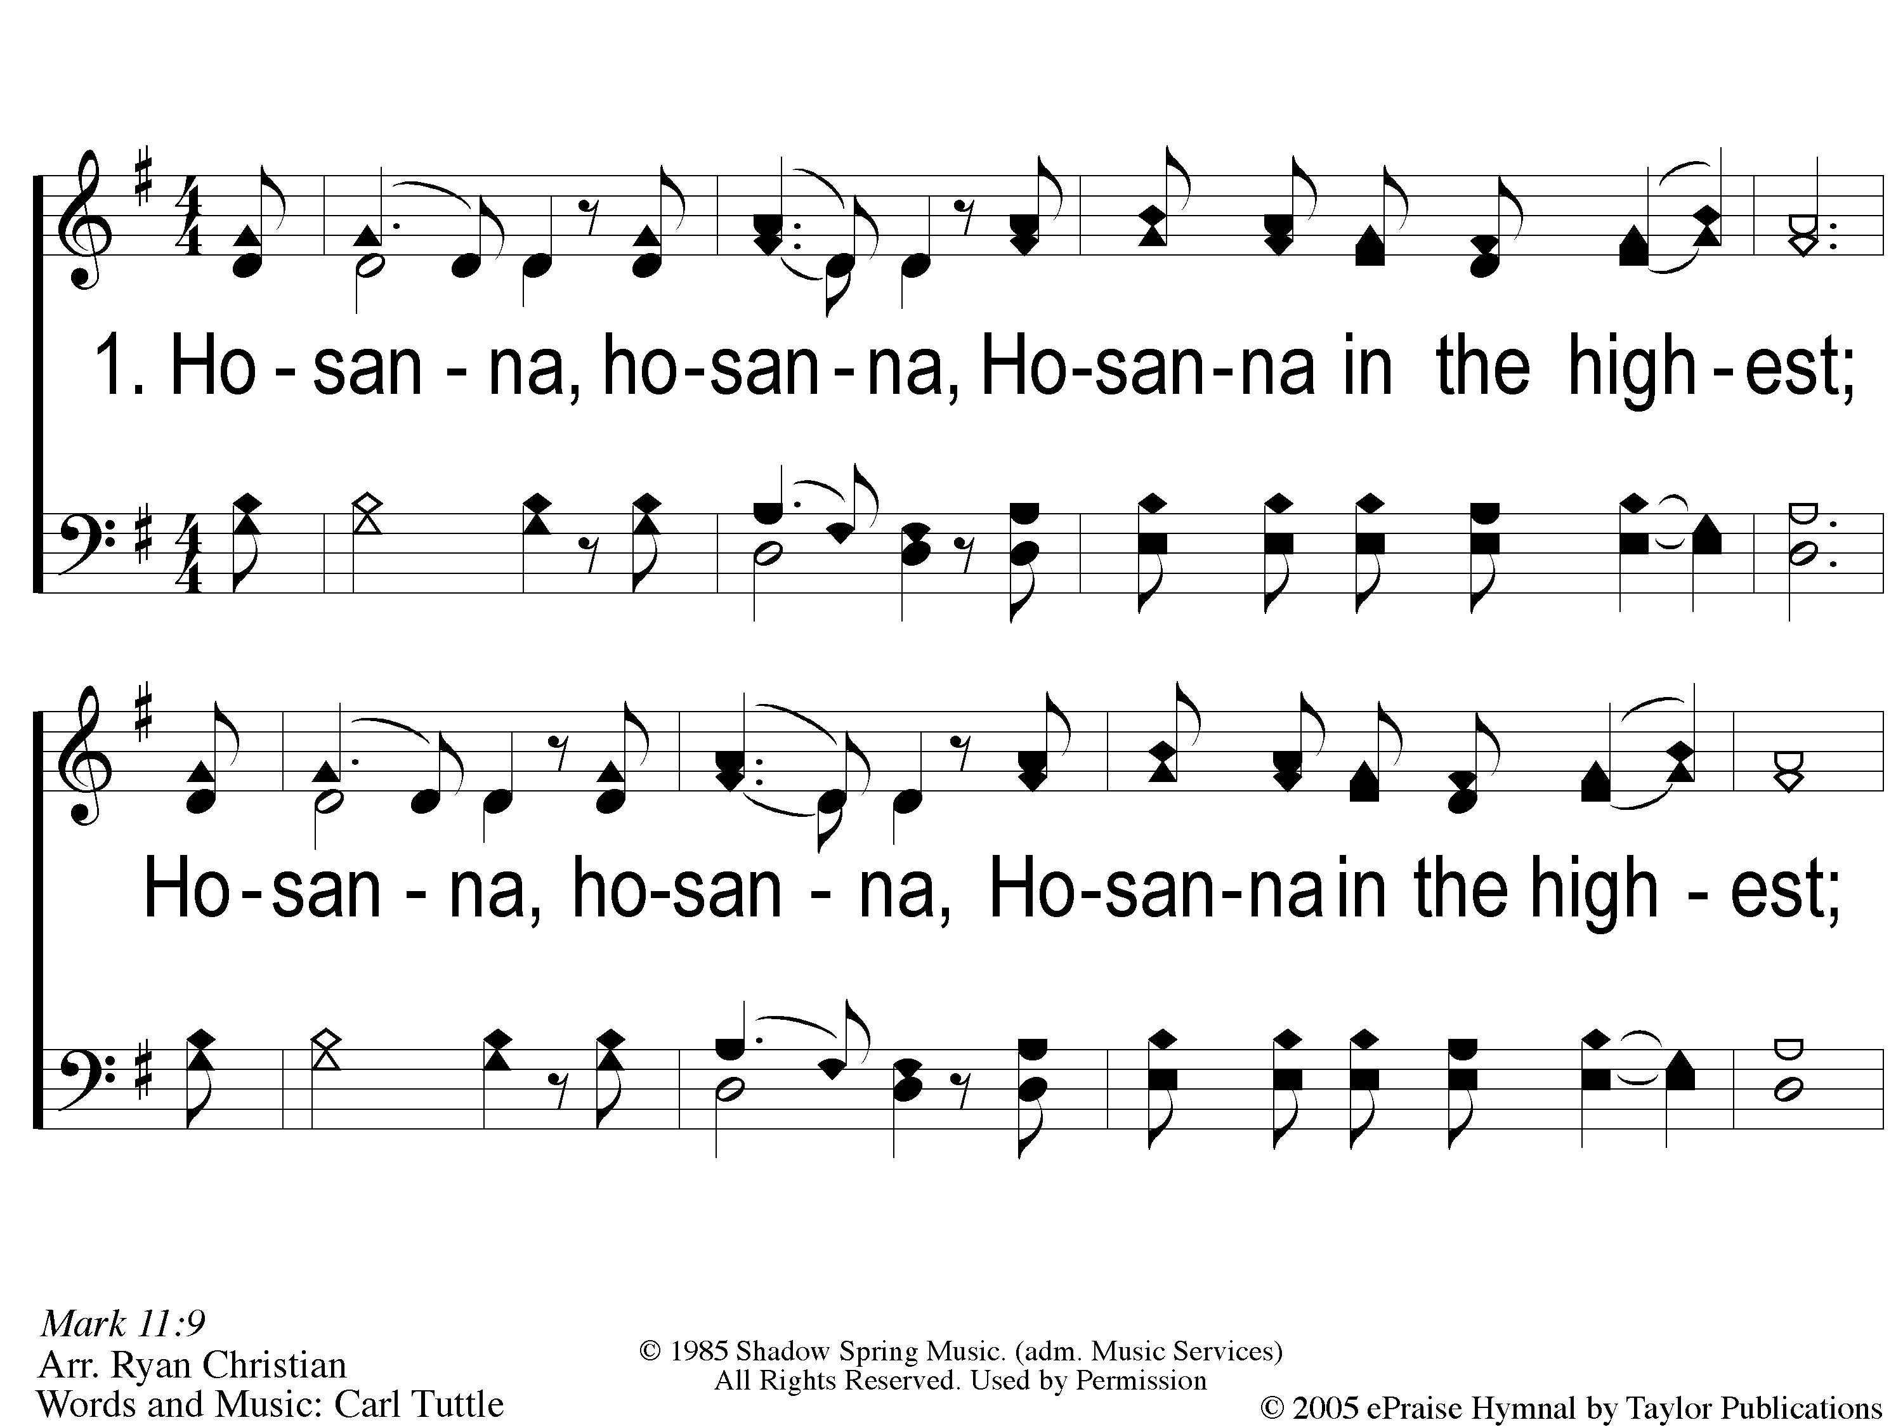
1 Hosanna
Hosanna
167

Slide 2
C-1 Hosanna
Hosanna
167

Slide 3
C-2 Hosanna
Hosanna
167

Slide 4
2 Hosanna
Hosanna
167

Slide 5
C-1 Hosanna
Hosanna
167

Slide 6
C-2 Hosanna
Hosanna
167

Slide 7
RESTORE REBUILD RENEW
welcome
we are glad to
Have you with us
IN 2022
WHEELER
CHURCH
OF
CHRIST

Slide 8
Song:
Sing & Be Happy
#587

Slide 9
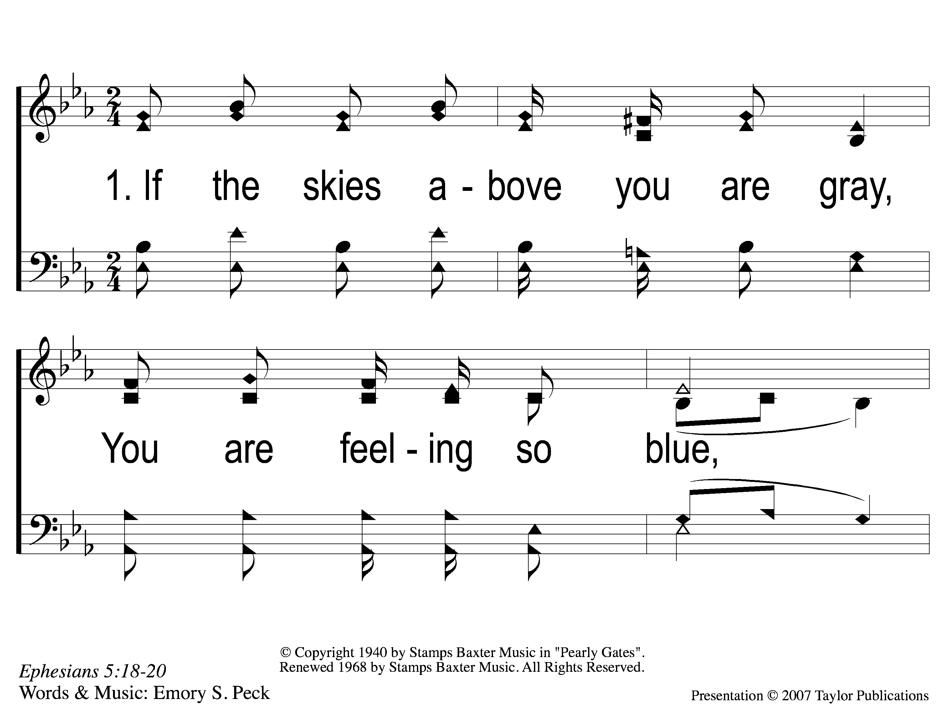
1-1 Sing and Be Happy
Sing and Be Happy
587

Slide 10
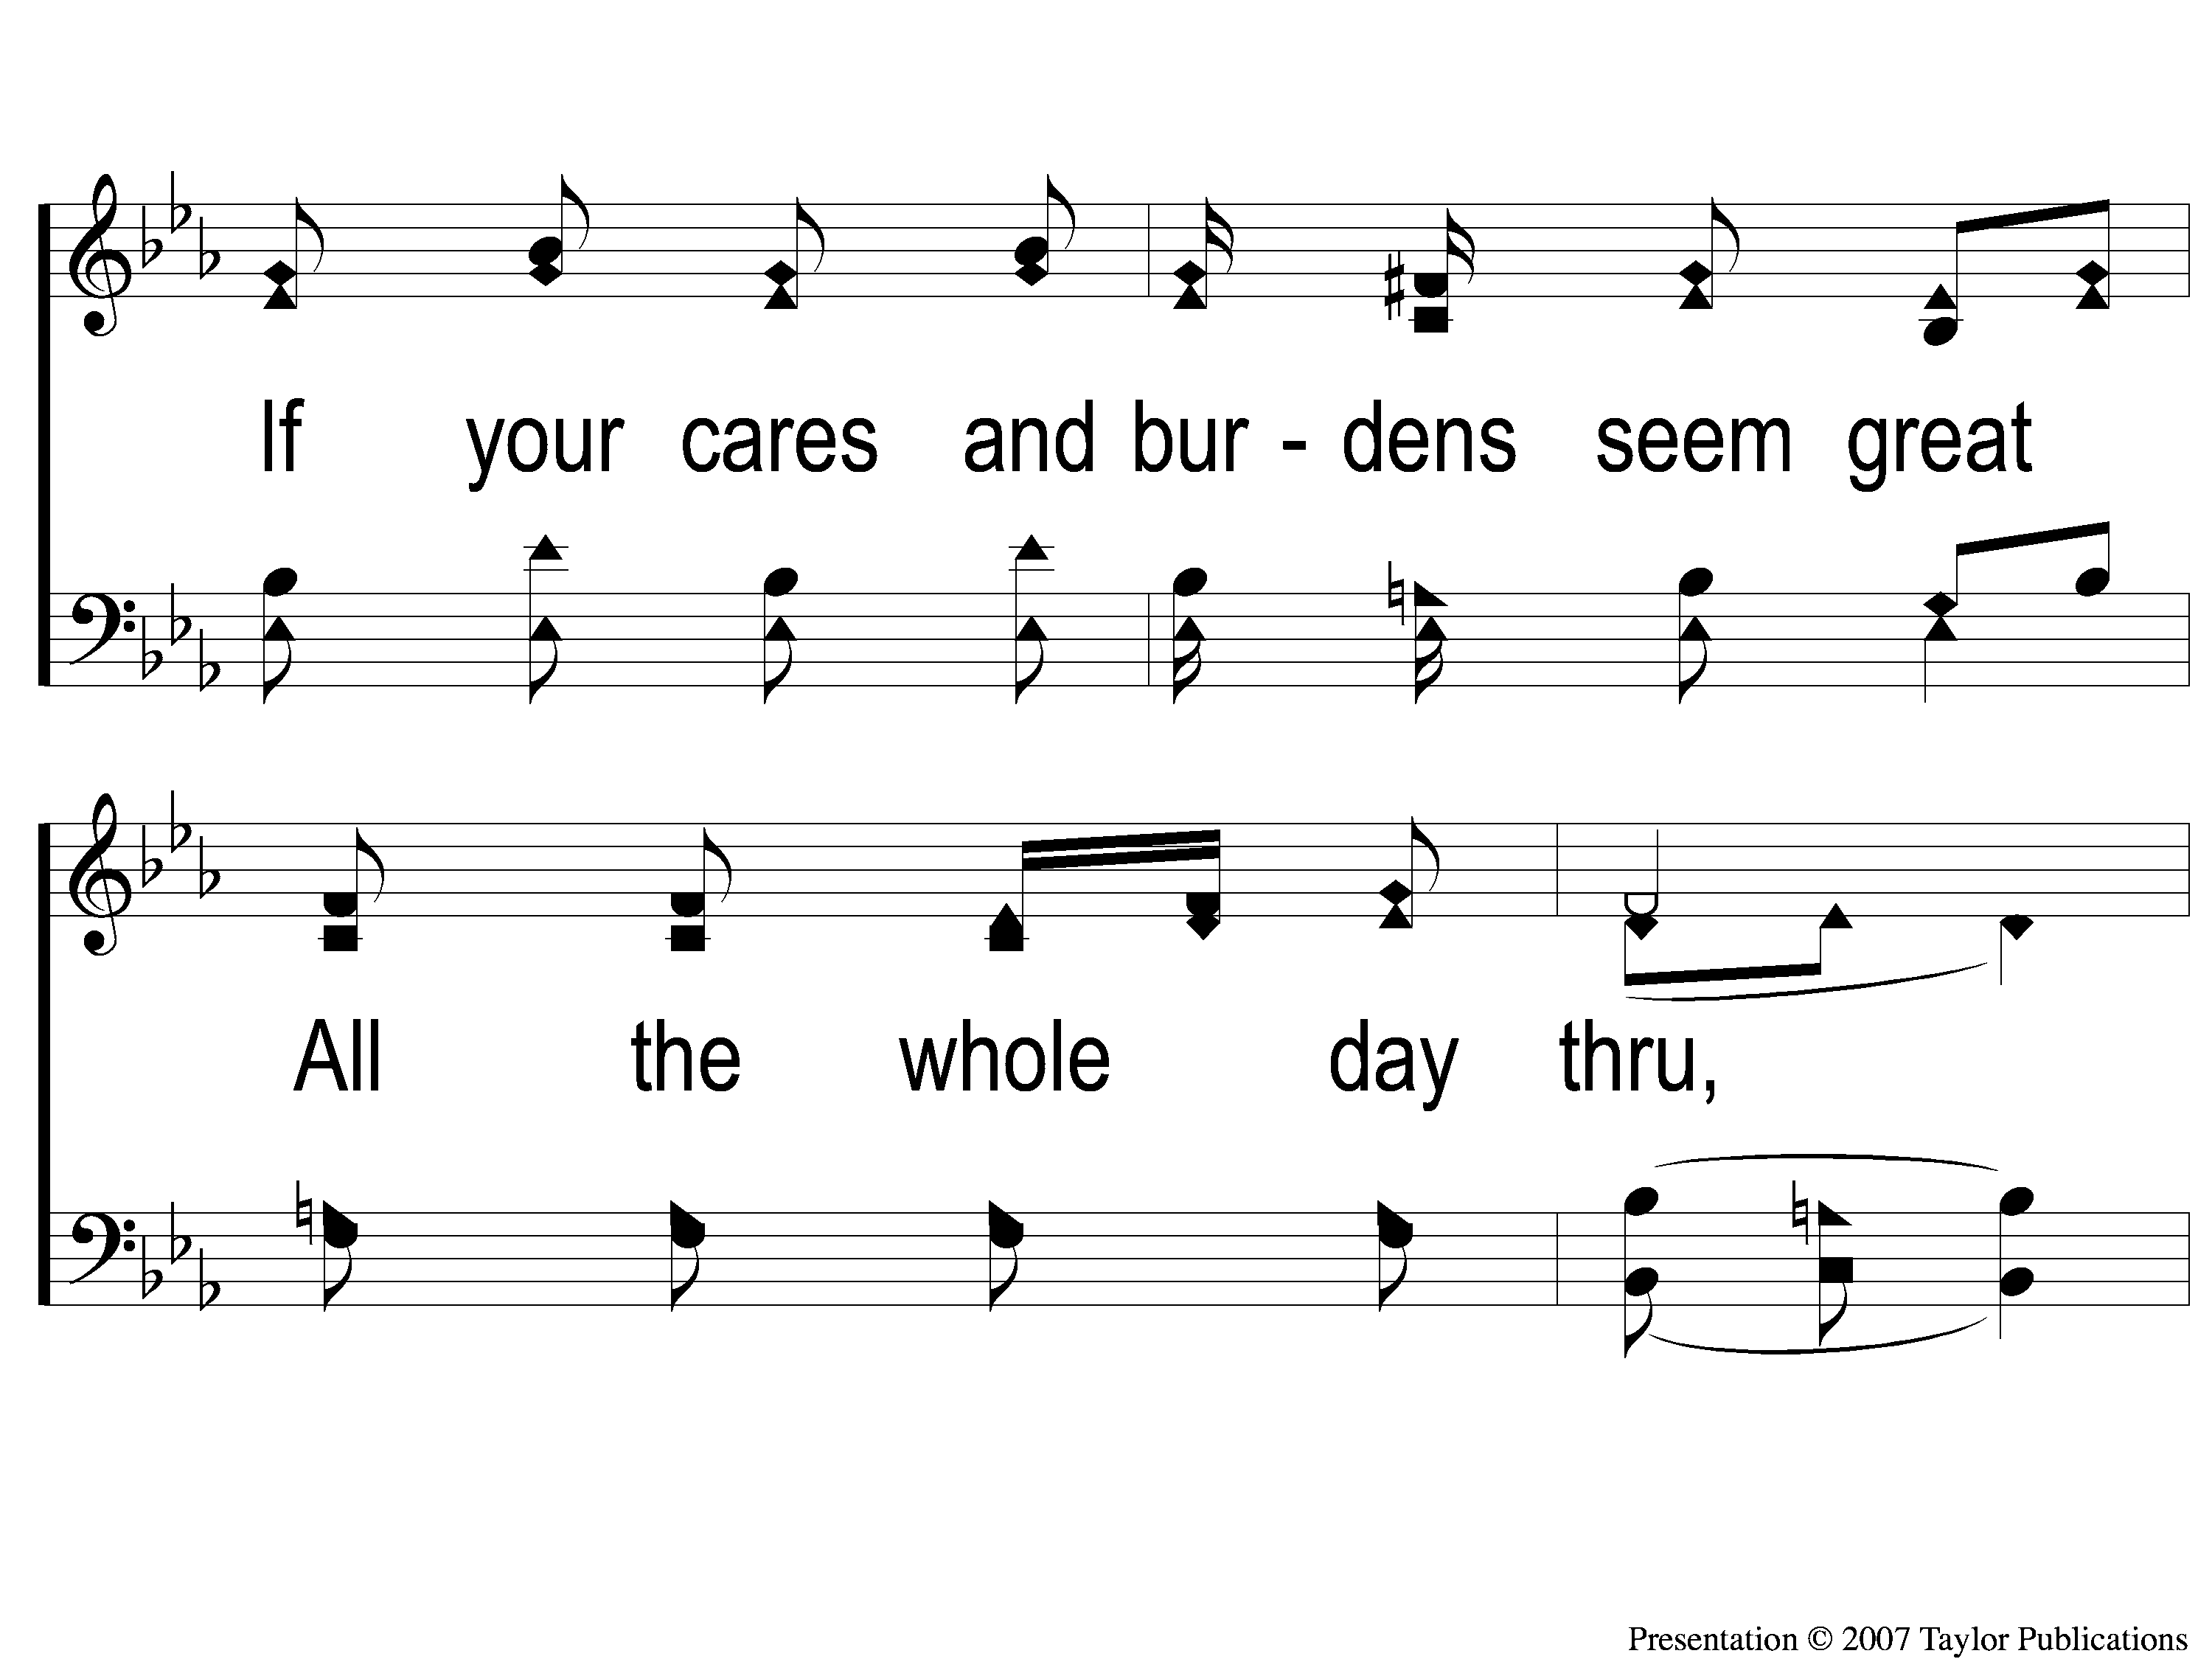
1-2 Sing and Be Happy
Sing and Be Happy
587

Slide 11
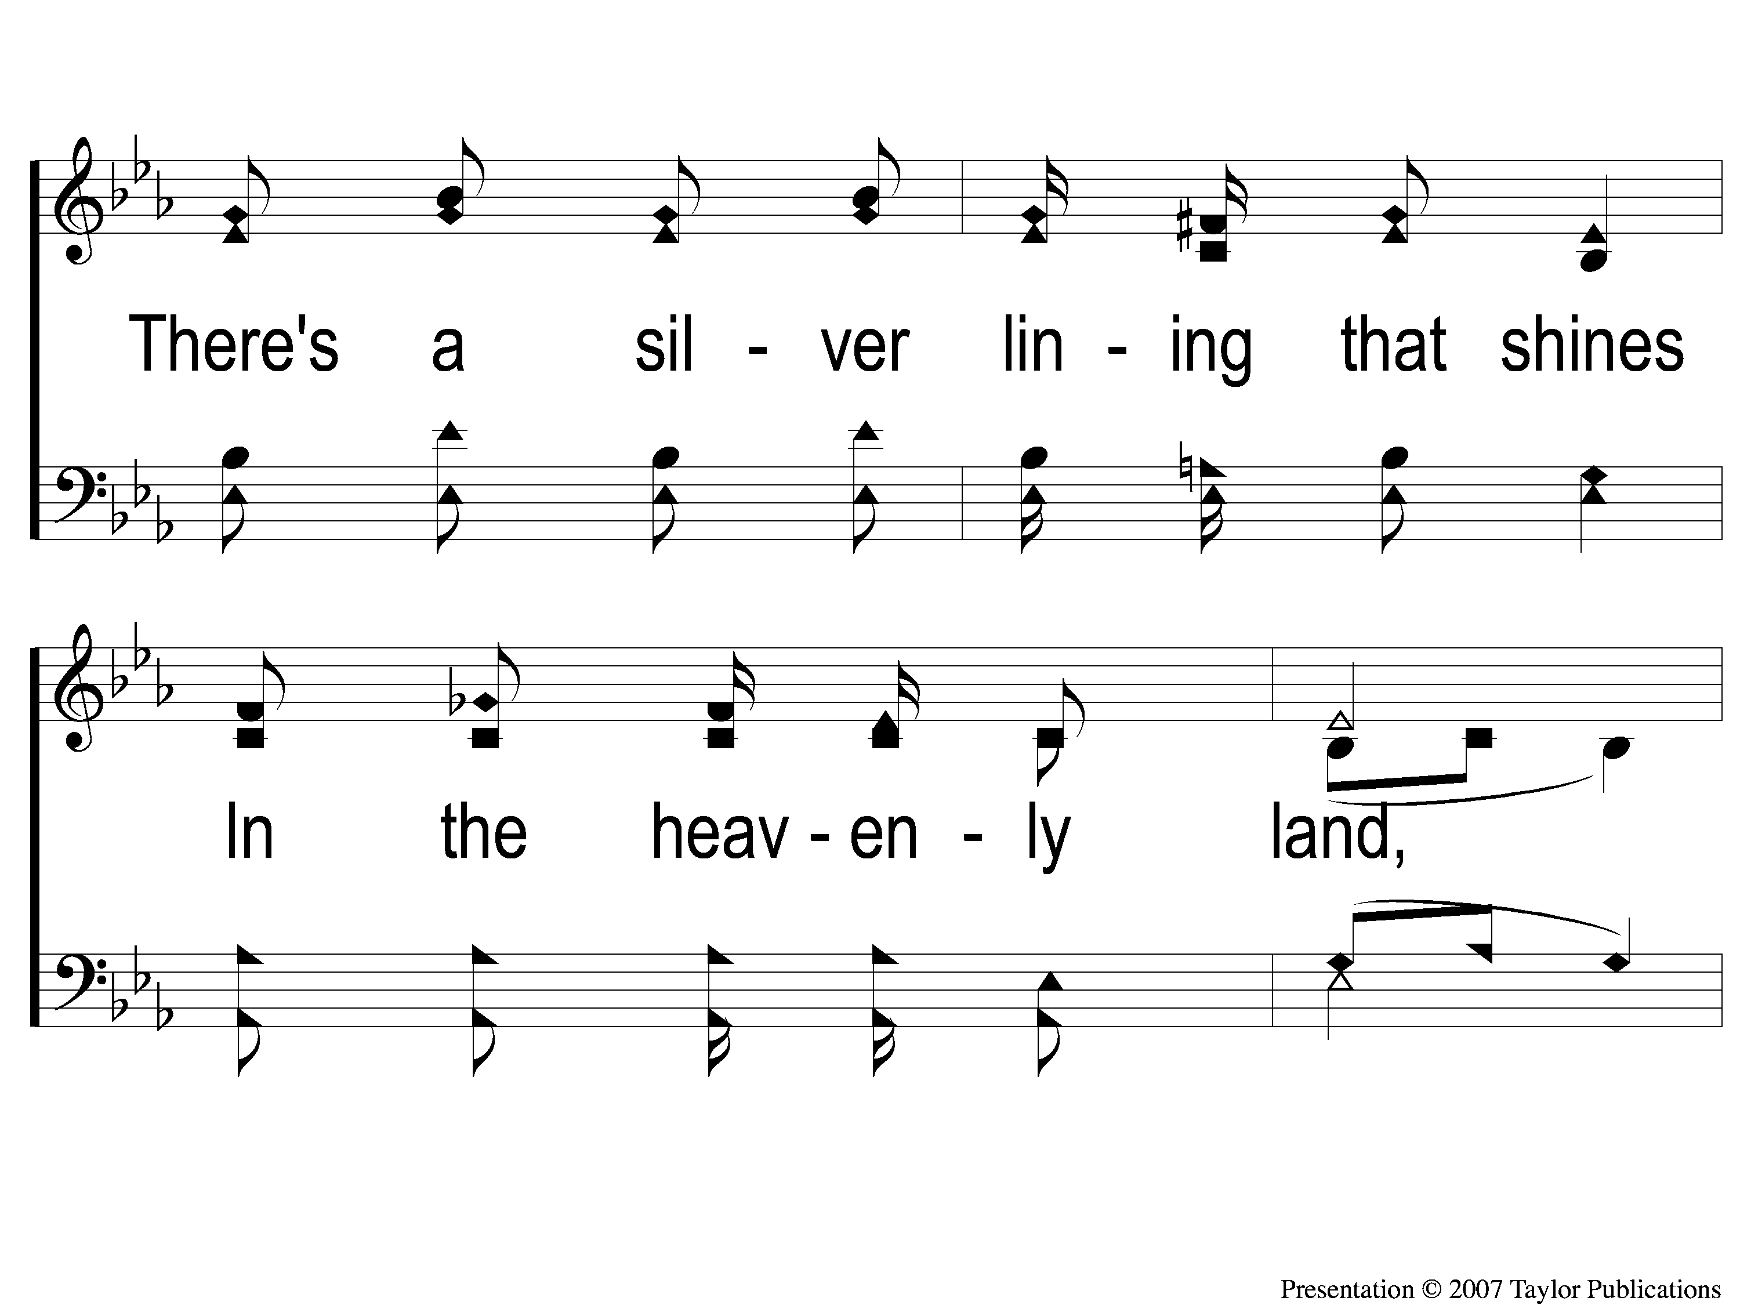
1-3 Sing and Be Happy
Sing and Be Happy
587

Slide 12
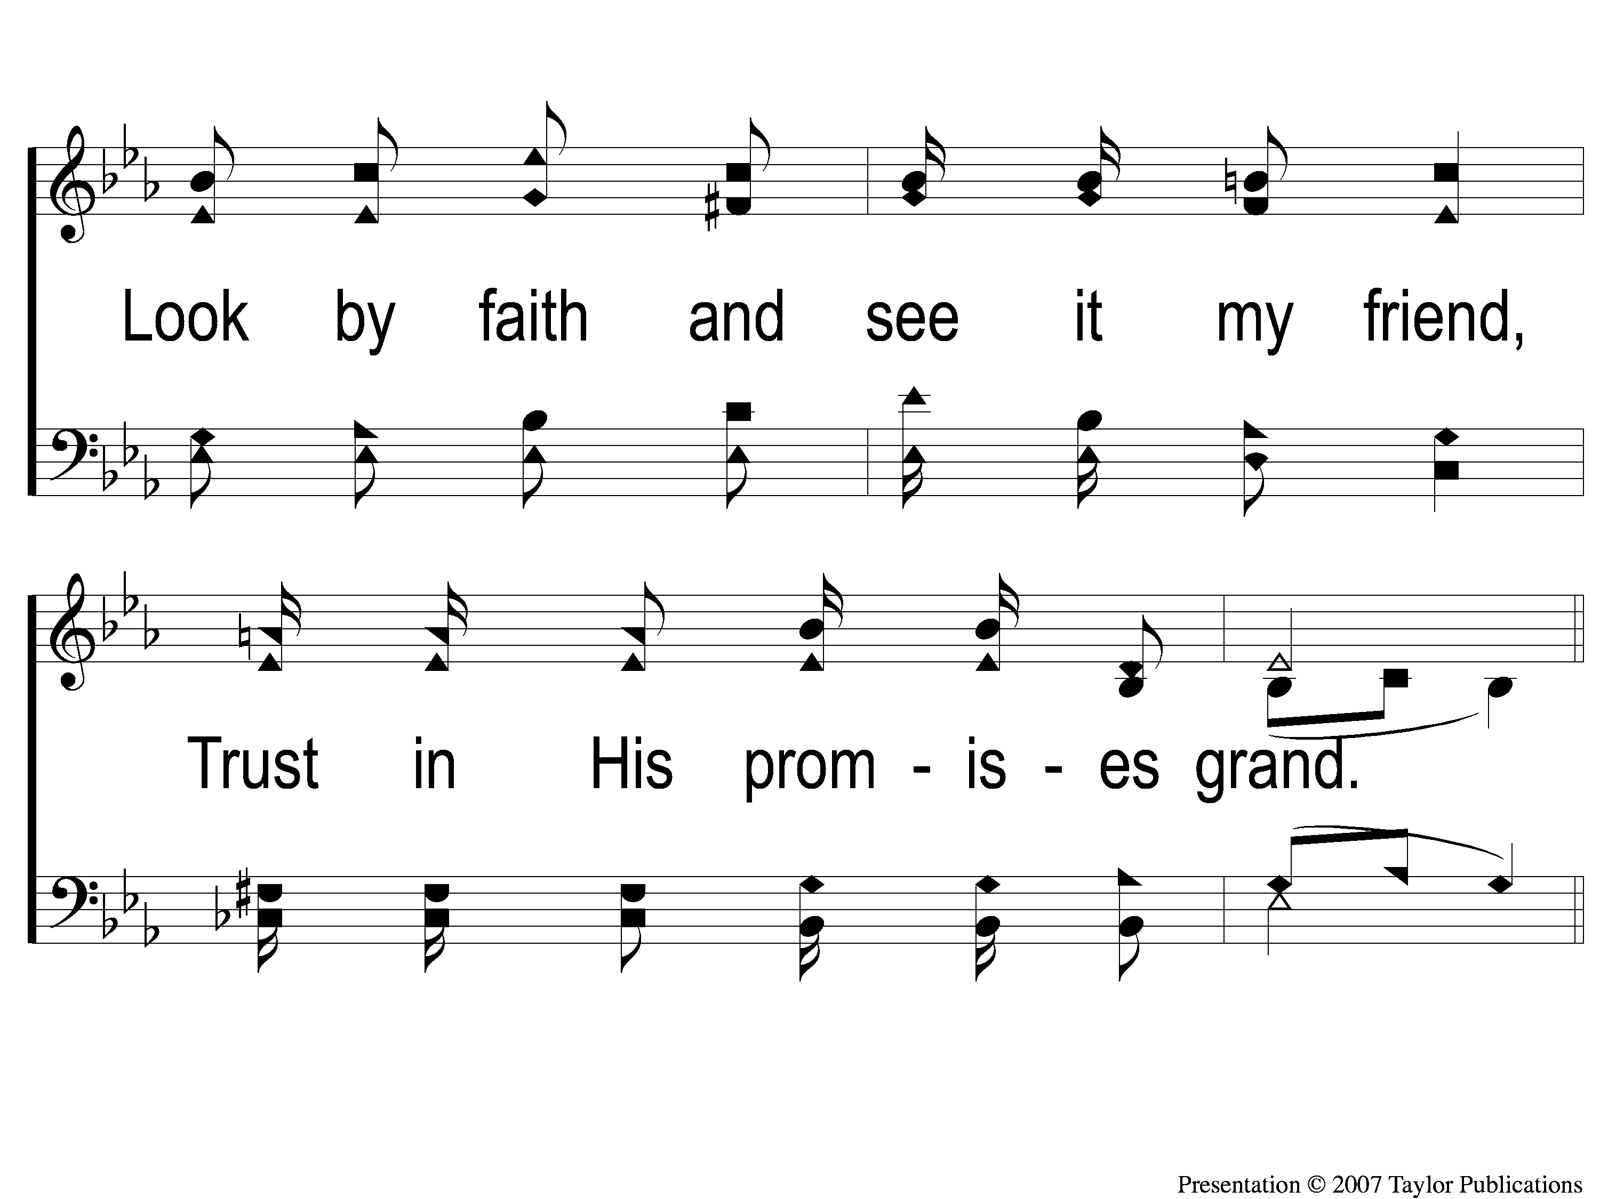
1-4 Sing and Be Happy
Sing and Be Happy
587

Slide 13
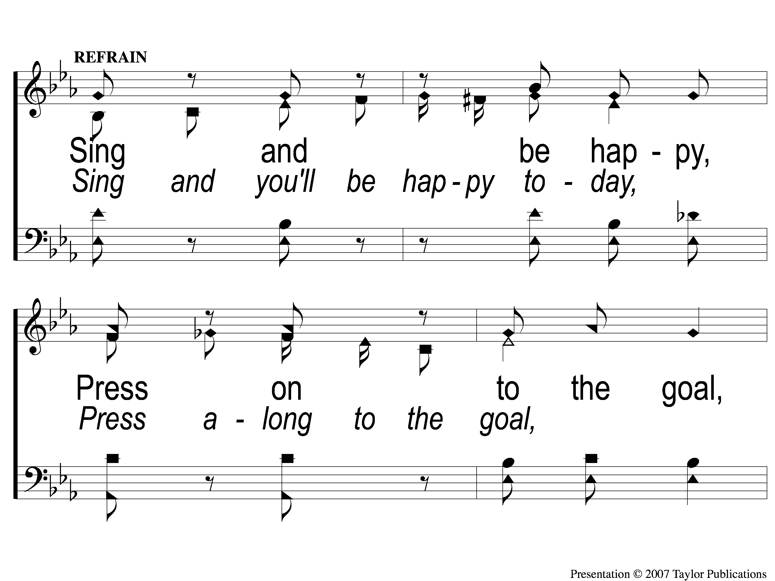
C-1 Sing and Be Happy
Sing and Be Happy
587

Slide 14
C-2 Sing and Be Happy
Sing and Be Happy
587

Slide 15
C-3 Sing and Be Happy
Sing and Be Happy
587

Slide 16
C-4 Sing and Be Happy
Sing and Be Happy
587

Slide 17
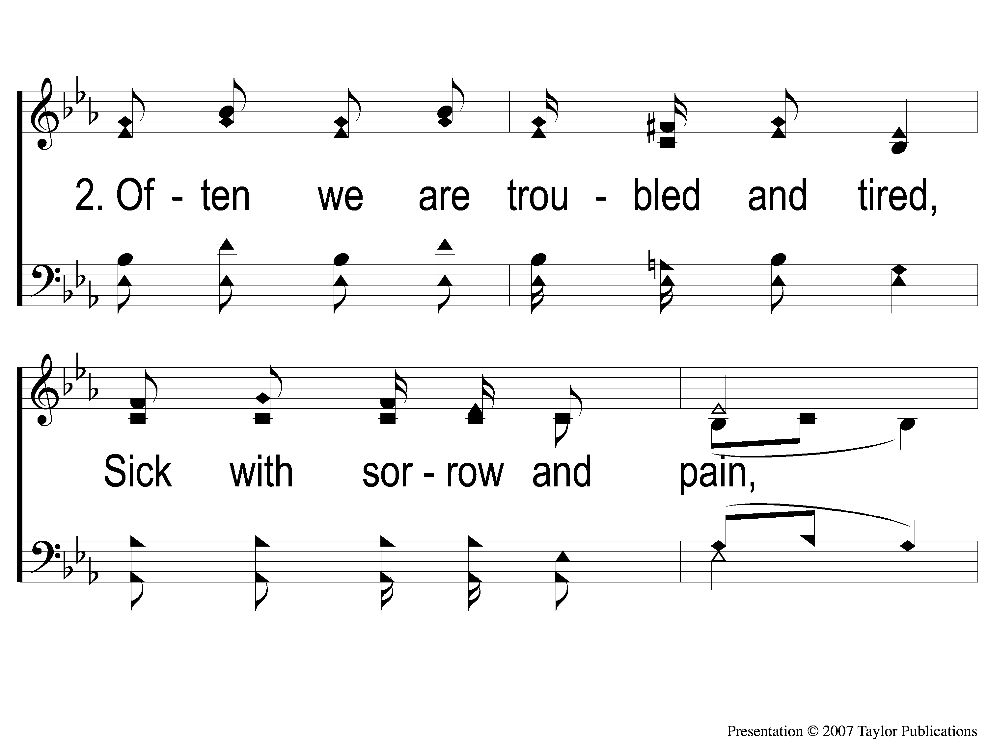
2-1 Sing and Be Happy
Sing and Be Happy
587

Slide 18
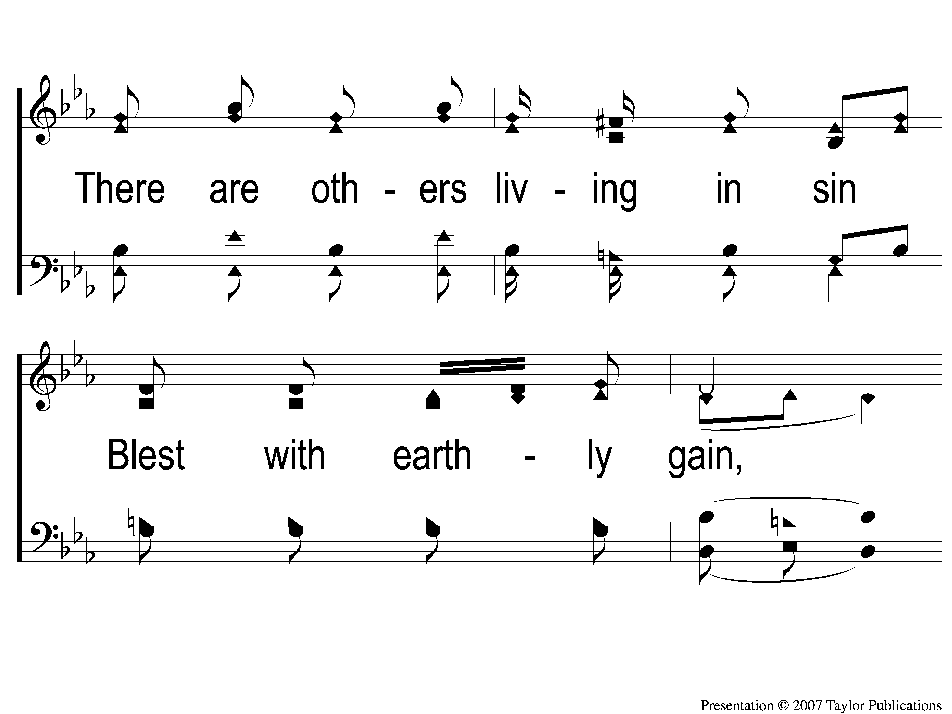
2-2 Sing and Be Happy
Sing and Be Happy
587

Slide 19
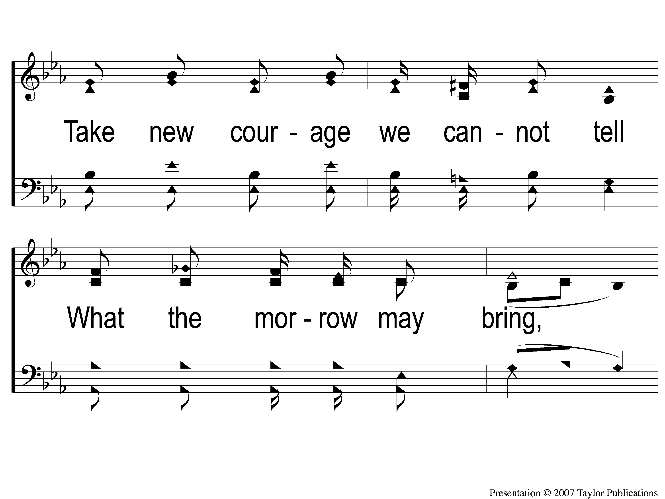
2-3 Sing and Be Happy
Sing and Be Happy
587

Slide 20
2-4 Sing and Be Happy
Sing and Be Happy
587

Slide 21
C-1 Sing and Be Happy
Sing and Be Happy
587

Slide 22
C-2 Sing and Be Happy
Sing and Be Happy
587

Slide 23
C-3 Sing and Be Happy
Sing and Be Happy
587

Slide 24
C-4 Sing and Be Happy
Sing and Be Happy
587

Slide 25
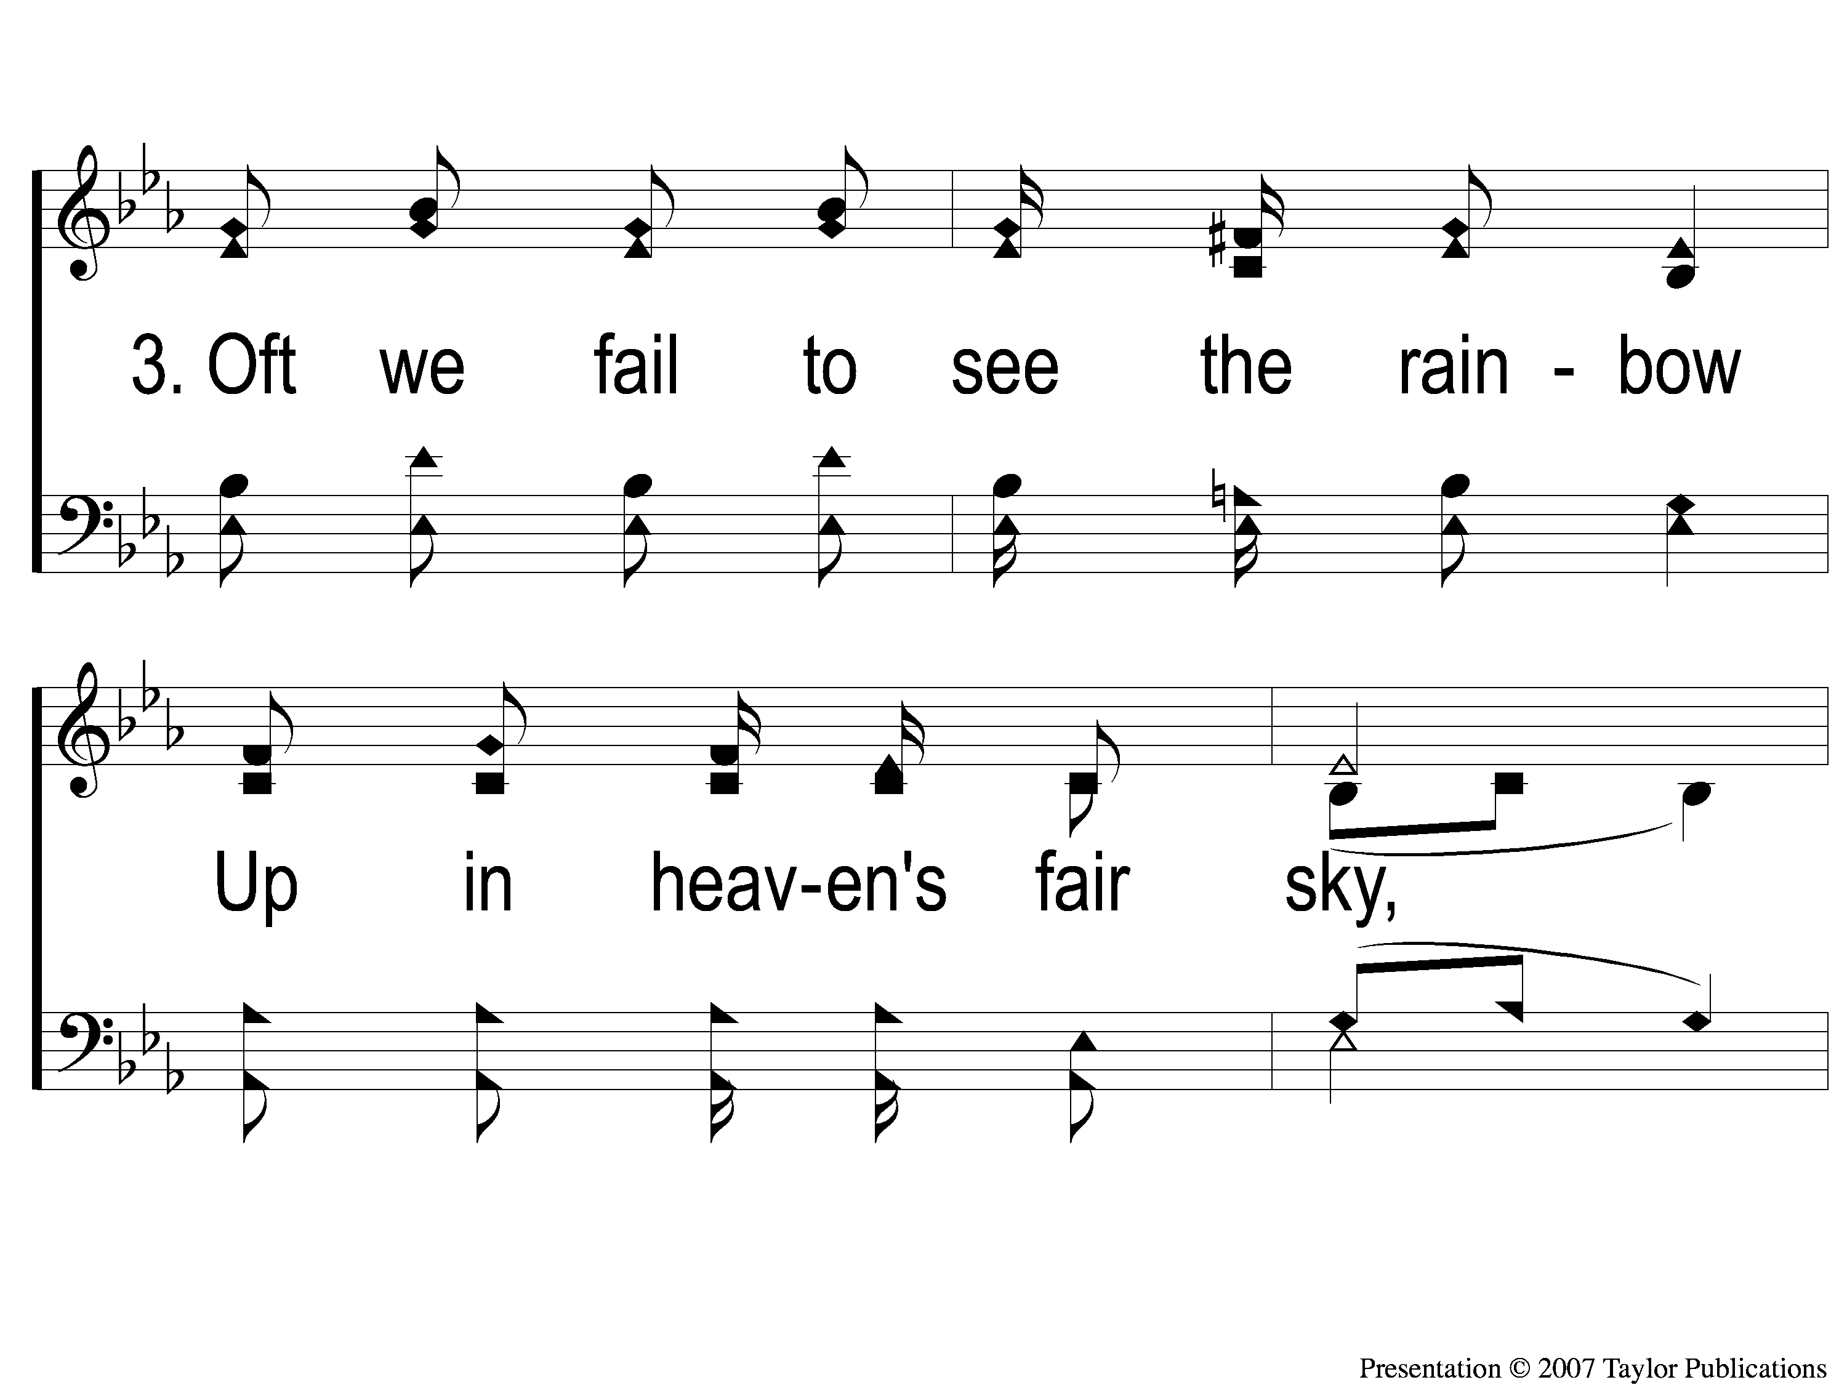
3-1 Sing and Be Happy
Sing and Be Happy
587

Slide 26
3-2 Sing and Be Happy
Sing and Be Happy
587

Slide 27
3-3 Sing and Be Happy
Sing and Be Happy
587

Slide 28
3-4 Sing and Be Happy
Sing and Be Happy
587

Slide 29
C-1 Sing and Be Happy
Sing and Be Happy
587

Slide 30
C-2 Sing and Be Happy
Sing and Be Happy
587

Slide 31
C-3 Sing and Be Happy
Sing and Be Happy
587

Slide 32
C-4 Sing and Be Happy
Sing and Be Happy
587

Slide 33
Song:
Just A Little Talk With Jesus
#959

Slide 34
1-1 Just A Little Talk With Jesus
Just A Little Talk With Jesus
959

Slide 35
1-2 Just A Little Talk With Jesus
Just A Little Talk With Jesus
959

Slide 36
C-1 Just A Little Talk With Jesus
Just A Little Talk With Jesus
959

Slide 37
C-2 Just A Little Talk With Jesus
Just A Little Talk With Jesus
959

Slide 38
C-3 Just A Little Talk With Jesus
Just A Little Talk With Jesus
959

Slide 39
2-1 Just A Little Talk With Jesus
Just A Little Talk With Jesus
959

Slide 40
2-2 Just A Little Talk With Jesus
Just A Little Talk With Jesus
959

Slide 41
C-1 Just A Little Talk With Jesus
Just A Little Talk With Jesus
959

Slide 42
C-2 Just A Little Talk With Jesus
Just A Little Talk With Jesus
959

Slide 43
C-3 Just A Little Talk With Jesus
Just A Little Talk With Jesus
959

Slide 44
3-1 Just A Little Talk With Jesus
Just A Little Talk With Jesus
959

Slide 45
3-2 Just A Little Talk With Jesus
Just A Little Talk With Jesus
959

Slide 46
C-1 Just A Little Talk With Jesus
Just A Little Talk With Jesus
959

Slide 47
C-2 Just A Little Talk With Jesus
Just A Little Talk With Jesus
959

Slide 48
C-3 Just A Little Talk With Jesus
Just A Little Talk With Jesus
959

Slide 49
Opening Prayer

Slide 50
Song:
The Battle Belongs To The Lord
#749

Slide 51
1-1 The Battle Belongs to the Lord
The Battle Belongs to the Lord
749

Slide 52
1-2 The Battle Belongs to the Lord
The Battle Belongs to the Lord
749

Slide 53
C-1 The Battle Belongs to the Lord
The Battle Belongs to the Lord
749

Slide 54
C-2 The Battle Belongs to the Lord
The Battle Belongs to the Lord
749

Slide 55
2-1 The Battle Belongs to the Lord
The Battle Belongs to the Lord
749

Slide 56
2-2 The Battle Belongs to the Lord
The Battle Belongs to the Lord
749

Slide 57
C-1 The Battle Belongs to the Lord
The Battle Belongs to the Lord
749

Slide 58
C-2 The Battle Belongs to the Lord
The Battle Belongs to the Lord
749

Slide 59
3-1 The Battle Belongs to the Lord
The Battle Belongs to the Lord
749

Slide 60
3-2 The Battle Belongs to the Lord
The Battle Belongs to the Lord
749

Slide 61
C-1 The Battle Belongs to the Lord
The Battle Belongs to the Lord
749

Slide 62
C-2 The Battle Belongs to the Lord
The Battle Belongs to the Lord
749

Slide 63
Song:
You Are My All In All
#484

Slide 64
1 All in All
You Are My All in All
484

Slide 65
2 All in All
You Are My All in All
484

Slide 66
3 All in All
You Are My All in All
484

Slide 67
4 All in All
You Are My All in All
484

Slide 68
5 All in All
You Are My All in All
484

Slide 69
6 All in All
You Are My All in All
484

Slide 70
C-1 All in All
You Are My All in All
484

Slide 71
C-2 All in All
You Are My All in All
484

Slide 72
Scripture Reading:
Genesis 15:1-6

Slide 73
RESTORE
OUR
FOUNDATIONS
JANUARY - APRIL

Slide 74
Struggling Faith:
patience

Slide 75
Patience & The Child of God
Gal. 5:16, 22-23
1 Thess. 5:14
Heb. 6:1-3
Jms. 1:2-5

Slide 76
The Impatience of Abram & Sarai
Genesis 12:1-3
15:1-3, 4-6
16:1-4
21:1-3

Slide 77
The Impatience of You & I
When we are impatient…

Slide 78
The Impatience of You & I
When we are impatient…
Sin lies at the door

Slide 79
When We Are Impatient…
Sin lies at the door

Slide 80
When We Are Impatient…
Sin lies at the door
Improper Relationships (16:2-4)

Slide 81
When We Are Impatient…
Sin lies at the door
Improper Relationships (16:2-4)
Improper Speech (12:10-13, 20:1-2, 16:2)

Slide 82
When We Are Impatient…
Sin lies at the door
Improper Relationships (16:2-4)
Improper Speech (12:10-13, 20:1-2, 16:2)
Improper Activities (Ex. 32:1-4)

Slide 83
The Impatience of You & I
When we are impatient…
Sin lies at the door
Lives are affected

Slide 84
When We Are Impatient…
Lives Are Affected

Slide 85
When We Are Impatient…
Lives Are Affected
Our Own (16:4)

Slide 86
When We Are Impatient…
Lives Are Affected
Our Own (16:4)
Our Family’s (21:9)

Slide 87
When We Are Impatient…
Lives Are Affected
Our Own (16:4)
Our Family’s (21:9)
Others’ (12:17-18, 20:17-18)

Slide 88
When We Patiently Wait…
Heb. 6:13-15

Slide 89
When We Patiently Wait…
Heb. 6:13-15
We Receive the Reward

Slide 90
When We Patiently Wait…
Heb. 6:13-15
We Receive the Reward
We Learn to Trust in God

Slide 91
When We Patiently Wait…
Heb. 6:13-15
We Receive the Reward
We Learn to Trust in God
We Learn to Focus on God

Slide 92
The Promise To Abram
Heb. 11:13

Slide 93
The Promise To Abram
Heb. 11:13
Who Saw The Promise Fulfilled?
Lk. 1:68, 72-73
Gal. 3:29

Slide 94
Are You Struggling?

Slide 95
Invitation
Song:
What A Day That Will Be
#916

Slide 96
1-1 What a Day That Will Be
What a Day That Will Be
916

Slide 97
1-2 What a Day That Will Be
What a Day That Will Be
916

Slide 98
1-3 What a Day That Will Be
What a Day That Will Be
916

Slide 99
C-1 What a Day That Will Be
What a Day That Will Be
916

Slide 100
C-2 What a Day That Will Be
What a Day That Will Be
916

Slide 101
C-3 What a Day That Will Be
What a Day That Will Be
916

Slide 102
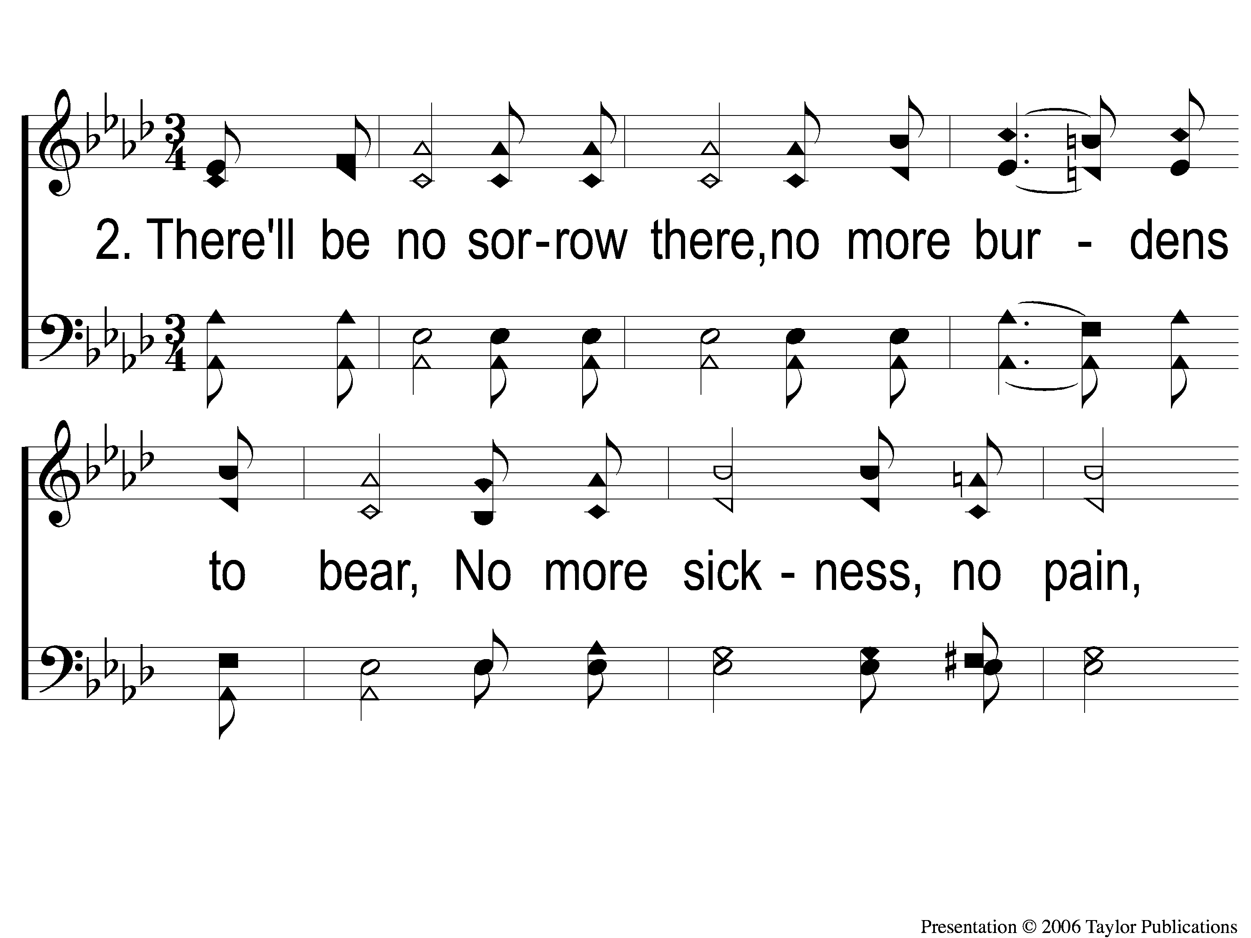
2-1 What a Day That Will Be
What a Day That Will Be
916

Slide 103
2-2 What a Day That Will Be
What a Day That Will Be
916

Slide 104
2-3 What a Day That Will Be
What a Day That Will Be
916

Slide 105
C-1 What a Day That Will Be
What a Day That Will Be
916

Slide 106
C-2 What a Day That Will Be
What a Day That Will Be
916

Slide 107
C-3 What a Day That Will Be
What a Day That Will Be
916

Slide 108
The Contribution:
Mark 12:43-44
“So He called His disciples to Himself and said to them, ‘Assuredly, I say to you that this poor widow has put in more than all those who have given to the treasury; for they all put in out of their abundance, but she out of her poverty put in all that she had, her whole livelihood.’ ”

Slide 109
Song:
Lamb Of God
#176

Slide 110
1-1 Lamb of God
Lamb of God
176

Slide 111
1-2 Lamb of God
Lamb of God
176

Slide 112
1-3 Lamb of God
Lamb of God
176

Slide 113
1-4 Lamb of God
Lamb of God
176

Slide 114
C-1 Lamb of God
Lamb of God
176

Slide 115
C-2 Lamb of God
Lamb of God
176

Slide 116
2-1 Lamb of God
Lamb of God
176

Slide 117
2-2 Lamb of God
Lamb of God
176

Slide 118
C-1 Lamb of God
Lamb of God
176

Slide 119
C-2 Lamb of God
Lamb of God
176

Slide 120
The Unleavened Bread
Matthew 26:26
“And as they were eating, Jesus took bread, blessed and broke it, and gave it to the disciples and said, ‘Take, eat; this is My body.’ ”

Slide 121
The Fruit of the Vine
Matthew 26:27-29
“Then He took the cup, and gave thanks, and gave it to them, saying, ‘Drink from it, all of you. For this is My blood of the new covenant, which is shed for many for the remission of sins. But I say to you, I will not drink of this fruit of the vine from now on until that day when I drink it new with you in My Father’s kingdom.’ ”

Slide 122
Closing Prayer

Slide 123
Song:
The Greatest Commands
#448

Slide 124
1-1 The Greatest Commands-SFP
The Greatest Commands
448

Slide 125
1-2 The Greatest Commands-SFP
The Greatest Commands
448

Slide 126
1-3 The Greatest Commands-SFP
The Greatest Commands
448

Slide 127
1-4 The Greatest Commands-SFP
The Greatest Commands
448

Slide 128
2-1 The Greatest Commands-SFP
The Greatest Commands
448

Slide 129
2-2 The Greatest Commands-SFP
The Greatest Commands
448

Slide 130
2-3 The Greatest Commands-SFP
The Greatest Commands
448

Slide 131
2-4 The Greatest Commands-SFP
The Greatest Commands
448

Slide 132
3-1 The Greatest Commands-SFP
The Greatest Commands
448

Slide 133
3-2 The Greatest Commands-SFP
The Greatest Commands
448

Slide 134
3-3 The Greatest Commands-SFP
The Greatest Commands
448

Slide 135
3-4 The Greatest Commands-SFP
The Greatest Commands
448

Slide 136
4-1 The Greatest Commands-SFP
The Greatest Commands
448

Slide 137
4-2 The Greatest Commands-SFP
The Greatest Commands
448

Slide 138
4-3 The Greatest Commands-SFP
The Greatest Commands
448

Slide 139
4-4 The Greatest Commands-SFP
The Greatest Commands
448

Slide 140
RESTORE REBUILD RENEW
JOIN US
IN THE MPB FOR
A FELLOWSHIP MEAL
@ NOON
IN 2022
WHEELER
CHURCH
OF
CHRIST

Slide 141
Tonight
WORSHIP @ 6:00 pm
Wednesday
WORSHIP @ 6:30 pm
Bible classes @ 7:00 pm
RESTORE REBUILD RENEW
IN 2022
WHEELER
CHURCH
OF
CHRIST

