Slide 1
1 Highest Place
Highest Place
155

Slide 2
2 Highest Place
Highest Place
155

Slide 3
3 Highest Place
Highest Place
155

Slide 4
4 Highest Place
Highest Place
155

Slide 5
5 Highest Place
Highest Place
155

Slide 6
3 Highest Place
Highest Place
155

Slide 7
4 Highest Place
Highest Place
155

Slide 8
5 Highest Place
Highest Place
155

Slide 9
Tag Highest Place
Highest Place
155

Slide 10
WELCOME
WE ARE GLAD YOU ARE HERE

Slide 11
SONG
OUR GOD, HE IS ALIVE
#23

Slide 12
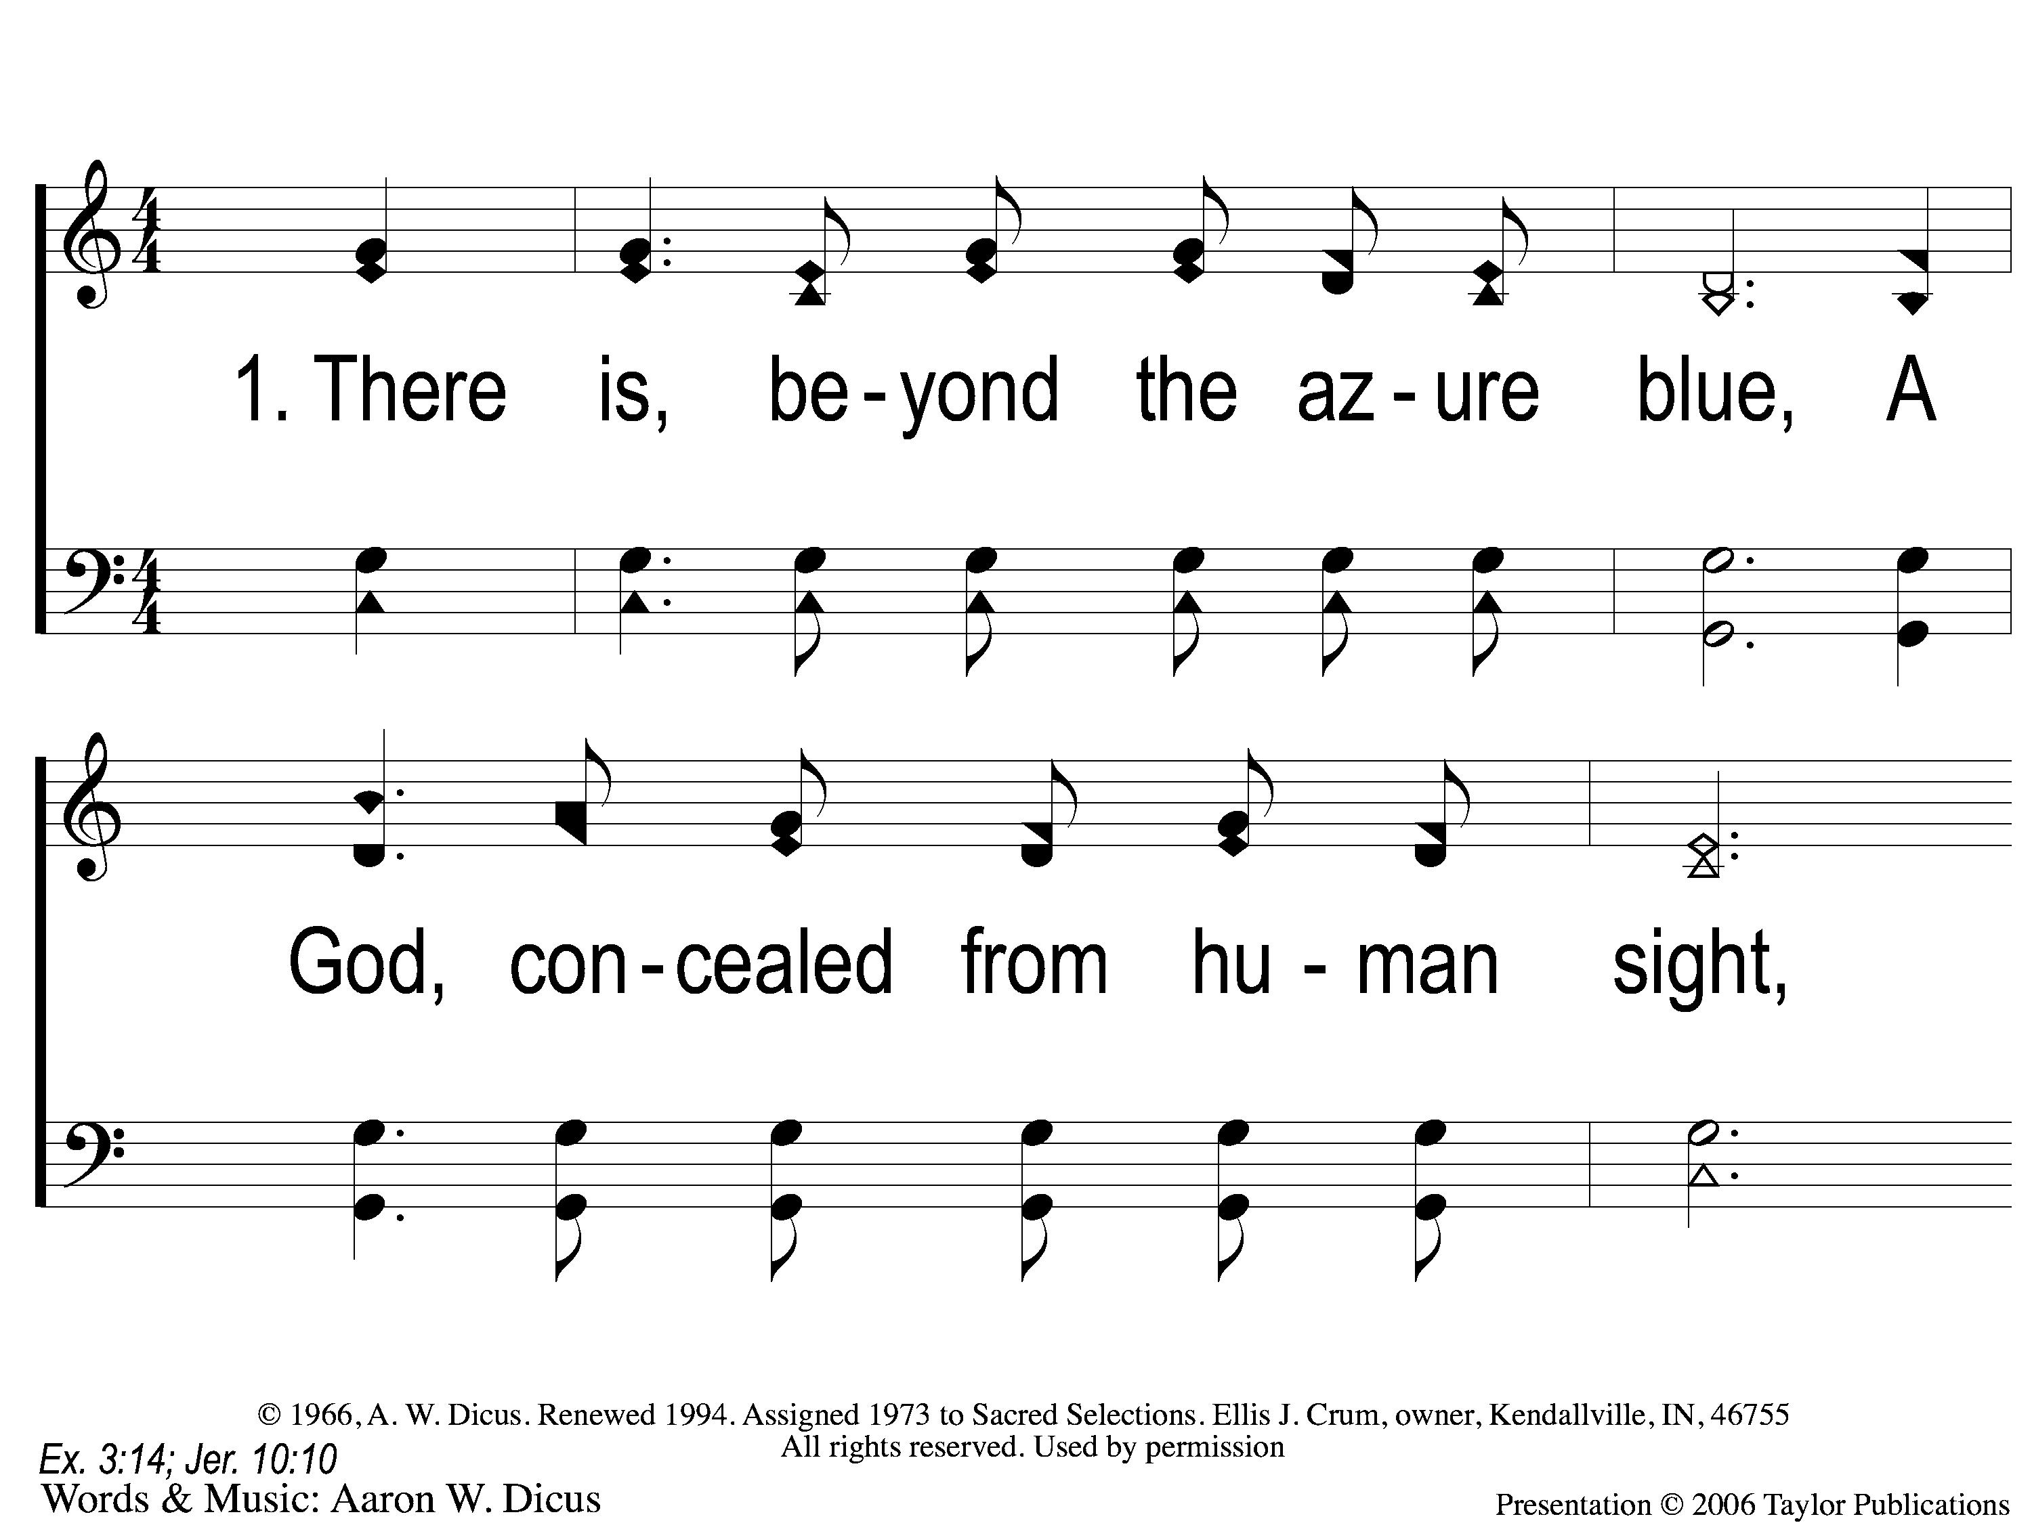
1-1 Our God He Is Alive
Our God, He Is Alive
23

Slide 13
1-2 Our God He Is Alive
Our God, He Is Alive
23

Slide 14
C-1 Our God He Is Alive
Our God, He Is Alive
23

Slide 15
C-2 Our God He Is Alive
Our God, He Is Alive
23

Slide 16
2-1 Our God He Is Alive
Our God, He Is Alive
23

Slide 17
2-2 Our God He Is Alive
Our God, He Is Alive
23

Slide 18
C-1 Our God He Is Alive
Our God, He Is Alive
23

Slide 19
C-2 Our God He Is Alive
Our God, He Is Alive
23

Slide 20
4-1 Our God He Is Alive
Our God, He Is Alive
23

Slide 21
4-2 Our God He Is Alive
Our God, He Is Alive
23

Slide 22
C-1 Our God He Is Alive
Our God, He Is Alive
23

Slide 23
C-2 Our God He Is Alive
Our God, He Is Alive
23

Slide 24
SONG
ANCIENT WORDS

Slide 25
1-1 Ancient Words
Ancient Words

Slide 26
1-2 Ancient Words
Ancient Words

Slide 27
1-3 Ancient Words
Ancient Words

Slide 28
C-1 Ancient Words
Ancient Words

Slide 29
C-2 Ancient Words
Ancient Words

Slide 30
2-1 Ancient Words
Ancient Words

Slide 31
2-2 Ancient Words
Ancient Words

Slide 32
2-3 Ancient Words
Ancient Words

Slide 33
C-1 Ancient Words
Ancient Words

Slide 34
C-2 Ancient Words
Ancient Words

Slide 35
Coda-1 Ancient Words
Ancient Words

Slide 36
Coda-2 Ancient Words
Ancient Words

Slide 37
tag Ancient Words
Ancient Words

Slide 38
OPENING
PRAYER

Slide 39
SONG
GREAT ARE YOU, LORD

Slide 40
1 Great Are You Lord
Great Are You Lord

Slide 41
2 Great Are You Lord
Great Are You Lord

Slide 42
3 Great Are You Lord
Great Are You Lord

Slide 43
4 Great Are You Lord
Great Are You Lord

Slide 44
5 Great Are You Lord
Great Are You Lord

Slide 45
6 Great Are You Lord
Great Are You Lord

Slide 46
7 Great Are You Lord
Great Are You Lord

Slide 47
SONG
I LOVE YOU WITH
THE LOVE OF THE LORD
#703

Slide 48
1-1 I Love You with the Love of the Lord
I Love You With the Love of the Lord
703

Slide 49
1-2 I Love You with the Love of the Lord
I Love You With the Love of the Lord
703

Slide 50
1-1 The Greatest Commands-SFP
The Greatest Commands
448

Slide 51
1-2 The Greatest Commands-SFP
The Greatest Commands
448

Slide 52
1-3 The Greatest Commands-SFP
The Greatest Commands
448

Slide 53
1-4 The Greatest Commands-SFP
The Greatest Commands
448

Slide 54
2-1 The Greatest Commands-SFP
The Greatest Commands
448

Slide 55
2-2 The Greatest Commands-SFP
The Greatest Commands
448

Slide 56
2-3 The Greatest Commands-SFP
The Greatest Commands
448

Slide 57
2-4 The Greatest Commands-SFP
The Greatest Commands
448

Slide 58
3-1 The Greatest Commands-SFP
The Greatest Commands
448

Slide 59
3-2 The Greatest Commands-SFP
The Greatest Commands
448

Slide 60
3-3 The Greatest Commands-SFP
The Greatest Commands
448

Slide 61
3-4 The Greatest Commands-SFP
The Greatest Commands
448

Slide 62
4-1 The Greatest Commands-SFP
The Greatest Commands
448

Slide 63
4-2 The Greatest Commands-SFP
The Greatest Commands
448

Slide 64
4-3 The Greatest Commands-SFP
The Greatest Commands
448

Slide 65
4-4 The Greatest Commands-SFP
The Greatest Commands
448

Slide 66
4-1 The Greatest Commands-SFP
The Greatest Commands
448

Slide 67
4-2 The Greatest Commands-SFP
The Greatest Commands
448

Slide 68
4-3 The Greatest Commands-SFP
The Greatest Commands
448

Slide 69
4-4 The Greatest Commands-SFP
The Greatest Commands
448

Slide 70
SCRIPTURE READING:
1 Corinthians 13:1-7

Slide 71
STAND
IN THE LOVE OF GOD

Slide 72
FOUR WORDS
PHILEO
STORGE
EROS
AGAPE

Slide 73
AGAPE
ἀγάπη

Slide 74
AGAPE LOVE
= selfless, universal love for all
Rom. 5:6-8
1 Jn. 4:9-10, 19

Slide 75
3 Key Facts:
1. It Is NOT An Emotion

Slide 76
3 Key Facts:
1. It Is NOT An Emotion
2. It Is NOT An Option

Slide 77
3 Key Facts:
1. It Is NOT An Emotion
2. It Is NOT An Option
3. It Will NOT Occur By Accident

Slide 78
AGAPE LOVE IS…
…Patient

Slide 79
PATIENT
MAKROTHUMEO
Makros = Long, Far, Distant from
Thumos = Anger, Rage
1 Thess. 5:14, Jms. 5:7-8

Slide 80
PATIENT WITH WHOM?
Elders
Preacher/Teachers
Spouse
Children/Parents
New Christians

Slide 81
AGAPE LOVE IS…
…Patient
…Kind

Slide 82
KIND
CHRASTEUOMAI
= to provide something beneficial
for someone
Eph. 4:32, Lk. 6:35

Slide 83
KIND WITH WHOM?
Elders
Preacher/Teachers
Spouse
Children/Parents
New Christians

Slide 84
AGAPE LOVE IS…
…Patient
…Kind
…Not Envious

Slide 85
NOT ENVIOUS
ZELÓO
= strong resentment towards someone;
a desire for another’s possessions
Gal. 5:26, Acts 7:9

Slide 86
NOT ENVIOUS OF WHOM?
Elders
Preacher/Teachers
Spouse
Children/Parents
New Christians

Slide 87
AM I SHOWING
AGAPE LOVE
TO ALL?

Slide 88
INVITATION SONG
WONDERFUL, MERCIFUL SAVIOR

Slide 89
1-1 Wonderful Merciful Savior
Wonderful, Merciful, Savior

Slide 90
1-2 Wonderful Merciful Savior
Wonderful, Merciful, Savior

Slide 91
2-1 Wonderful Merciful Savior
Wonderful, Merciful, Savior

Slide 92
2-2 Wonderful Merciful Savior
Wonderful, Merciful, Savior

Slide 93
C-1 Wonderful Merciful Savior
Wonderful, Merciful, Savior

Slide 94
C-2 Wonderful Merciful Savior
Wonderful, Merciful, Savior

Slide 95
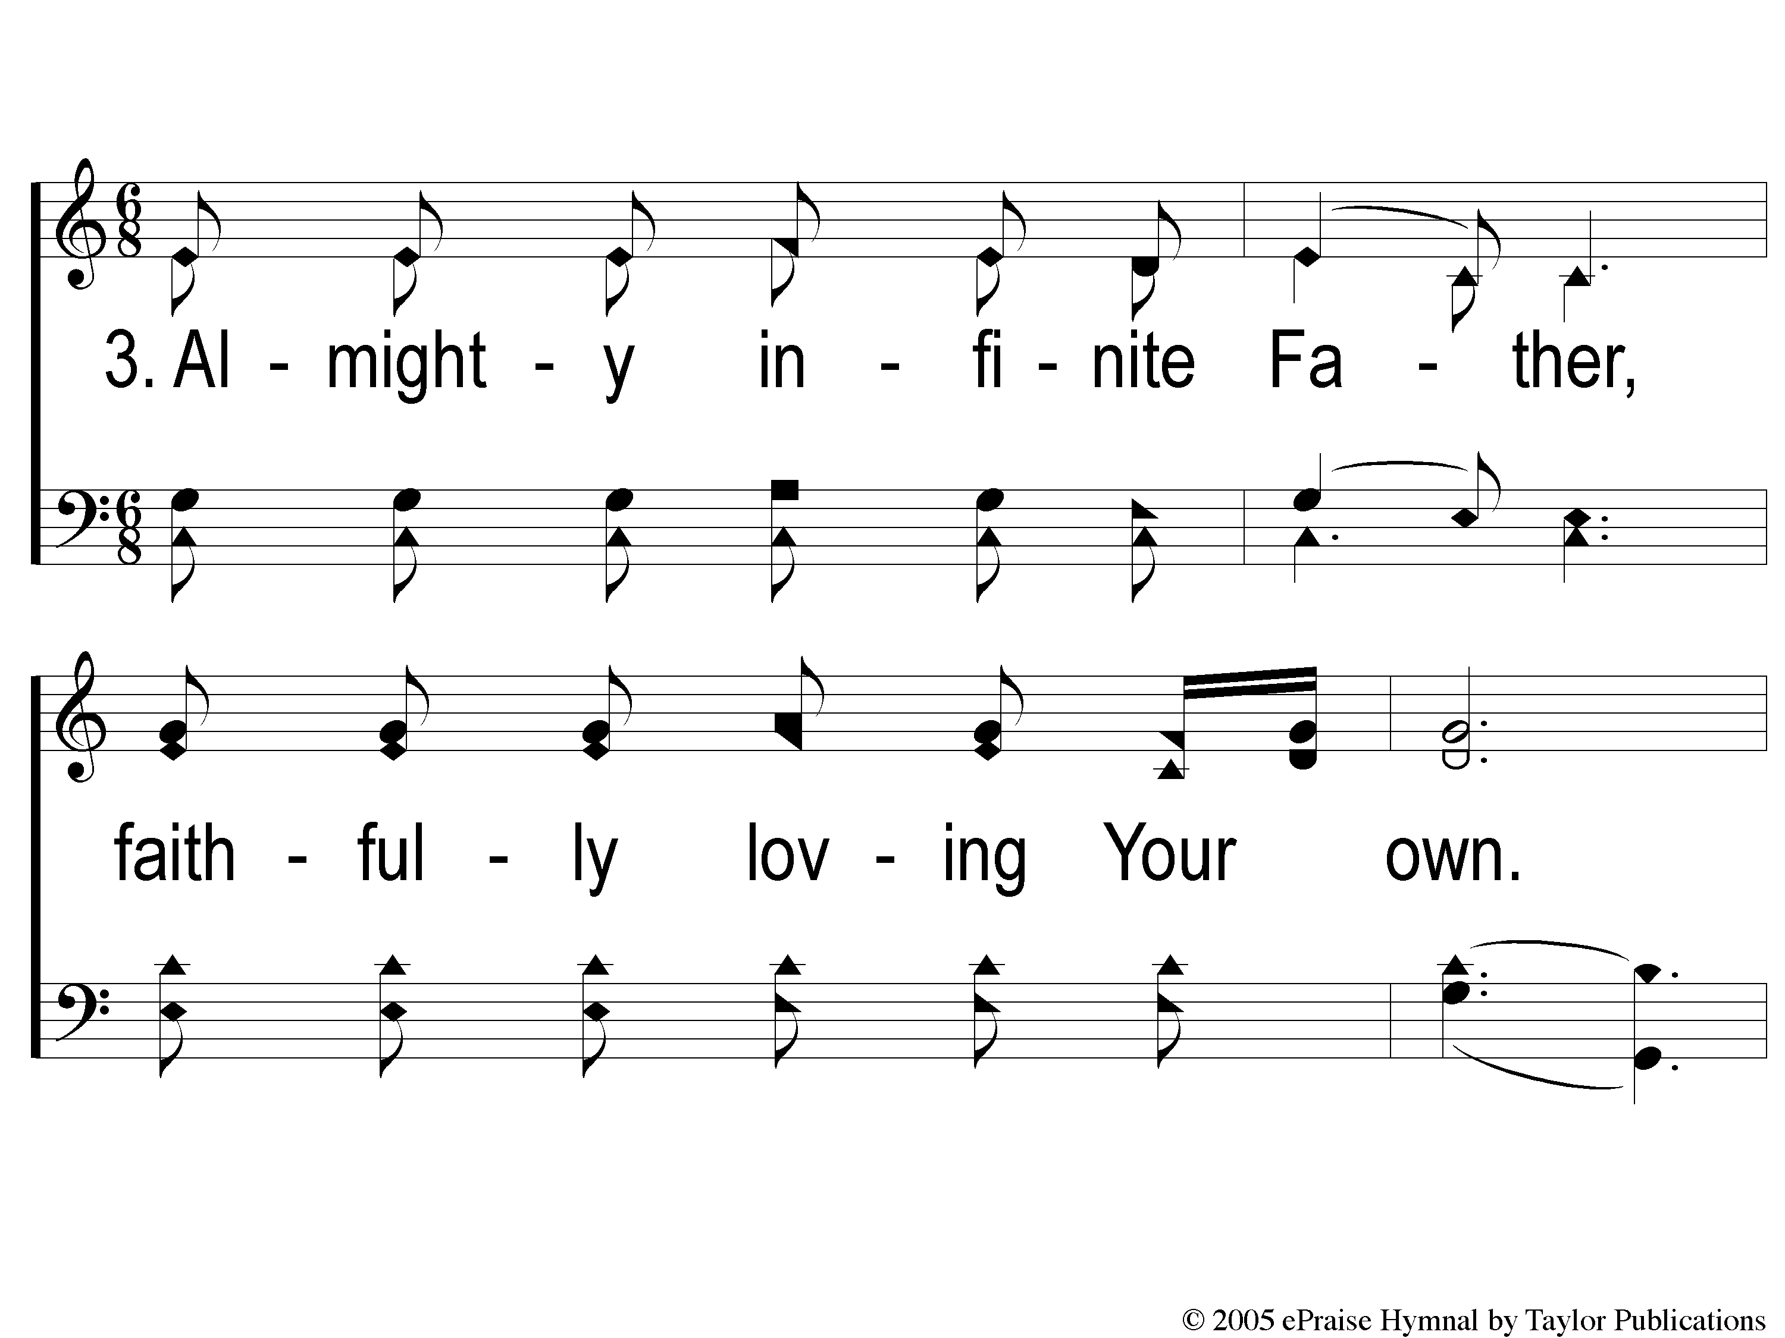
3-1 Wonderful Merciful Savior
Wonderful, Merciful, Savior

Slide 96
3-2 Wonderful Merciful Savior
Wonderful, Merciful, Savior

Slide 97
C-1 Wonderful Merciful Savior
Wonderful, Merciful, Savior

Slide 98
C-2 Wonderful Merciful Savior
Wonderful, Merciful, Savior

Slide 99
THE OFFERING
2 CORINTHIANS 8:12
“For if there is first a willing mind, it is accepted according to what one has, and not according to what he does not have.”

Slide 106
THE LORD’S SUPPER
ACTS 20:7

Slide 107
THE UNLEAVENED BREAD
ISAIAH 53:1-3
“Who has believed our report? And to whom has the arm of the Lord been revealed? For He shall grow up before Him as a tender plant, And as a root out of dry ground.
He has no form or comeliness; And when we see Him, There is no beauty that we should desire Him. He is despised and rejected by men, A Man of sorrows and acquainted with grief. And we hid, as it were, our faces from Him; He was despised, and we did not esteem Him.”

Slide 108
THE FRUIT OF THE VINE
ISAIAH 53:4-5
“Surely He has borne our griefs
And carried our sorrows;
Yet we esteemed Him stricken,
Smitten by God, and afflicted.
But He was wounded for our transgressions,
He was bruised for our iniquities;
The chastisement for our peace was upon Him,
And by His stripes we are healed.”

Slide 109
CLOSING
PRAYER

Slide 110
SONG
NO TEARS IN HEAVEN
#882

Slide 111
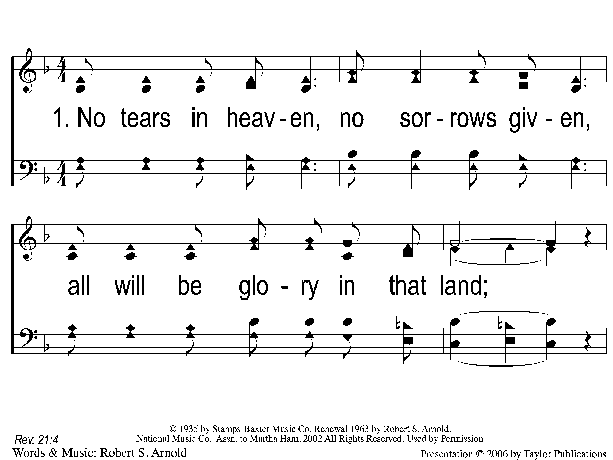
1-1 No Tears in Heaven
No Tears In Heaven
882

Slide 112
1-2 No Tears in Heaven
No Tears In Heaven
882

Slide 113
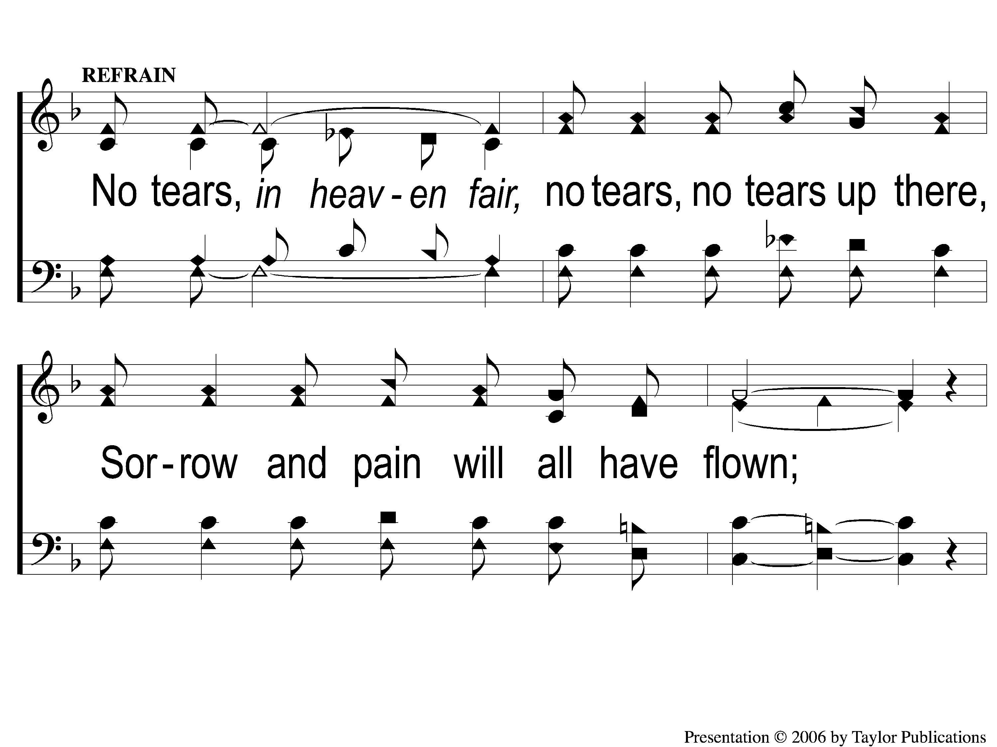
C-1 No Tears in Heaven
No Tears In Heaven
882

Slide 114
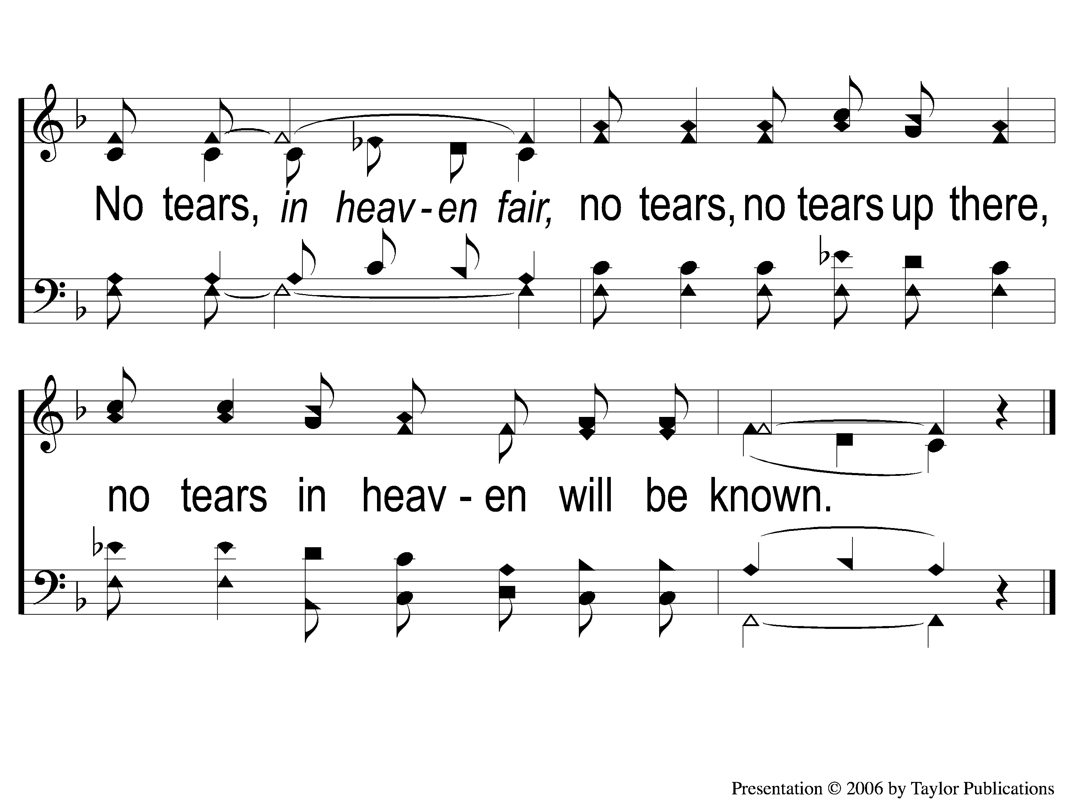
C-2 No Tears in Heaven
No Tears In Heaven
882

Slide 115
3-1 No Tears in Heaven
No Tears In Heaven
882

Slide 116
3-2 No Tears in Heaven
No Tears In Heaven
882

Slide 117
C-1 No Tears in Heaven
No Tears In Heaven
882

Slide 118
C-2 No Tears in Heaven
No Tears In Heaven
882

Slide 119
TONIGHT’S LESSON:
DEFINING AGAPE (PART 2)
@ 6:00 PM

