Slide 1
1-1 Shine Jesus Shine
Shine, Jesus, Shine
290

Slide 2
1-2 Shine Jesus Shine
Shine, Jesus, Shine
290

Slide 3
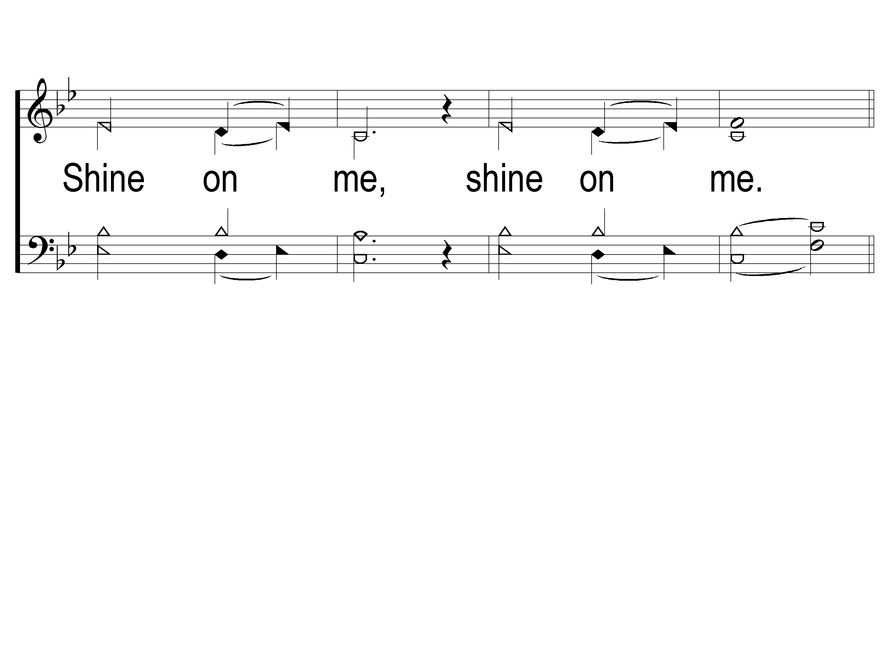
1-3 Shine Jesus Shine
Shine, Jesus, Shine
290

Slide 4
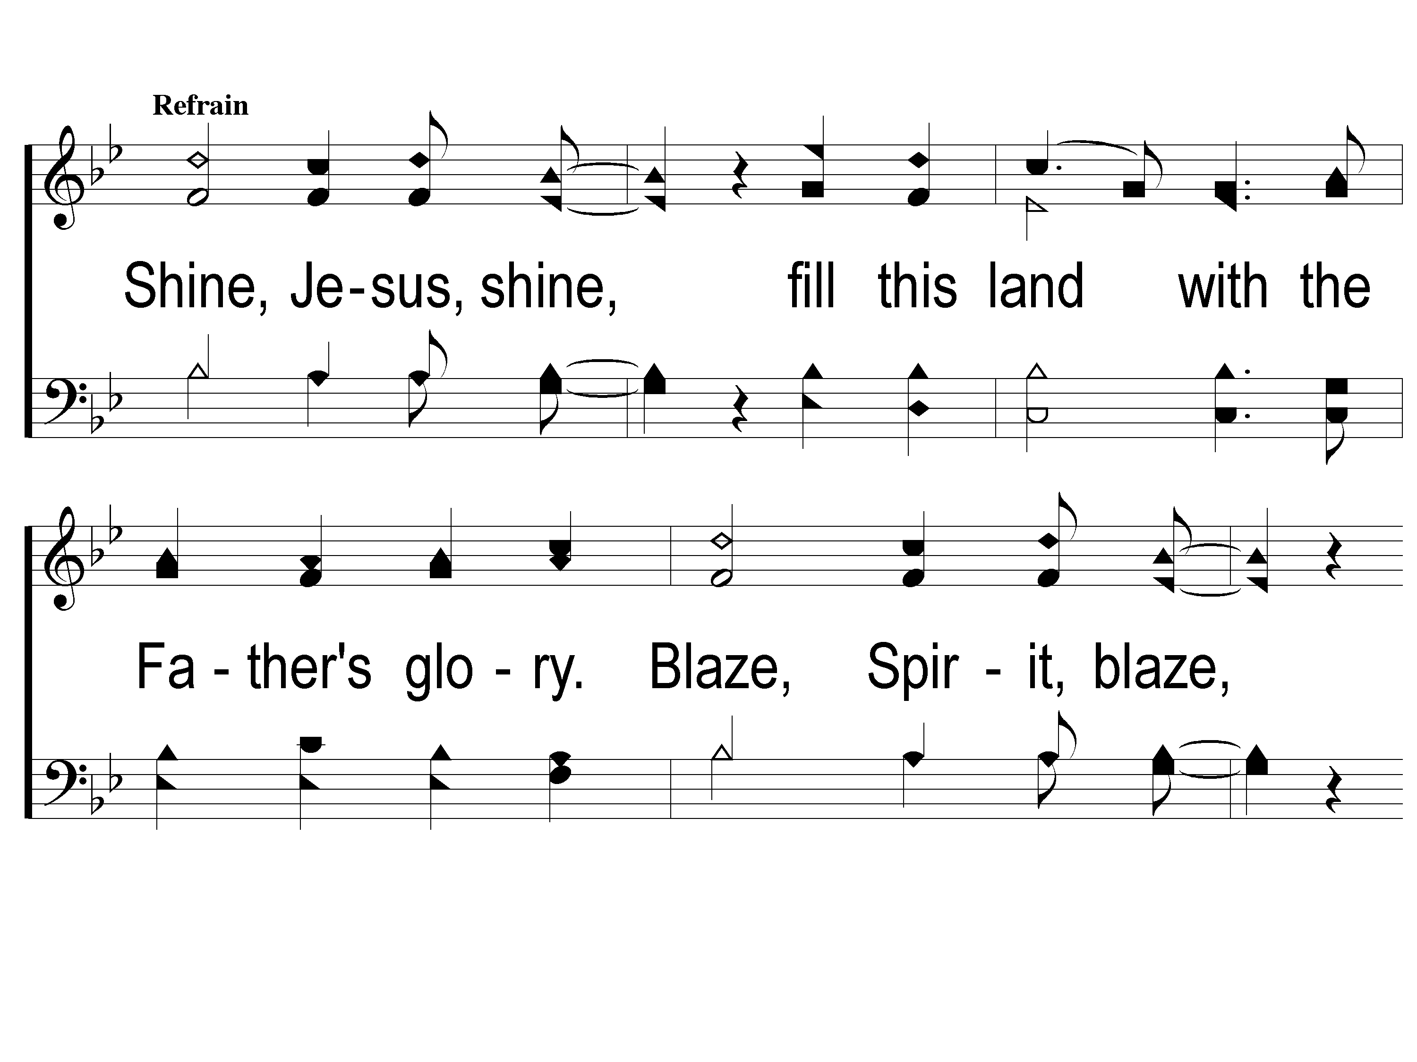
C-1 Shine Jesus Shine
Shine, Jesus, Shine
290

Slide 5
C-2 Shine Jesus Shine
Shine, Jesus, Shine
290

Slide 6
C-3 Shine Jesus Shine
Shine, Jesus, Shine
290

Slide 7
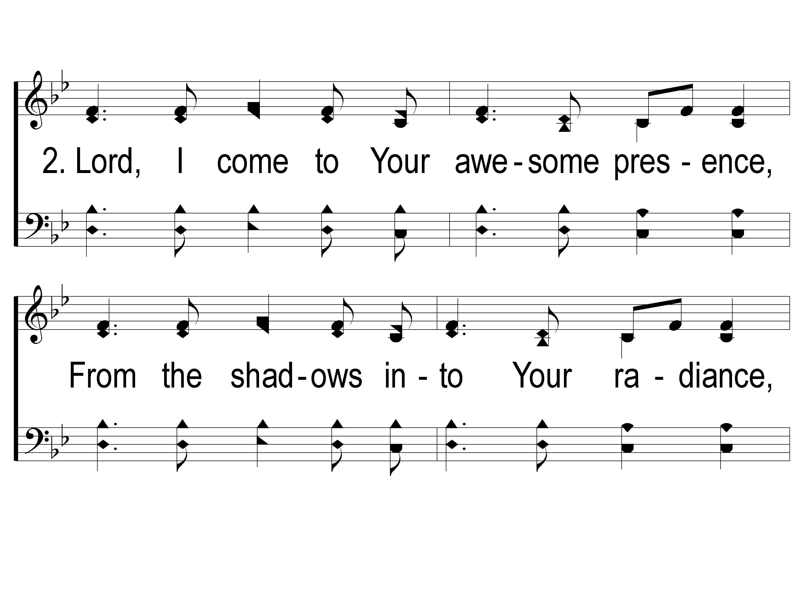
2-1 Shine Jesus Shine
Shine, Jesus, Shine
290

Slide 8
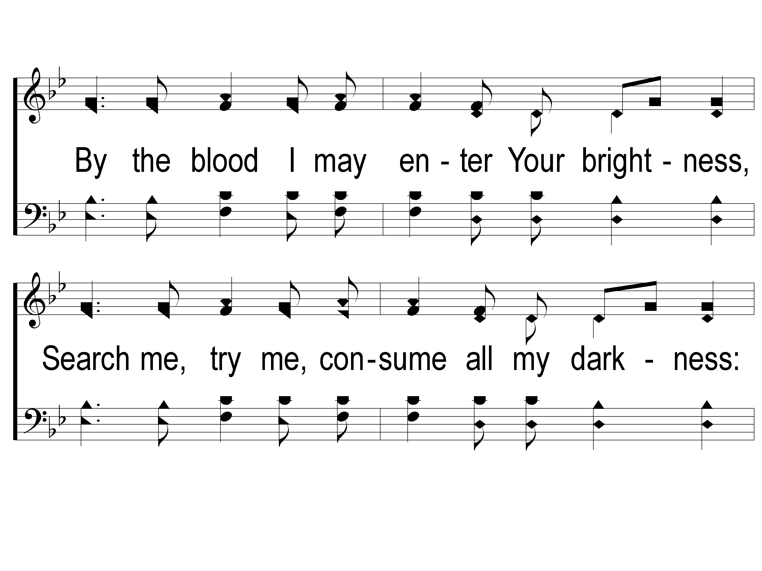
2-2 Shine Jesus Shine
Shine, Jesus, Shine
290

Slide 9
2-3 Shine Jesus Shine
Shine, Jesus, Shine
290

Slide 10
C-1 Shine Jesus Shine
Shine, Jesus, Shine
290

Slide 11
C-2 Shine Jesus Shine
Shine, Jesus, Shine
290

Slide 12
C-3 Shine Jesus Shine
Shine, Jesus, Shine
290

Slide 14
Song:
My Hope Is Built
#538

Slide 15
1-1 My Hope is Built
My Hope Is Built
538

Slide 16
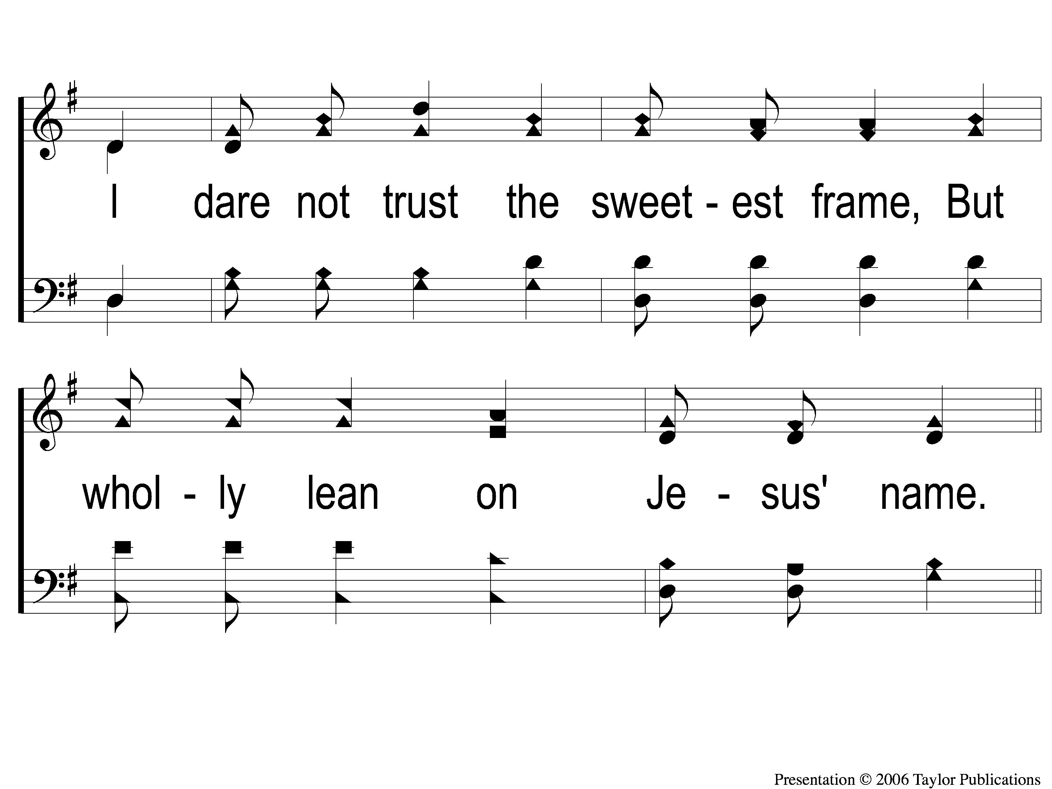
1-2 My Hope is Built
My Hope Is Built
538

Slide 17
c My Hope is Built
My Hope Is Built
538

Slide 18
2-1 My Hope is Built
My Hope Is Built
538

Slide 19
2-2 My Hope is Built
My Hope Is Built
538

Slide 20
c My Hope is Built
My Hope Is Built
538

Slide 21
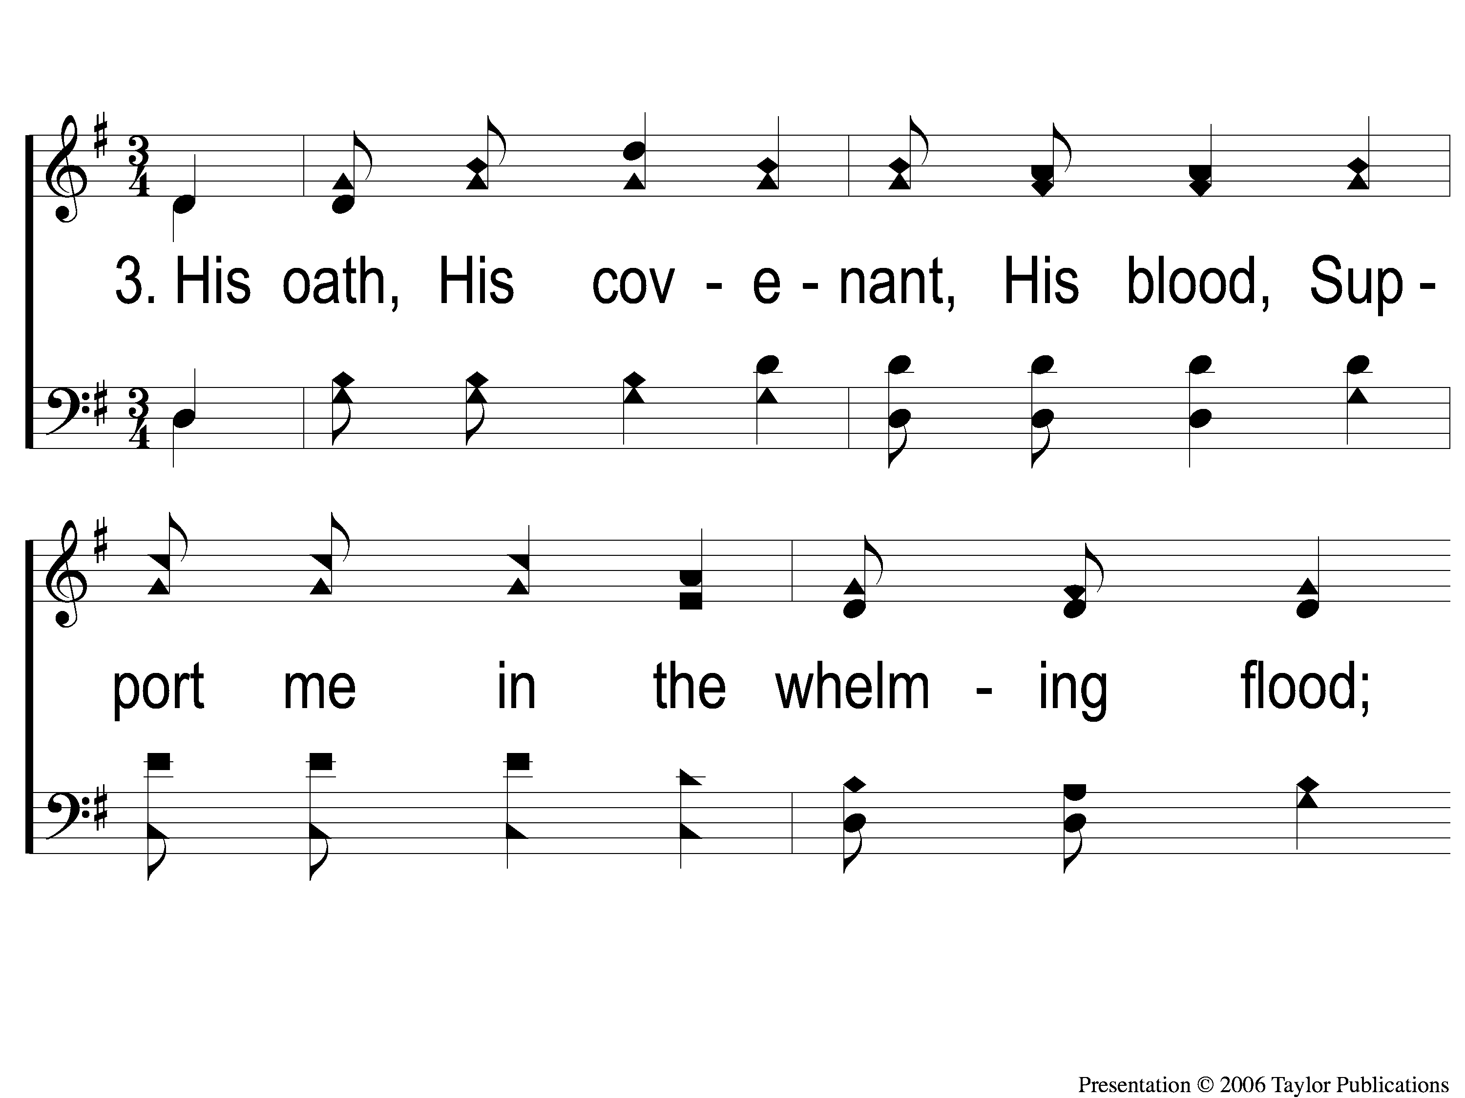
3-1 My Hope is Built
My Hope Is Built
538

Slide 22
3-2 My Hope is Built
My Hope Is Built
538

Slide 23
c My Hope is Built
My Hope Is Built
538

Slide 24
4-1 My Hope is Built
My Hope Is Built
538

Slide 25
4-2 My Hope is Built
My Hope Is Built
538

Slide 26
c My Hope is Built
My Hope Is Built
538

Slide 27
Song:
Just A Little Talk With Jesus
#959

Slide 28
1-1 Just A Little Talk With Jesus
Just A Little Talk With Jesus
959

Slide 29
1-2 Just A Little Talk With Jesus
Just A Little Talk With Jesus
959

Slide 30
C-1 Just A Little Talk With Jesus
Just A Little Talk With Jesus
959

Slide 31
C-2 Just A Little Talk With Jesus
Just A Little Talk With Jesus
959

Slide 32
C-3 Just A Little Talk With Jesus
Just A Little Talk With Jesus
959

Slide 33
2-1 Just A Little Talk With Jesus
Just A Little Talk With Jesus
959

Slide 34
2-2 Just A Little Talk With Jesus
Just A Little Talk With Jesus
959

Slide 35
C-1 Just A Little Talk With Jesus
Just A Little Talk With Jesus
959

Slide 36
C-2 Just A Little Talk With Jesus
Just A Little Talk With Jesus
959

Slide 37
C-3 Just A Little Talk With Jesus
Just A Little Talk With Jesus
959

Slide 38
3-1 Just A Little Talk With Jesus
Just A Little Talk With Jesus
959

Slide 39
3-2 Just A Little Talk With Jesus
Just A Little Talk With Jesus
959

Slide 40
C-1 Just A Little Talk With Jesus
Just A Little Talk With Jesus
959

Slide 41
C-2 Just A Little Talk With Jesus
Just A Little Talk With Jesus
959

Slide 42
C-3 Just A Little Talk With Jesus
Just A Little Talk With Jesus
959

Slide 43
Opening Prayer

Slide 44
Song:
The Battle Belongs To The Lord
#749

Slide 45
1-1 The Battle Belongs to the Lord
The Battle Belongs to the Lord
749

Slide 46
1-2 The Battle Belongs to the Lord
The Battle Belongs to the Lord
749

Slide 47
C-1 The Battle Belongs to the Lord
The Battle Belongs to the Lord
749

Slide 48
C-2 The Battle Belongs to the Lord
The Battle Belongs to the Lord
749

Slide 49
2-1 The Battle Belongs to the Lord
The Battle Belongs to the Lord
749

Slide 50
2-2 The Battle Belongs to the Lord
The Battle Belongs to the Lord
749

Slide 51
C-1 The Battle Belongs to the Lord
The Battle Belongs to the Lord
749

Slide 52
C-2 The Battle Belongs to the Lord
The Battle Belongs to the Lord
749

Slide 53
3-1 The Battle Belongs to the Lord
The Battle Belongs to the Lord
749

Slide 54
3-2 The Battle Belongs to the Lord
The Battle Belongs to the Lord
749

Slide 55
C-1 The Battle Belongs to the Lord
The Battle Belongs to the Lord
749

Slide 56
C-2 The Battle Belongs to the Lord
The Battle Belongs to the Lord
749

Slide 57
Song:
Light The Fire

Slide 58
1 Light The Fire
Light The Fire

Slide 59
C-1 Light The Fire
Light The Fire

Slide 60
C-2 Light The Fire
Light The Fire

Slide 61
2-1 Light The Fire
Light The Fire

Slide 62
2-2 Light The Fire
Light The Fire

Slide 63
C-1 Light The Fire
Light The Fire

Slide 64
C-2 Light The Fire
Light The Fire

Slide 65
Scripture Reading:
Matthew 22:1-10

Slide 66
STAND
IN GOOD STEAD

Slide 67
WHY
OFFER AN
INVITATION?

Slide 68
A BRIEF HISTORY
Not Seen in the Early Church
Brought About in the 1800s

Slide 69
A BRIEF HISTORY
“At first, [it] was used as an efficient way to gather spiritually interested people together for counseling after a sermon. Rather than searching out penitent seekers one by one, a preacher would call them up to the front, or into another room, for conversation and prayer.”

Slide 70
WHAT
IS THE LORD’S INVITATION?

Slide 71
THE LORD’S INVITATION
Matt. 11:28-30
Matt. 22:1-14
Rev. 22:17

Slide 72
THE LORD’S INVITATION
Matt. 11:28-30

Slide 73
THE LORD’S INVITATION
Matt. 11:28-30
Matt. 22:1-14

Slide 74
THE LORD’S INVITATION
Matt. 22:1-14 – The Wedding Feast
Place: Jesus in the Temple (21:23)

Slide 75
THE LORD’S INVITATION
Matt. 22:1-14 – The Wedding Feast
Place: Jesus in the Temple (21:23)
Parallel: “The Kingdom of Heaven”

Slide 76
THE LORD’S INVITATION
Matt. 22:1-14 – The Wedding Feast
Place: Jesus in the Temple (21:23)
Parallel: “The Kingdom of Heaven”
Principle: God Invites All To Him

Slide 77
THE LORD’S INVITATION
Matt. 11:28-30
Matt. 22:1-14
Rev. 22:17

Slide 78
THE LORD’S INVITATION
Rev. 22:17 – The Invitation

Slide 79
THE LORD’S INVITATION
Rev. 22:17 – The Invitation
The Bride = The Church
Invite all to be a part!

Slide 80
TWO COMMON QUESTIONS:

Slide 81
TWO COMMON QUESTIONS:
Do I Have To Go To The Front?

Slide 82
TWO COMMON QUESTIONS:
Do I Have To Go To The Front?
Do I Have To Have Sinned?

Slide 83
TWO COMMON QUESTIONS:
Do I Have To Go To The Front?
Do I Have To Have Sinned?
Jms. 5:16, Matt. 11:28, 1 Pet. 5:7

Slide 84
THE INVITATION:
The Water is Ready,
God is Ready,
Are you Ready?

Slide 85
InvitationSong:
What A Day
That Will Be
#916

Slide 86
1-1 What a Day That Will Be
What a Day That Will Be
916

Slide 87
1-2 What a Day That Will Be
What a Day That Will Be
916

Slide 88
1-3 What a Day That Will Be
What a Day That Will Be
916

Slide 89
C-1 What a Day That Will Be
What a Day That Will Be
916

Slide 90
C-2 What a Day That Will Be
What a Day That Will Be
916

Slide 91
C-3 What a Day That Will Be
What a Day That Will Be
916

Slide 92
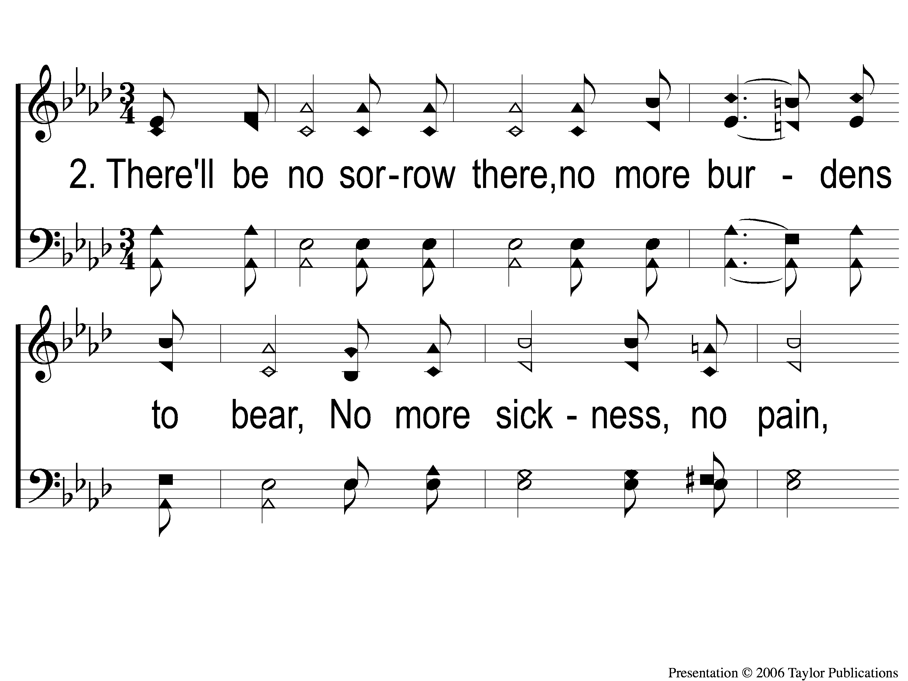
2-1 What a Day That Will Be
What a Day That Will Be
916

Slide 93
2-2 What a Day That Will Be
What a Day That Will Be
916

Slide 94
2-3 What a Day That Will Be
What a Day That Will Be
916

Slide 95
C-1 What a Day That Will Be
What a Day That Will Be
916

Slide 96
C-2 What a Day That Will Be
What a Day That Will Be
916

Slide 97
C-3 What a Day That Will Be
What a Day That Will Be
916

Slide 98
The Offering:
Hebrews 13:15-16
“Therefore by Him let us continually offer the sacrifice of praise to God, that is, the fruit of our lips, giving thanks to His name. But do not forget to do good and to share, for with such sacrifices God is well pleased.”

Slide 99
Song:
Have You Seen Jesus, My Lord?
#214

Slide 100
1-1 Have You Seen Jesus My Lord
Have You Seen Jesus My Lord
214

Slide 101
1-2 Have You Seen Jesus My Lord
Have You Seen Jesus My Lord
214

Slide 102
C-1 Have You Seen Jesus My Lord
Have You Seen Jesus My Lord
214

Slide 103
C-2 Have You Seen Jesus My Lord
Have You Seen Jesus My Lord
214

Slide 104
2-1 Have You Seen Jesus My Lord
Have You Seen Jesus My Lord
214

Slide 105
2-2 Have You Seen Jesus My Lord
Have You Seen Jesus My Lord
214

Slide 106
C-1 Have You Seen Jesus My Lord
Have You Seen Jesus My Lord
214

Slide 107
C-2 Have You Seen Jesus My Lord
Have You Seen Jesus My Lord
214

Slide 108
3-1 Have You Seen Jesus My Lord
Have You Seen Jesus My Lord
214

Slide 109
3-2 Have You Seen Jesus My Lord
Have You Seen Jesus My Lord
214

Slide 110
C-1 Have You Seen Jesus My Lord
Have You Seen Jesus My Lord
214

Slide 111
C-2 Have You Seen Jesus My Lord
Have You Seen Jesus My Lord
214

Slide 112
4-1 Have You Seen Jesus My Lord
Have You Seen Jesus My Lord
214

Slide 113
4-2 Have You Seen Jesus My Lord
Have You Seen Jesus My Lord
214

Slide 114
C-1 Have You Seen Jesus My Lord
Have You Seen Jesus My Lord
214

Slide 115
C-2 Have You Seen Jesus My Lord
Have You Seen Jesus My Lord
214

Slide 116
The Lord’s Supper
Acts 20:7

Slide 117
The Unleavened Bread
Hebrews 4:14-16
“Seeing then that we have a great High Priest who has passed through the heavens, Jesus the Son of God, olet us hold fast our confession. For pwe do not have a High Priest who cannot sympathize with our weaknesses, but qwas in all points tempted as we are, ryet without sin. Let us therefore come boldly to the throne of grace, that we may obtain mercy and find grace to help in time of need.”

Slide 118
The Fruit of the Vine
Hebrews 9:11-12
“But Christ came as High Priest of the good things to come, with the greater and more perfect tabernacle not made with hands, that is, not of this creation. Not with the blood of goats and calves, but with His own blood He entered the Most Holy Place once for all, having obtained eternal redemption.”

Slide 119
Closing Prayer

Slide 120
Song:
Victory In Jesus
#470

Slide 121
1-1 Victory in Jesus
Victory in Jesus
470

Slide 122
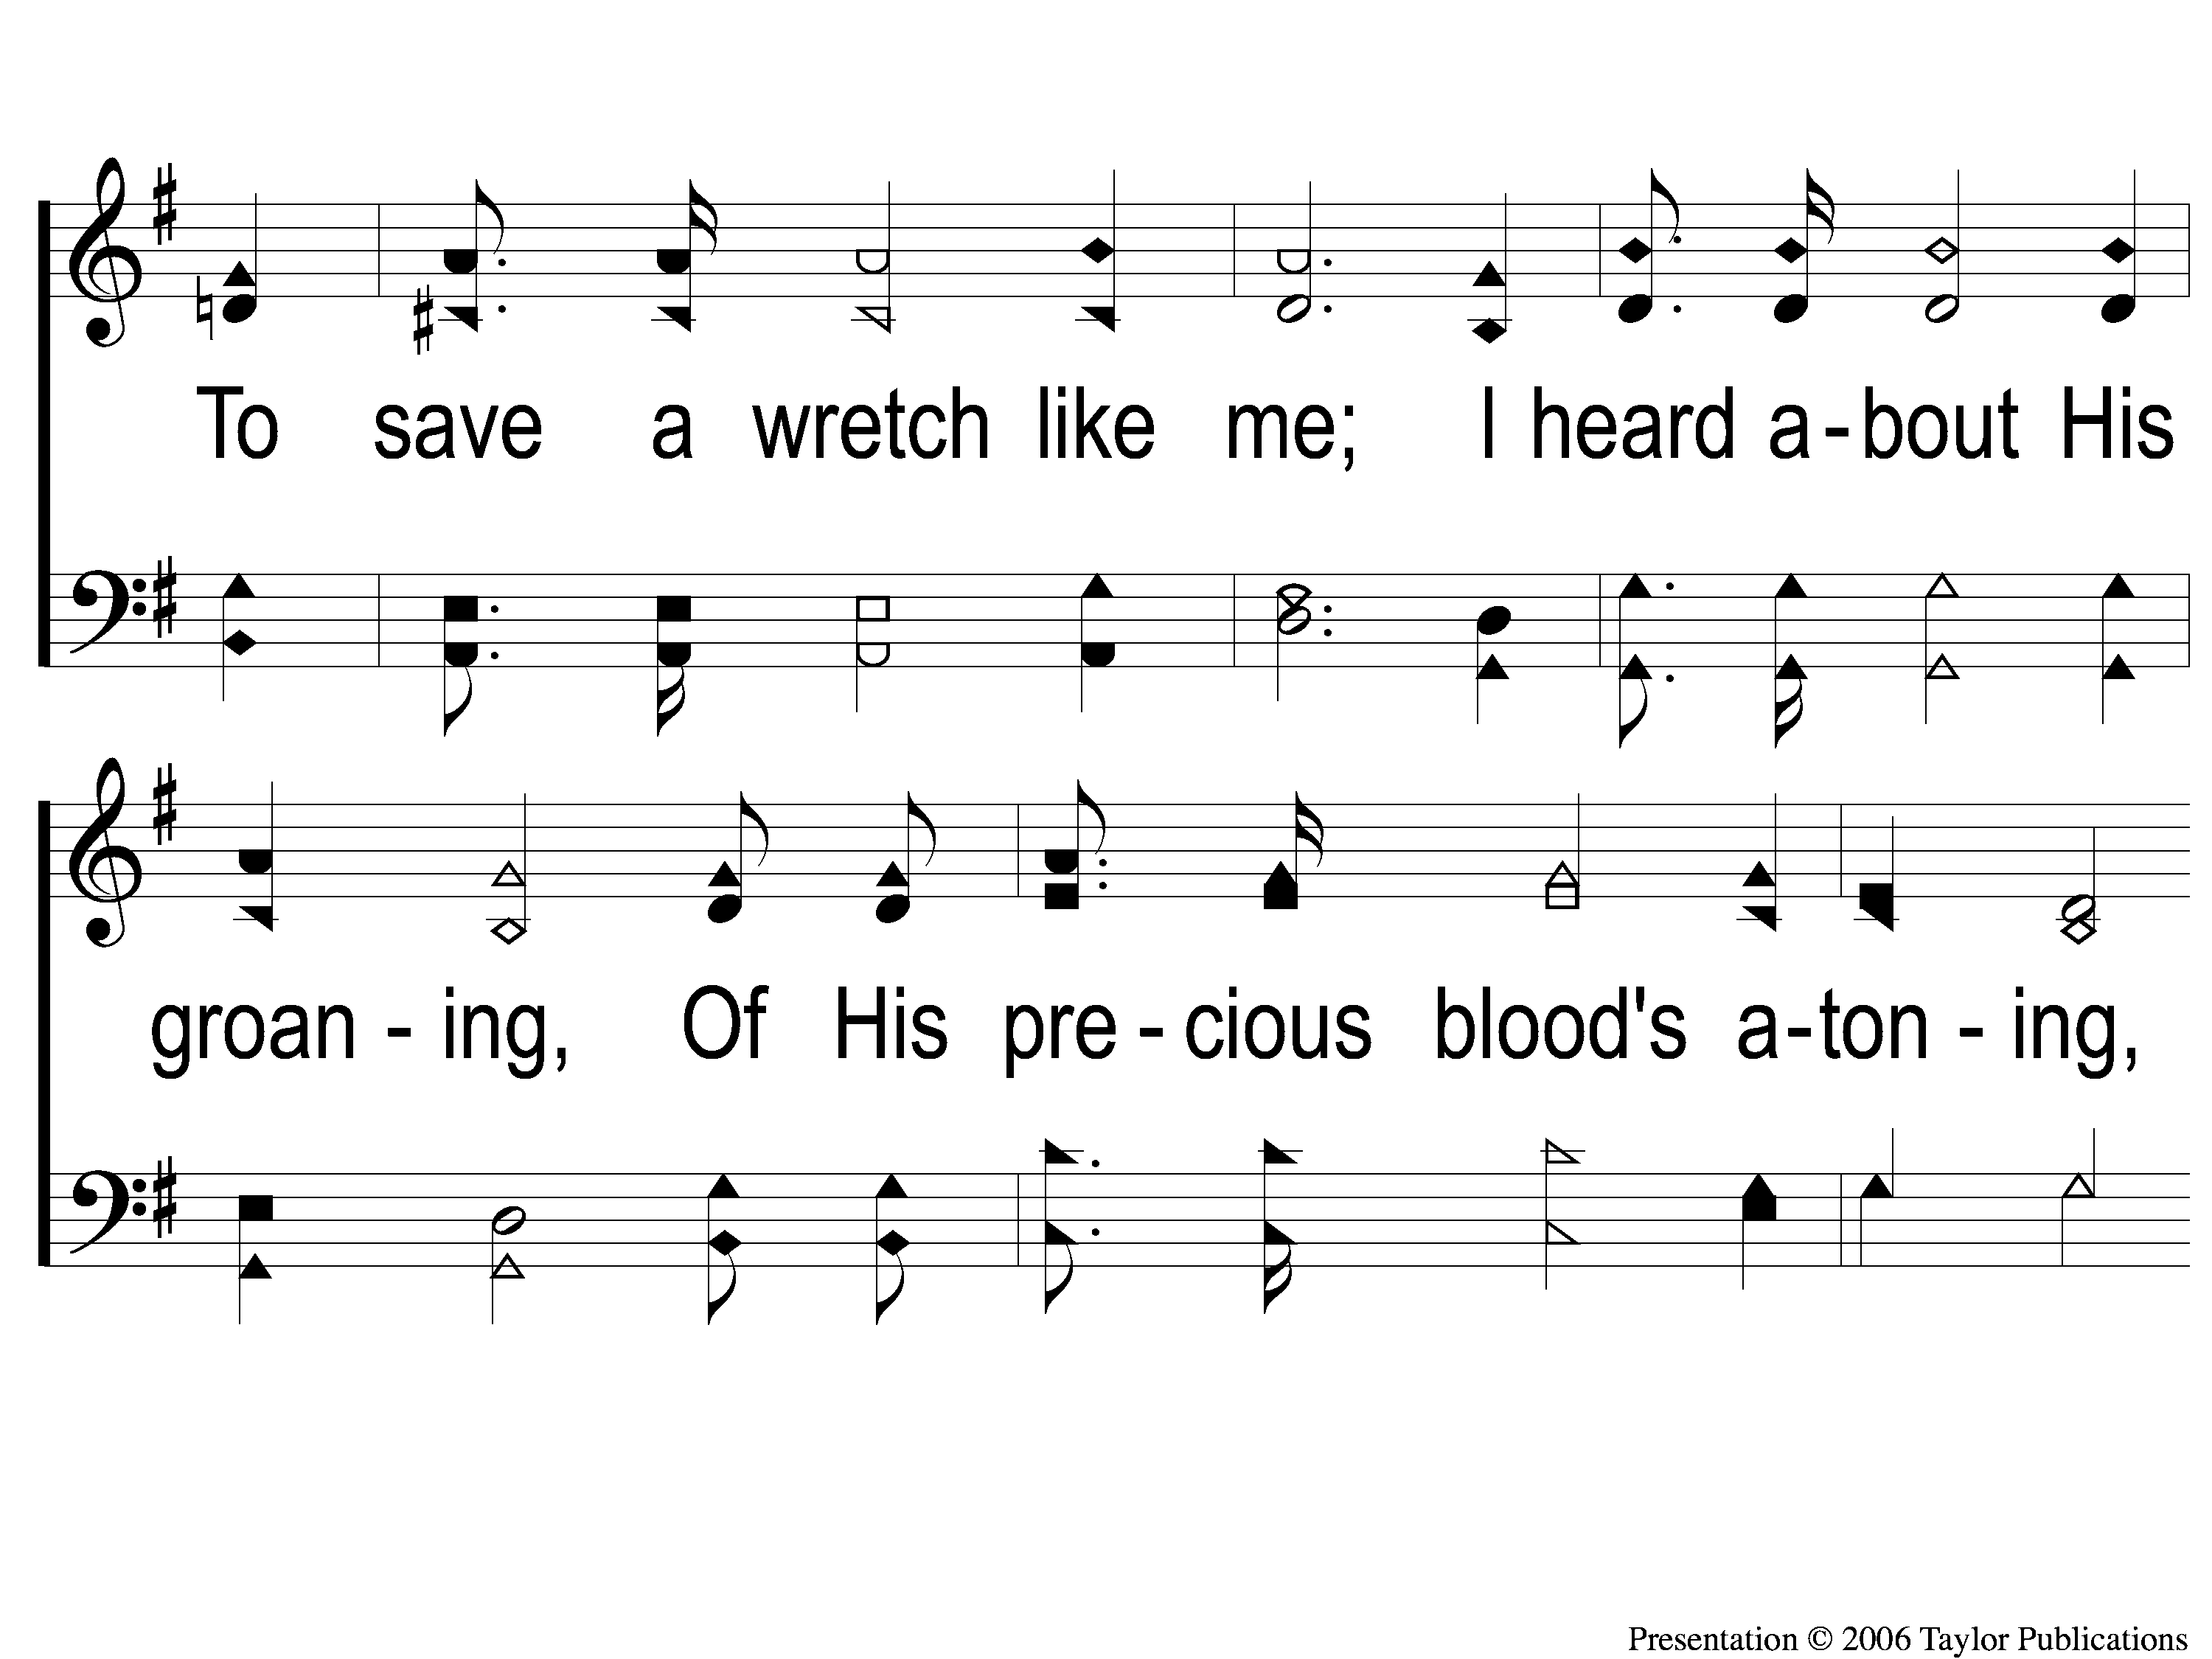
1-2 Victory in Jesus
Victory in Jesus
470

Slide 123
1-3 Victory in Jesus
Victory in Jesus
470

Slide 124
C-1 Victory in Jesus
Victory in Jesus
470

Slide 125
C-2 Victory in Jesus
Victory in Jesus
470

Slide 126
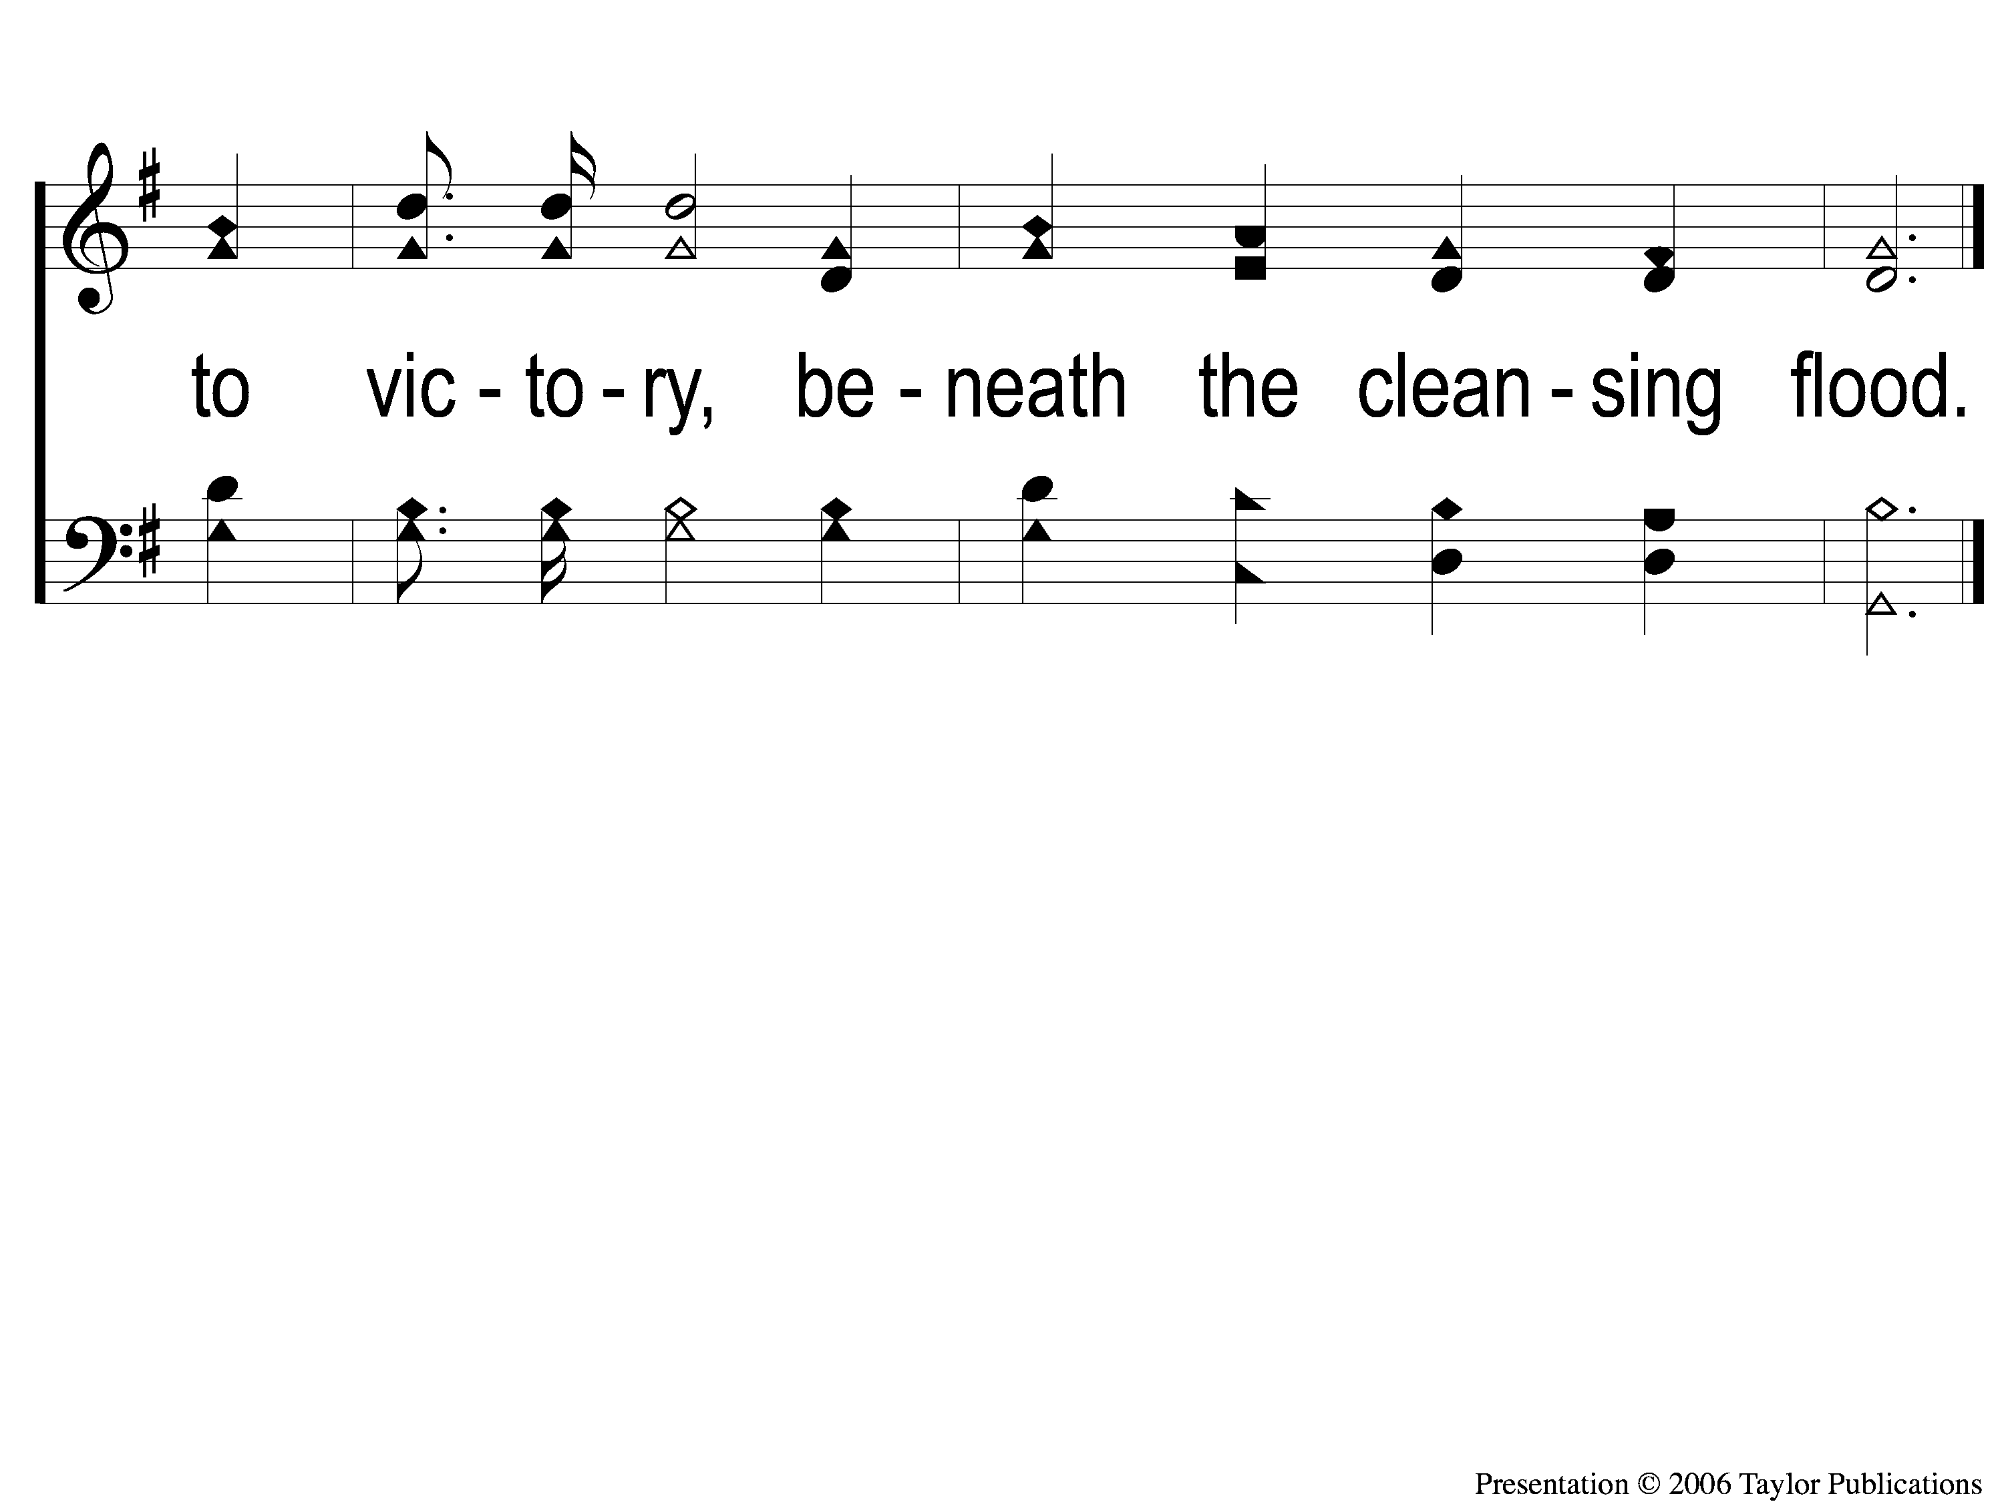
C-3 Victory in Jesus
Victory in Jesus
470

Slide 127
2-1 Victory in Jesus
Victory in Jesus
470

Slide 128
2-2 Victory in Jesus
Victory in Jesus
470

Slide 129
2-3 Victory in Jesus
Victory in Jesus
470

Slide 130
C-1 Victory in Jesus
Victory in Jesus
470

Slide 131
C-2 Victory in Jesus
Victory in Jesus
470

Slide 132
C-3 Victory in Jesus
Victory in Jesus
470

Slide 133
3-1 Victory in Jesus
Victory in Jesus
470

Slide 134
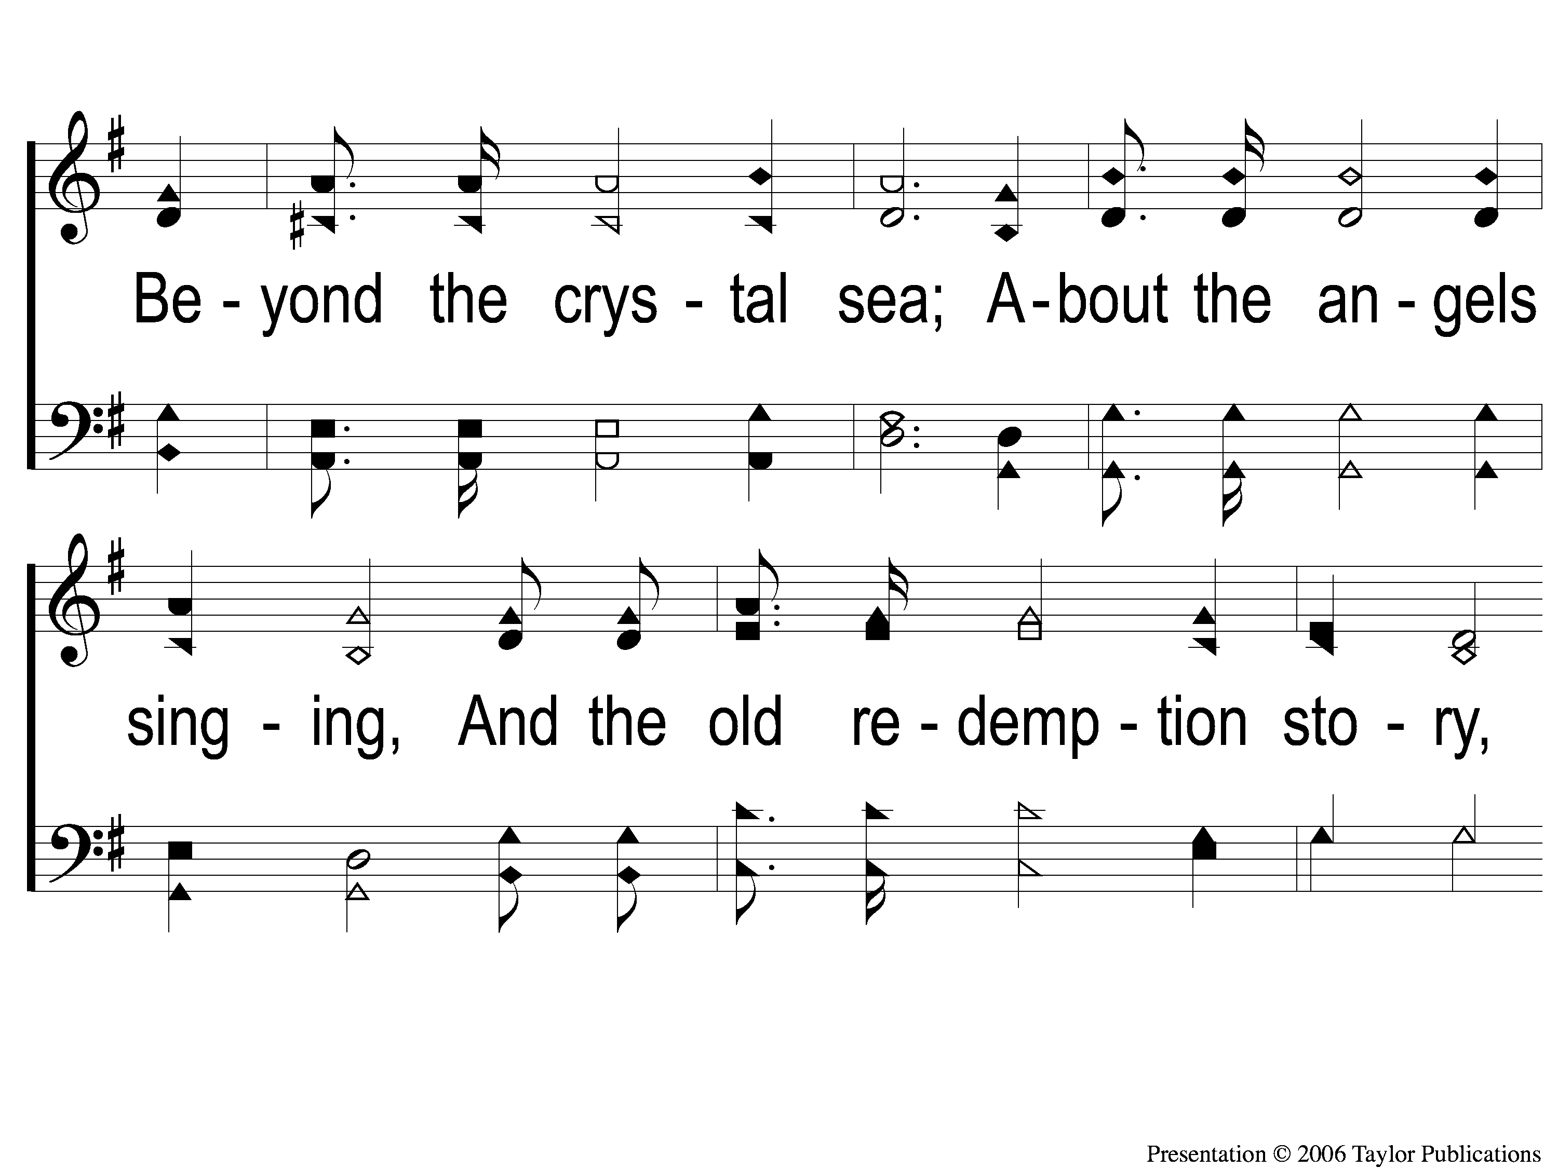
3-2 Victory in Jesus
Victory in Jesus
470

Slide 135
3-3 Victory in Jesus
Victory in Jesus
470

Slide 136
C-1 Victory in Jesus
Victory in Jesus
470

Slide 137
C-2 Victory in Jesus
Victory in Jesus
470

Slide 138
C-3 Victory in Jesus
Victory in Jesus
470

Slide 139
Reminders
Tonight:
Worship @ 6:00pm

