Slide 1
1-1 On Bended Knee
On Bended Knee
791

Slide 2
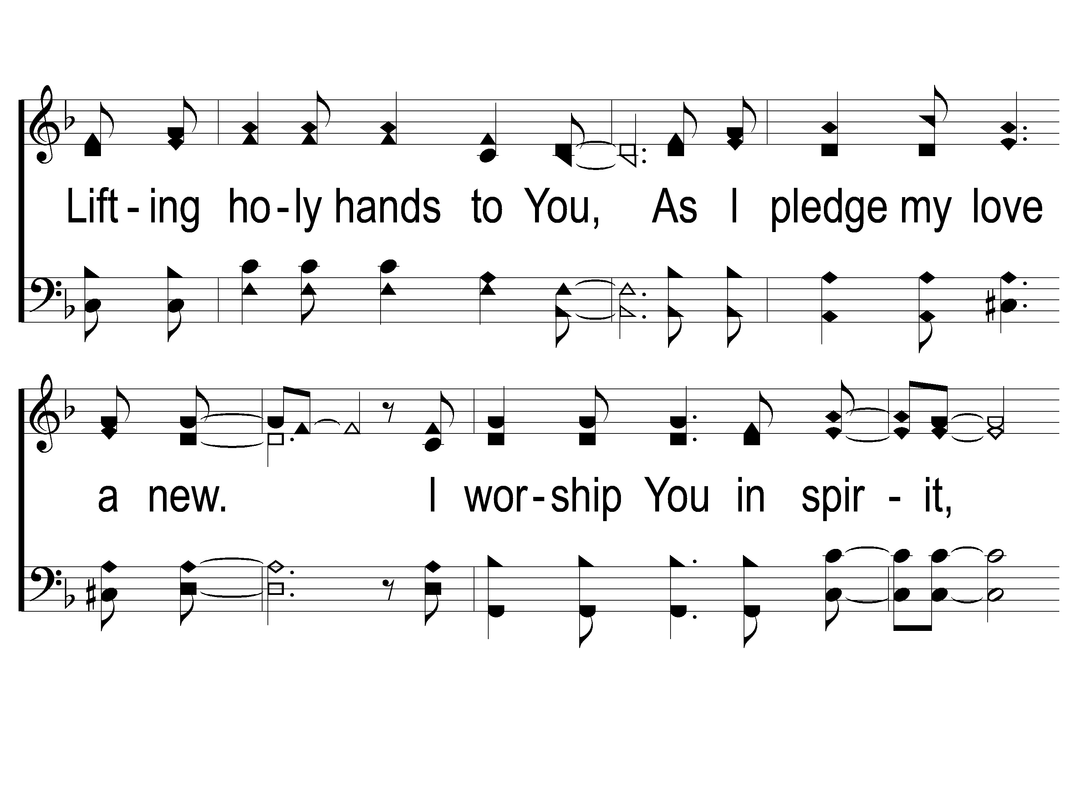
1-2 On Bended Knee
On Bended Knee
791

Slide 3
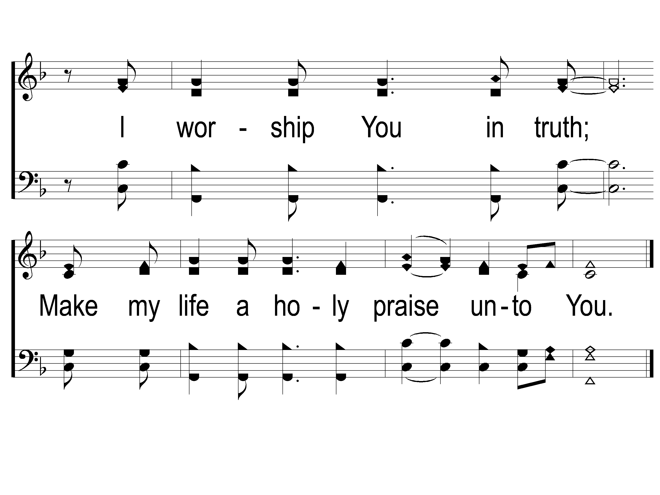
1-3 On Bended Knee
On Bended Knee
791

Slide 4
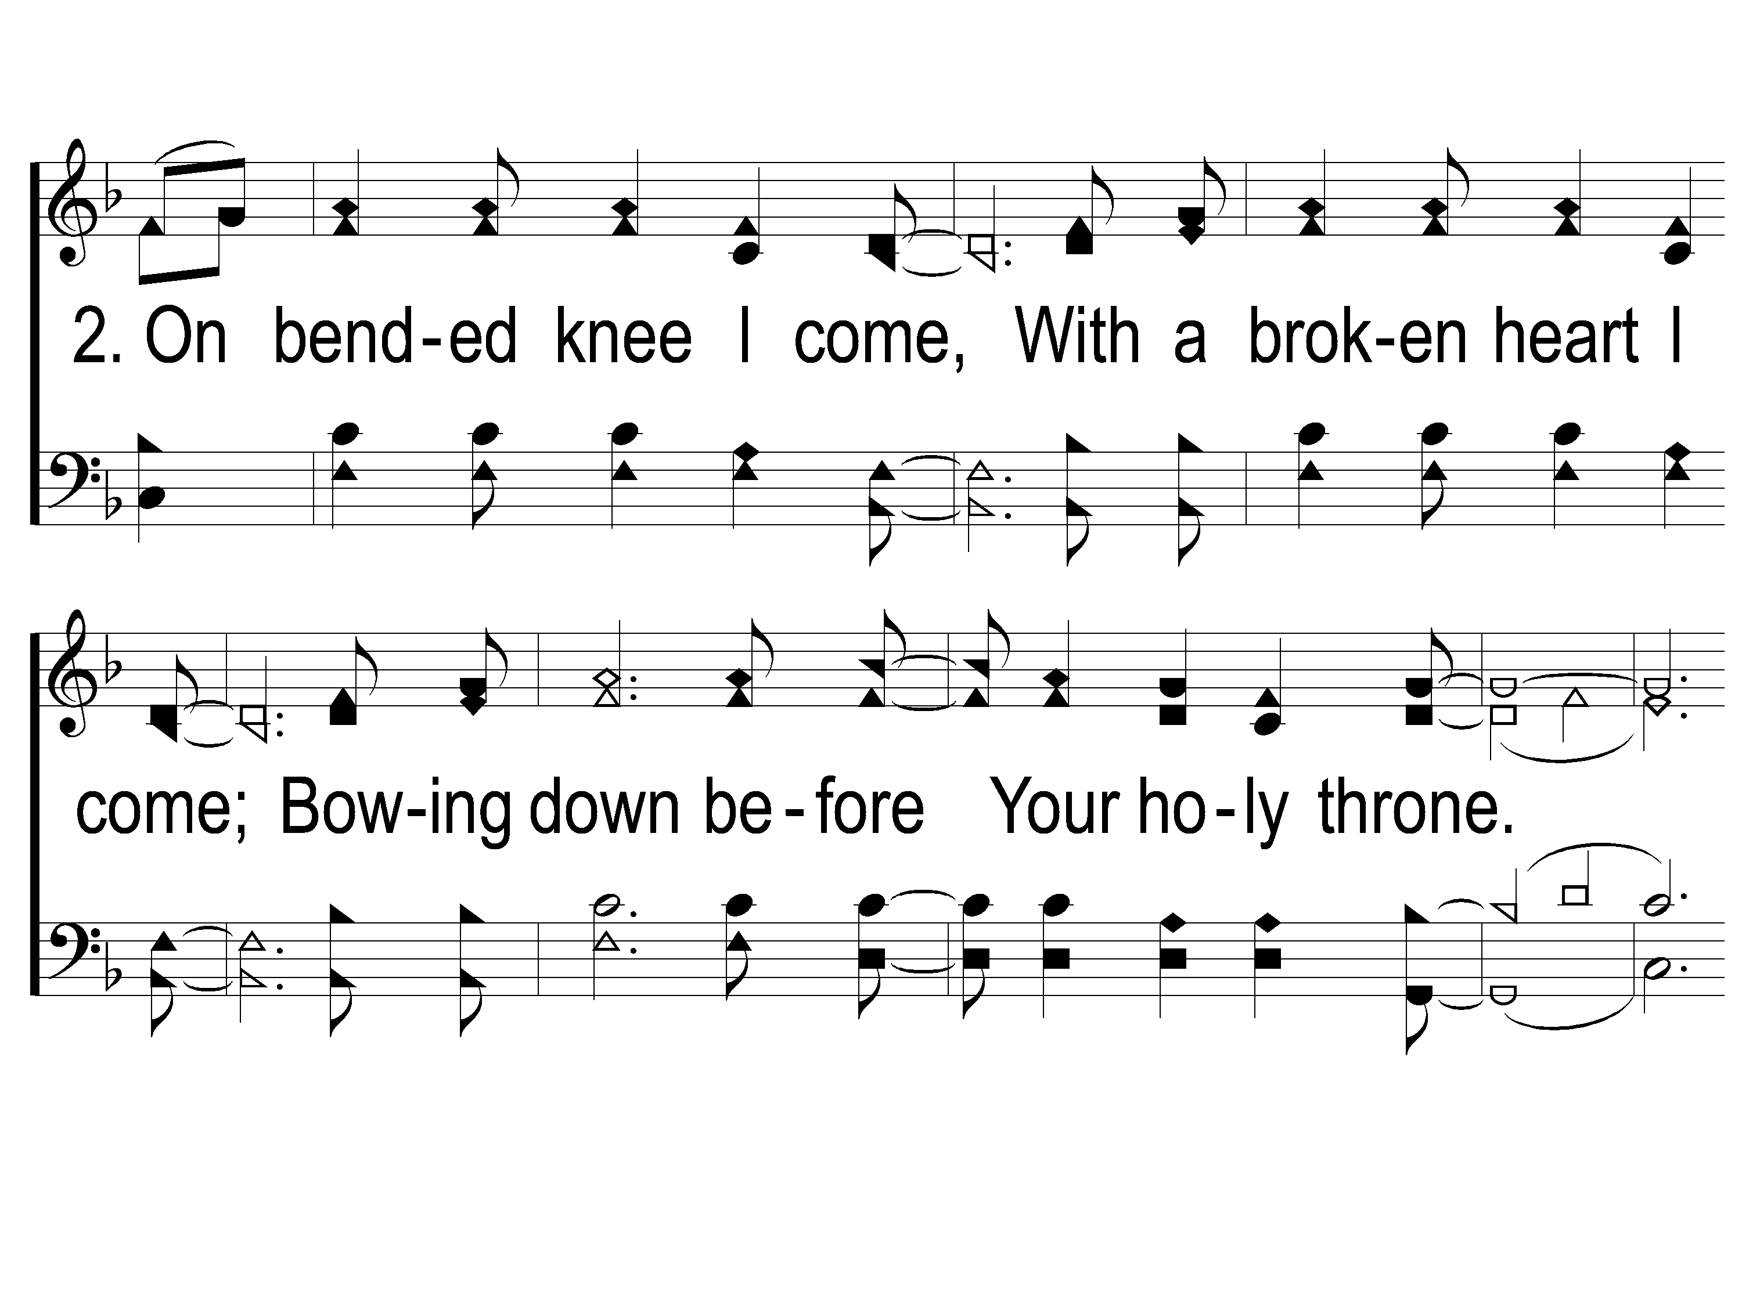
2-1 On Bended Knee
On Bended Knee
791

Slide 5
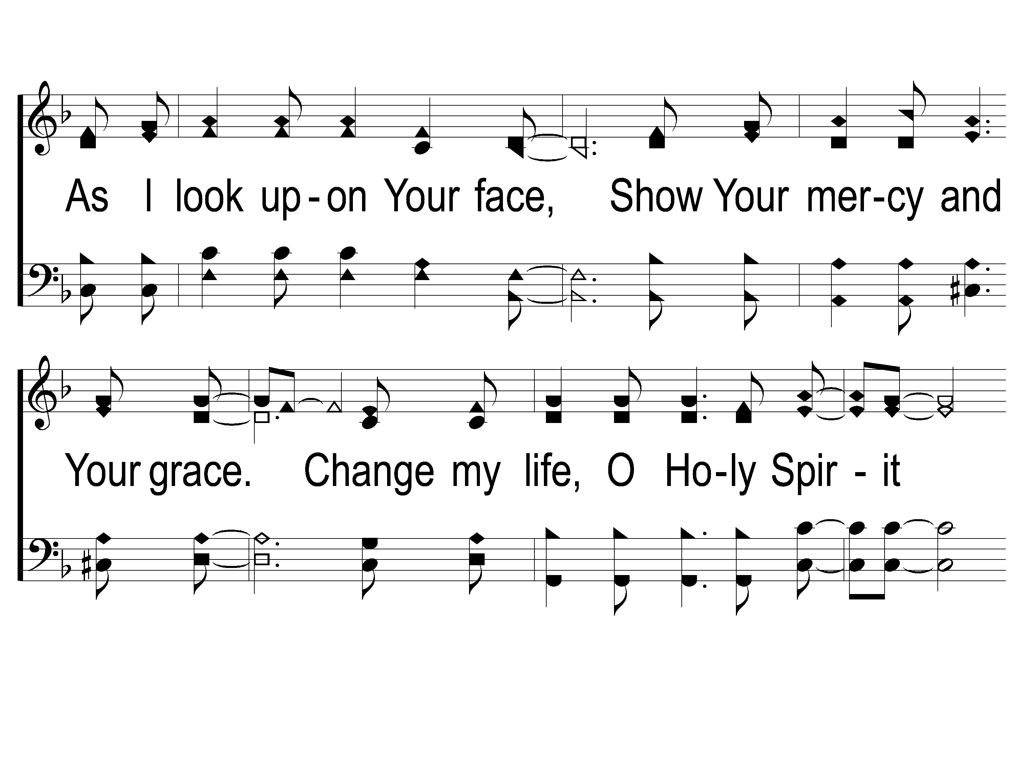
2-2 On Bended Knee
On Bended Knee
791

Slide 6
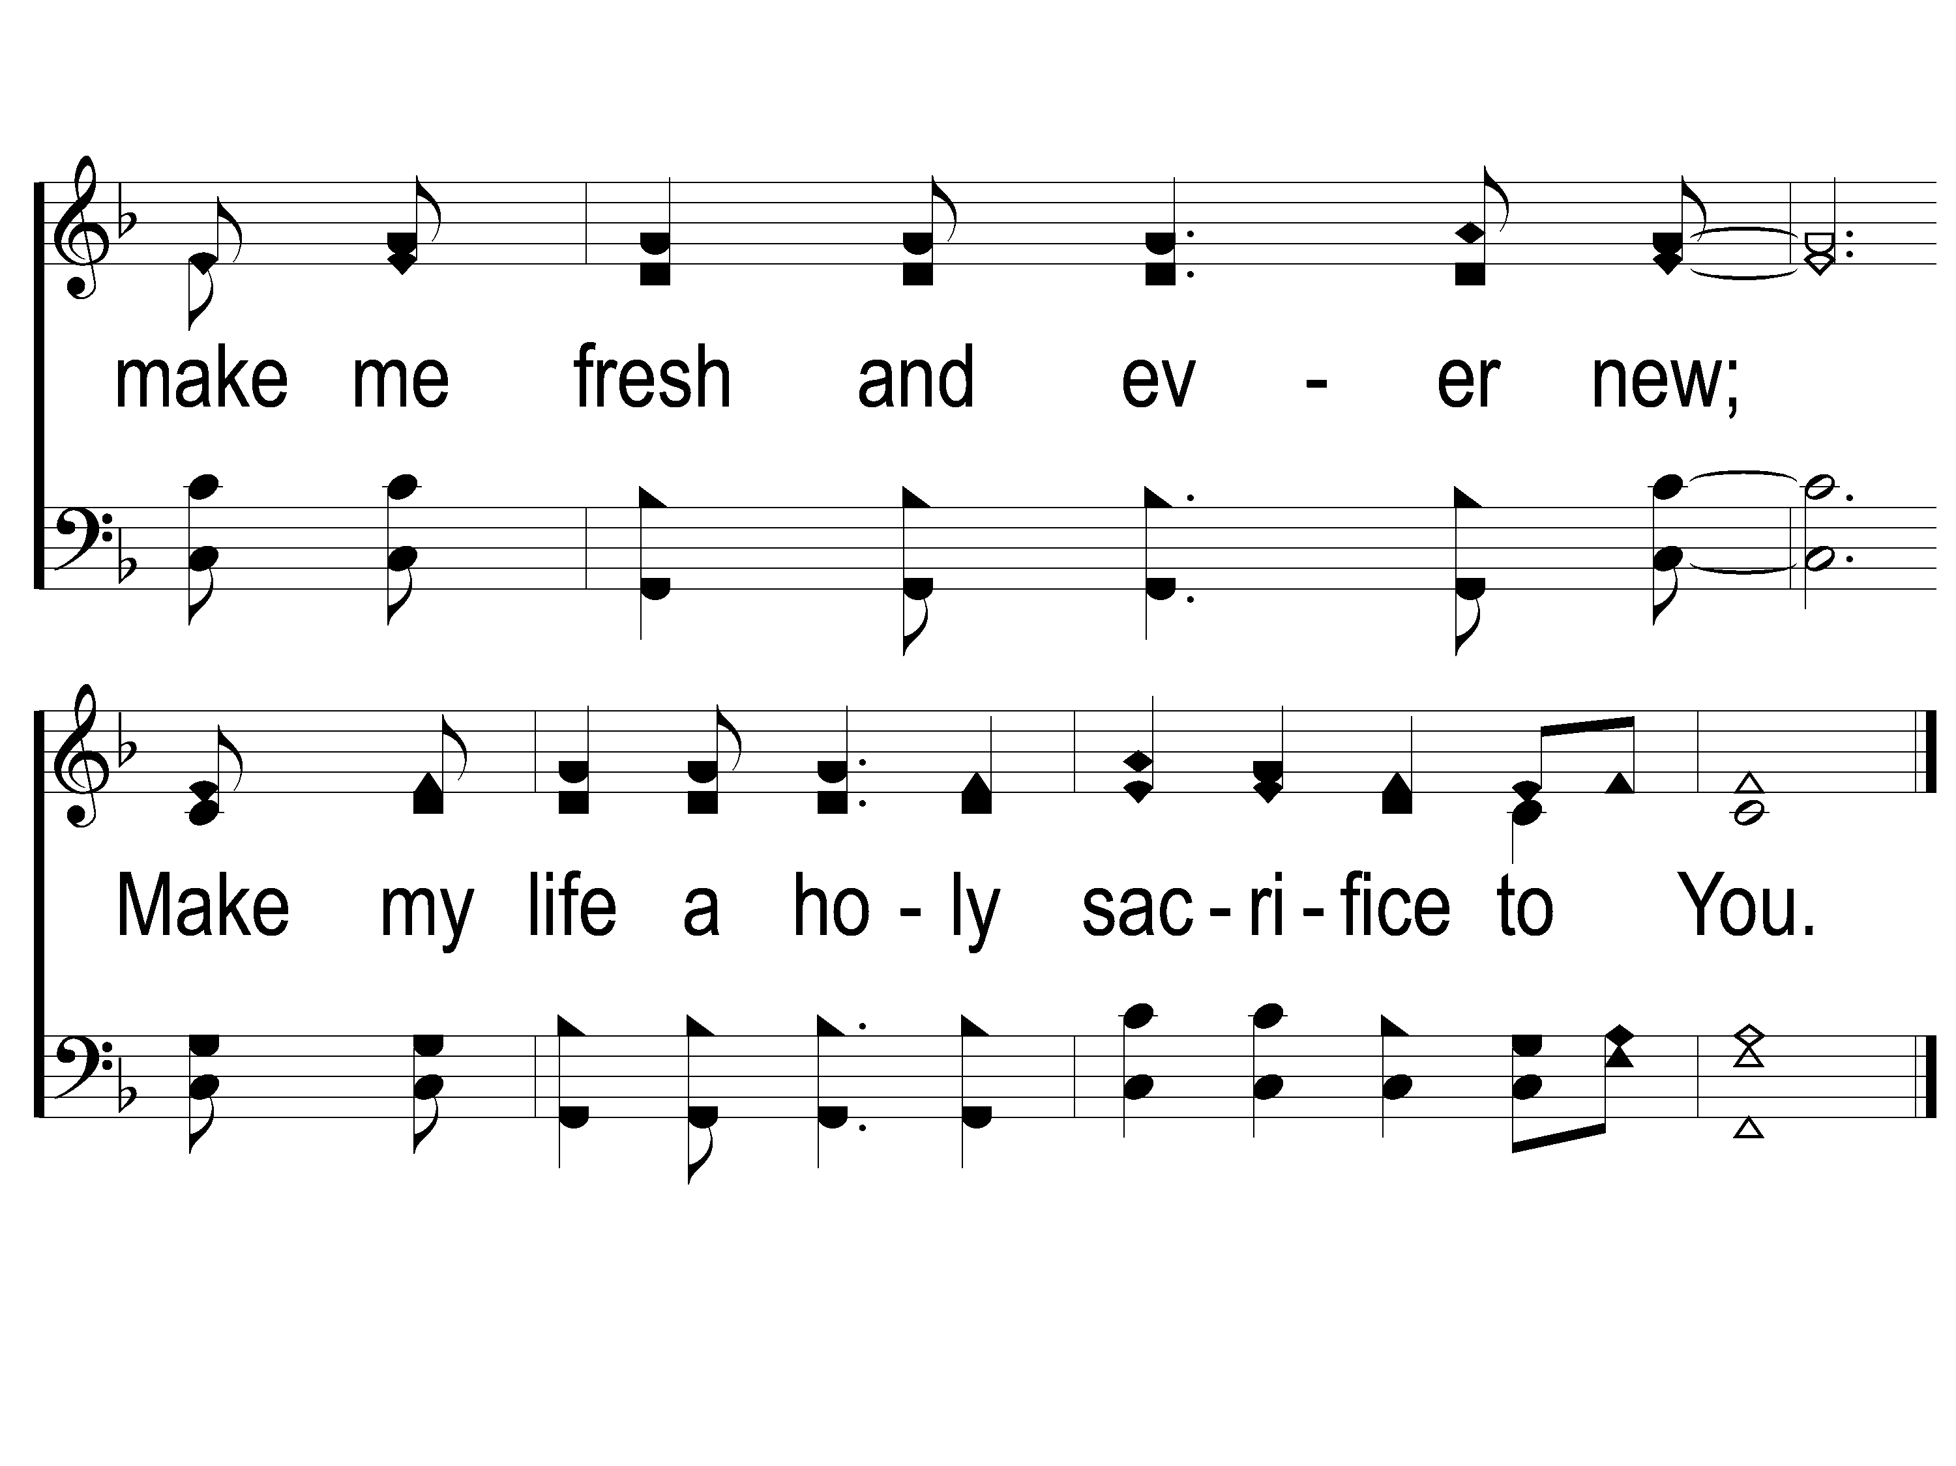
2-3 On Bended Knee
On Bended Knee
791

Slide 8
Song:
Our God,
He Is Alive
#23

Slide 9
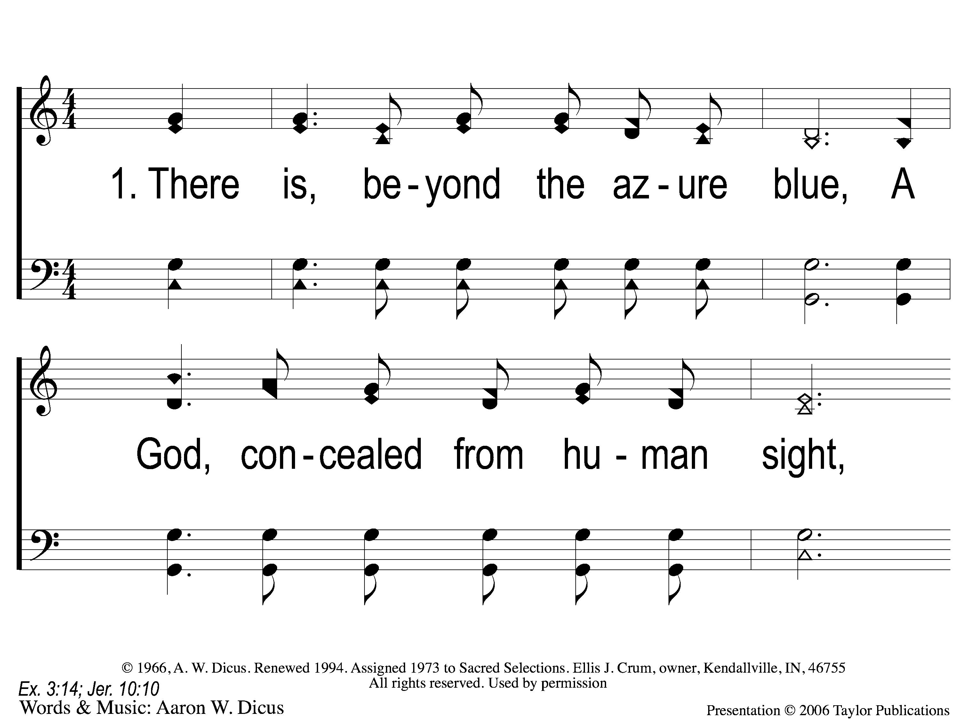
1-1 Our God He Is Alive
Our God, He Is Alive
23

Slide 10
1-2 Our God He Is Alive
Our God, He Is Alive
23

Slide 11
C-1 Our God He Is Alive
Our God, He Is Alive
23

Slide 12
C-2 Our God He Is Alive
Our God, He Is Alive
23

Slide 13
2-1 Our God He Is Alive
Our God, He Is Alive
23

Slide 14
2-2 Our God He Is Alive
Our God, He Is Alive
23

Slide 15
C-1 Our God He Is Alive
Our God, He Is Alive
23

Slide 16
C-2 Our God He Is Alive
Our God, He Is Alive
23

Slide 17
4-1 Our God He Is Alive
Our God, He Is Alive
23

Slide 18
4-2 Our God He Is Alive
Our God, He Is Alive
23

Slide 19
C-1 Our God He Is Alive
Our God, He Is Alive
23

Slide 20
C-2 Our God He Is Alive
Our God, He Is Alive
23

Slide 21
1 Mighty is our God
Mighty Is Our God
41

Slide 22
2 Mighty is our God
Mighty Is Our God
41

Slide 23
Bridge1 Mighty is our God
Mighty Is Our God
41

Slide 24
Bridge2 Mighty is our God
Mighty Is Our God
41

Slide 25
DC1 Mighty is our God
Mighty Is Our God
41

Slide 26
Coda Mighty is our God
Mighty Is Our God
41

Slide 27
Song:
As The Deer
#71

Slide 28
1-1 As the Deer
As The Deer
71

Slide 29
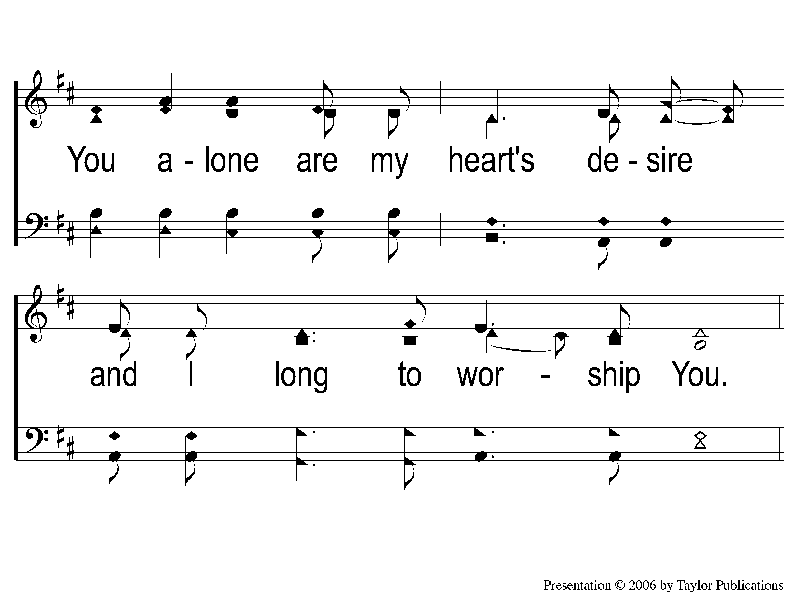
1-2 As the Deer
As The Deer
71

Slide 30
C-1 As the Deer
As The Deer
71

Slide 31
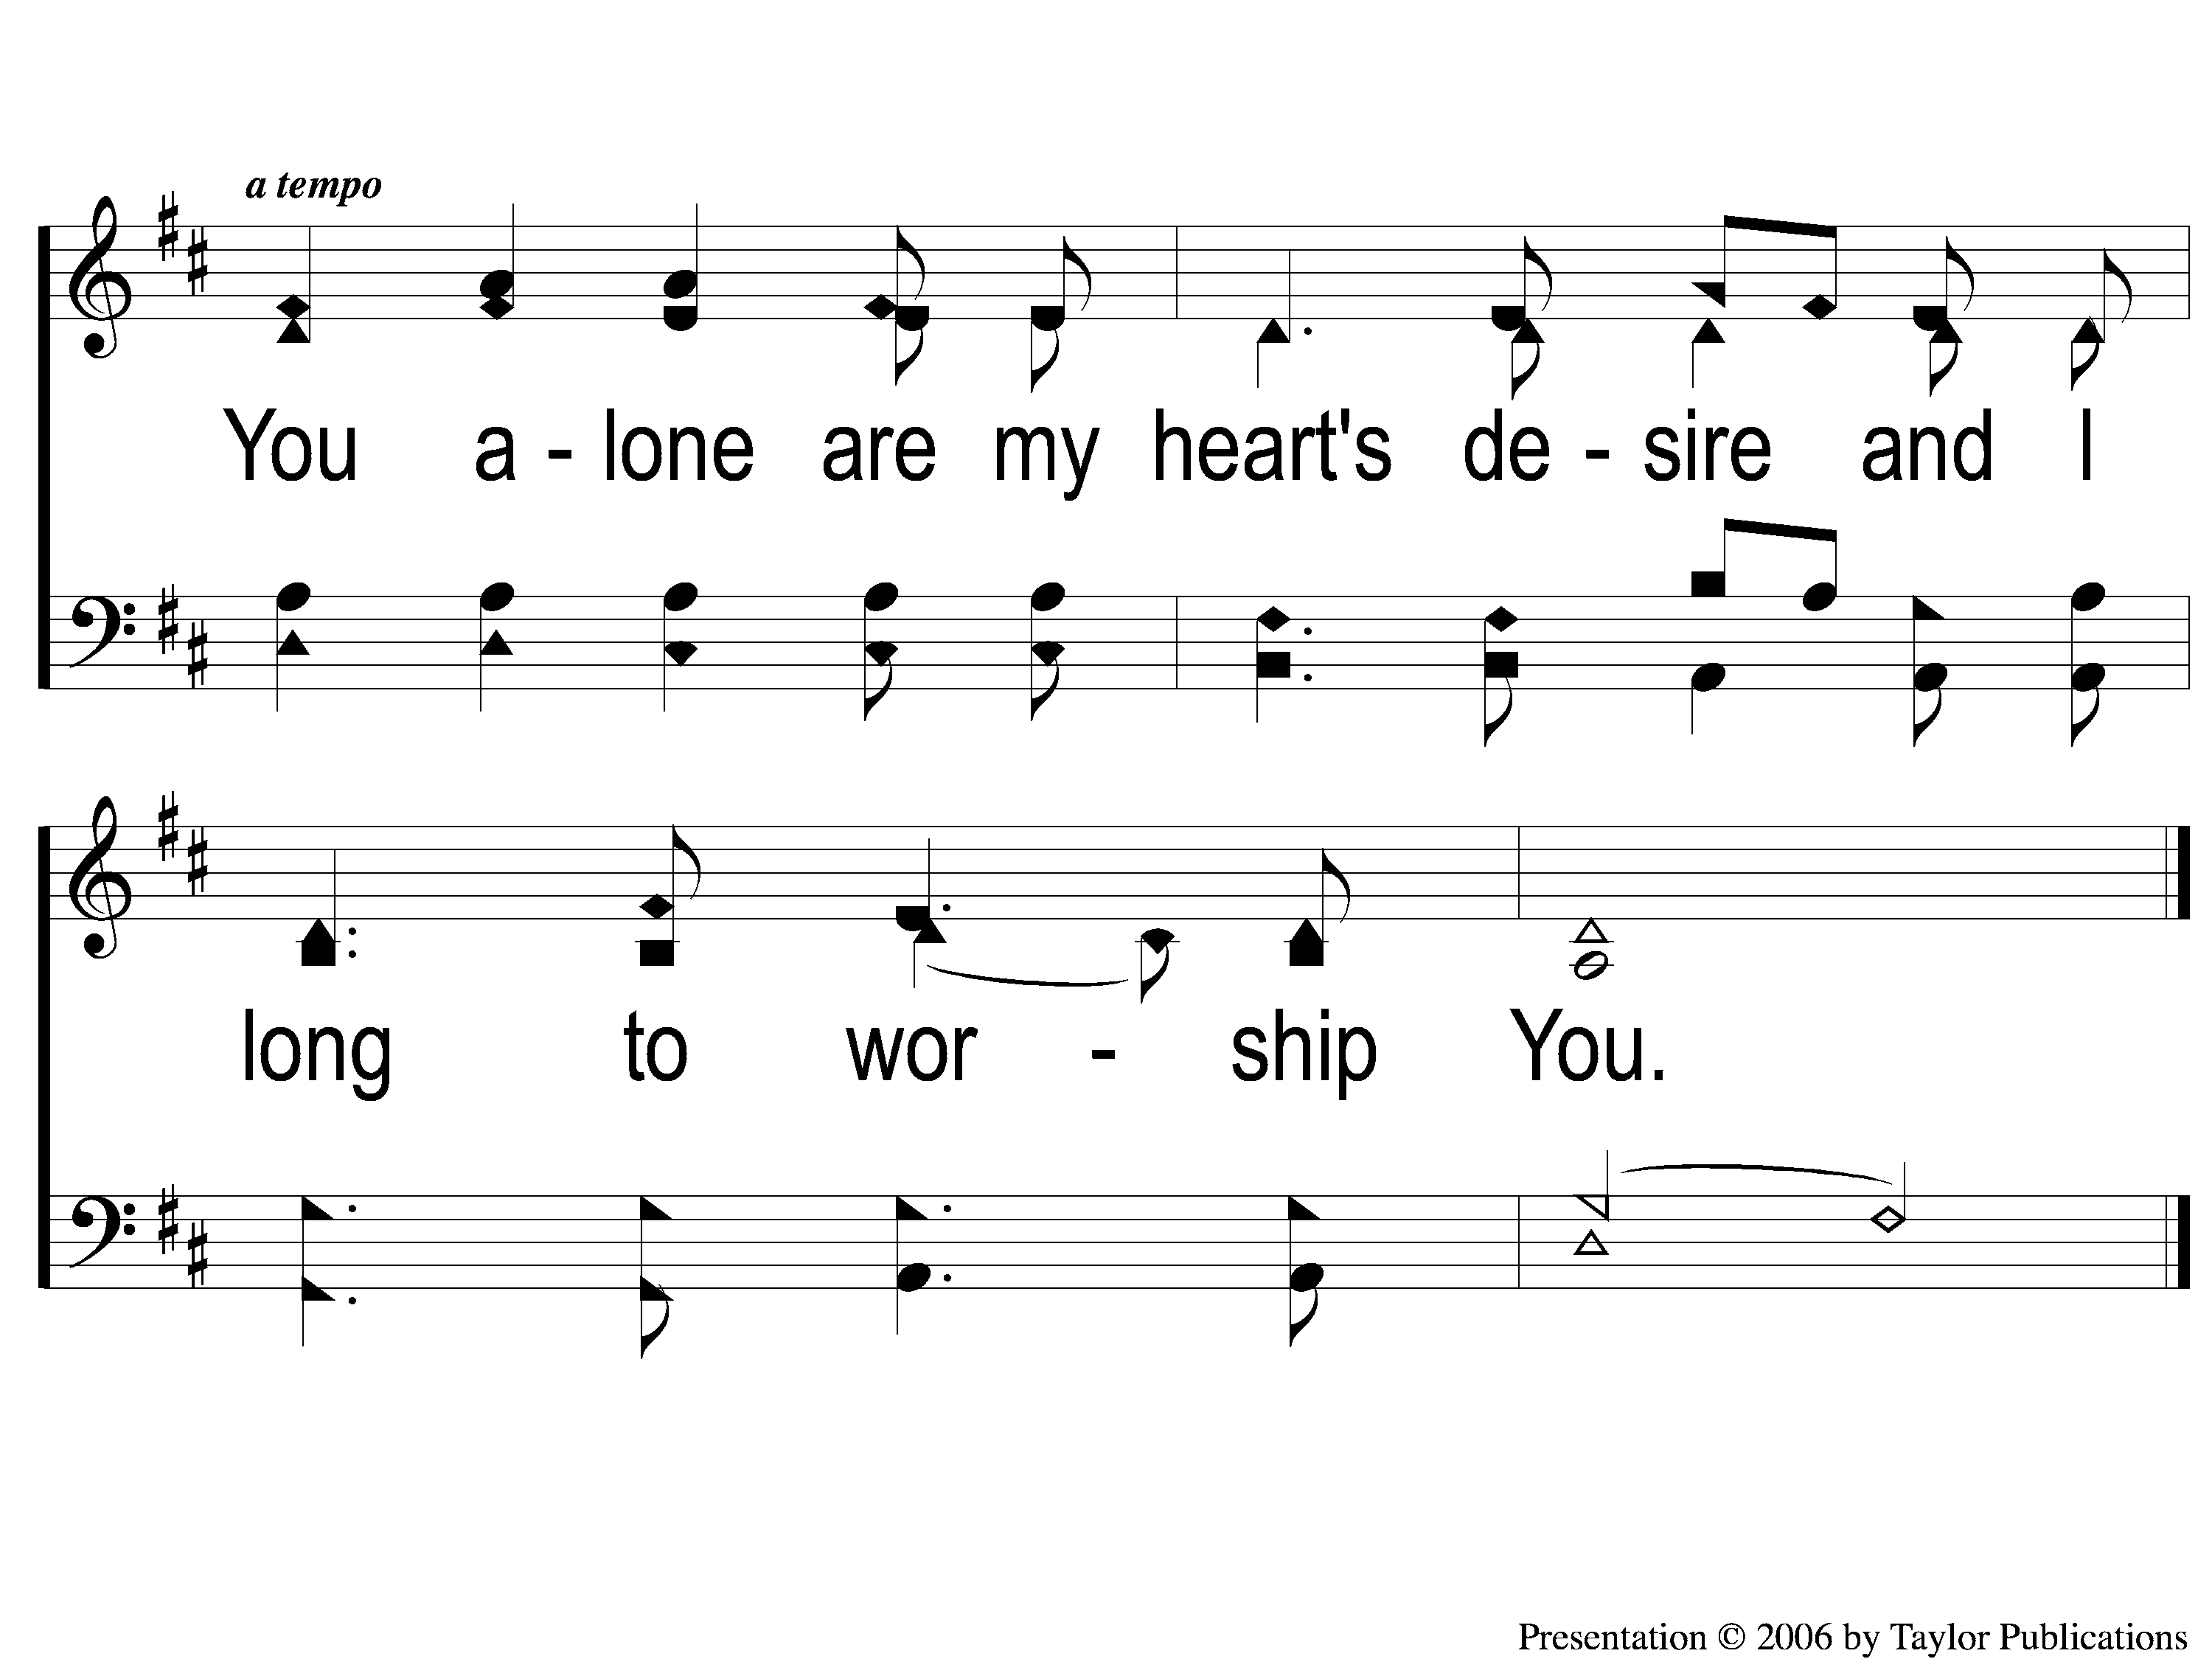
C-2 As the Deer
As The Deer
71

Slide 32
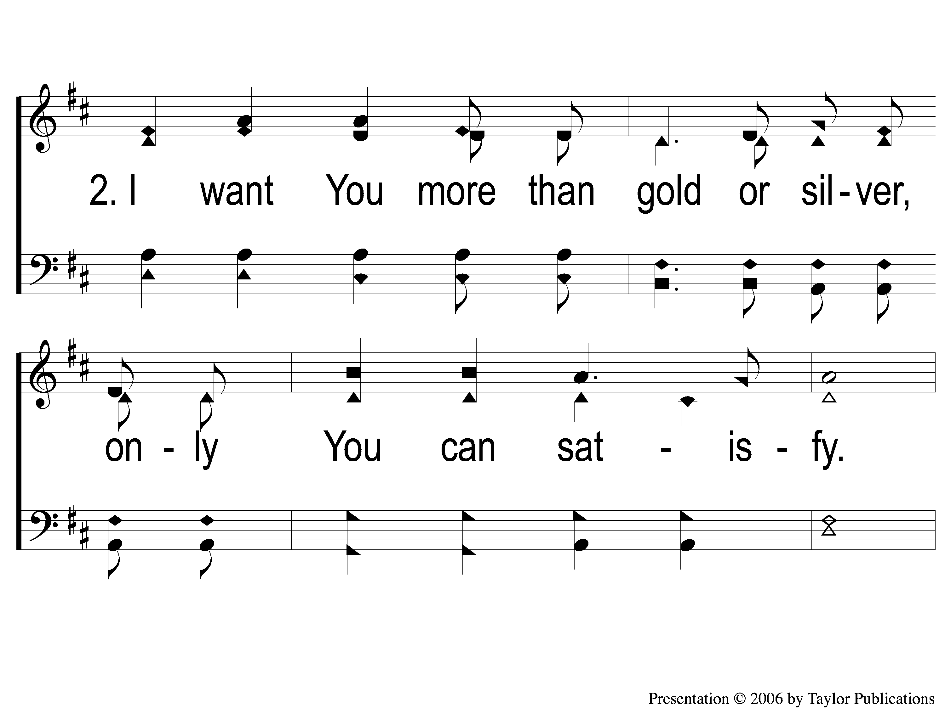
2-1 As the Deer
As The Deer
71

Slide 33
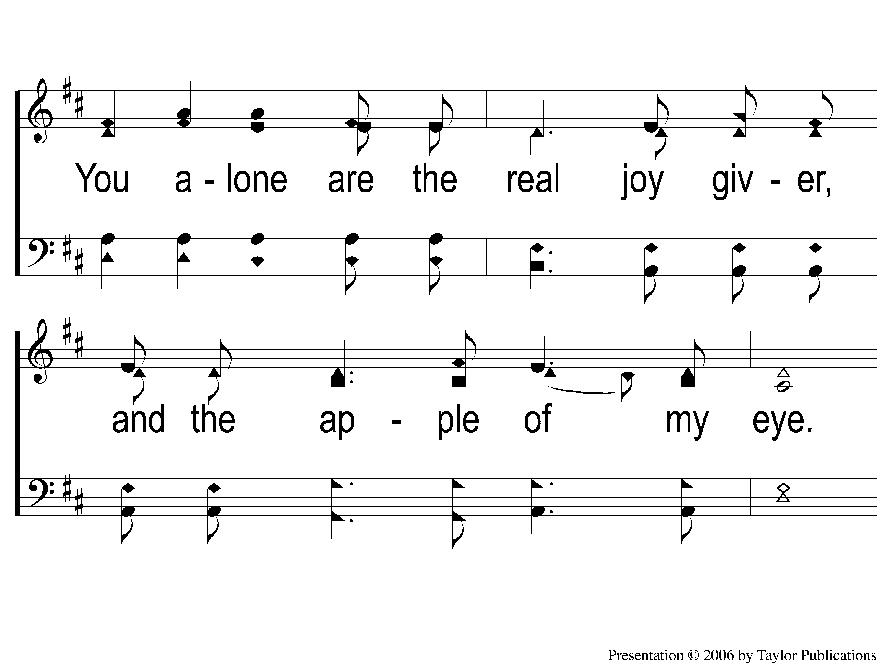
2-2 As the Deer
As The Deer
71

Slide 34
C-1 As the Deer
As The Deer
71

Slide 35
C-2 As the Deer
As The Deer
71

Slide 36
Opening Prayer

Slide 37
Song:
Angry Words
#719

Slide 38
1-1 Angry Words
Angry Words
719

Slide 39
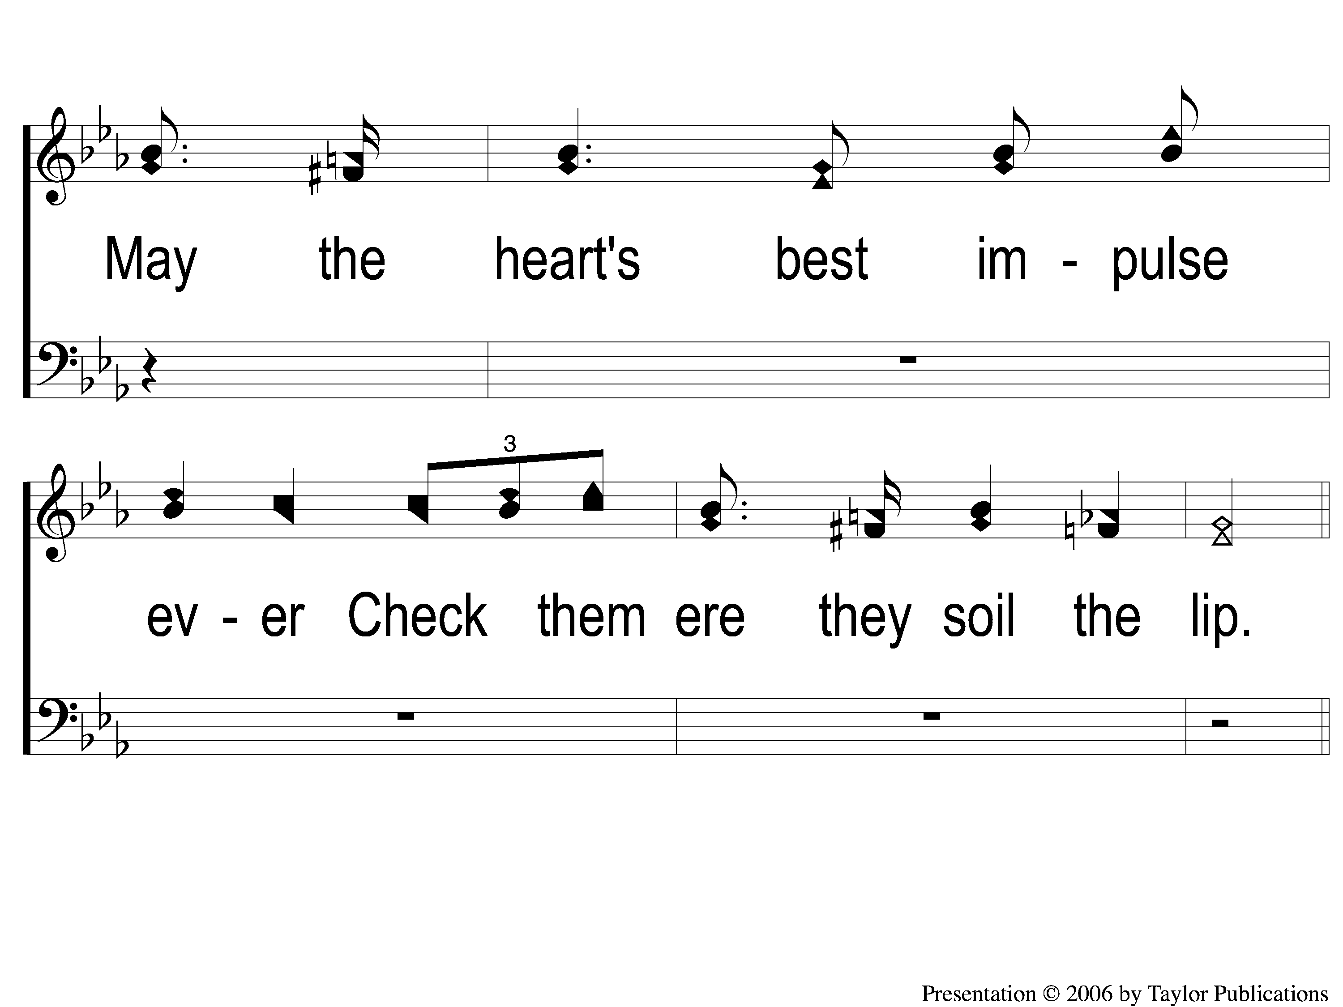
1-2 Angry Words
Angry Words
719

Slide 40
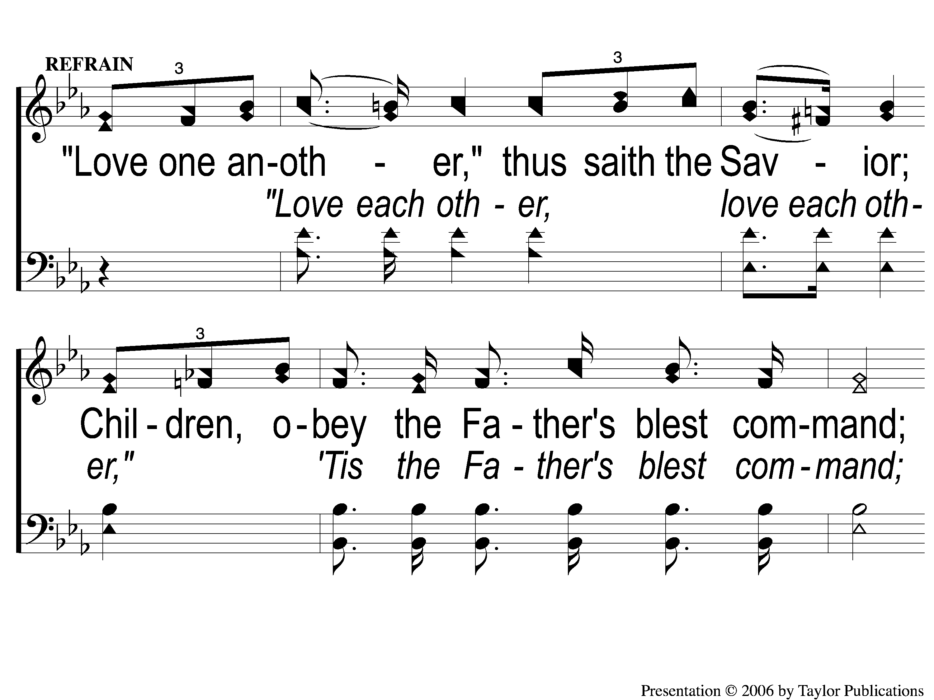
C-1 Angry Words
Angry Words
719

Slide 41
C-2 Angry Words
Angry Words
719

Slide 42
2-1 Angry Words
Angry Words
719

Slide 43
2-2 Angry Words
Angry Words
719

Slide 44
C-1 Angry Words
Angry Words
719

Slide 45
C-2 Angry Words
Angry Words
719

Slide 46
3-1 Angry Words
Angry Words
719

Slide 47
3-2 Angry Words
Angry Words
719

Slide 48
C-1 Angry Words
Angry Words
719

Slide 49
C-2 Angry Words
Angry Words
719

Slide 50
Song:
Come, Share
The Lord
#364

Slide 51
1-1 Come Share the Lord
Come, Share The Lord
364

Slide 52
1-2 Come Share the Lord
Come, Share The Lord
364

Slide 53
C-1 Come Share the Lord
Come, Share The Lord
364

Slide 54
2-1 Come Share the Lord
Come, Share The Lord
364

Slide 55
2-2 Come Share the Lord
Come, Share The Lord
364

Slide 56
C-2 Come Share the Lord
Come, Share The Lord
364

Slide 57
3-1 Come Share the Lord
Come, Share The Lord
364

Slide 58
3-2 Come Share the Lord
Come, Share The Lord
364

Slide 59
Scripture Reading:
Matthew 26:26-29

Slide 60
STAND
IN GOOD STEAD

Slide 61
WHY
PARTAKE EVERY
SUNDAY?

Slide 62
WHY PARTAKE EVERY SUNDAY?
THE EARLY CHRISTIANS’ EXAMPLE
Acts 20:7
Acts 2:42
1 Cor. 11:23-26, 33

Slide 63
FINDING BIBLE AUTHORITY
Explicit Commands
Necessary Implications
Constraining Examples
Silence

Slide 64
WHY USE ONLY THESE ELEMENTS?
Unleavened Bread
Unfermented Grape Juice

Slide 65
WHY USE ONLY THESE ELEMENTS?
The Timeframe

Slide 66
WHY USE ONLY THESE ELEMENTS?
The Timeframe → Passover
Matt. 26:17-19
Ex. 12:15, 19-20

Slide 67
WHY USE ONLY THESE ELEMENTS?
The Timeframe
The Symbolism

Slide 68
WHY USE ONLY THESE ELEMENTS?
The Symbolism → Purity
Matt. 26:26-28
1 Cor. 11:24-25

Slide 69
WHY USE ONLY THESE ELEMENTS?
The Timeframe → Passover
The Symbolism
The Command & Example of Christ

Slide 70
WHY USE ONLY THESE ELEMENTS?
The Command & Example of Christ
Matt. 26:26
1 Cor. 11:23

Slide 71
WHAT IF I TREAT IT COMMONLY?

Slide 72
WHAT IF I TREAT IT COMMONLY?
Judgment To Ourselves
1 Cor. 11:26-34

Slide 73
WHY DID GOD GIVE HIS SON?
Rom. 5:6-11

Slide 74
WHY DID GOD GIVE HIS SON?
Rom. 5:6-11
To Show His Love
To Provide Salvation

Slide 75
InvitationSong:
Have You Been To Jesus?
#904

Slide 76
1-1 There Is Power In the Blood
There Is Power In the Blood
903

Slide 77
1-2 There Is Power In the Blood
There Is Power In the Blood
903

Slide 78
C-1 There Is Power In the Blood
There Is Power In the Blood
903

Slide 79
C-2 There Is Power In the Blood
There Is Power In the Blood
903

Slide 80
4-1 There Is Power In the Blood
There Is Power In the Blood
903

Slide 81
4-2 There Is Power In the Blood
There Is Power In the Blood
903

Slide 82
C-1 There Is Power In the Blood
There Is Power In the Blood
903

Slide 83
C-2 There Is Power In the Blood
There Is Power In the Blood
903

Slide 84
The Offering:
2 Corinthians 9:7
“So let each one give as he purposes in his heart, not grudgingly or of necessity; for God loves a cheerful giver.”

Slide 85
Song:
A Hill Called Mount Calvary
#373

Slide 86
1-1 A Hill Called Mount Calvary
A Hill Called Mount Calvary
373

Slide 87
1-2 A Hill Called Mount Calvary
A Hill Called Mount Calvary
373

Slide 88
C-1 A Hill Called Mount Calvary
A Hill Called Mount Calvary
373

Slide 89
C-2 A Hill Called Mount Calvary
A Hill Called Mount Calvary
373

Slide 90
2-1 A Hill Called Mount Calvary
A Hill Called Mount Calvary
373

Slide 91
2-2 A Hill Called Mount Calvary
A Hill Called Mount Calvary
373

Slide 92
C-1 A Hill Called Mount Calvary
A Hill Called Mount Calvary
373

Slide 93
C-2 A Hill Called Mount Calvary
A Hill Called Mount Calvary
373

Slide 94
3-1 A Hill Called Mount Calvary
A Hill Called Mount Calvary
373

Slide 95
3-2 A Hill Called Mount Calvary
A Hill Called Mount Calvary
373

Slide 96
C-1 A Hill Called Mount Calvary
A Hill Called Mount Calvary
373

Slide 97
C-2 A Hill Called Mount Calvary
A Hill Called Mount Calvary
373

Slide 98
The Lord’s Supper
Acts 20:7

Slide 99
The Unleavened Bread
Matt. 26:26
“And as they were eating, Jesus took bread, blessed and broke it, and gave it to the disciples and said, “Take, eat; this is My body.”

Slide 100
The Fruit of the Vine
Matt. 26:27-28
“Then He took the cup, and gave thanks, and gave it to them, saying, “Drink from it, all of you. For this is My blood of the new covenant, which is shed for many for the remission of sins.”

Slide 101
Closing Prayer

Slide 102
Song:
What A Day
That Will Be
#916

Slide 103
1-1 What a Day That Will Be
What a Day That Will Be
916

Slide 104
1-2 What a Day That Will Be
What a Day That Will Be
916

Slide 105
1-3 What a Day That Will Be
What a Day That Will Be
916

Slide 106
C-1 What a Day That Will Be
What a Day That Will Be
916

Slide 107
C-2 What a Day That Will Be
What a Day That Will Be
916

Slide 108
C-3 What a Day That Will Be
What a Day That Will Be
916

Slide 109
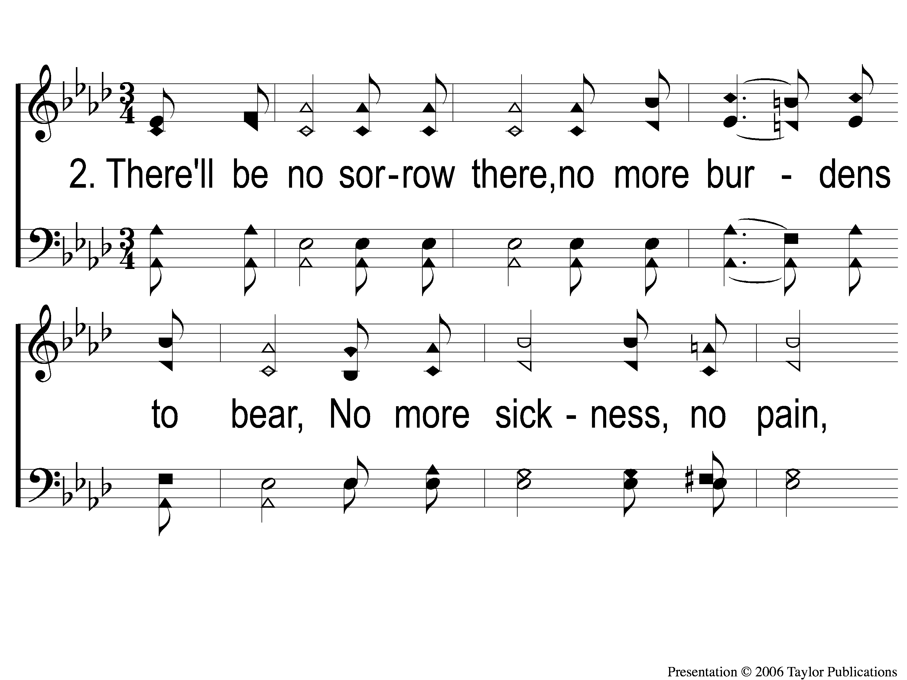
2-1 What a Day That Will Be
What a Day That Will Be
916

Slide 110
2-2 What a Day That Will Be
What a Day That Will Be
916

Slide 111
2-3 What a Day That Will Be
What a Day That Will Be
916

Slide 112
C-1 What a Day That Will Be
What a Day That Will Be
916

Slide 113
C-2 What a Day That Will Be
What a Day That Will Be
916

Slide 114
C-3 What a Day That Will Be
What a Day That Will Be
916

Slide 115
Reminders
Tonight:
LTC @ 4:30pm
Marriage Seminar @ 6:00pm

