Slide 1
1-1 Anywhere with Jesus
Anywhere With Jesus
414

Slide 2
1-2 Anywhere with Jesus
Anywhere With Jesus
414

Slide 3
C-1 Anywhere with Jesus
Anywhere With Jesus
414

Slide 4
4-1 Anywhere with Jesus
Anywhere With Jesus
414

Slide 5
4-2 Anywhere with Jesus
Anywhere With Jesus
414

Slide 6
C-1 Anywhere with Jesus
Anywhere With Jesus
414

Slide 7
RESTORE REBUILD RENEW
welcome
we are glad to
Have you with us
IN 2022
WHEELER
CHURCH
OF
CHRIST

Slide 8
Song:
On Bended Knee
#791

Slide 9
1-1 On Bended Knee
On Bended Knee
791

Slide 10
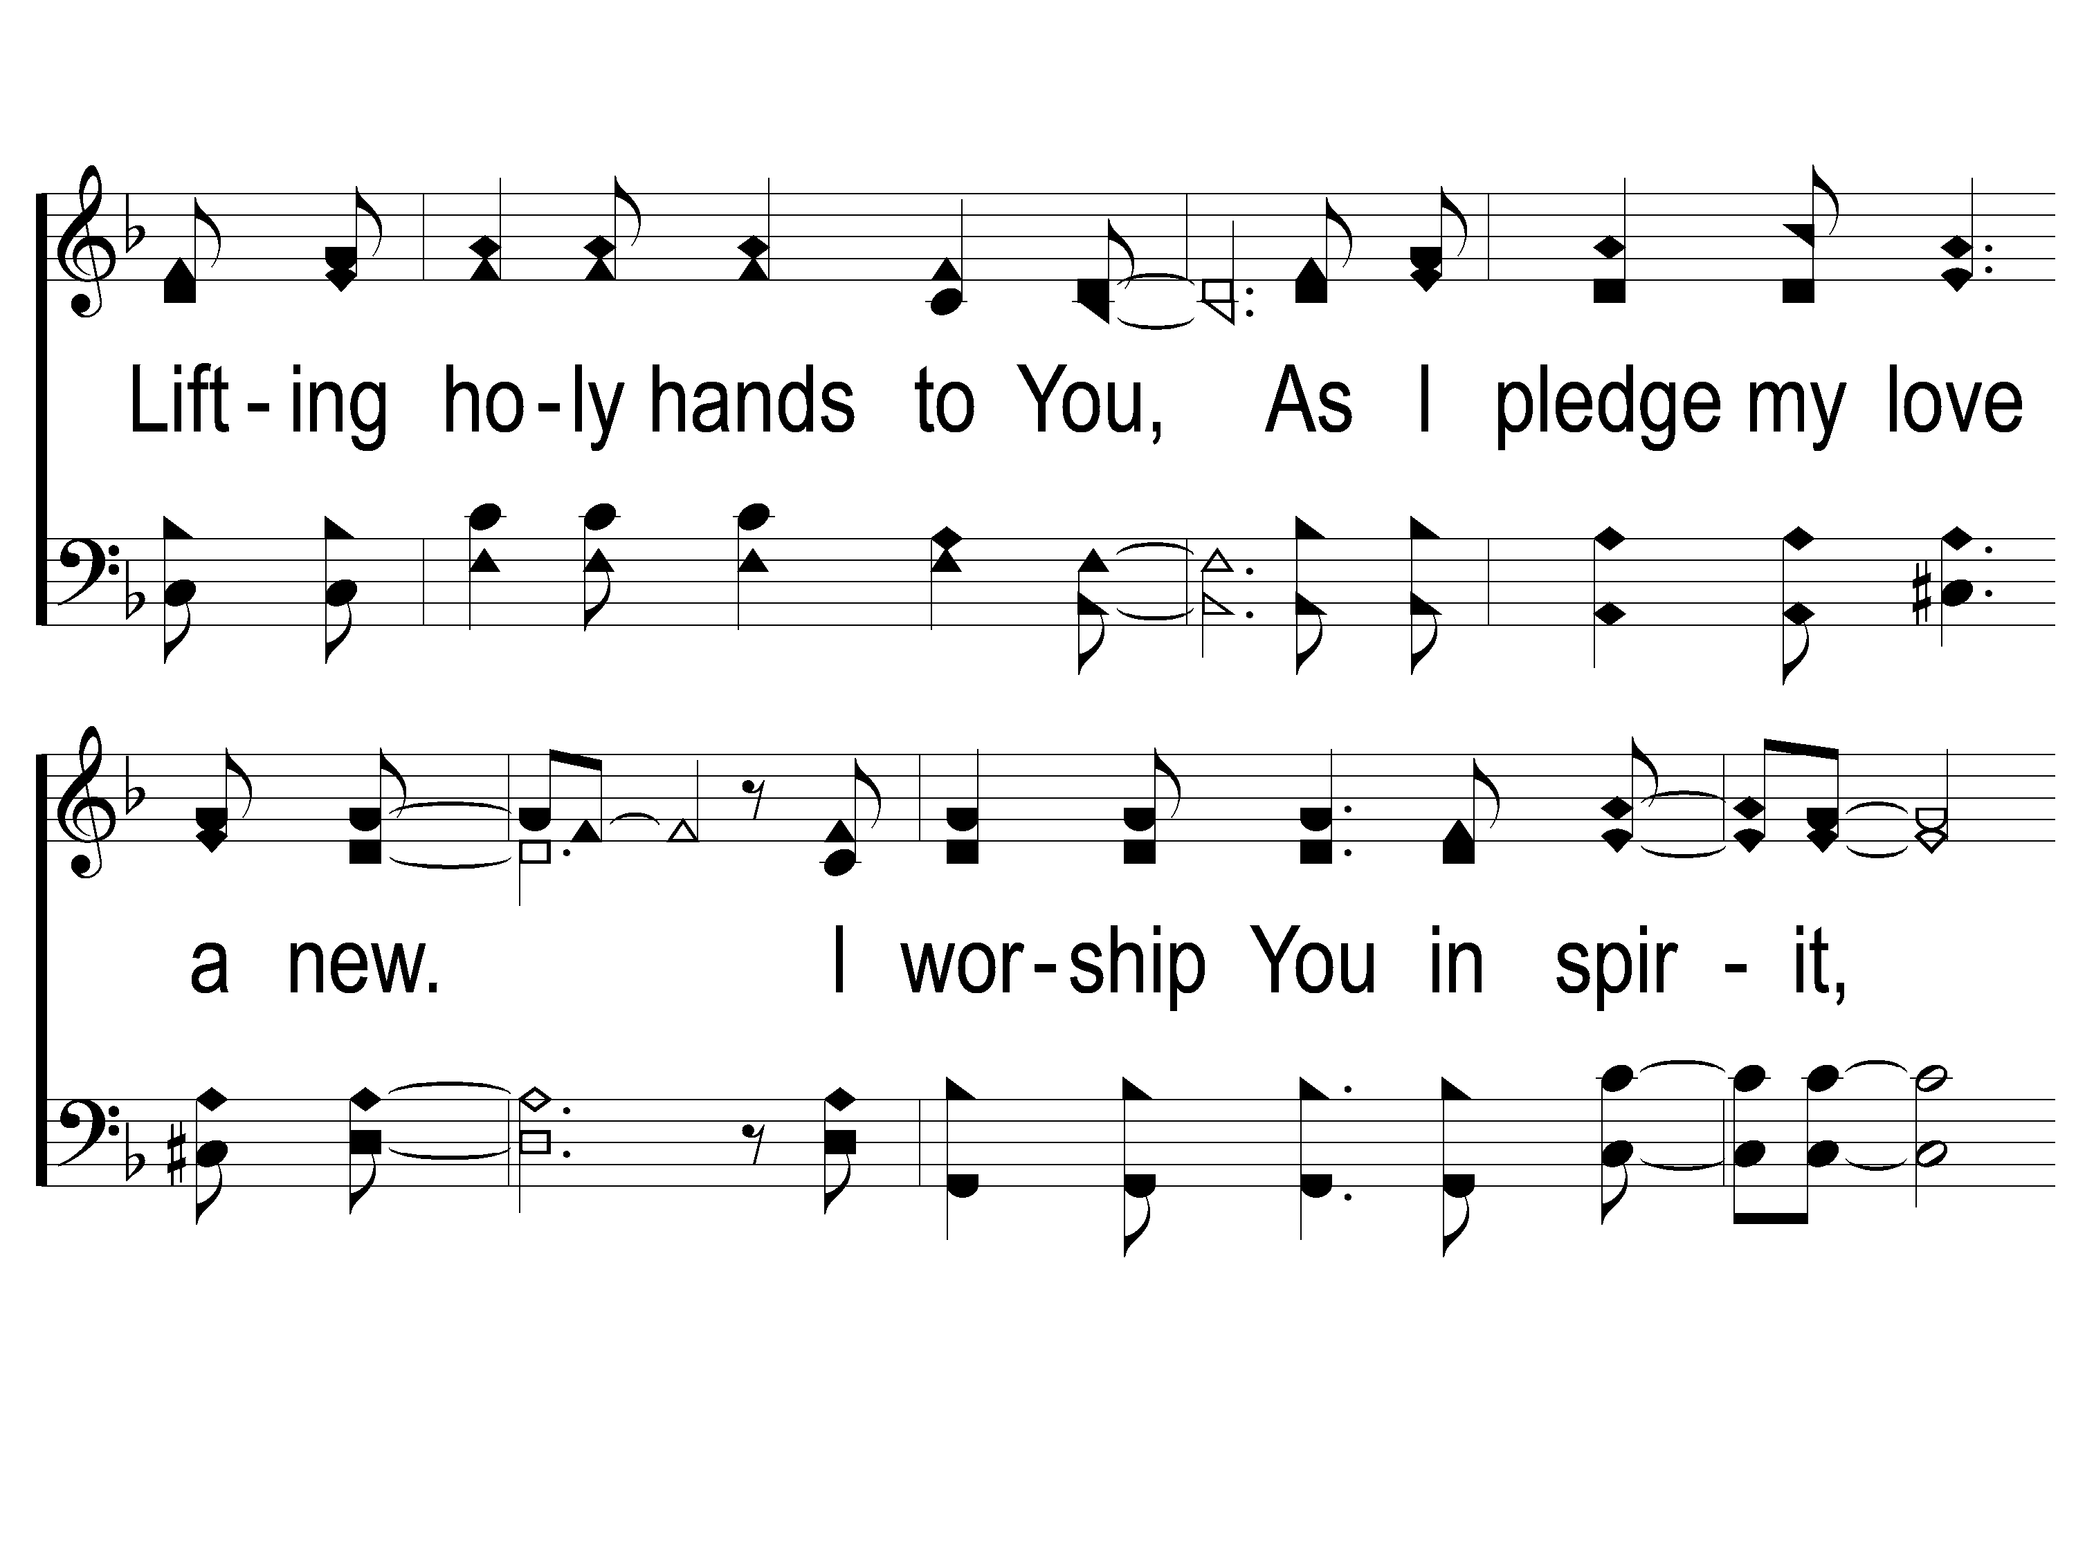
1-2 On Bended Knee
On Bended Knee
791

Slide 11
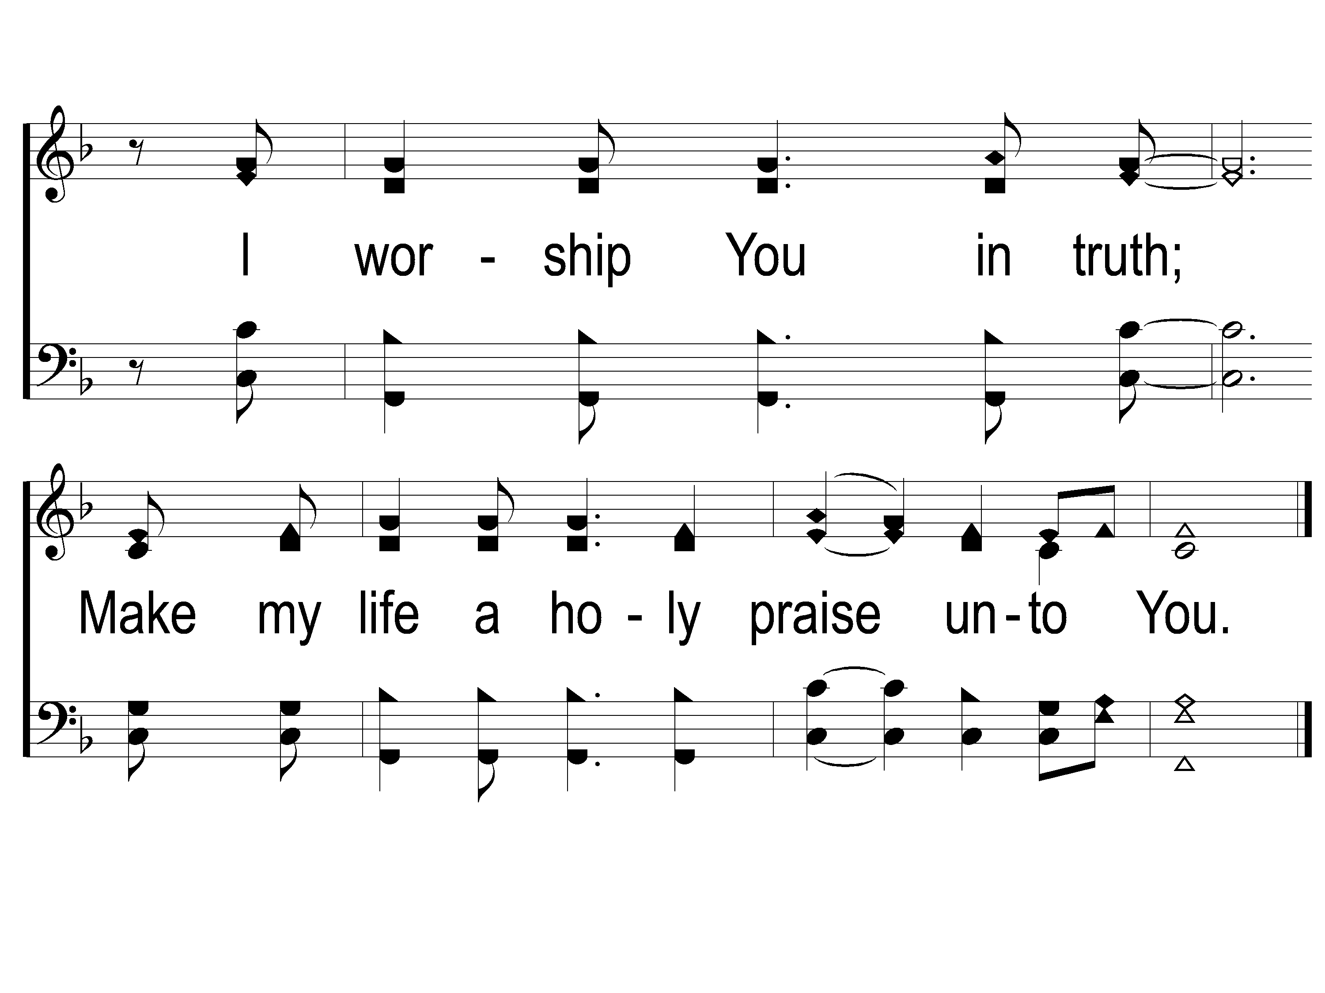
1-3 On Bended Knee
On Bended Knee
791

Slide 12
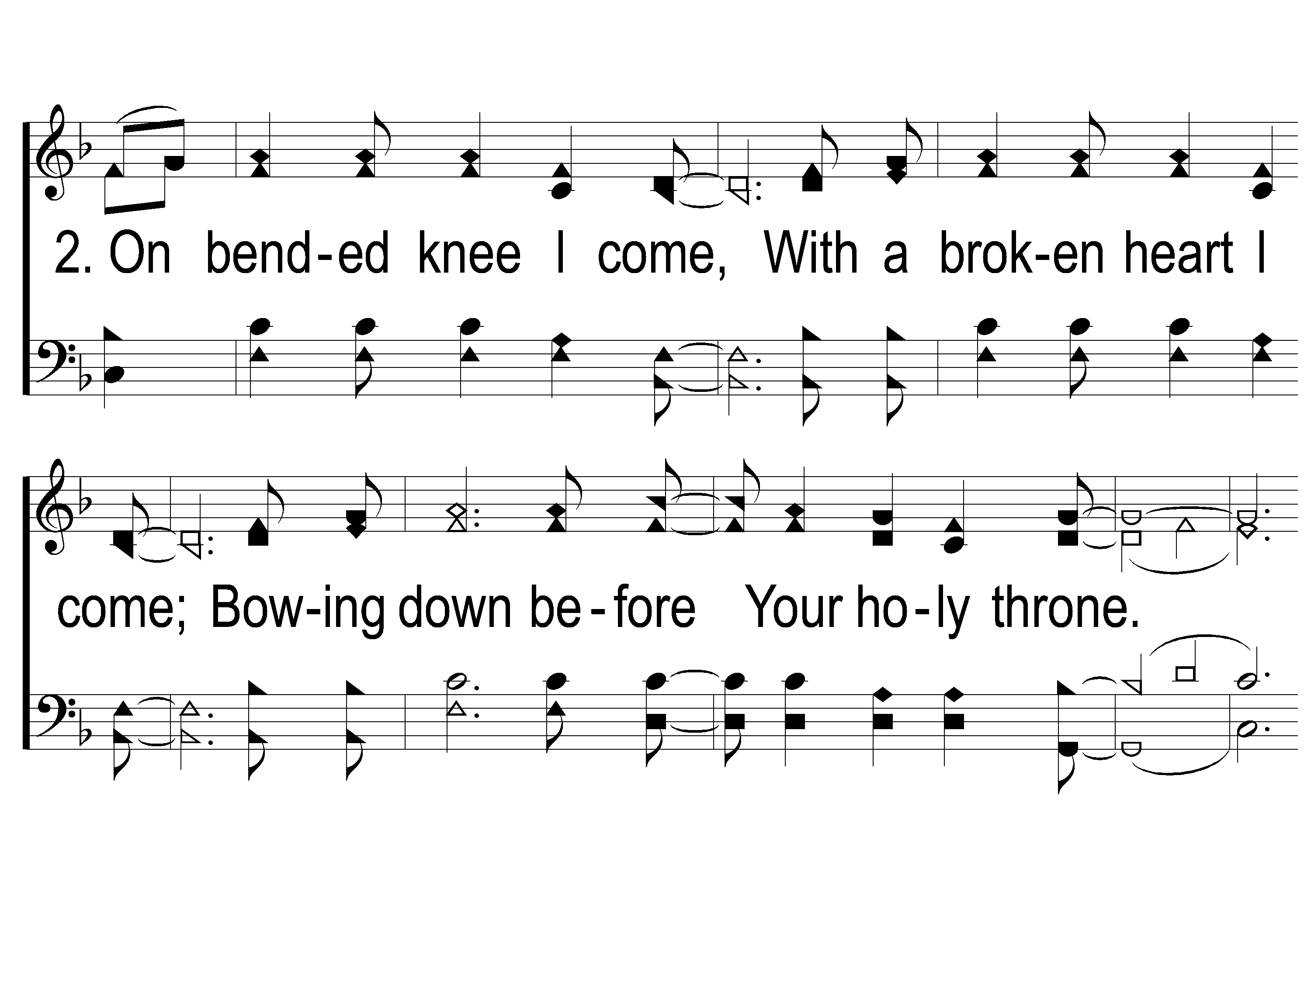
2-1 On Bended Knee
On Bended Knee
791

Slide 13
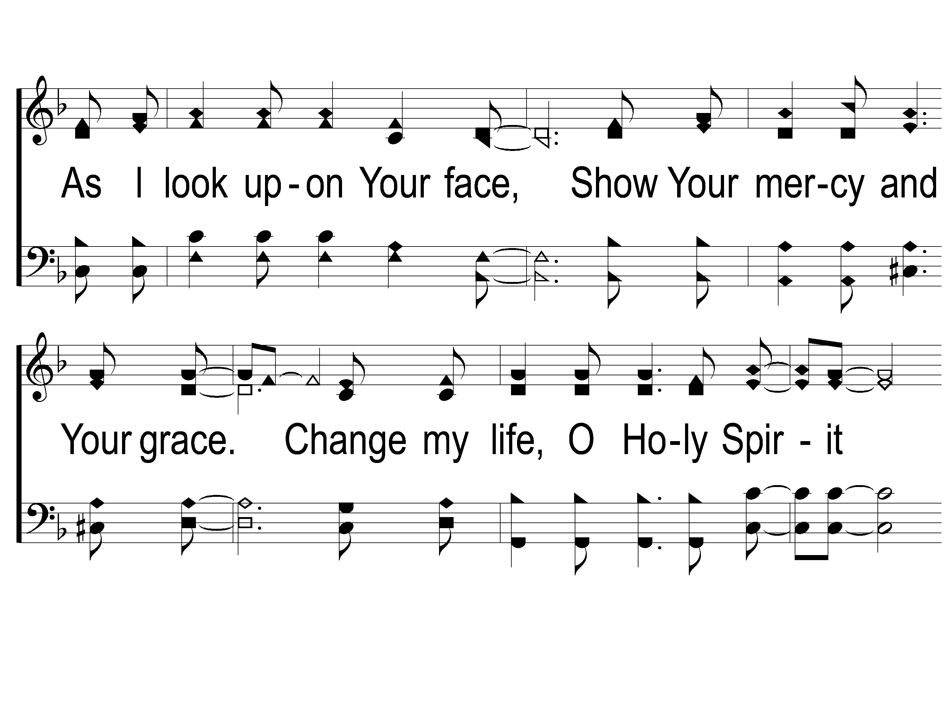
2-2 On Bended Knee
On Bended Knee
791

Slide 14
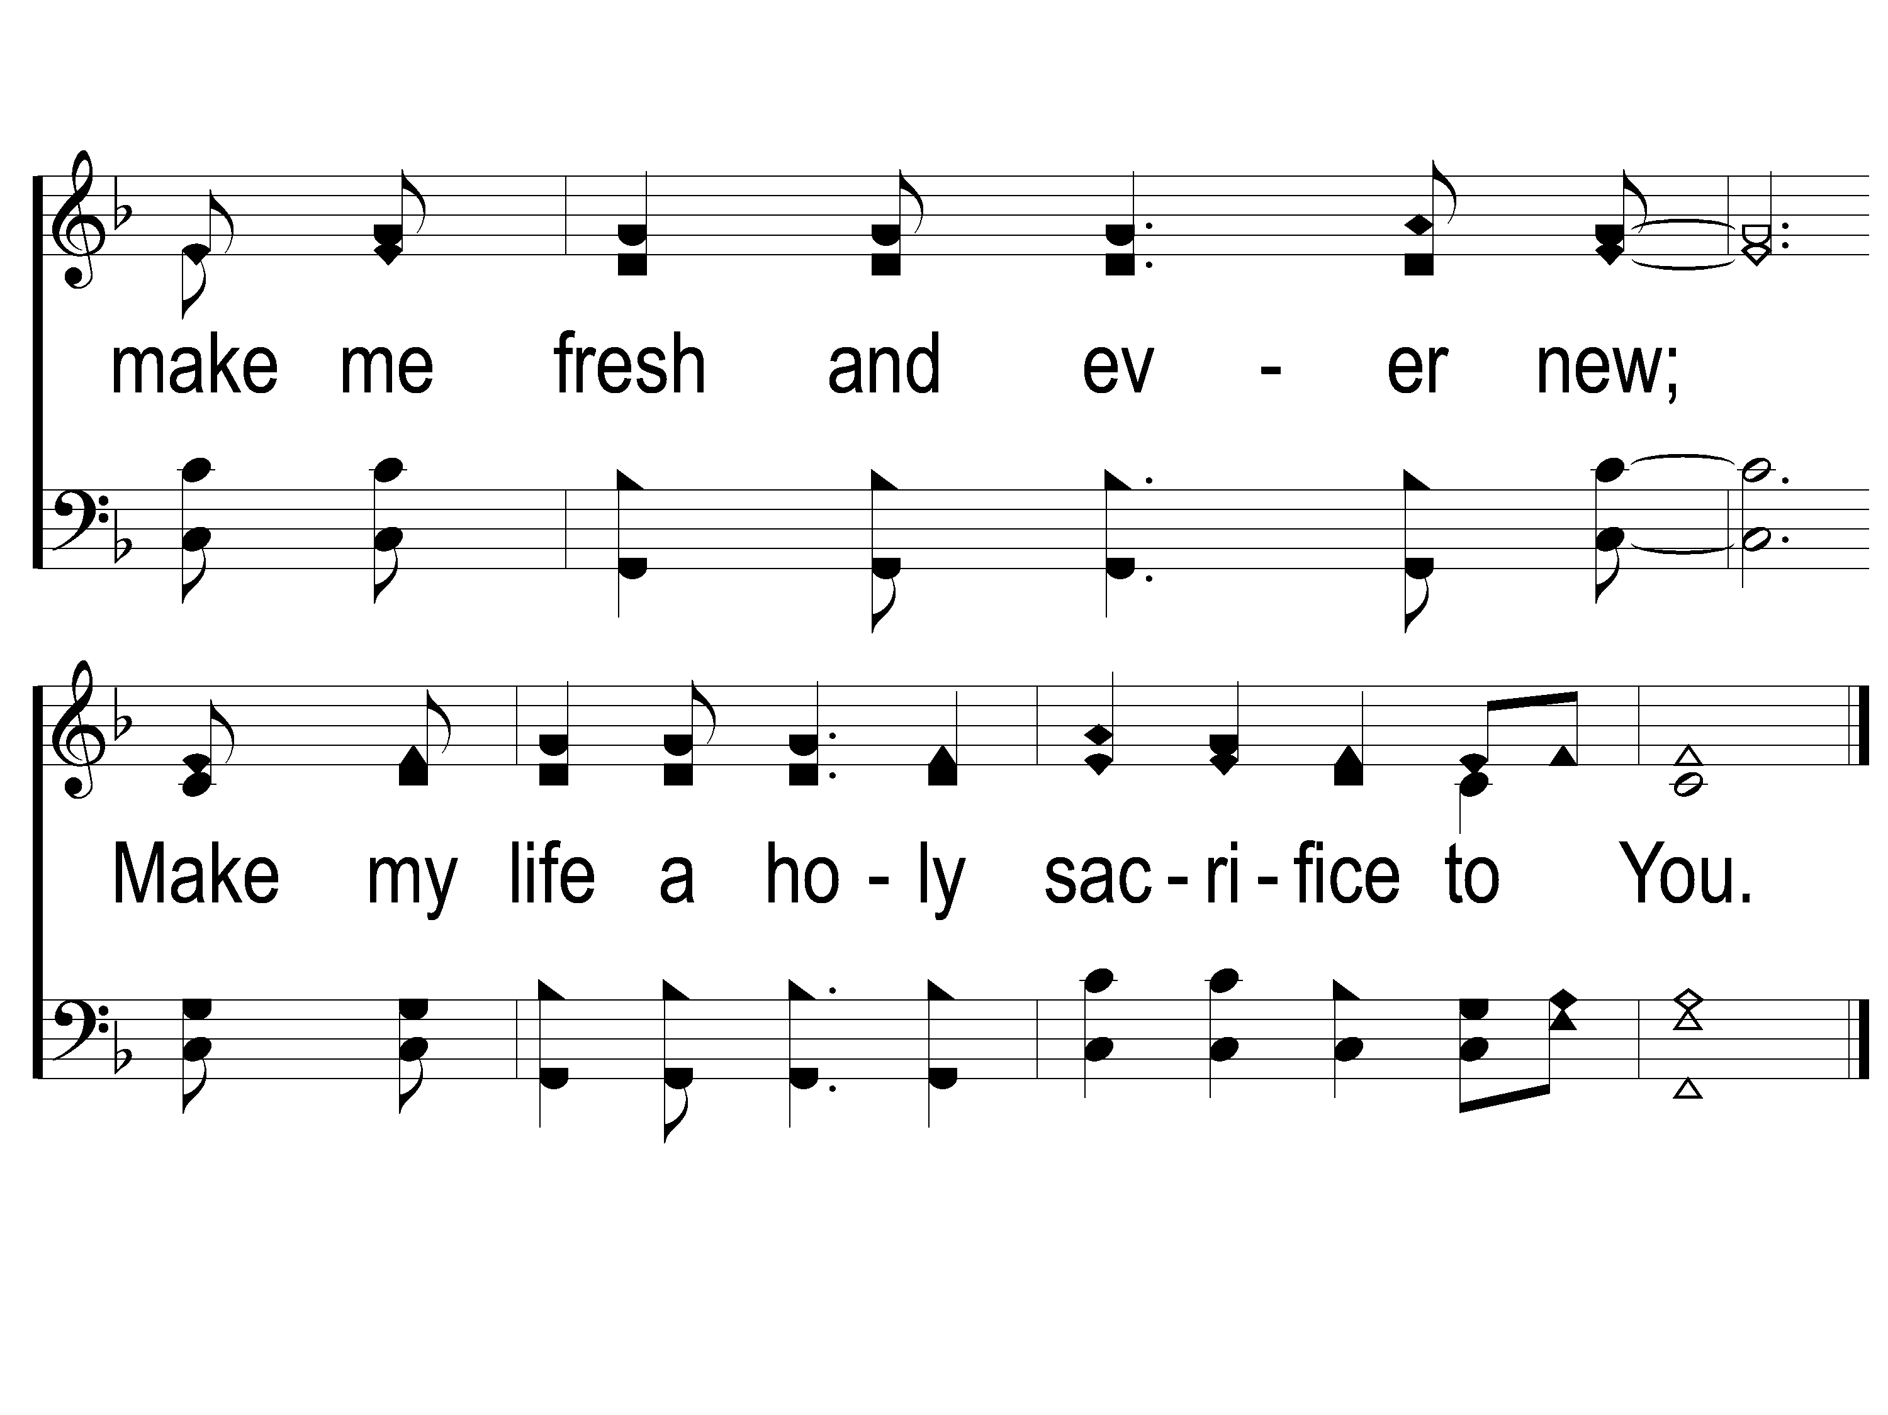
2-3 On Bended Knee
On Bended Knee
791

Slide 15
Song:
Count Your Blessings
#742

Slide 16
1-1 Count Your Blessings
Count Your Blessings
742

Slide 17
1-2 Count Your Blessings
Count Your Blessings
742

Slide 18
C-1 Count Your Blessings
Count Your Blessings
742

Slide 19
C-2 Count Your Blessings
Count Your Blessings
742

Slide 20
2-1 Count Your Blessings
Count Your Blessings
742

Slide 21
2-2 Count Your Blessings
Count Your Blessings
742

Slide 22
C-1 Count Your Blessings
Count Your Blessings
742

Slide 23
C-2 Count Your Blessings
Count Your Blessings
742

Slide 24
3-1 Count Your Blessings
Count Your Blessings
742

Slide 25
3-2 Count Your Blessings
Count Your Blessings
742

Slide 26
C-1 Count Your Blessings
Count Your Blessings
742

Slide 27
C-2 Count Your Blessings
Count Your Blessings
742

Slide 28
Opening Prayer

Slide 29
Song:
I Stand Amazed
#147

Slide 30
1-1 I Stand Amazed
I Stand Amazed
147

Slide 31
1-2 I Stand Amazed
I Stand Amazed
147

Slide 32
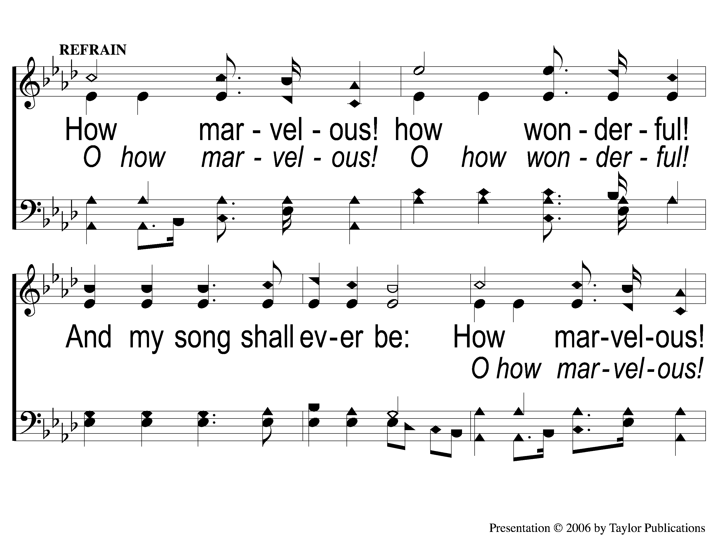
C-1 I Stand Amazed
I Stand Amazed
147

Slide 33
C-2 I Stand Amazed
I Stand Amazed
147

Slide 34
2-1 I Stand Amazed
I Stand Amazed
147

Slide 35
2-2 I Stand Amazed
I Stand Amazed
147

Slide 36
C-1 I Stand Amazed
I Stand Amazed
147

Slide 37
C-2 I Stand Amazed
I Stand Amazed
147

Slide 38
4-1 I Stand Amazed
I Stand Amazed
147

Slide 39
4-2 I Stand Amazed
I Stand Amazed
147

Slide 40
C-1 I Stand Amazed
I Stand Amazed
147

Slide 41
C-2 I Stand Amazed
I Stand Amazed
147

Slide 42
Song:
I Know Whom I Believed
#524

Slide 43
1-1 I Know Whom I have Believed
I Know Whom I Believed
524

Slide 44
1-2 I Know Whom I have Believed
I Know Whom I Believed
524

Slide 45
C-1 I Know Whom I have Believed
I Know Whom I Believed
524

Slide 46
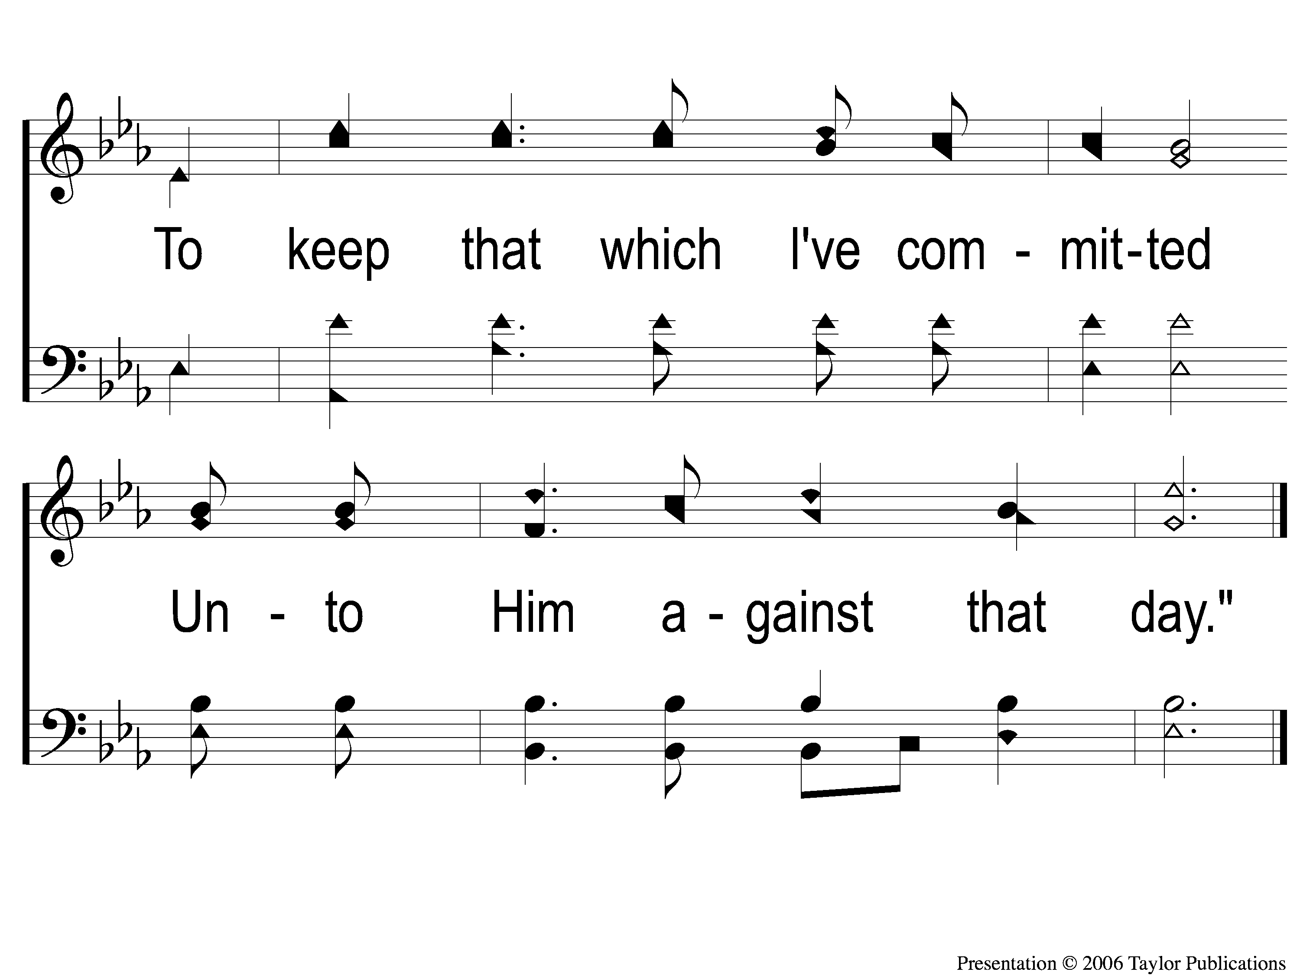
C-2 I Know Whom I have Believed
I Know Whom I Believed
524

Slide 47
2-1 I Know Whom I have Believed
I Know Whom I Believed
524

Slide 48
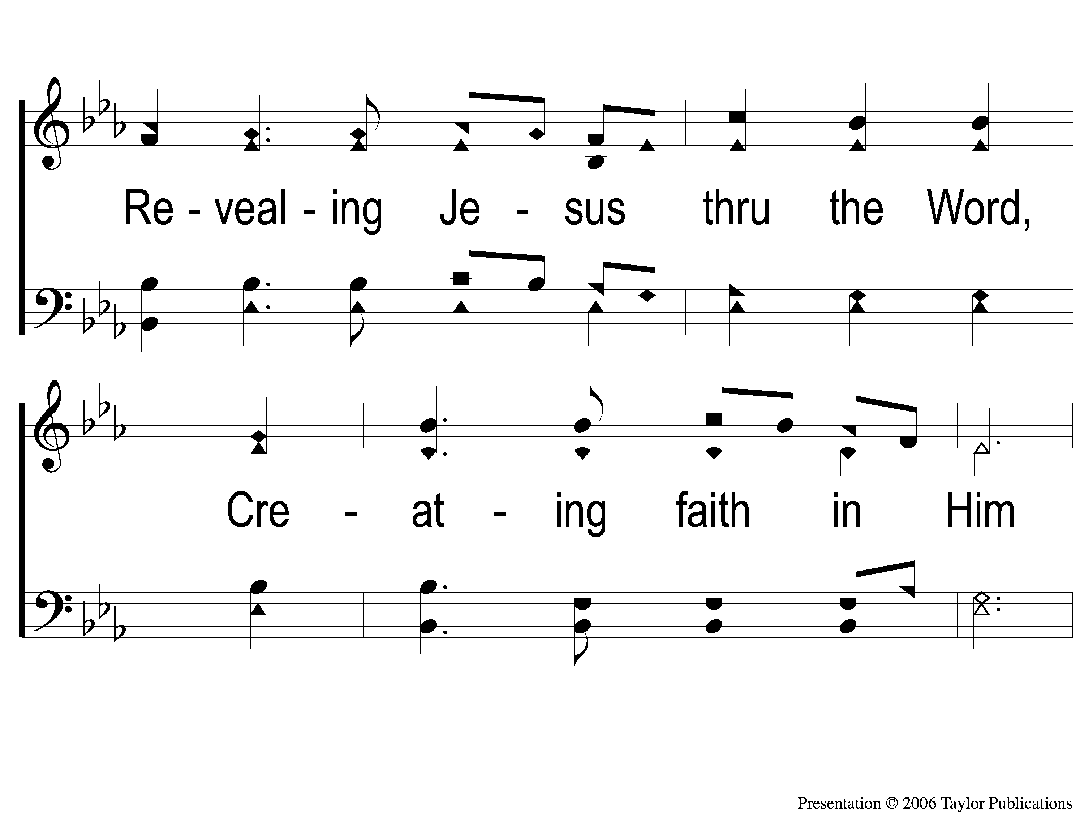
2-2 I Know Whom I have Believed
I Know Whom I Believed
524

Slide 49
C-1 I Know Whom I have Believed
I Know Whom I Believed
524

Slide 50
C-2 I Know Whom I have Believed
I Know Whom I Believed
524

Slide 51
4-1 I Know Whom I have Believed
I Know Whom I Believed
524

Slide 52
4-2 I Know Whom I have Believed
I Know Whom I Believed
524

Slide 53
C-1 I Know Whom I have Believed
I Know Whom I Believed
524

Slide 54
C-2 I Know Whom I have Believed
I Know Whom I Believed
524

Slide 55
Scripture Reading:
2 Timothy 2:14-19

Slide 58
BIBLE

Slide 59
BIBLE

Slide 60
Renew my
LOVE
for God’s Word

Slide 61
COMMON REASONS MANY DO NOT STUDY THE BIBLE

Slide 62
COMMON REASONS MANY DO NOT STUDY THE BIBLE
It Is TIME-CONSUMING

Slide 63
COMMON REASONS MANY DO NOT STUDY THE BIBLE
It Is TIME-CONSUMING
It Is BORING

Slide 64
COMMON REASONS MANY DO NOT STUDY THE BIBLE
It Is TIME-CONSUMING
It Is BORING
It Is CONDEMNING

Slide 65
COMMON REASONS MANY DO NOT STUDY THE BIBLE
It Is TIME-CONSUMING
It Is BORING
It Is CONDEMNING
It Is HARD TO UNDERSTAND

Slide 66
COMMON REASONS MANY DO NOT STUDY THE BIBLE
It Is TIME-CONSUMING
It Is BORING
It Is CONDEMNING
It Is HARD TO UNDERSTAND
It Is INTIMIDATING

Slide 67
REASONS TO STUDY THE BIBLE:
2 Timothy 3:16-17

Slide 68
REASONS TO STUDY THE BIBLE:
It Was Profitable For JESUS

Slide 69
REASONS TO STUDY THE BIBLE:
It Was Profitable For JESUS
Lk. 2:42 – in His Childhood
Lk. 4:16 – in His Ministry

Slide 70
REASONS TO STUDY THE BIBLE:
It Was Profitable For JESUS
It Is Profitable For YOUR CAREER

Slide 71
REASONS TO STUDY THE BIBLE:
It Is Profitable For YOUR CAREER
2 Pet. 1:3
Eccl. 1:9
Lev. 19:13, 25:14
Prov. 10:4, 11:25, 13:11

Slide 72
REASONS TO STUDY THE BIBLE:
It Is Profitable For YOUR CAREER
Eph. 6:5-9
Col. 3:22-4:1
1 Tim. 6:1-2
Titus 2:9
1 Pet. 2:18

Slide 73
REASONS TO STUDY THE BIBLE:
It Was Profitable For JESUS
It Is Profitable For YOUR CAREER
It Is Profitable For YOUR FAMILY

Slide 74
REASONS TO STUDY THE BIBLE:
It Is Profitable For YOUR FAMILY

Slide 75
REASONS TO STUDY THE BIBLE:
It Is Profitable For YOUR FAMILY
Spousal Relationship
Eph. 5:22-33, Col. 3:18-19, 1 Pet. 3:1-7

Slide 76
REASONS TO STUDY THE BIBLE:
It Is Profitable For YOUR FAMILY
Spousal Relationship
Eph. 5:22-33, Col. 3:18-19, 1 Pet. 3:1-7
Parent-Child Relationship
Eph. 6:1-4, Col. 3:20
Prov. 13:24, 19:18

Slide 77
REASONS TO STUDY THE BIBLE:
It Was Profitable For JESUS
It Is Profitable For YOUR CAREER
It Is Profitable For YOUR FAMILY
It Is Profitable For YOUR SOUL

Slide 78
REASONS TO STUDY THE BIBLE:
It Is Profitable For YOUR SOUL
2 Pet. 1:3
2 Tim. 3:16-17
Psalm 119
Phili. 4:8

Slide 79
THE CHALLENGE

Slide 80
THE CHALLENGE
Read your Bible for 10 minutes more every day
Pray 5 times more every day
Meet with the Church for an extra time

Slide 81
Sing To Me Of Heaven
#716
Invitation
Song:

Slide 82
1-1 Sing to Me of Heaven
Sing To Me of Heaven
716

Slide 83
1-2 Sing to Me of Heaven
Sing To Me of Heaven
716

Slide 84
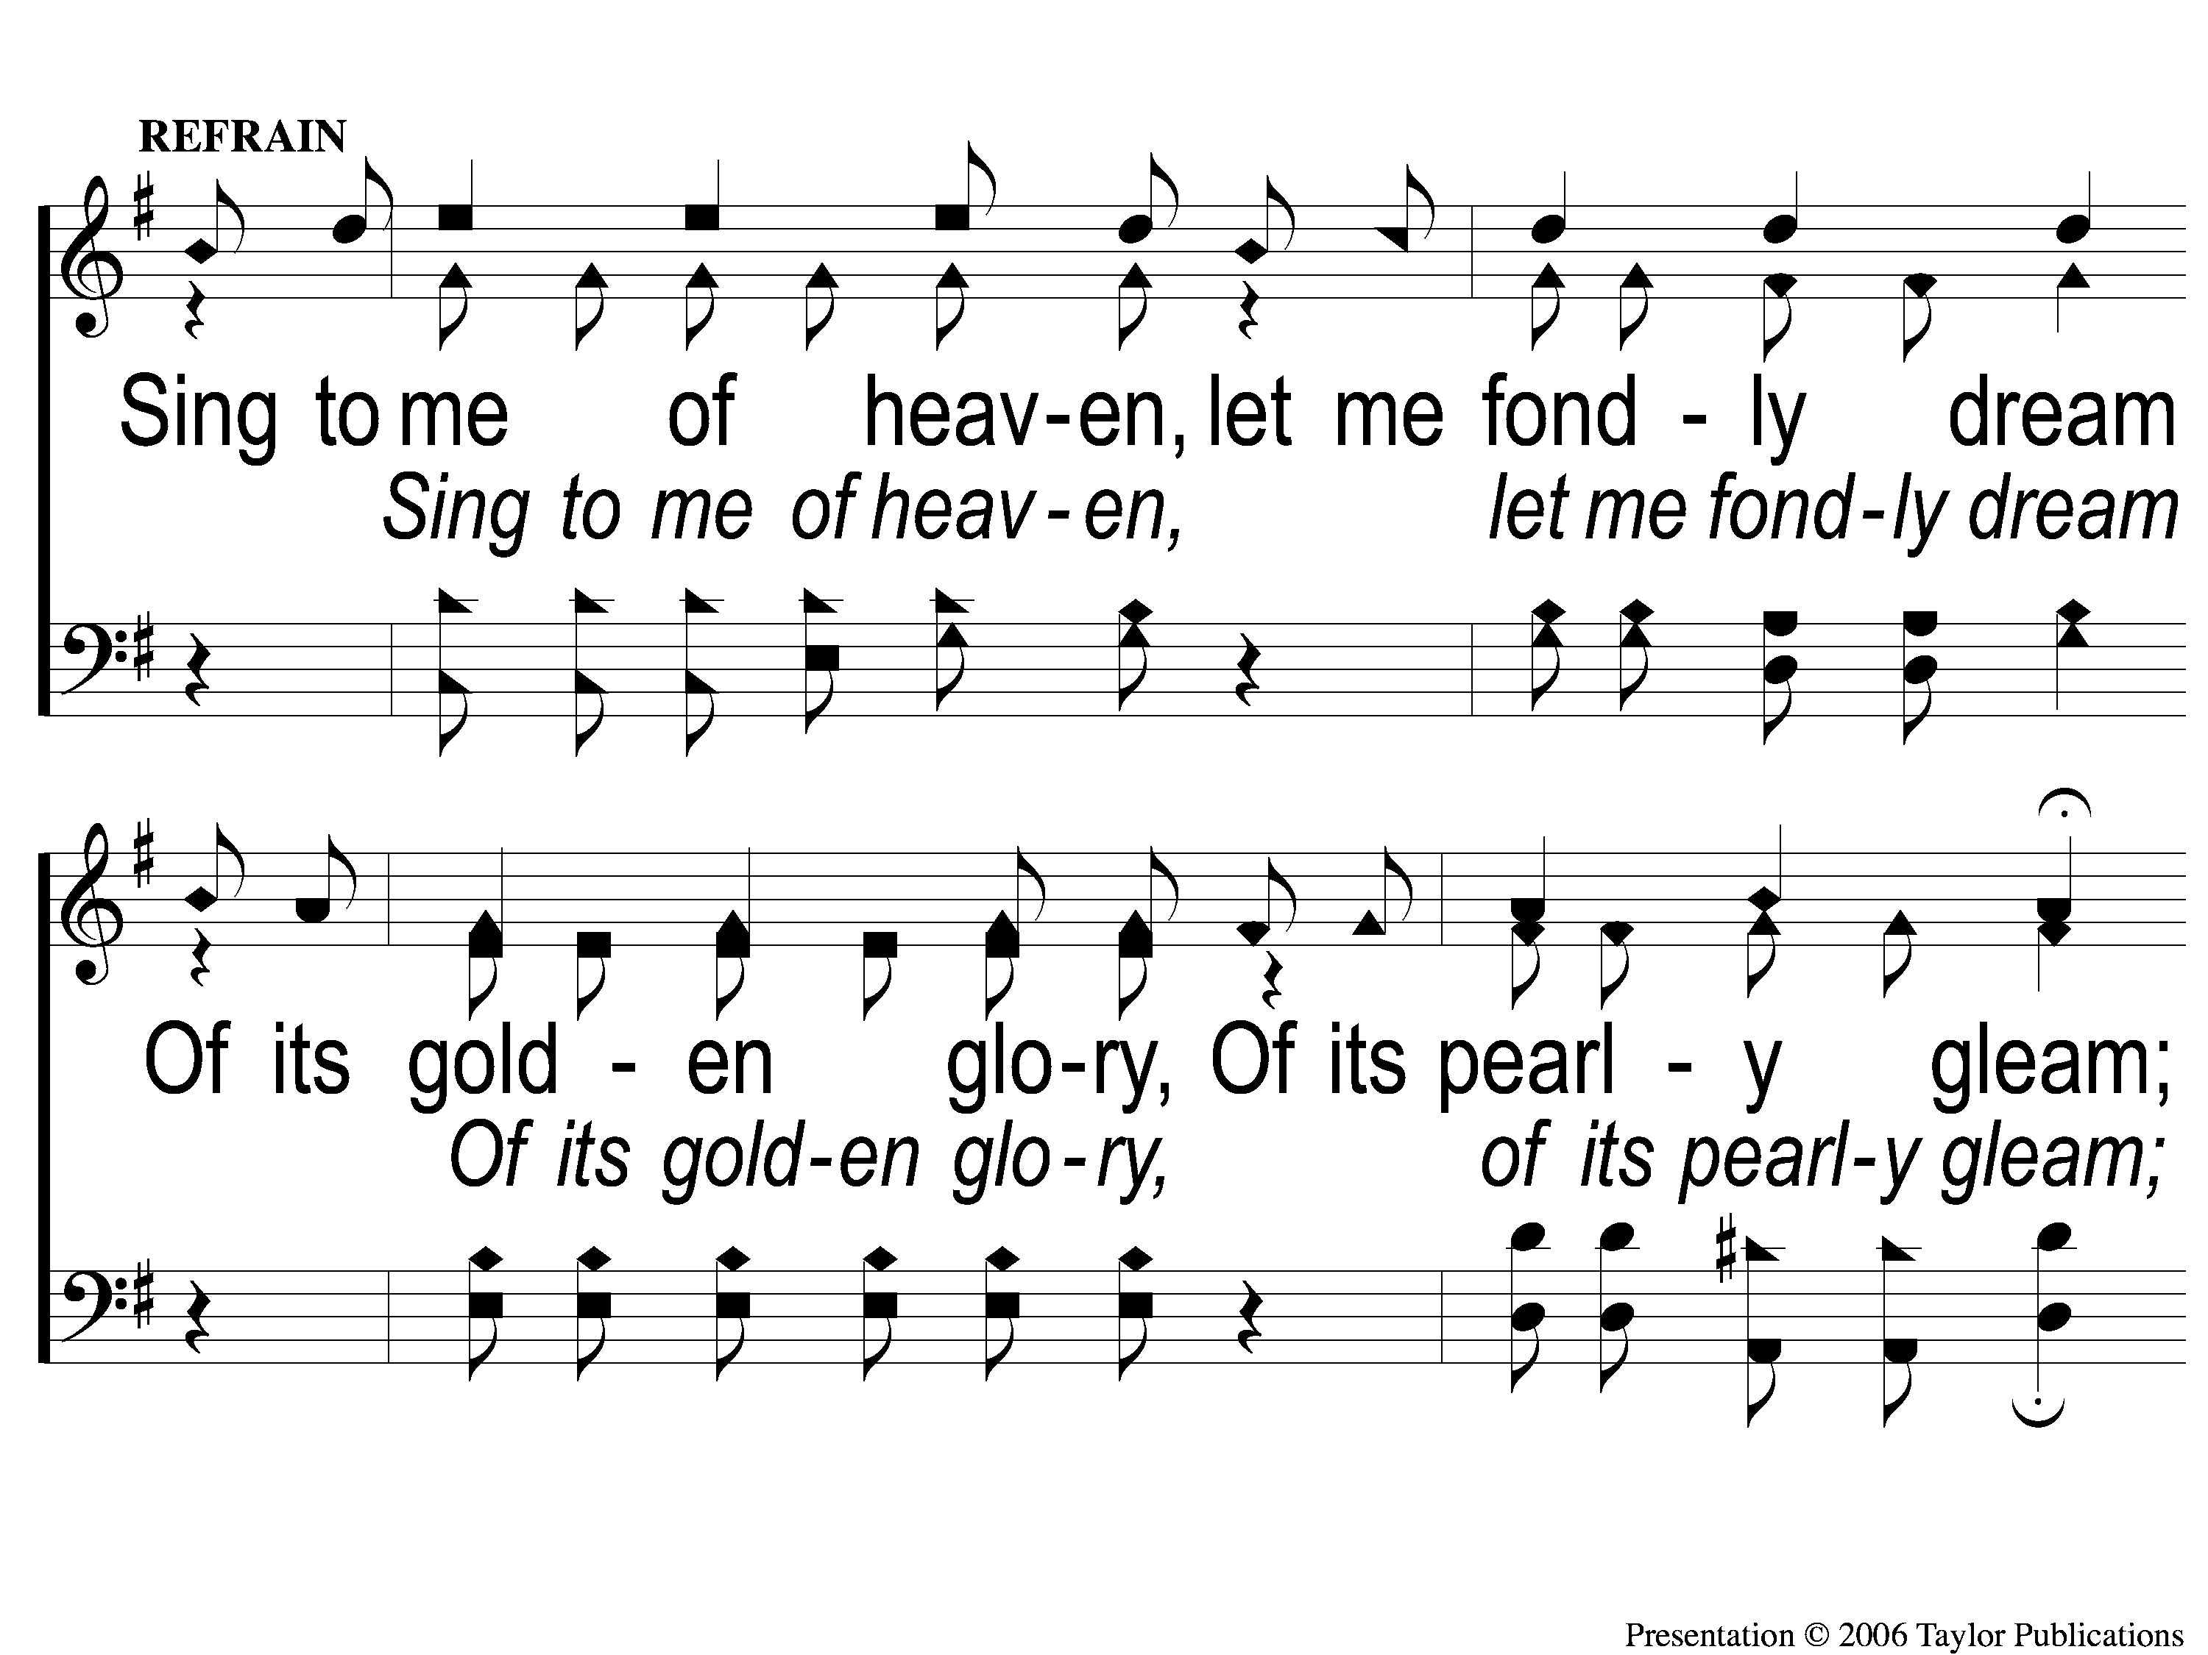
C-1 Sing to Me of Heaven
Sing To Me of Heaven
716

Slide 85
C-2 Sing to Me of Heaven
Sing To Me of Heaven
716

Slide 86
3-1 Sing to Me of Heaven
Sing To Me of Heaven
716

Slide 87
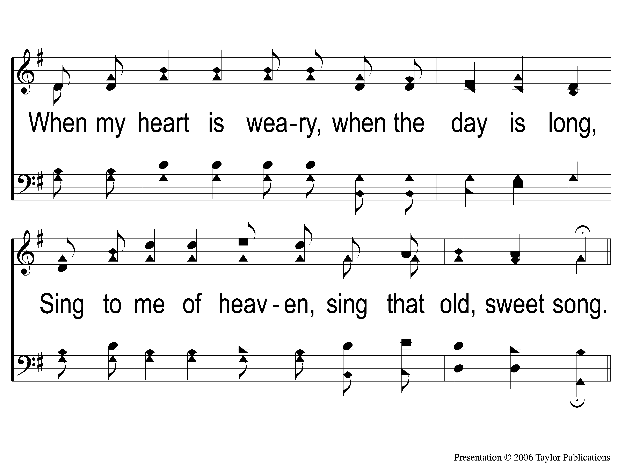
3-2 Sing to Me of Heaven
Sing To Me of Heaven
716

Slide 88
C-1 Sing to Me of Heaven
Sing To Me of Heaven
716

Slide 89
C-2 Sing to Me of Heaven
Sing To Me of Heaven
716

Slide 90
The Contribution:
Mark 10:21
Then Jesus, looking at him, loved him, and said to him, ‘One thing you lack: Go your way, sell whatever you have and give to the poor, and you will have treasure in heaven; and come, take up the cross, and follow Me.’ ”

Slide 91
Song:
He Paid A Debt
#376

Slide 92
1-1 He Paid a Debt
He Paid A Debt
376

Slide 93
1-2 He Paid a Debt
He Paid A Debt
376

Slide 94
c He Paid a Debt
He Paid A Debt
376

Slide 95
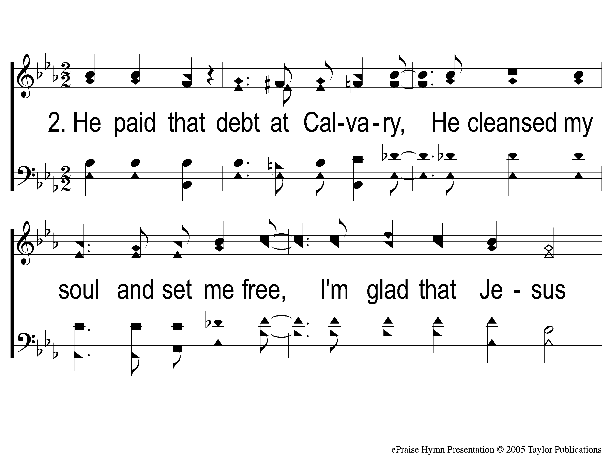
2-1 He Paid a Debt
He Paid A Debt
376

Slide 96
2-2 He Paid a Debt
He Paid A Debt
376

Slide 97
c He Paid a Debt
He Paid A Debt
376

Slide 98
3-1 He Paid a Debt
He Paid A Debt
376

Slide 99
3-2 He Paid a Debt
He Paid A Debt
376

Slide 100
c He Paid a Debt
He Paid A Debt
376

Slide 101
The Unleavened Bread
Mark 14:22
“And as they were eating, Jesus took bread, blessed and broke it, and gave it to them and said, ‘Take, eat; this is My body.’ ”

Slide 102
The Fruit
of the Vine
Mark 14:23-25
Then He took the cup, and when He had given thanks He gave it to them, and they all drank from it. And He said to them, ‘This is My blood of the new covenant, which is shed for many. Assuredly, I say to you, I will no longer drink of the fruit of the vine until that day when I drink it new in the kingdom of God.’ ”

Slide 103
Closing Prayer

Slide 104
Song:
Unto Thee, O Lord
#794

Slide 105
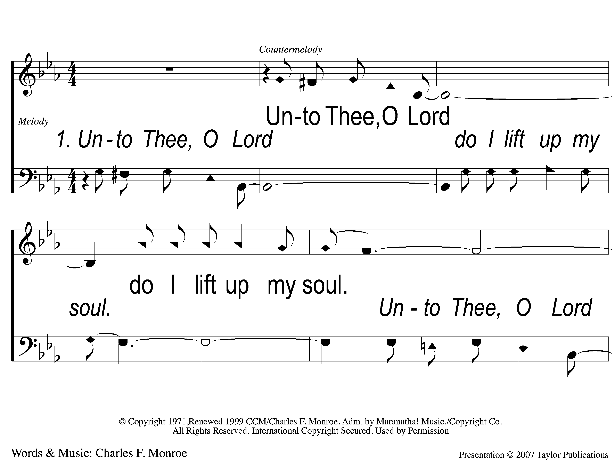
1-1 Unto Thee O Lord
Unto to Thee O Lord
794

Slide 106
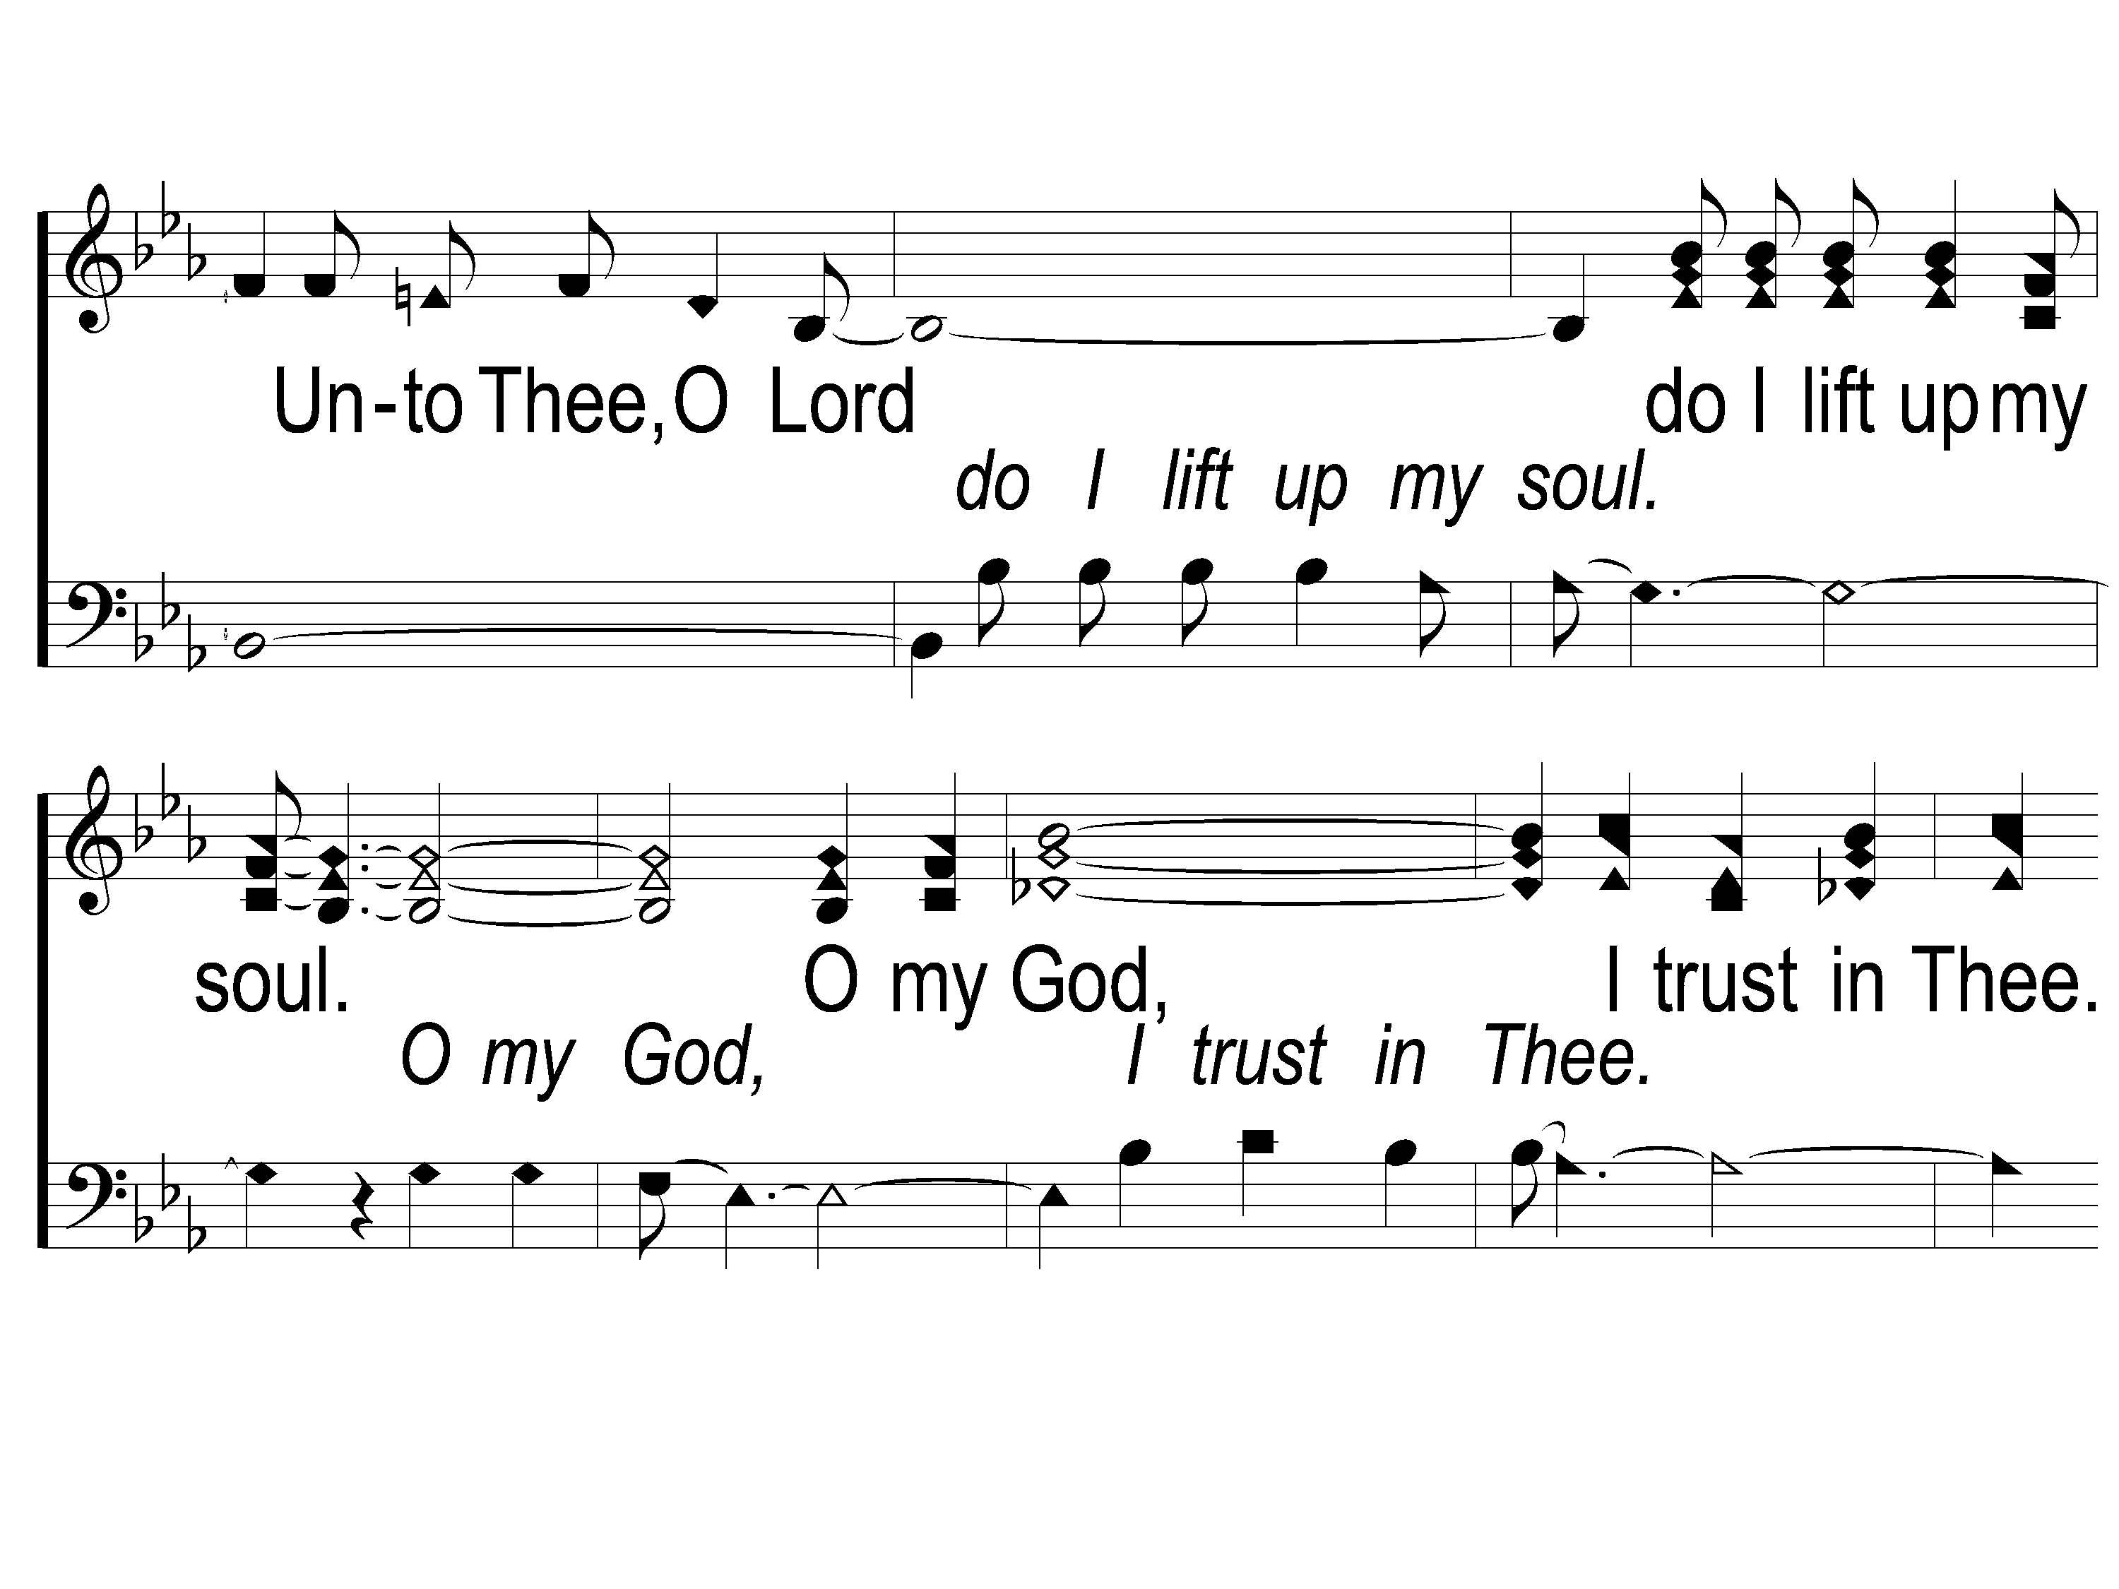
1-2 Unto Thee O Lord
Unto to Thee O Lord
794

Slide 107
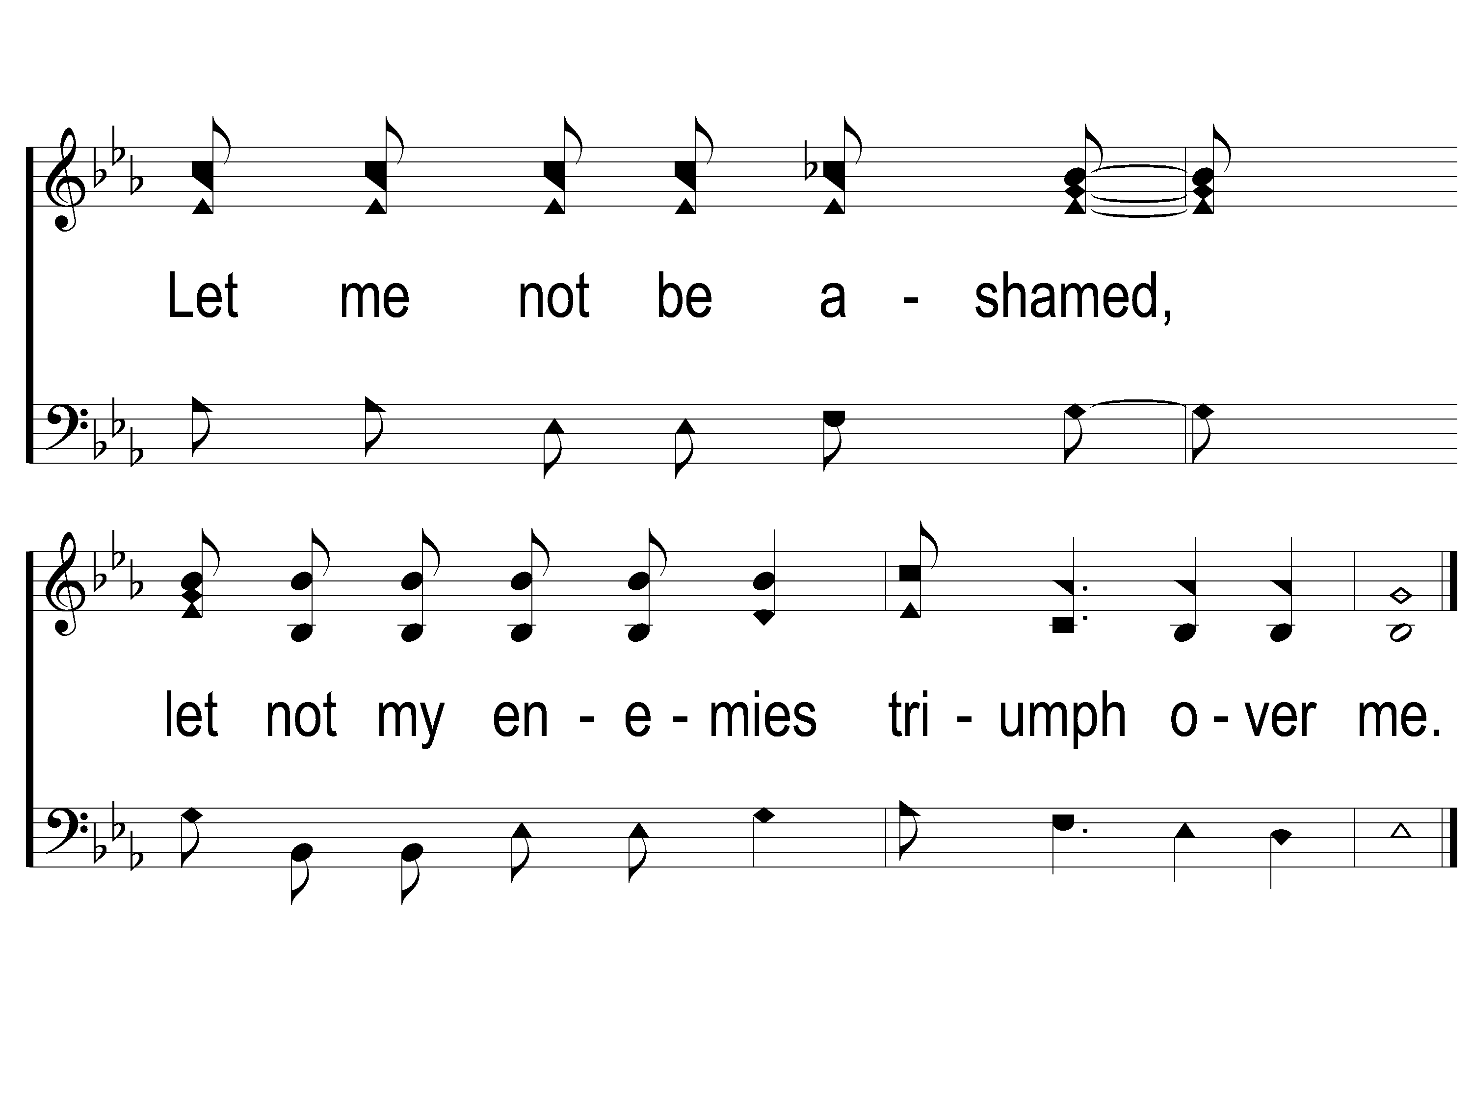
1-3 Unto Thee O Lord
Unto to Thee O Lord
794

Slide 108
2-1 Unto Thee O Lord
Unto to Thee O Lord
794

Slide 109
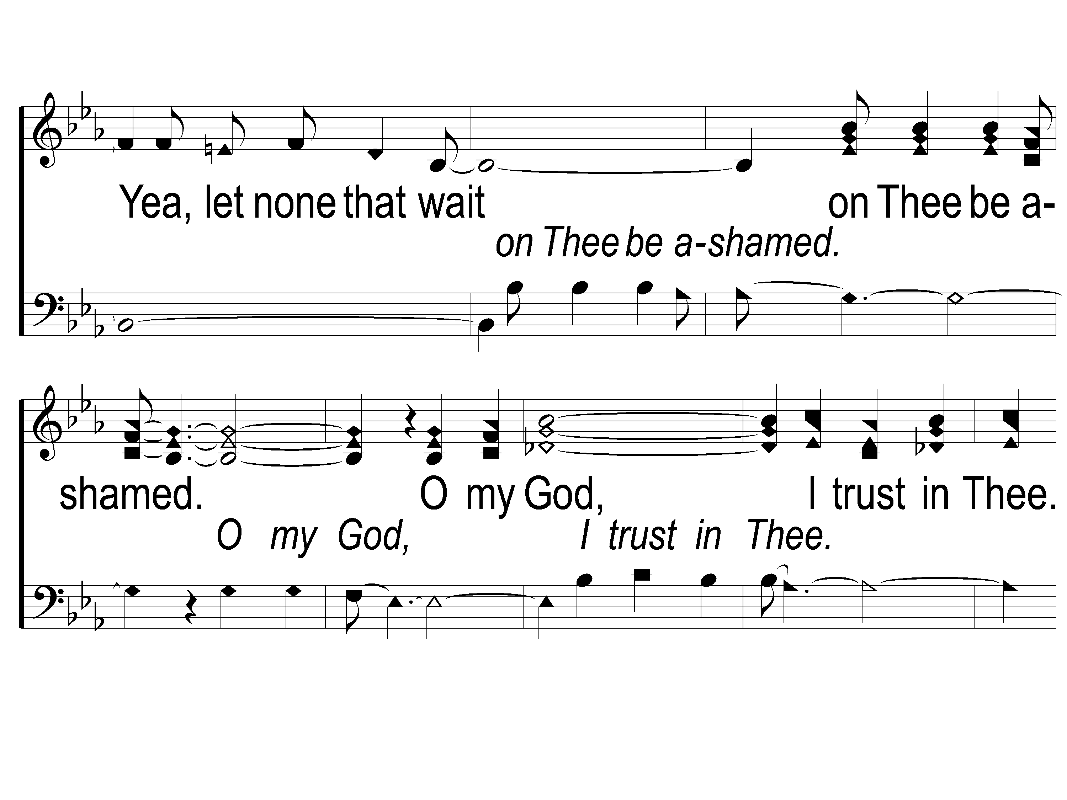
2-2 Unto Thee O Lord
Unto to Thee O Lord
794

Slide 110
2-3 Unto Thee O Lord
Unto to Thee O Lord
794

Slide 111
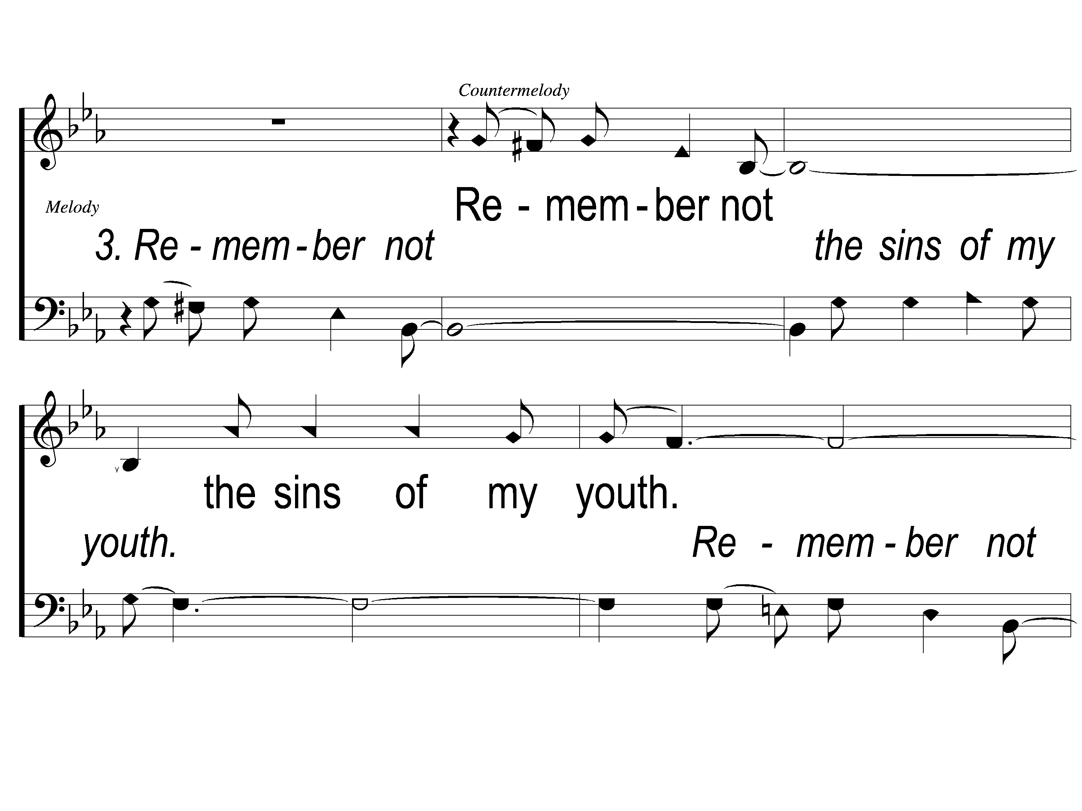
3-1 Unto Thee O Lord
Unto to Thee O Lord
794

Slide 112
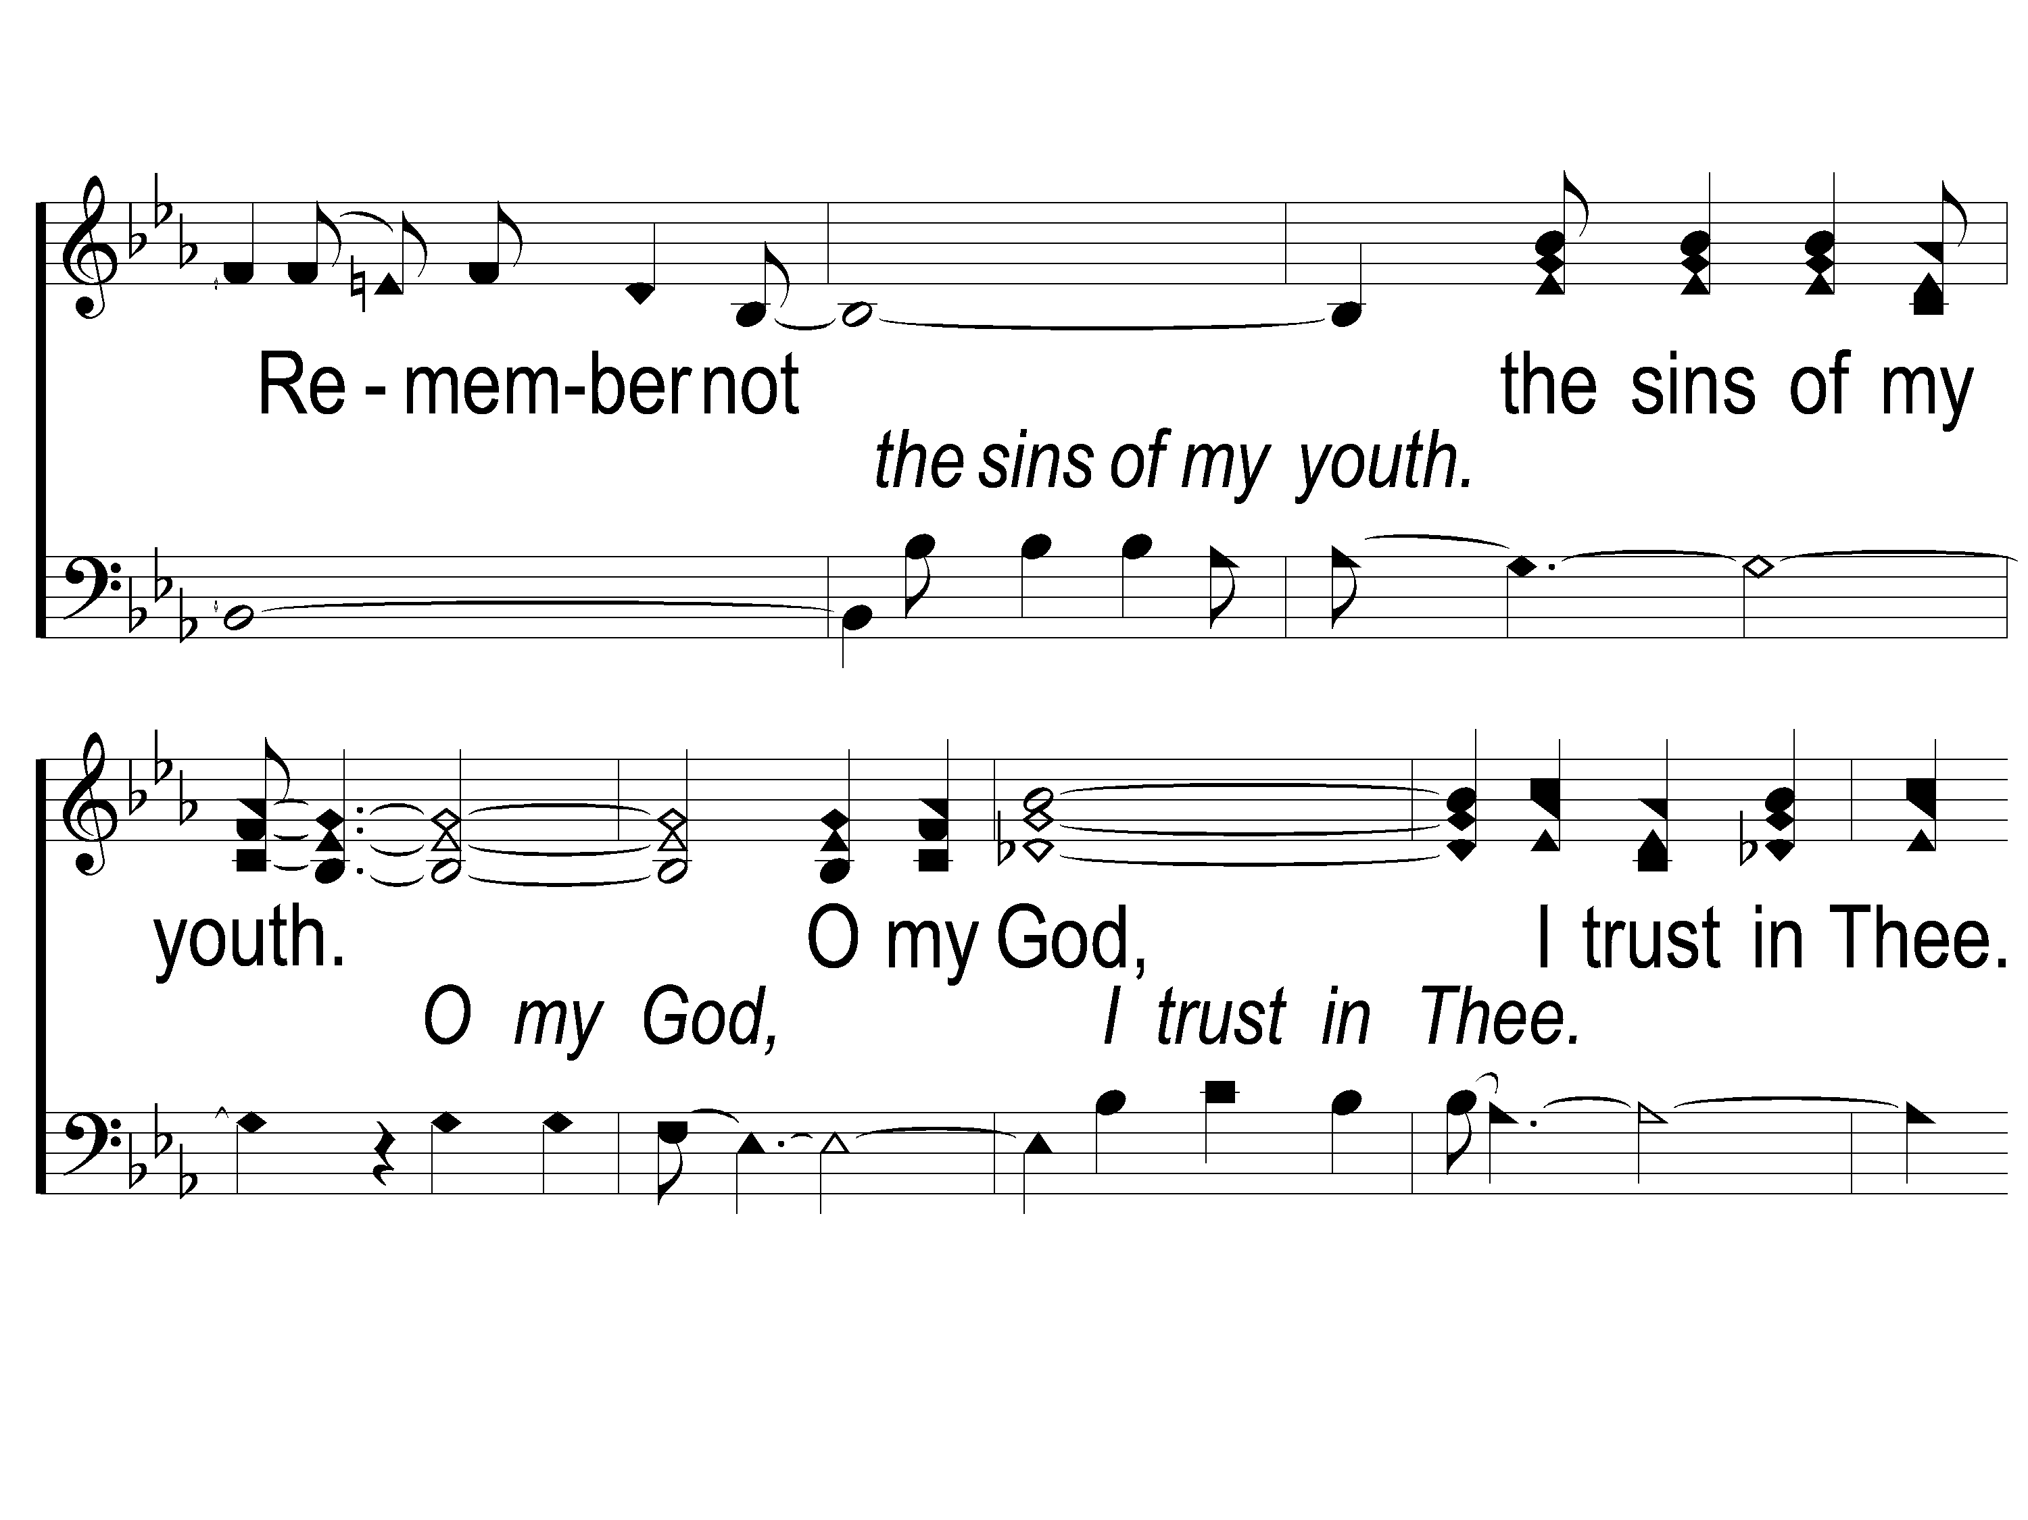
3-2 Unto Thee O Lord
Unto to Thee O Lord
794

Slide 113
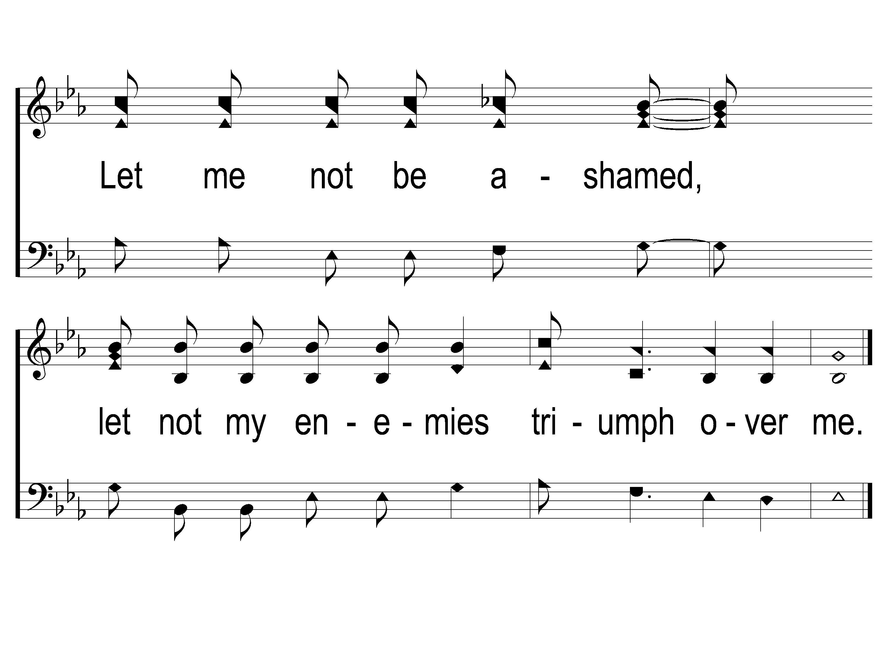
3-3 Unto Thee O Lord
Unto to Thee O Lord
794

Slide 114
RESTORE REBUILD RENEW
tonight
Worship @ 6:00 PM
Wednesday
Worship & Classes & 6:30 PM
IN 2022
WHEELER
CHURCH
OF
CHRIST

Slide 115
Today
Join us in the MPB for
A Fellowship Meal & Devo
Wednesday
Worship & Classes & 6:30 PM
RESTORE REBUILD RENEW
IN 2022
WHEELER
CHURCH
OF
CHRIST

