Slide 1
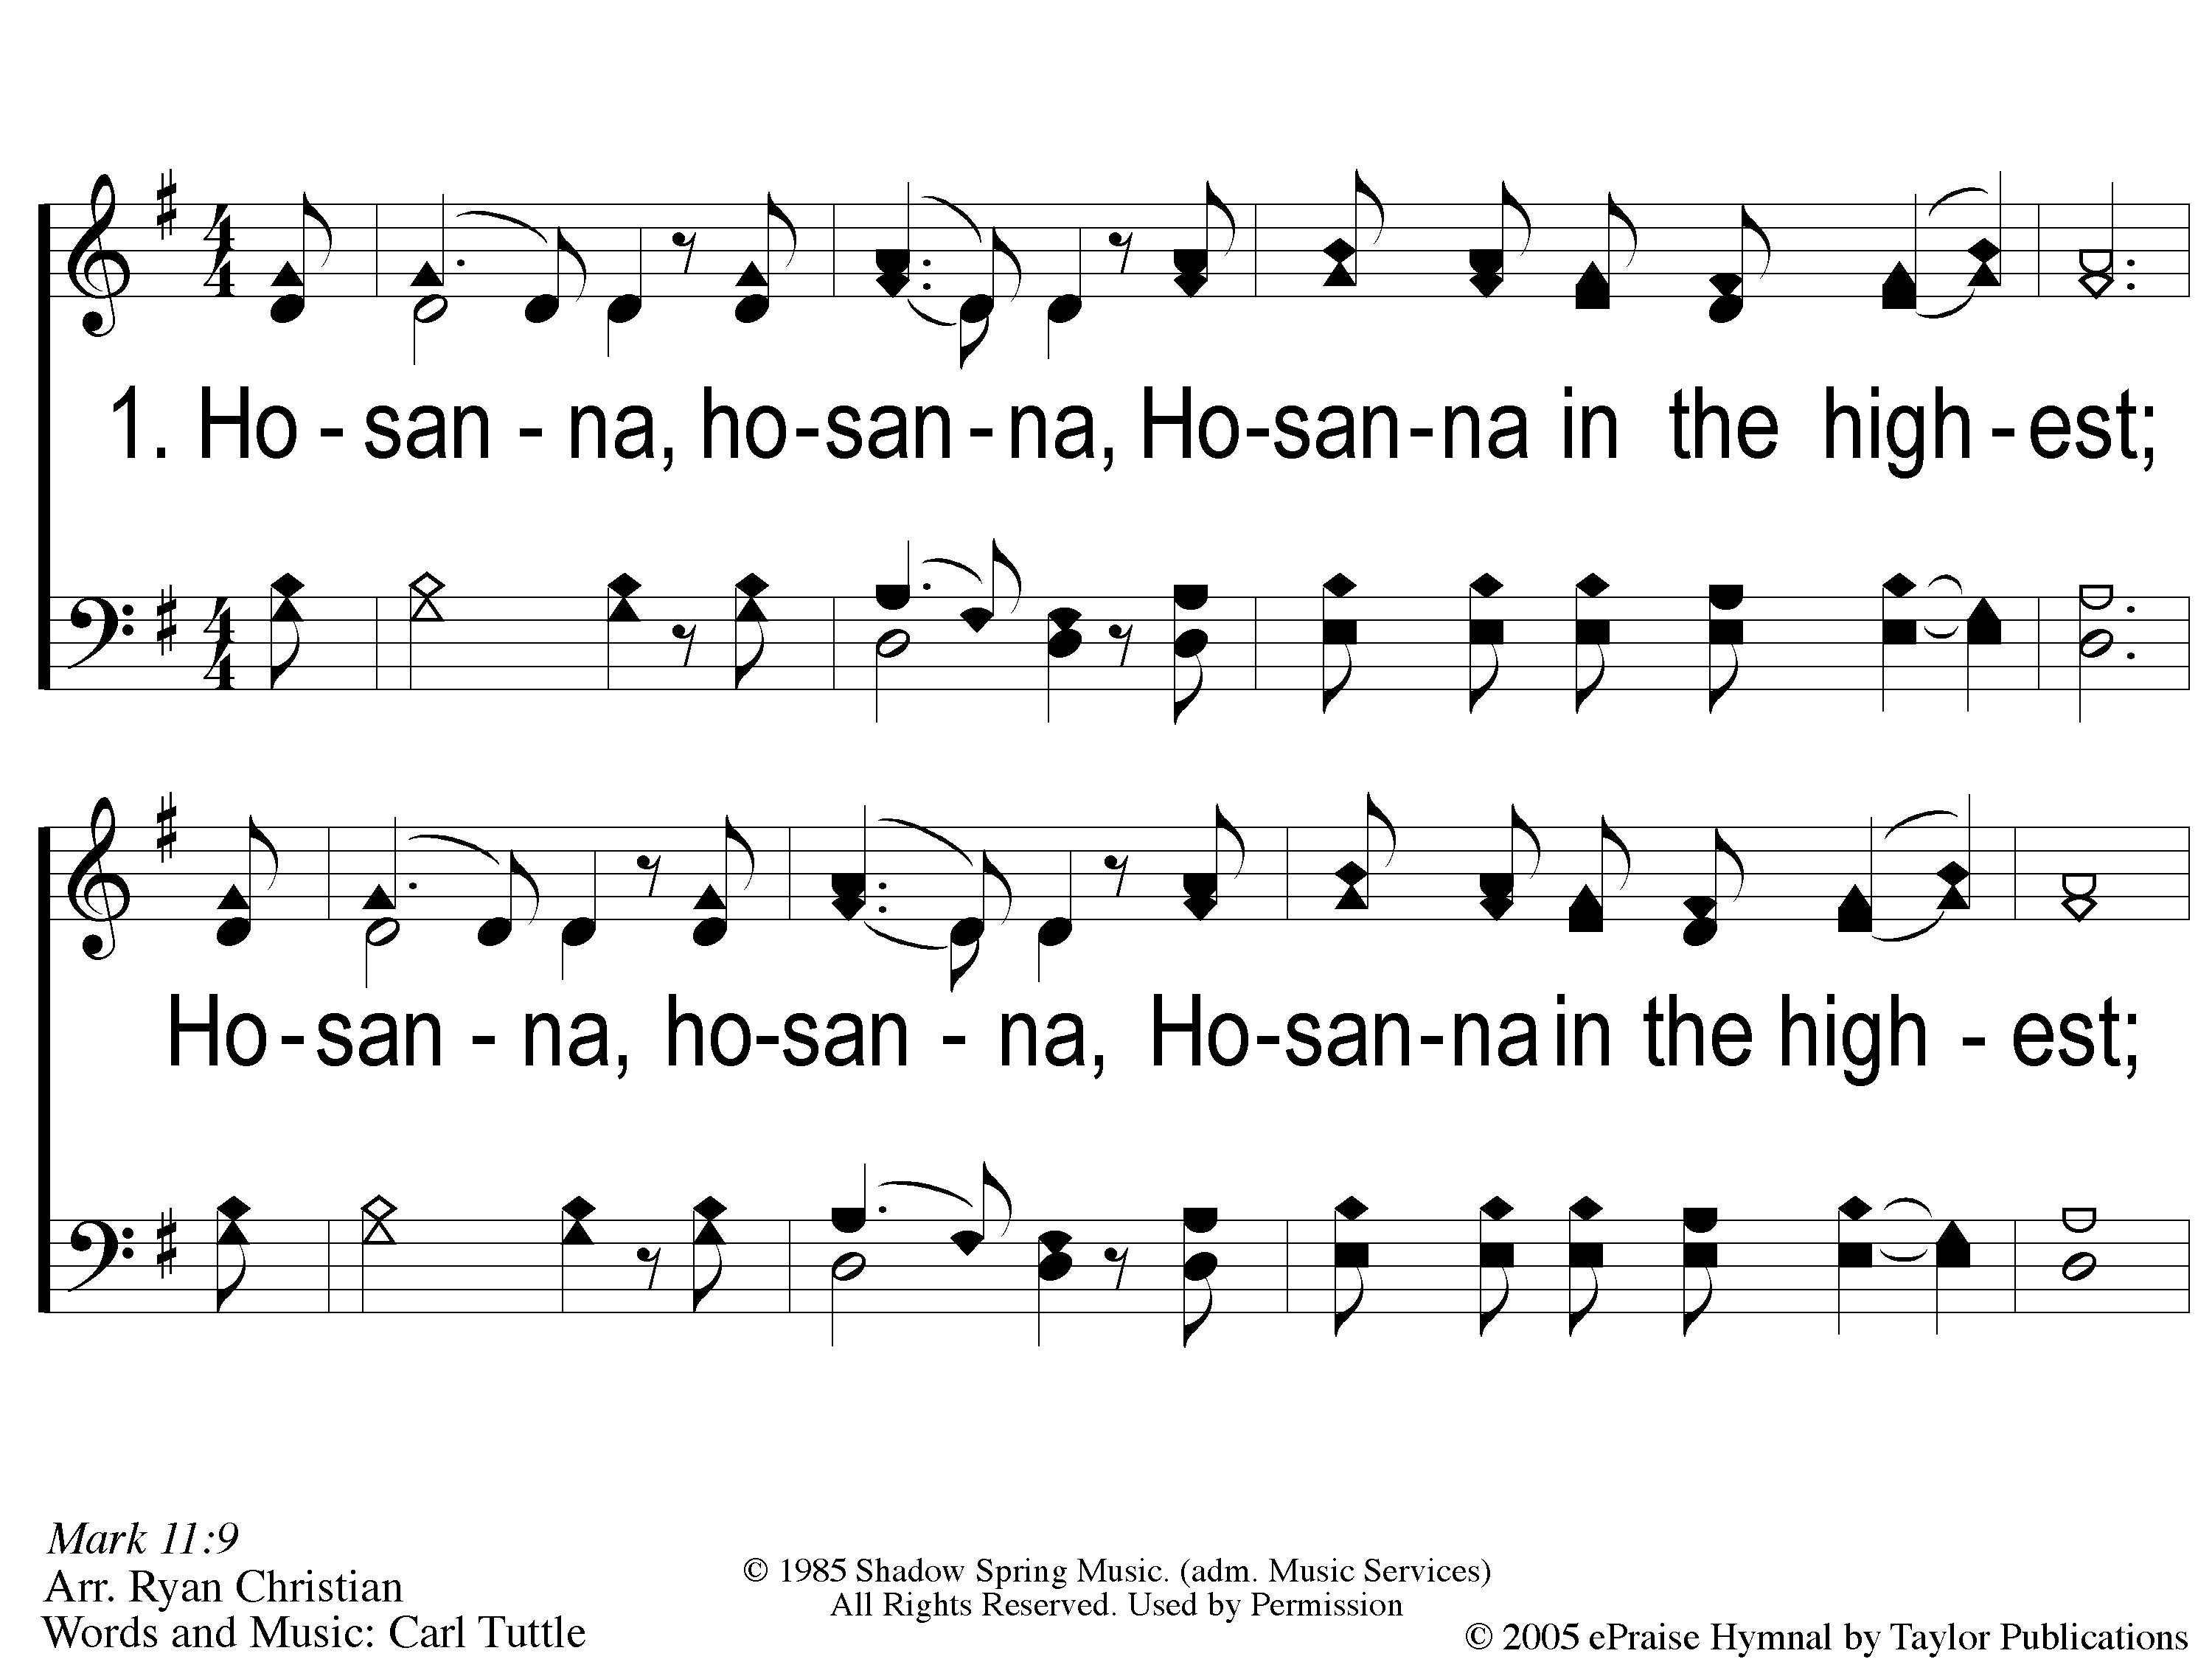
1 Hosanna
Hosanna
167

Slide 2
C-1 Hosanna
Hosanna
167

Slide 3
C-2 Hosanna
Hosanna
167

Slide 4
2 Hosanna
Hosanna
167

Slide 5
C-1 Hosanna
Hosanna
167

Slide 6
C-2 Hosanna
Hosanna
167

Slide 7
RESTORE REBUILD RENEW
welcome
we are glad to
Have you with us
IN 2022
WHEELER
CHURCH
OF
CHRIST

Slide 8
Song:
My Hope Is Built
#538

Slide 9
1-1 My Hope is Built
My Hope Is Built
538

Slide 10
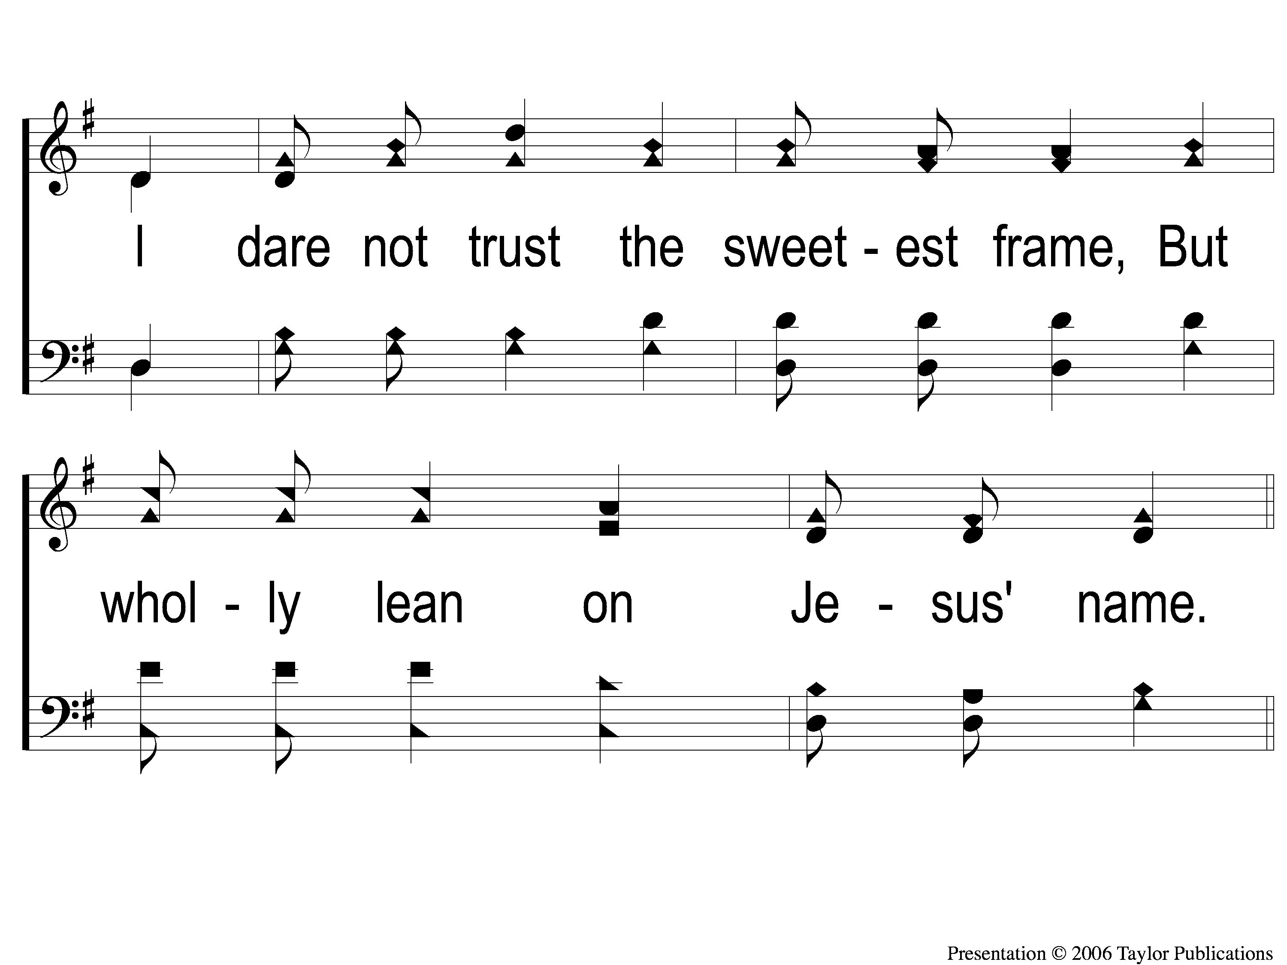
1-2 My Hope is Built
My Hope Is Built
538

Slide 11
c My Hope is Built
My Hope Is Built
538

Slide 12
2-1 My Hope is Built
My Hope Is Built
538

Slide 13
2-2 My Hope is Built
My Hope Is Built
538

Slide 14
c My Hope is Built
My Hope Is Built
538

Slide 15
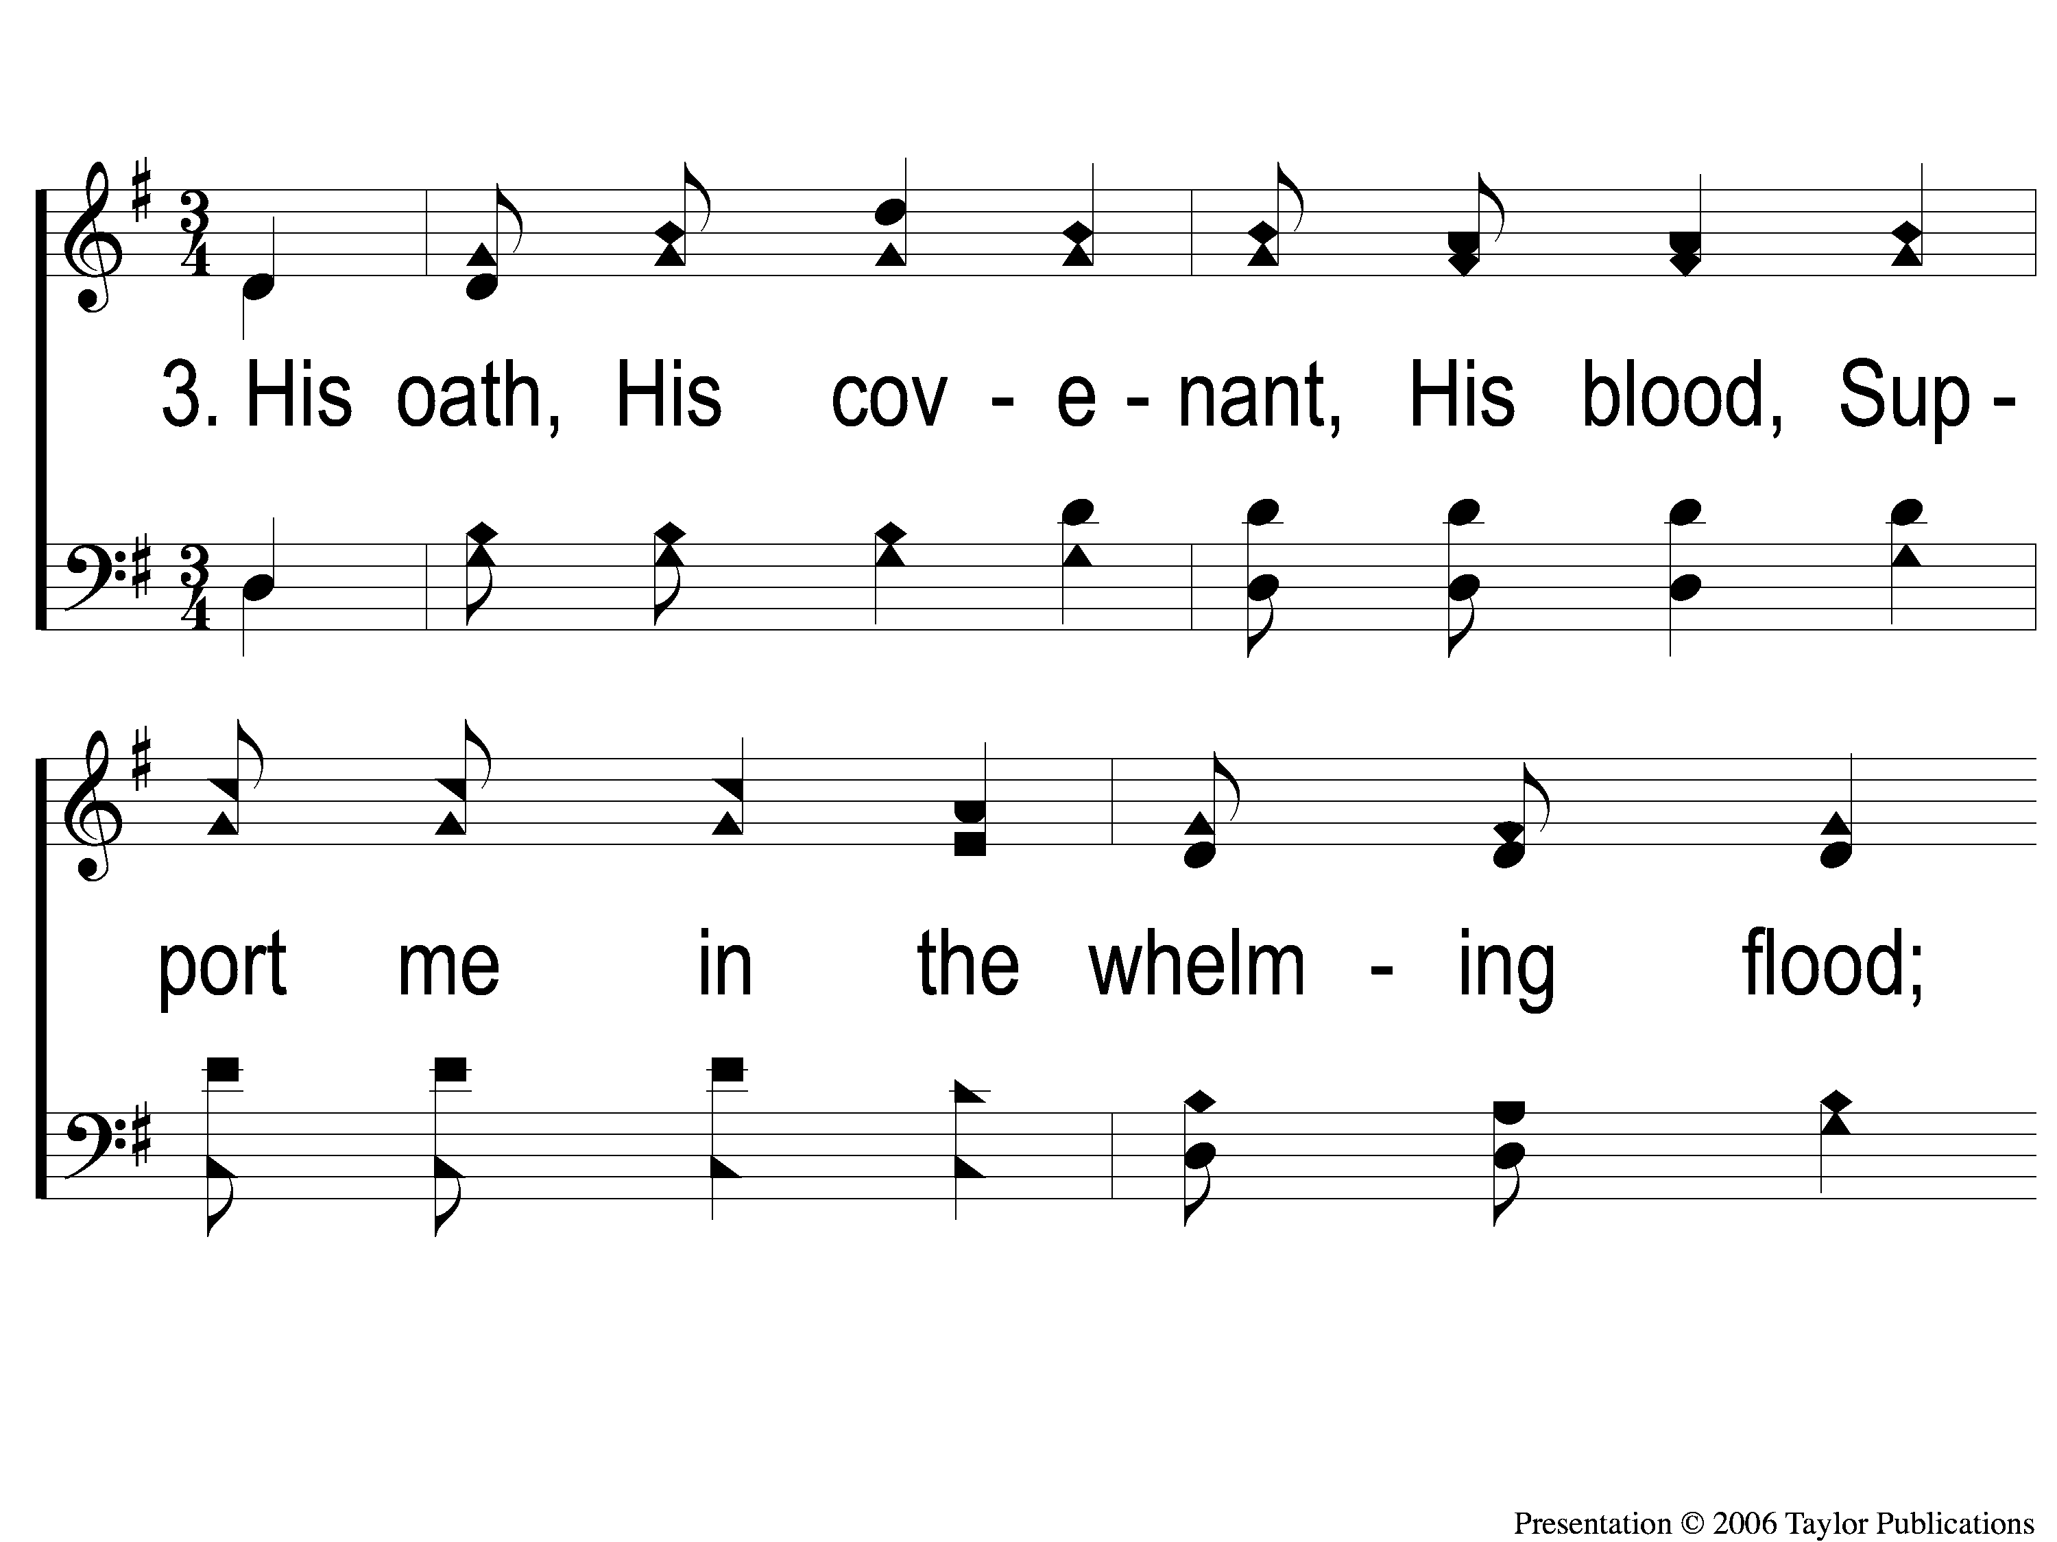
3-1 My Hope is Built
My Hope Is Built
538

Slide 16
3-2 My Hope is Built
My Hope Is Built
538

Slide 17
c My Hope is Built
My Hope Is Built
538

Slide 18
4-1 My Hope is Built
My Hope Is Built
538

Slide 19
4-2 My Hope is Built
My Hope Is Built
538

Slide 20
c My Hope is Built
My Hope Is Built
538

Slide 21
Song:
The Lily of the Valley
#548

Slide 22
1-1 The Lily of the Valley
The Lily of the Valley
548

Slide 23
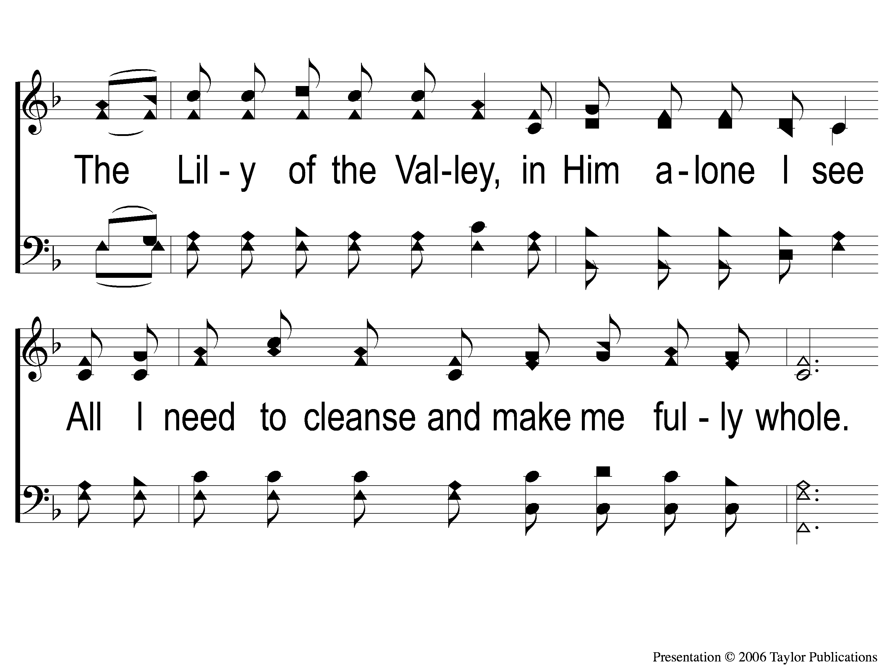
1-2 The Lily of the Valley
The Lily of the Valley
548

Slide 24
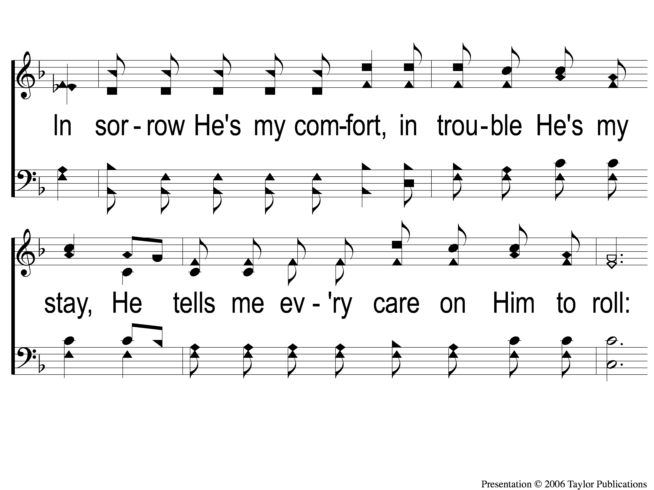
1-3 The Lily of the Valley
The Lily of the Valley
548

Slide 25
C The Lily of the Valley
The Lily of the Valley
548

Slide 26
2-1 The Lily of the Valley
The Lily of the Valley
548

Slide 27
2-2 The Lily of the Valley
The Lily of the Valley
548

Slide 28
2-3 The Lily of the Valley
The Lily of the Valley
548

Slide 29
C The Lily of the Valley
The Lily of the Valley
548

Slide 30
3-1 The Lily of the Valley
The Lily of the Valley
548

Slide 31
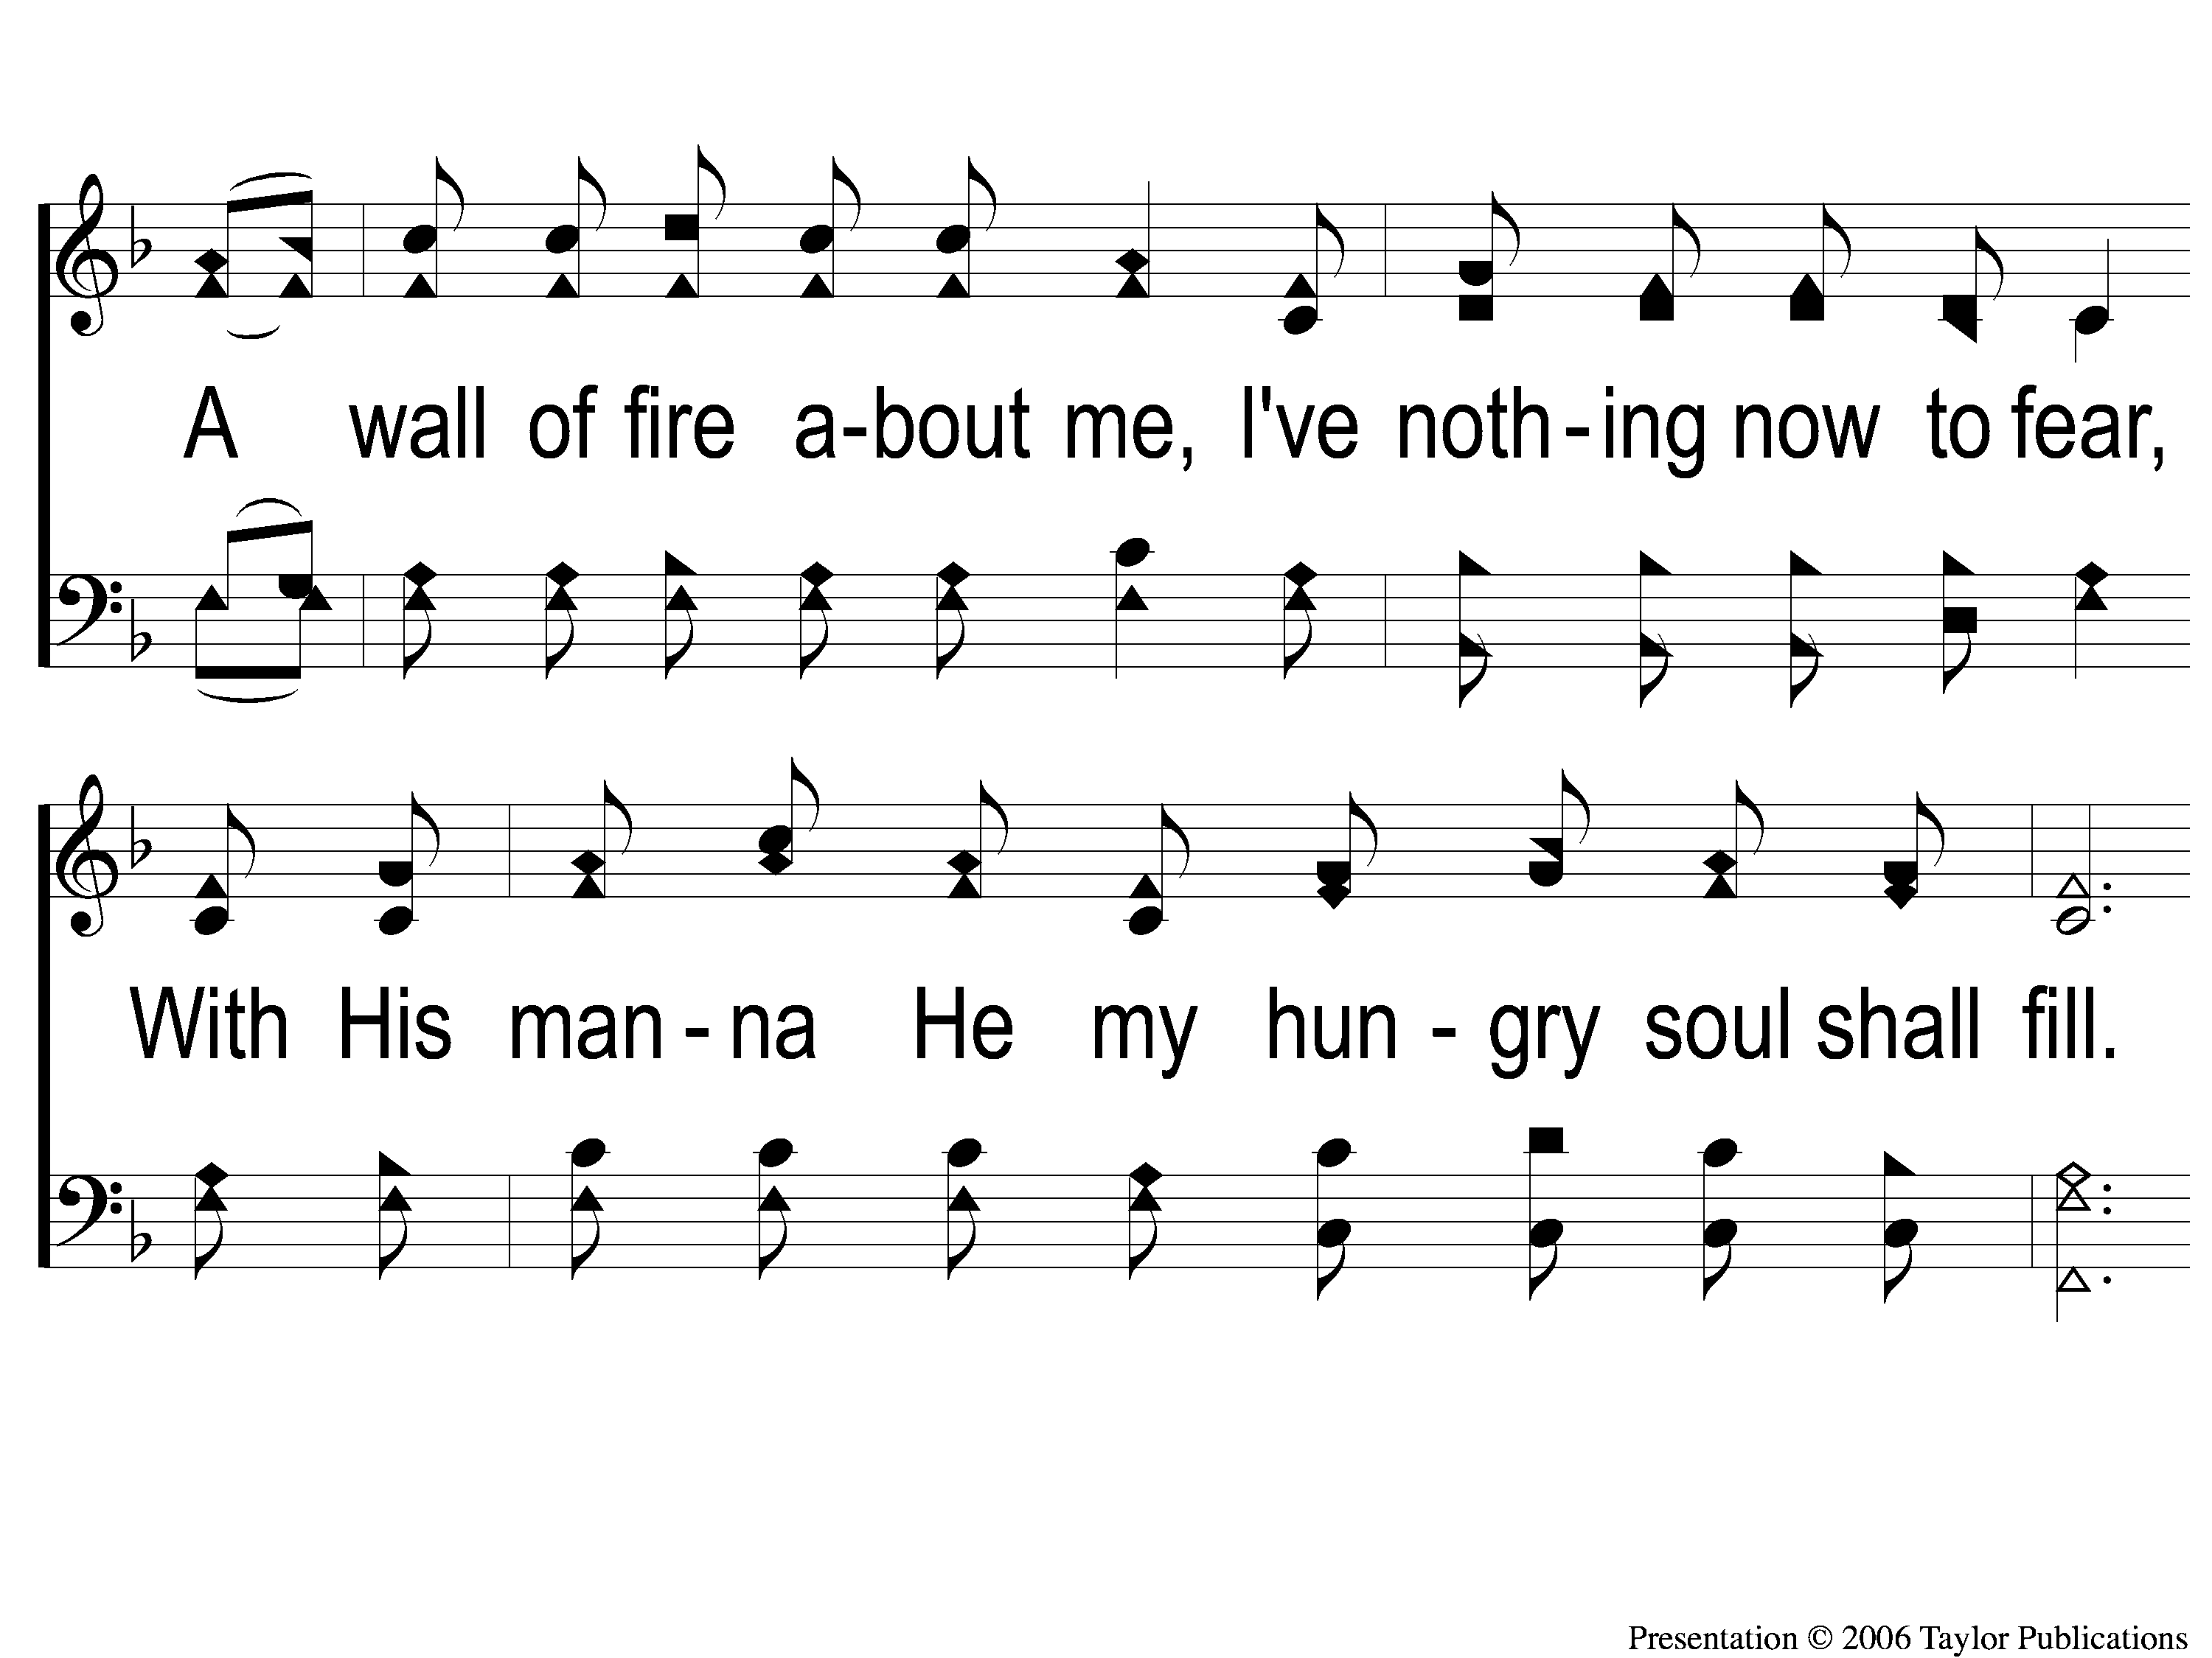
3-2 The Lily of the Valley
The Lily of the Valley
548

Slide 32
3-3 The Lily of the Valley
The Lily of the Valley
548

Slide 33
C The Lily of the Valley
The Lily of the Valley
548

Slide 34
Opening Prayer

Slide 35
Song:
Sing & Be Happy
#587

Slide 36
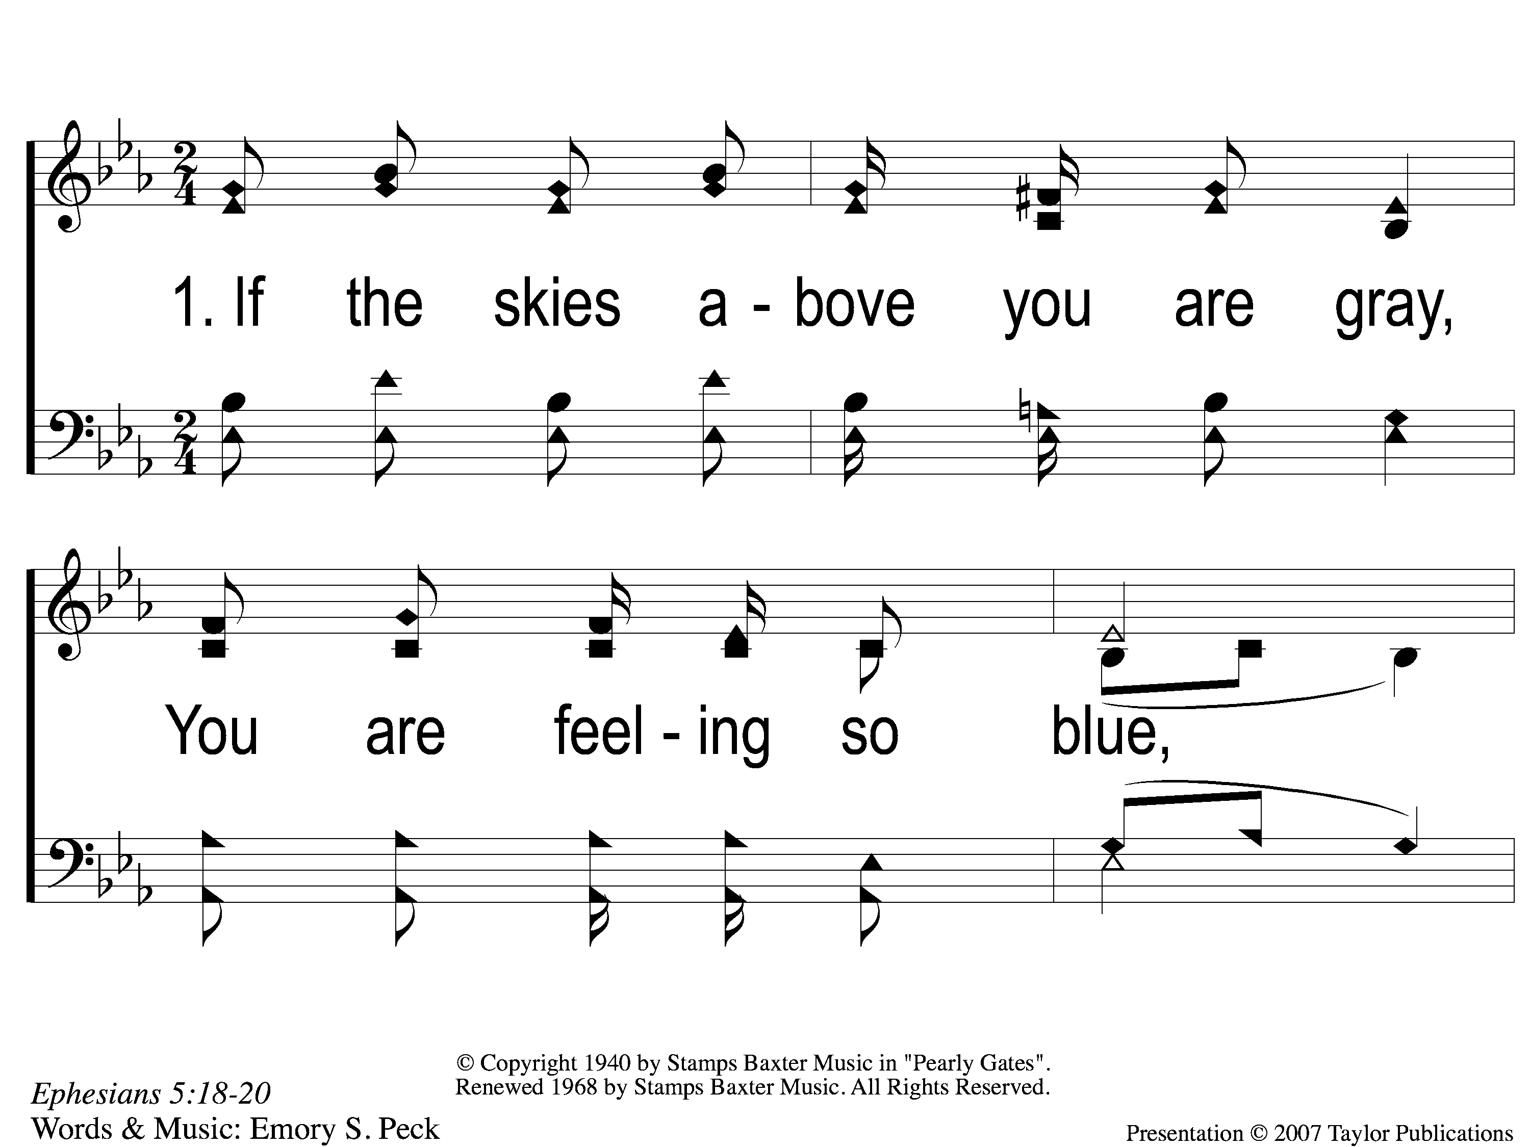
1-1 Sing and Be Happy
Sing and Be Happy
587

Slide 37
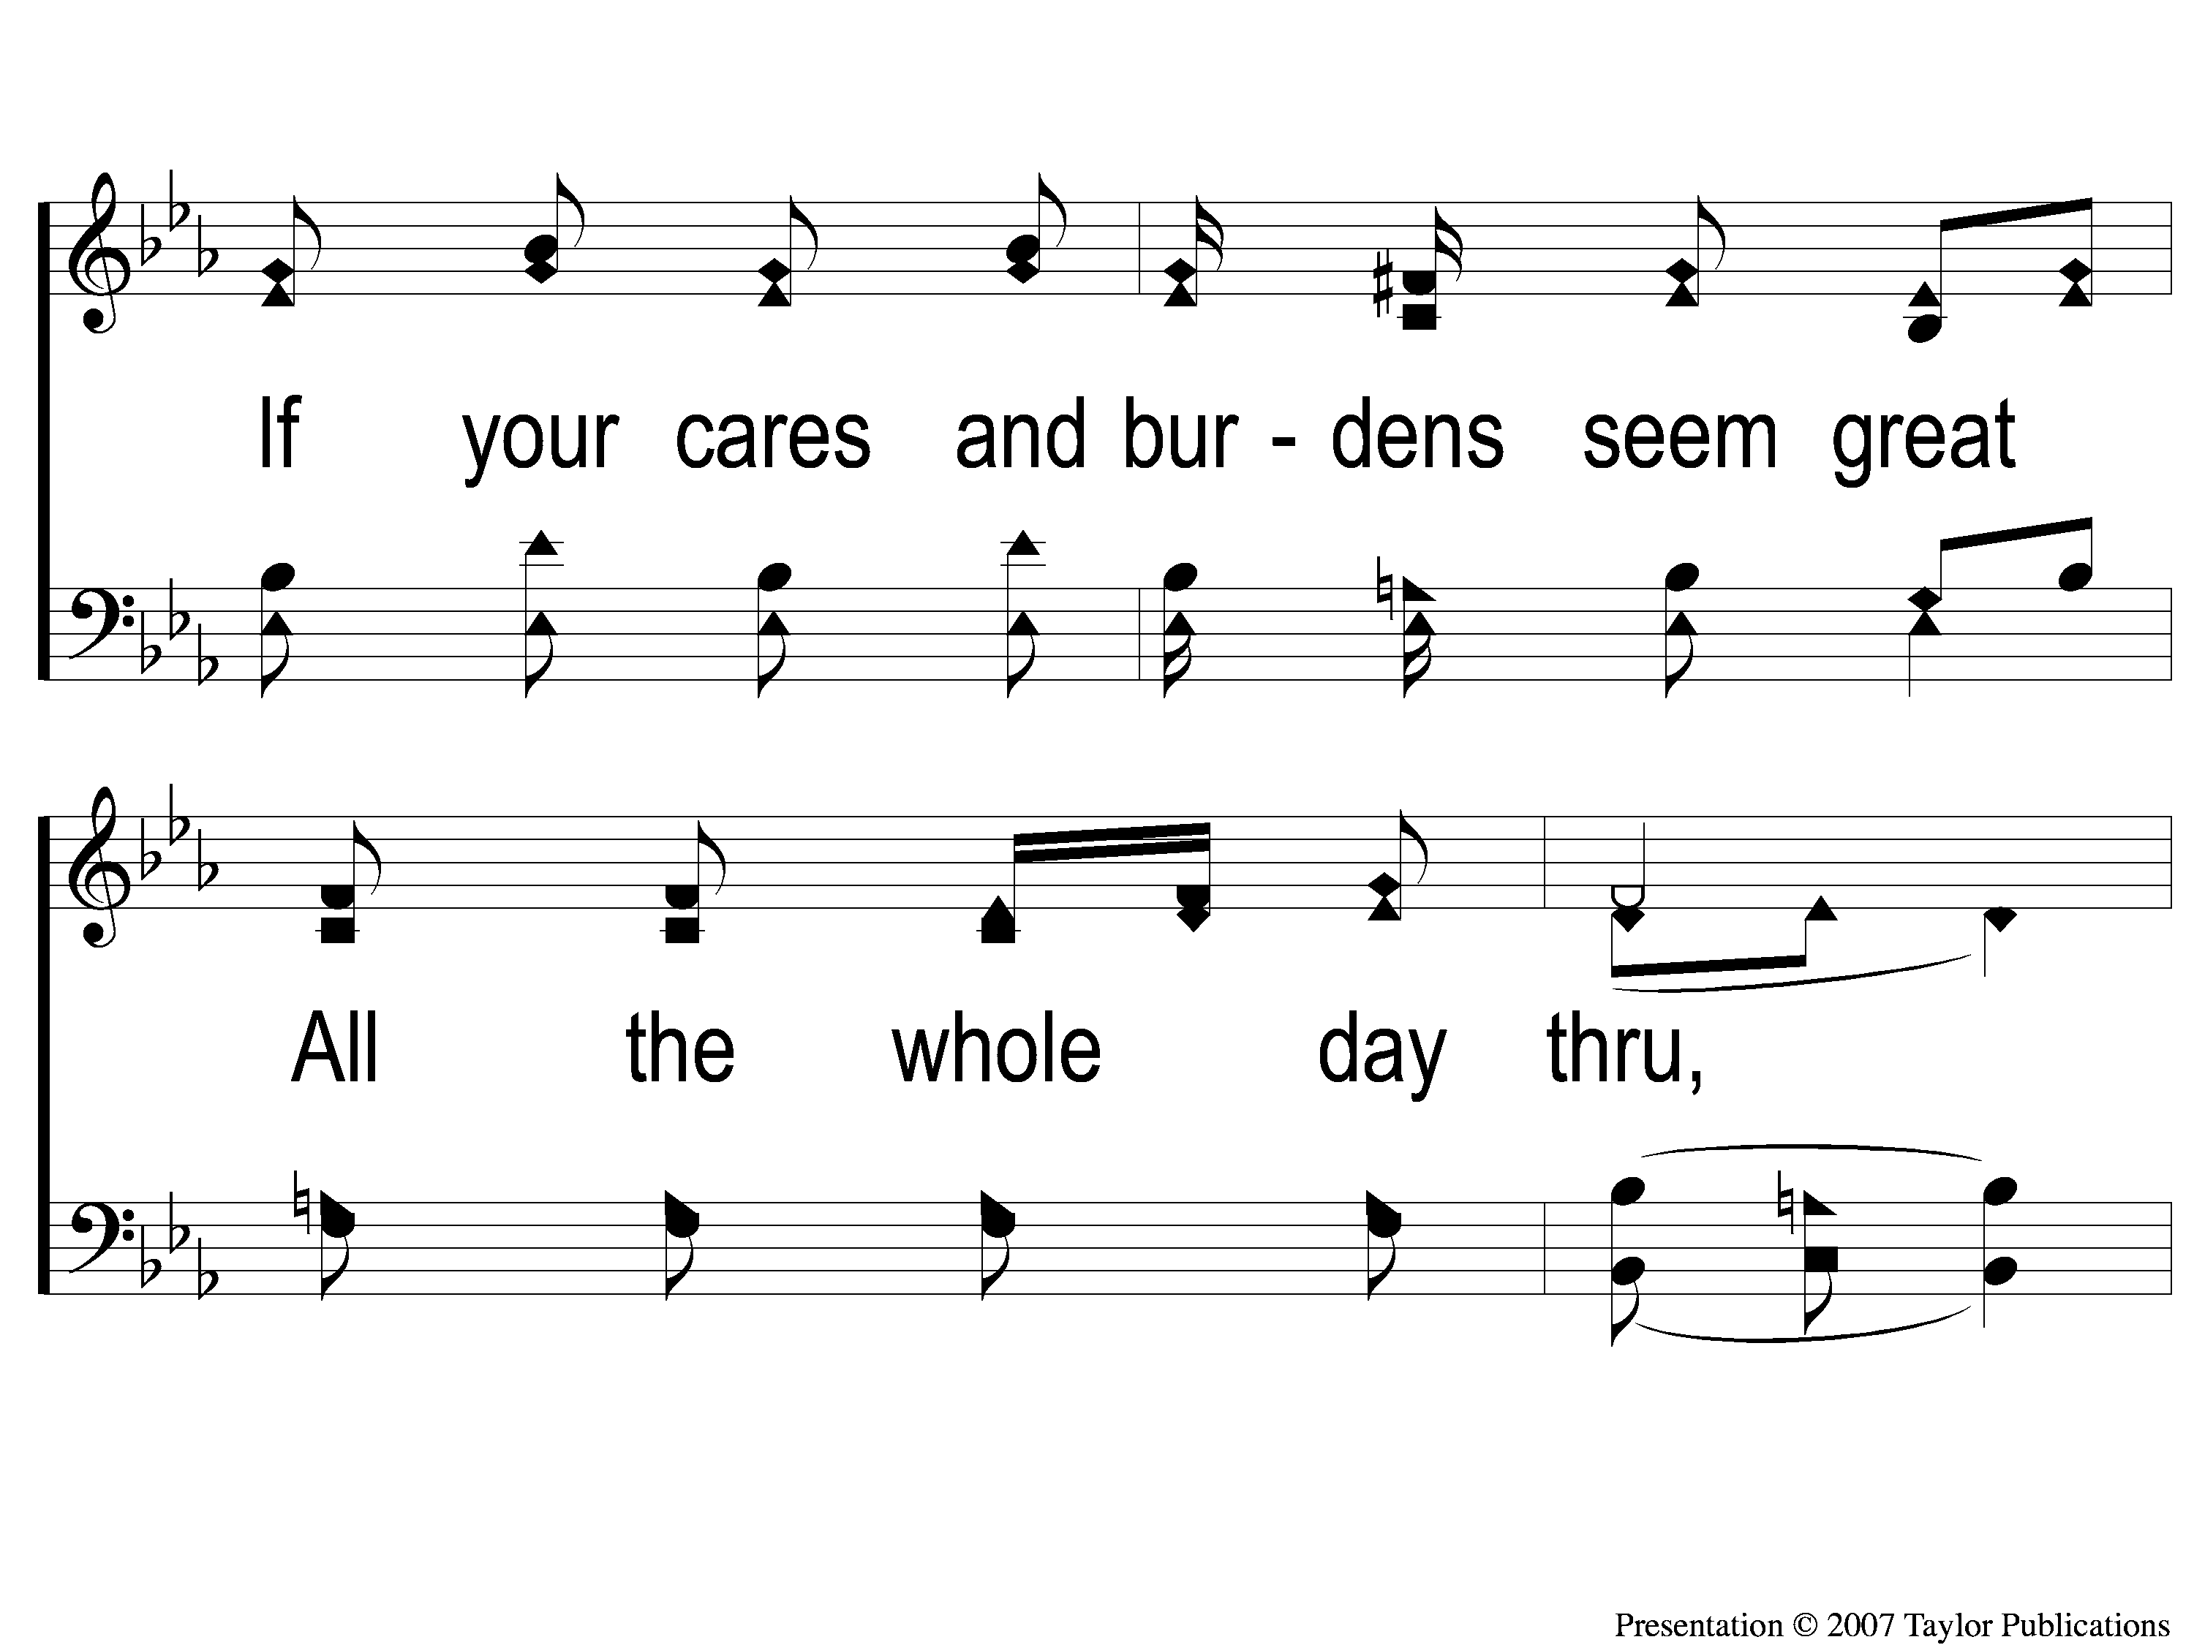
1-2 Sing and Be Happy
Sing and Be Happy
587

Slide 38
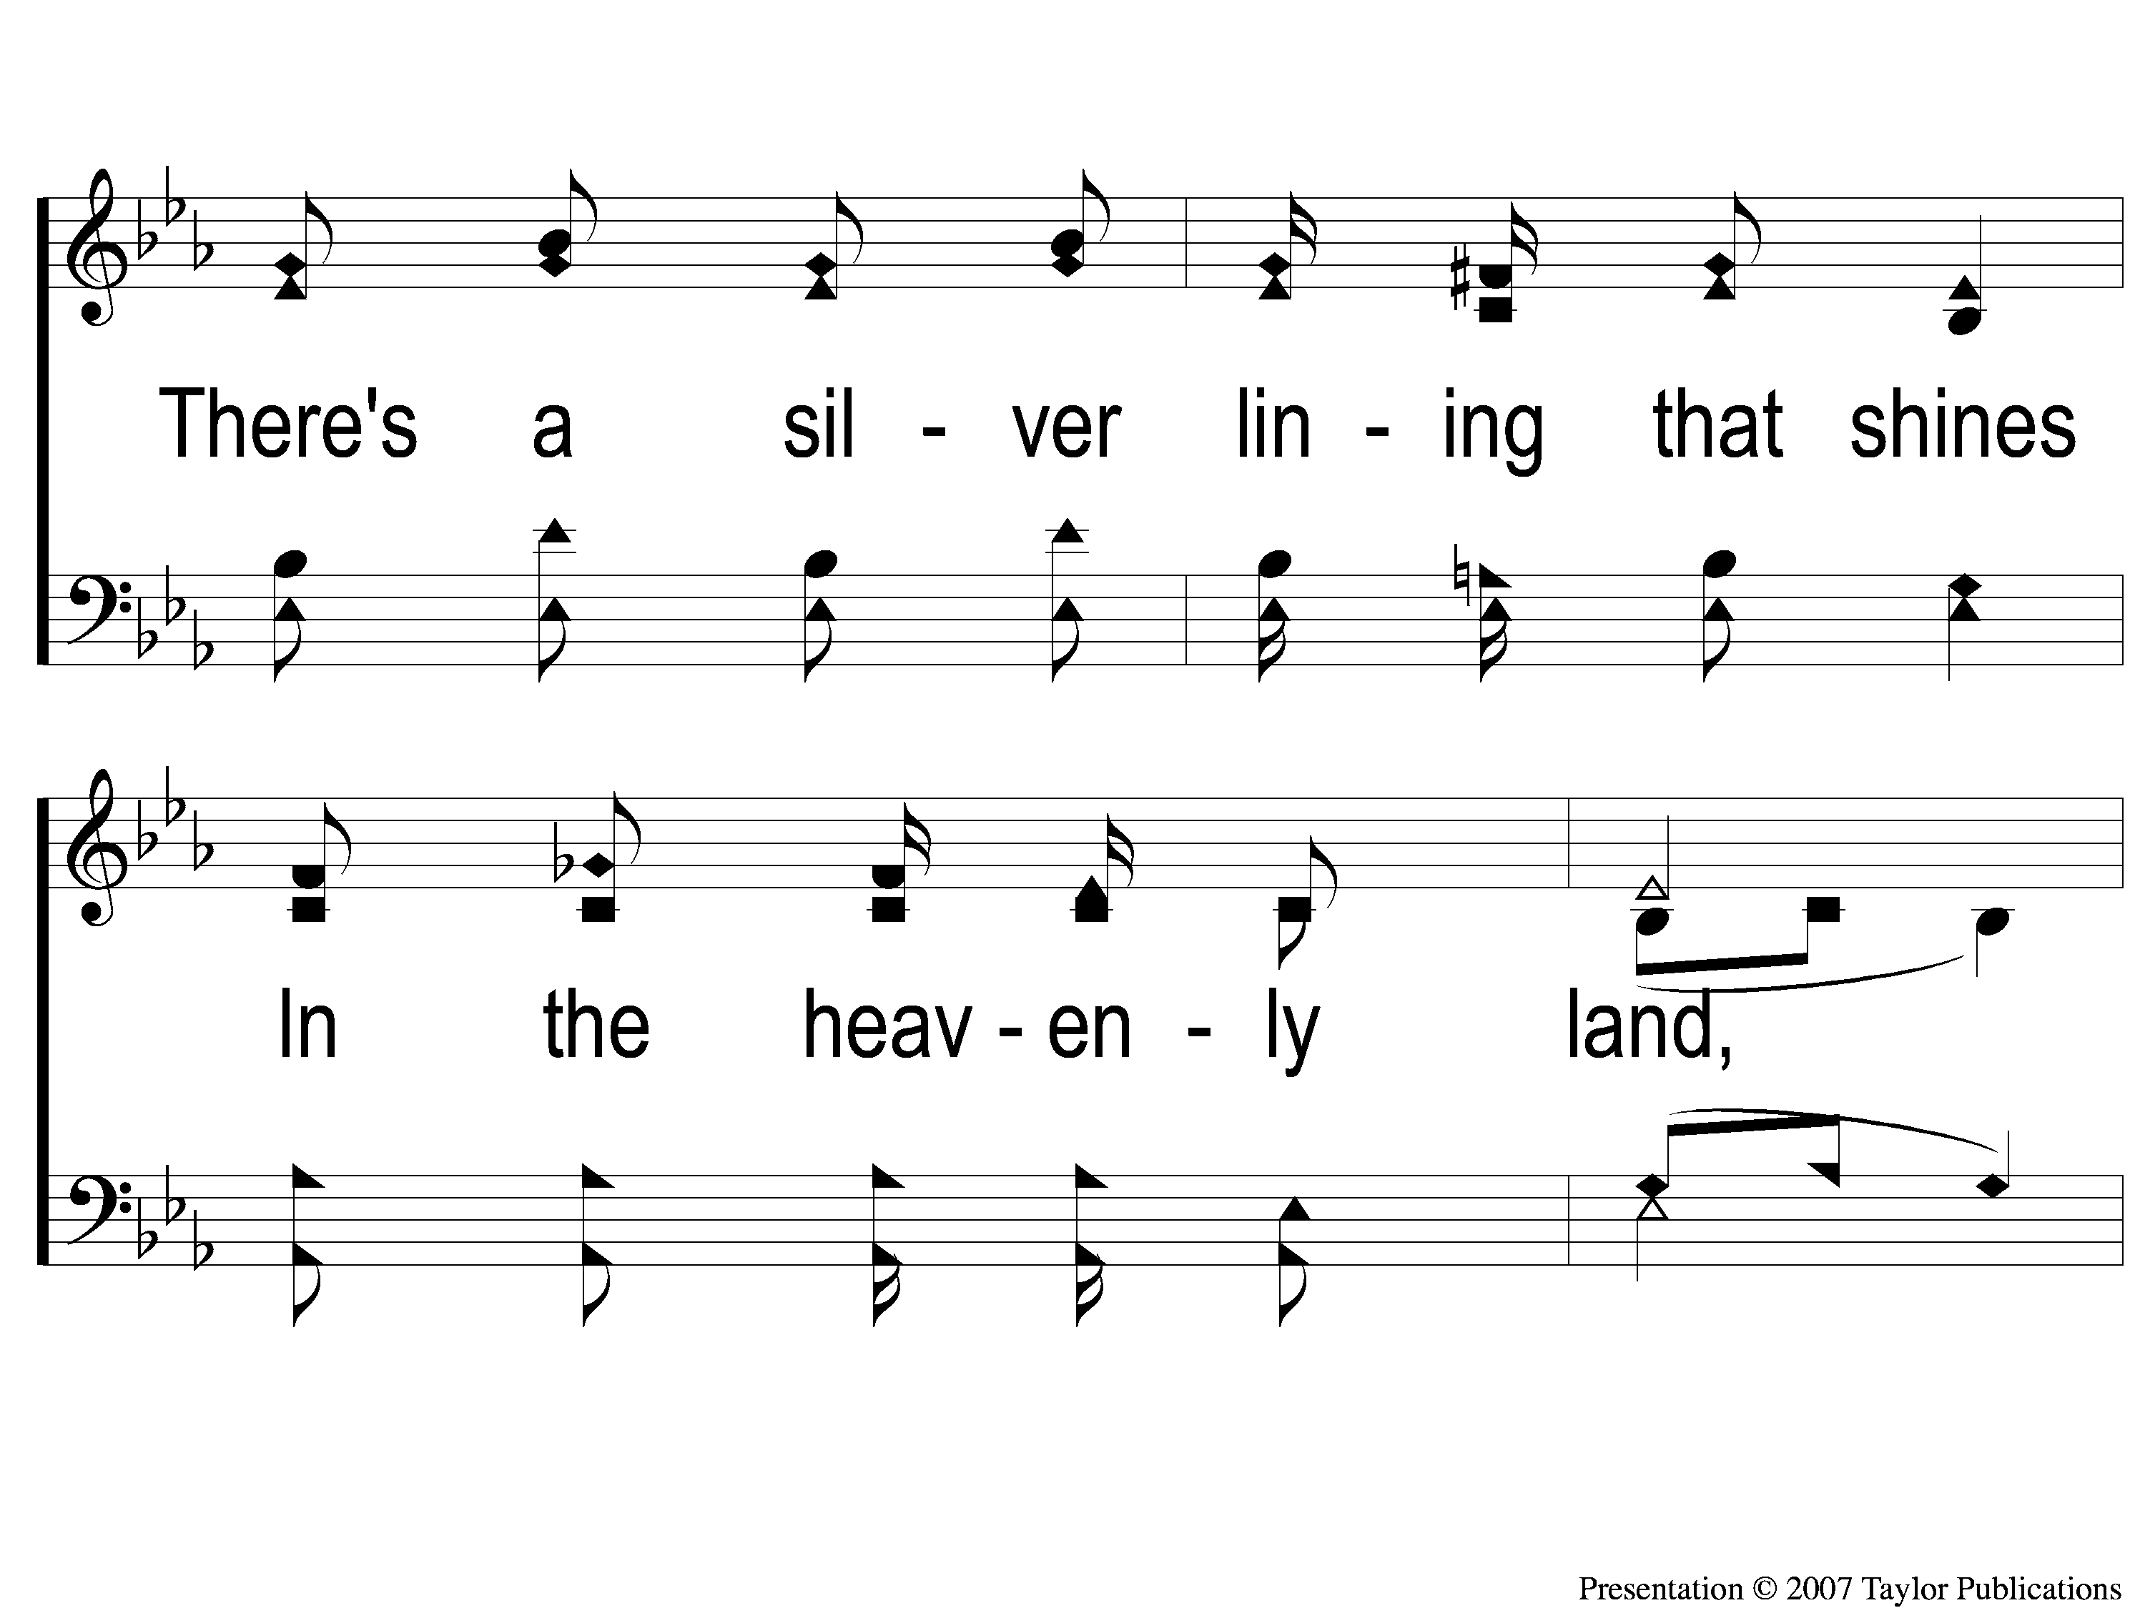
1-3 Sing and Be Happy
Sing and Be Happy
587

Slide 39
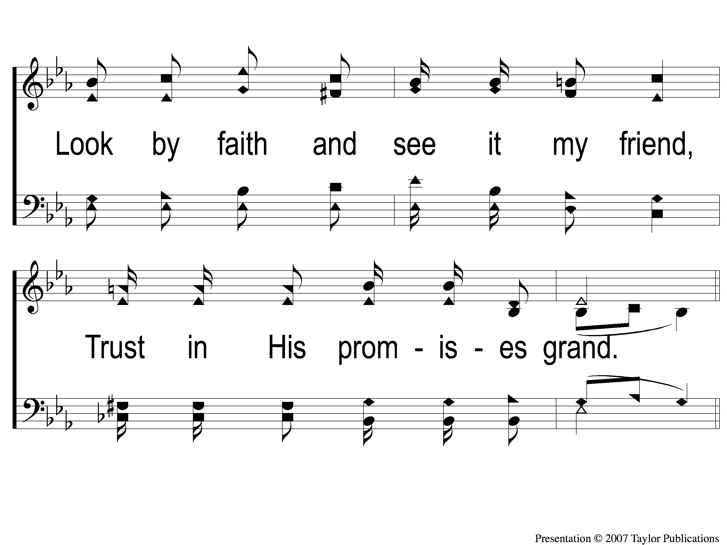
1-4 Sing and Be Happy
Sing and Be Happy
587

Slide 40
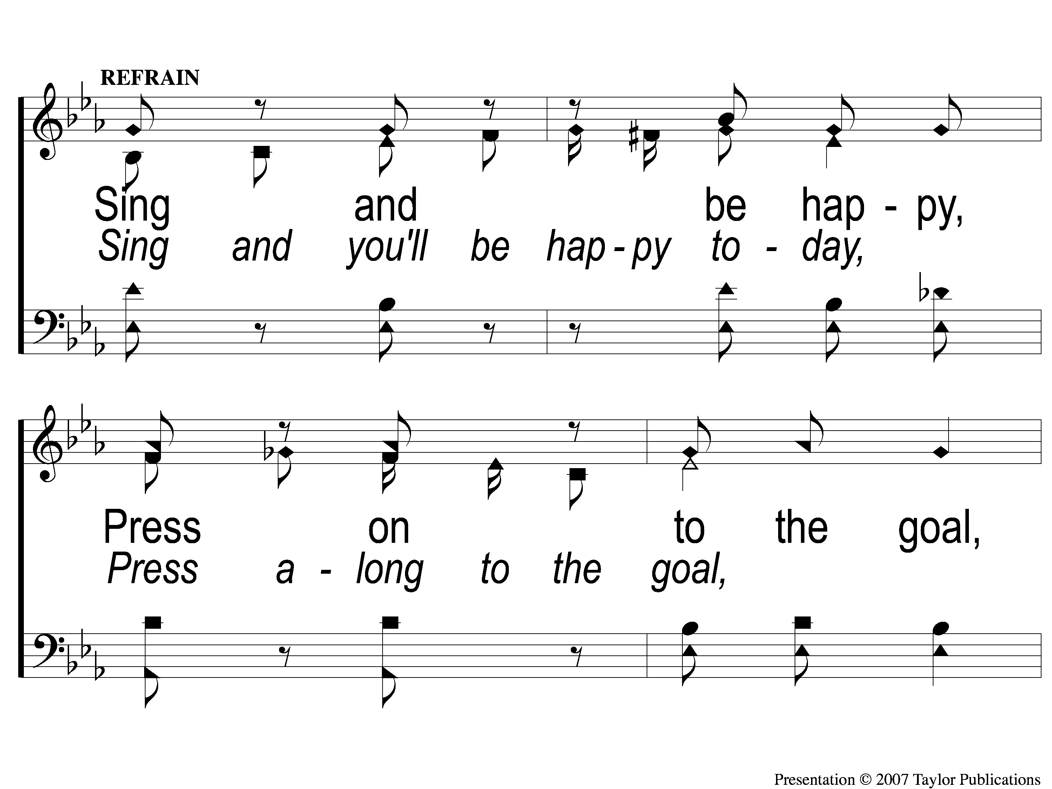
C-1 Sing and Be Happy
Sing and Be Happy
587

Slide 41
C-2 Sing and Be Happy
Sing and Be Happy
587

Slide 42
C-3 Sing and Be Happy
Sing and Be Happy
587

Slide 43
C-4 Sing and Be Happy
Sing and Be Happy
587

Slide 44
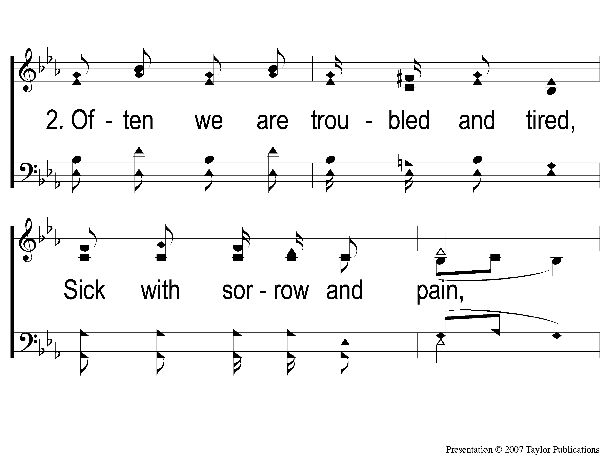
2-1 Sing and Be Happy
Sing and Be Happy
587

Slide 45
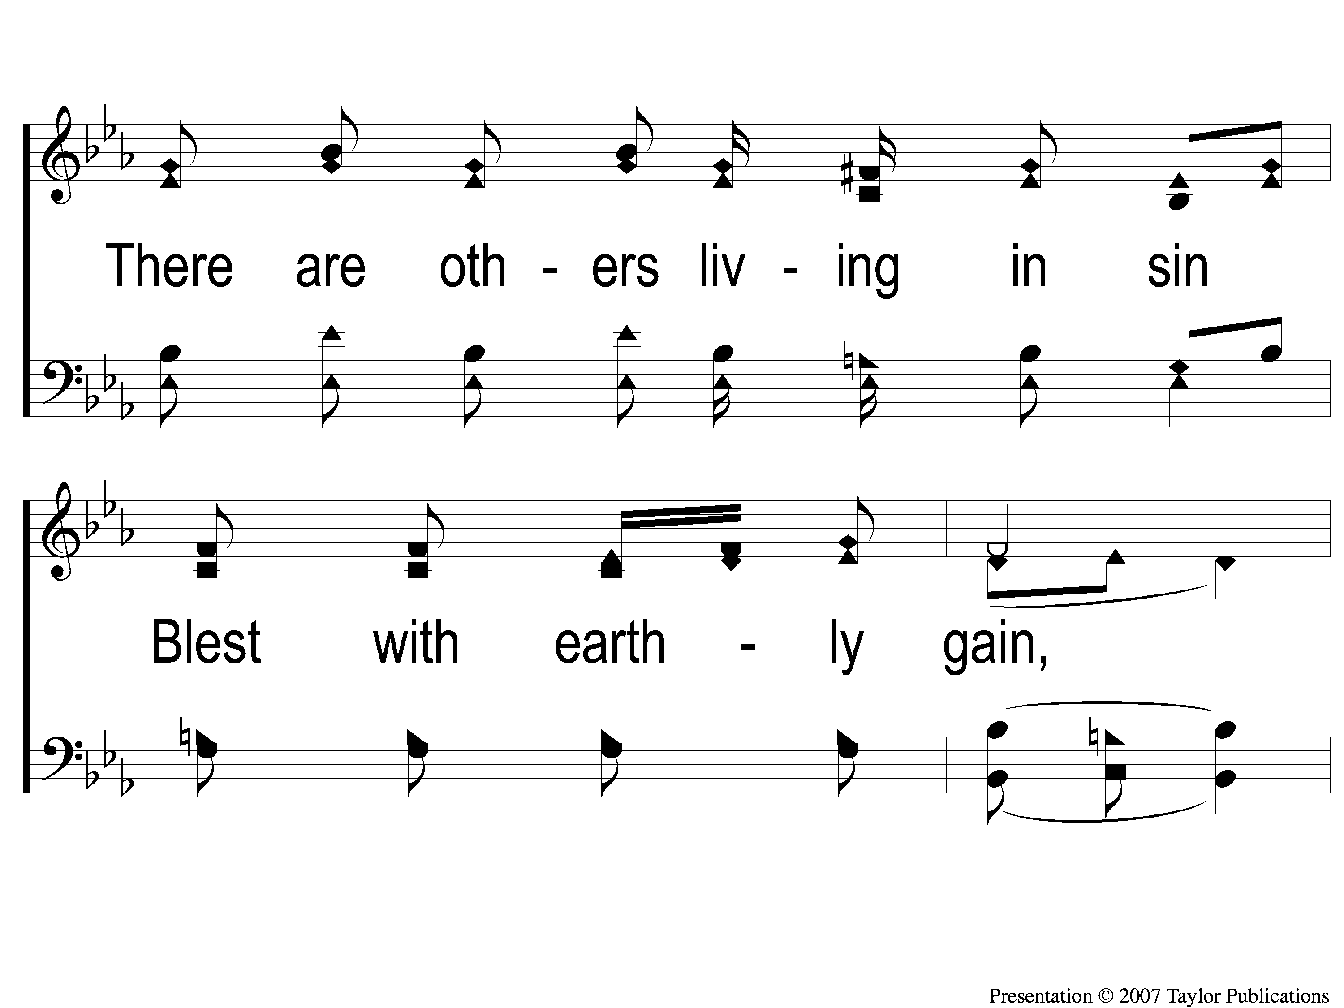
2-2 Sing and Be Happy
Sing and Be Happy
587

Slide 46
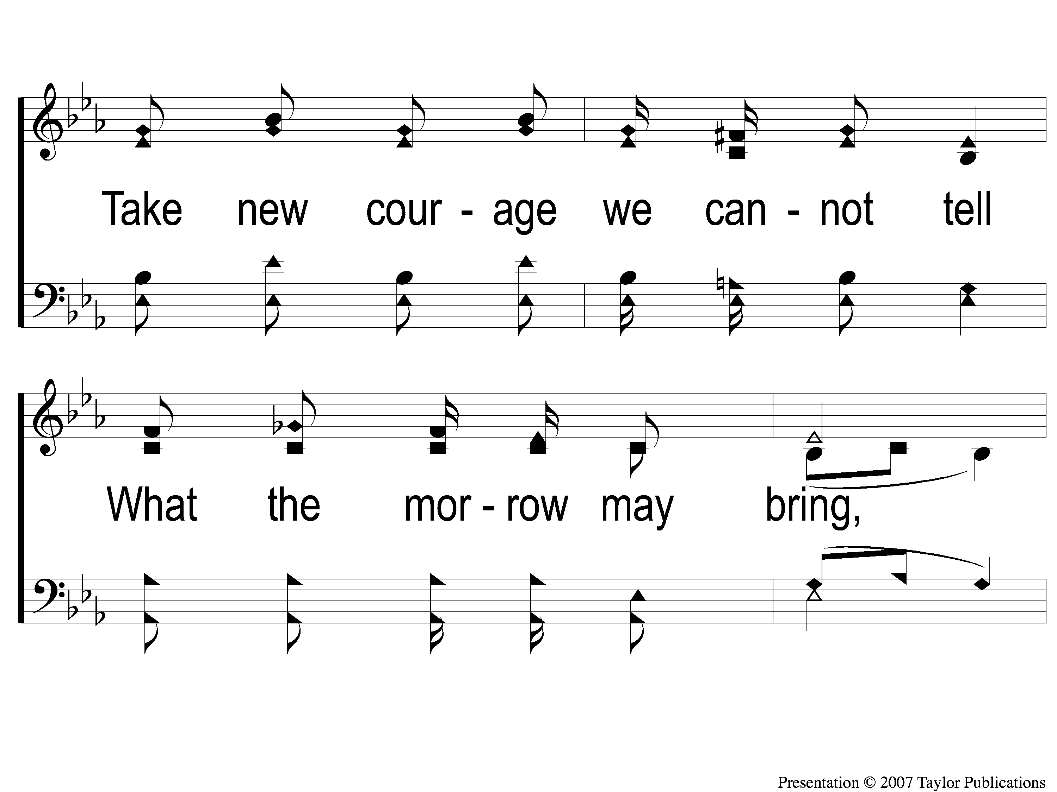
2-3 Sing and Be Happy
Sing and Be Happy
587

Slide 47
2-4 Sing and Be Happy
Sing and Be Happy
587

Slide 48
C-1 Sing and Be Happy
Sing and Be Happy
587

Slide 49
C-2 Sing and Be Happy
Sing and Be Happy
587

Slide 50
C-3 Sing and Be Happy
Sing and Be Happy
587

Slide 51
C-4 Sing and Be Happy
Sing and Be Happy
587

Slide 52
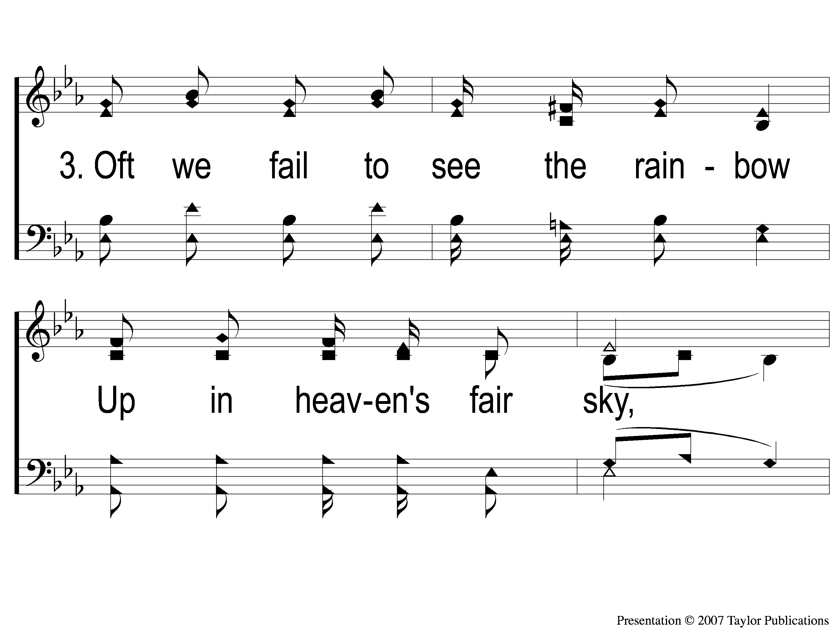
3-1 Sing and Be Happy
Sing and Be Happy
587

Slide 53
3-2 Sing and Be Happy
Sing and Be Happy
587

Slide 54
3-3 Sing and Be Happy
Sing and Be Happy
587

Slide 55
3-4 Sing and Be Happy
Sing and Be Happy
587

Slide 56
C-1 Sing and Be Happy
Sing and Be Happy
587

Slide 57
C-2 Sing and Be Happy
Sing and Be Happy
587

Slide 58
C-3 Sing and Be Happy
Sing and Be Happy
587

Slide 59
C-4 Sing and Be Happy
Sing and Be Happy
587

Slide 60
Song:
I’ll Fly Away
#851

Slide 61
1-1 I’ll Fly Away
I’ll Fly Away
851

Slide 62
1-2 I’ll Fly Away
I’ll Fly Away
851

Slide 63
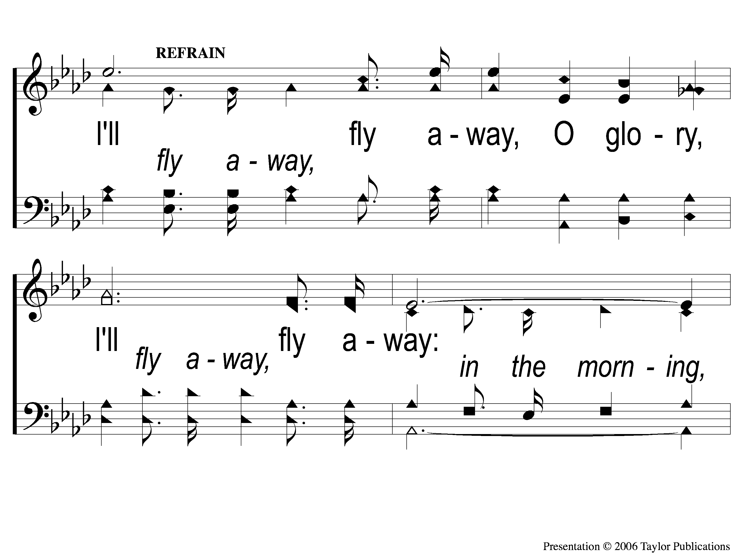
C-1 I’ll Fly Away
I’ll Fly Away
851

Slide 64
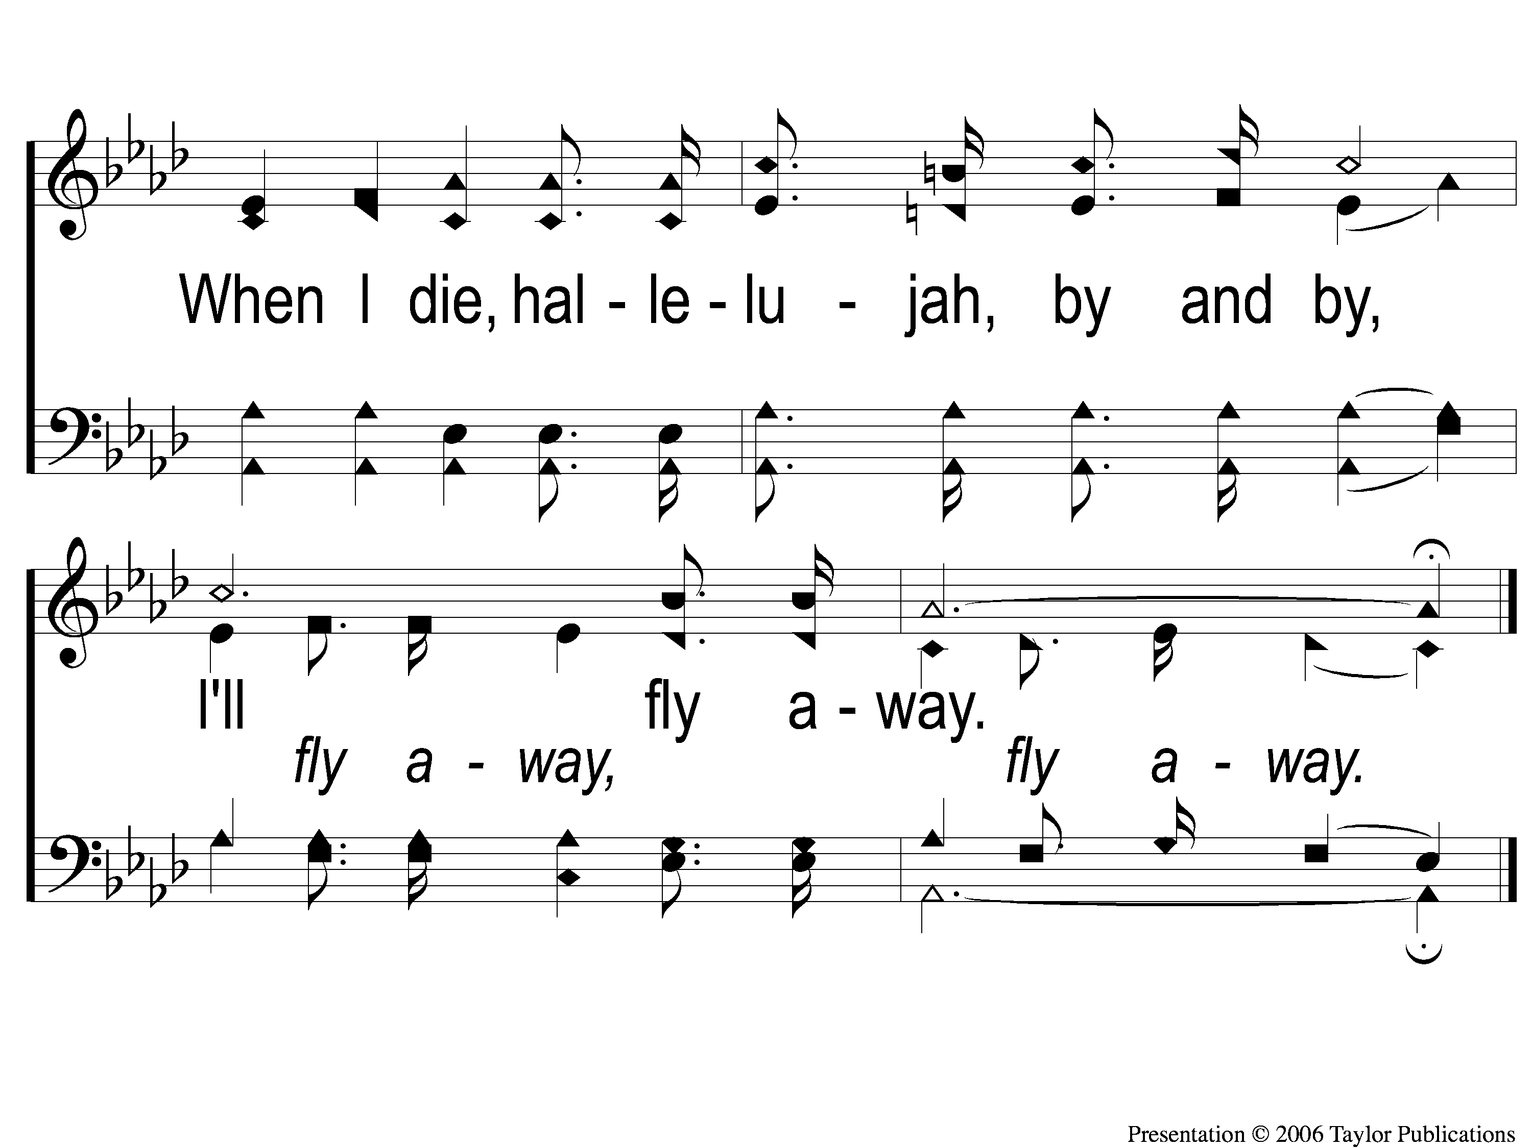
C-2 I’ll Fly Away
I’ll Fly Away
851

Slide 65
2-1 I’ll Fly Away
I’ll Fly Away
851

Slide 66
2-2 I’ll Fly Away
I’ll Fly Away
851

Slide 67
C-1 I’ll Fly Away
I’ll Fly Away
851

Slide 68
C-2 I’ll Fly Away
I’ll Fly Away
851

Slide 69
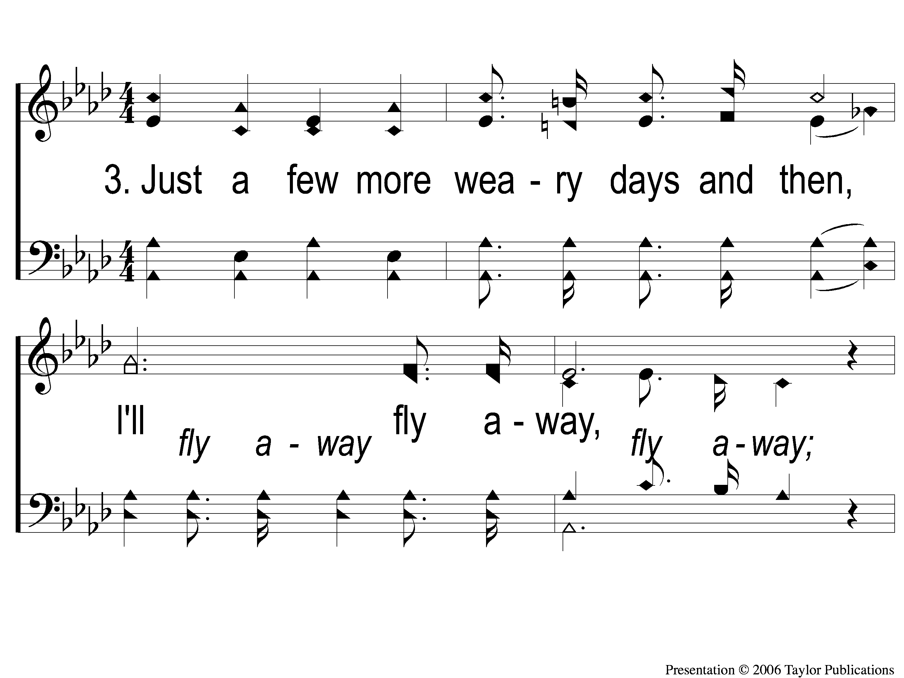
3-1 I’ll Fly Away
I’ll Fly Away
851

Slide 70
3-2 I’ll Fly Away
I’ll Fly Away
851

Slide 71
C-1 I’ll Fly Away
I’ll Fly Away
851

Slide 72
C-2 I’ll Fly Away
I’ll Fly Away
851

Slide 73
Scripture Reading:
Genesis 6:5-8

Slide 74
RESTORE
OUR
FOUNDATIONS
JANUARY - APRIL

Slide 75
Tonight:
The Global Flood:
Biblical Evidences

Slide 76
IN The World,
Not OF The World:
Genesis Ch. 6-9

Slide 77
IN The World, Not OF the World
1 Jn. 2:15
Col. 2:20
Jn. 15:19, 16:33, 17:14-15
1 Cor. 5:9-10

Slide 78
IN The World, Not OF the World
3 Examples from Ezek. 14:14:

Slide 79
IN The World, Not OF the World
3 Examples from Ezek. 14:14:
Noah
Daniel
Job

Slide 80
The Characteristics of Noah:

Slide 81
The Characteristics of Noah:
Righteous

Slide 82
Righteous
Gen. 6:9, 7:1

Slide 83
Righteous
Gen. 6:9, 7:1
“just” = pertaining to being a person in according with a proper standard
Ezek. 14:14

Slide 84
The Characteristics of Noah:
Righteous
Obedient to God

Slide 85
Obedient To God
Gen. 6:22, 7:5
Jms. 1:19
Heb. 11:7
1 Jn. 5:3 – Jn. 14:15

Slide 86
The Characteristics of Noah:
Righteous
Obedient to God
Hardworking

Slide 87
Hardworking
Gen. 6:15
Eccl. 10:18
Deut. 6:5
Mark 12:30

Slide 88
The Characteristics of Noah:
Righteous
Obedient to God
Hardworking
A Worshiper of God

Slide 89
A Worshiper Of God
Gen. 8:18-21
Lev. 11
Gen. 7:2-3, 9

Slide 90
The Characteristics of Noah:
Righteous
Obedient to God
Hardworking
A Worshiper of God
An Evangelist

Slide 91
An Evangelist
2 Pet. 2:5
Heb. 11:7
Gen. 9:1
Mk. 8:36

Slide 92
If God needed a Noah today, could he count on you?

Slide 93
Invitation
Song:
What A Day That Will Be
#916

Slide 94
1-1 What a Day That Will Be
What a Day That Will Be
916

Slide 95
1-2 What a Day That Will Be
What a Day That Will Be
916

Slide 96
1-3 What a Day That Will Be
What a Day That Will Be
916

Slide 97
C-1 What a Day That Will Be
What a Day That Will Be
916

Slide 98
C-2 What a Day That Will Be
What a Day That Will Be
916

Slide 99
C-3 What a Day That Will Be
What a Day That Will Be
916

Slide 100
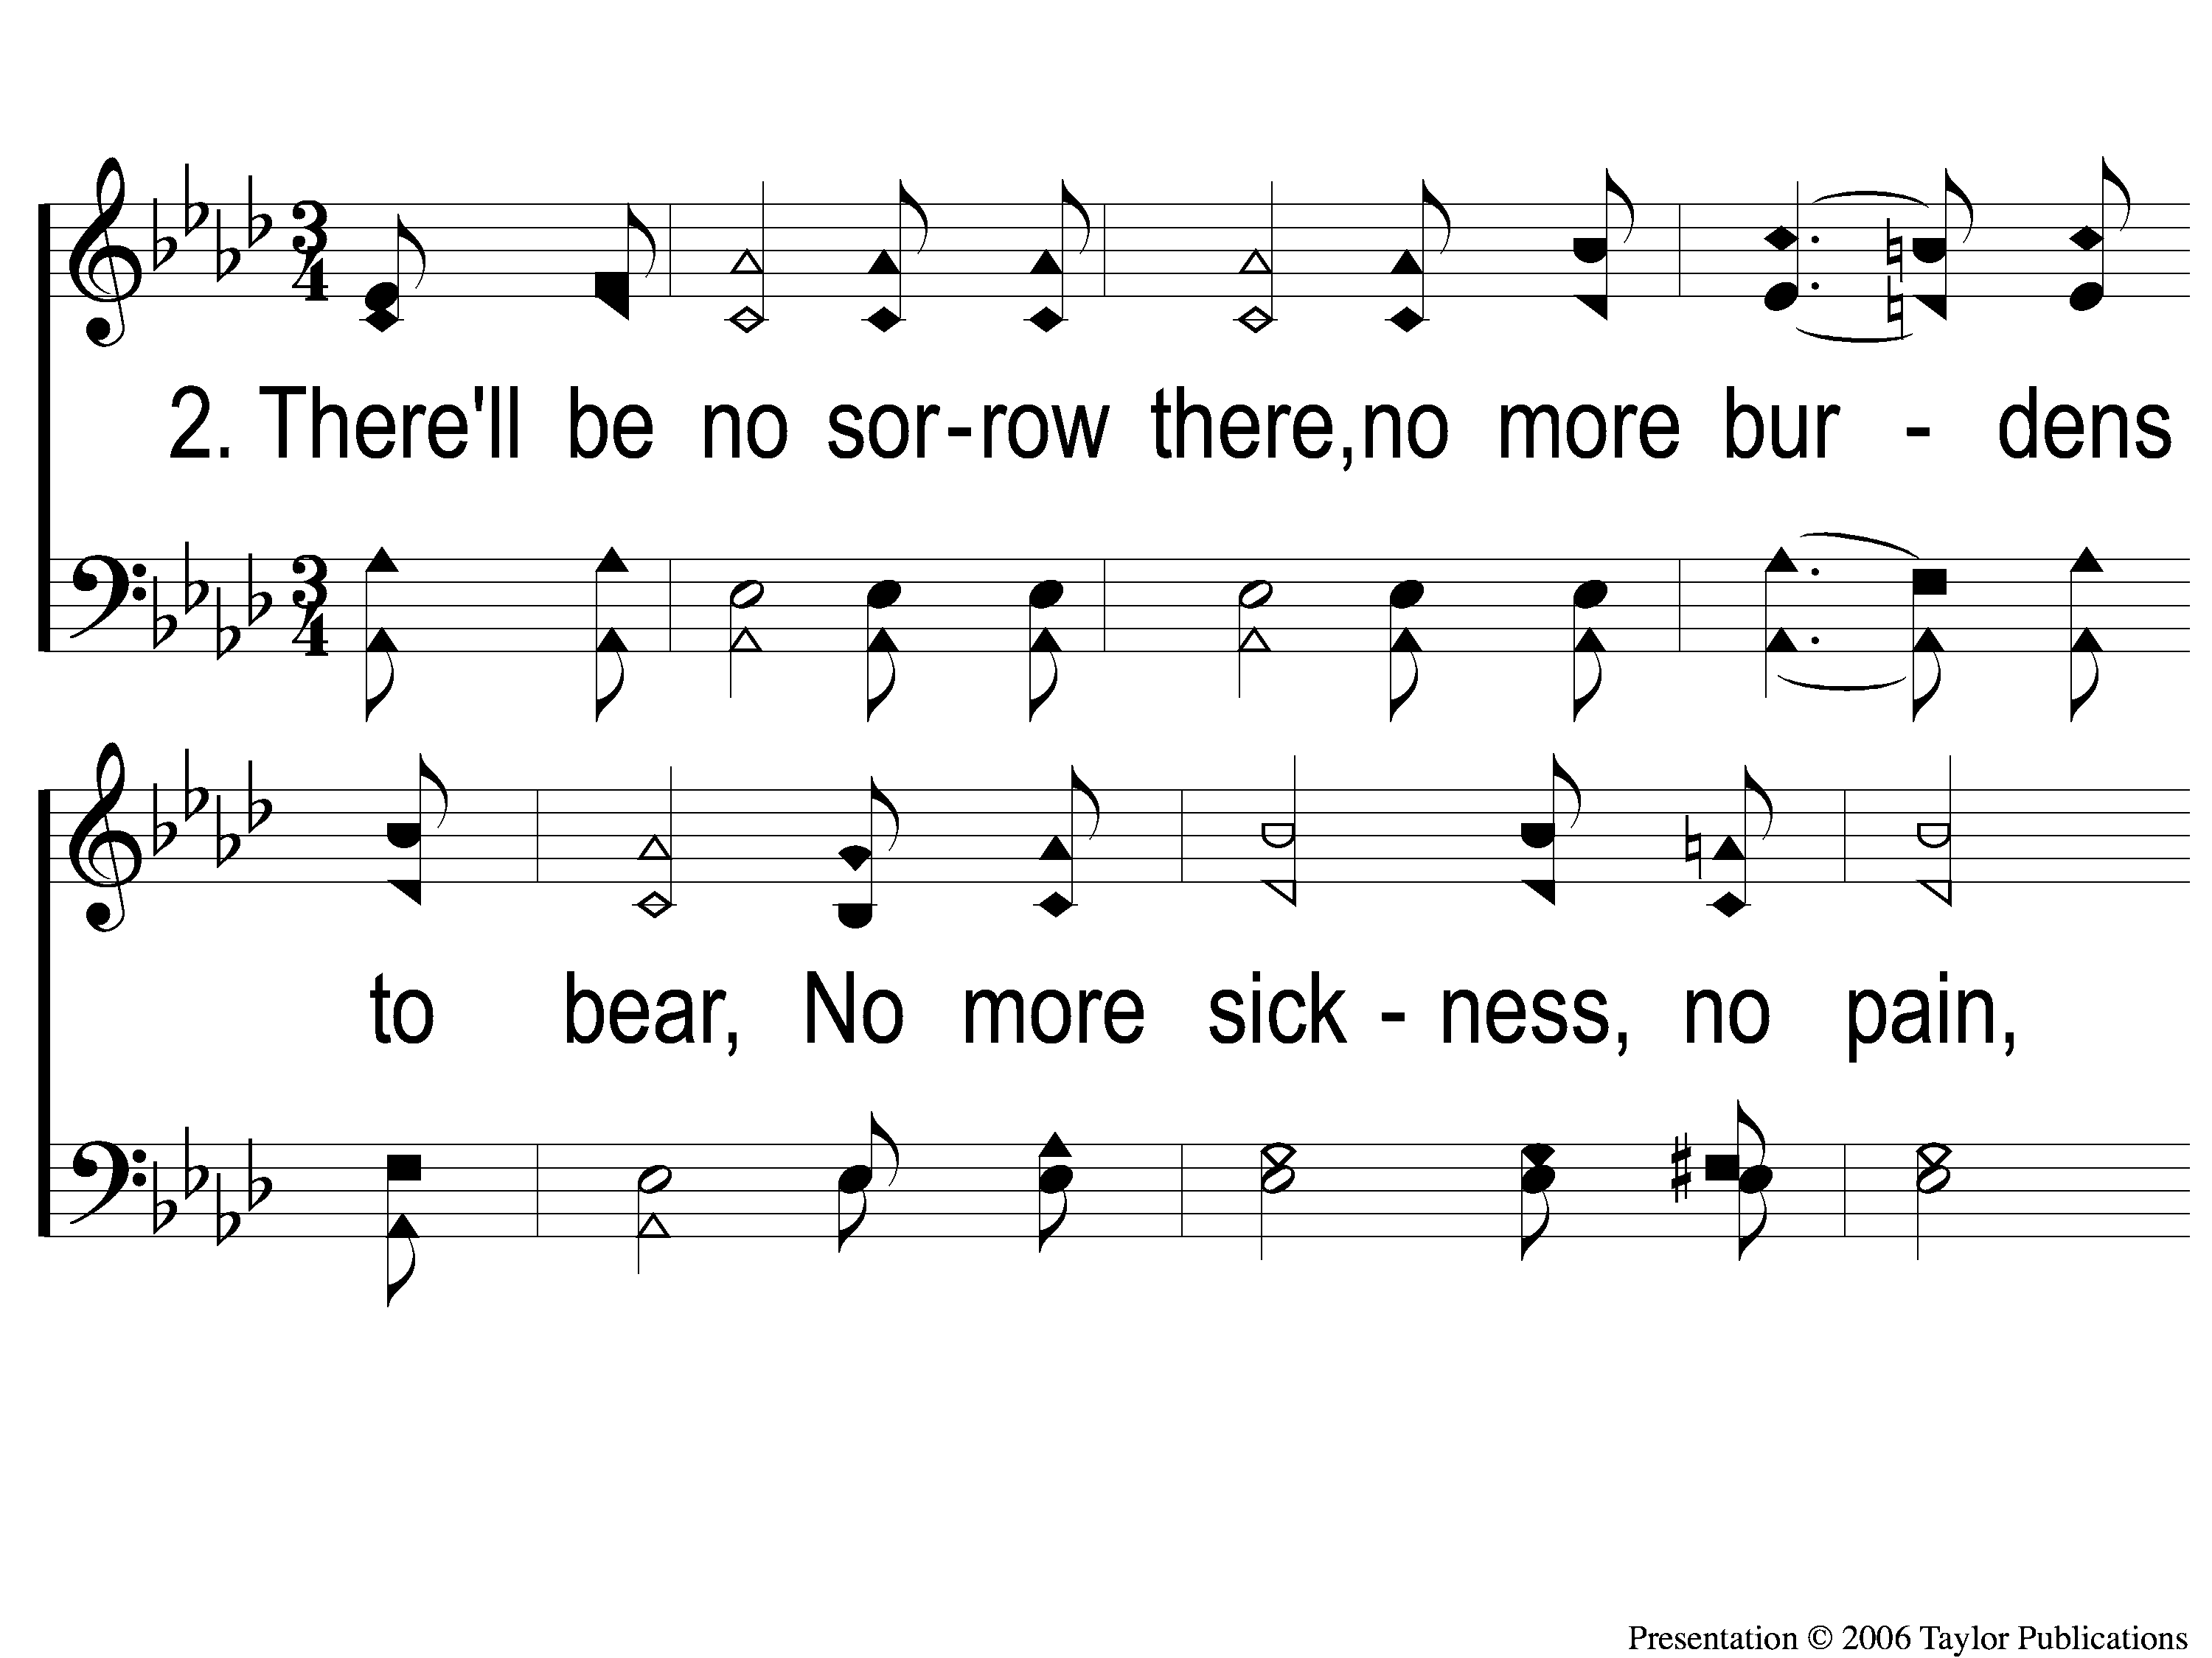
2-1 What a Day That Will Be
What a Day That Will Be
916

Slide 101
2-2 What a Day That Will Be
What a Day That Will Be
916

Slide 102
2-3 What a Day That Will Be
What a Day That Will Be
916

Slide 103
C-1 What a Day That Will Be
What a Day That Will Be
916

Slide 104
C-2 What a Day That Will Be
What a Day That Will Be
916

Slide 105
C-3 What a Day That Will Be
What a Day That Will Be
916

Slide 106
The Contribution:
1 Peter 4:10
“As each one has received a gift, minister it to one another, as good stewards of the manifold grace of God.”

Slide 107
Song:
How Deep The Father’s Love

Slide 108
1-1 How Deep the Father’s Love
How Deep The Father’s Love

Slide 109
1-2 How Deep the Father’s Love
How Deep The Father’s Love

Slide 110
1-3 How Deep the Father’s Love
How Deep The Father’s Love

Slide 111
1-4 How Deep the Father’s Love
How Deep The Father’s Love

Slide 112
2-1 How Deep the Father’s Love
How Deep The Father’s Love

Slide 113
2-2 How Deep the Father’s Love
How Deep The Father’s Love

Slide 114
2-3 How Deep the Father’s Love
How Deep The Father’s Love

Slide 115
2-4 How Deep the Father’s Love
How Deep The Father’s Love

Slide 116
3-1 How Deep the Father’s Love
How Deep The Father’s Love

Slide 117
3-2 How Deep the Father’s Love
How Deep The Father’s Love

Slide 118
3-3 How Deep the Father’s Love
How Deep The Father’s Love

Slide 119
3-4 How Deep the Father’s Love
How Deep The Father’s Love

Slide 120
The Unleavened Bread
Ephesians 5:11-13
“Therefore remember that you, once Gentiles in the flesh—who are called Uncircumcision by what is called the Circumcision made in the flesh by hands— that at that time you were without Christ, being aliens from the commonwealth of Israel and strangers from the covenants of promise, having no hope and without God in the world. But now in Christ Jesus you who once were far off have been brought near by the blood of Christ.”

Slide 121
The Fruit of the Vine
Ephesians 1:7-10
“In Him we have redemption through His blood, the forgiveness of sins, according to the riches of His grace which He made to abound toward us in all wisdom and prudence, having made known to us the mystery of His will, according to His good pleasure which He purposed in Himself, that in the dispensation of the fullness of the times He might gather together in one pall things in Christ, both which are in heaven and which are on earth—in Him.”

Slide 122
Closing Prayer

Slide 123
Song:
Victory In Jesus
#470

Slide 124
1-1 Victory in Jesus
Victory in Jesus
470

Slide 125
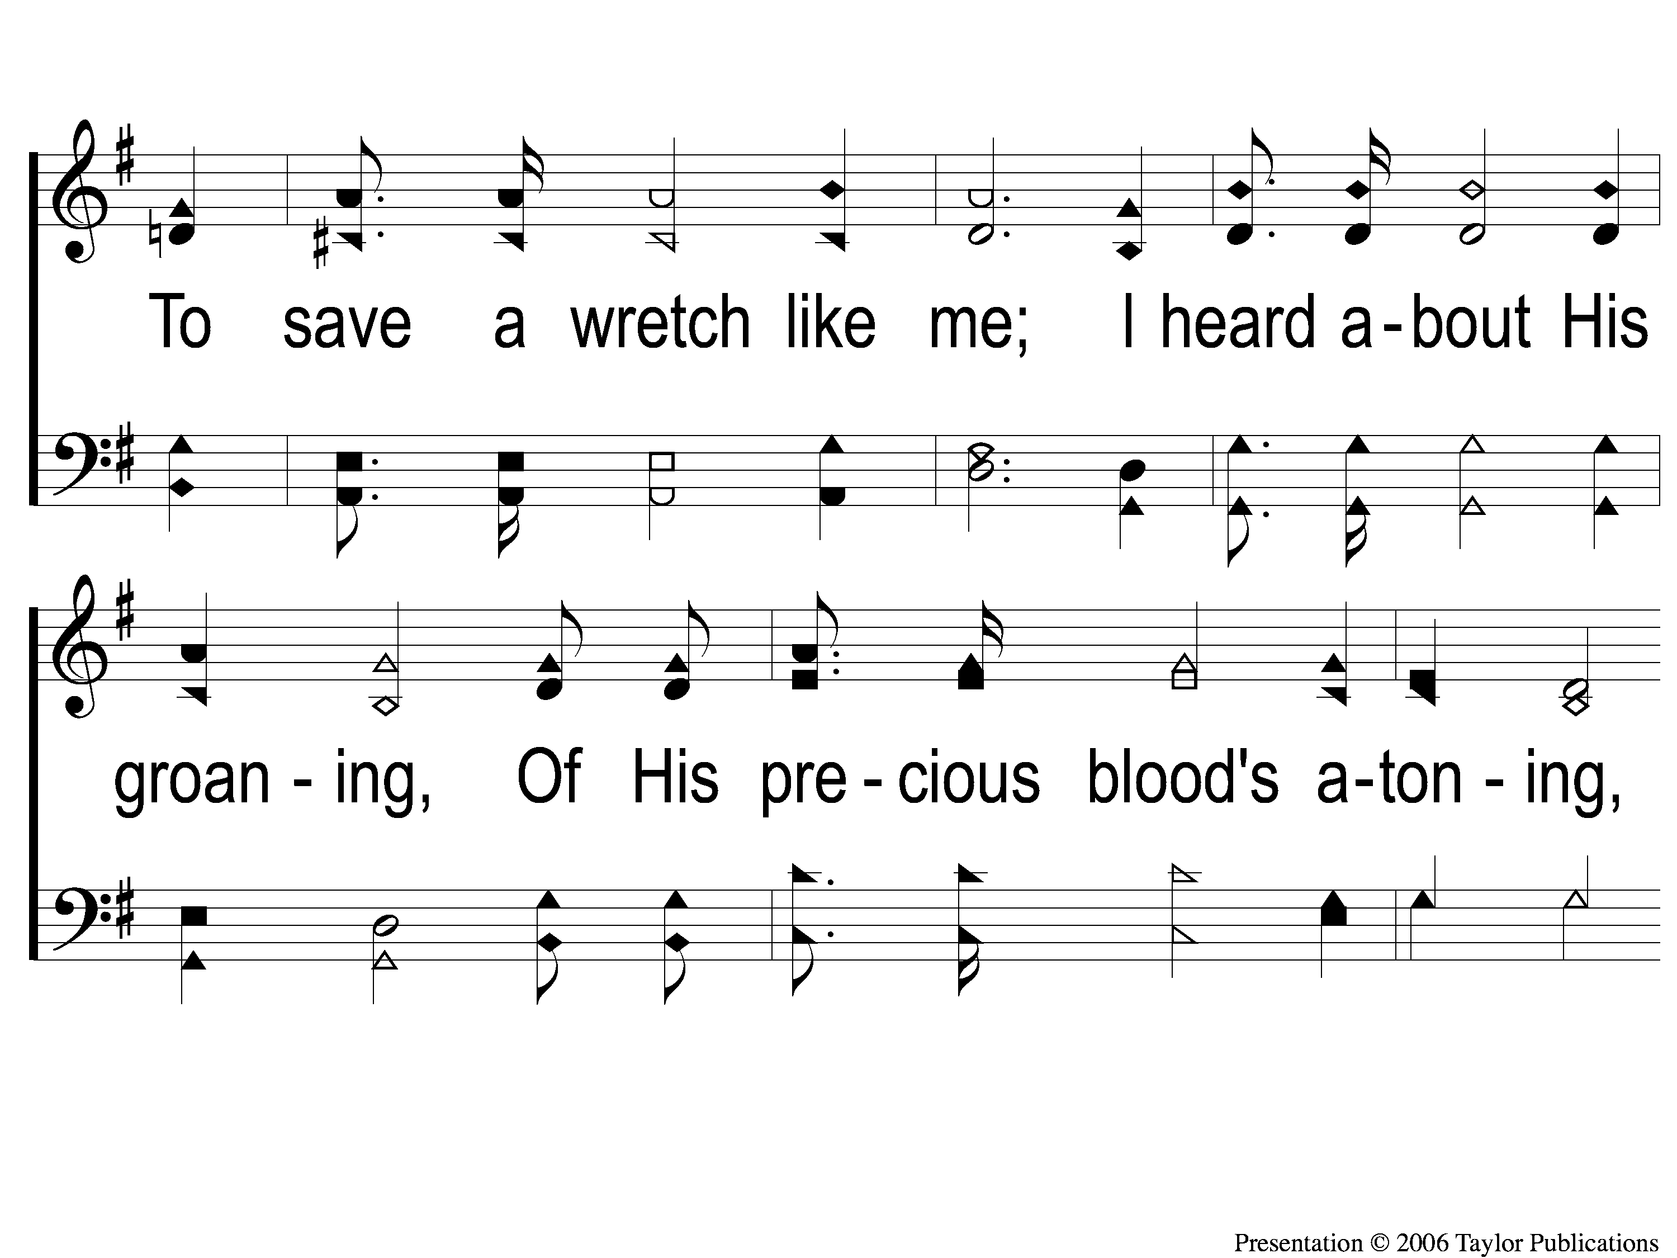
1-2 Victory in Jesus
Victory in Jesus
470

Slide 126
1-3 Victory in Jesus
Victory in Jesus
470

Slide 127
C-1 Victory in Jesus
Victory in Jesus
470

Slide 128
C-2 Victory in Jesus
Victory in Jesus
470

Slide 129
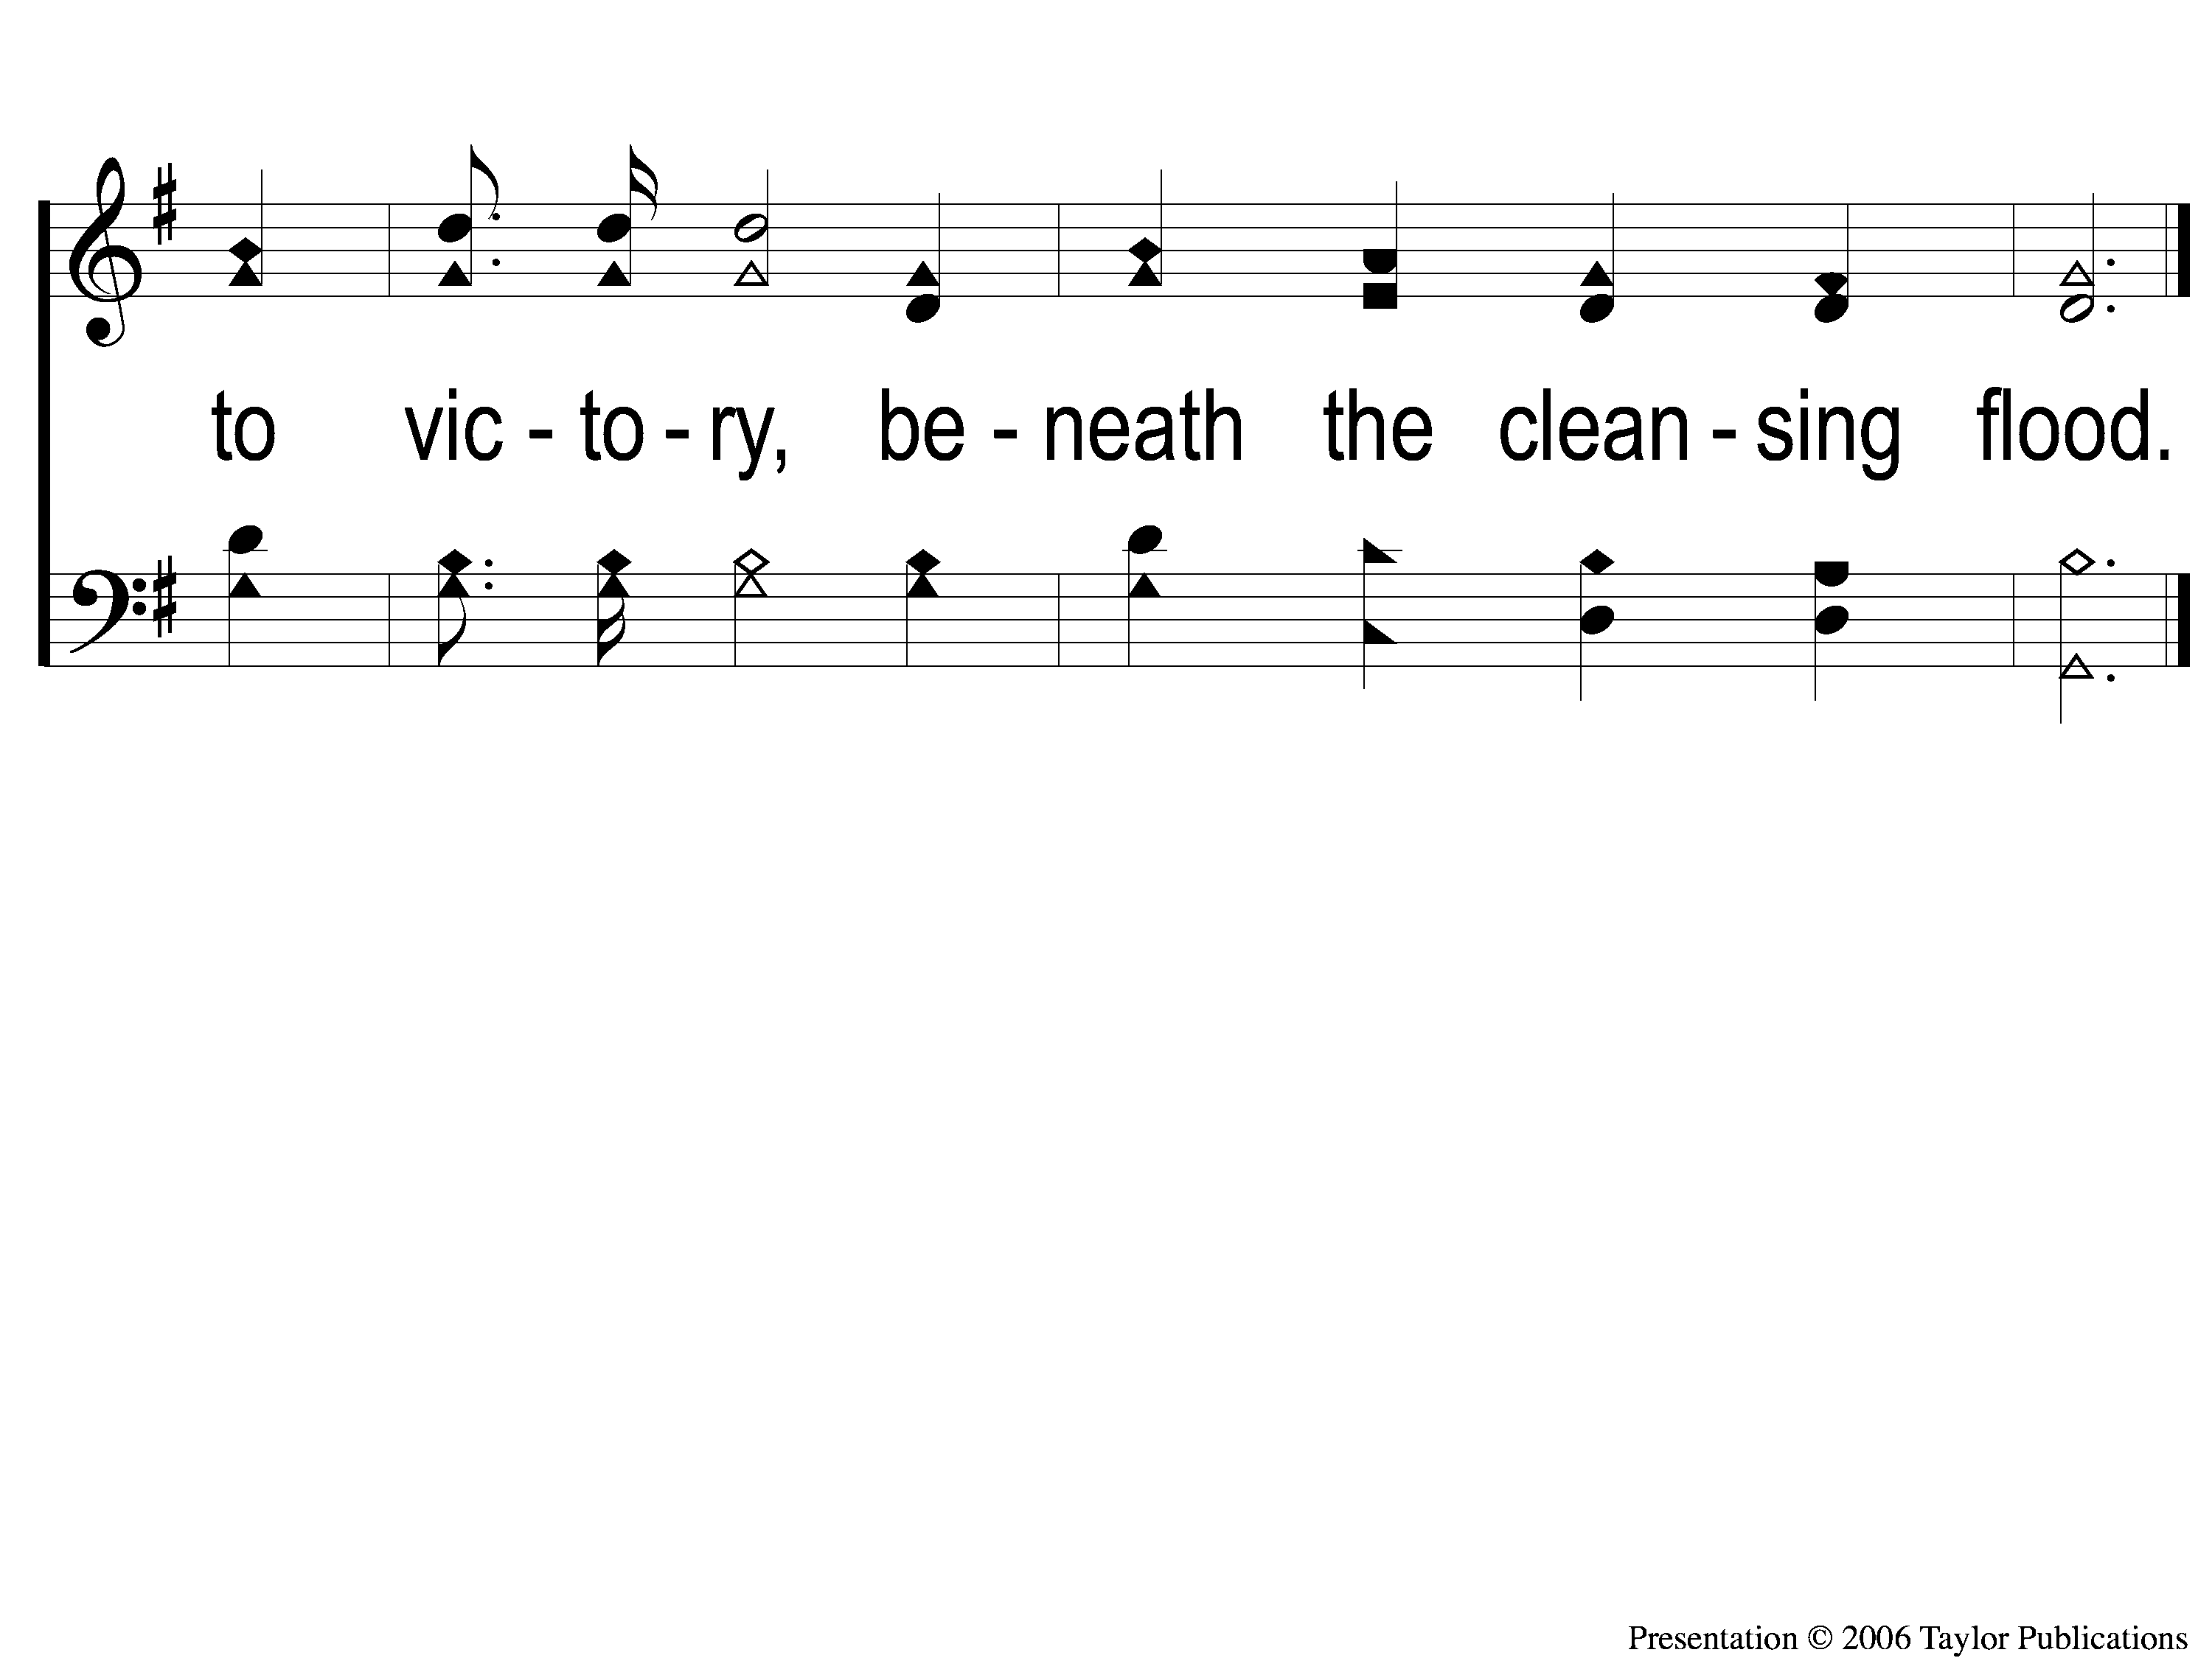
C-3 Victory in Jesus
Victory in Jesus
470

Slide 130
2-1 Victory in Jesus
Victory in Jesus
470

Slide 131
2-2 Victory in Jesus
Victory in Jesus
470

Slide 132
2-3 Victory in Jesus
Victory in Jesus
470

Slide 133
C-1 Victory in Jesus
Victory in Jesus
470

Slide 134
C-2 Victory in Jesus
Victory in Jesus
470

Slide 135
C-3 Victory in Jesus
Victory in Jesus
470

Slide 136
3-1 Victory in Jesus
Victory in Jesus
470

Slide 137
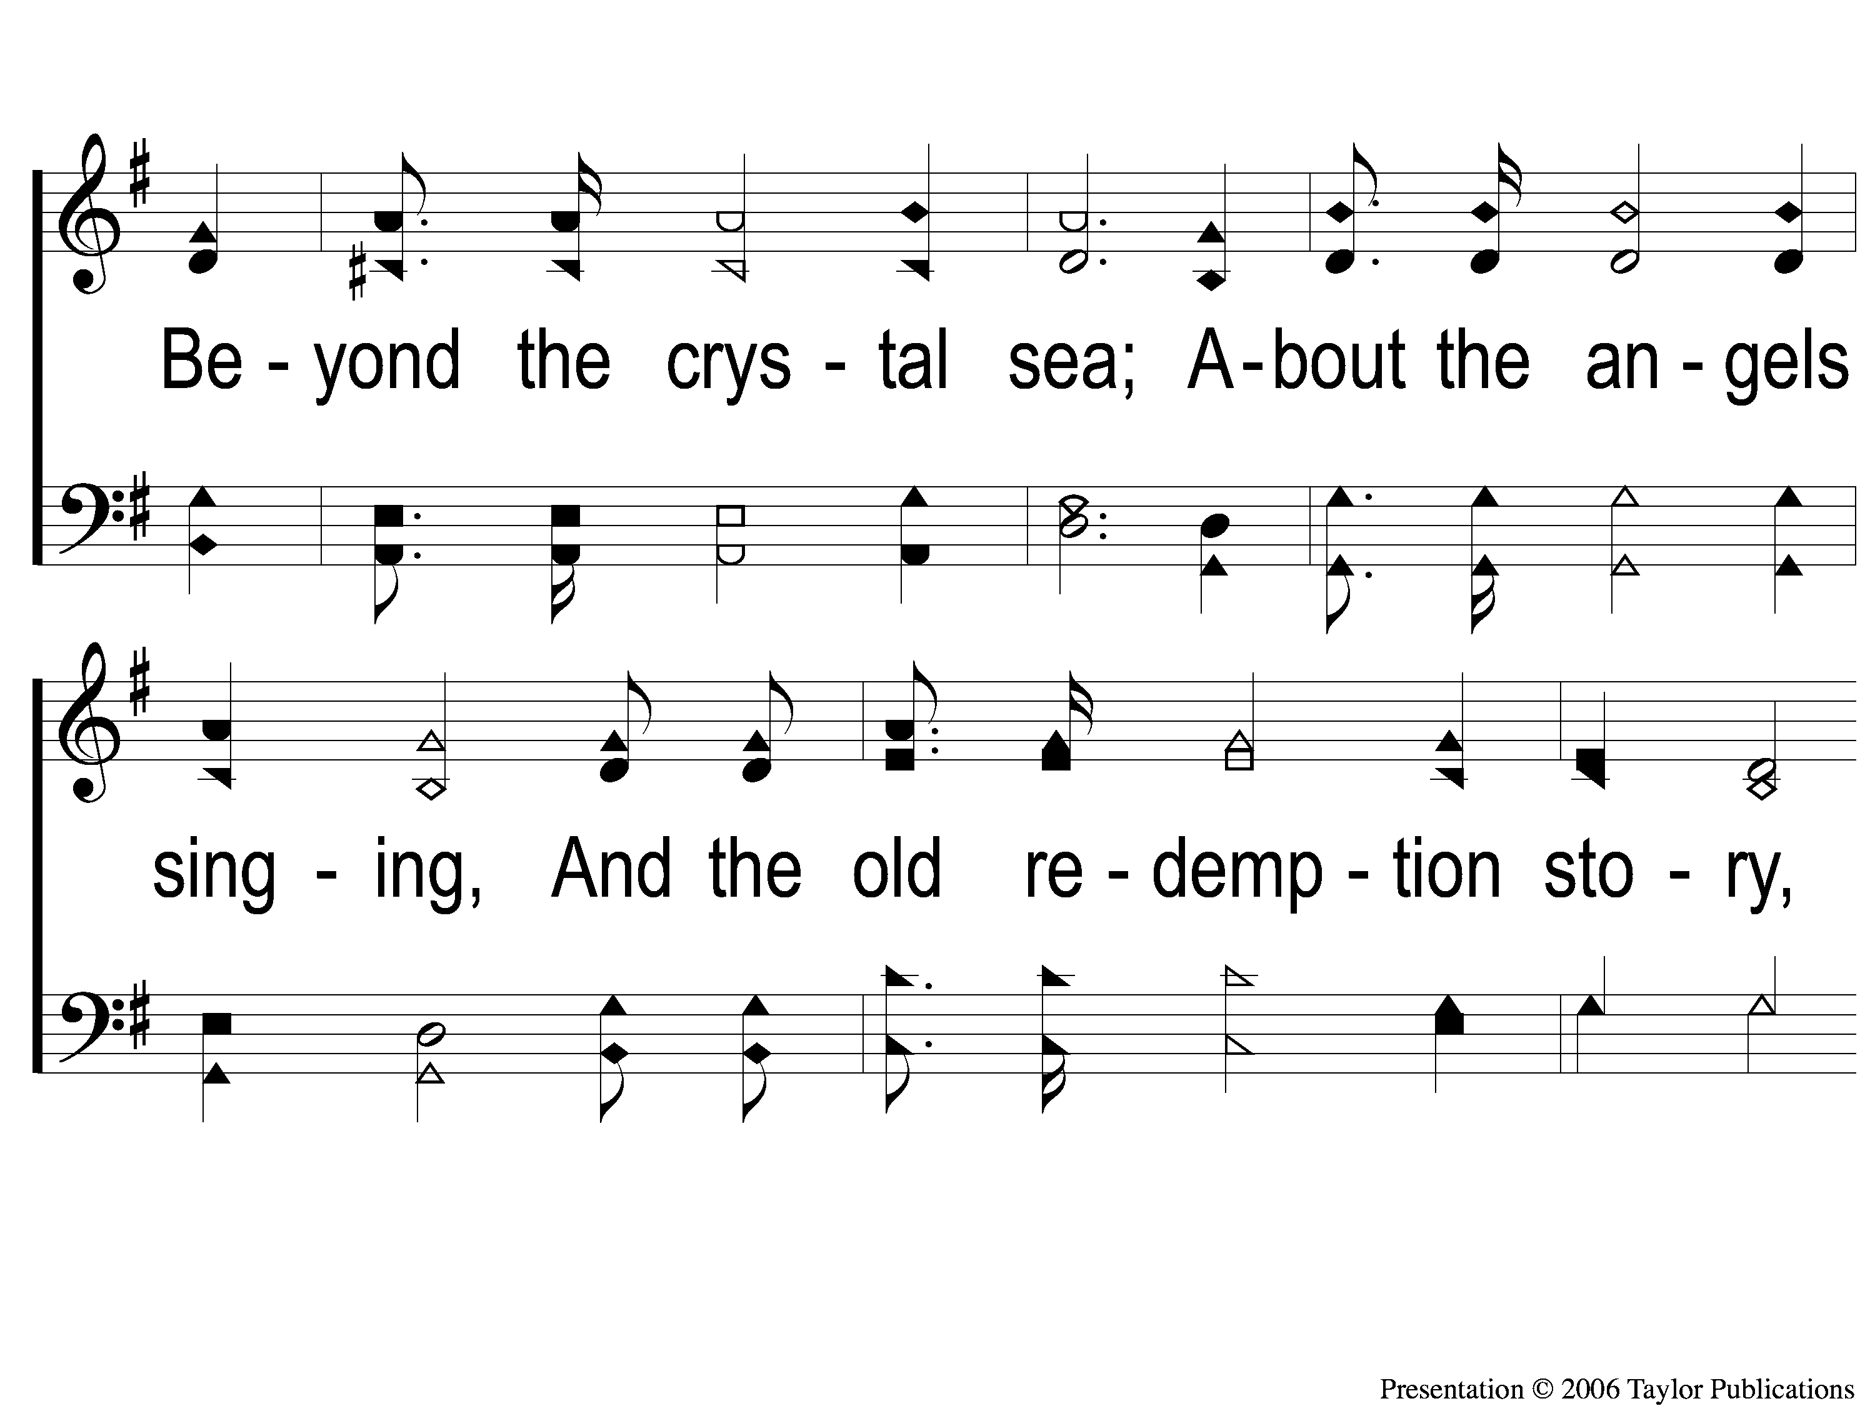
3-2 Victory in Jesus
Victory in Jesus
470

Slide 138
3-3 Victory in Jesus
Victory in Jesus
470

Slide 139
C-1 Victory in Jesus
Victory in Jesus
470

Slide 140
C-2 Victory in Jesus
Victory in Jesus
470

Slide 141
C-3 Victory in Jesus
Victory in Jesus
470

Slide 142
RESTORE REBUILD RENEW
JOIN US
IN THE MPB FOR
A FELLOWSHIP MEAL
@ NOON
IN 2022
WHEELER
CHURCH
OF
CHRIST

Slide 143
Tonight
WORSHIP @ 6:00 pm
Wednesday
WORSHIP @ 6:30 pm
Bible classes @ 7:00 pm
RESTORE REBUILD RENEW
IN 2022
WHEELER
CHURCH
OF
CHRIST

